Slide 1
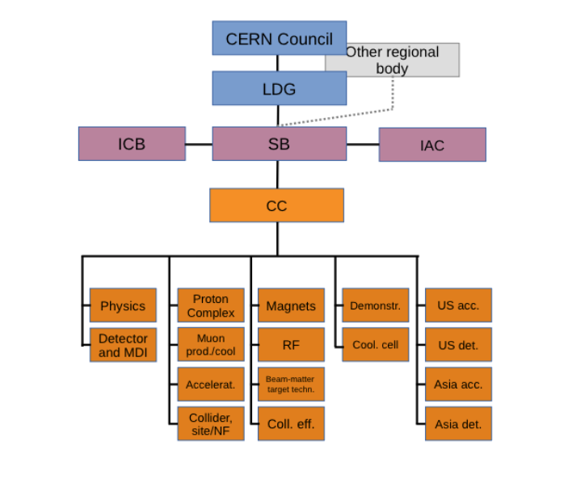
The Steering Board
The SB is composed of:
The lead representative of the Host Organisation (for CERN the ATS director Mike Lamont)
Up to two additional members appointed by the Host Organisation, Gianluigi Arduini, Steinar Stapnes (Chair)
Up to three members appointed by the ICB
Dave Newbold (STFC), Mats Lindroos (ESS)+, Pierre Vedrine (CEA)
Director of National laboratories and Particle Physics, STFC and Leader of the LDG
ESS Head of Accelerator Division and Accelerator sub-project
Head of Accelerators, Cryogenics and Magnetism Division (DACM), CEA – IRFU
The Study Leader, Deputies, ICB chair
Also appointed but interim for 2024, Beate Heinemann, Director for Particle Physics DESY
Invited from the US:
Mark Palmer (BNL), Sergo Jindariani (FNAL), Sridhara Dasu (Wisconsin),
Diktys Stratakis (FNAL)
Need to renew and update membership: Propose to wait until after the summer.
New CERN management, US developments, Will ask CB for suggestions. Address
diversity.
+ Passed away in 2024
Could not assemble the full SB here:
Schedule meeting June
Use more limited meeting tomorrow to discus the R&D roadmap development for the LDG and IAC review

Slide 2
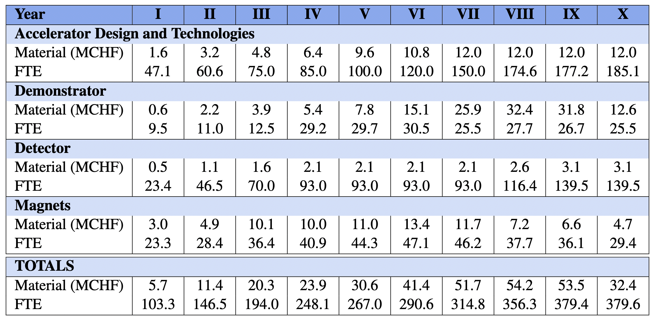
R&D Deliverables and Resources

Slide 3
LDG
Reviewed the progress and the proposed R&D plan
Good progress noted, estimated that 75% of Roadmap goals have been achieved
Reviewers: Norbert Holtkamp (chair), Mei Bai, Frederick Bordry, Nuria Catalan-Lasheras, Barbara Dalena, Massimo Ferrario, Andreas Jankowiak,
Robert Rimmer, Herman ten Kate, Peter Williams
Recommendations:
Develop a Start-to-End Performance Simulator: Create a comprehensive simulation framework to assess the robustness of key parameters, including luminosity, cost, and energy consumption. This tool should enable performance optimization, sensitivity analysis, and risk mitigation across the entire collider complex.
Define and fund a High-Field HTS and RF Development Strategy: Establish a clear roadmap for the development of the high-field HTS magnet and the RF systems, including well-defined specifications and performance targets. Securing dedicated funding is essential to advance these critical technologies.
Conduct an Independent Review of Scope, Schedule, and Costs: An urgent, independent evaluation is needed to assess the overall scope, timeline, and budget of the Muon Collider R&D program for the period 2026-2036. This review will be crucial to ensure that funding requests for this R&D phase are well-justified and aligned with project objectives.
Mike Seidel (LDG chair) wants to improve the effectiveness of LDG
Prepare a Roadmap update during the ESPPU process (early 2026)

Slide 4
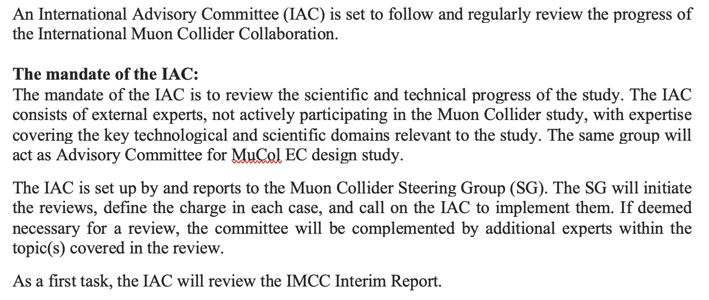
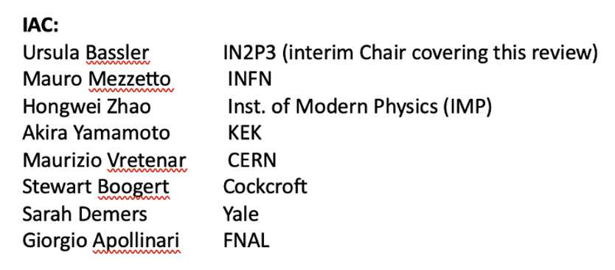
IAC
IN2P3 Chair

Slide 5
LDG planning - IAC review in June
The Lab Director Group will update the plans for accelerator R&D during this year, among them the muon collider R&D planning. The IAC review is an important preparation for the LDG accelerator R&D roadmap update.
The draft mandate (below) for the review reflects this:
The review will cover R&D planned for the IMCC over the next decade.
Key questions to be answered are:
Is the overall programme complete or are there important missing topics ?
Is the R&D proposed for the various parts and challenges appropriate, and if not, how can the plans be improved ?
How should the programme be prioritised in case of resource shortage ?
Are there clear intermediate evaluation and decision points within the 10 year programme ?
Identify opportunities for common work with other projects or R&D initiatives (e.g. for HFM and RF), or industry (e.g. HTS magnets) ?
In general the IAC shall consider how the muon collider R&D is presented and pursued in the landscape of other studies, e.g. for Higgs factories, hadron machines and high energy e+e- machines, and if appropriate, provide advice for common or complementary studies.
The committee is invited to give suggestions on any aspect of the IMCC R&D plans beyond the above points.
Complement the IAC with up to 10 experts
Session yesterday will provide key material for the reviewers

Slide 6
Proposal for developing a plan
through 2025: panel work continues; time is used to evaluate collaboration options and future activities are brainstormed by panels; sustainability panel needs directions soon – could be aimed at establishing «best practices» for collider projects
Dec 1-6, 2025: Drafting Session of Strategy Process, first opportunity to obtain feedback from the strategy process; March/June 2026 discussion of draft by council and update of strategy
Jan/Feb 2026 (?): 2 day LDG workshop (place tbd, PSI can offer to organise near Zürich) on future roadmap activities, incl. discussion on other topics like detector R&D, talent development etc.
May 2026: «update» or «implementation» (?) document augmenting original roadmap, formulated and distributed in LDG for comments
July 2026: Accelerator Roadmap Implementation Plan published

Slide 7
Overall comments
Several new developments:
LDG acc. R&D roadmap review (February) very useful – established the 10 year scope
IMCC ESPP input very good, provide a much stronger and well documented case for MC developments
Plans for updating the LDG roadmap in the coming 7-8 months
SB need a significant change in membership (but we also need to wait a few months)
IAC and SB meetings in June
R&D plan taking shape – good basis but the “resource loading” aligned with lab/institute plans needed to make it stronger
Longer term:
Explore - with common “studies” - synergies & complementarities with Higgs factories, Muon Collider and Hadron Collider, wrt physics primarily,
but also to encourage/stimulate common work on detectors, software and a widening community

