Slide 1
W/Z+b jets in ATLAS
Takanori Kono (DESY)
LHC physics discussion, 05.12.2011

Slide 2
Introduction
W/Z + b-jet cross section measurement
  Interesting Standard Model (SM) process
  Improve the measurement precision at the LHC
  Comparison with NLO QCD calculation
Important background for W/Z+Higgs (→bb) search
  Contribution of W/Z+bb from gluon splitting
  High sensitivity in Higgs search with a boosted Higgs
This talk : ATLAS results with 2010 data (35 pb⁻¹)
  arxiv:1109.1403 (Z+b)
  arxiv:1109.1470 (W+b)

Slide 3
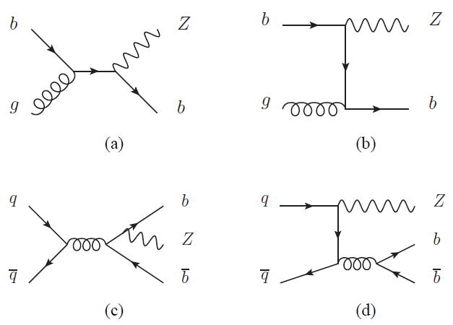
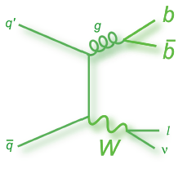
W/Z+b(b) production
Z+b, Z+bb
b-quark PDF in the initial state
Cross section ~3 pb
W+c
Sensitive to the charm PDF
Cross section ~130 pb
W+b, W+bb
W+b suppressed by PDF and off-diagonal CKM matrix element
Large irreducible background from ttbar
Cross section ~10 pb

Slide 4
Z+b event selection
Trigger: Single lepton trigger
Electron channel
E_{T}>20 GeV
|η|<2.47 (but remove 1.37<|η|<1.52)
Tight identification criteria
Isolation based on calorimeter and tracks
Jet selection
Anti-k_{T} algorithm with R=0.4
E_{T}>25 GeV, |y|<2.1
Remove jets within ΔR<0.4 of an electron
>75 % of the sum of p_{T} of tracks in the jet come from the primary vertex
Muon channel
E_{T}>20 GeV
|η|<2.4
Tight identification criteria
Reject muons within ΔR<0.4
Isolation based on calorimeter and tracks
b-tagging

Slide 5
b-tagging
b-jets are selected exploiting the long lifetime and the large mass of B-hadrons
SV0 b-tagging algorithm reconstructs a secondary vertex within a jet
  decay length significance > 5.85
b-tagging performance is studied using semi-leptonic B-decays in multi-jet events and top events

Slide 6
Z+b distributions
Main backgrounds after b-tagging
  ttbar
  Z→ττ + jets
  W→eν(μν)+jets
  Diboson
QCD background estimated from data
S/B > 10 in both electron and muon channels

Slide 7
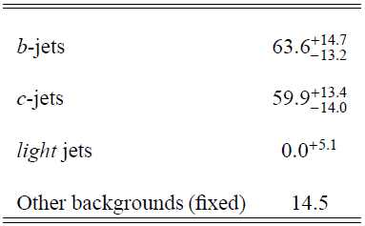
Extraction of b-jet fraction
Maximum likelihood fit is used to the SV0 mass distribution to separate b-jets from c- and light-jets
SV0 mass templates are modeled with MC
Templates sensitive to p_{T} spectrum of the b-jets → systematics

Slide 8

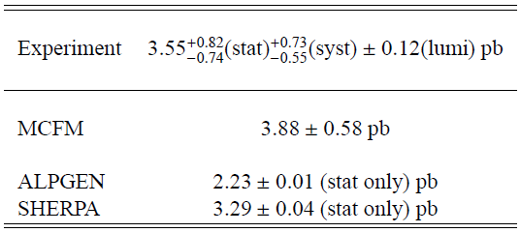
Z+b cross sections
Phase space definition
Dressed leptons
  combined QED radiation in ΔR<0.1
p_{T}>20 GeV, |η|<2.5
E_{T}>25 GeV
m^{W}_{T}>40 GeV
Anti-k_{T} R=0.4 jets: p_{T}>25 GeV, |y|<2.1
Remove jets if ΔR(jet, lepton)<0.5
b-jet: ΔR(jet, B-hadron)<0.3,
p_{T}(B-hadron)>5 GeV
Combined the e- and μ-channels as there are no differences
Results compared with MCFM+ non-perturbative corrections
Good agreement with data

Slide 9
W+b event selection
Trigger: Single lepton trigger
Electron channel
E_{T}>20 GeV
|η|<2.47 (but remove 1.37<|η|<1.52)
Tight identification criteria
Isolation based on calorimeter and tracks
Jet selection
Anti-k_{T} algorithm with R=0.4
E_{T}>25 GeV, |y|<2.1
Remove jets within ΔR<0.4 of an electron
>75 % of the sum of p_{T} of tracks in the jet come from the primary vertex
Muon channel
E_{T}>20 GeV
|η|<2.4
Tight identification criteria
Reject muons within ΔR<0.4
Isolation based on calorimeter and tracks
Missing E_{T} selection
E_{T}^{miss}>25 GeV
m_{T}>40 GeV
b-tagging

Slide 10
SV0 mass distributions
1-jet bin
2-jet bin

Slide 11
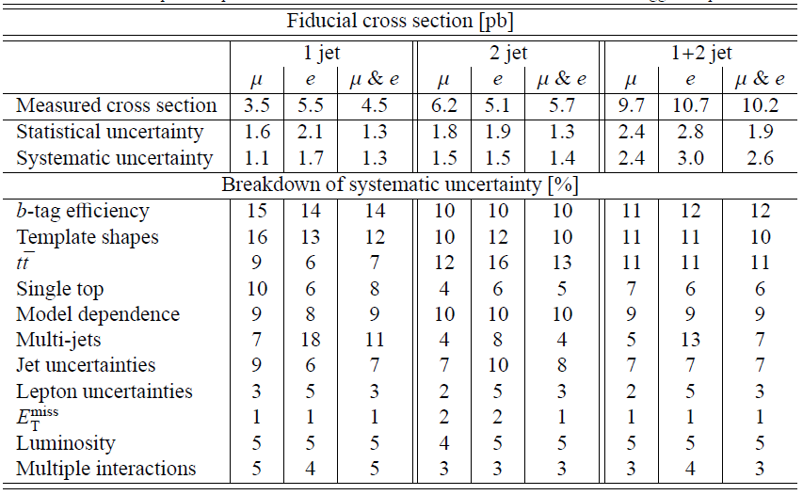
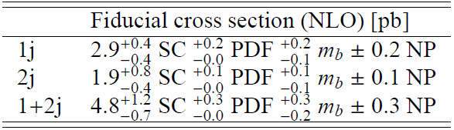
Cross sections and systematics

Slide 12
W+b cross section
Phase space definition
Dressed leptons
  combined QED radiation in ΔR<0.1
p_{T}>20 GeV, |η|<2.5
E_{T}>25 GeV
m^{W}_{T}>40 GeV
Anti-k_{T} R=0.4 jets: p_{T}>25 GeV, |y|<2.1
Remove jets if ΔR(jet, lepton)<0.5
b-jet: ΔR(jet, B-hadron)<0.3,
p_{T}(B-hadron)>5 GeV
Measured value is above the NLO prediction but within 1.5σ
Similar trend as the measurement at CDF
Theoretical predictions
NLO QCD : 5 Flavor Number Scheme (5FNS)
ALPGEN (LO)

Slide 13
Outlook for analysis with 2011 data
Huge increase in statistics with 2011 data
  35 pb⁻¹ → 5 fb⁻¹
Improvements in experimental techniques
  More statistics to control b-tagging performance and also use more advanced b-taggers
  Data-driven background estimation. Especially important to understand ttbar contribution in W+b analysis
More measurements underway
  Precise cross section measurement to investigate further the tension between the measurement and NLO prediction (W+b)
  W+c production (sensitive to s-quark PDF)
  Differential cross sections
  Disentangling single-b and double-b tagged events (g→bb)

