Slide 1
MicroTCA Next Generation Update
Kay Rehlich, DESY
12. Dec. 2024

Slide 2
Motivation & Requirements for the Next Generation
Keep the standard alive for a long time
Adapt state-of-the-art technology
PCIe gen 5 and 100 GbE —> 32 Gbps
More power for more processing speed
Backward compatibility as much as possible

Slide 3
PICMG MicroTCA Next Generation Working Group
Initial Executive Members … 14.11.2019 | ESS DESY Lodz University of Technology N.A.T. nVent
+ Members of working group | Amphenol Atom Computing BAE Systems Comtel Concurrent Technologies Embeck IOxOS ORNL Pixus Technologies Positronic powerBridge Samtec VadaTech Yamaichi
Chair Editor Secretary | Kay Rehlich, DESY Heiko Körte, N.A.T Thomas Holzapfel, powerBridge

Slide 4
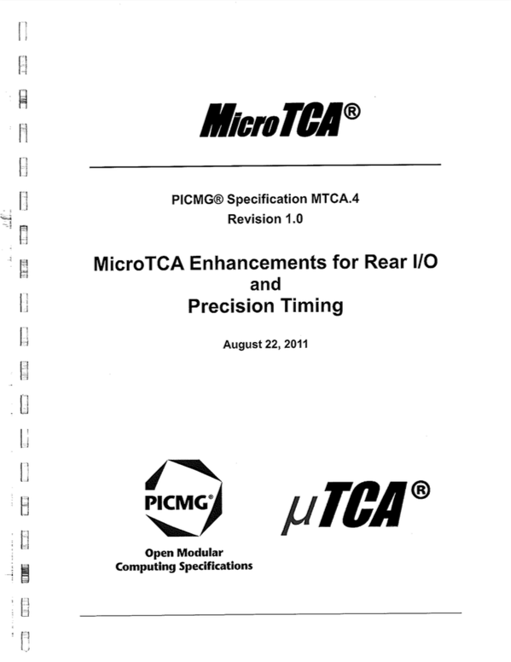
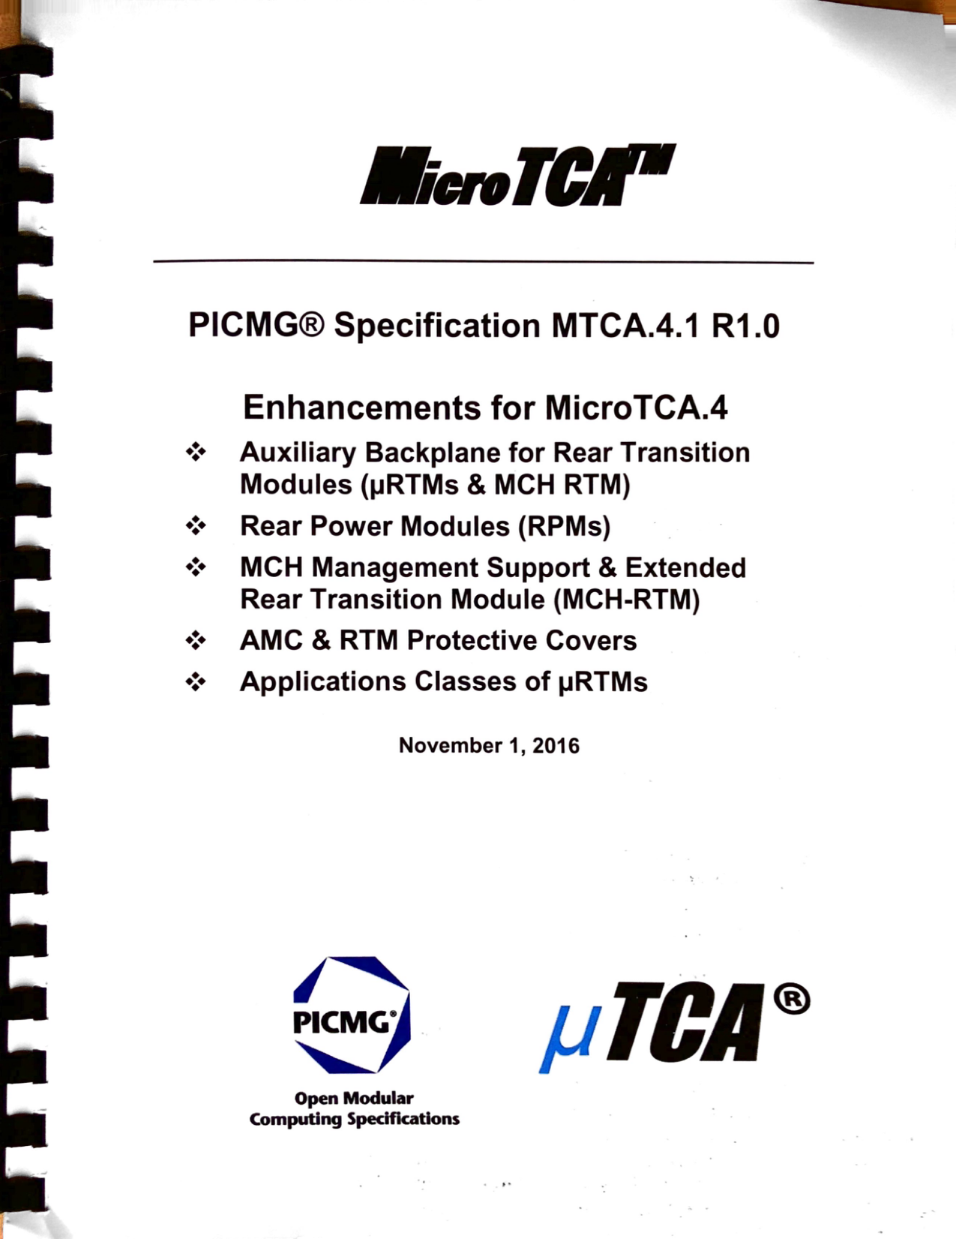
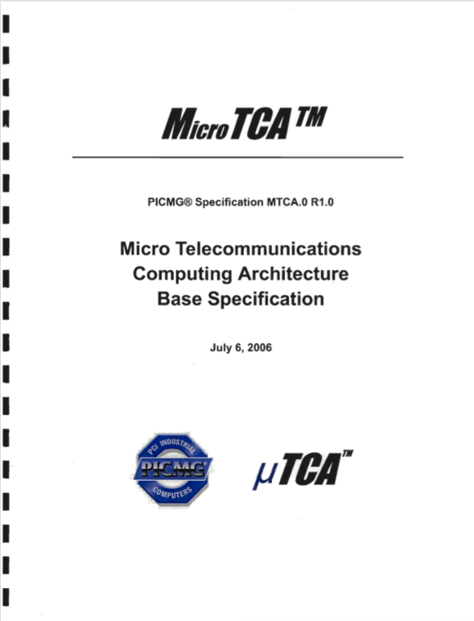
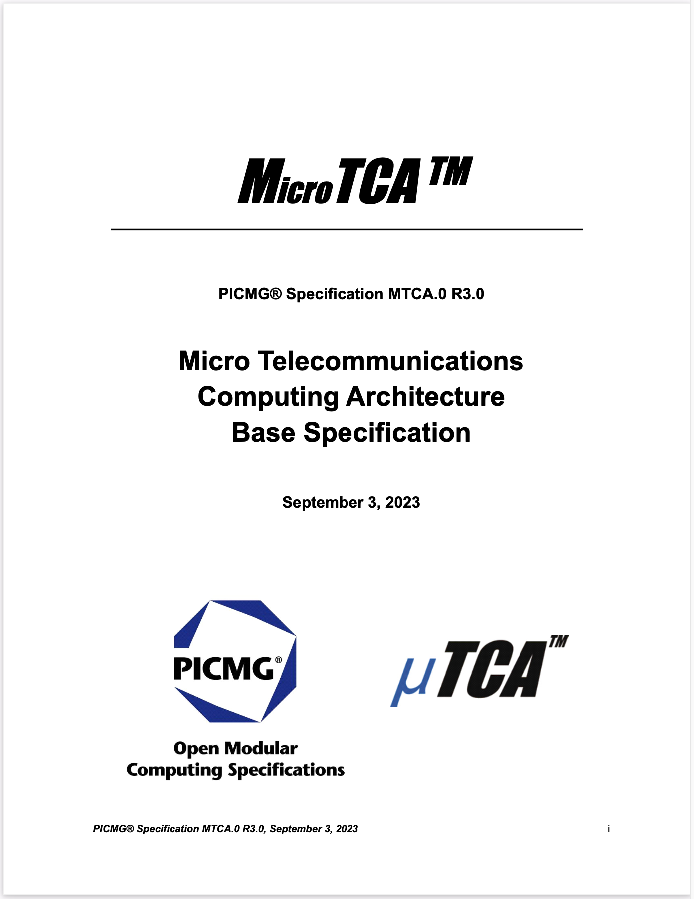
MicroTCA Specifications
Next Gen
MicroTCA.4
MicroTCA.4.1
2011
2016
2025
Rev. 2
Rev. 3
MicroTCA.0
682 Pages
> 764 Pages
2006
MicroTCA.0 r2
MicroTCA.0 r3
2020
2023

Slide 5
MicroTCA Specifications
Next Gen
MicroTCA.4
MicroTCA.4.1
2011
2016
2024
Rev. 2
Rev. 3
MicroTCA.0
682 Pages
> 764 Pages
2006
MicroTCA.0 r2
MicroTCA.0 r3
2020
2023

Slide 6
MTCA.0 Rev 3: PCIe Gen 4 and 5, 100GbEthernet
MTCA.0 Rev 3: PCIe Gen 4 and 5, 100GbEthernet ✅
PCI Express version | Introduced | Line code | Transfer rate | Throughput (simplex)
 |  |  |  | ×1 | ×2 | ×4 | ×8 | ×16
1.0 | 2003 | 8b/10b | 2.5 GT/s | 250 MB/s | 0.50 GB/s | 1.0 GB/s | 2.0 GB/s | 4.0 GB/s
2.0 | 2007 | 8b/10b | 5.0 GT/s | 500 MB/s | 1.0 GB/s | 2.0 GB/s | 4.0 GB/s | 8.0 GB/s
3.0 | 2010 | 128b/130b | 8.0 GT/s | 985 MB/s | 1.97 GB/s | 3.9 GB/s | 7.88 GB/s | 15.8 GB/s
4.0 | 2017 | 128b/130b | 16.0 GT/s | 1969 MB/s | 3.94 GB/s | 7.9 GB/s | 15.75 GB/s | 31.5 GB/s
5.0 | 2019 | 128b/130b | 32.0 GT/s | 3938 MB/s | 7.88 GB/s | 15.8 GB/s | 31.51 GB/s | 63.0 GB/s
6.0 | In preparation | PAM4 | 64.0 GT/s | ~7800 MB/s | ~15.7 MB/s | ~31.4.8 GB/s | ~62 GB/s | ~124 GB/s
Old
• 4
New
80 W —> 110 W power increase for MCH and cooling
MCH in center of crate

Slide 7
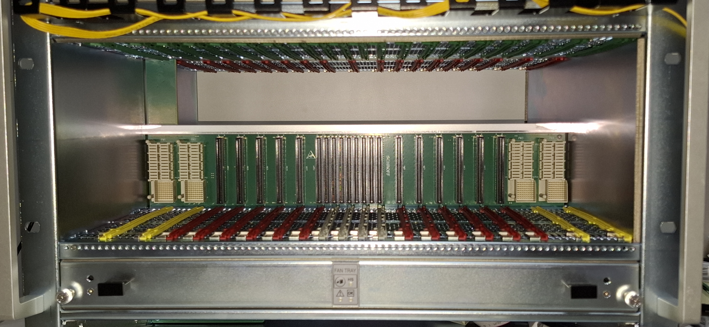
MicroTCA Update 2023: MTCA.0 Rel. 3
Backplane 32 Gbps data transfer:
PCIe gen 5
100 Gb Ethernet
© nVent / Schroff
Redundant MCH in center of crate to achieve 32 Gbps in all slots

Slide 8
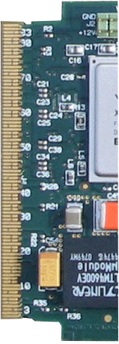
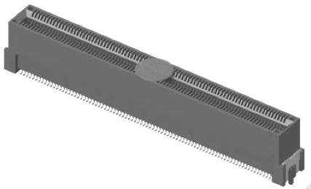
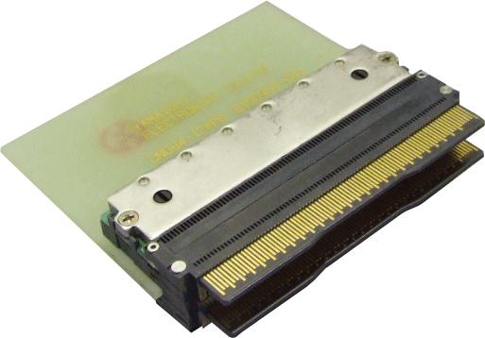
MCH & AMC Connector for 32Gb/s
1️⃣
Backplane connector:
No change required
Improved PCB layout
2️⃣
Harting connector does not allow > PCIe gen 3 (remains backward compatible)
Options for the AMC are:
1️⃣ PCB Card Edge contacts
2️⃣ Yamaichi connectors
PCB thickness = 1.6 mm !

Slide 9
Power Module Spec Incompatibility Solved
Old specifications:
AMC.0R2
Req 3.4b: SHALL be 2.2K Ohm
MTCA.0 R1.0
Req 4.122 SHALL be 10K Ohm or lower value resistor
MTCA.0 R2.0 :
REQ 4.122 The Power Subsystem should pull up each PS1_[Slot]# pin to Management Power with a 2.2K Ohm ±10% resistor.
REQ 4.123 The Power Subsystem may pull up each PS1_[Slot]# pin to Management Power with a 10K Ohm ±10% to 1K Ohm ±10% resistor.
3.3V_MP
2.2k
PS1#
12V_PP
12V
Extraction
detect
PS0#
D
PM
AMC
New:
MTCA.0 R3.0 :
REQ 4.125 An AMC implementing a means against Surprise State Change due to extraction (aka “surprise extraction”) requires a pull-up resistor of 2.2K Ohm in the Power Module. In this case the Power Subsystem shall implement a 2.2K Ohm ±10%.

Slide 10
MicroTCA Next Generation
Provide 80, 110 or 220 Watt to all AMCs
Crate power ≥ 2 kW
Split MCH
Hardware based enhanced security
Better FMC management integration
More option definitions for ports 2 and 3 (so far SATA)

Slide 11
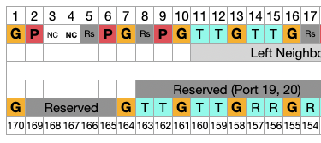
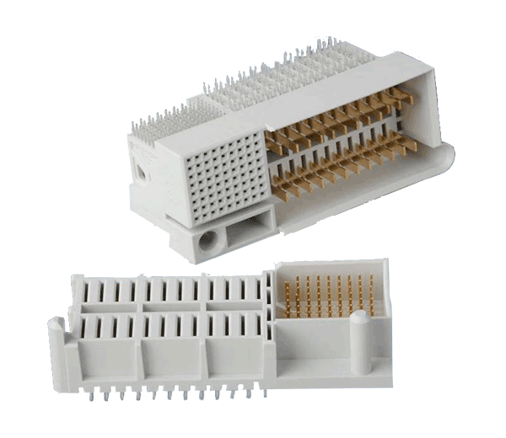
Power: up to 220 W per AMC
Limitation of MCH connector:
MCH/AMC connector: 8 pins @ 10.8 V = 98 W max
Solution:
Use 9 power pins on MCH ==> 110W
Enable management of mixed 80 W / 110 W / 220 W channels
2nd AMC connector for 220 W
Power Module & Crate cooling
More airflow ==> Fans need more power
Limitation of Power Module connector: 110 W
Use two connectors

Slide 12
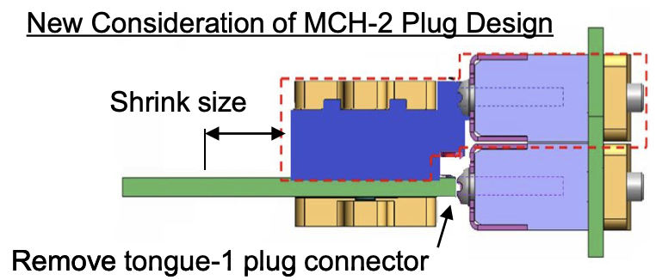
AMC Connector for 220 W and More Connectivity
New
Yamaichi
Connector
OPTIONAL!
More Fat Pipe lanes
e.g.
PCIe x8, x16
Card-edge
Connector
1 Tongue: 110 W
With 9 power pins
2 Tongues: 220 W
With 18 power pins
100% backward compatible

Slide 13
110 Watt for AMC per Connector
Use pin 6 in addition to the existing 8 power pins —> 110 W
Together with a second tongue —> 220 W
MTCA.0 Rev 3
Crate management handles compatibility
of 80W / 110 W / 220 W channels with new records for:
Power source capability
Backplane capability
Power consumer demand

Slide 14
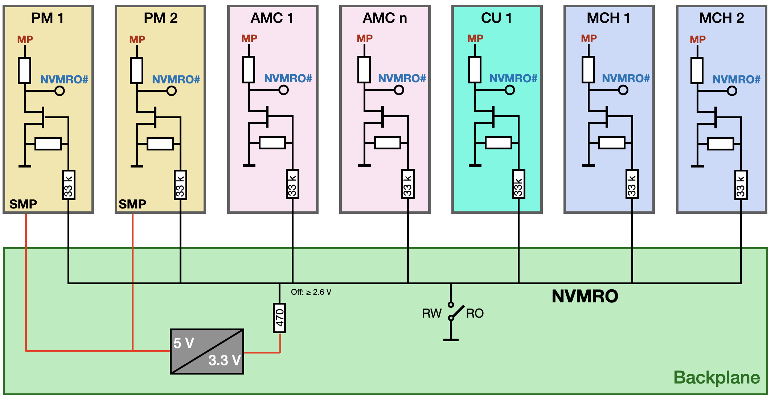
MicroTCA Next Generation: new Signal
PRELIMINARY
Non Volatile Memory Read Only (NVMRO)
Enhances the security of a MicroTCA system by preventing the overwriting or updating of non-volatile memory
It is available on all AMCs, MCHs, Cooling Units, and Power Modules
A not inserted jumper protects the system from remote modifications
Firmware updates are allowed only when a mechanical switch (e.g. jumper) is closed on the backplane

Slide 15
Conclusions
MTCA.0 Rev. 3 is ready!
32 GT/s = PCIe gen 5
With 4 lanes:
PCIs gen 5: 15.8 GB/s
Ethernet: 12.5 GB/s
110 W for MCH and cooling
Management of 80 / 110 W power channels
MicroTCA Next Generation
Goals:
Provide up to 220 W for AMCs
≥ 2 kW / crate cooling solution
More fat pipes: MCH & AMCs
Further items:
Ports 2, 3 protocols (now SATA)
FMC management:
VITA agreed to improve (Dariusz M, ....)
HW based security option to prevent remote manipulation of firmware

