Slide 1
Main Oscillator with sub-fs Resolution
and
High Performance Local Oscillator Generation in MicroTCA.4
KVG: Jiaoni Bai
DESY: Frank Ludwig, Uroš Mavrič, Heinrich Pryschelski

Slide 2
Agenda
KVG Introduction
Quartz Crystal Products
Main Oscillator with high Power and sub-fs Resolution
High Performance Local Oscillator Generation

Slide 3
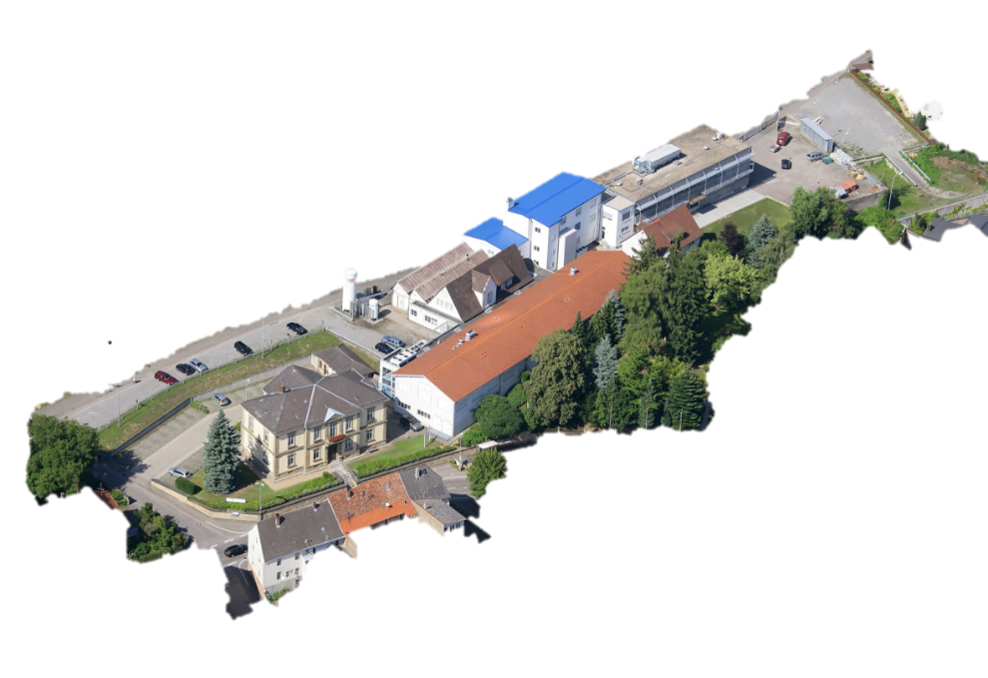
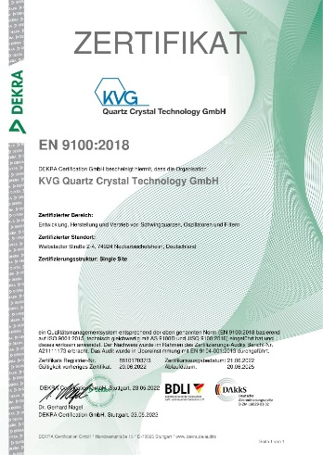
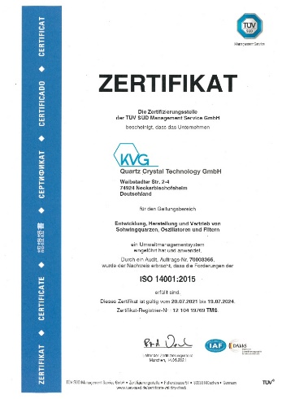



KVG Introduction
  KVG Quartz Crystal Technology GmbH
Location / Headquarter: Neckarbischofsheim,
Germany
  We provide
  state-of-the-art frequency control products for Science & Industry
  e.g., crystals, oscillators, filters, specific quartz crystal products, etc.
  Customized products, solution and excellent service
  Certification
  EN9100 and ISO14001

Slide 4
Quartz Crystal Products
Ultra-low Phase Noise OCXO Series
10 MHz
Case: 51x51x16 mm THT
Supply voltage: 12.0V
Current consumption:
  Warm-up ≤ 7.2 W max.
  Steady State ≤ 3 W max
Frequency stability:
  -20°C ~ 70°C ≤ ± 2 ppb
Output power:
≥ +5 dBm, Sine wave, 50 Ohm
  Short-term stability:
  ≤ 9 x 10⁻¹⁴ @ tau = 1 sec
Aging:
< ± 20ppb per year
Phase noise:
≤ - 90 dBc/Hz at 0.1 Hz
  ≤ - 124 dBc/Hz at 1 Hz
  ≤ - 149 dBc/Hz at 10 Hz
  ≤ - 162 dBc/Hz at 100 Hz
  ≤ - 166 dBc/Hz at 1 kHz
  ≤ - 166 dBc/Hz at 10 kHz

Slide 5
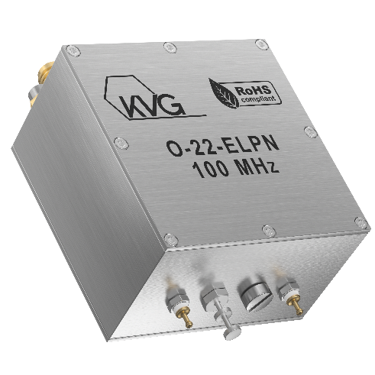
Quartz Crystal Products
Ultra-low Phase Noise OCXO Series
100 MHz
Case: 51 x 51 x 29 mm SMA
Supply voltage: 12.0V
Current consumption:
  Warm-up ≤ 500 mA (6.0 W max.)
  Steady State ≤ 250 mA (3.0W max.)
Frequency stability:
  -20°C ~ 70°C ≤ ± 100 ppb
Output power:
≥ +18 dBm, Sine wave, 50 Ohm
  Low aging:
  per year ≤ ±300 ppb
Phase noise:
  ≤ - 110 dBc/Hz at 10 Hz
  ≤ - 140 dBc/Hz at 100 Hz
  ≤ - 170 dBc/Hz at 1 kHz
  ≤ - 185 dBc/Hz at 10 kHz
  ≤ - 190 dBc/Hz at 100 kHz
  ≤ - 190 dBc/Hz at 1 MHz

Slide 6
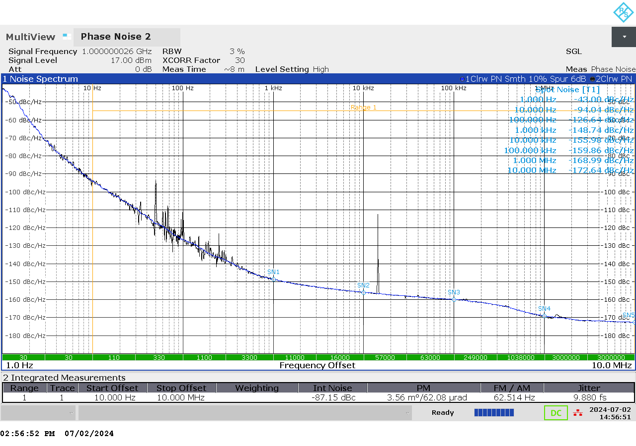
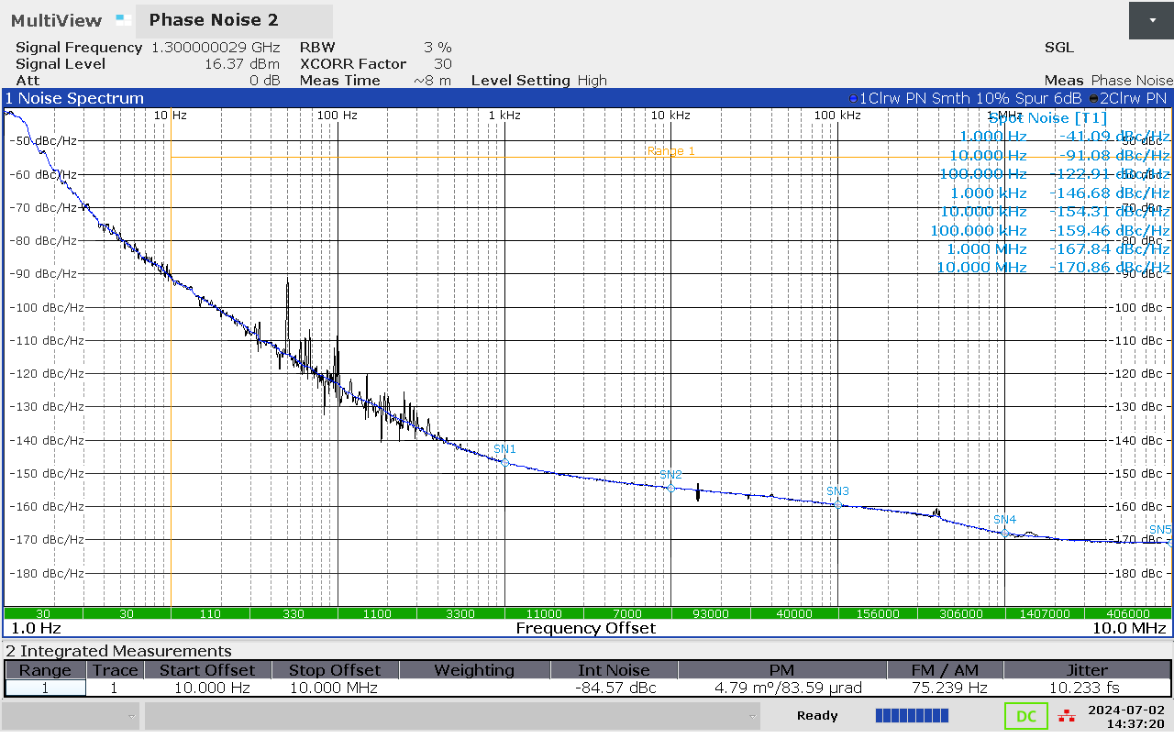
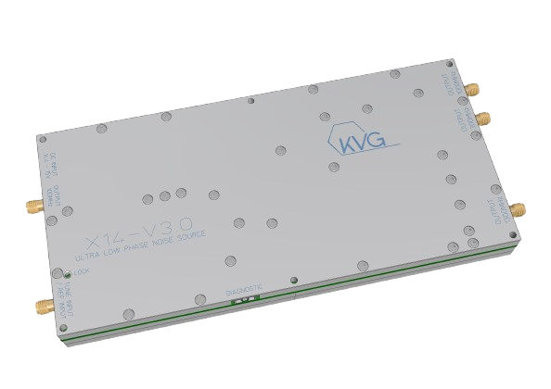
Ultra-low phase noise at 1 GHz
≤ -94 dBc/Hz at 10 Hz
≤ -126 dBc/Hz at 100 Hz
≤ -148 dBc/Hz at 1 kHz
≤ -156 dBc/Hz at 10 kHz
≤ -160 dBc/Hz at 100 kHz
≤ -169 dBc/Hz at 1 MHz
≤ -172 dBc/Hz at 10 MHz
X14 Ultra-low Phase Noise RF Signal Source
Frequency options:
100 MHz, 300 MHz, 500 MHz,
700 MHz, 1 GHz, 1.3 GHz Up to 24 GHz
External reference input options:
10 MHz, 20 MHz or 100 MHz
Ultra-low phase noise at 1.3 GHz
≤ -91 dBc/Hz at 10 Hz
≤ -122 dBc/Hz at 100 Hz
≤ -146 dBc/Hz at 1 kHz
≤ -154 dBc/Hz at 10 kHz
≤ -159 dBc/Hz at 100 kHz
≤ -167 dBc/Hz at 1 MHz
≤ -170 dBc/Hz at 10 MHz
External tuning voltage options:
0 …. 5 V or 0 …. 10 V
Phase noise will be improved 8-14 dB in 2025/2026.
Supply voltage 14.7V Current 1.5A
Diagnostic outputs
RMS jitter [10 Hz – 10 MHz] typ. < 10 fs @ 1300 MHz
Dimensions:
Max. 96.3 mm x 215 mm x 28.8 mm
incl. connectors

Slide 7
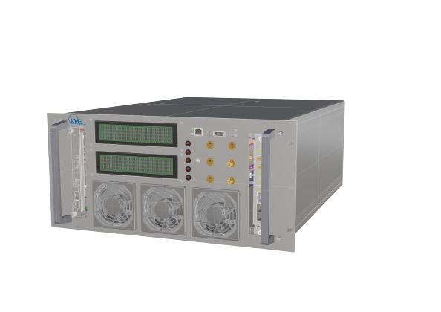
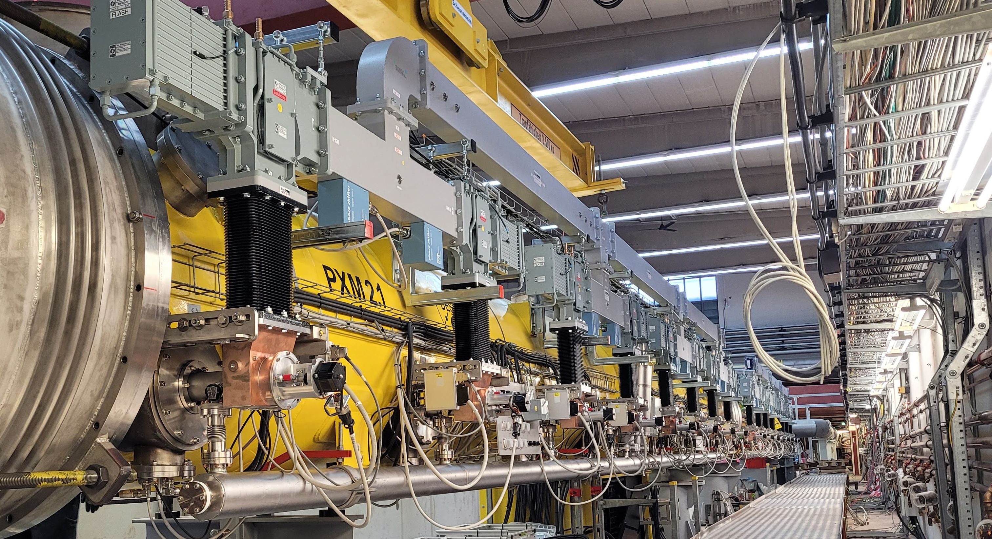

Main Oscillator (MO)
Technical Overview
Custom designed 19″ 600 mm 5U housing
Excellent short-term phase noise and jitter <1fs
Frequency stability better than 10⁻¹² (hours-days)
Support high power outputs ≥ +46 dBm
Provide different frequencies (optional)
Support remote diagnostic for maintenance
Tight operational reliability
Under license from DESY
Typical Application:
Providing high-power and ultra-low phase noise RF-signals in modern accelerators
Notes:
1.3 GHz und 1.5GHz are Under production
We plan to produce 3GHz module.
You can order module of your frequency application by us.

Slide 8
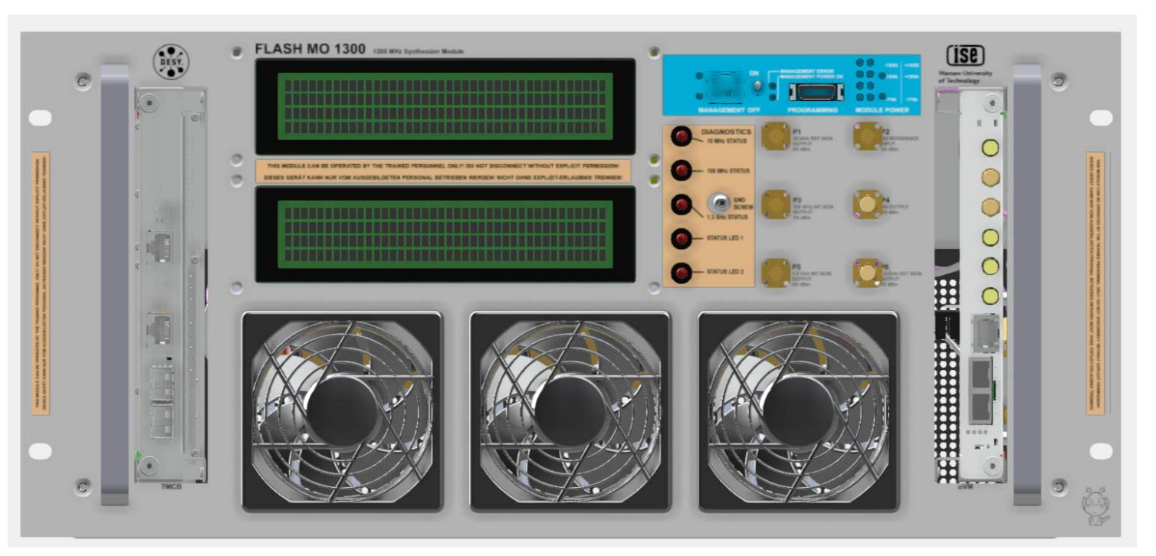

MO1300
Working Principle
MO synchronizes an ultra-low phase noise DRO output signal with a
1.3 GHz signal synthesized from an ultra-stable GPSDO 10 MHz signal.
Lock module 10 MHz to 100 MHz
Multiplier module 100MHz to 1.3 GHz
Lock module 1.3 GHz multiplier to DRO
1.3 GHz Dielectric Resonator Oscillator DRO
1.3 GHz high power amplifier
GPSDO
10 MHz
1.3 GHz
≥ +46 dBm
Notes:
Up to 15 dB improvement in range from 1 kHz to 100 kHz offsets, above 100 kHz the main limitation is the HPA

Slide 9
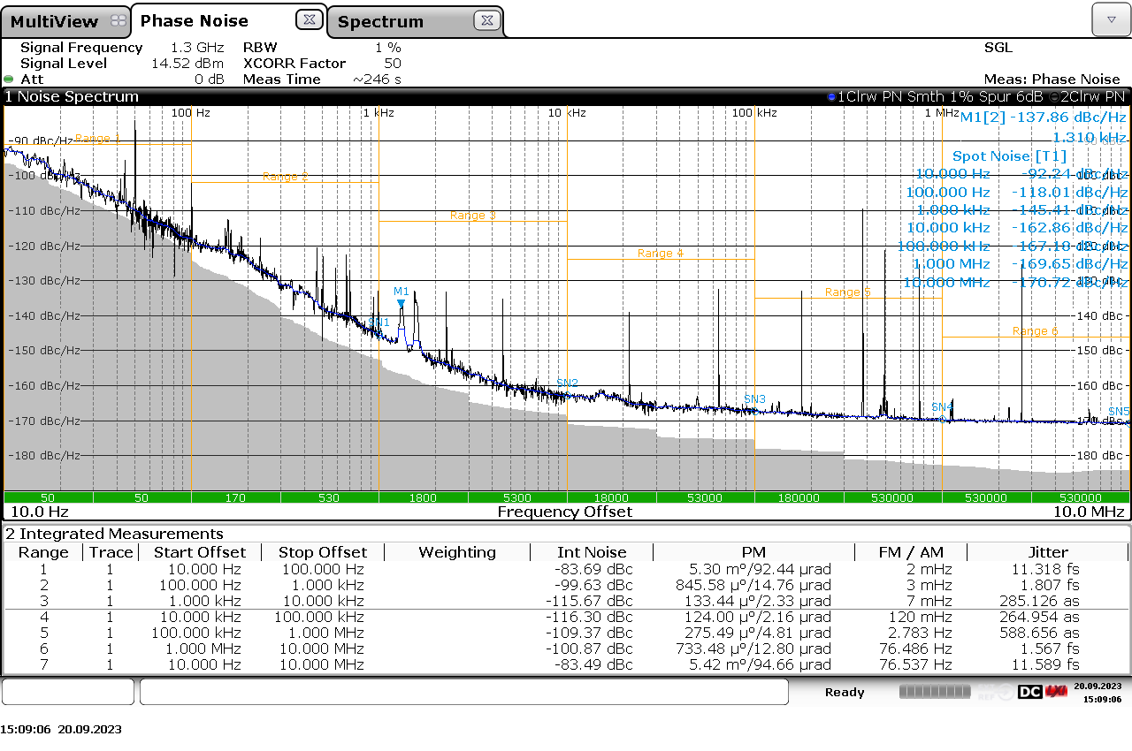
MO1300
RF Performance
Ultra-low phase noise at 1.3 GHz
≤ -92 dBc/Hz at 10 Hz
≤ -120 dBc/Hz at 100 Hz
≤ -145 dBc/Hz at 1 kHz
≤ -161 dBc/Hz at 10 kHz
≤ -165 dBc/Hz at 100 kHz
≤ -169 dBc/Hz at 1 MHz
≤ -170 dBc/Hz at 10 MHz
Measurement result provided by F.Ludwig and H.Pryschelski (MSK, DESY)

Slide 10
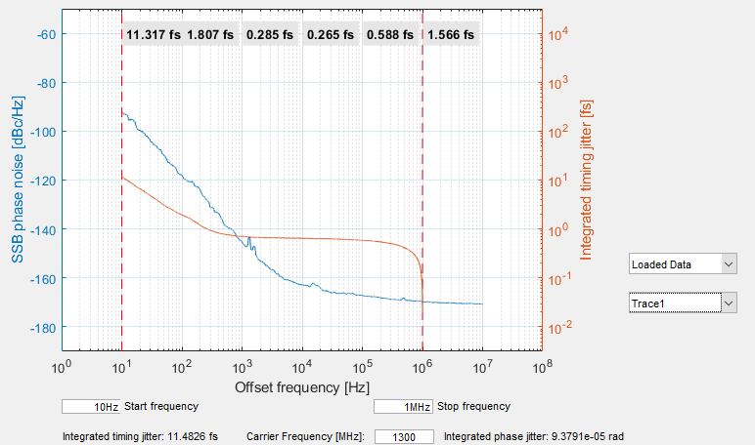
MO1300
RF Performance
Ultra-low integrated jitter at 1.3 GHz
  < 12 fs [10 Hz to 100 Hz]
  < 2 fs [100 Hz to 1 kHz]
  < 0.8 fs [1 kHz to 1 MHz]
Measurement result provided by F.Ludwig and H.Pryschelski (MSK, DESY)

Slide 11
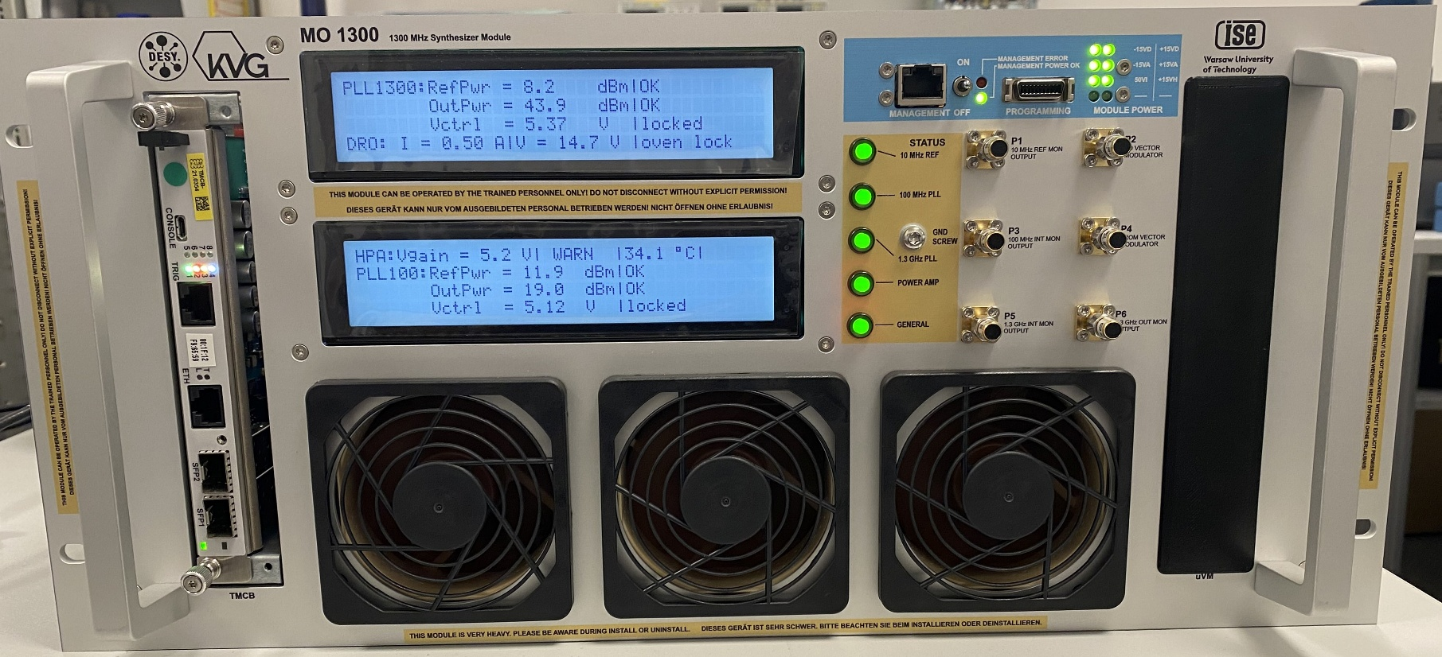
MO1300
We provide Main Oscillator for your frequency application.

Slide 12
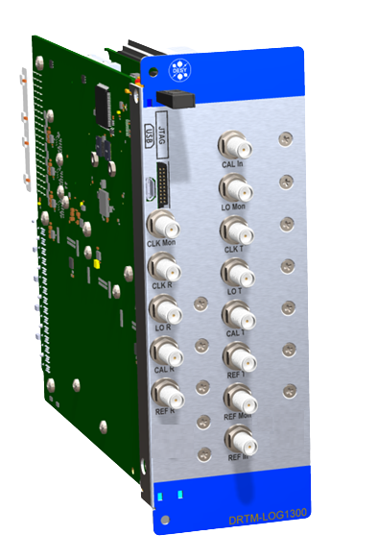

Local Oscillator Generation (DeRTM-LOG)
Technical Overview
A multi-channel local oscillator, RF signal and clock generator
  9 REF, 9 LO and 9 CAL signals [400 MHz to 6 GHz]
  22 low-jitter, differential CLK signals up to 160 Msps
Two double-width, full-height, MicroTCA.4 compliant
extended Rear Transition Module (eRTM)
LO residual phase noise < 5 fs (rms)
[10 Hz to 1 MHz] at 1.354 GHz
On/Off switching of output clocks and RF signals
Temperature regulation for long-term stability of RF signals
  Diagnostic for RF power, DC voltage, temperature, humidity
Under license from DESY

Slide 13
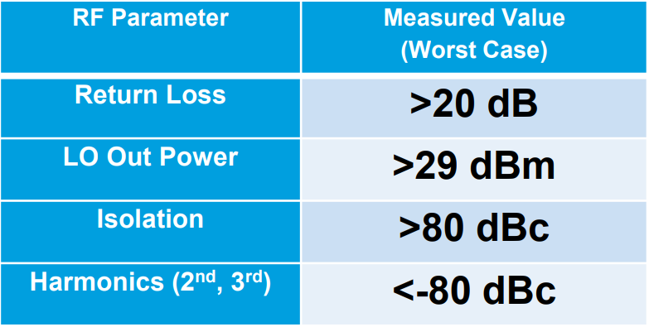
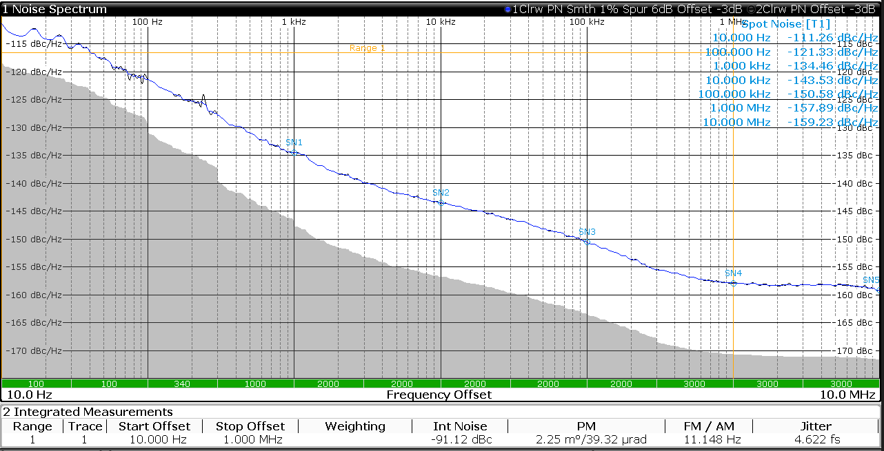
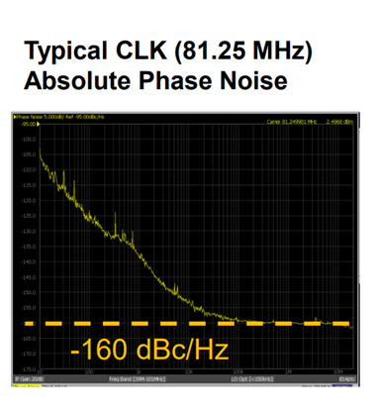
DeRTM-LOG
RF Performance
DeRTM-LOG 1.3 GHz:
REF 1.300 GHz
LO 1.354 GHz
CLK 81.25 MHz
Measurement results provided by U.Mavrič (MSK, DESY)
Measured Residual Phase Noise
LO 1.354 GHz 4.6 fs [10 Hz to 1 MHz]

Slide 14
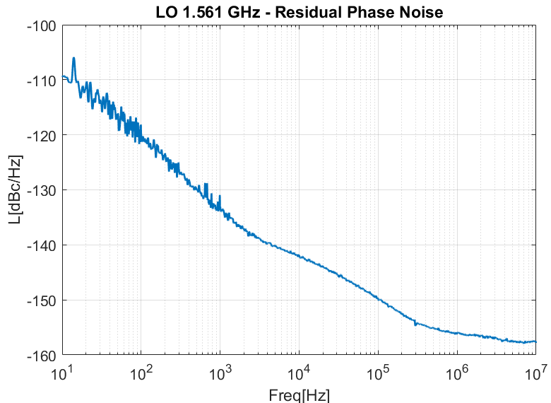
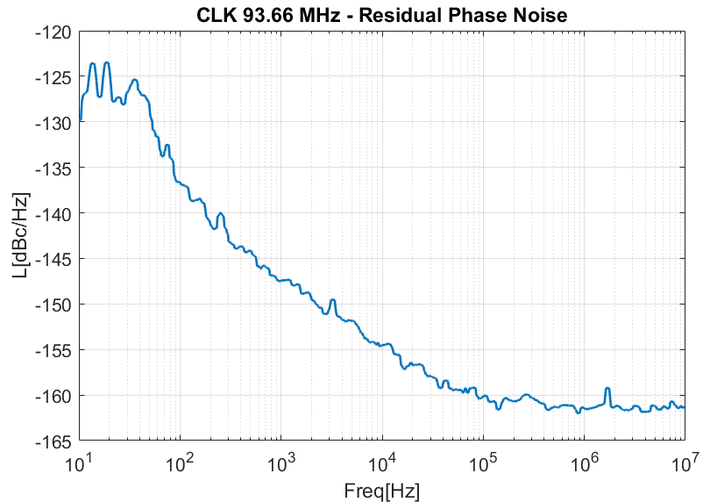
DeRTM-LOG
RF Performance
DeRTM-LOG 1.5 GHz:
REF 1.500 GHz
LO 1.561 GHz
CLK 93.66 MHz
Measurement results provided by U.Mavrič (MSK, DESY)
14

Slide 15
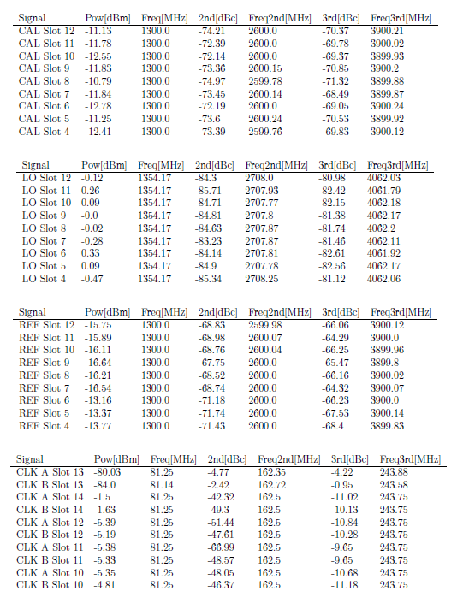
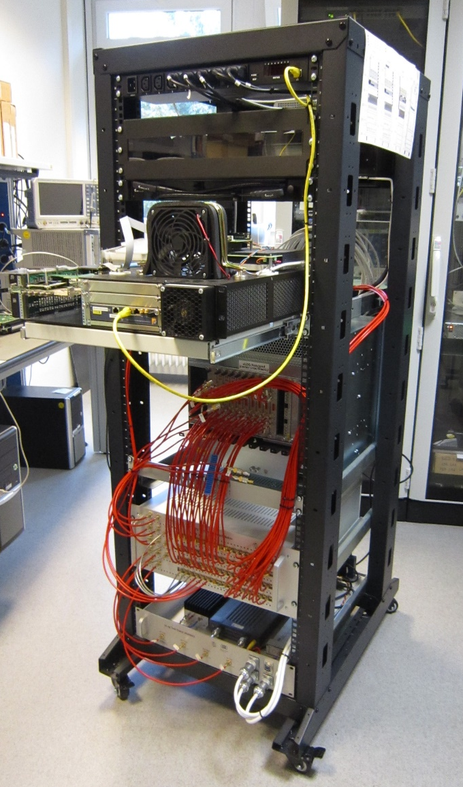
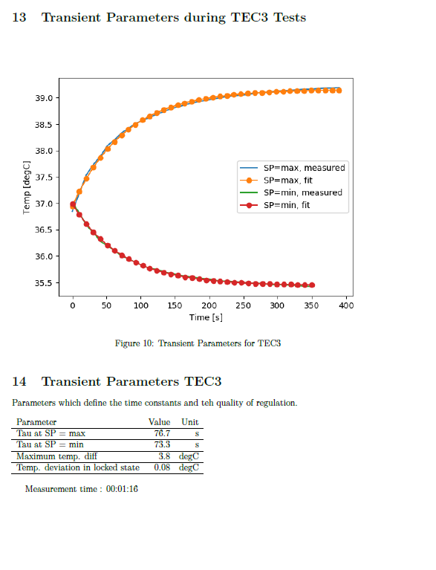
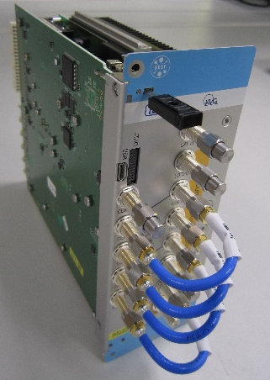
DeRTM-LOG
Test-Stand
A fully automated test stand developed and provided
by DESY to check possible production errors.
Measure:
  individual mezzanines
  (DC/DC mezz., RF mezz., ...)
  A fully assembled module
Test:
  CLK frequency [1 MHz to 500 MHz]
  LO, REF and calibration signals
  [1 MHz to 6 GHz]

Slide 16
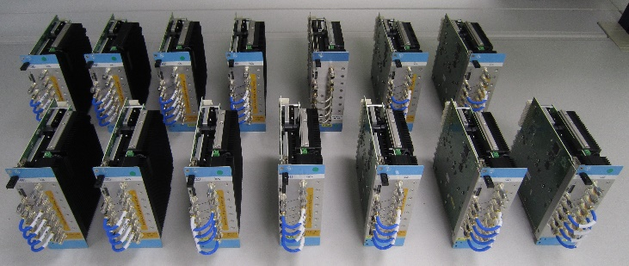
DeRTM-LOG
Production and Future Development
Available Options: DeRTM-LOG 1.3 GHz and 1.5 GHz
Working on 3 GHz
Further developments by DESY with new architecture
  Cover various LO and CLK generation scenarios
  Cover more REF frequencies applications
  Residual phase noise of the LO and CLK generation
  ≤ -165 dBc/Hz white noise
We provide DeRTM-LOG for your frequency application.

Slide 17
Thank you for your attention!
Thanks to DESY colleagues for their support.
Further questions, please contact us.
Email: jbai@kvg-gmbh.de

