Slide 1
Update of controls for the MINERVA project
Kris Meeus, Product Owner Fast Control
MicroTCA Workshop DESY,
December 2024
An innovative Large Research Infrastructure in Belgium towards sustainable nuclear energy

Slide 2
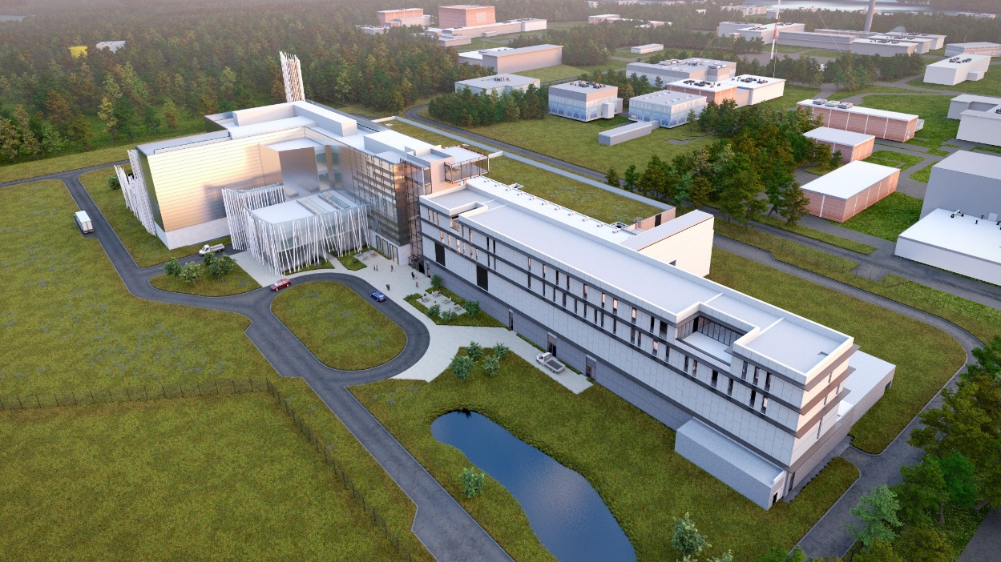
Content
Short recap on the project
Controls development team and environment
Hardware and purchasing challenges
Where will MicroTCA be used
Concluding

Slide 3
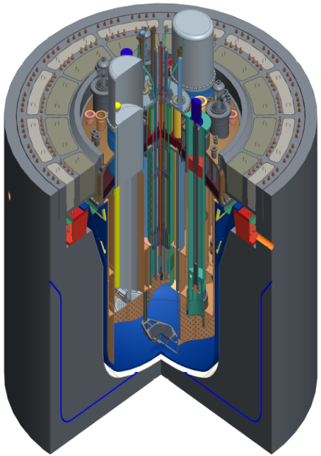
MYRRHA (Multi-purpose hYbrid Research Reactor for High-tech Applications)
Accelerator Driven System (ADS)
≈360 m
Linear accelerator
(600 MeV)
42 m
Main Objectives
Transmutation demonstration
ADS at pre-industrial scale
Flexible irradiation facility
Reactor
(Sub-critical, Lead-Bismuth cooled)

Slide 4

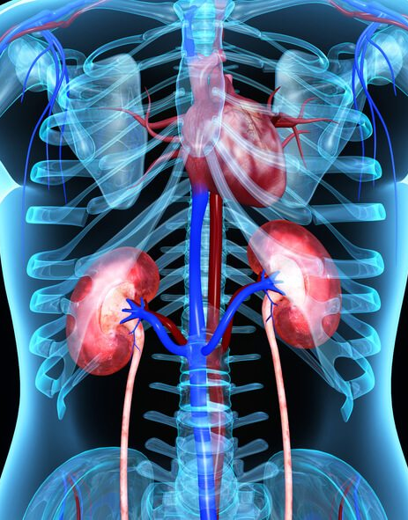
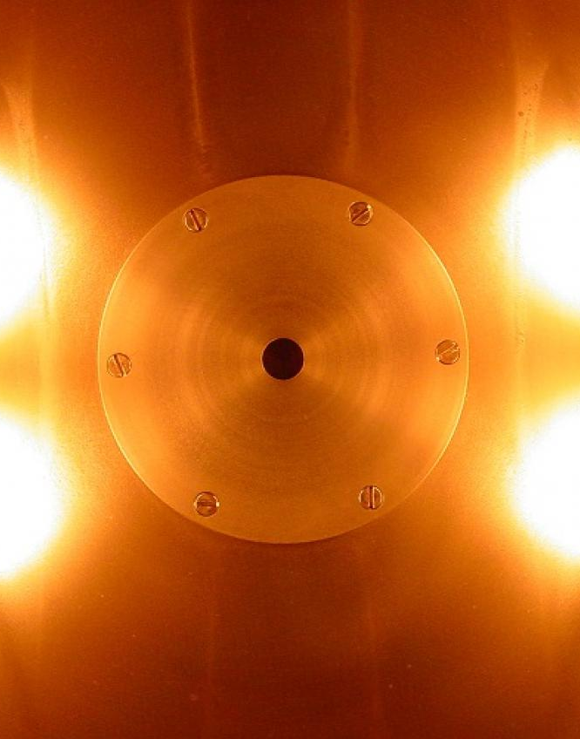
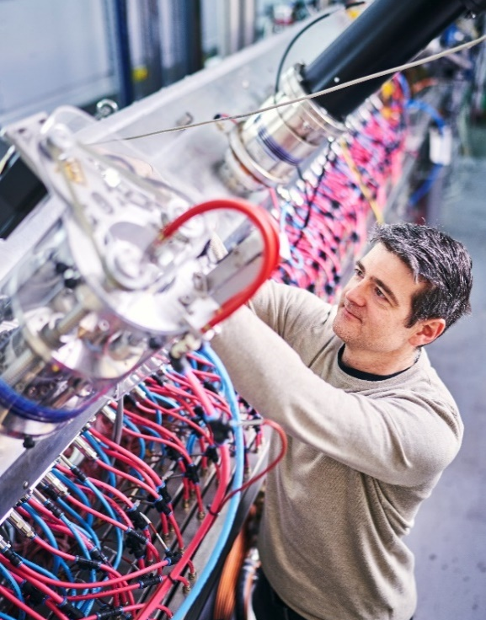
MYRRHA’s versatility
Less (toxic) nuclear waste
Production of medical radio-isotopes
New reactor concepts
Fundamental research
Transmutation reduces the final residual waste volume by a factor 100 and natural radiation level is reached after 300 years
Therapeutic radio-isotopes can fight cancer cells in a more targeted way with significant reduction of side effects for patient
A wide range of material testing by fast neutrons for development of fusion reactors as well as used in current fission reactors
Deepening understandings in Nuclear physics, atomic physics, fundamental interactions, solid state physics & nuclear medicine

Slide 5
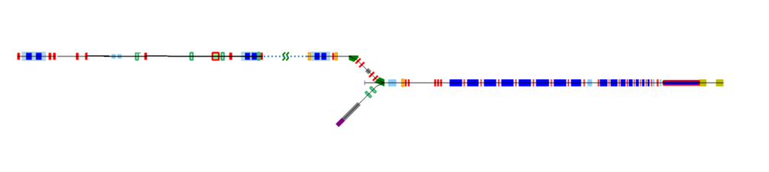
MINERVA / MYRRHA - short recap
Phase 2 - 600 MeV
Application Centers
Phase 1 - 100 MeV
“MINERVA”
100 MeV
17 MeV
SUPERCONDUCTING LINAC
INJECTOR
60 SRF LB CAVITIES
20 NCRF CAVITIES
Phase 3 - Reactor
Serial redundancy
Parallel redundancy
Conservative approach:
Power overhead
Fast reconfiguration
2 injectors, demonstration with 1 injector
5

Slide 6
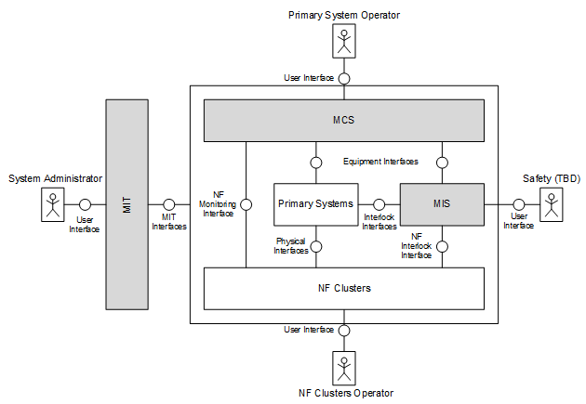
Controls development team
Task to implement control and interlock system
  Team – 4 scrum teams (all domains like C++, PLC, FPGA and DevOps)
  Interlock system independent from control system
  Integrate primary systems (LLRF, BCM, VAC, …)
  Services: navigator; alarm; archive; log; …

Slide 7
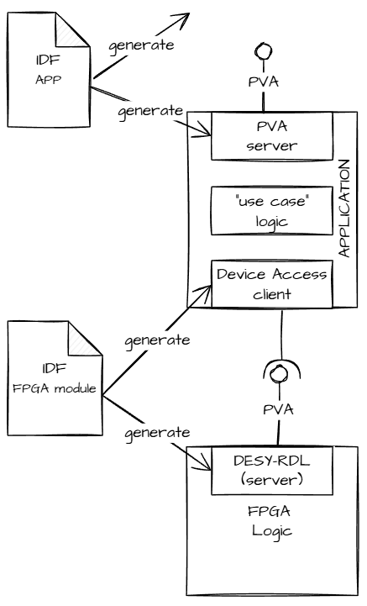
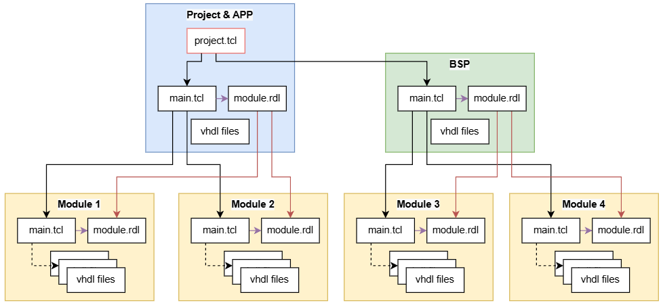
Controls development environment
  MINERVA Development environment
  EPICS PVA protocol, C++ applications
  Applications realized in C++, PLC and FPGA
  Interface definition files (IDF), generating interfaces
  DESY’s FWK based development framework, adopted for MINERVA
  Conan for dependency and package management
  TDD approach. Tests executed with each commit
  CI_{(ntegration)}/CD_{(elivery)} using Bitbucket pipelines

Slide 8
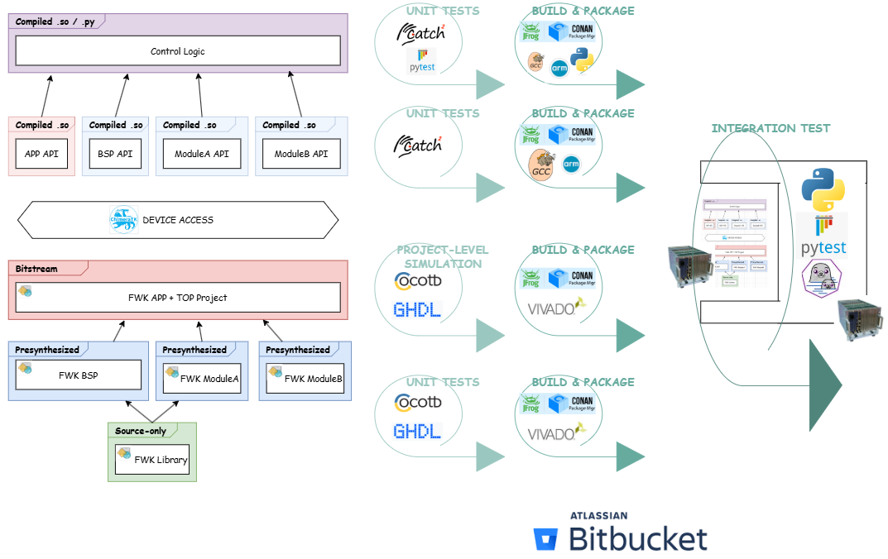
Controls dev. env. for FPGA illustrated

Slide 9
Fast control hardware standardization
All fast control hardware for MINERVA will be based on MicroTCA
“MINERVA Hardware Catalogue”, for primary system integration
  COTS products
  Spare part management
  Keep integration and purchasing effort to minimum
MicroTCA products be used
  Beam diagnostic systems
  LLRF systems
  Fast DF-Cells (corrector, collimators, …)
  Fast Interlock
  Timing and triggering system
Custom development (next to RF-SoC) limited to RTM / FMC boards
⇒ development team

Slide 10
Purchasing challenges vs digitizer needs
Tender process or development of primary systems is ongoing
⇒ no clear specs
3 Different hardware groups
⇒ Reference boards defined for MINERVA catalogue
Group | Systems | Sampling rate
RF | LLRF-CFC, … | > 4Gsps
Fast analogue | BPM, … | >1,8Gsps
Medium analogue | BCM, COL, … | >100Msps

Slide 11
Concluding
Short term next steps
MicroTCA products tender will be published soon
Realizing test stands for primary system prototypes
Credits: R. Moser, I. Pechan, K. Kovacs, M. Jardin, L. Cuypers, M. Boros
… in extend the full ICS team !
Contact: kris.meeus@sckcen.be

Slide 12
Copyright © SCK CEN
PLEASE NOTE!
This presentation contains data, information and formats for dedicated use only and may not be communicated, copied, reproduced, distributed or cited without the explicit written permission of SCK CEN.
If this explicit written permission has been obtained, please reference the author, followed by ‘by courtesy of SCK CEN’.
Any infringement to this rule is illegal and entitles to claim damages from the infringer, without prejudice to any other right in case of granting a patent or registration in the field of intellectual property.
SCK CEN
Belgian Nuclear Research Centre
Foundation of Public Utility
Registered Office: Avenue Herrmann-Debrouxlaan 40 – BE-1160 BRUSSELS
Operational Office: Boeretang 200 – BE-2400 MOL

