Slide 1
The Path to Series Production of the MicroTCA.4 Based Scientific Detector Controller (NGCII) for the Extremely Large Telescope
Mathias Richerzhagen, Matthias Seidel
Max Engelhardt, Alexander Rüde

Slide 2
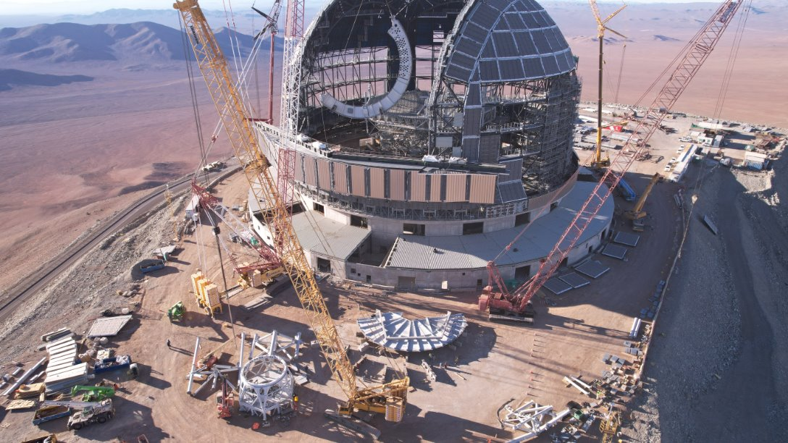
ELT Construction Progress
Image Credit: ESO

Slide 3
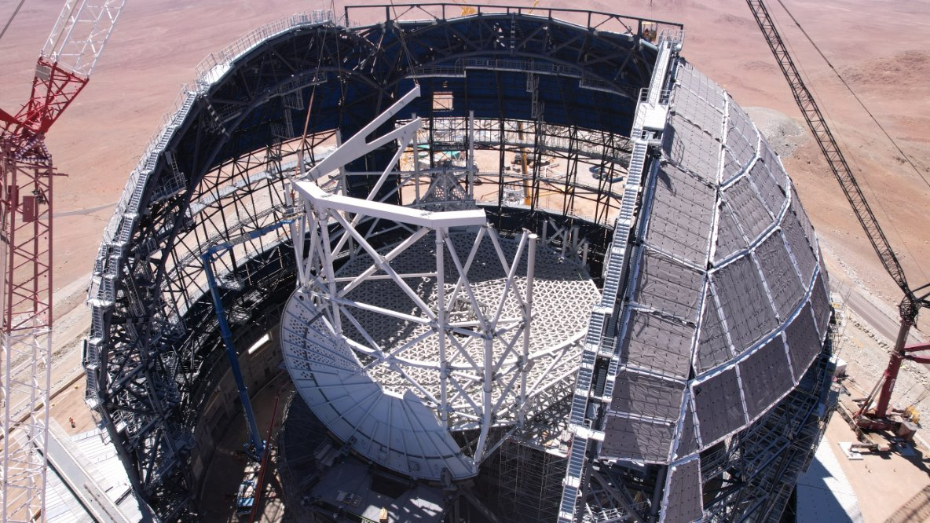
ELT Construction Progress
Image Credit: ESO

Slide 4
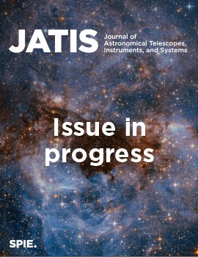
Publication in JATIS
Published journal article in Journal of Astronomical Telescopes, Instruments, and Systems VOL. 10 · NO. 4 | October 2024
https://doi.org/10.1117/1.JATIS.10.4.046001
Preprint available at:
https://doi.org/10.48550/arXiv.2410.22965

Slide 5
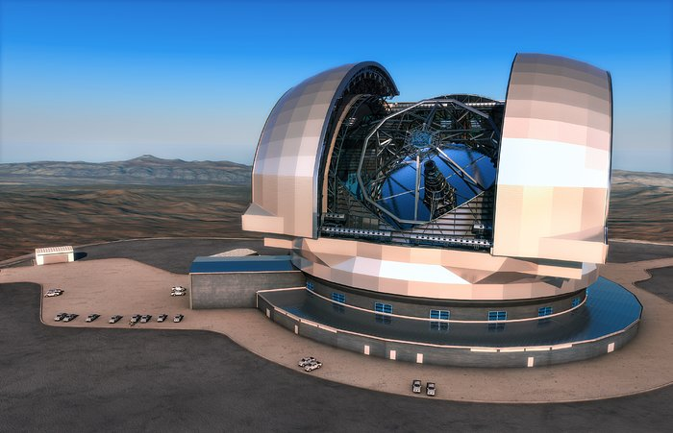
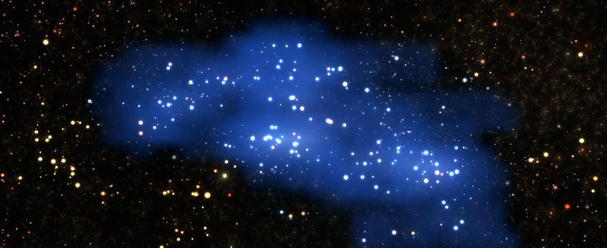
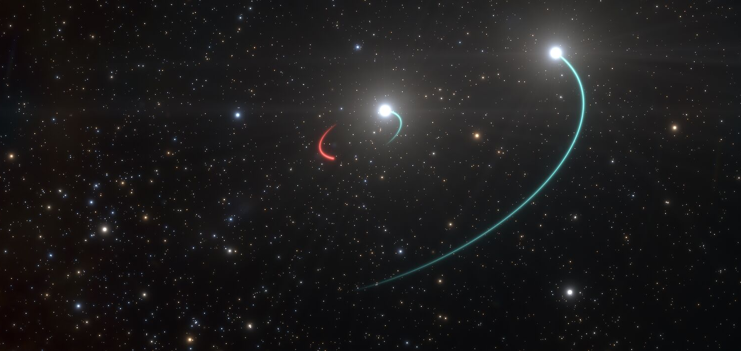
NGCII Detector Controller for ELT 2020
Extremely Large Telescope
4x Very Large Telescope
Credit: ESO/L. Calçada
Credit: J.L. Dauvergne & G. Hüdepohl
HARMONI
(e.g. High Red-Shift Galaxies)
METIS
(e.g. High Red-Shift Galaxies)
MICADO
(e.g. Black Holes)
Credit: ESO/L. Calçada
Credit: ESO/L. Calçada
Credit: ESO/L. Calçada & Olga Cucciati et al.
8 Detectors
7 Detectors
9 Detectors

Slide 6
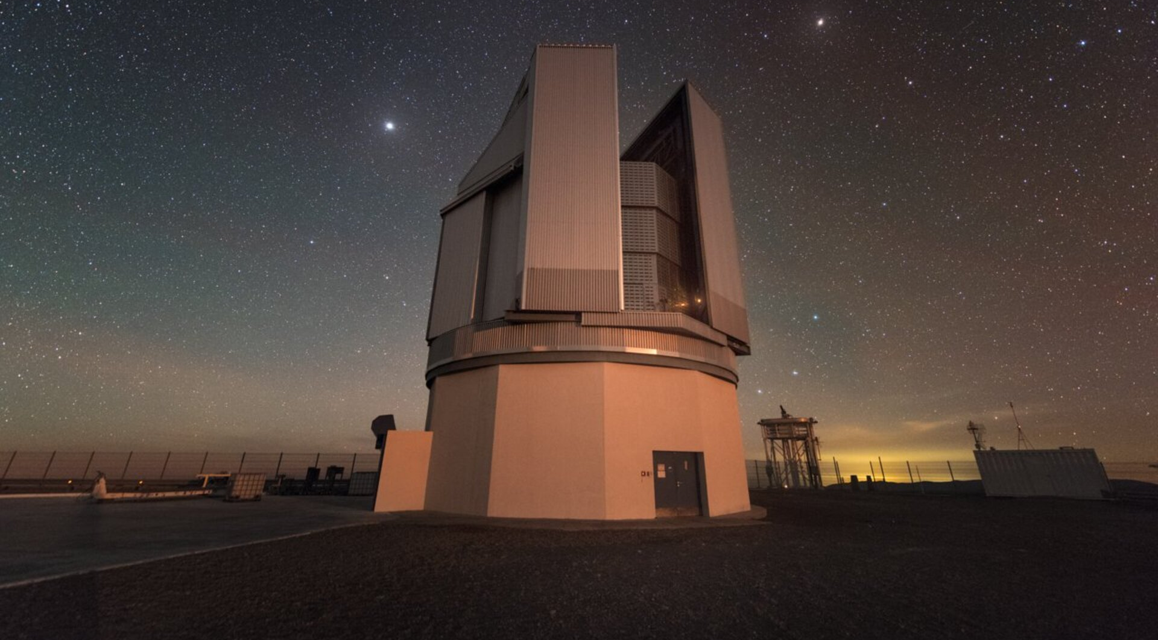
NGCII Detector Controller for ELT/VLT/VST 2024
Extremely Large Telescope
Phasing and
Diagnostics Station
4x Very Large Telescope
ANDES
MOSAIC
Credit: ESO/L. Calçada
Credit: J.L. Dauvergne & G. Hüdepohl
HARMONI
(e.g. High Red-Shift Galaxies)
METIS
(e.g. High Red-Shift Galaxies)
MICADO
(e.g. Black Holes)
MAVIS
Credit: ESO/L. Calçada
Credit: ESO/L. Calçada
Blue MUSE
Credit: ESO/L. Calçada & Olga Cucciati et al.
CUBES
8 Detectors
7 Detectors
9 Detectors
VLT Survey Telescope
FORS-Up
Credit: ESO/Y.Beletsky

Slide 7
Detectors
CMOS
CCD
GEOSNAP
40
2024
27
2024
26
2020 | 2024
1
3
2020
2020
Circle area proportional to total number of detectors

Slide 8
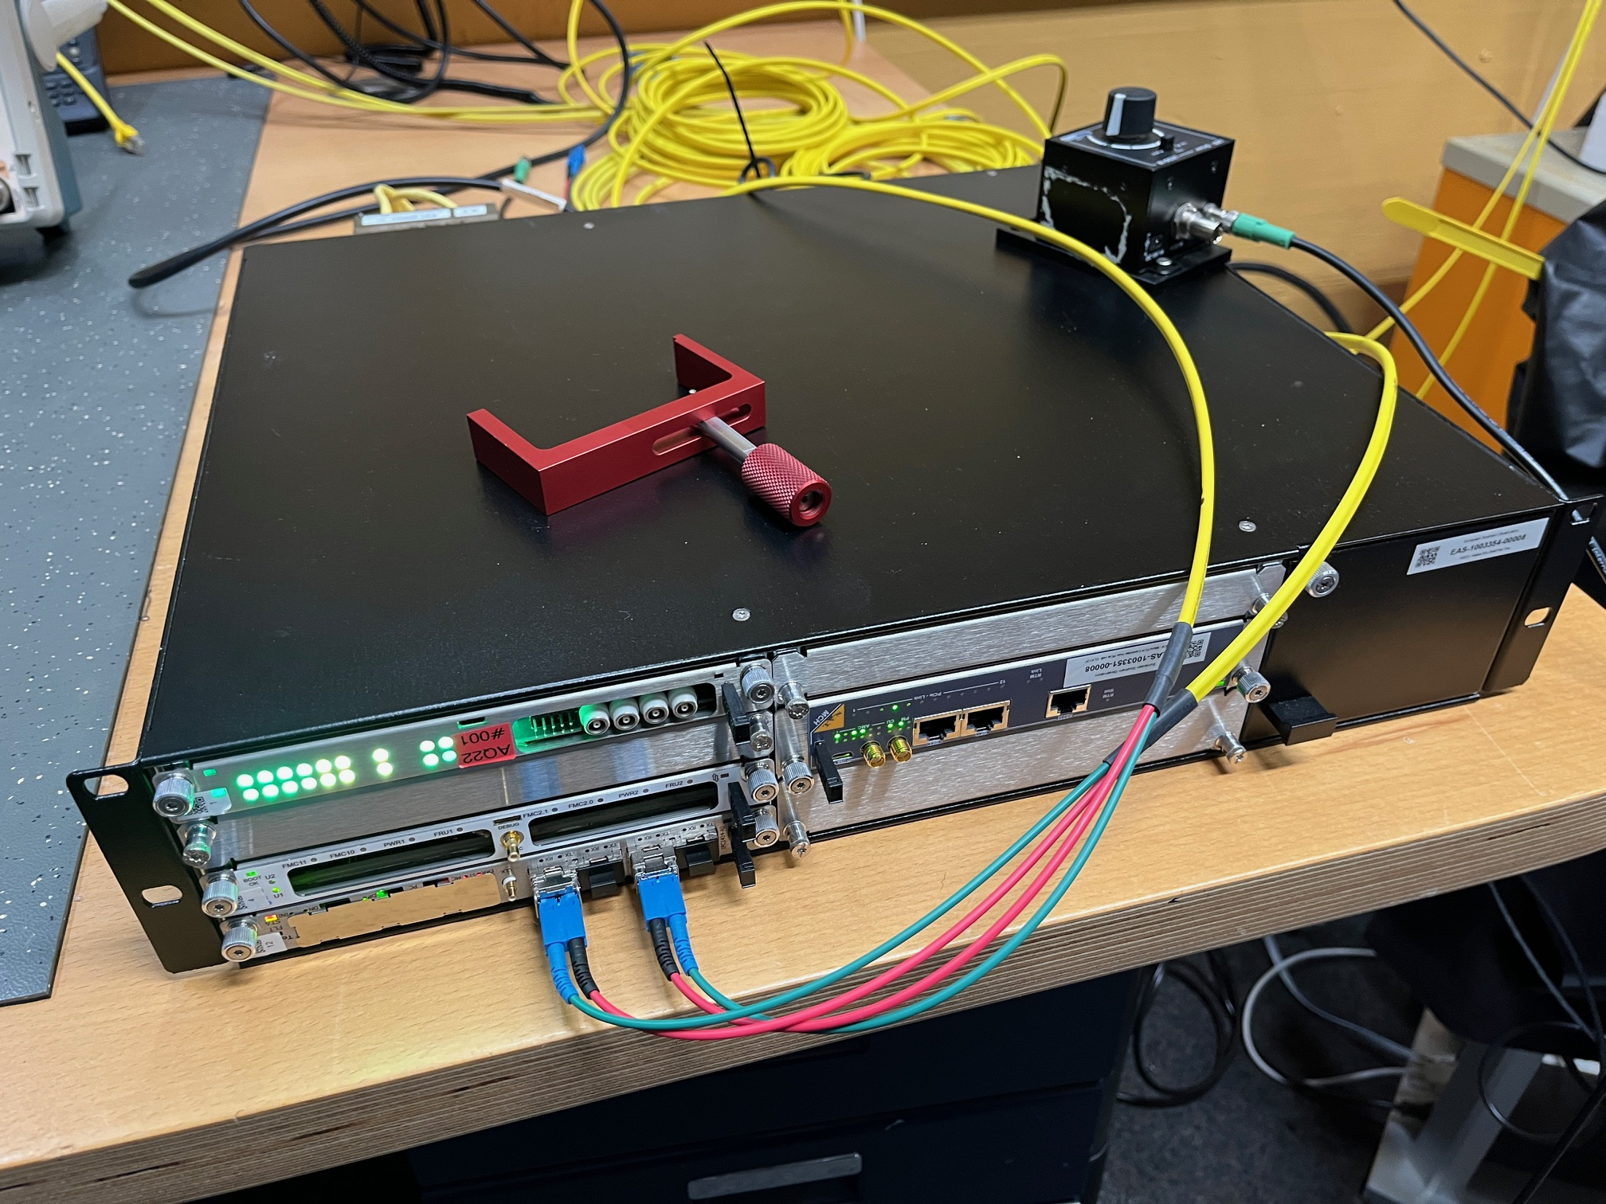
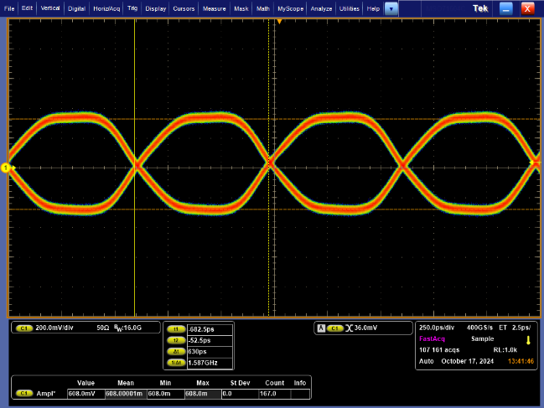
CCD + GEOSNAP Development Update
CCD Systems
All modules ready as prototypes
Integration test with CCD detector ongoing
GEOSNAP System
Fully digital detector @ 1.6Gbps
Currently developing firmware
Integration testing Q1, 2025
Eye diagram with connector and cable @1.6Gbps

Slide 9
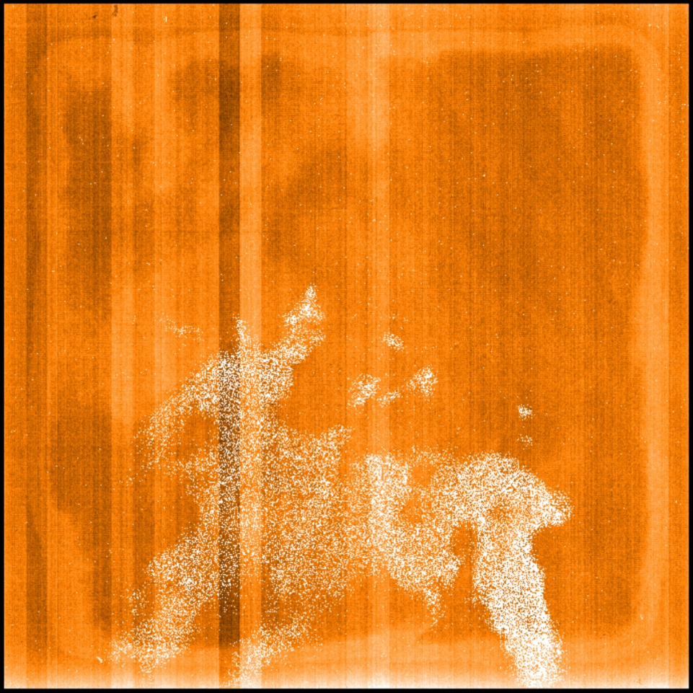
CMOS System Finalized
HAWAII-2RG
Engineering Grade
Detector

Slide 10
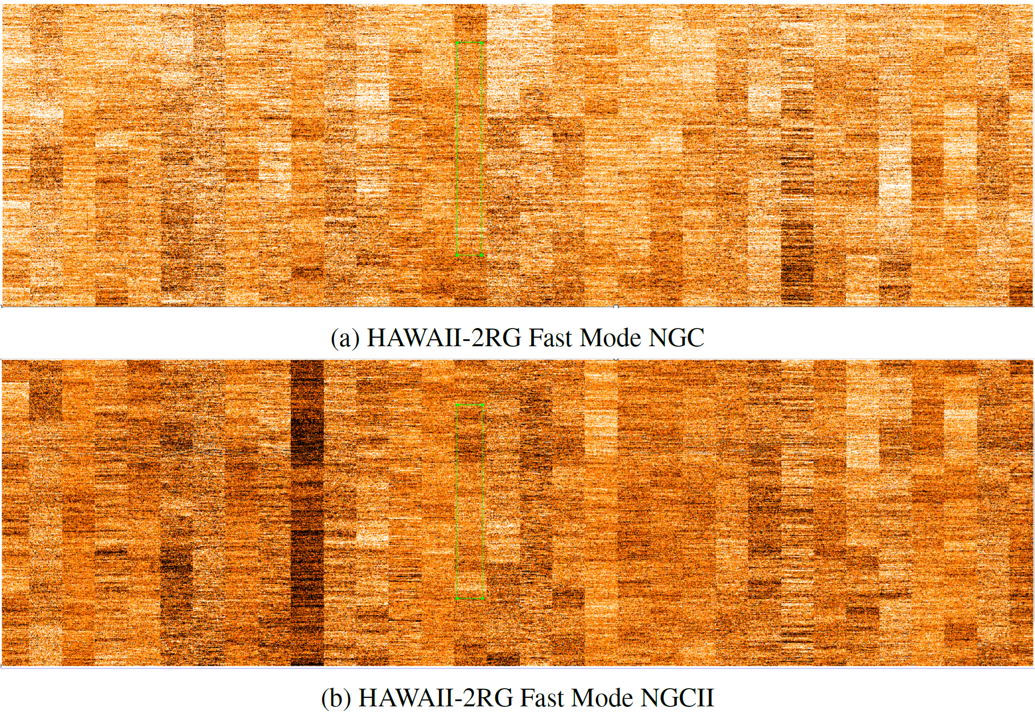
CMOS System Finalized
HAWAII-2RG fast mode noise is detector limited as for NGC1.
HAWAII-2RG slow mode achieving noise levels not seen before at <10e− for simple CDS.

Slide 11
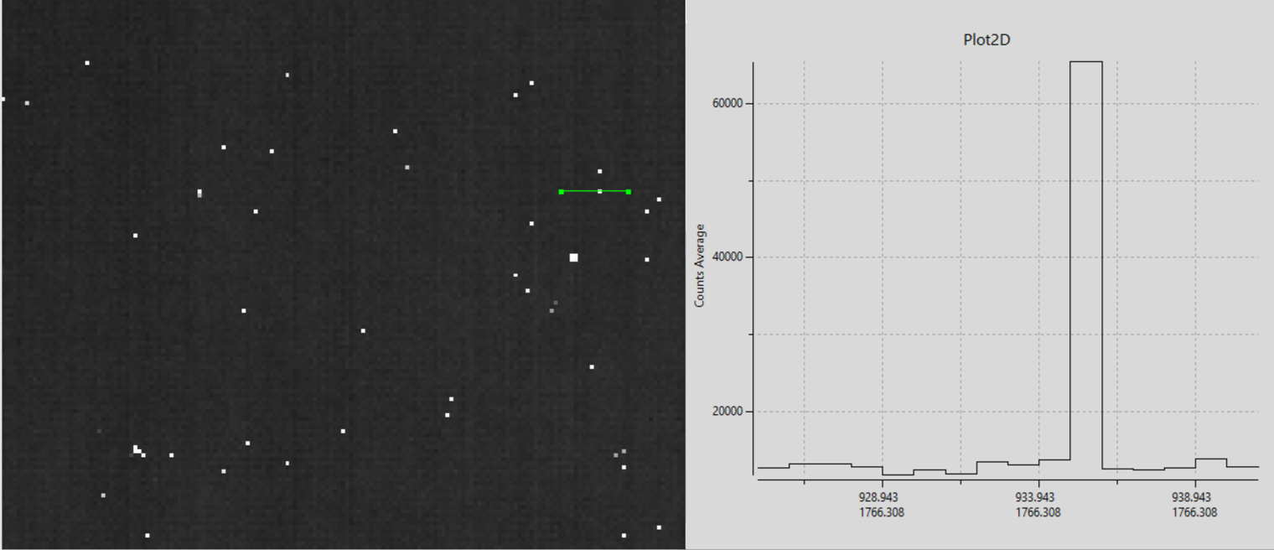
CMOS System Finalized
HAWAII-2RG running at 30fps without observable hot-pixel trailing

Slide 12
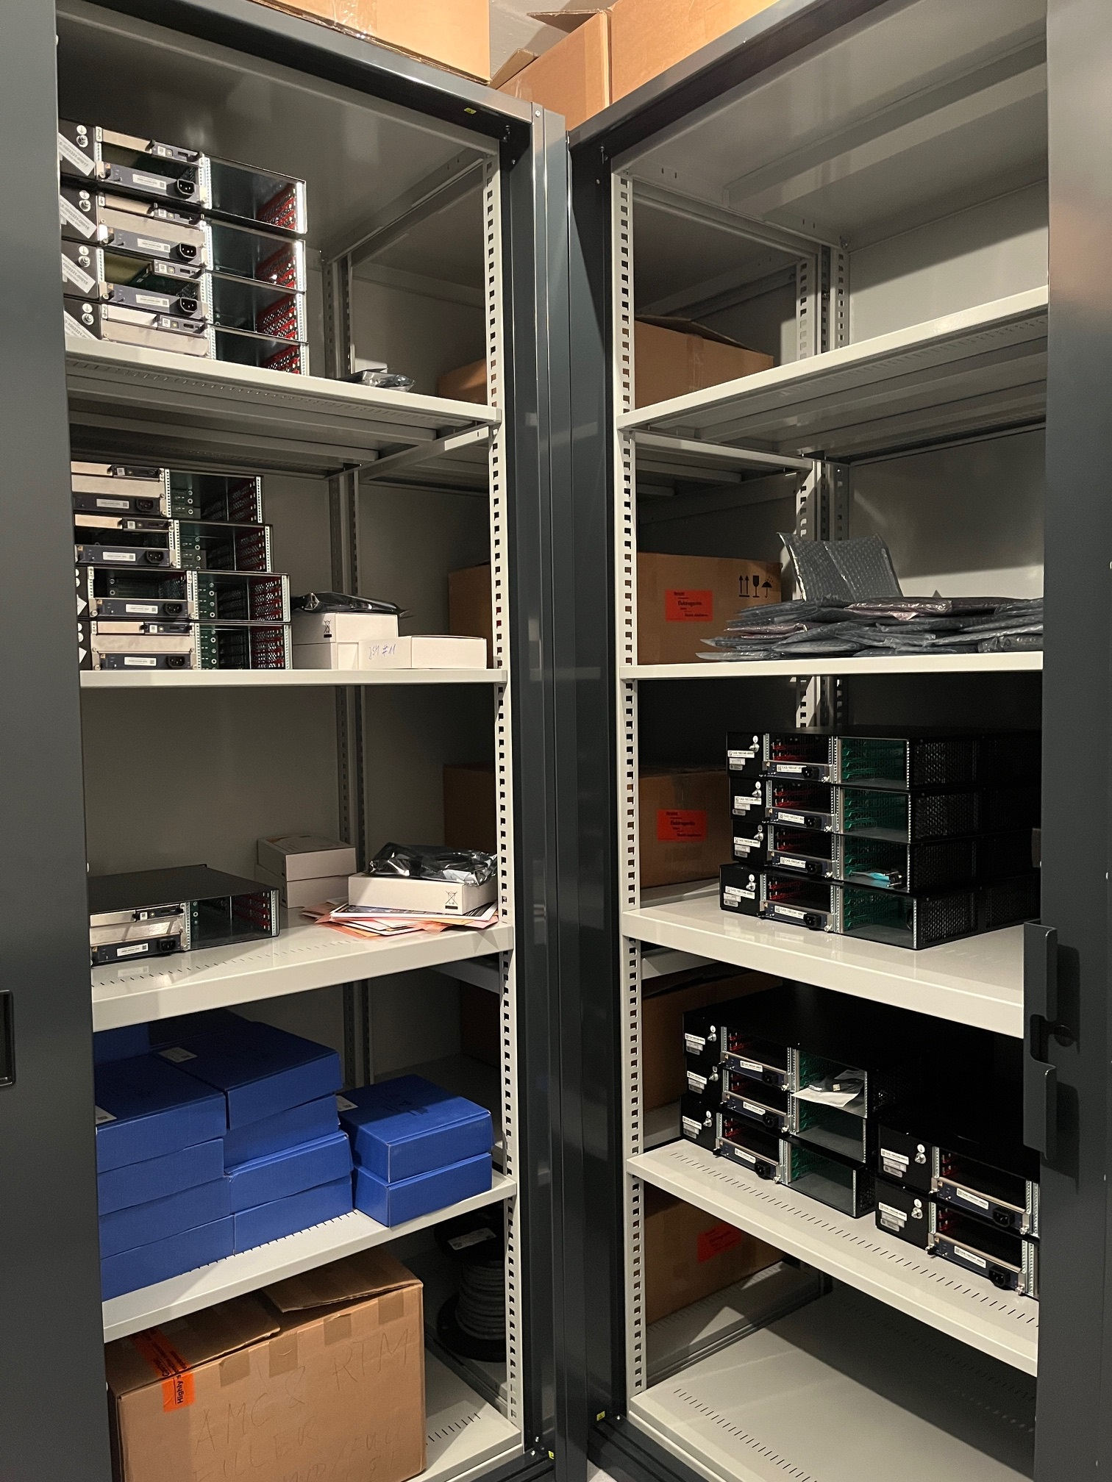
CMOS System Production
COTS Components available for ~25 systems
Will procure:
6-Slot shelves (Req. ESO-394252)
Zynq US+ FPGA Modules D1.2 (Req. ESO-393209)
ESO designed CMOS modules in pre-series
Fully functional
Still missing environmental test
Fully tested by manufacturing company
Enough for ~10 systems

Slide 13
Design Quality Measures in Workflow
Hardware Design
On-site Gitlab Server
Build Server
Creates Gerbers, PDFs, BOMs
Performs independent DRC+ERC check
Performs BOM sanity check
Validates data sources
Calculates estimate for MTBF according to modified MIL-HDBK-217F
2
3
Payungkead - Flaticon
Payungkead - Flaticon
xnimrodx - Flaticon
1
4
Build Artifacts and GIT Snapshot to Document Archive
Freepik - Flaticon
Four-eye reviewed Altium libraries

Slide 14
Firmware and Software
AQ22 AMC
AQ22 AMC
AQ22 AMC
Host Controller
IOxOS IFC1414
MCH
CMOS AQ22 RTM
CMOS AQ22 RTM
CMOS AQ22 RTM
CMOS C20B20 RTM
Several identical AMC modules:
Position unknown
Ideally access to GA through MMC
Standardize an MMC interface?
GA
RTM Enable
Temperature Sensors

Slide 15
Image Credit: ESO/S. Brunier
Questions and Answers

Slide 16
Mathias Richerzhagen
Matthias Seidel
Max Engelhardt
Alexander Rüde
@ESOAstronomy
@esoastronomy
@ESO
european-southern-observatory
@ESOobservatory

