Slide 1
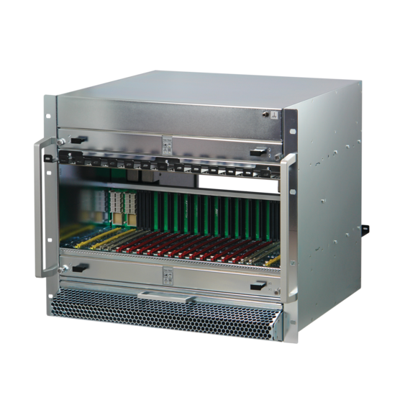
New MTCA.4 Crate
in accordance to Revision 3.0 of MTCA.0 Standard
Christian Ganninger
12-2024

Slide 2
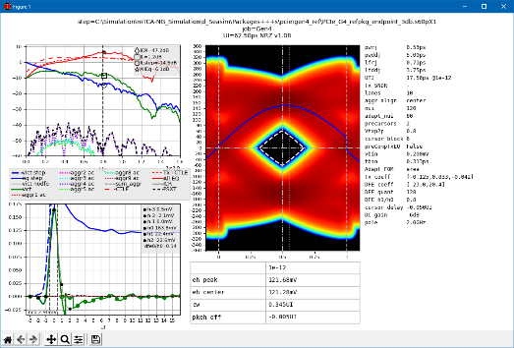
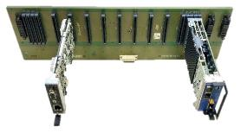
Next Generation MicroTCA
The PICMG released MTCA.0 Rev 3.0 in September 2023
NEW FEATURES
Supports PCI Express Gen 4 & 5
Supports 100 Gb Ethernet (100GBASE-KR4)
MCH with new management features
MCH slot gets 110 W of power to support 100 GbE or PCIe Gen 4 / 5 switches
Power Module with 110 W channels for MCH and CU

Slide 3
NEW MTCA.0 Rev 3.0 compliant backplane
Signal Integrity, compatibility and differences

Slide 4
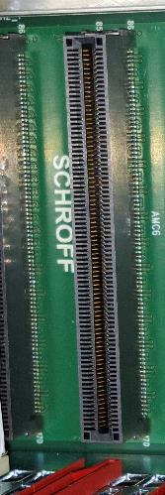
New Backplane Design
Connectors changed from Press Fit to Surface Mount to minimize the losses in the through holes
Connectors are downward compatible
Low loss material and new routing strategy for pcb to improve the signal integrity
Data transmission channel from PCI-SIG and IEEE divided into sections, with limits defined for MCH, AMC and Backplane
The backplane in the NEW nVent SCHROFF MTCA.4 crate meets the requirements of the MTCA.0 Rev. 3.0 Standard for PCIe Gen 4 & (5) and 100GBASE-KR4
Rx/Tx Chip
Tx/Rx Chip
transmission channel

Slide 5
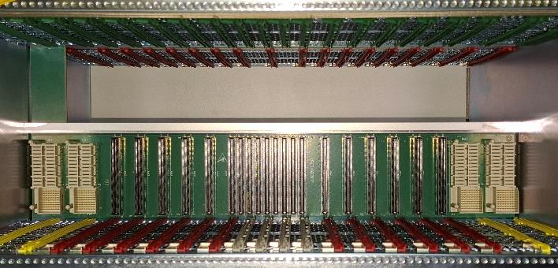
New Backplane Signal Integrity
Updated Trace lengths in MTCA.0 Rev 3.0 required that MCH’s moved to the middle
AMC/MCH card: Backplane:
min trace length: 35mm min trace length: 60mm (100mm for HUB channels) max trace length: 127mm max trace length: 250mm
New Backplane realized with same number of layers (30) as the commonly used nVent SCHROFF 9 U 12 slot Chassis 11850-026 / 11850-027

Slide 6
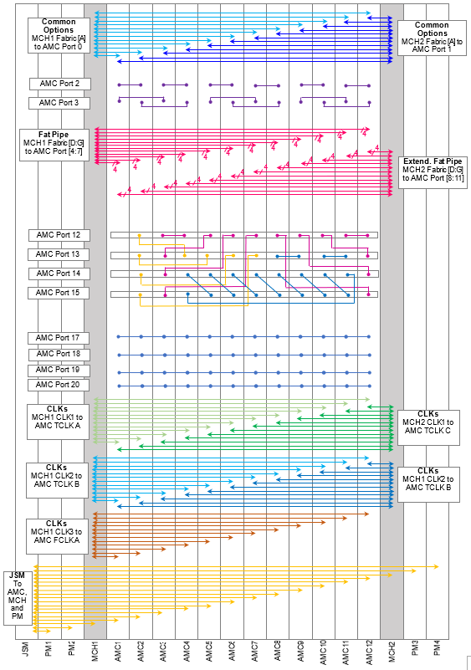
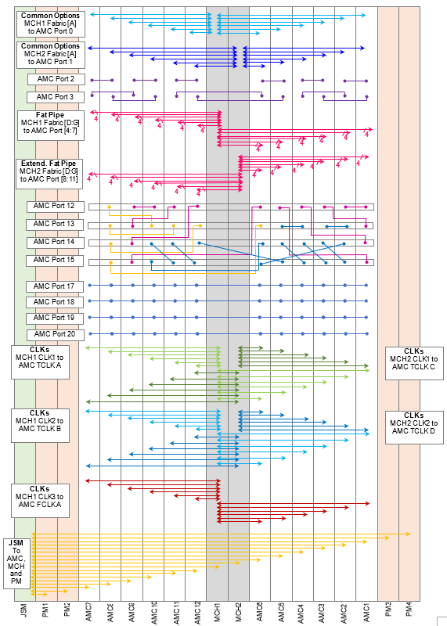
Similar Backplane Topology BUT different physical AMC locations
New MCH location required new optimized routing strategy
NEW AMC module order is (from left to right):
7-8-9-10-11-12-MCH1-MCH2-6-5-4-3-2-1
Topology:
Physical module interconnects are (except Port 14 & 15) similar
Logical module position differs
“Daisy Chain Return Channel” (Port 14 & 15) is different to achieve max. trace length < 250 mm
old topology
NEW topology

Slide 7
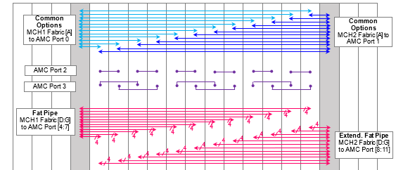
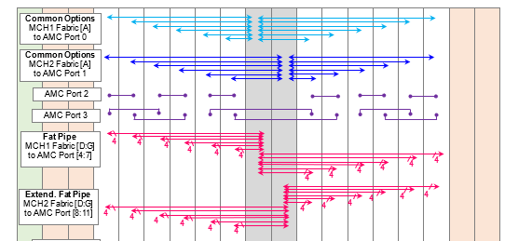
Similar Backplane Topology, details
Common options, fat pipe, JSM connections etc. are similar, looks different as the MCH slots moved to the middle
Logical AMC module position is changed
1 2 3 4 5 6 7 8 9 10 11 12
7 8 9 10 11 12 6 5 4 3 2 1
old topology
old topology
NEW topology
NEW topology

Slide 8
Similar Backplane Topology, details
“Daisy Chain Return Channel” (Port 14 & 15) is different to achieve max. trace length < 250 mm
Different “logical” AMC module connections!
Power lines to Cooling units and MCH’s are updated to handle 110 W
old topology
NEW topology

Slide 9
Cooling Unit update

Slide 10
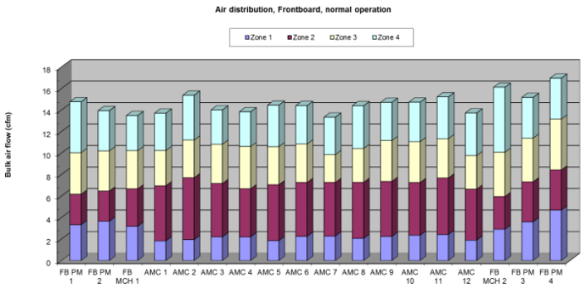
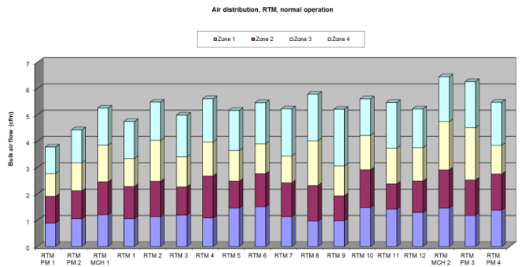
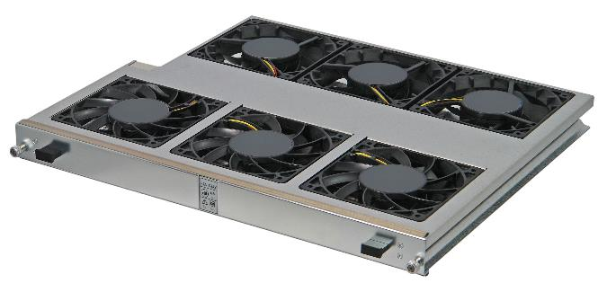
Current nVent SCHROFF Cooling Unit
MTCA.0 Rev3: Cooling Unit Power Channel enhancement: 80 W -> 110 W
Already using the strongest 120 mm, 12 V DC fans available in the front
Rear fans are upgraded to improve air flow in the RTM section
No cooling improvement of front card cage possible with current System architecture

Slide 11
NEW Cooling Unit Manager
The current used H8S controller from Renesas is set to EOL, LTB is beginning of 2025
The Cooling Unit Manager has been redesigned, now using the STMicro STM 32 controller
The hot swap controller went from the adapter board to the controller
The cooling unit will run (@80 W) in old chassis (same connector to the backplane)
The former JSM signals are used for the additional power
We will implement a mechanical coding that old cooling units cannot be installed into new chassis (to avoid short cuts on JSM lines)

Slide 12
Thank You!

