Slide 1
Status of upgrades to MicroTCA at the Spallation Neutron Source
13th Annual MicroTCA Workshop
Alan Justice
Controls Hardware System Engineer
Oak Ridge National Laboratory
Spallation Neutron Source

Slide 2
What will be covered today?
MicroTCA future at SNS
MicroTCA Systems in Production
Future Upgrades to MicroTCA
Lessons Learned

Slide 3
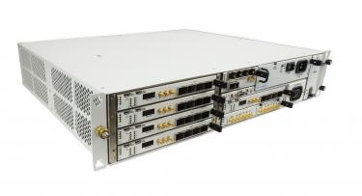
MicroTCA future at SNS
VME to MicroTCA upgrades are part of the Integrated Controls Section modernization strategy at SNS
7 years of production at SNS for MicroTCA
Extensive in-house hardware & firmware expertise
Improving the reliability through extensive component health monitoring (IPMI)
EPICS interface is deployed for production
This Photo by Unknown Author is licensed under CC BY-SA-NC
Vadatech VT814

Slide 4
MicroTCA Applications at SNS
Currently 69 MicroTCA Systems in Production
Low Level RF
Ring LLRF
LINAC LLRF
Machine Protection System(MPS)
Magnet Power Supplies(PS) - Injection Kickers
Waveform Monitor
Waveform Generator
Personnel Protection System(PPS)
Beam Power Limiting System

Slide 5
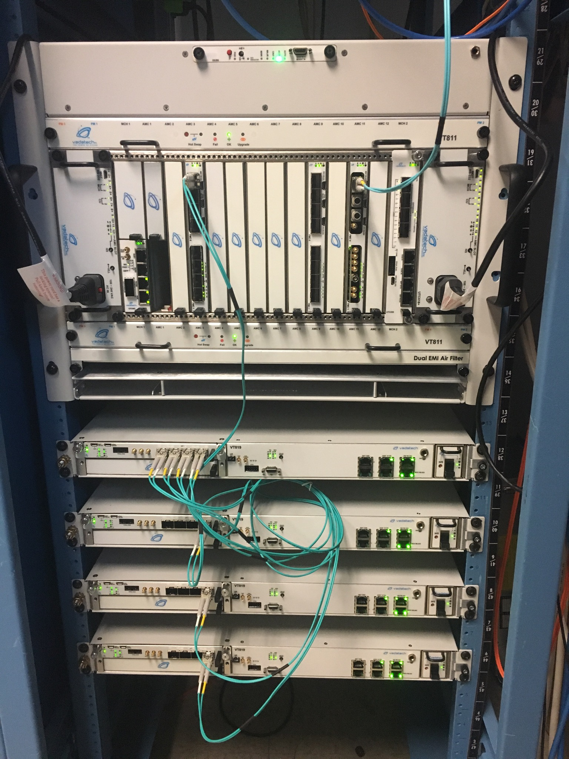
Upgraded Machine Protection System
Largest deployment so far with a total of 48 systems
Master Hardware
Vadatech VT815 Chassis
Vadatech UTC006 MCH
Vadatech UTC006 Crossbar/MCH
Vadatech AMC502 carrier cards
Vadatech FMC105 SFP transceivers
Vadatech AMC726 Processor
Field Node Hardware
Vadatech VT819 Chassis
Vadatech AMC523
Custom RTM
SNS MPS Master and Trigger Control
Notes:
Crossbar reference at the bottom

Slide 6
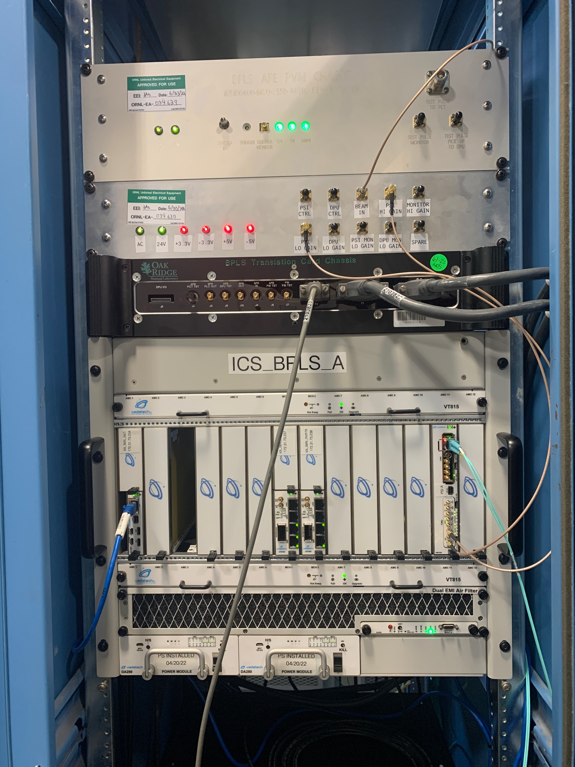
Beam Power Limiting System
Personnel Protection System and Machine Protection System functions
Limit Beam Power on First Target Station
Hardware
Vadatech VT815 Chassis
Vadatech UTC002 MCH
Vadatech AMC560 carrier cards
Vadatech AMC726 Processor
FMC 155 – RS485
FMC267 - ADC
Custom FMC Timing Receiver

Slide 7
Future Upgrades to MicroTCA
Timing Master
HPRF
Extraction Kicker Magnet Power Supplies
LEBT Chopper

Slide 8
Timing Master
Replacing existing VME based custom Timing System Master
Functions
Generate Timing Link with Events and Real Time Data
GPS Interface for Timestamping
Interface to Beam Monitor to provide Beam Charge Per Pulse
Hardware
Vadatech VT815 Chassis
Vadatech UTC006 MCH
Vadatech AMC502 or AMC560 carrier cards
Vadatech AMC756 Processor
Custom FMCs
Target completion by end of 2025 and placed into production early 2026

Slide 9
High Power RF
Upgrade from existing VME-based system to MicroTCA-based
Existing system has 15 VME chassis; the MicroTCA-based system will have 4-5 chassis
Functions
Control for HPRF Modulators and Transmitters
Provides Timing to HPRF Modulators and Transmitters
Upgrade from existing VME-based system to MicroTCA-based
Hardware
Vadatech VT815 Chassis
Vadatech UTC006 MCH
Vadatech AMC756 Processor
Vadatech AMC560
Custom FMC Timing Receiver
Custom FMC Fiber Fanout

Slide 10
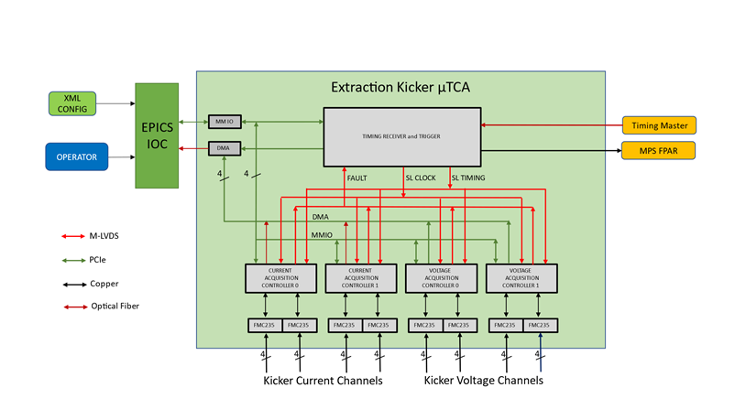
Extraction Kicker
Replacing existing analog solution
Function
Digitize Extraction Kicker Charge and Fire Waveforms
Apply Window to each and trip MPS for any fault condition
Hardware
Vadatech VT815 Chassis
Vadatech UTC006 MCH
Vadatech AMC756 Processor
Vadatech AMC560
Vadatech FMC235 ADC
Custom FMC Timing Receiver

Slide 11
Lessons Learned
Plan Ahead for Hardware lead times
Be wary of obsolescence
Collaborate more
Utilize IPMI more extensively

Slide 12
MicroTCA Working Group
Half day session at the EPICS Meeting hosted at Oak Ridge National Laboratory/Spallation Neutron Source
Over 25 participants
6 presentations
Argonne National Laboratory
European Spallation Source
Facility for Rare Isotopes Beams (FRIB)
Fermi National Accelerator Laboratory
Spallation Neutron Source
IPMI over EPICS
Lots of discussion and opportunities for collaboration

Slide 13
Questions
Thanks to my colleagues Miljko Bobrek and Brian Shepetofsky for their contributions to this presentation and their work!

