Slide 1
ITER Fast Instrumentation and Control: Current Status and Plans for MTCA
Sergio Esquembri
ITER, Central Control Integration (CCI)

Slide 2
Index
Context
  ITER Fast Controllers
Current Status
  Fast Controller Catalogue
  PXI/e
  MTCA
Future Plans
Conclusions

Slide 3
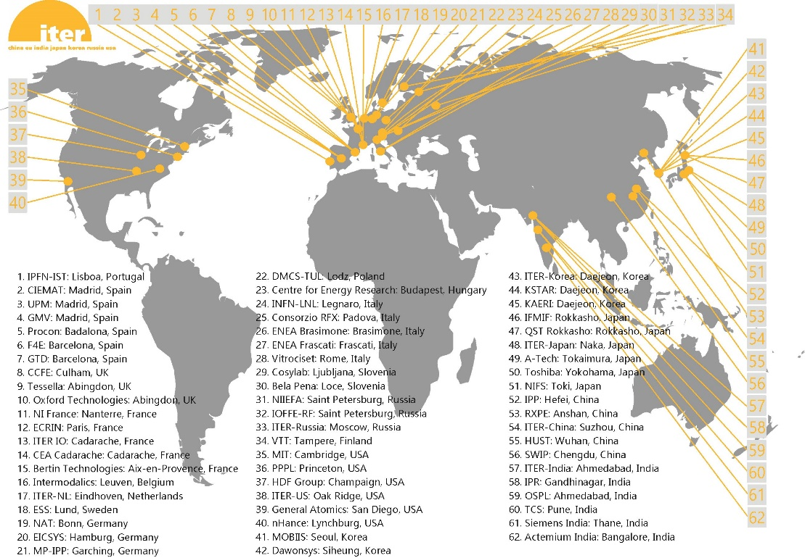

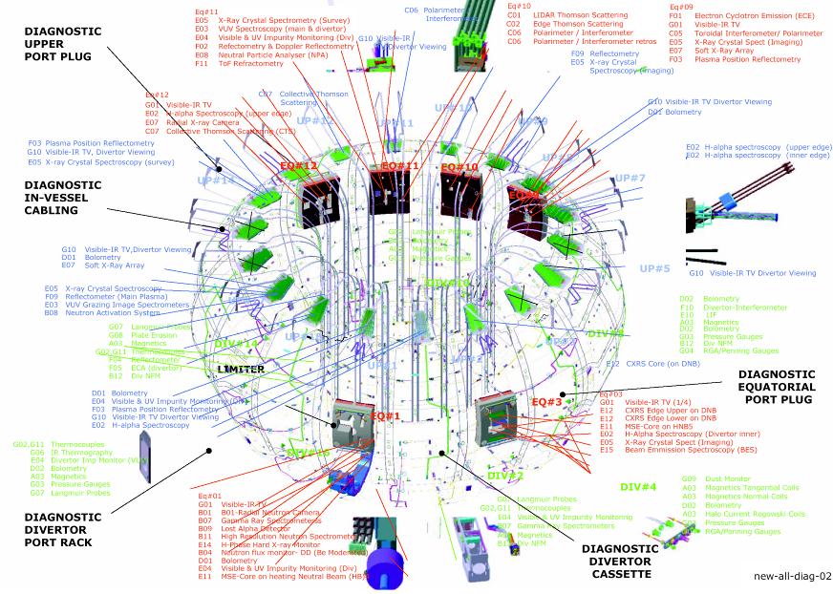
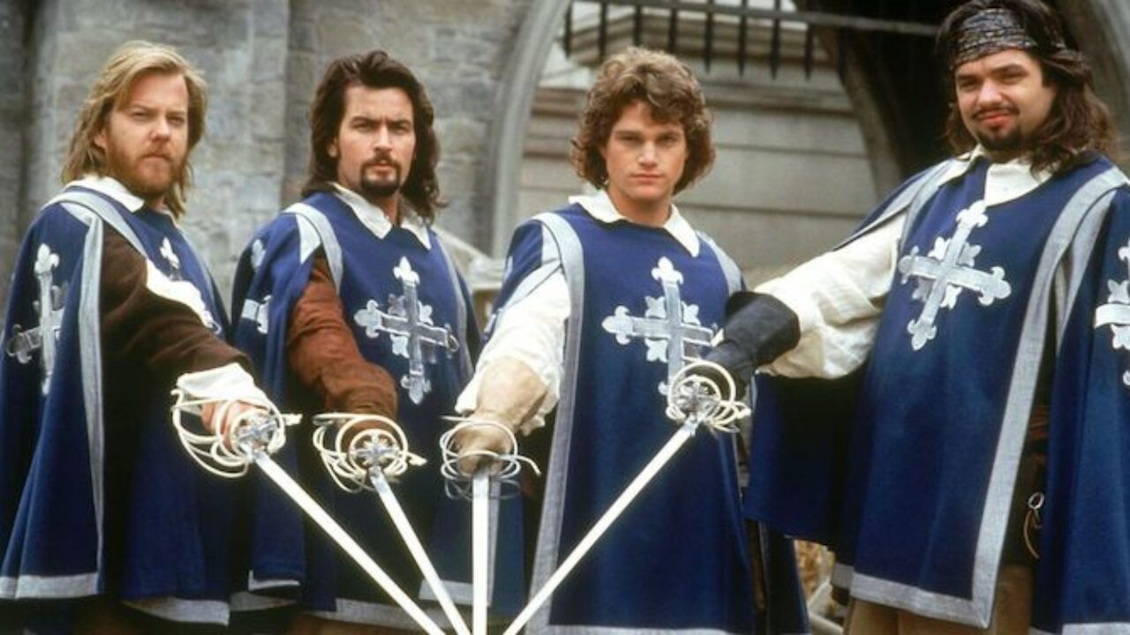
Context: ITER
ITER
  Approximately 171 Plant System I&Cs (>60 Diagnostics)
  Each plant with several controllers (fast, slow, interlock, safety)
  Each controller with its own functions, configuration, inputs/outputs
  Everything to be integrated and operated together
“All for one, and one for all”
Alexander Dumas
The Three Musketeers

Slide 4
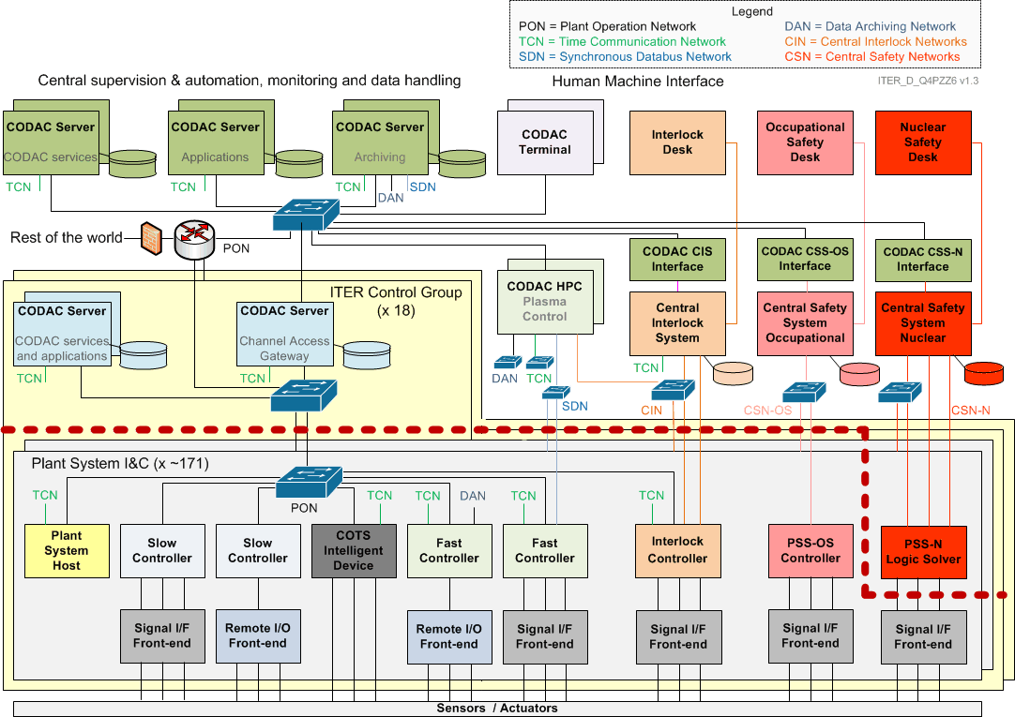
Context: I&C Overview

Slide 5
Context: Fast I&C Overview

Slide 6
Context: ITER Infrastructure
Plant Operation Network (PON)
  Network for the operation of Plant Systems. Control and operation based on EPICS. (1GigE)
Data Archiving Network (DAN)
  High performance network for data archiving (10GigE)
Synchronous Databus Network (SDN)
  High performance network for real-time applications (e.g. plasma control) (10GigE)
Time Communication Network (TCN)
  Timing synchronization network based on PTPv2 (IEEE 1588-2008) (1GigE)

Slide 7

Context: ITER CODAC
CODAC Core System (CCS)
  Software infrastructure (including operating system) for all standard I&C computers (except PLC)
  Based on RHEL (v8.5 for CCS 7.2)
ITER Control System: based on EPICS 7
  Distributed Control System based on network-connected controllers.
  Communication based on Process Variables (PVs) and EPICS protocols (Channel Access or pvAccess)

Slide 8
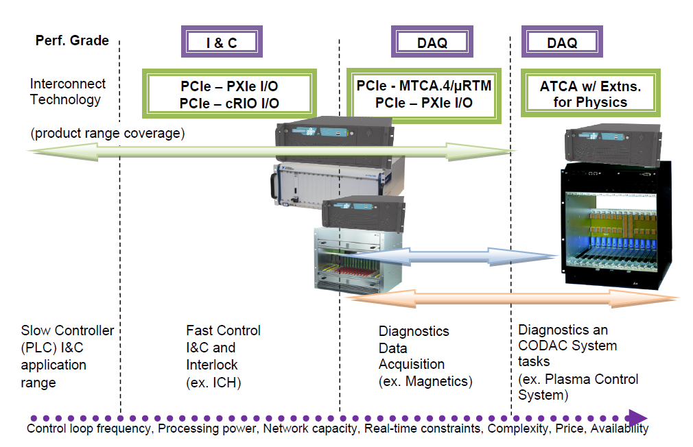
Context: Fast vs Slow
Notes:
PLCs: up to 100Hz/1kHz
PXI/MTCA up to Gigasamples

Slide 9
Context: Requirements
I&C requirements given by PCDH
  Maintainability
    HW/SW Documentation
    Procurement and Maintenance plans
    Obsolescence management
  Software compatibility with CODAC
    Linux, Integration in EPICS
  Hardware
    Cubicle Integration
    Proof of compatibility with magnetic fields and radiation
    Reliability and Availability analysis
    No embedded controller
      Remote I/O Chassis connected to controller
  Functional
    ITER Time synchronization (TCN)
    Data networks (PON/DAN/SDN)

Slide 10
Current Status
ITER Fast Controller Catalogue
  ITER Recommended COTS Products
  Tested and integrated with CODAC
  Supported and maintained by CODAC
    Including Obsolescence Management
  3 main form-factors
    CompactRIO/PXIe
    MTCA.4
    “ATCA”

Slide 11
Current Status: PXIe
Based on National Instruments CompactRIO and PXIe chassis
No embedded controller, MXIe link to Remote Host
FPGA developed using LabVIEW Graphical Language
Modular design based on fixed I/O or FlexRIO+ Adapter Module
Fully integrated into CODAC
  Driver
  EPICS Integration
Obsolescence managed by ITER
User support given by ITER

Slide 12
Current Status: MTCA
No MTCA systems have been manufactured for ITER yet
All Fast Controllers delivered until now were based on CompactRIO/PXIe
But this is changing…
Several diagnostics are now evaluating MTCA
  Density, Toroidal and Poloidal Interferometer Polarimeter
  Divertor Neutron Flux Monitoring
  Upper/Equatorial Wide Angle Viewing Systems
Why
  Wider market, easier to obtain customized solution
  Better performance
  NI not predictable with obsolescence/maintenance
    No strategic agreement in place

Slide 13
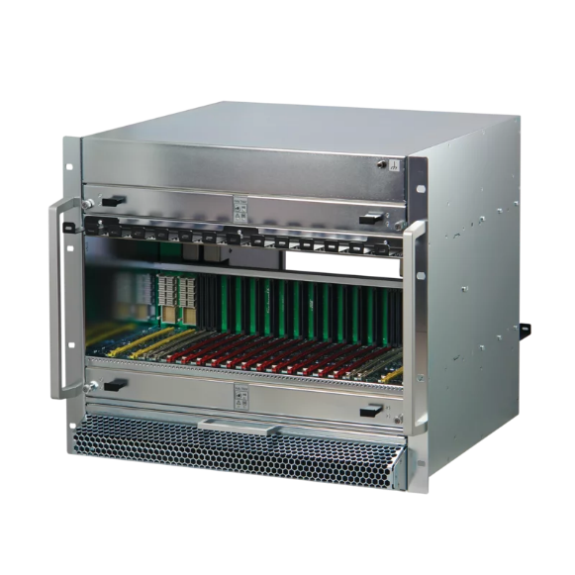
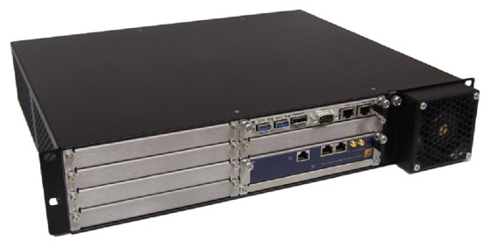
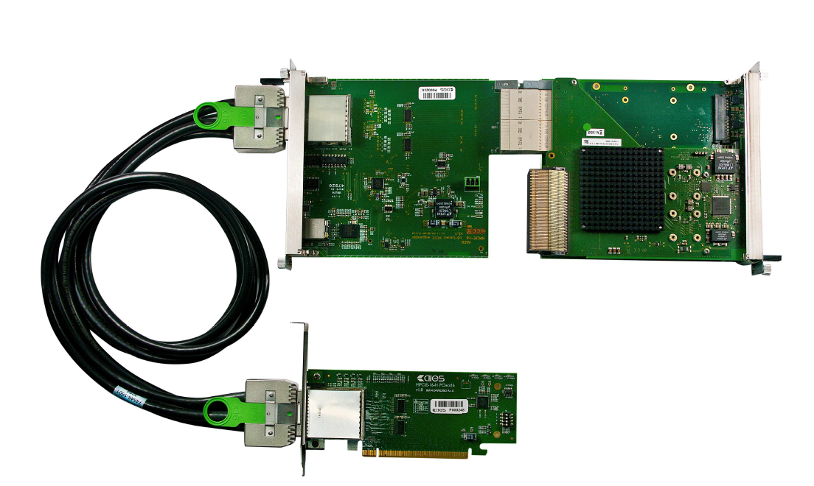
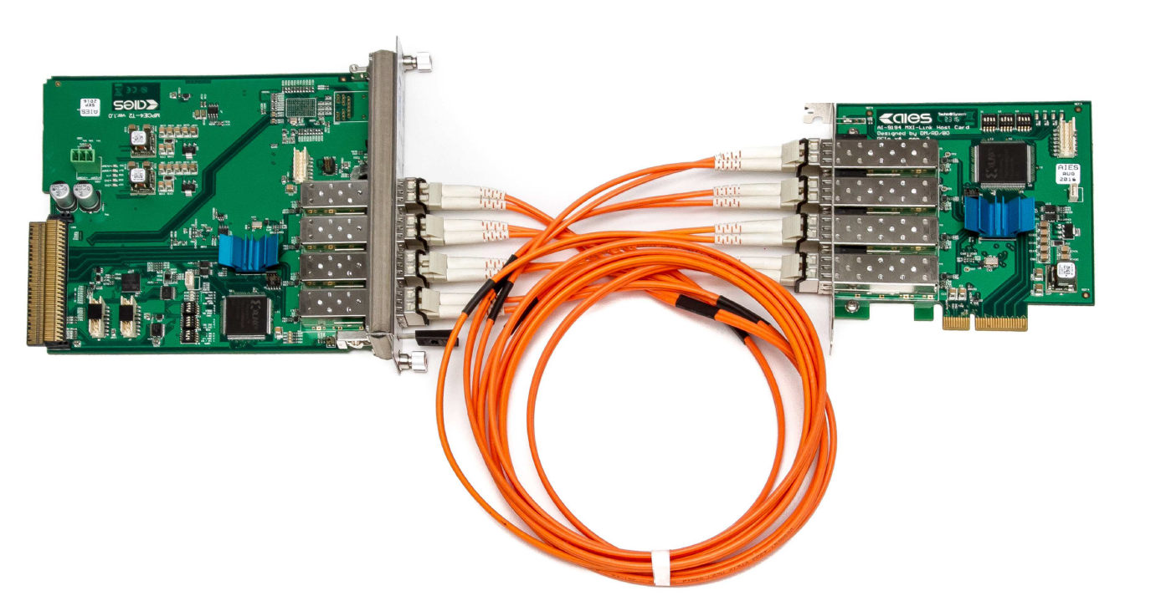
Current Status: MTCA on ITER Catalogue
Chassis
  Schroff 9U 12-slot MTCA.4
  Powerbridge Rackpak M5-1 2U 6-slot
MCH
  NAT MCH PHYS80
PCIe Link
  AIES MPCIE-16
    16xPCIe Gen3 MCH RTM for NAT MCH-PHYS80 Fibre/Copper
  AIES MPCIe-4
    4xPCIe Gen2 AMC Fiber

Slide 14
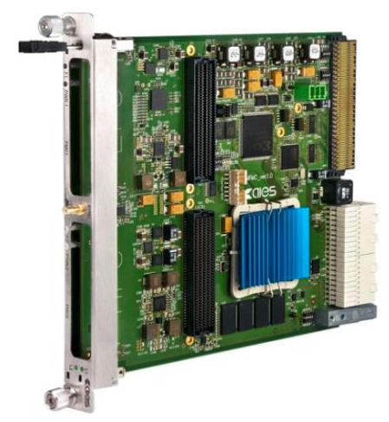
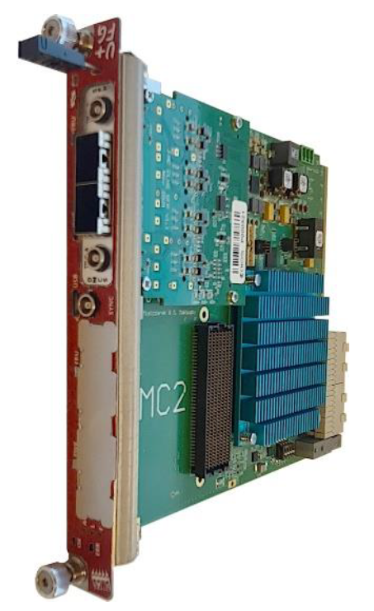
Current Status: MTCA on ITER Catalogue
Timing
  AIES PTM-1588 AMC PTP Synchronized
    10MHz Ref Clock
    Timestamping and Future Time Events capabilities.
DAQ
  AIES MFMC AMC
    FPGA based FMC Carrier. 2 Options
      Artix (HPC & LPC)
      Zynq Ultra Scale (HSPC & HPC)
    Reference Implementations with
      Abaco FMC 168 (4 channels ADC 1GS/s)
      AIES GigE and CameraLink FMCs
  Teledyne ADQ14
    1/2/4 channels ADC 2/1/0.5 GS/s

Slide 15
Current Status: MTCA Systems on ITER
(Current) Common characteristics:
  Normally, not many AMCs in one chassis
    Timing board + 1/2 DAQ
  Fast DAQ, processing/preprocessing in FPGA
  Precise timestamp with absolute timing
    But not requiring distributed clock phase synchronization
  Raw and process data sent to host

Slide 16
Current Status: Experience on MTCA
Reference DAQ and IMAQ Systems developed by DMCS using AIES MFMC
  Integrated in EPICS using ITER NDS Framework
Now first system prototypes with MTCA are been developed
Some systems (e.g. Popola) are developing their own MTCA solutions (with Mitsubishi)

Slide 17
Current Status
Opportunities
  Working with DMCS/AIES allowed to have integration of the MTCA systems in ITER (EPICS and NDS)
  Quick support and availability for custom developments
  In time to define a Standard use of MTCA in ITER to guide Diagnostics Developments
Risks/Problems
  First users experience difficulties when porting reference systems
  ITER has no resources for the support/maintainability, need to be redirected to DMCS/AIES
    Some developers then decide to use custom solutions.
  Integration into ITER CODAC needs to improve.

Slide 18
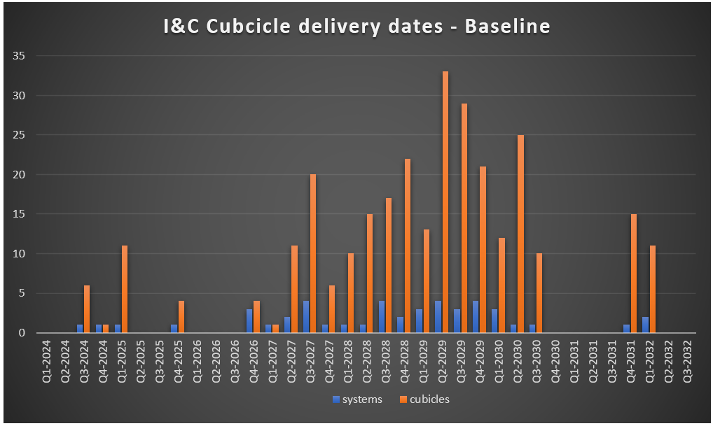
Future Plans
ITER Currently in rebase lining and re-organization
Most diagnostics systems will start coming on 2027
Proposal to work for a MTCA Standardization on ITER.
  Technically approved.
  No resources allocated yet.

Slide 19
Future Plans: MTCA Standardization
Objectives
  Define a methodology for MTCA Systems development in ITER by standardizing:
    Hardware devices
    FPGA Firmware
    Software (from Device Driver to Control System Integration)
  Provide clear strategy to manage obsolescence
How
  Provide updated MTCA catalogue with more devices
  Improve the user support with development frameworks and internal expertise
  Implement technological surveillance plan

Slide 20
Future Plans: MTCA Standardization
Hardware Catalogue
  Base hardware (Chassis, MCH, Timing board, Power supply, PCIe Link, Cooling)
    Common for “all” systems.
    Standard integration/functionality
  DAQ Hardware
    FPGA based AMCs with FMCs
    Different “tiers” of AMCs and selection of FMCs
    Different manufacturers to avoid vendor locking
    Standard integration but custom functionality.

Slide 21
Future Plans: MTCA Standardization
FPGA Firmware
  Split user logic from “hardware device specific”
  Define standardized interfaces between BSP, user logic and driver
  Allows porting user logic to new device
  Provide framework for development
    Choose BSP
    Develop User Logic

Slide 22
Future Plans: MTCA Standardization
Software
  Standard BSP Interface → Standard Device Driver
    Low level, register access
  Custom user app developed within standard framework (NDS)
  Standard interface to control system
Inspired (and possibly reusing) FWK & ChimeraTK

Slide 23
Conclusions
ITER needs standardization on their systems
  Integration, Maintenance, Obsolescence Management
Some ITER Diagnostics systems are migrating their design from PXIe to MTCA
First MTCA systems for ITER are now in prototyping phase
Current MTCA solutions based on AIES hardware with DMCS FW development
Flaws detected in ITER user support and CODAC integration
  Lack of internal technical expertise
  Lack of maturity of the solution

Slide 24

ITER Fast Instrumentation and Control: Current Status and Plans for MTCA
Sergio Esquembri
sergio.esquembri@iter.org
ITER, Central Control Integration (CCI)

