Slide 1

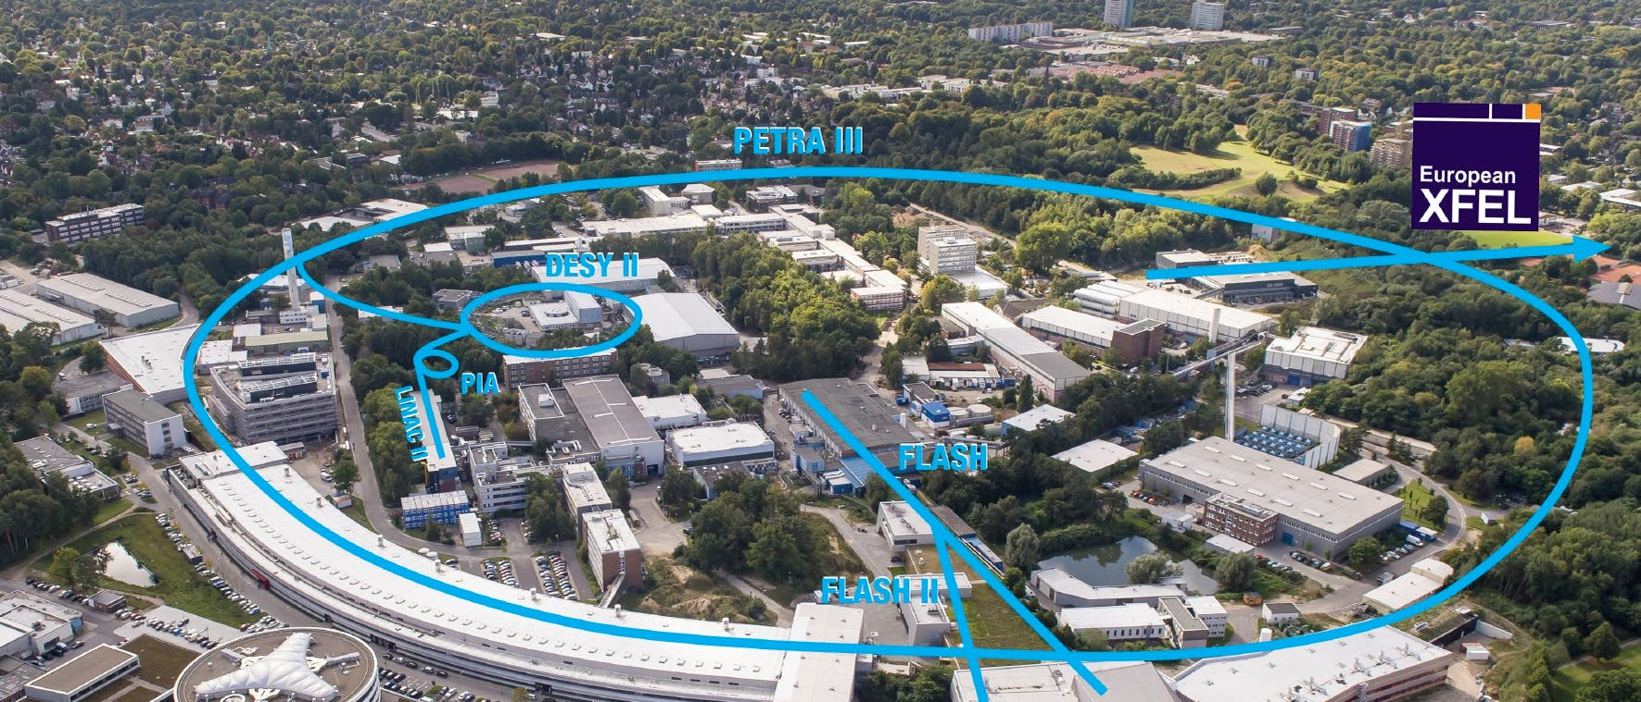
DESY. The Decoding of Matter
Beate Heinemann
Director in charge of Particle Physics

Slide 2
What is DESY?
A major German research laboratory
Founded 1959
350M Euro annual budget
Nearly 3000 employees
Powerful X-ray facilities:
  PETRA III, FLASH, EU.XFEL
About 10000 visitors per year
Large Scale Research Infrastructures enable
science, technology, collaboration and train people
Notes:
4 key areas of research in two locations, Hamburg and Zeuthen
Photon Science: Several of the worlds best light sources are located at DESY, their special X-ray radiation makes atomatic structures and reactions in the nanocosmos visible.„Können wir die Funktion von (Bio-) Materialien auf allen relevanten Längen- und Zeitskalen abbilden ?“
Accelerators: DESY develops, operates and utilizes state of th art accelerator facilities → know-how„Können wir neuartige kompaktere Beschleuniger entwickeln?“
Particle Physics: Investigation of the fundamental building blocks and forces of nature, „Was ist die Physik jenseits des Standardmodells. DESY is in charge for the german contribution of the CERN in Switzerland
Astroparticle Physics: using comis messengers such as gamma rays or neutrinos to understand high-energy processes in the universe. Rolle spielen hochenergetische Teilchen in der Evolution des Universums?“ ,Zeuthen will be an international reference point for scientists involved in high-energy astrophysics
Some further info:
Employees: approximately 2300, including 650 scientists working in the fields of accelerator operation, research and development
Guest scientists: more than 3000 from over 40 countries come to DESY each year to run experiments.
DESY cooperates with industry and business to promote new technologies that will benefit society and encourage innovations. This also benefits the metropolitan regions of the two DESY locations, Hamburg and Zeuthen near Berlin.

Slide 3
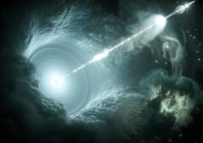
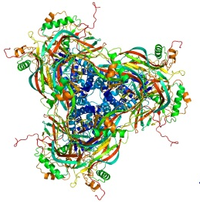
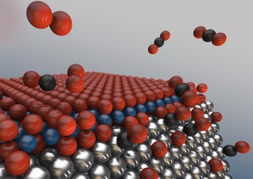
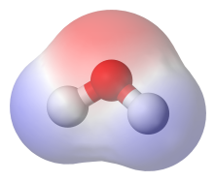
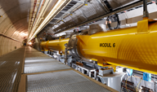
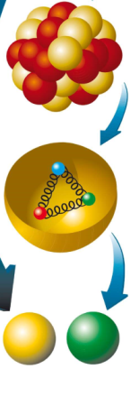
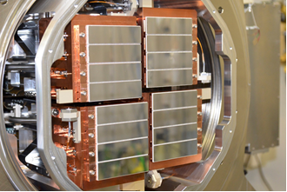
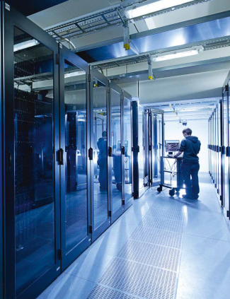
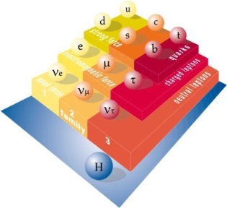
The Decoding of Matter
What role do high energy particles play in cosmic evolution?
Mission: Turning science data into knowledge on structure and dynamics of matter at all scales
Can we understand infection on the molecular level?
Galaxy
How can we control the function of materials on the level of individual electrons and spins?
Virus
Nanoparticle
How do we build compact accelerators?
Molecule
Accelerators
What are the most fundamental particles and laws of Nature?
Atom
Proton
Detectors
How do we take pictures with a rate of millions/second?
Computing
Quark
How can we meet the data challenge in today’s experiments?
Notes:
I said initially that our motto is “the decoding of matter”, and we do this is on practically all possible length scales – starting at the largest structures in the universe (and studying the history and development of the universe) – over intermediate scales down to the smallest imaginable structures – the elementary particles currently known and their interactions.
In trying to answer these and other research questions, we rely on high tech – in particular in the fields of accelerators, but also of particle and radiation detectors, and of computing: (We are experts in big data, in grid & cloud computing and related areas. )
Not only understand – but use! → function as an important term.

Slide 4
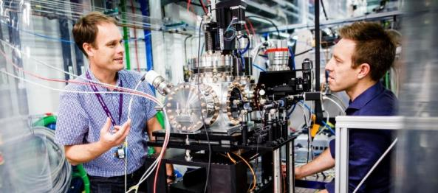
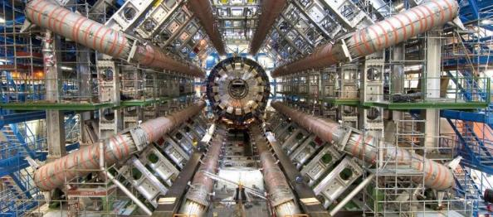

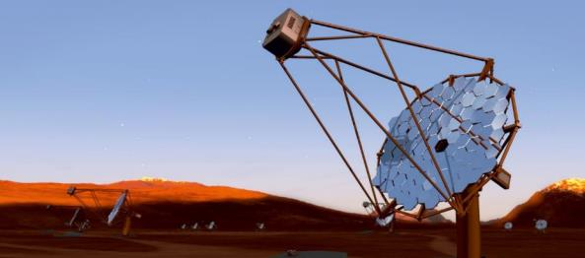
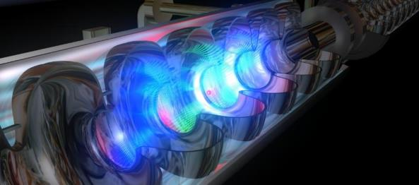
DESY – Areas of Research
Accelerators
Particle Physics
Photon Science
Astro
Particle Physics
Notes:
4 key areas of research in two locations, Hamburg and Zeuthen
Photon Science: Several of the worlds best light sources are located at DESY, their special X-ray radiation makes atomatic structures and reactions in the nanocosmos visible.„Können wir die Funktion von (Bio-) Materialien auf allen relevanten Längen- und Zeitskalen abbilden ?“
Accelerators: DESY develops, operates and utilizes state of th art accelerator facilities → know-how„Können wir neuartige kompaktere Beschleuniger entwickeln?“
Particle Physics: Investigation of the fundamental building blocks and forces of nature, „Was ist die Physik jenseits des Standardmodells. DESY is in charge for the german contribution of the CERN in Switzerland
Astroparticle Physics: using comis messengers such as gamma rays or neutrinos to understand high-energy processes in the universe. Rolle spielen hochenergetische Teilchen in der Evolution des Universums?“ ,Zeuthen will be an international reference point for scientists involved in high-energy astrophysics
Some further info:
Employees: approximately 2300, including 650 scientists working in the fields of accelerator operation, research and development
Guest scientists: more than 3000 from over 40 countries come to DESY each year to run experiments.
DESY cooperates with industry and business to promote new technologies that will benefit society and encourage innovations. This also benefits the metropolitan regions of the two DESY locations, Hamburg and Zeuthen near Berlin.

Slide 5
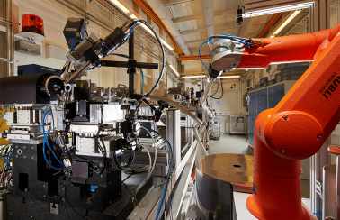
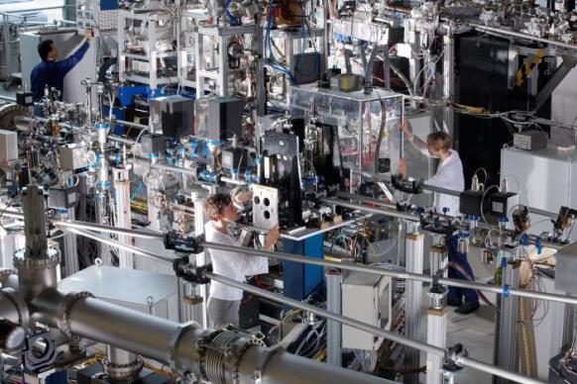
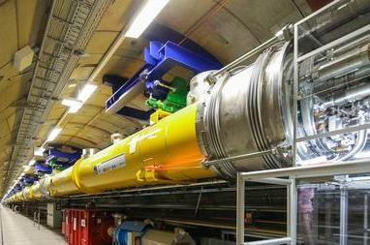
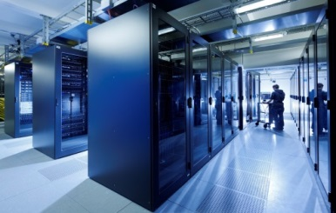
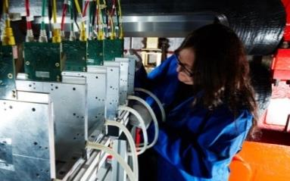
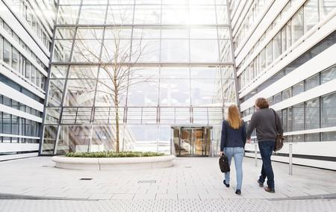
Modern research infrastructures @DESY
PETRA III World‘s largest synchrotron X-ray source
FLASH World’s first free electron laser
EU-XFEL world‘s most powerful free electron laser
Large Computing Center
Test facilties for detectors
Interdisciplinary Research Centers
Notes:
HD
An important aspect of DESY are its large scale facilities which are open to all scientists worldwide by a peer-review system.
the 6 GeV PETRA III Storage Ring
the 1,5 GeV Soft X-Ray Laser FLASH
the TIER-2 Center
These 3 facilities are supported by the Helmholtz Association within the special LK II funding scheme, also under review this week.
DESY also operates the DESY Testbeam facility for detector tests.
From Sep 2017 on, DESY is also responsable for the operation of the XFEL accelerator.

Slide 6



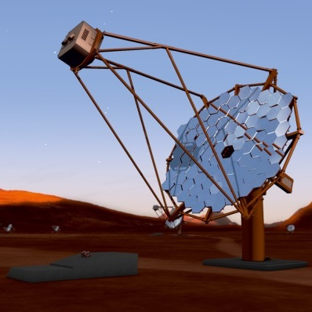

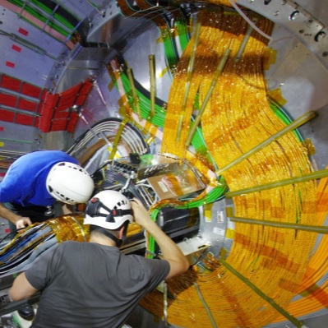

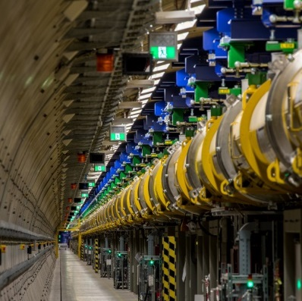


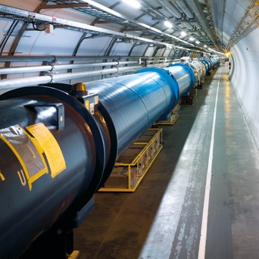
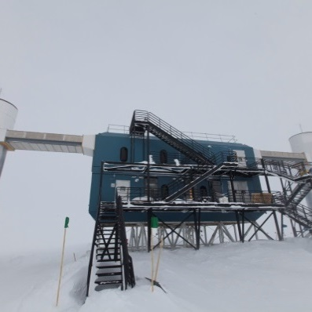

International Cooperations
DESY as strong partner in international research projects
Russland
Kanada
Georgien
Kasachstan
Mongolei
European XFEL
USA
Armenien
Japan
Finnland
CTA
Zypern
Türkei
China
Südkorea
Norwegen
Israel
Irak
Iran
Pakistan
Belle II
Schweden
Mexiko
Kuba
Algerien
Bangladesch
Thaiwan
Estland
Indien
Thailand
Dänemark
Lettland
Trinidad & Tobago
Sudan
Niederlande
Litauen
Costa Rica
Venezuela
Kamerun
Irland
Weißrussland
Ecuador
Singapur
Großbritannien
Belgien
Polen
Brasilien
Tschechien
Slowakei
Ukraine
Peru
Frankreich
Schweiz
Österreich
Ungarn
Moldawien
Chile
Australien
LHC@CERN
Slowenien
Rumänien
Südafrika
Italien
Serbien
Bulgarien
Portugal
Spanien
Griechenland
Icecube
1-5
6-45
46-200
International guest scientists at DESY

Slide 7
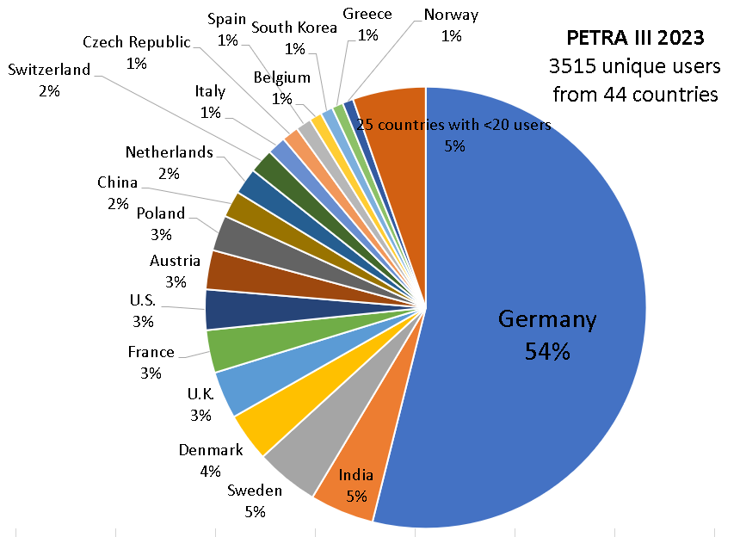
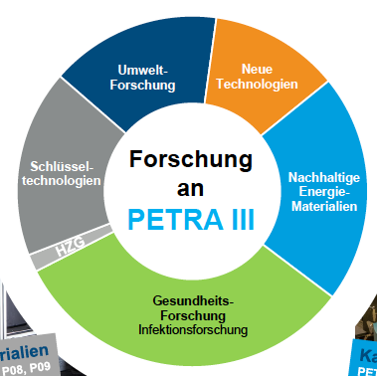
PETRA III
Nutzer-Herkunft
World leading facilities for photon science
PETRA III operating since 2013, 27 beam lines
About 8000 user visits per year (45% intl.); 800 publications/year
Beamlines support science and industrial research
Environmental
Research
Novel
technologies
Felder
Research
at
Key
Techno-
logies
Sustainable
Energy
materianls
Health related
Research

Slide 8
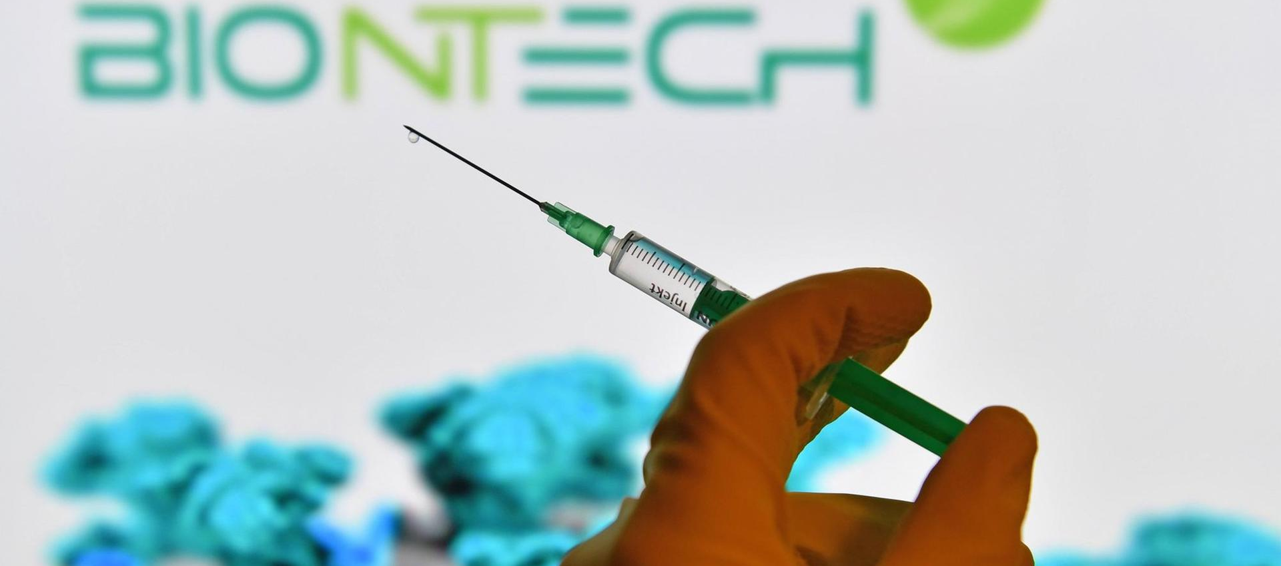

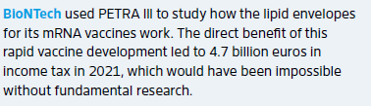
Example: Cooperation with BioNTech & partnerns
Notes:
Biodistribution von Nanopartikeln in Mäusen
DESY wird Einzelzell-XFI-Messungen durchführen um Verteilungskarten von Nanopartikeln zu erstellen, die von einzelnen Zellen aufgenommen werden
Erste Messungen erfolgt, Ergebnisse liegen aber noch nicht vor
Aktuell werden bei DESY an PETRA III bildgebende Röntgenfluoreszenzmessungen durchgeführt, vorbereitend zur Entwicklung einer Methode zur Verfolgung der biologischen Verteilung von Nanopartikeln. Diese Erkenntnisse sind insbesondere auch relevant für die mRNA-Wirkstoffentwicklung. Hierbei kooperieren BioNTech, die Exzellenzuniversität Hamburg und DESY gemeinsam für einen Zeitraum von zwei Jahren. Erste Auswertungen der Messungen laufen, mit Ergebnissen wird noch im Laufe von 2023 gerechnet.

Slide 9

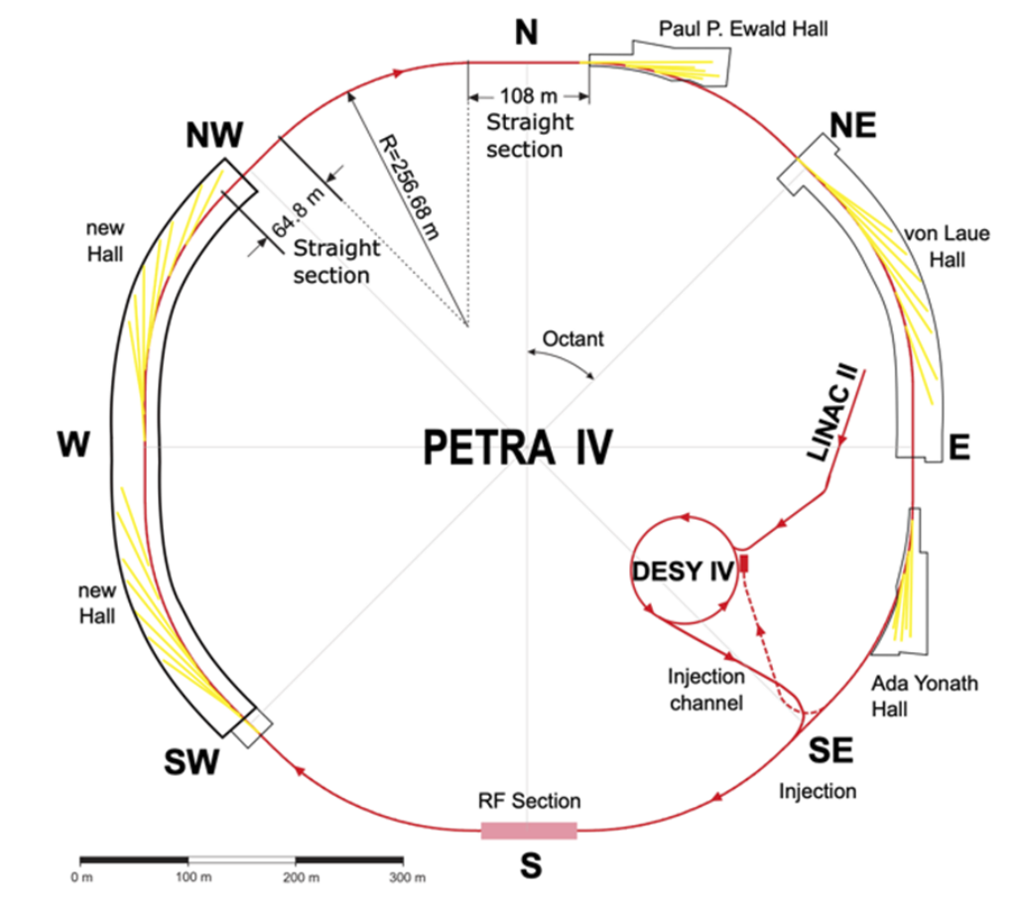
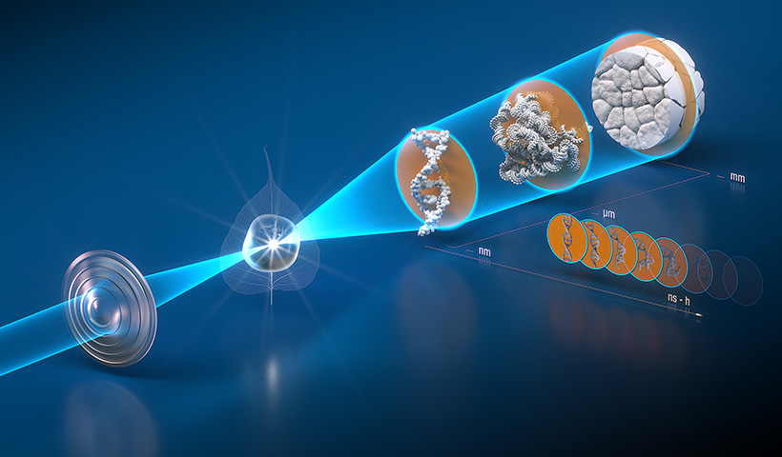
PETRA IV: the world’s best X-ray microscope
Planning for construction 2027-2032 (pending funding approval)
Will enable improved methods for studying complex processes in nature and technology in real time and under realistic operating conditions.
PETRA IV will use microTCA

Slide 10
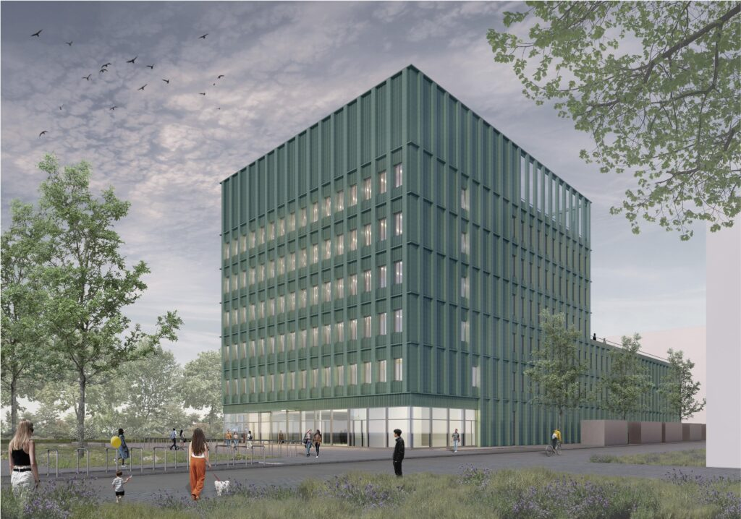
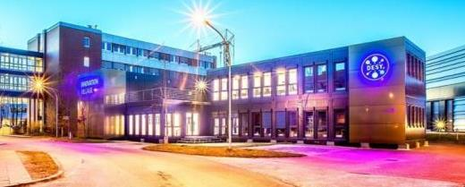
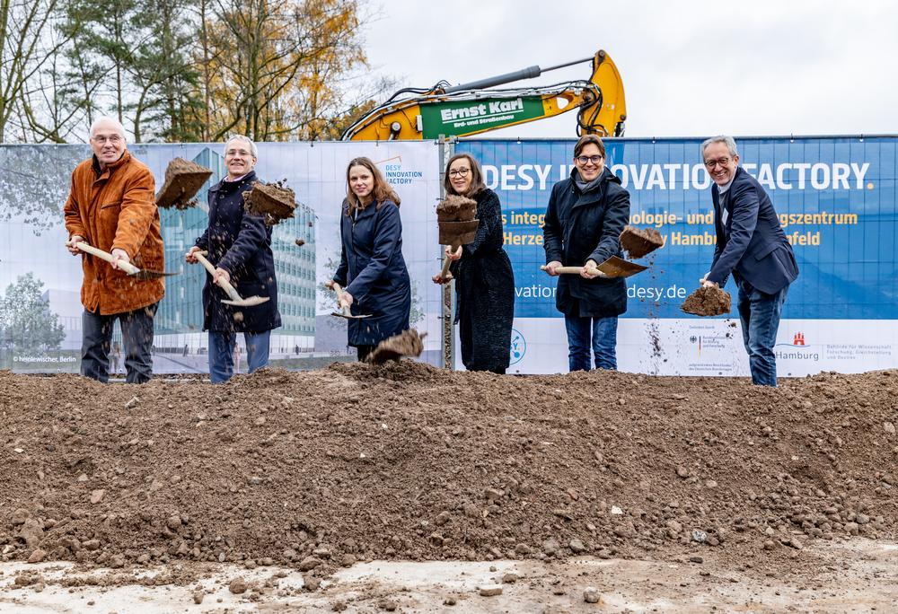

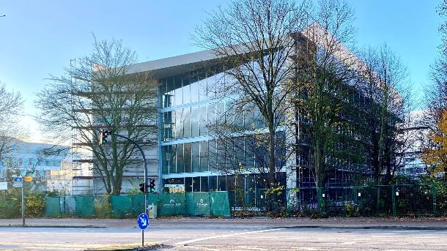
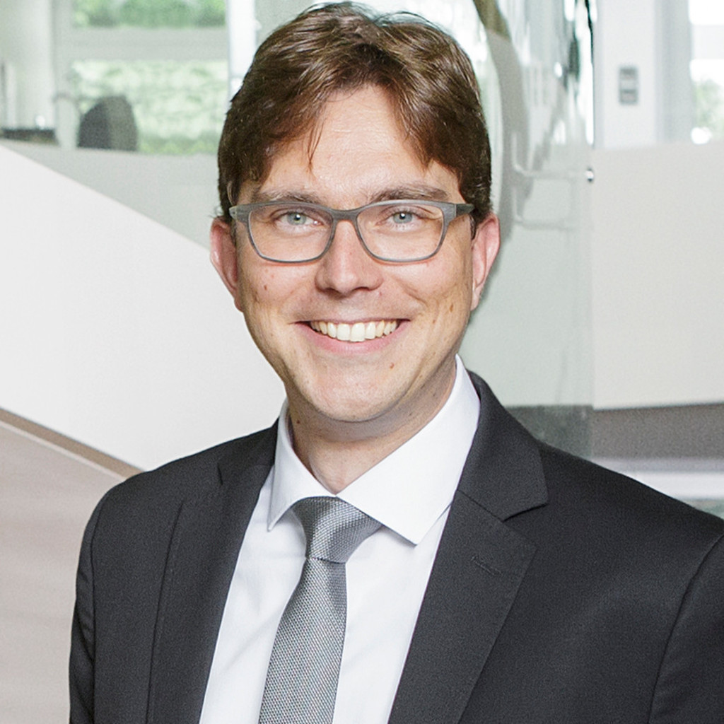
An innovation ecosystem is developing
At DESY and in the Science City Hamburg Bahrenfeld
Since 02/2019: Innovation Village on campus for startups
DESY innovation factory:
8500 m² starting 2027
(groundbreaking 11/24)
Since 9/2021:”Start-up Labs Hamburg” for hightech start-ups adjacent to campus (2700 m²)
Dr. Arik Willner
CTO

Slide 11
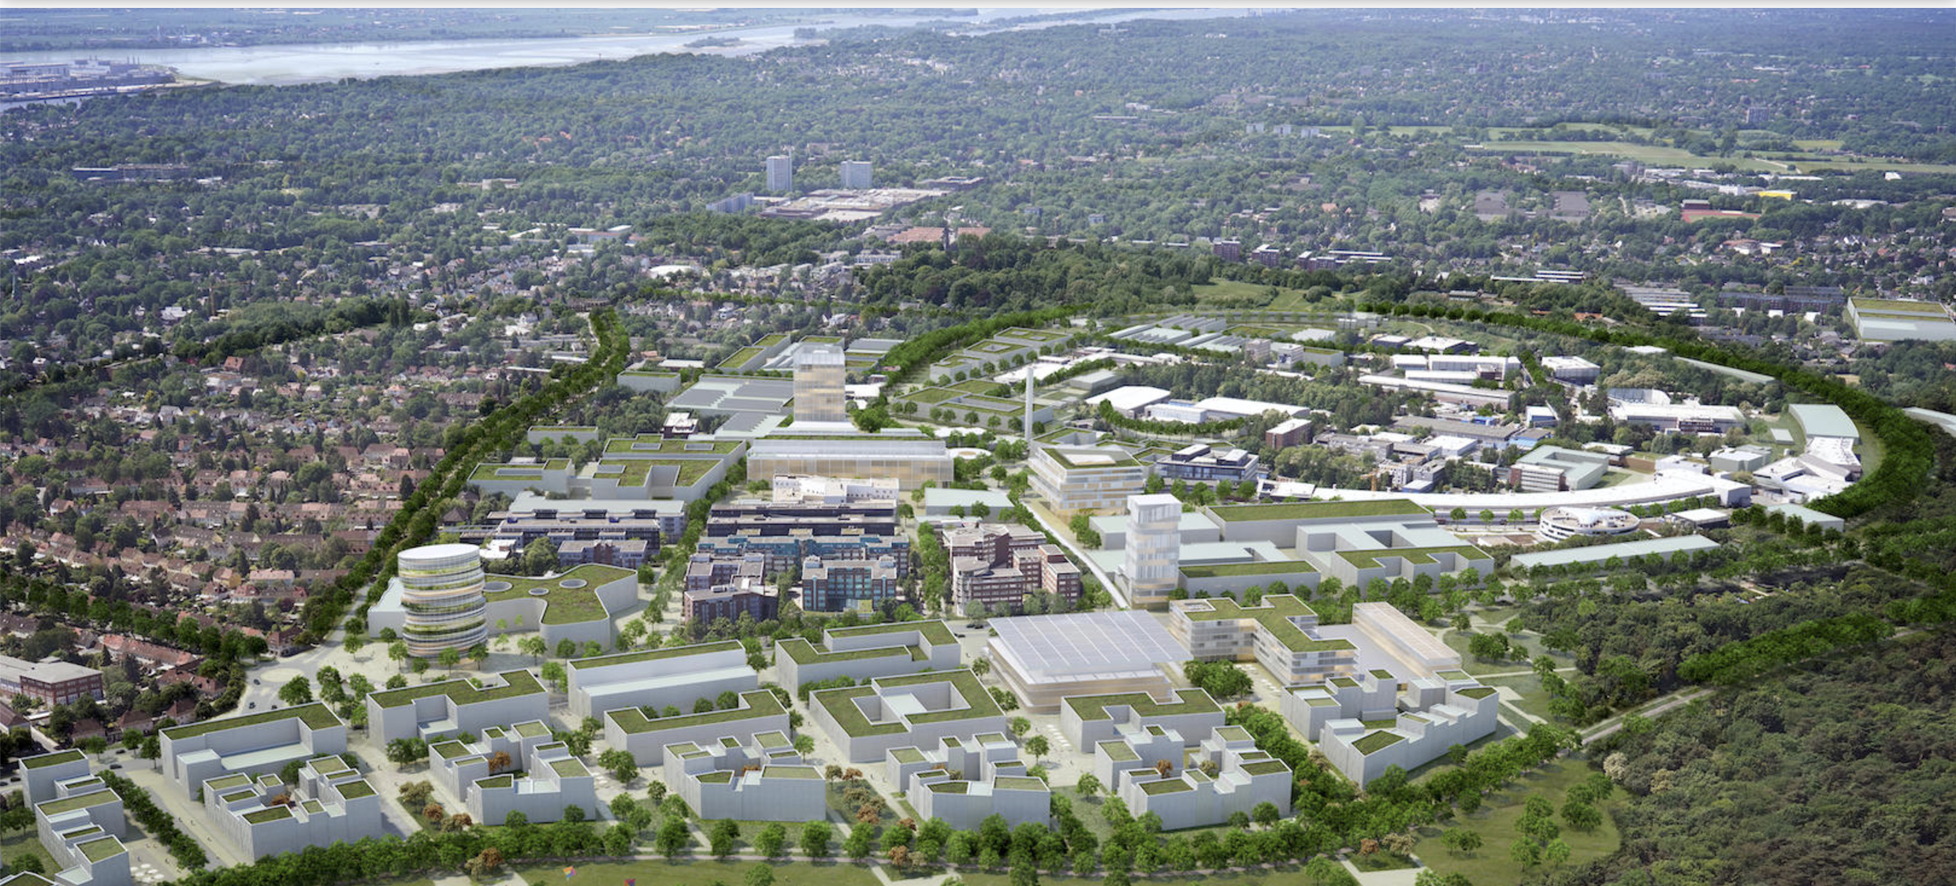
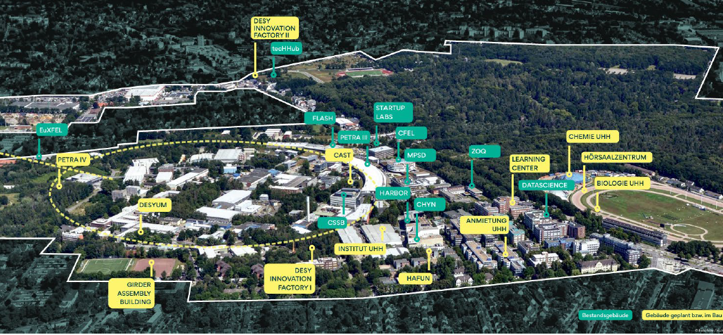
A Vision for the Science City Hamburg Bahrenfeld
Science, Technology, Education and modern sustainable Urban Living

Slide 12
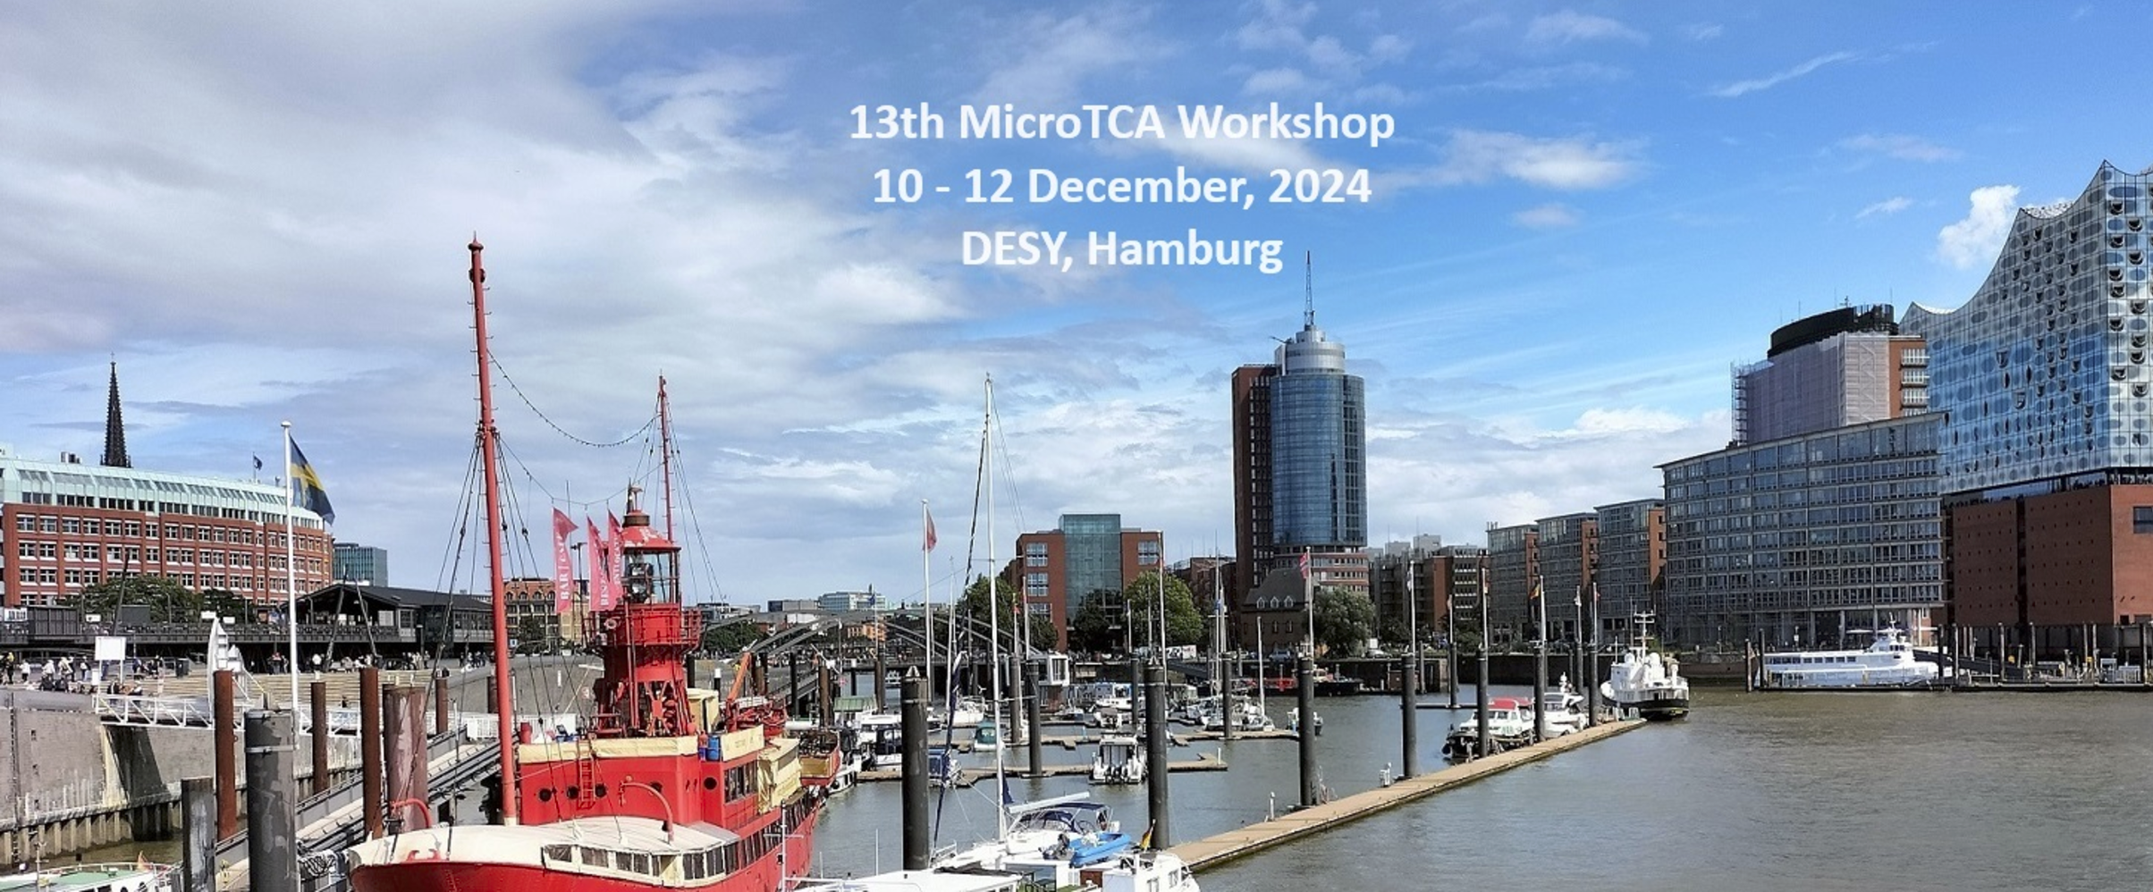
Welcome to DESY and enjoy the microTCA workshop!!

