Slide 1
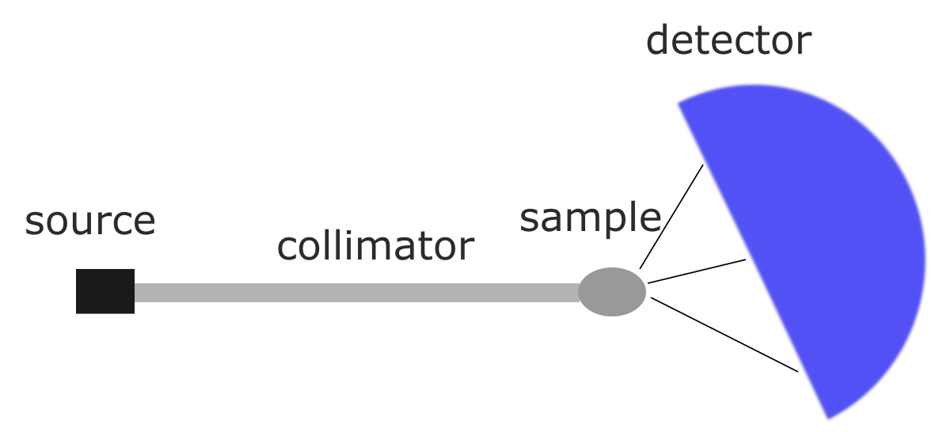
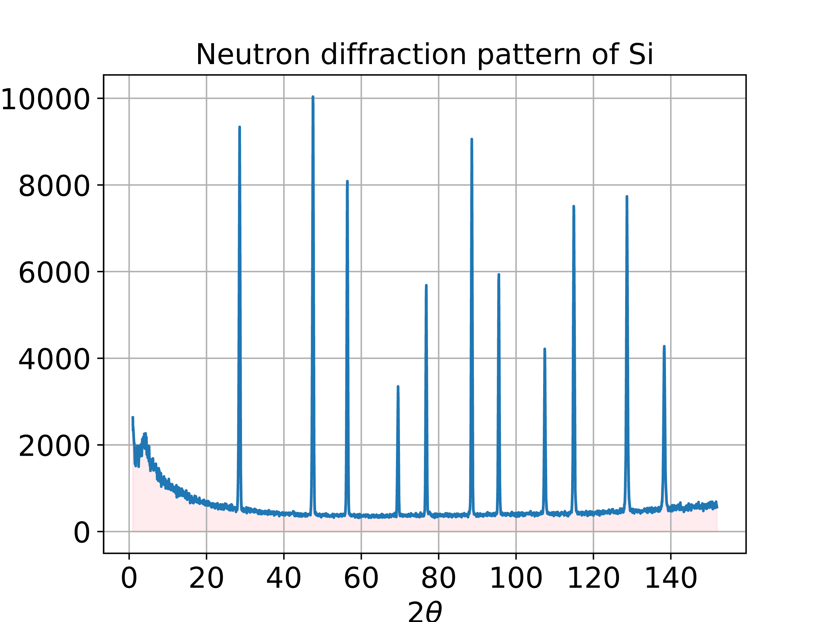
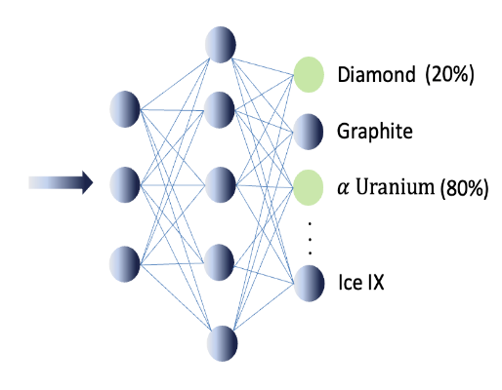
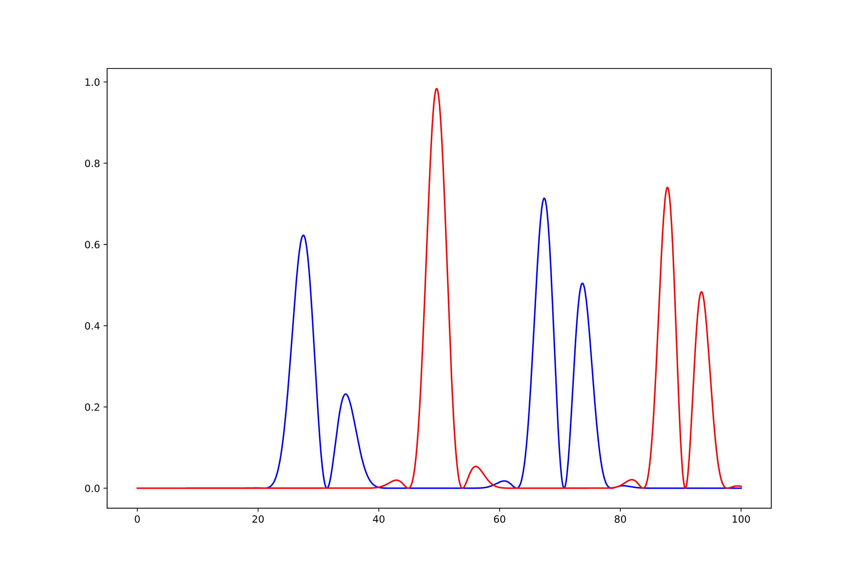
Applying Information Field Theory for Background Removal in Crystalline Diffraction Patterns – EvalSpek-ML project
Author: Loubna Kadri
Data preprocessing
Phase identification and quantification
Running different supervised ML
by: Anatoliy Senyshyn
Background can be subtracted using:
Manual selection and fitting of mathematical function (usually polynomial)
Numerical information field theory (NIFTy) - ?

Slide 2
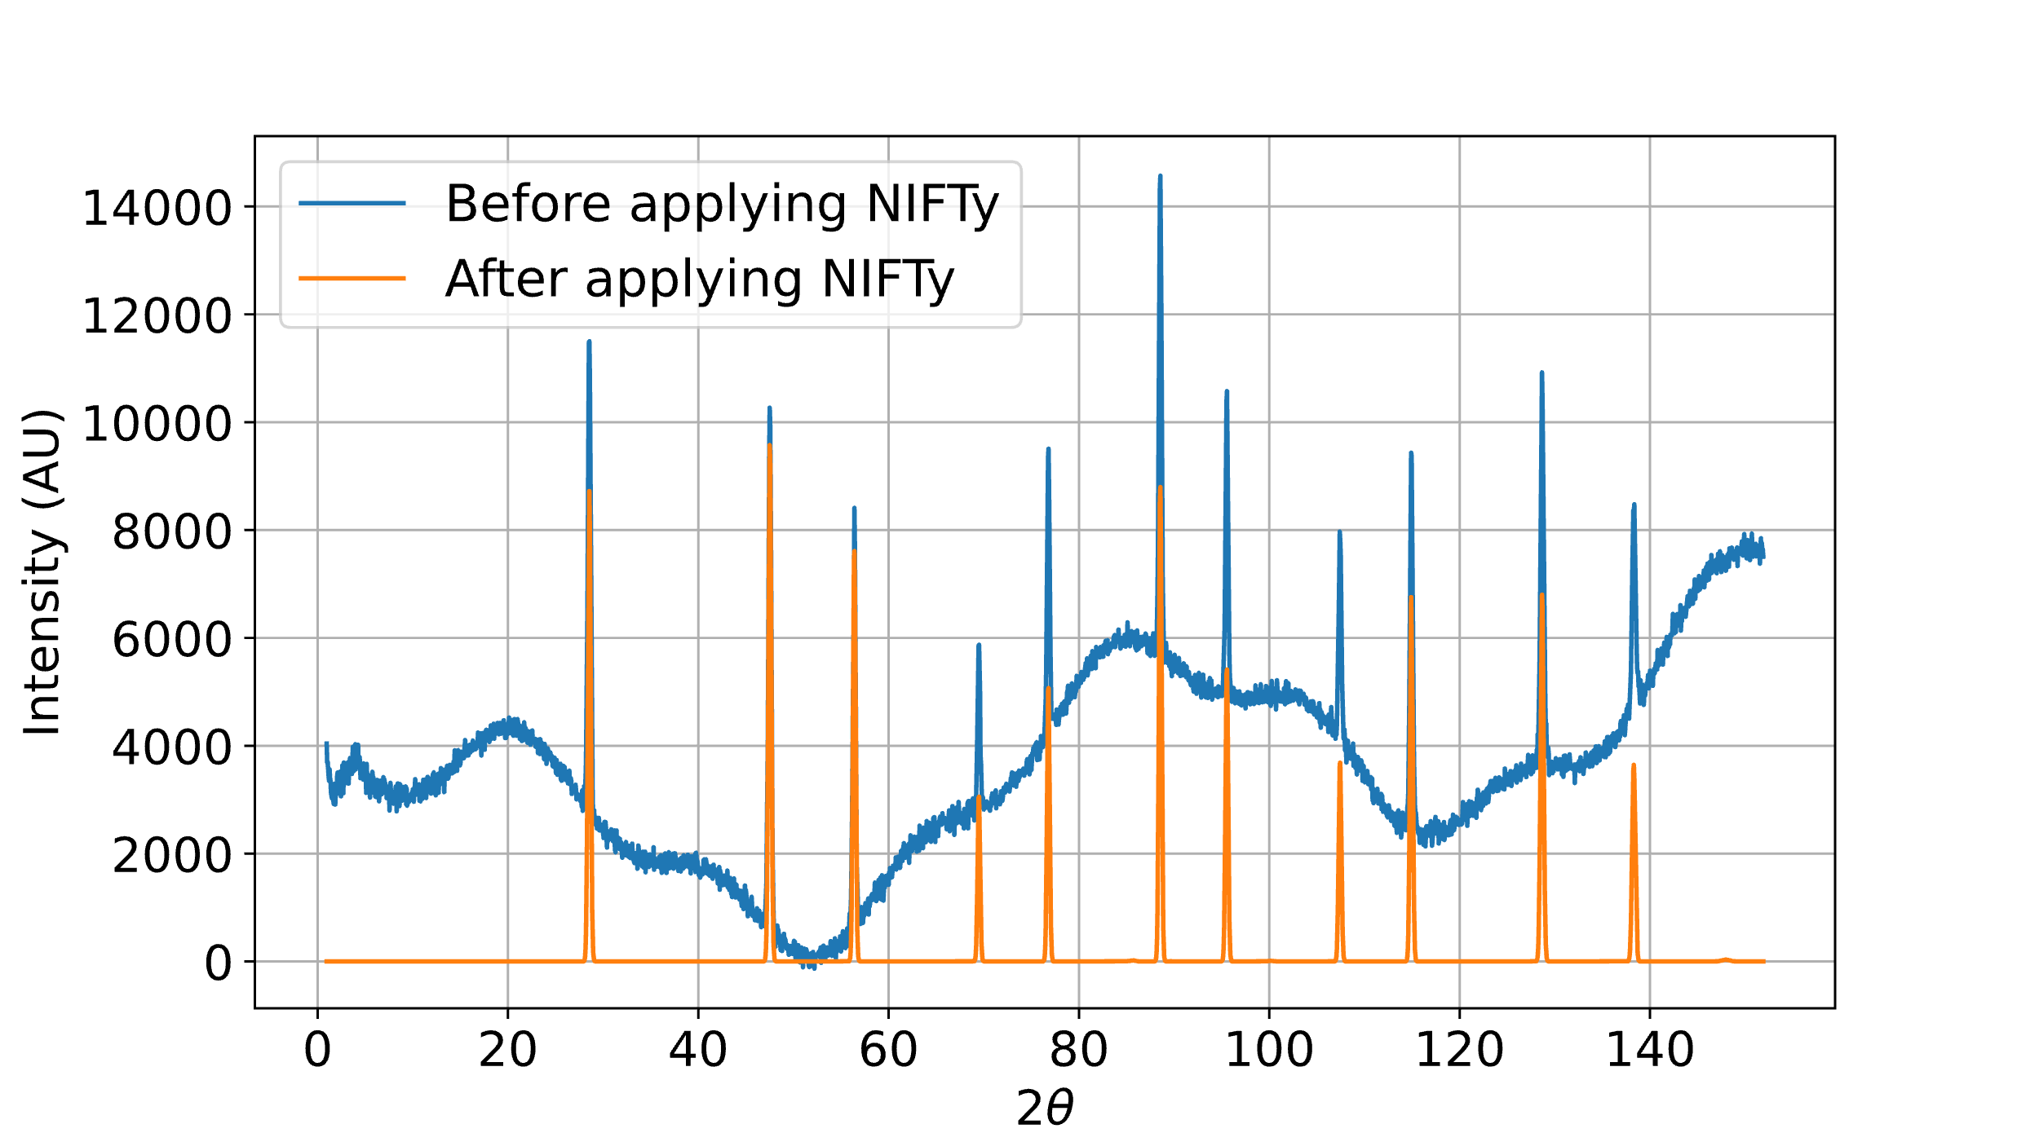
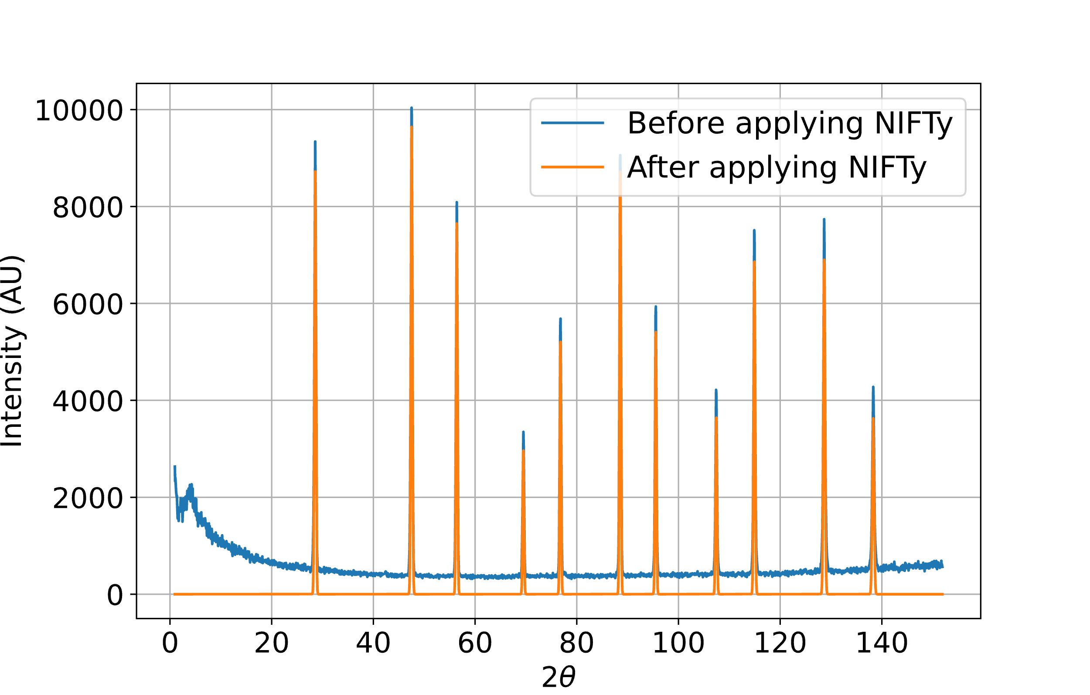
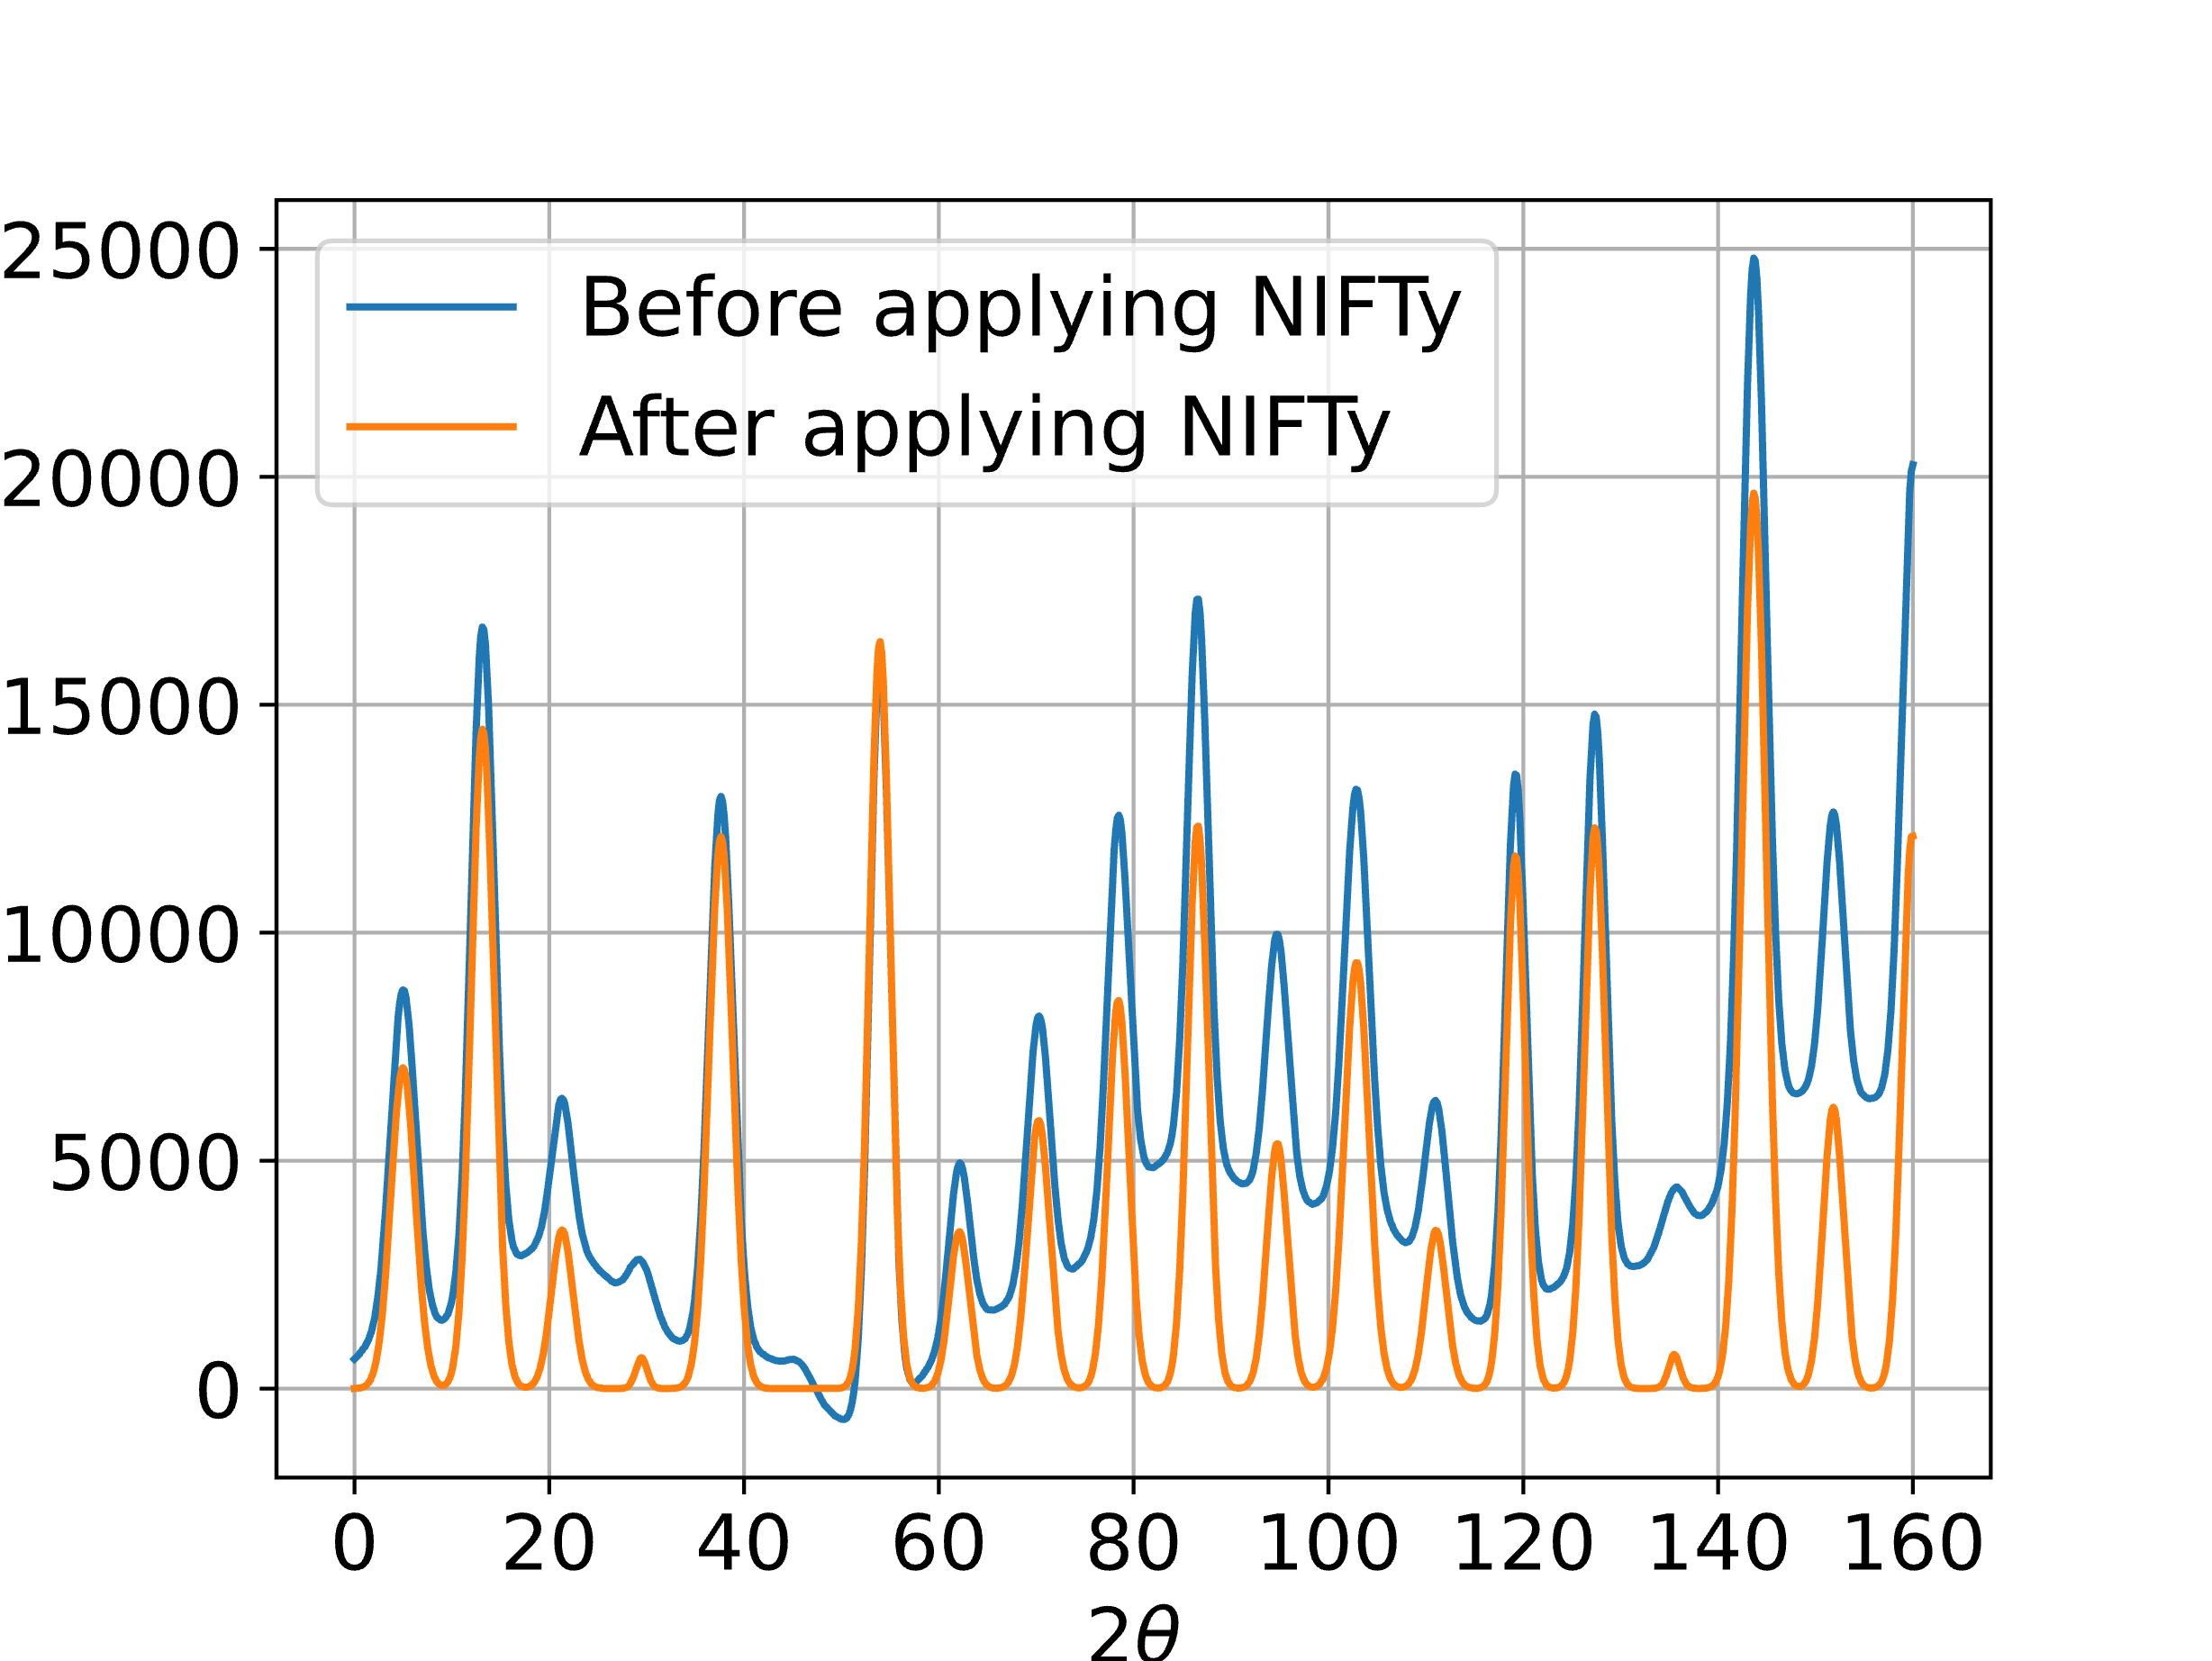
Applying Information Field Theory for Background Removal in Crystalline Diffraction Patterns – EvalSpek-ML project
Author: Loubna Kadri
Numerical information field theory: Applying Bayesian inference and probabilistic models to well-behaved signal at low and high dimensional spaces.
Ensures reproducibility of results and provides uncertainty estimates.

