Slide 1


Disappearing track trigger in ATLAS for Run 3 searches
Hanyi Jang
ATLAS DESY Summer student presentation
28th August, 2024
Notes:
I am in Federico’s group

Slide 2
Content
Introduction
Dark matter candidate in SUSY
Trigger system
Dataset- 2022, ATLAS experiment
$$pp collisions \sqrt{s}=13.6 TeV, integrated luminosity: {29049.3 pb}^{−1}$$
Study efficiency of disappearing track trigger
Generated events- MadGraph5 ver.3.5.4, Pythia8 ver.8.311, generate signal events
$$pp collisions \sqrt{s}=13.6 TeV, integrated luminosity: 137{fb}^{−1}$$
Study gained signal events with disappearing track trigger
Notes:
A lot happened and then I became a bacheolor student
Didn’t really get to BSM yet…. SO a little diffficult now, but still fun

Slide 3
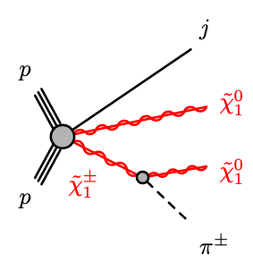
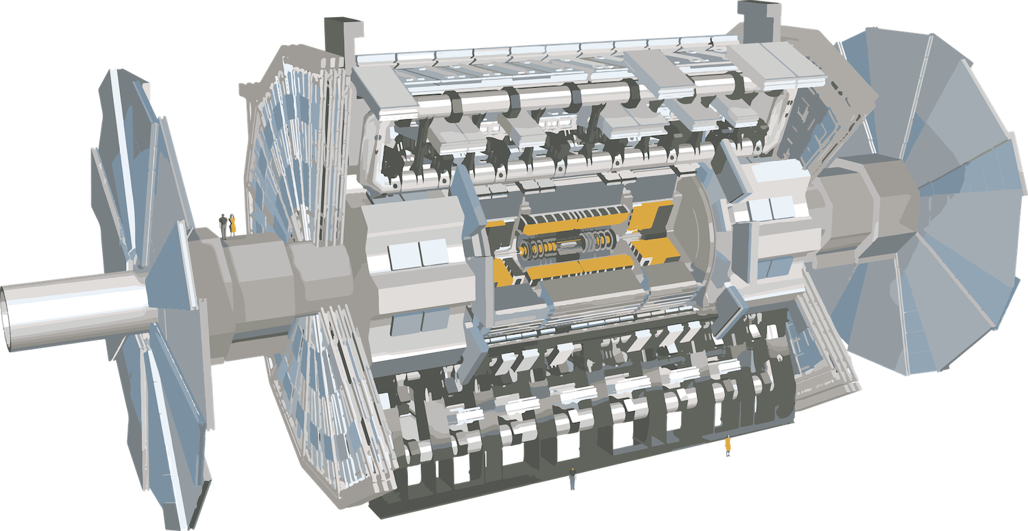

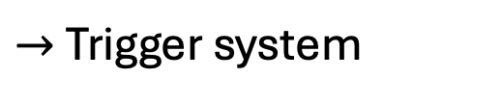
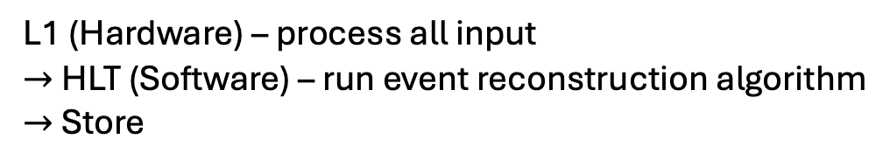
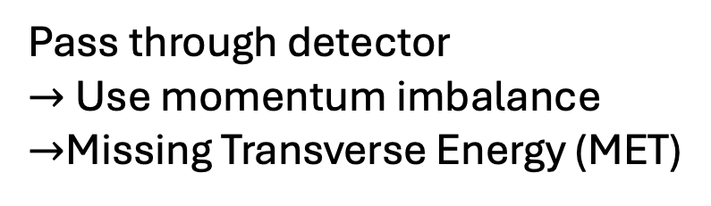
Introduction
Target: SUSY model – LSP(Neutralino)
Dark matter candidate
Collision (event) every 25ns !
😱
Neutralino
$→$Trigger system
Chargino
L1 (Hardware) – process all input
$→$HLT (Software) – run event reconstruction algorithm
$→$ Store
Pass through detector
$→$Use momentum imbalance
$→$Missing Transverse Energy (MET)
Adjust the triggers to see
new signal candidates
Aad, G., Abbott, B., Abbott, D.C. et al. Search for long-lived charginos based on a disappearing-track signature using 136 fb of pp collisions at = 13 TeV with the ATLAS detector. Eur. Phys. J. C 82, 606 (2022).
Notes:
Diagram only for EWK.
So, my target is in the supersymmetry model
In supersymmetry, each particle in the SM has a super partner that is very heavy.
And the the lightest super partner particles (LSP) is a candidate for dark matter since it’s undetectable and very stable so it could survive from the BigBang until now.
In proton collisions of LHC, as you can see in this picture, after some decay chains, they can produce these neutralinos
However, like the neutrinos, these do not interact with the detector and just pass through.
So to detect this, we use the fact that total momentum is conserved, and tract down where the energy is missing.
This is calle dthe MET, and this will be our goal of search
A problem: ATLAS sees a bunch crossing every 25ns (40MHz). That is more than we can readout, store.
But luckily we only need a subset of the total data, -> Use trigger system to get them
-L1 (Hardware) – decision made within 25ns, L1 runs very simple algorithms in FPGA hardware in about 2 microseconds, with and output rate of about 100 kHz.
-HLT has access to the full detector information and can run a simplified version of the full event reconstruction algorithms. HLT has an output rate of about 1.5 kHz and all events accepted by the HLT are sent to permanent storage.
Our objective is to adjust the triggers to open the window and see if there’s new signal candidates.
And among these several triggers, we will focus on the MET trigger because our objective is to see the mET.
neutralinos", formed as combinations of a zino, a photino and two higgsinos
The weakly interacting LSP will escape detection and lead to missing transverse momentum, while the pion from the chargino decay has insufficient momentum to be reconstructed as a track, resulting in a characteristic signature where the track from the chargino disappears a short distance into the detector.
high-momentum jet from initial-state radiation (ISR) is required in order to ensure that significant missing transverse momentum is available for event triggering.

Slide 4
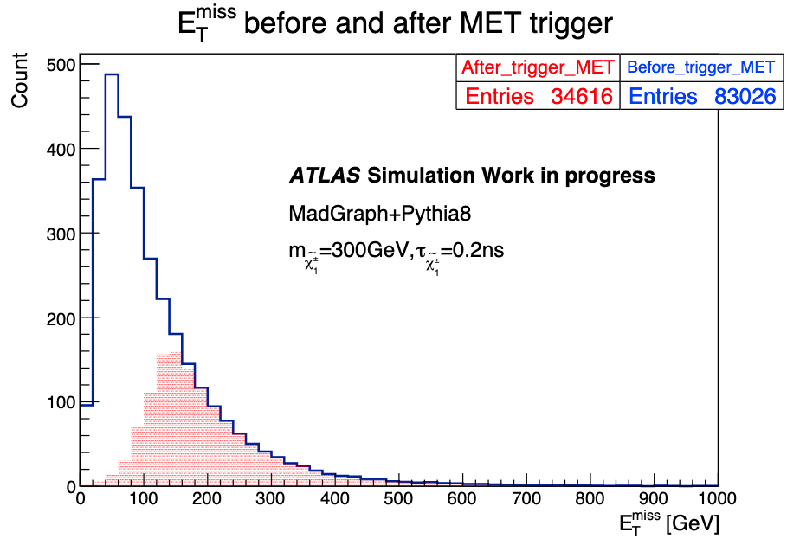
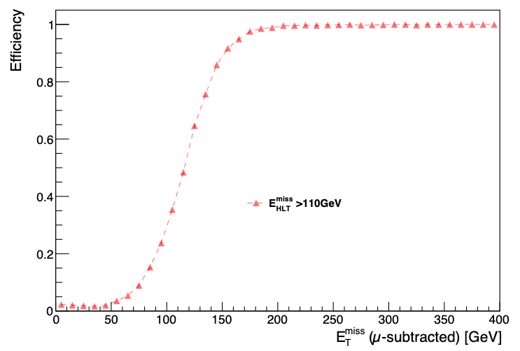

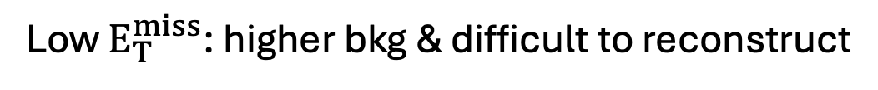


MET trigger
L1 + HLT Trigger
L1:
$$E_{T}^{miss}>50GeV$$
keep data take-in managable $→$ Cut
HLT:
$$E_{T}^{miss}>110GeV$$
MET trigger efficiency plot
Low $E_{T}^{miss}$: higher bkg & difficult to reconstruct
Aaboud, Morad, et al. "Search for long-lived, massive particles in events with displaced vertices and missing transverse momentum in s= 13 TeV pp collisions with the ATLAS detector." Physical review D 97.5 (2018): 052012
Notes:
-Several trigger, I am looking at the MET trigger that is currently being used.
As I said before, we cannot take in all the data, so we need to give a cut in it. The L1 trigger is at 50GeV, and the HLT enables us to cut at 110GeV.
The reason we cut off the low MET is because it has higher bkg, and difficut to reconstruct than higher MET.
So when we look at the MET trigger efficiency plot where the x axis is the MET and y axis is the efficiency, from approx 110GeV, the efficiency is 100%
And when we apply this map to the generated signal events, we can see that the blue histogram which was before the MET trigger reduces to the red histogram, leaving only a fraction of signal events.

Slide 5




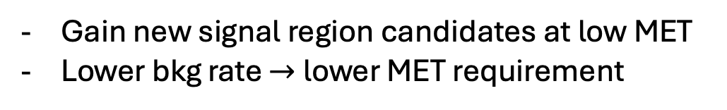

Objective
- Upgrade trigger!
L1 + HLT Trigger
+ Disappearing track Trigger
Gain new signal region candidates at low MET
Lower bkg rate $→$lower MET requirement
New!
Notes:
This is great, but we want to upgrade the trigger so that we can accept new possible signal region events at lower momnentum.
For the new trigger, we implement the Disappearing track trigger which lower bkg rate at the lower MET which enables us to do this!
Now you can see because the efficiency has rosen here, the expected number of events we take in has also rosen at low MET, which is exactly what we want
So what is a disappering track trigger?

Slide 6
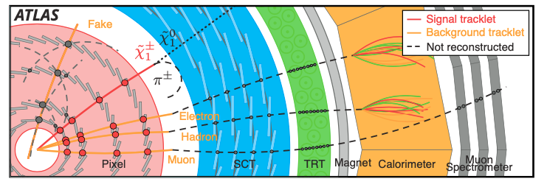
Upgraded trigger –Disappearing track trigger
Detector view
‘tracklet’ = only Pixel hits
Invisible
-
‘Decay’
Aad, G., Abbott, B., Abbott, D.C. et al. Search for long-lived charginos based on a disappearing-track signature using 136 fb of pp collisions at = 13 TeV with the ATLAS detector. Eur. Phys. J. C 82, 606 (2022).
Notes:
Disappearing track literally means that a charged prtcle decay into invisible prtcl after ID before SCT, so it only has pixel hits.
We call this a tracklet’ and not a ‘track’ which is a fully reconstructed object.
The reason we are looking at the ’trackelt’ is because our interest, the chargino is one..
It is indicated as the redline, decaying into a invisible neutralino and pion as we saw before.
Disappearing tracks: fake, $Z→μμ$ , $W→eν$etc

Slide 7
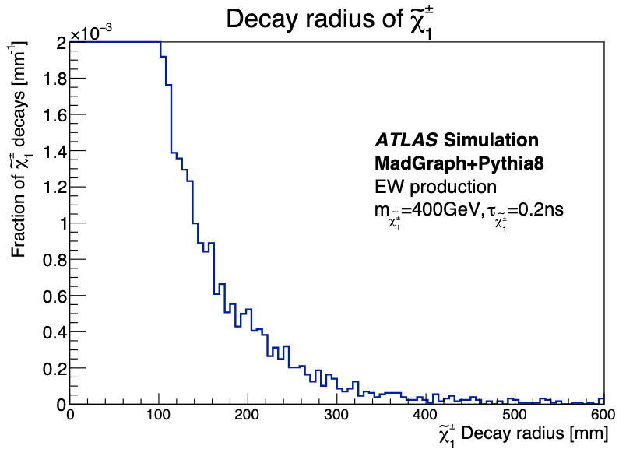
Upgraded trigger –Disappearing track trigger
Detector view
‘tracklet’ = only Pixel hits
Invisible
Pixel
SCT
Notes:
This plot has the x axis as the decay radius of the chargino, and the y axis as the fraction of chargino decays, and the detectors in shaded colors,
This red dash box indicates the charginos that are trackelts, so the region of charginos that we are interested in.

Slide 8
Upgraded trigger –Disappearing track trigger
Detector view
‘tracklet’ = only Pixel hits
Detector view
Fake
Electron & Hadron
Muon
Fully reconstructed track
BDT (Boosted Decision Tree)
-
-Separate bkg (fake) & signal tracklet
-12 variables (track parameters, quality of fit, number of Pixel hits etc)
Aad, G., Abbott, B., Abbott, D.C. et al. Search for long-lived charginos based on a disappearing-track signature using 136 fb of pp collisions at = 13 TeV with the ATLAS detector. Eur. Phys. J. C 82, 606 (2022).
Notes:
However, there are also bkg tracklets, for example e, h,mu, these leave hits on the ID, but for some reason gets deflected and cannot be reconstructed as a full track like it should’ve been as seen in this picture, so it becomes a tracklet.
Also the major contrubution is the combination fo random hits that just turned out to look like a tracklet.
So to distinguish these bkg from the signals, we use the BDT algorithm which is a machine learning algorithm that
Use 12 variables such as track parameters including impact parameters ,

Slide 9

Upgraded trigger –Disappearing track trigger
>110GeV
Pass
Reconstruct tracklet
Evaluate
using real data!
$$E_{HLT}^{miss}$$
80~110GeV
BDT algorithm
Pass
Fail
<80GeV
Fail
Notes:
So the overview of the upgraded trigger will look like this.
For MET over 110, we use the original L1 & HLT to pass the events, and for between 80 and 110GeV, we reconstruct the tracklet and run it through the BDT algorithm which will pass or fail the events depending on the score, and for uner 80GeV is always a fail.
In this way, even if we take in the data for lower momentum, the 80~110GeV, the disappearing track will only receive the signal events, reducing the data rate we need to take in.
Now we have the idea of the new trigger, we need to evaluate the performance of it by using Real data, which means we want to plot an efficiency map like we saw before.

Slide 10
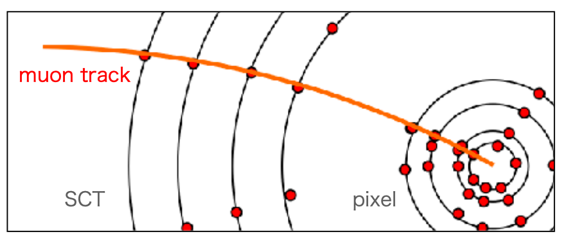
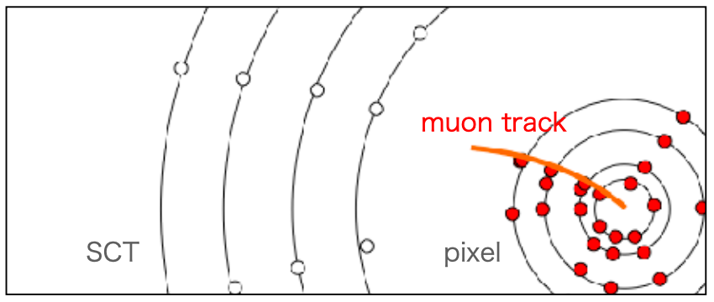
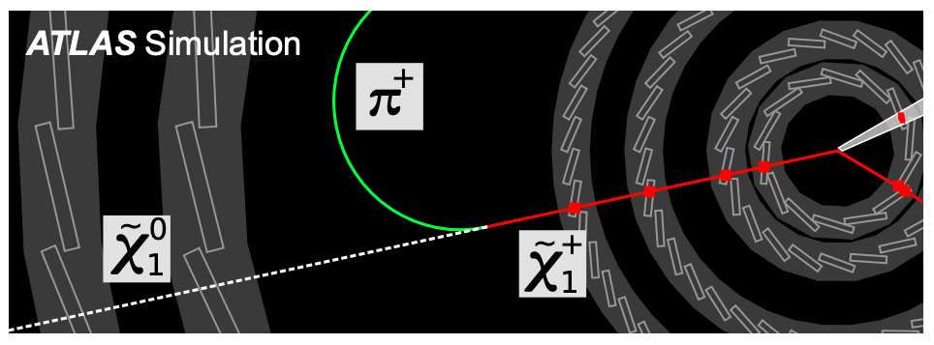
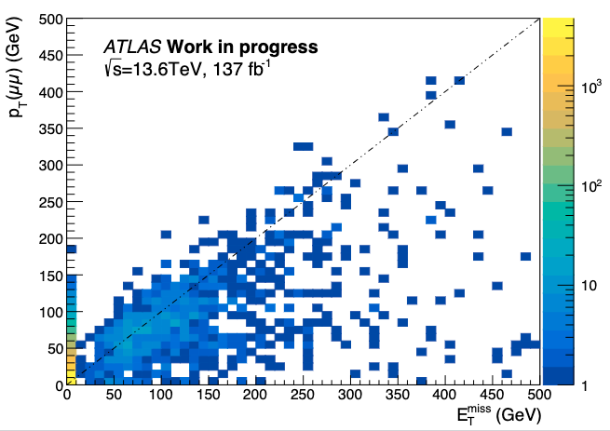



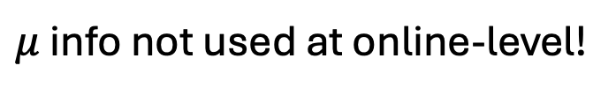
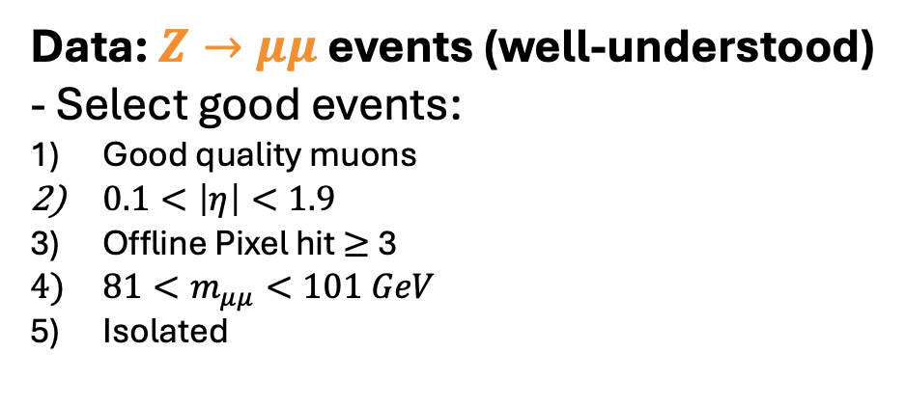

Real Data-Evaluate performance of MET trigger
Offline (after collecting data)
Online (while collecting data)
Event we are interested in
$μ$track
$μ$tracklet
$$≈$$
$μ$ info not used at online-level!
$μ:$proxy for MET
Data: $Z→μμ$ events (well-understood)
- Select good events:
Good quality muons
$0.1<\left|η\right|<1.9$
Offline Pixel hit $≥$ 3
$81<m_{μμ}<101 GeV$
Isolated
Aaboud, Morad, et al. "Search for long-lived, massive particles in events with displaced vertices and missing transverse momentum in s= 13 TeV pp collisions with the ATLAS detector." Physical review D 97.5 (2018): 052012
Notes:
And there’s a trick we use here: we use the muons, instead of the actual MET.
Ofcourse, the in the offline reconstruction(meaning after we collect the data and do analysis), the muon is a track, but during the online reconstruction(while getting data), the muon information is not considered, so it looks like a tracklet.
So the thing is, at the online-level, the muon tracklet looks very much like the chargino decay so we can use the muon as a proxy of the MET when we evaluate the performance.
Consequently, we use the z->mumu events that were collected by the muon trigger as our data, and from here we select the good events, following this category written here.
After these, we can see that the MET and the dimuon pT agrees well.

Slide 11
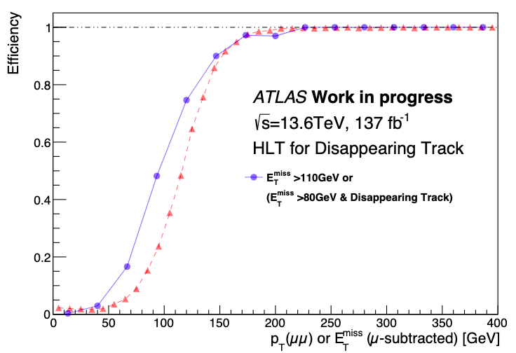
Efficiency of new trigger
Accept more events with
Potential candidates!
Apply this new efficiency to generated events!
Original Efficiency used in 2018
Aaboud, Morad, et al. "Search for long-lived, massive particles in events with displaced vertices and missing transverse momentum in s= 13 TeV pp collisions with the ATLAS detector." Physical review D 97.5 (2018): 052012
Notes:
So by using the muon as the MET proxy, from the original efficiency plot that we have seen before, we upgrade it by using the new algorithm, and we can see that there’s an improvement for lower MET, and we can accept more events with potential candidates.
Now we’ll apply this efficiency to the simulated events to see how much we can improve our signal region events.

Slide 12
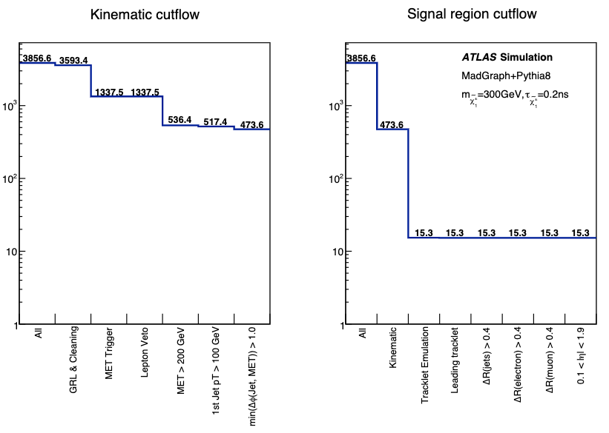
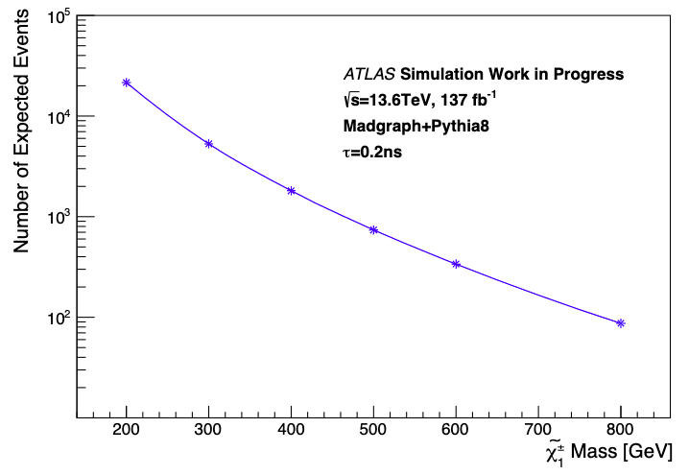
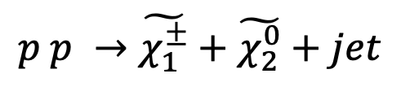
Generated events
Simple Analysis
Analyze
$$p p →\tilde{χ_{1}^{±}}+\tilde{χ_{2}^{0}}+jet$$
Online + Offline
Signal events!
Get Signals that we are interested in!
Number of Events generated for different masses
Signal Region!
Need higher efficiency for large mass!
Notes:
These events are generated by madgraph and pythia, and I requested a proton proton collision to a chargino and neutralino and jet.
This plot shows the number of events the we expect for each mass, so we can see that wow there’s really little number of events expected for large chargino mass, so we need to do our best to make the efficiency higher for these regions.
Using these generated simulation data, we analyz the events using SimpleAnalysis, which is a mix of online and offline processes.
For example, here we give the MET trigger to emulate the online process, and the others are cleaning processes done offline to get the signal region that we want.
The end is the final signal region that is the most probable signal.

Slide 13
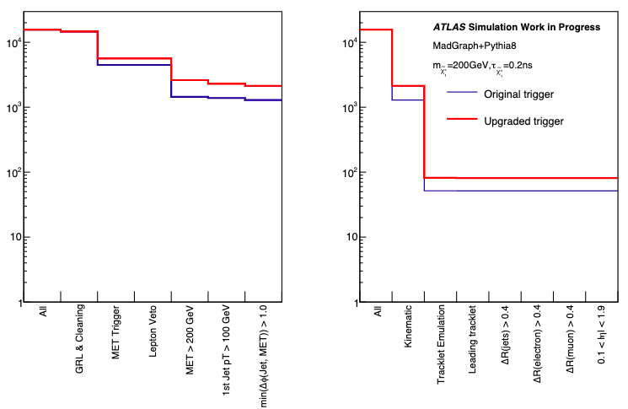
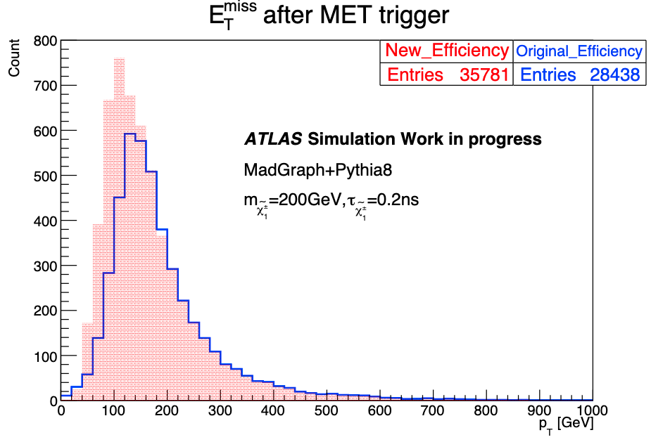
Result - Apply disappearing track trigger
- Replace efficiency
Increase in candidate events!
Increase in signal region events!
Notes:
SO now let’s see how much our new trigger system worked well and incresaed the signals that we wanted! This example is for when the chargino mass is 200GeV with a lifetime of 0.2ns.
The plot shows the MET after the MET trigger, so after giving a cut according to the fficiency plot. The result of the new efficiency map in red and We can see that there is an increas in the candidate events for low momentum, which is good. The effect of this is the increase of signal region events that is the red line which is great!

Slide 14
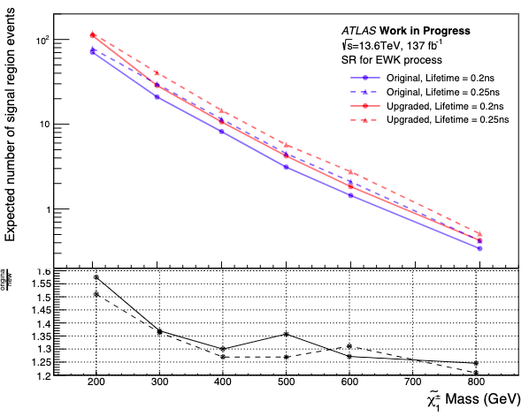
Result - Apply disappearing track trigger
Number of Signal Region events for differing chargino mass
After Upgraded trigger, SR events:
~1.35 times increase
Less increase for higher mass
Original
Upgraded
Notes:
Finally this is the plot for the signal region events by mass. The blue lines are the original MET trigger, and the red lines are the Upgraded Met trigger, with the two life time in solid and dash.
We can see that as the mass increase, the

Slide 15
Summary
Motivation
Search for dark matter candidate predicted by SUSY
Method
Implement disappearing track trigger (BDT)
-Lower momentum threshold for MET
-Increase acceptence of signals
Results
- Signal region improved ~ 35%
Further improvments
Notes:
Improvement by
-includeing not only 4 hit tracklets but 3,
-adjusting the cuts, bdt scores
Trials and errors are required.

Slide 16
Thank you
Notes:
I am in Federico’s group

Slide 17
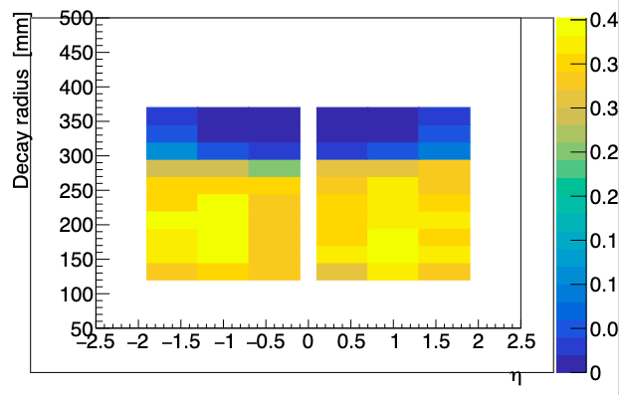
Track Emulation
Notes:
Learned how to use MadGraph and Pythia 8 which is a simulation tool for what happens in a particle collision.
Got the cross section, and using the luminosity of run3, calculated the number of events, so I can say that wow there’s really little number of events expected for large chargino mass…
I should stack a lot of statistics.
-Get cross section $→$ # of events
Then I analyzed events that I got from the simulation
-- mix of online and offline
From there became bit difficult.
-was trying to understand the code
-lot of troubles on the way like we can’t detect any charginos, or afterwards we detected the same charginos several times,
So we had to print out several values so that we can make a decision of picking out the appropriate chargino.
Process of getting into signals that we are interested in!

Slide 18
Data Analysis
Analysis of generated data $→$Get Signals that we are interested in!
SimpleAnalysis
- online + offline
Overlap removal
Smear pT
Object reconstruction
Signal region selection
Notes:
Learned how to use MadGraph and Pythia 8 which is a simulation tool for what happens in a particle collision.
Got the cross section, and using the luminosity of run3, calculated the number of events, so I can say that wow there’s really little number of events expected for large chargino mass…
I should stack a lot of statistics.
-Get cross section $→$ # of events
Then I analyzed events that I got from the simulation
-- mix of online and offline
From there became bit difficult.
-was trying to understand the code
-lot of troubles on the way like we can’t detect any charginos, or afterwards we detected the same charginos several times,
So we had to print out several values so that we can make a decision of picking out the appropriate chargino.
Process of getting into signals that we are interested in!

Slide 19
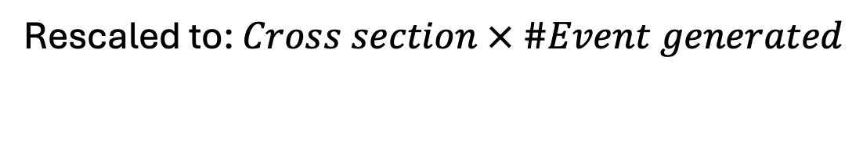
Expected number of events
Number of events generated
$$Cross section × integrated luminosity=expected number of events$$
Where, $integrated luminosity=137fb^{−1}$
Binning
Rescaled to: $Cross section × \#Event generated$

Slide 20
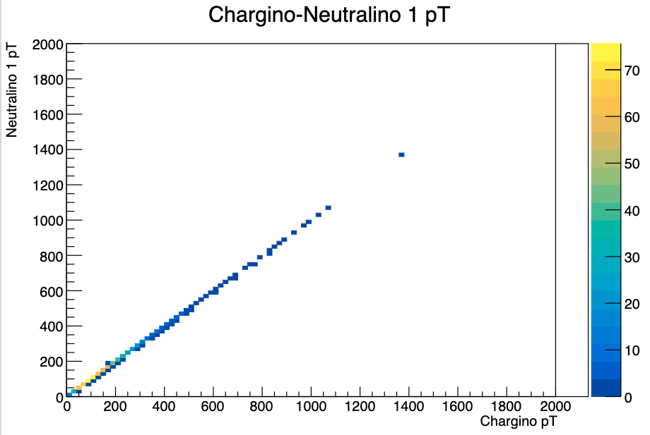
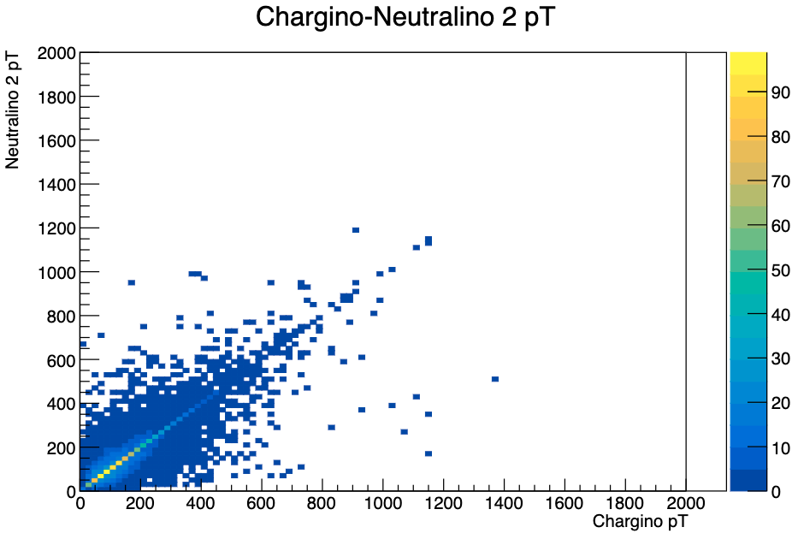

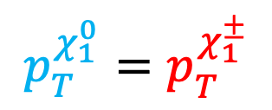
Decay radius
Set production vertex of $χ_{1}^{0}$, $χ_{2}^{0}$ as decay vertex
$$χ_{2}^{0}$$
$$p_{T}^{χ_{1}^{0}}=p_{T}^{χ_{1}^{±}}$$
$$χ_{1}^{0}$$
Chargino decay
50%
$$χ_{2}^{0}$$
$χ_{2}^{0}$ not the only one
$$χ_{2}^{0}$$

Slide 21

Diagram
Jet
Muon
Muon
$$≈$$
Jet
MET
Jet
Chargino
MET
MET

Slide 22
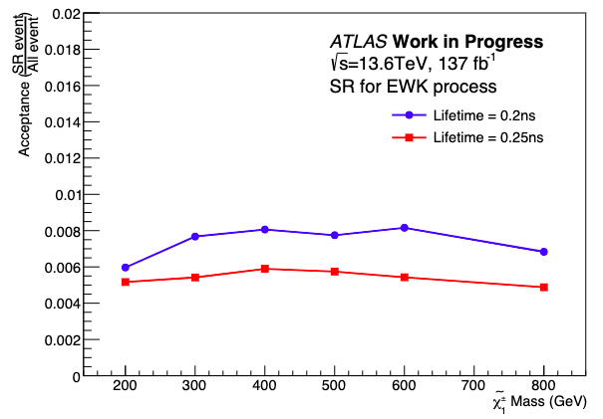
Acceptance times Efficiency

Slide 23
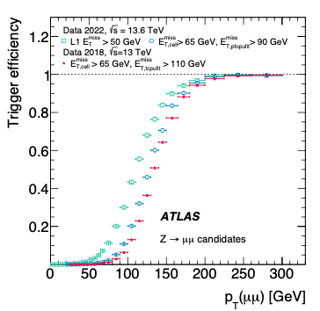
How HLT was improved

Slide 24
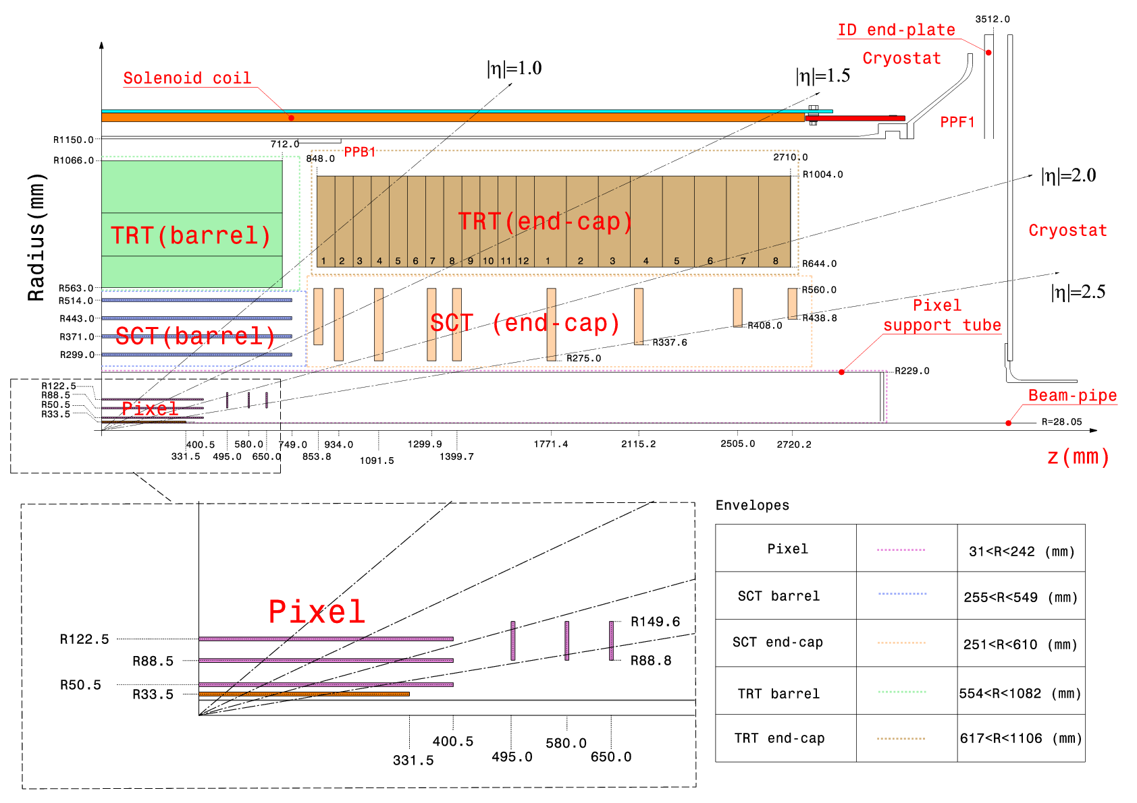
ATLAS Detector

Slide 25
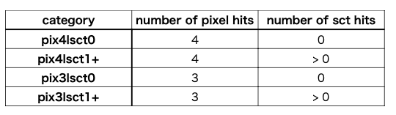
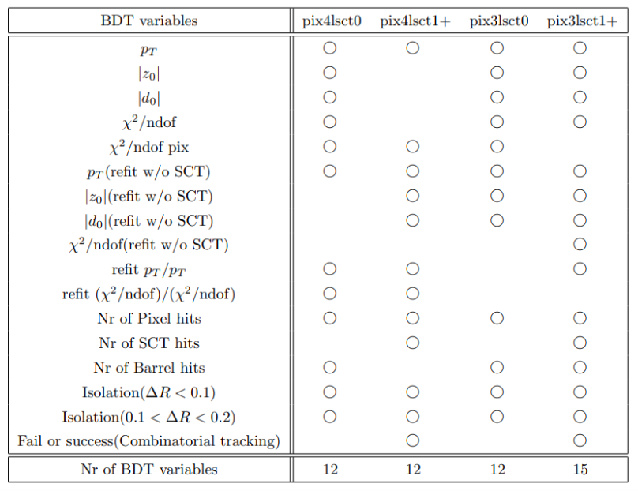
BDT

Slide 26
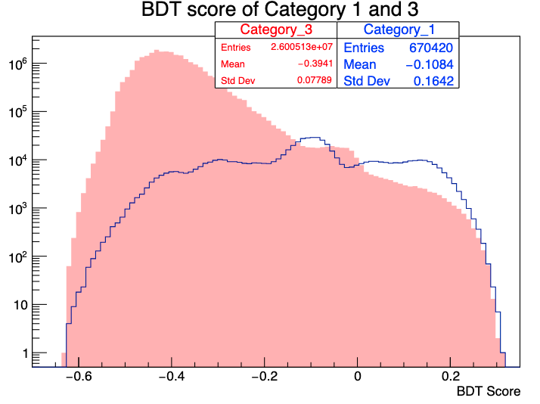
BDT
 | Number of contributing pixel hits | BDT cut score
Category 1 | 4-layer tracklet | -0.1
Category 3 | 3-layer tracklet | 0.04

Slide 27
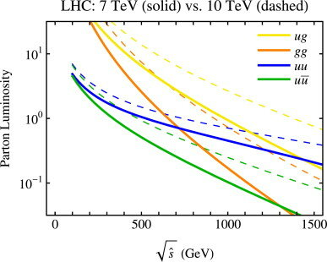
Parton Luminosity

Slide 28
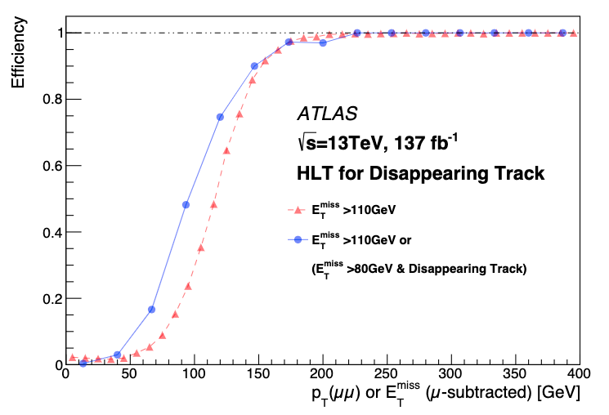

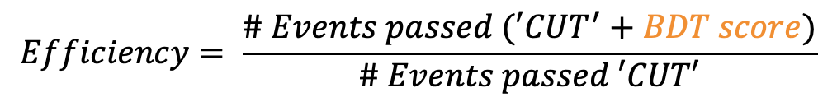
Efficiency of new trigger
$$Efficiency= \frac{\# Events passed (′CUT^{′}+BDT score)}{\# Events passed ′CUT′}$$
Original (L1+HLT)
New (Loosned HLT + BDT algorithm)
Notes:
Red triangle is the original
Blue circile is the new

