Slide 1
Quantum Turbulence in Superfluid Helium and its Damping Effect on MAGO Cavity Oscillations

Slide 2
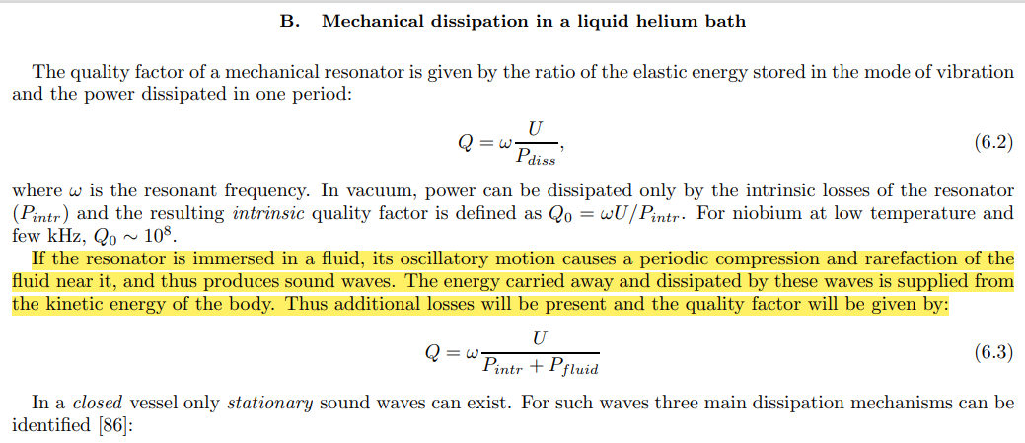
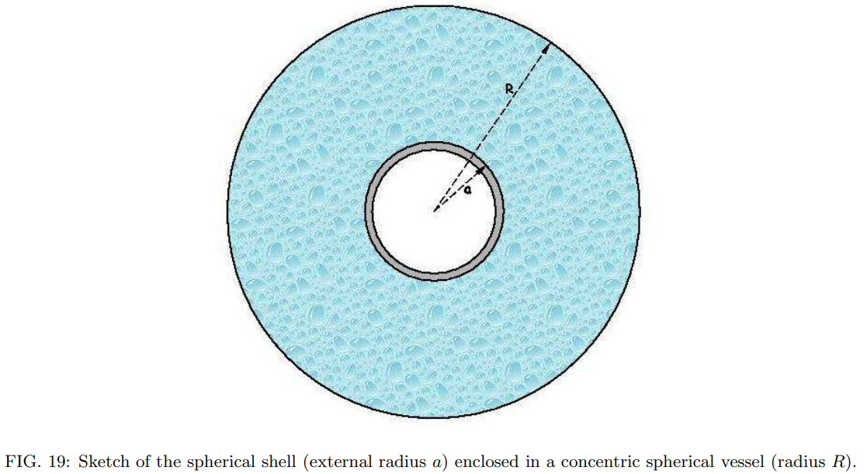
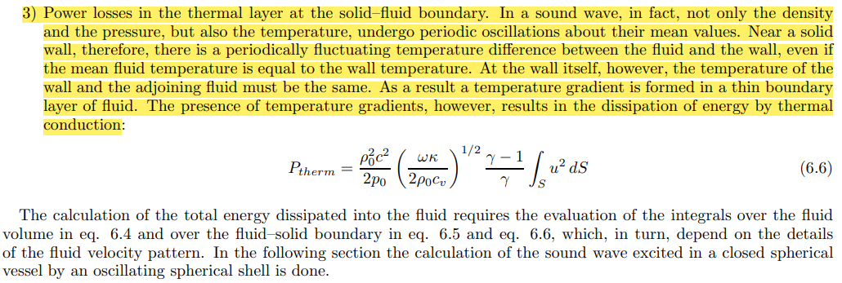
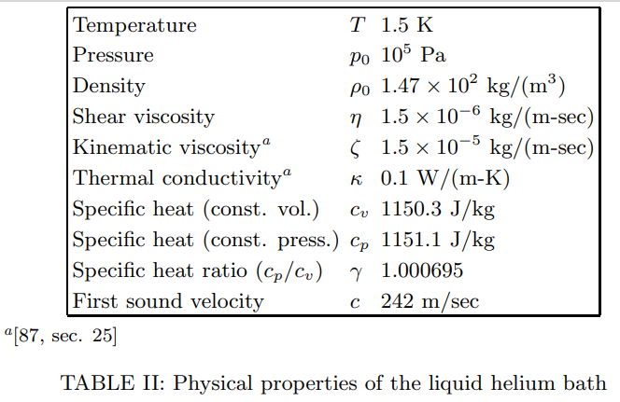
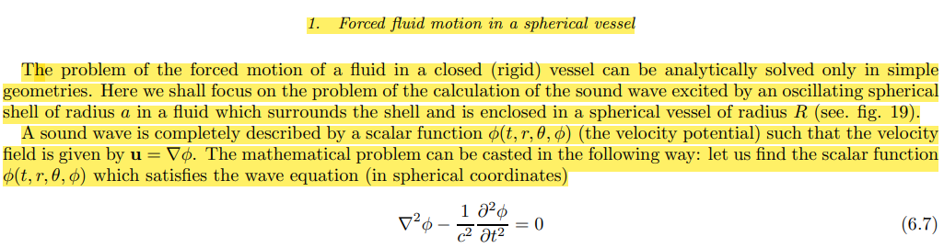
MAGO paper

Slide 3
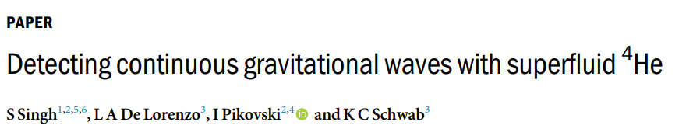
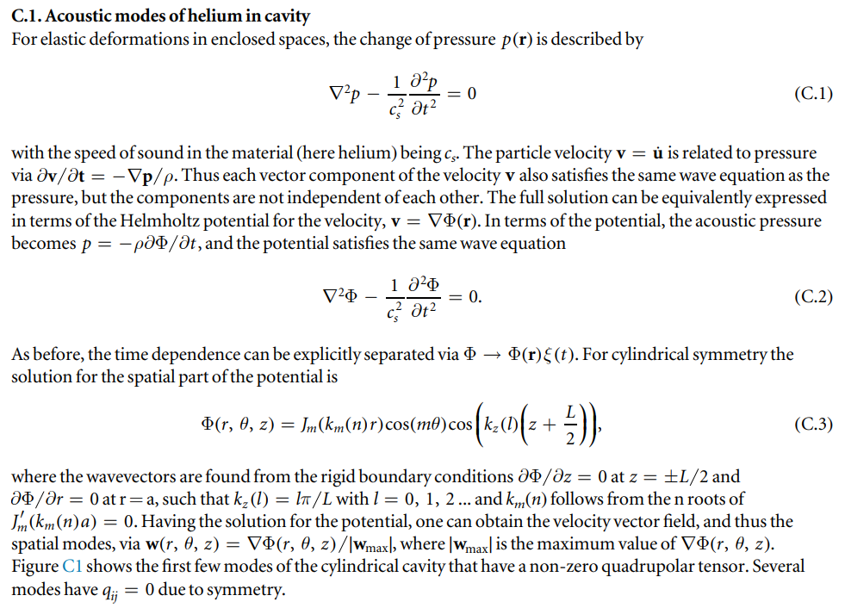
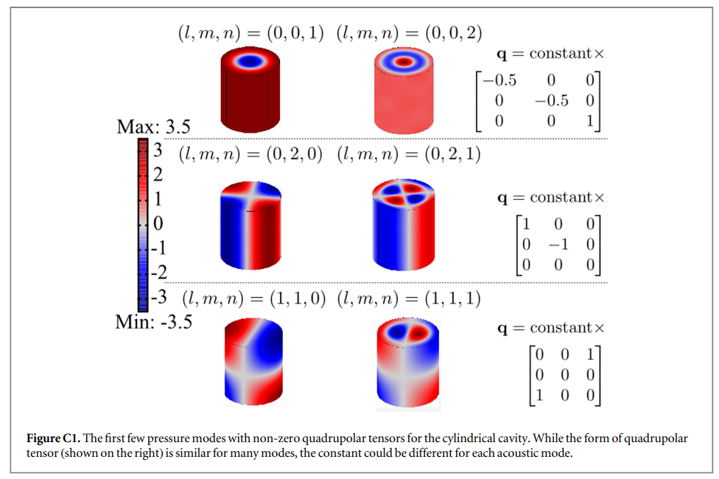

Slide 4
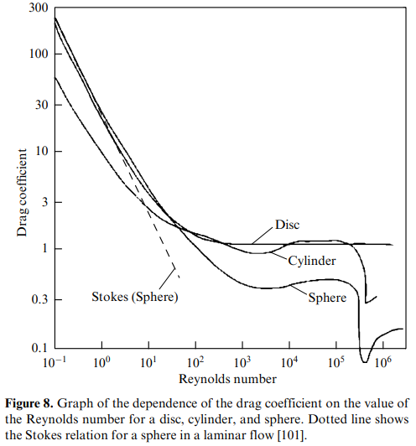
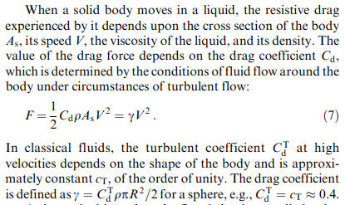
QT due to oscillating structures
V B Efimov, Quantum turbulence in superfluid helium (2023)

Slide 5
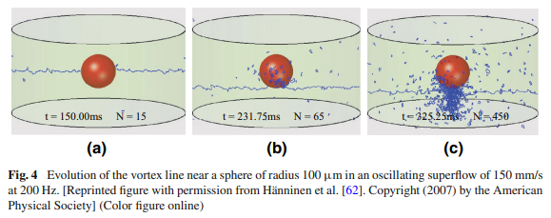
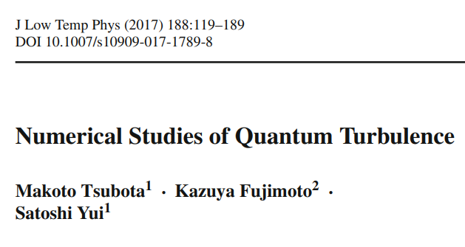
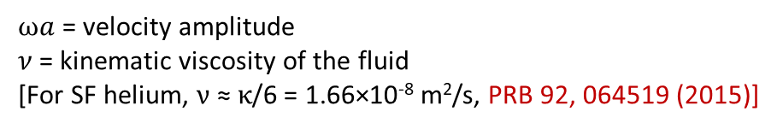
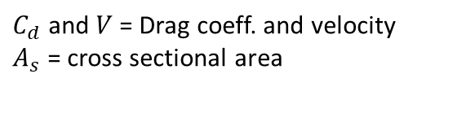


QT due to oscillating structures
Reynolds number:
$$Re=\frac{Inertial force}{Viscous force}=\frac{ωad}{ν}$$
$ωa$ = velocity amplitude
$ν$= kinematic viscosity of the fluid
[For SF helium, $ν$ ≈ $κ$/6 = 1.66×10⁻⁸ m²/s, PRB 92, 064519 (2015)]
Drag force:
$$F=\frac{1}{2}C_{d}ρA_{s}V^{2}$$
$C_{d}$ and $V$= Drag coeff. and velocity
$A_{s}$ = cross sectional area

Slide 6

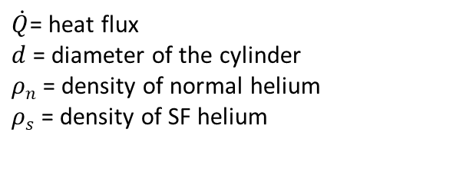




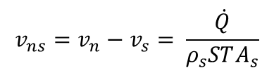
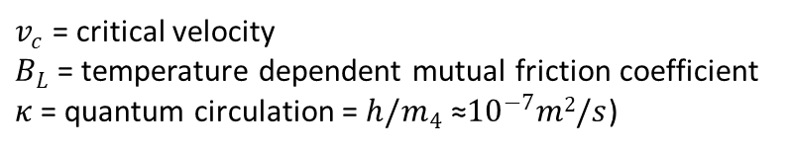
QT due to heat flux
Total density:
$$ρ{=ρ}_{n}+ρ_{s}$$
Momentum density:
$$J=ρ_{s}v_{s}+ρ_{n}v_{n}$$
J Low Temp Phys 153, 162 (2008) and PRF 3, 114701 (2018)
Counterflow velocity:
$$v_{ns}=v_{n}−v_{s}= \frac{\dot{Q}}{ρ_{s}STA_{s}}$$
Reynolds number:
$$Re=\frac{v_{ns}d}{ν}$$
Vortex line density
$$L^{1/2}=γ(T)(v_{ns}−v_{c})$$
PRB 86, 134515 (2012)
Drag force per unit volime:
$$F_{ns}=\frac{k}{3}\frac{ρ_{s}ρ_{n}}{ρ}B_{L}(T)Lv_{ns}$$
Bao et al., PRB 103, 134510 (2021)
$\dot{Q}$= heat flux
$d$= diameter of the cylinder
$ρ_{n}$ = density of normal helium
$ρ_{s}$ = density of SF helium
$v_{c}$ = critical velocity
$B_{L}$ = temperature dependent mutual friction coefficient
$κ$= quantum circulation = $h/m_{4}$ ≈${10}^{−7}m2/s$)

Slide 7
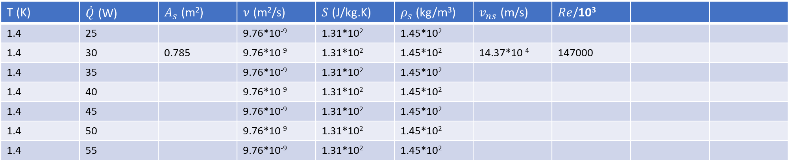
QT due to heat flux
T (K) | $\dot{Q}$ (W) | $A_{s}$ (m²) | $ν$ (m²/s) | $S$(J/kg.K) | $ρ_{s}$ (kg/m³) | $v_{ns}$ (m/s) | $Re$/10³
1.4 | 25 |  | 9.76*10⁻⁹ | 1.31*10² | 1.45*10²
1.4 | 30 | 0.785 | 9.76*10⁻⁹ | 1.31*10² | 1.45*10² | 14.37*10⁻⁴ | 147000
1.4 | 35 |  | 9.76*10⁻⁹ | 1.31*10² | 1.45*10²
1.4 | 40 |  | 9.76*10⁻⁹ | 1.31*10² | 1.45*10²
1.4 | 45 |  | 9.76*10⁻⁹ | 1.31*10² | 1.45*10²
1.4 | 50 |  | 9.76*10⁻⁹ | 1.31*10² | 1.45*10²
1.4 | 55 |  | 9.76*10⁻⁹ | 1.31*10² | 1.45*10²

Slide 8
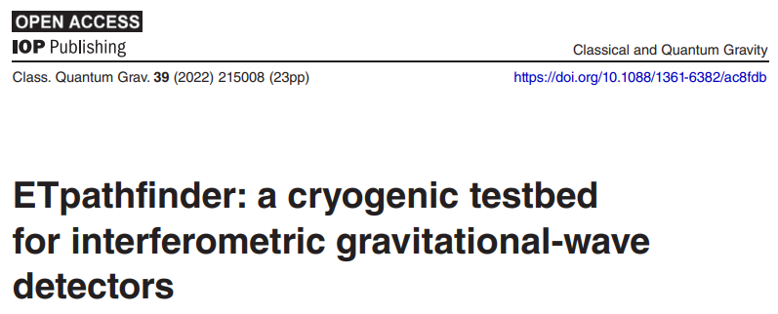
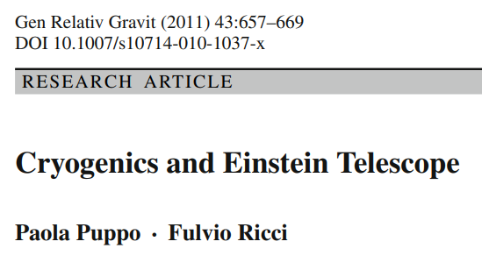
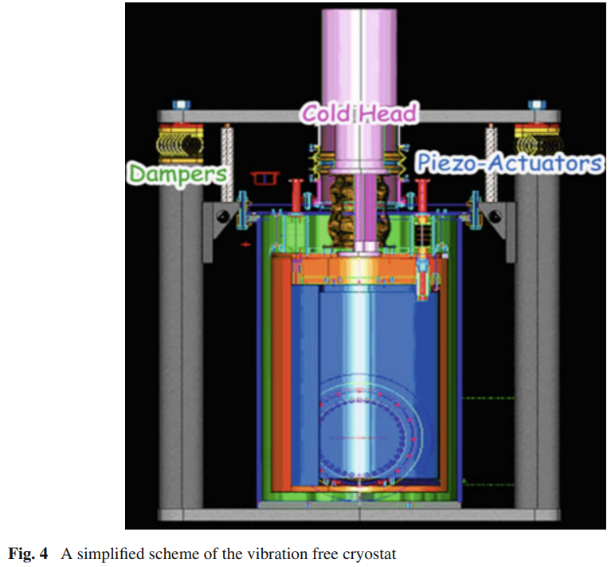
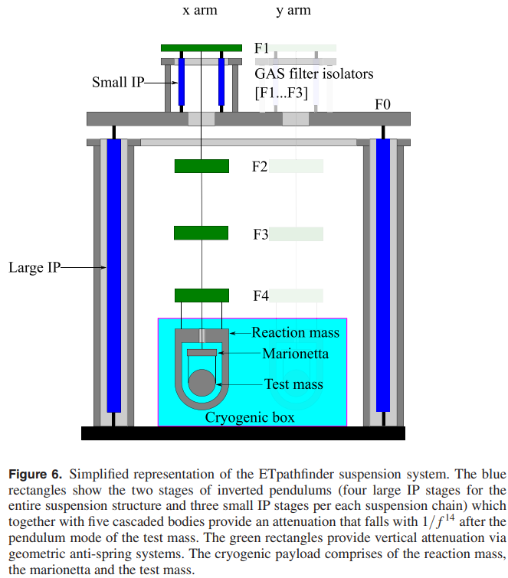
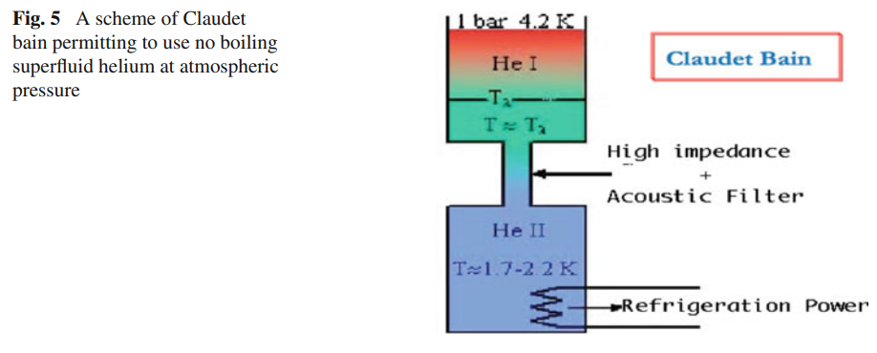

Slide 9
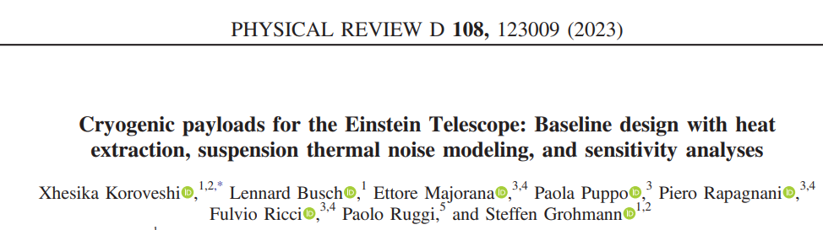
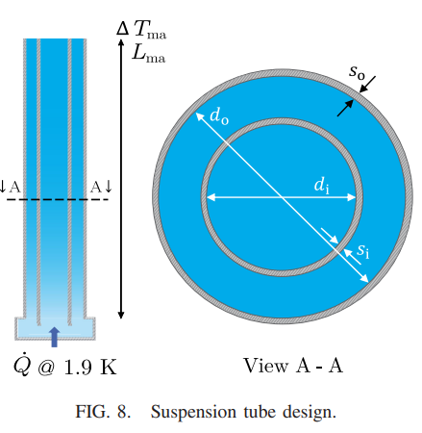
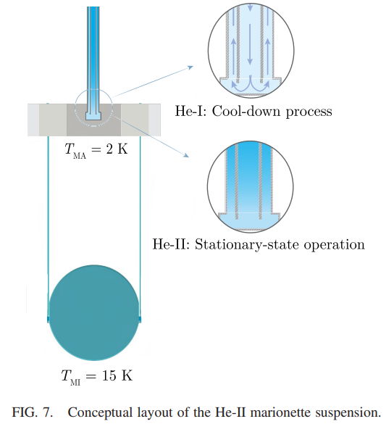


Slide 10
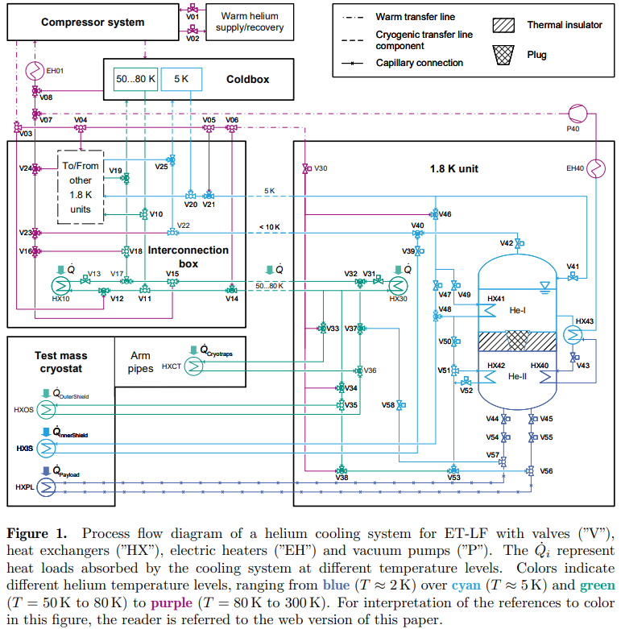
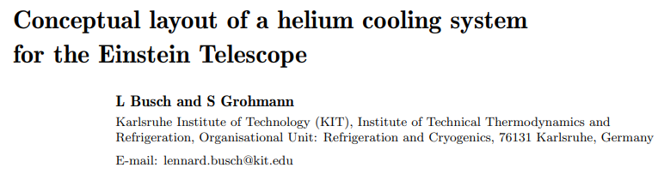

Slide 11
Back up

Slide 12
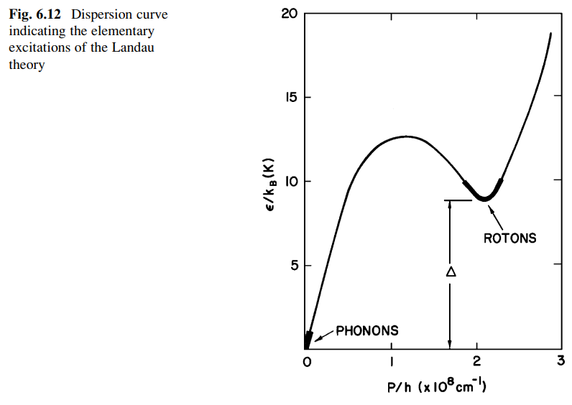
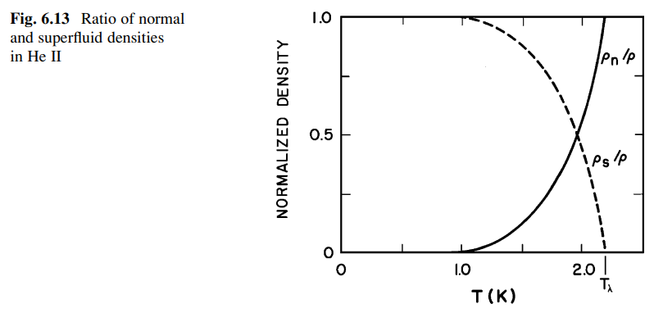
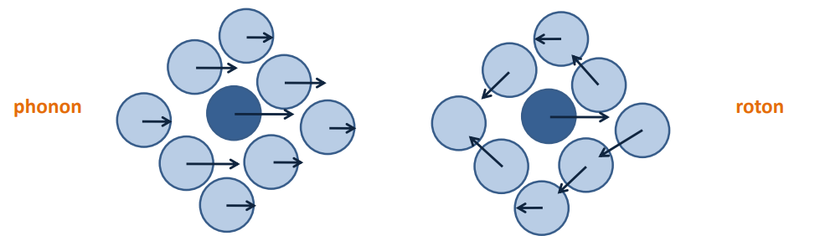


Rotons and phonons in SF helium as well as its two-fluid behavior
Due to strong temperature dependence, the superfluid component composes about 99% of He II at 1 K.
Specific heat dominated by rotons between 1.1 and 2.1 K and not by phonons
Steven W. Van Sciver, Helium Cryogenics (2012)
Phys. Rev. B 103, 104516 (2021)

Slide 13
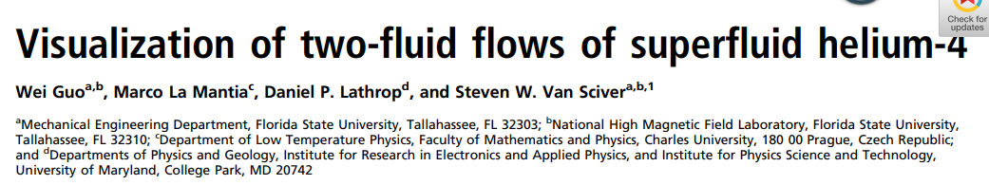
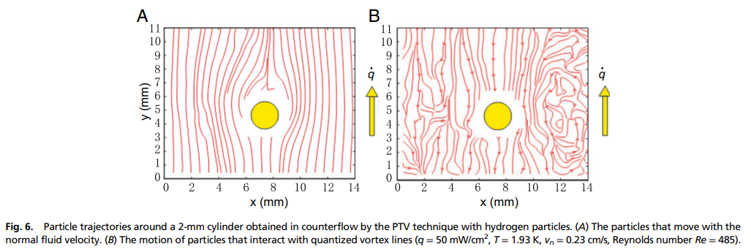

Slide 14
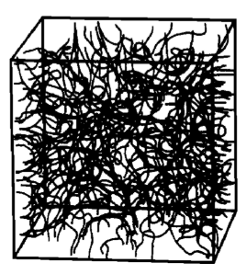
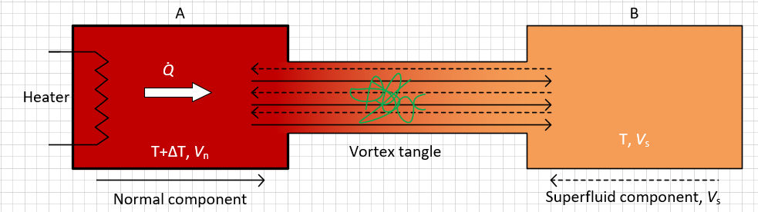
SF helium counterflow, quantum turbulence and vortex tangle
Phys. Rev. B 38, 2398 (1988)
Thermal counterflow: Due to heat dissipation in SF helium, a certain temperature gradient develops, causing the SF components to flow towards the heat source while the normal component flows away from it. Such a phenomenon, called thermal counterflow, is being used to study the properties of SF helium.
Quantized vortices and quantum turbulence: In a thermal counterflow, when the relative velocity of the components (V_{ns} = V_{n} - V_{s}) becomes larger than a critical velocity, the laminar flow turns into turbulent flow generating quantized vortex tangle. This phenomenon is known as quantum turbulence.
Drag Coefficient: Specifically, the two fluids behave somewhat like a single turbulent fluid, resulting in a drag coefficient similar to that in classical fluids. The drag force can be given as:

Slide 15
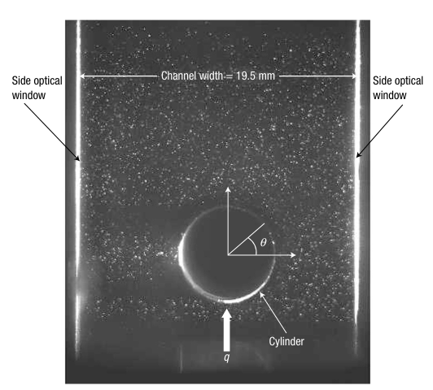
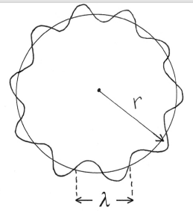
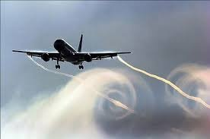
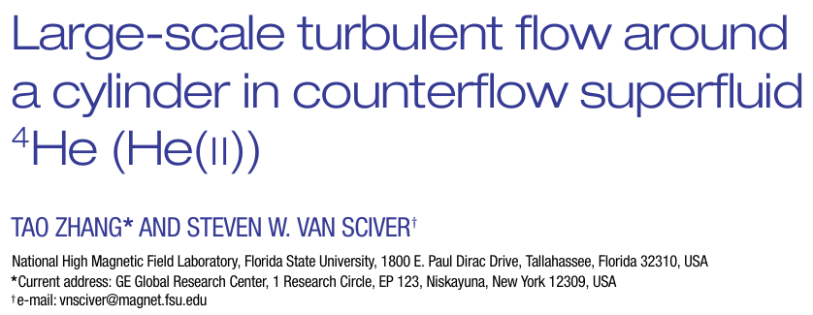
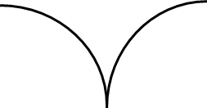

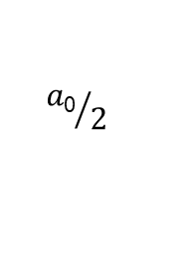
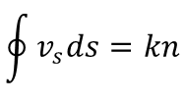
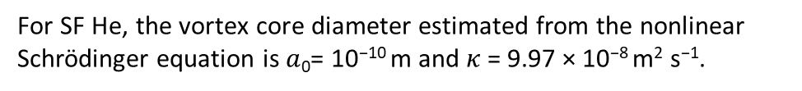





SF helium counterflow, quantum turbulence and vortex tangle
Similar to vortices in type-II superconductors, quantized vortices in SF He consisting of circulating superfluid component around a normal core.
$$J=ρ_{s}v_{s}+ρ_{n}v_{n}$$
$m_{s}v_{s}=p=h/$λ
$${a\text{0}}/2$$
$$\oint{v_{s}ds}=kn$$
$(n$ = 0,1,2…)
Quantum of circulation: $κ = h/m$
For SF He, the vortex core diameter estimated from the nonlinear Schrödinger equation is $a$₀= 10⁻¹⁰ m and $κ$= 9.97 × 10⁻⁸ m² s⁻¹.
Core size very small!!!
a₀= 10⁻¹⁰ m
$$ρ_{s}$$
$$v_{s}$$
Vinen et al., Quantum turbulence generated by oscillating structures, PNAS (2014)

