Slide 1
Curtain up for Open Access DESY’s Way
Quantum Universe Days 2025
Lisa-Marie Stein
Hamburg, 20 February 2025 https://bib-pubdb1.desy.de/record/623757

Slide 2
How to publish Open Access at DESY?

Slide 3
How to publish Open Access at DESY?
DESY Publication Guideline:
Publish 100% Open Access (Helmholtz Guideline)
Archive scientific Output in DESY Publications Database (PubDB)
Keep rights on figures and pictures
Use allocated funds economically
Ensure correct affiliations
Open Access (OA) Options:
Gold OA
Green OA
Hybrid OA
Library:
Final editorial work before OA release: Licenses, Publisher's Conditions, Author's Rights, DESY & Helmholtz
Your address for publishing issues! l.publishing@desy.de

Slide 4
How to publish Open Access at DESY?
Publish & Read/Transformative Agreements & Memberships:
ACS (American Chemical Society)
AIP (American Institute of Physics)
APS (American Physical Society)
CUP (Cambridge University Press)
Cornell Univ. arXiv
DEAL Elsevier
DEAL Springer Nature
DEAL Wiley
IOP (Institute of Physics)
Nature
Optica (Optica Publishing Group)
SCOAP³
The Royal Society London

Slide 5
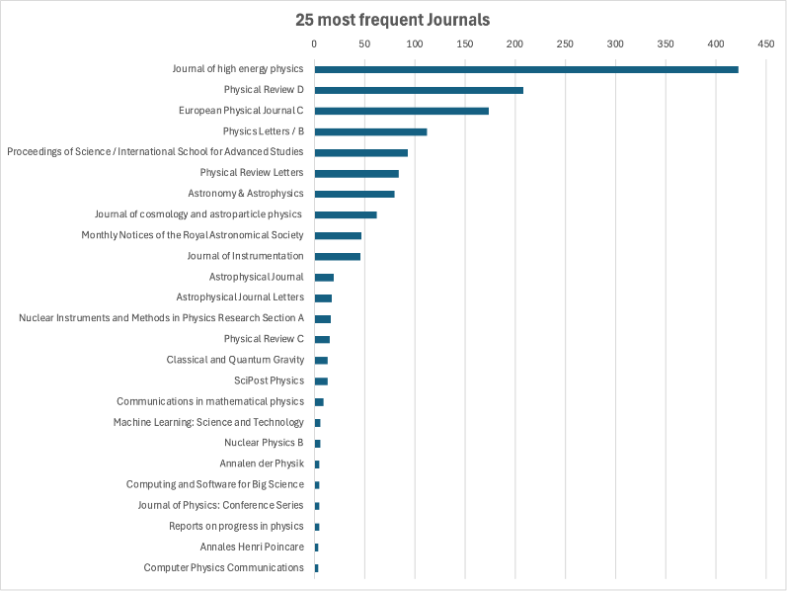
How to publish Open Access at DESY?
OA-Agreements & Quantum Universe:
Reference: Dr. Michael Grefe, Statistics from the research information system of the University of Hamburg

Slide 6
How to publish Open Access at DESY?
OA-Agreements & Quantum Universe:
Journal: | DESY Contract: | Open Access (DESY):
The Journal of High Energy Physics | SCOAP³
Physical Review D | SCOAP³/APS
European Physical Journal C | SCOAP³
Physics Letters / B | SCOAP³
Proceedings of Science/International School for Advanced Studies | / (→ gold)
Physical Review Letters | SCOAP³/APS
Astronomy and Astrophysics | / (→ Subscribe to Open)
Journal of Cosmology and Astroparticle Physics | IOP
Monthly Notices of the Royal Astronomical Society | / (→ gold)
Journal of Instrumentation | IOP
The Astrophysical Journal | / (→ gold)

Slide 7
How to publish Open Access at DESY?
OA-Agreements & Quantum Universe:
Journal: | DESY Contract: | Open Access (DESY):
The Astrophysical Journal Letters | / (→ gold)
Nuclear Instruments & Methods in Physics Research/Section A | DEAL Elsevier
Physical Review C | SCOAP³/APS
Classical and Quantum Gravity | IOP
SciPost Physics | / (→ gold)
Communications in Mathematical Physics | DEAL Springer Nature
Machine Learning: Science and Technology | IOP
Nuclear Physics B | SCOAP³
Annalen der Physik | DEAL Wiley
Computing and Software for Big Science | DEAL Springer Nature
Journal of physics: Conference Series | / (→ gold)

Slide 8
How to publish Open Access at DESY?
OA-Agreements & Quantum Universe:
Journal: | DESY Contract: | Open Access (DESY):
Reports on Progress in Physics | IOP
Annales Henri Poincaré | DEAL Springer Nature
Computer physics communications | DEAL Elsevier

Slide 9
How to publish Open Access at DESY?
OA-Agreements & Quantum Universe:
Journal: | DESY Contract: | Open Access (DESY):
Reports on Progress in Physics | IOP
Annales Henri Poincaré | DEAL Springer Nature
Computer physics communications | DEAL Elsevier
Result:
SCOAP³: 7x
IOP: 5x
APS: 3x
DEAL Springer Nature: 3x
DEAL Elsevier: 2x
DEAL Wiley: 1x
7x not within the contract portfolio, but OA-Journals

Slide 10
How to publish Open Access at DESY?
OA-Agreements & Quantum Universe:
Journal: | DESY Contract: | Open Access (DESY):
Reports on Progress in Physics | IOP
Annales Henri Poincaré | DEAL Springer Nature
Computer physics communications | DEAL Elsevier
Result:
SCOAP³: 7x
IOP: 5x
APS: 3x
DEAL Springer Nature: 3x
DEAL Elsevier: 2x
DEAL Wiley: 1x
7x not within the contract portfolio, but OA-Journals
Full Open Access Possibility

Slide 11
How to get informed?

Slide 12
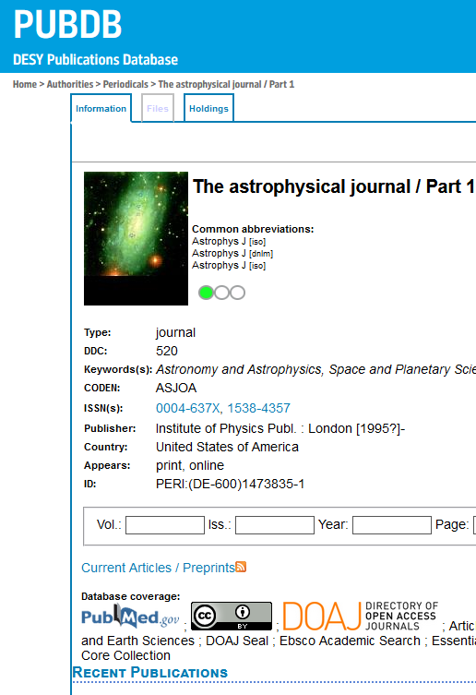
How to get informed?
First contact:
DESY Library Publishing Team, Bldg. 1d, l.publishing@desy.de
… about Open Access Journals:
Journals searchable in PubDB

Slide 13
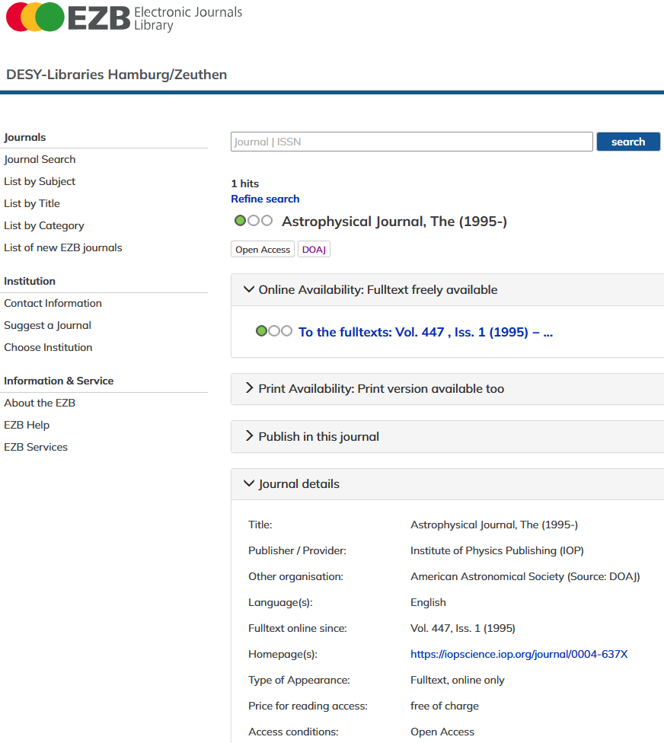
How to get informed?
First contact:
DESY Library Publishing Team, Bldg. 1d, l.publishing@desy.de
… about Open Access Journals:
Journals searchable in PubDB
Detailed information in the Electronic Journals Library (EZB)

Slide 14
How to get informed?
First contact:
DESY Library Publishing Team, Bldg. 1d, l.publishing@desy.de
… about Open Access Journals:
Journals searchable in PubDB
Detailed information in the Electronic Journals Library (EZB)

Slide 15
How to get informed?
First contact:
DESY Library Publishing Team, Bldg. 1d, l.publishing@desy.de
… about Open Access Journals:
Journals searchable in PubDB
Detailed information in the Electronic Journals Library (EZB)

Slide 16
How to get informed?
EZB publishing information
Information on secondary publication: Use important notes on how to provide your already published research results free of charge.

Slide 17
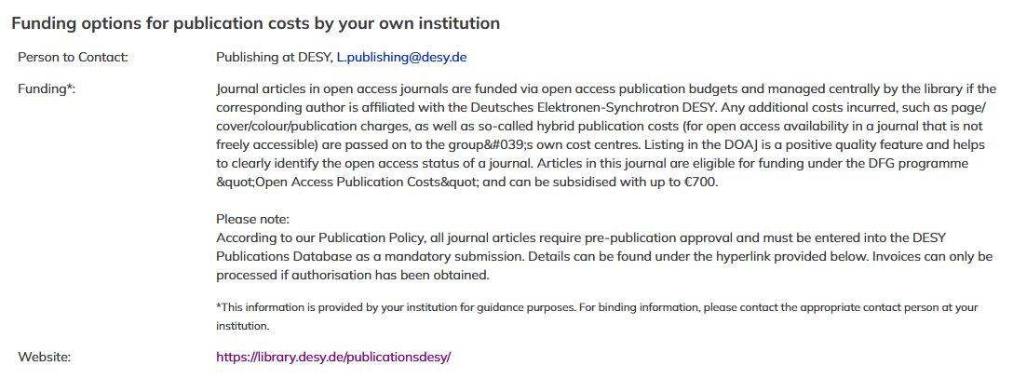
How to get informed?
EZB publishing information
Contact information: Get direct contact to your institution’s publication service and information on invoice processing.
Possibilities for grants: Find out about the funding options for publication costs at your institution.
Read further DESY-specific information, such as the required entry in PubDB and approval workflow.

Slide 18
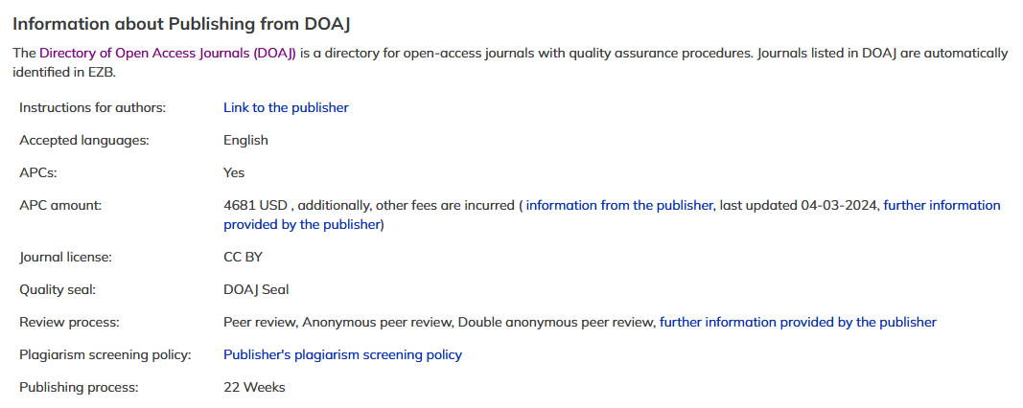
How to get informed?
DOAJ: quality feature, helps to clearly identify the Open Access status
EZB publishing information
Get journal-specific publishing details from the DOAJ, including information on:
• Article Processing Charges
• Link to submission guidelines
• Duration until publication
• Information on the review process
• License of the publications
• Accepted languages

Slide 19
How to get informed?
EZB publishing information
Find out the average publication costs actually paid for journals via OpenAPC.

Slide 20
How to get informed?
EZB publishing information
Take a flyer if you like!

Slide 21
How to finance a publication?

Slide 22
How to finance a publication?
Publication Costs
Submitting corresponding author’s institution pays
OA cost centers for Article Processing Charges (APC)
Additional costs & hybrid (not transformative) OA financed via group cost centres
Funding
Please always indicate third-party funding!
Excursus: DFG program Open Access Publication Funding

Slide 23
How to finance a publication?
Open Access Publication Funding
a program by the German Research Foundation (DFG)
Open Access publication?
DFG (co-)funded research? (does NOT have to refer to the Corresponding/First Author)
DFG project entered as “Grant” in the DESY PubDB?
If yes, collect €1400!

Slide 24
How to finance a publication?
Requirements
A publication can receive the DFG funding EXCLUSIVELY if ...
it is a publication in quality-assured Open Access publication organs or within the framework of OA Transformation Agreements.
at least one of the authors is funded by the DFG and the corresponding funding is mentioned in the Funding Acknowledgements.
it is guaranteed that an Open Access book is associated with DFG project funding (funding amount up to € 5000).
the Corresponding/First Author is affiliated with DESY and required to pay.
the DFG grant is entered in the corresponding field of the PubDB mask when applying for approval to publish.

Slide 25
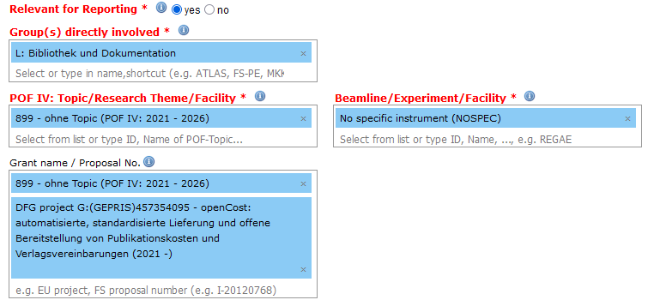
How to finance a publication?
How do I enter the grant in PubDB so that my publication is funded by the DFG?
publication
approval
Select the DFG grant in the corresponding field of the PubDB mask in the preliminary PubDB entry when applying for an approval.
Identifiable by project number, title, runtime
If this entry is missing, the DFG funding cannot be credited!

Slide 26
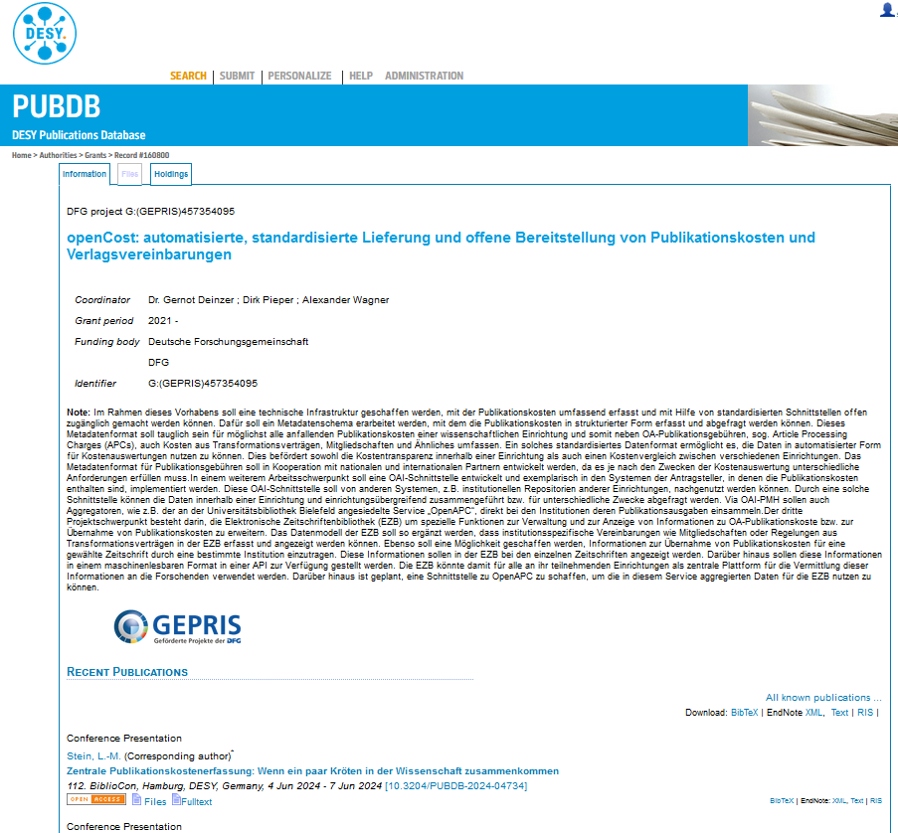
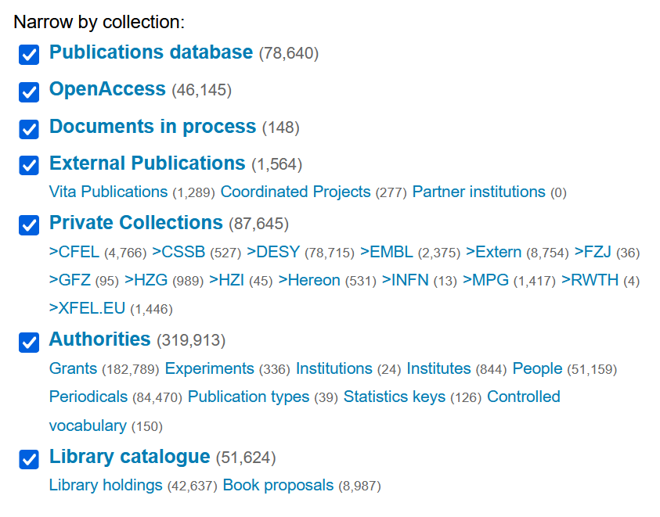
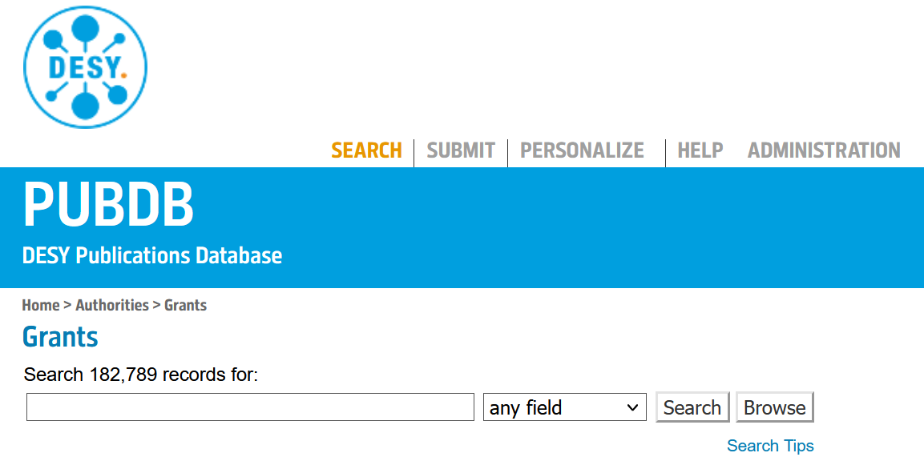
How to finance a publication?
Where can I find detailed information (including the project number) about the DFG projects?
GEPRIS Database:
The GEPRIS database contains all DFG projects and provides information on projects, researchers and institutions: https://gepris.dfg.de
PubDB:
The projects can also be searched through in the PubDB by clicking on ‘Grants‘:

Slide 27
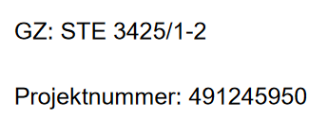
How to finance a publication?
What must be written in the Funding Acknowledgements?
According to DFG (01/2024): Funding Guidelines General Terms and Conditions for Funding Agreements with the Deutsche Forschungsgemeinschaft e.V. (DFG, German Research Foundation), p. 43, 13.1 Publication requirement:
„Project results which ensue from DFG-funded projects must be made accessible to the general public in a suitable manner. The publications must contain a reference to the DFG funding (so-called "Funding Acknowledgement") in the following form:
“funded by the Deutsche Forschungsgemeinschaft (DFG, German Research Foundation) – project number(s)”.
In other language publications, a translation should be added in the target language. In German, the following acknowledgement is to be used: "Gefördert durch die Deutsche Forschungsgemeinschaft (DFG) –Projektnummer(n)".
The project number of the referenced project can be found in the award letter or in the GEPRIS project information system. gepris.dfg.de. If a publication refers to several projects the numbers must be separated by a semicolon.”
Fun fact: The project number is not the GZ (= Geschäftszeichen). It is an integer:

Slide 28
Planning completed. How to submit a publication and generate payment?

Slide 29
How to submit a publication and generate payment?
Workflow
Every publication requires the approval by the Directorate/Delegate
Invoice payment only if approval has been obtained
Overall process centralized in library (We improve cost control and transparency by adjusting the structure of financing flows)
Submit preliminary entry → select form “Approval of Scientific Publication” and get approval → publish → costs paid by library and finance department

Slide 30
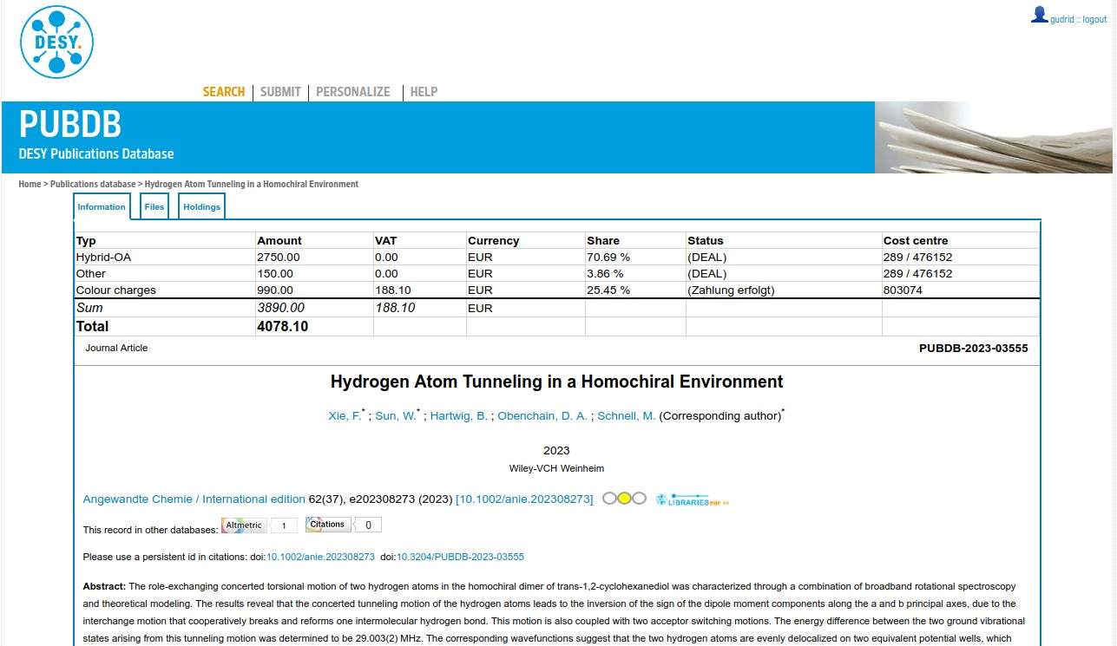
How to submit a publication and generate payment?
Cost documentation and transparency in PubDB
Display after login
Informed authorship!

Slide 31
Together for more transparency and fair science

Slide 32
Together for more transparency and fair science!
Why all this effort?
Informed authorship
Informed publishing sector (authors, publisher, librarians …)
Improved infrastructure and information offers
OA project openCost: Automated, standardized delivery and open provision
of publication costs and publishing agreements (cf. www.opencost.de)
FAIR conditions
No commercial control of science and steering of its topics
Scholar-led and community-driven publishing and decisions
More visibility and science in the public eye
Let’s stay together for an open, fair and transparent scientific landscape!
Thank you for your cooperation!

Slide 33
Thank you!
Questions? Please also contact l.publishing@desy.de
Lisa-Marie Stein
Library and Documentation
lisa-marie.stein@desy.de
0000-0001-7905-0462

