Slide 1
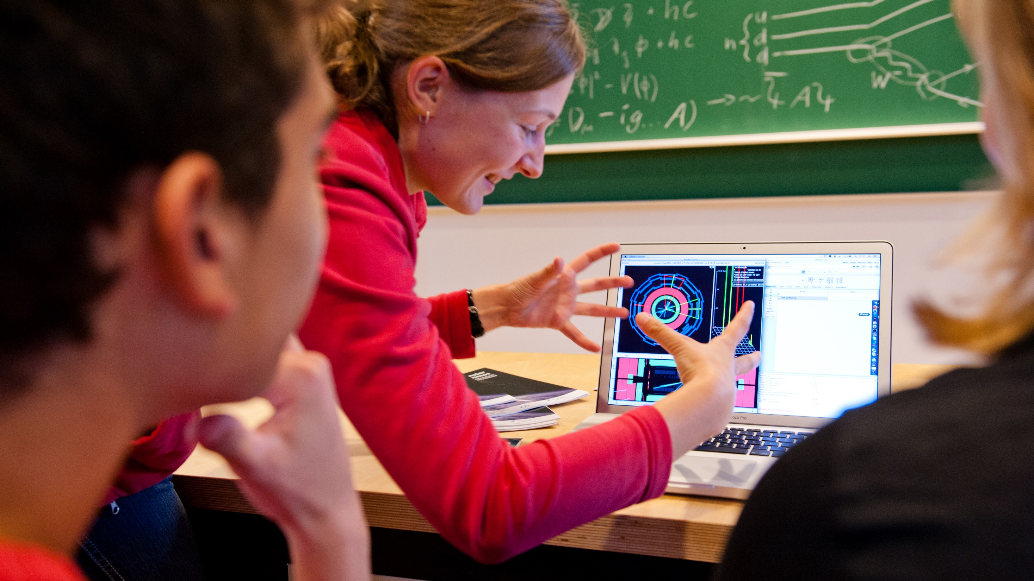


Netzwerk Teilchenwelt
Uta Bilow, TU Dresden
Introduction to the Terascale School ǀ March 18, 2025

Slide 2
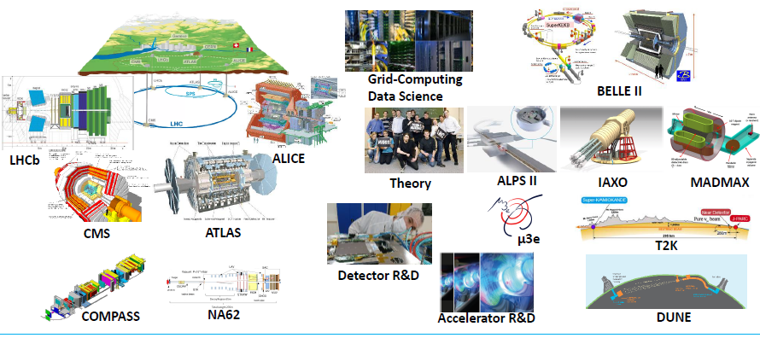
Particle Physics Research in Germany

Slide 3
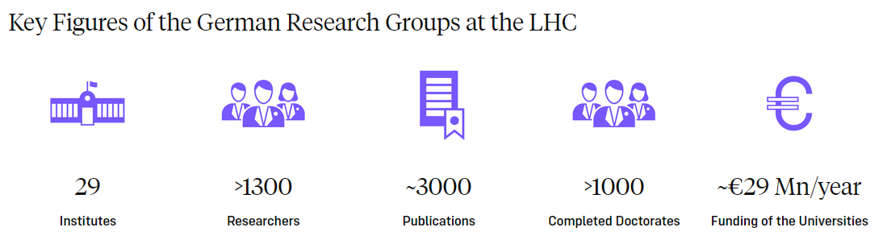
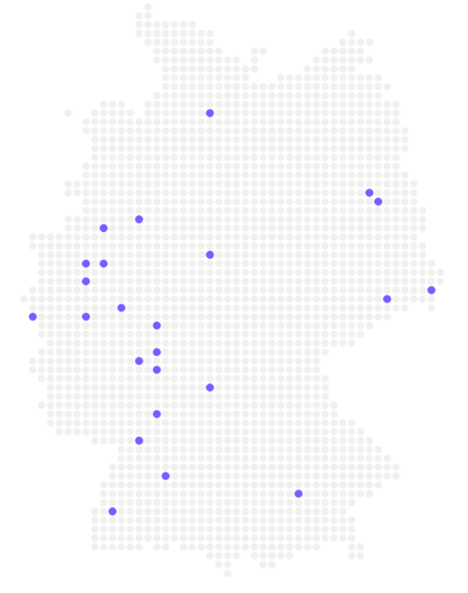
Particle Physics Research in Germany
> 20 universities
2 MPI
DESY
States BMBF DFG MPG Helmholtz-
Gemeinschaft
Source: https://lhc-deutschland.de/lhc_deutschland/index_eng.html#e225

Slide 4
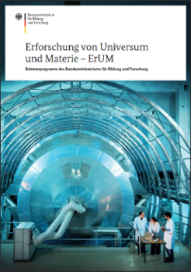
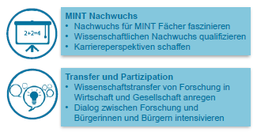

BMBF Research Program ErUM (Exploration of Universe and Matter)
Particle Physics Research is funded in framework program (10 y) ErUM
4 fields of action
Large Scale Facilities
Networking
STEM young scientists
Transfer & participation
→ Outreach is an integral component of research

Slide 5
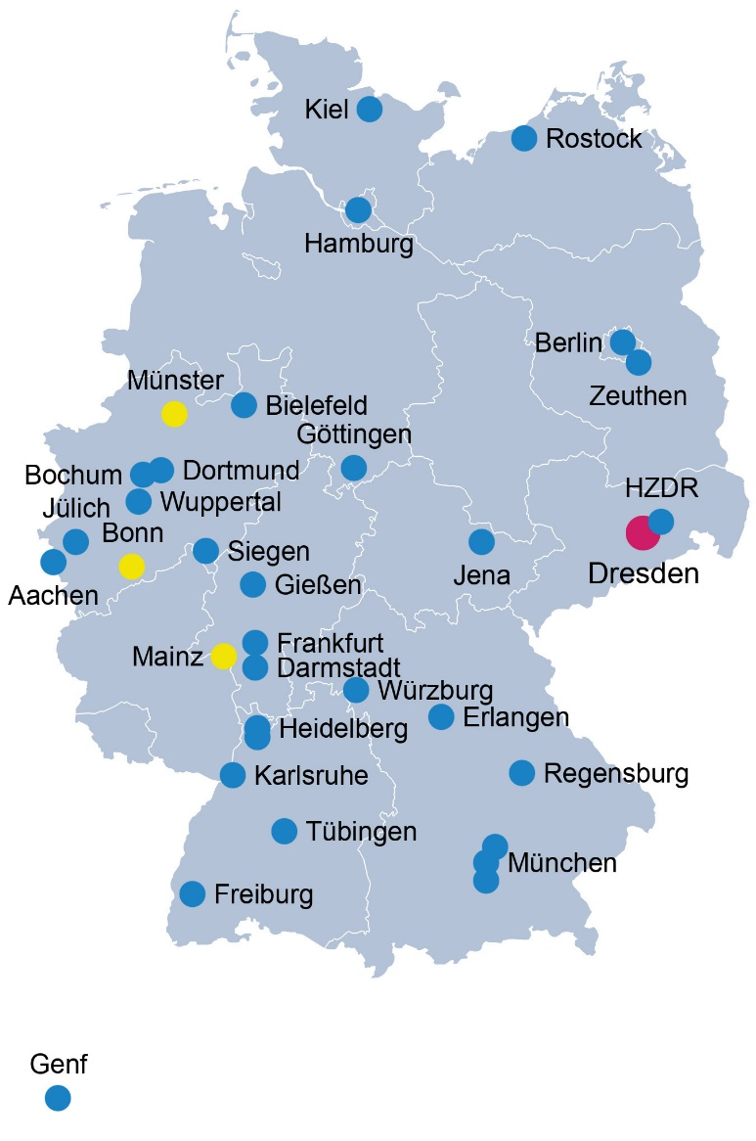
Actors in Outreach
Individual universities /research labs
Variety of local activities (Long Night of Science, Open Days, Physics on Saturday, Children´s University, School Lab, etc.)
Netzwerk Teilchenwelt
Joint outreach for “particles” as a visible and established brand
Bundle existing outreach activities
Share programs, structures, materials for outreach
Whole field of smallest particles (Particle Physics, Astroparticle Phyics, Nuclear and Hadron Physics)
High visibility and impact
Network of 34 universities/research labs (Standorte) + CERN
136 groups signed Letter of Interest
Contact person at each “Standort”
Lead by TU Dresden , 3 hubs at Uni Bonn, Uni Mainz, Uni Münster
Target groups: High school students, teachers, young students (Fellows), broad public

Slide 6
Our objectives in Netzwerk Teilchenwelt
Tell people (high school students) what our work is about
Provide insight into the process and organization of research
Present role models
Inspire young talents
Promote young scientists (e.g. science communication)
Intensify dialog between research and citizens

Slide 7
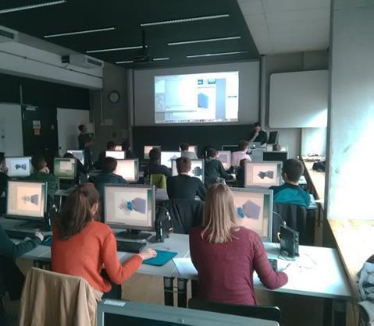
Masterclasses
Project day in school or university or online
International Masterclasses, International Day of Women and Girls in Science
Talks and Q&A with researchers
Own measurements and analysis of original data
Diverse set
ALICE, ATLAS, CMS, LHCb
Belle II
Machine Learning, Numeric (Planetary Orbits)
Hadron Therapy
Nuclear Astrophysics
IceCube, Auger, Cosmic@Web
High school students do research supported by young scientists
© Sebastian Neubert

Slide 8
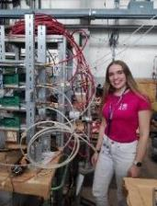
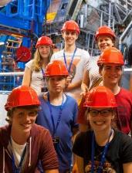
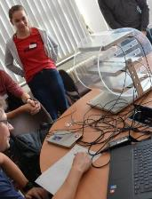
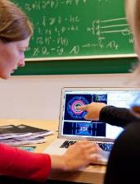
Masterclasses – first level of a multi-step program
CERN project weeks*, research projects at institutes
List of 156 essays, incl. 46 awards
CERN workshops*, Particle physics academy in Mainz
Active engagement, detector projects
Masterclasses
15
High proportion of women on higher levels
50% female
75
Female share in physics exams 2023:
22% Bachelor
25% Master
22% PhD
250
3500
Number of students per year
* currently suspended due to funding cuts

Slide 9
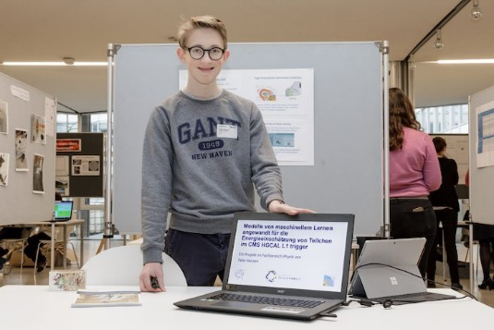

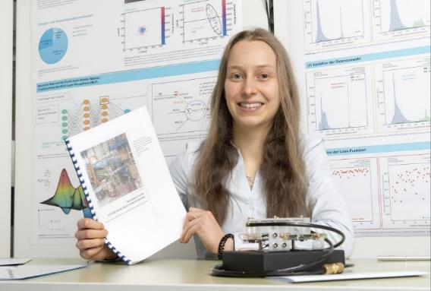
Own research projects: examples
Deep Learning Models for Energy Estimation in CMS HGCAL L1 Trigger (Felix Hansen)
First data classification at the InGrid detector at the CAST experiment using deep learning (Carolin Kohl)
The AWAKE experiment (Björn Dörschel)
The effects of radiation on the CMS pixel detector (Katharina Ploog)
Machine-learning based identification of highly collimated electron pairs from boosted Z boson decays (Sophia Veneris)
© FZ Jülich / Ralf-Uwe Limbach
© Wirtschaftsjunioren NRW

Slide 10
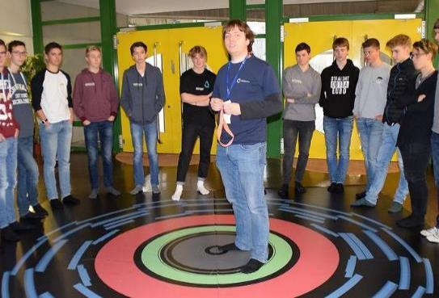
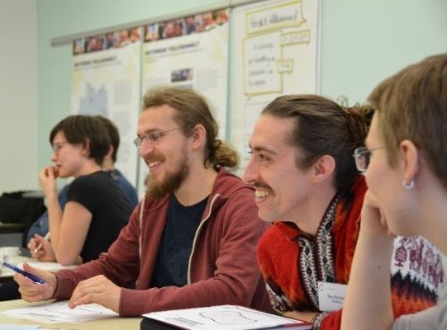

Facilitators („Vermittler:innen)
150 PhD and Master students (you! ☺)
guide Masterclasses, supervise students´ research projects
yearly science communication and outreach training
Next Workshop planned for Nov 2025 in Bad Honnef, in English
Frequent (online) onboarding events
get central reimbursement of expenses and travel cost*
Acquire soft skills, for personal and professional development.
experience interest in own research
practice supervision
ATLAS Masterclass in Bonn
Outreach workshop in Fulda
* currently suspended due to funding cuts

Slide 11
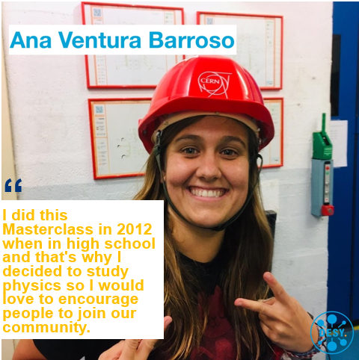
Inspire the next generation of scientists
Survey 2025 among young physicists/students in HEP:
„While visiting high school, I attended offers from Netzwerk Teilchenwelt.“
Result from survey 2024:
38% of PhD students guiding Masterclasses attended a Masterclass as a high school student
64 persons. age <36 years; highest grade = BA, MA or PhD; high school in Germany

Slide 12


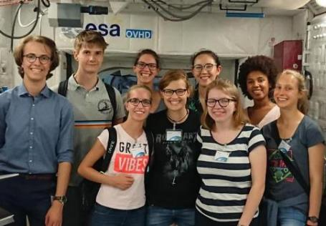
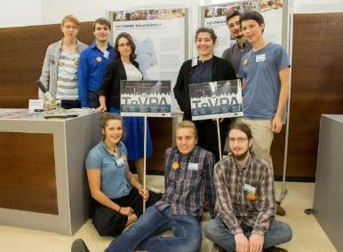
Fellow program
170 people, 50% female
Mainly alumni of CERN workshops
Now often studying physics or shortly before that
→ Close connection between highly motivated students and research groups
Central offers: Fellow physics schools (HEP, detectors), “Ask the expert“ lecture series (online)
Local offers: internships, excursions, invitation to outreach events, colloquia, regulars´ table, etc.
SCHOOL
RESEARCH GROUPS
© Saskia Plura
© DESY by Ashley Jones

Slide 13
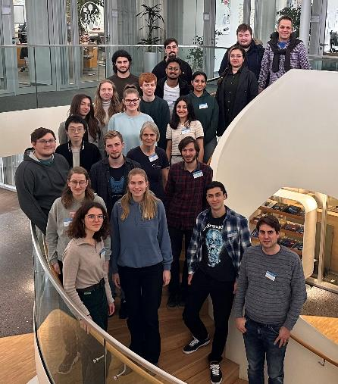
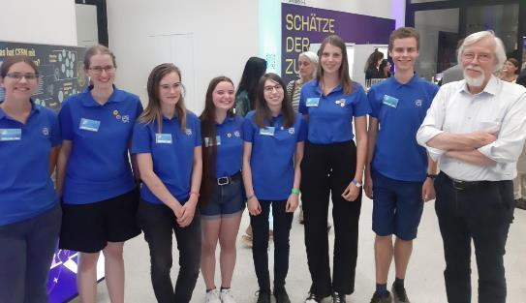
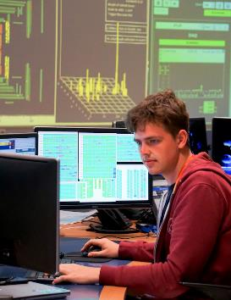
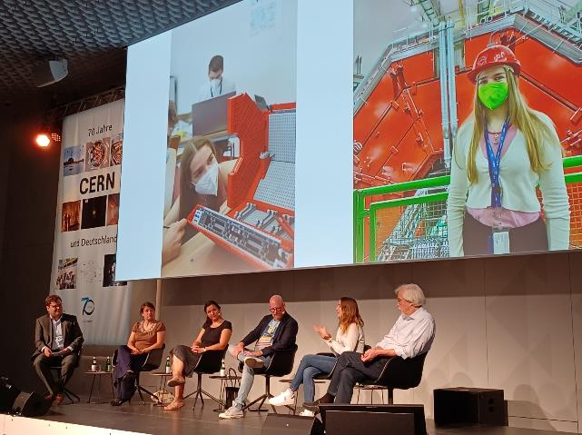
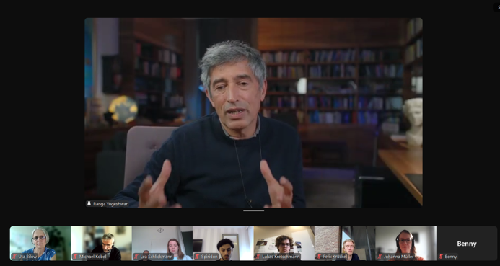
Fellows in science and outreach
School Introduction to the Terascale for Fellows and B.Sc.students
Fellows at CERN70 in Berlin helping as guides
Fellow Lukas: From internship to authorship ATLAS blog
Fellows invite prominent speakers for Ask the expert: Ranga Yogeshwar, Reinhard Genzel...
Fellow Julia Els in panel discussion at CERN70 LinkedIn

Slide 14
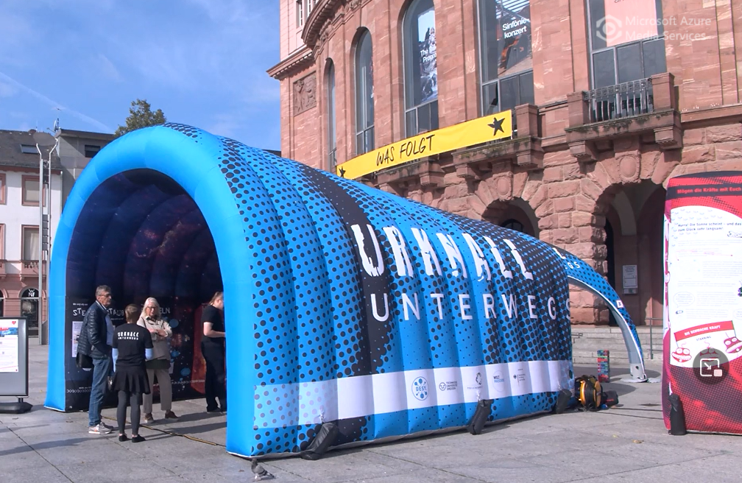
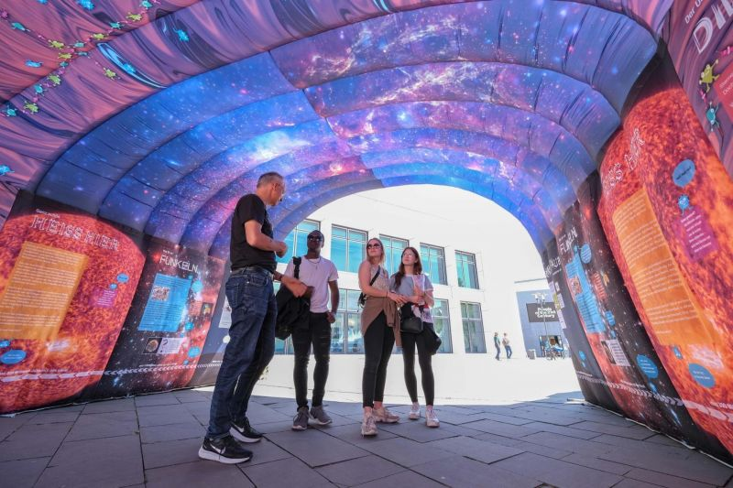
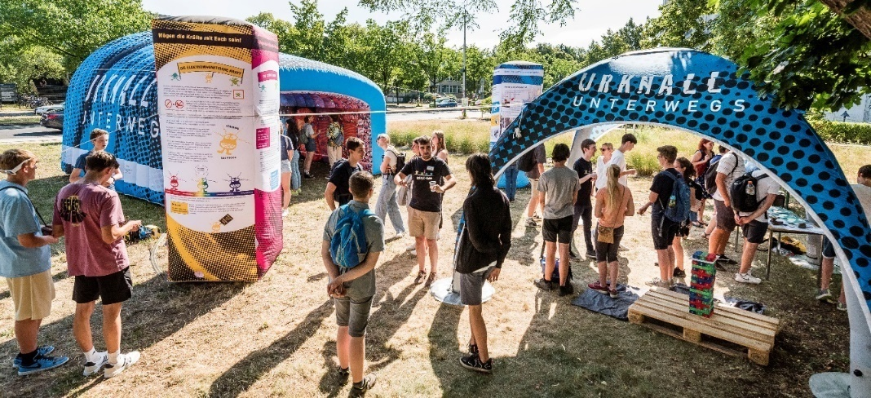
Mobile Exhibition: Urknall unterwegs
Pop-up exhibition on particle physics
Target audience: general public, people with less affinity for science
Shown in public places (market place, pedestrian zone, …)
Tunnel: time travel through the history of the universe
2 Elements: Interactions and particles, Research methods, spin-offs
Pavilion with games (Particle Twister, Particle Yenga, Lego building blocks)

Slide 15
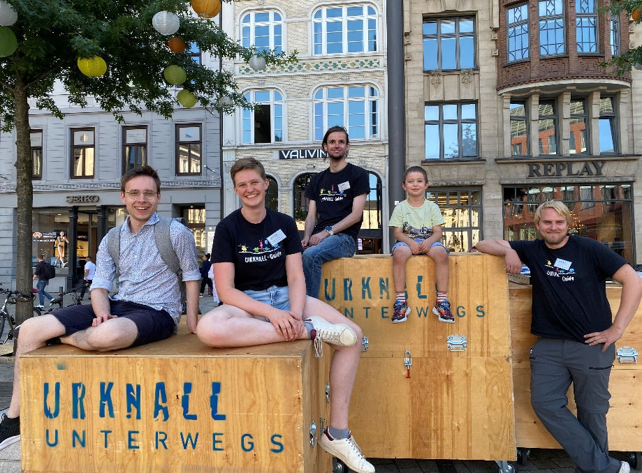
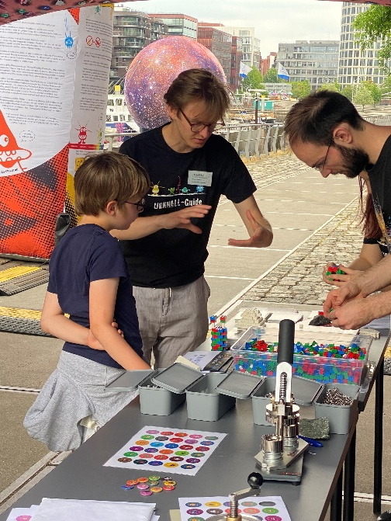
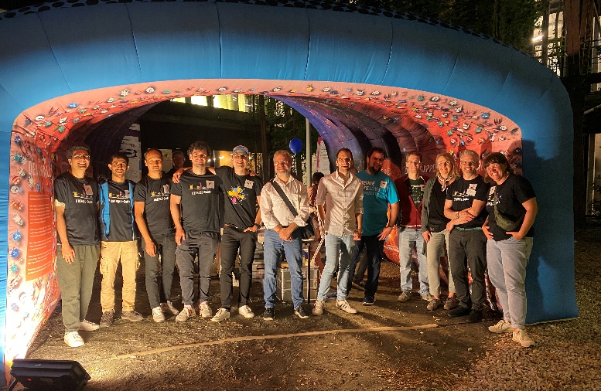
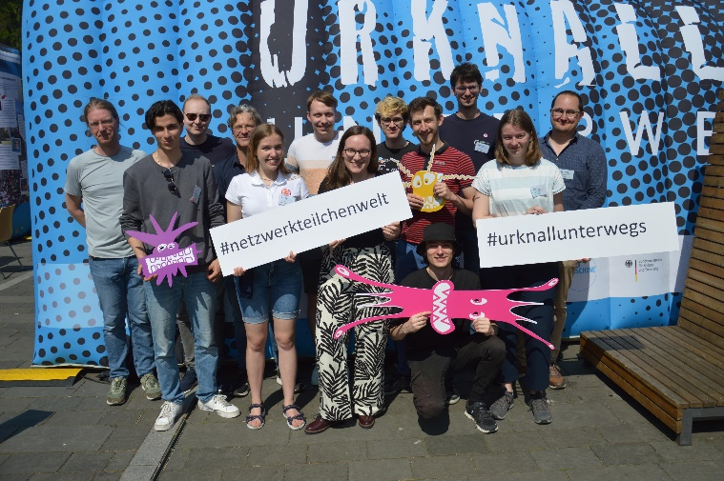
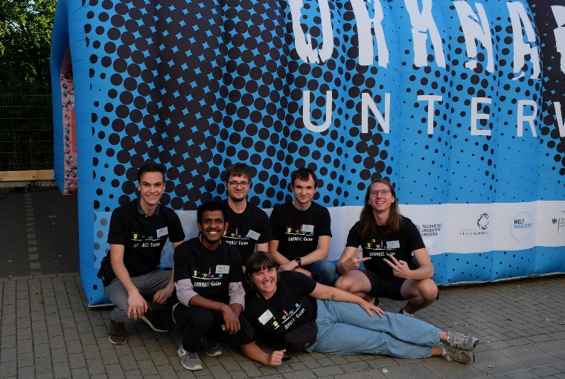
Urknall unterwegs: Urknall Guides
Students and Fellows from universities
arouse interest
convey pyhsics content
supervise games
Team effort

Slide 16
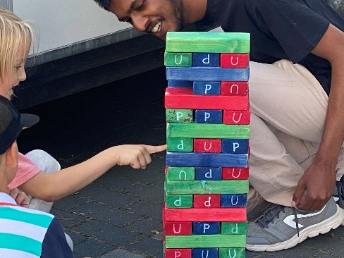
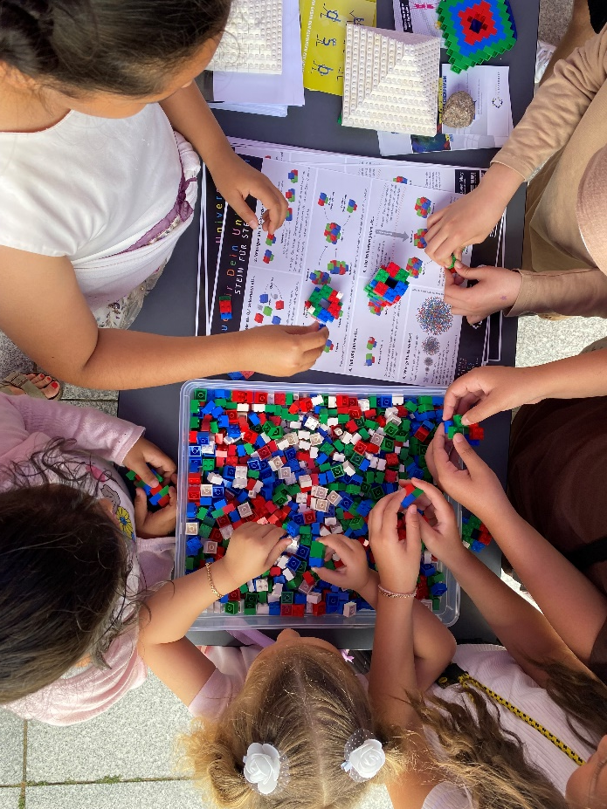
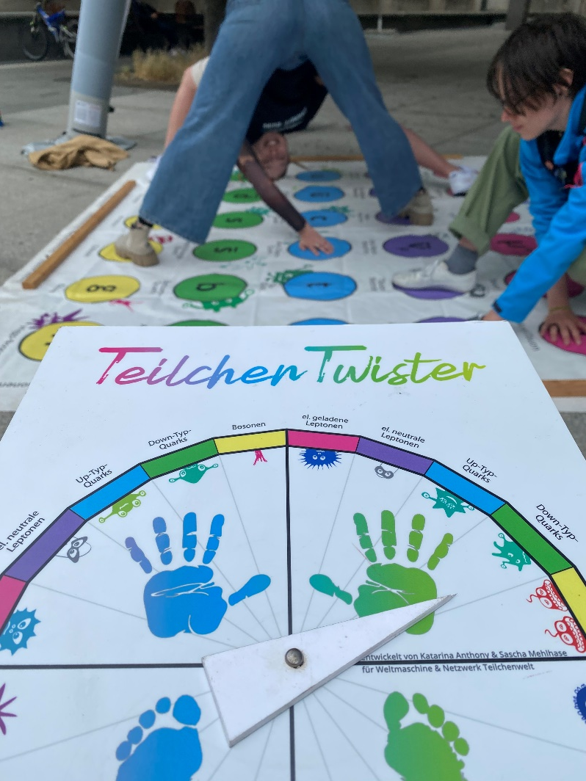
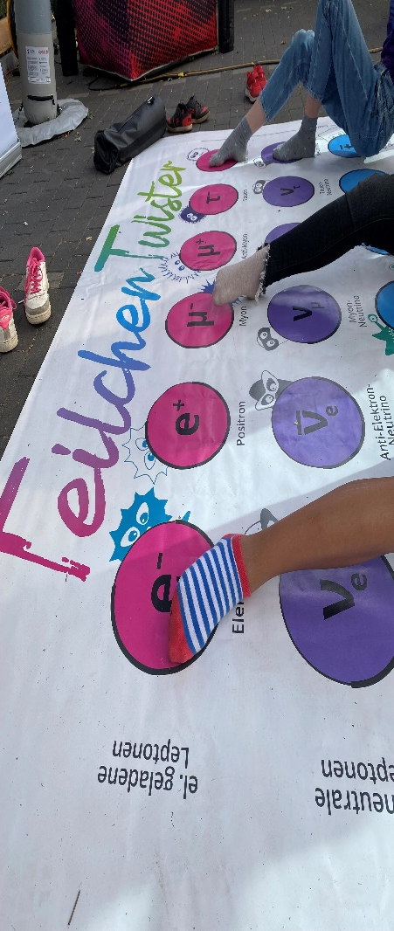
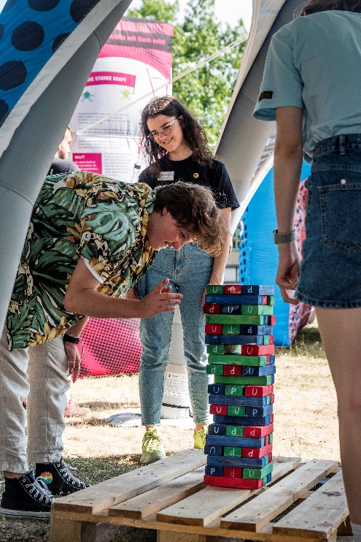
Urknall unterwegs: Interaction parts
Lego Quark-Tower (Jenga) Particle-Twister

Slide 17
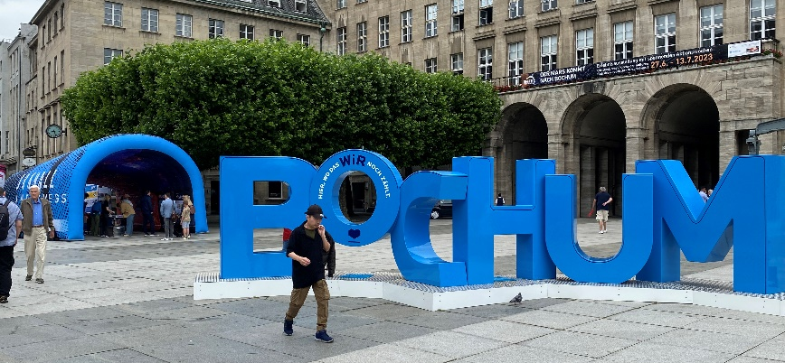
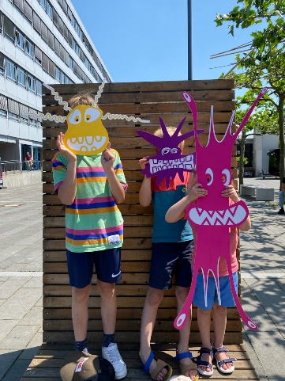
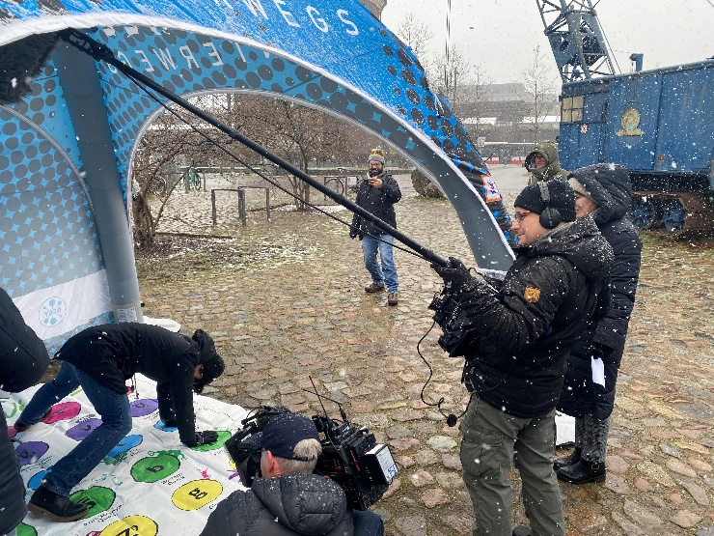
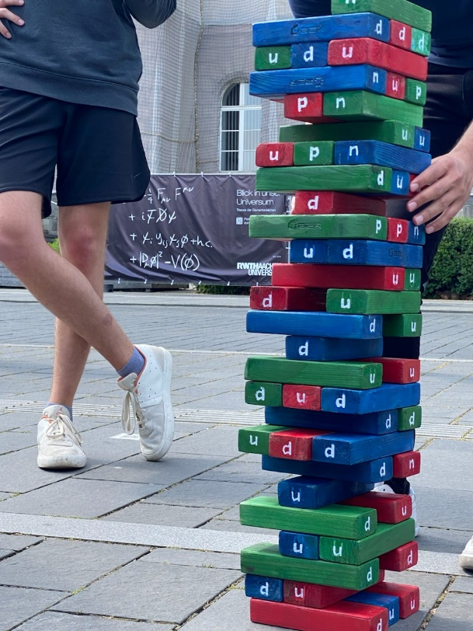
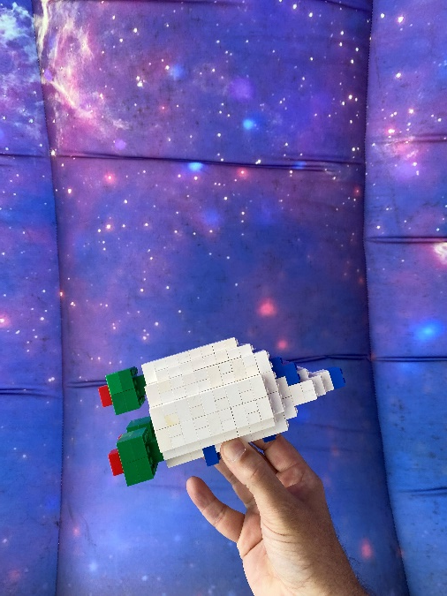
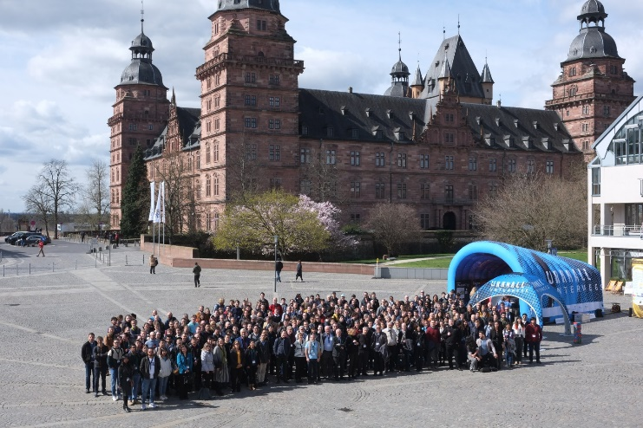
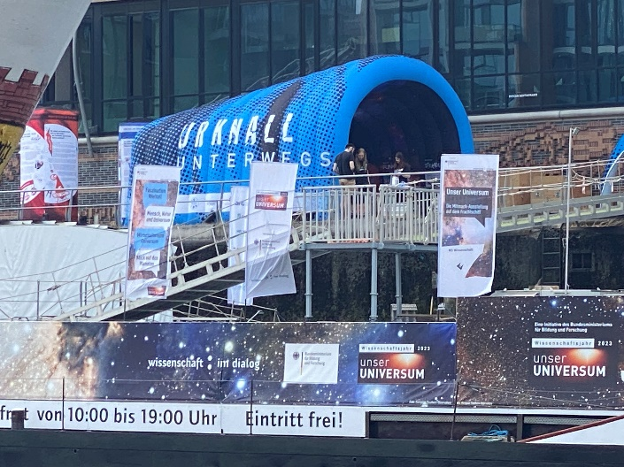
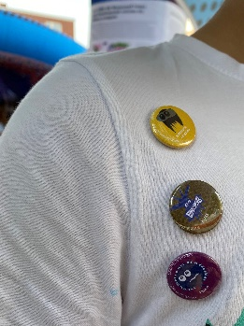
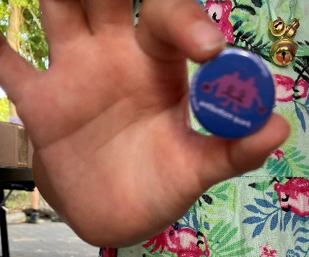
Urknall unterwegs: Review 2022-2024
See also https://www.teilchenwelt.de/angebote/urknall-unterwegs/stationen/

Slide 18
Summary
Outreach is integral part of our research … and increasingly important for your career − be it for scholarships, grant applications or appointments
Informing the public is our duty as scientists
Inspiring the next generation is an important task
Outreach brings personal benefit
Lots of opportunities to engage, well-structured outreach programs, diverse set of activities, professional support
Existing programs and structures create multiple benefit
win for high school students: experience modern research first-hand
win for (PhD) students: train their communication skills, participate in a rewarding activity
win for physicists: get young talents for the research groups

Slide 19
How to get involved and stay informed
Register at https://www.teilchenwelt.de/aktuelles/newsletter/ (Vermittler:in)
Follow us on social media (insta / facebook)
Contact your local Standort-Kontakt
to be found at https://www.teilchenwelt.de/ueber-uns/standorte/
Frequent onboarding events (English)
Next event: tbd, all events at https://indico.cern.ch/category/18177/
Netzwerk Teilchenwelt training courses on communication, didactics, presentation (general soft skills, pitching your research to non-experts)
Next event: Nov 2025, Bad Honnef, English workshop (if funding application successful)
More info at https://www.teilchenwelt.de/info-fuer/forschende/vermittlerin-werden/

