Slide 1
Where are we with SciCat @DESY?
Updates, status reports and involvements: PP and DDD.
Regina Hinzmann
Hamburg, 28.10.2024

Slide 2
P10 Follow Up
since Moras presentation last week
Major points to get scicat instance up at P10 :
Ingestion part by Jan K
  started scicat ingestion at P10, now P10 scientists need to define what should go in.
  found an error due to renaming of the instance which has been fixed (ingest also prosposalIDs)
IT part by Johannes R: solved error at login and keykloak forwarding
Mora and Fabian W work to
  get their desired meta data in (key parameters are transmission and exposure times), iterating with the users to fix a first draft of meta data.
  produce a schema in LinkML in order to fit into automatic data validation (in contact with resp. P08 person, Philipp Jordt)

Slide 3
P08 visit outcome
2024-10-16 during CAU (Kiel) beamtime
P08 SciCat misses some features to be really useful to them so they actually use it.
They want to identify certain datasets/scans that form e.g. a “reflectivity” or a “time scan”, consisting of SciCat datasets, ie several nexus or fio files (several points in a measurement plot). A button to group these files and a possibility to tag them would be great.
Then, for publication, several such reflectivity pre-selected datasets if identifiable, they’d like be able associate them to the paper. Example: In a publication, they have 10 reflectivities and 3 time scans.
Functionality is desired to group already grouped datasets and tag those too, so they can find all associated datasets by seeing 10 + 3 entries and more details are shown when they select one of them.
Improved search functionalities:
  An AND combined query (==applying several filters) is missing in the scientific metadata. Example ScanCommand: can one enable queries by just selecting pattern of the fields in that ScanCommand? This has the potential to help significantly!
Ideally, one would be able to issue a DOI for these grouped datasets and download them.
big thank you to CAU team, in particular Svenja H and Bridget M

Slide 4
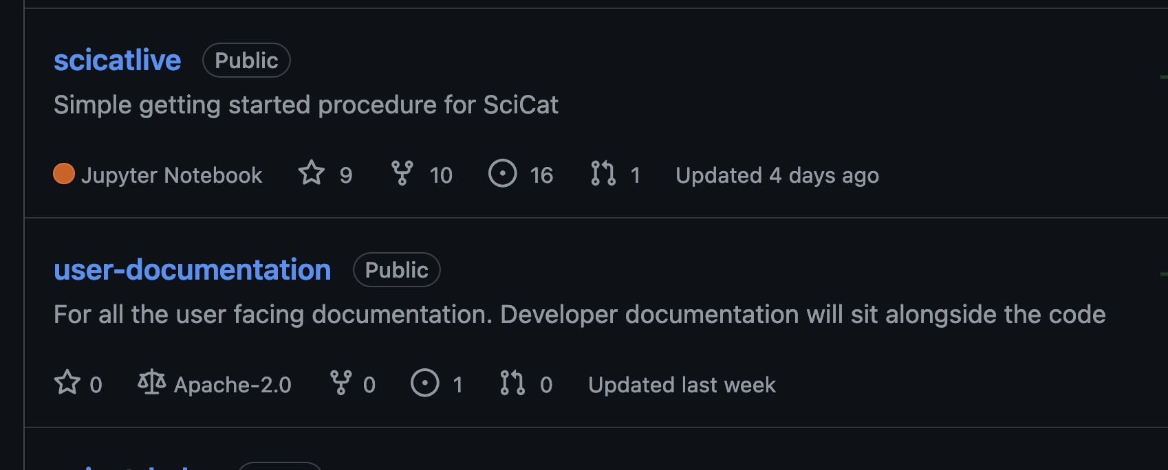
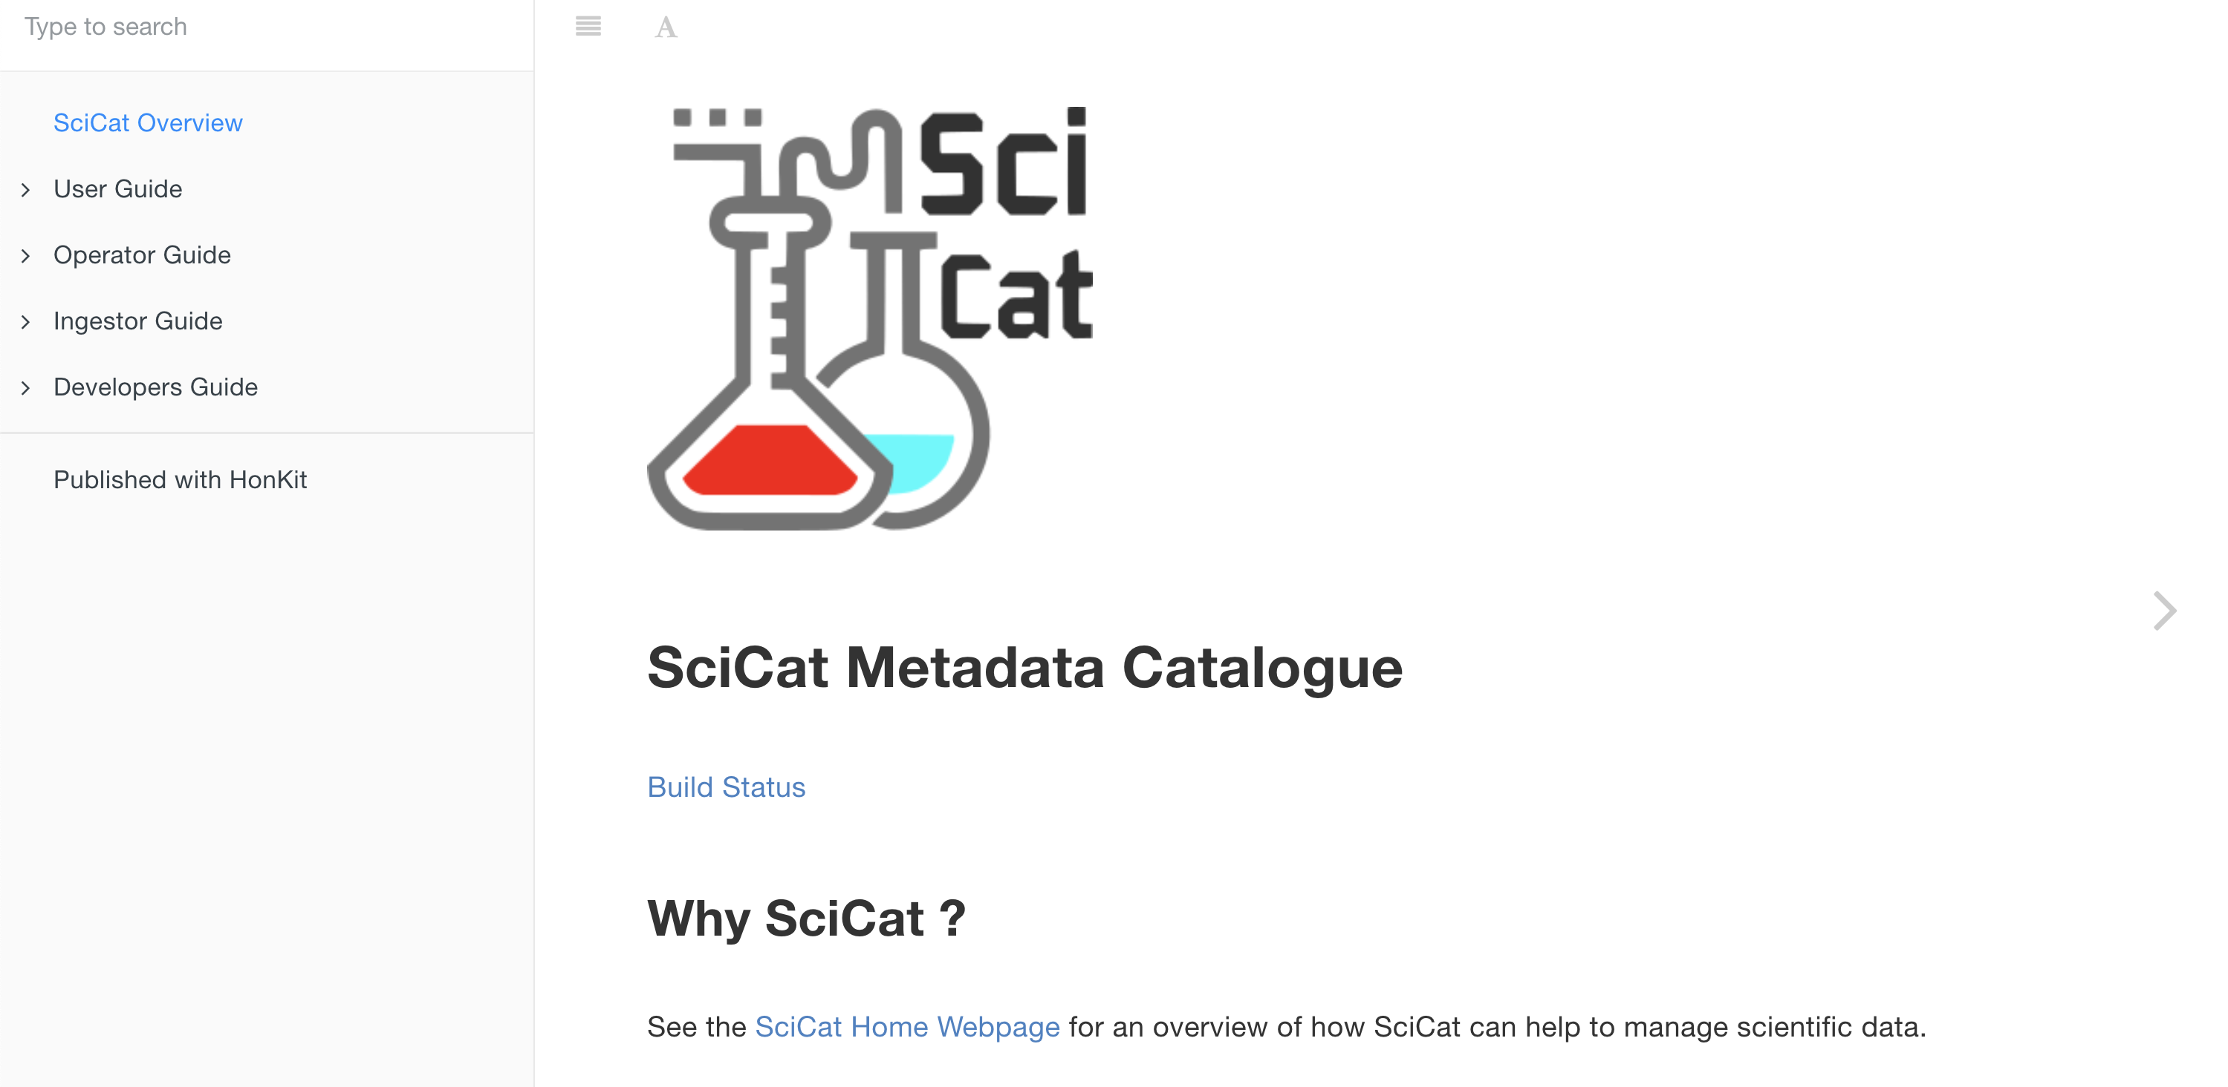
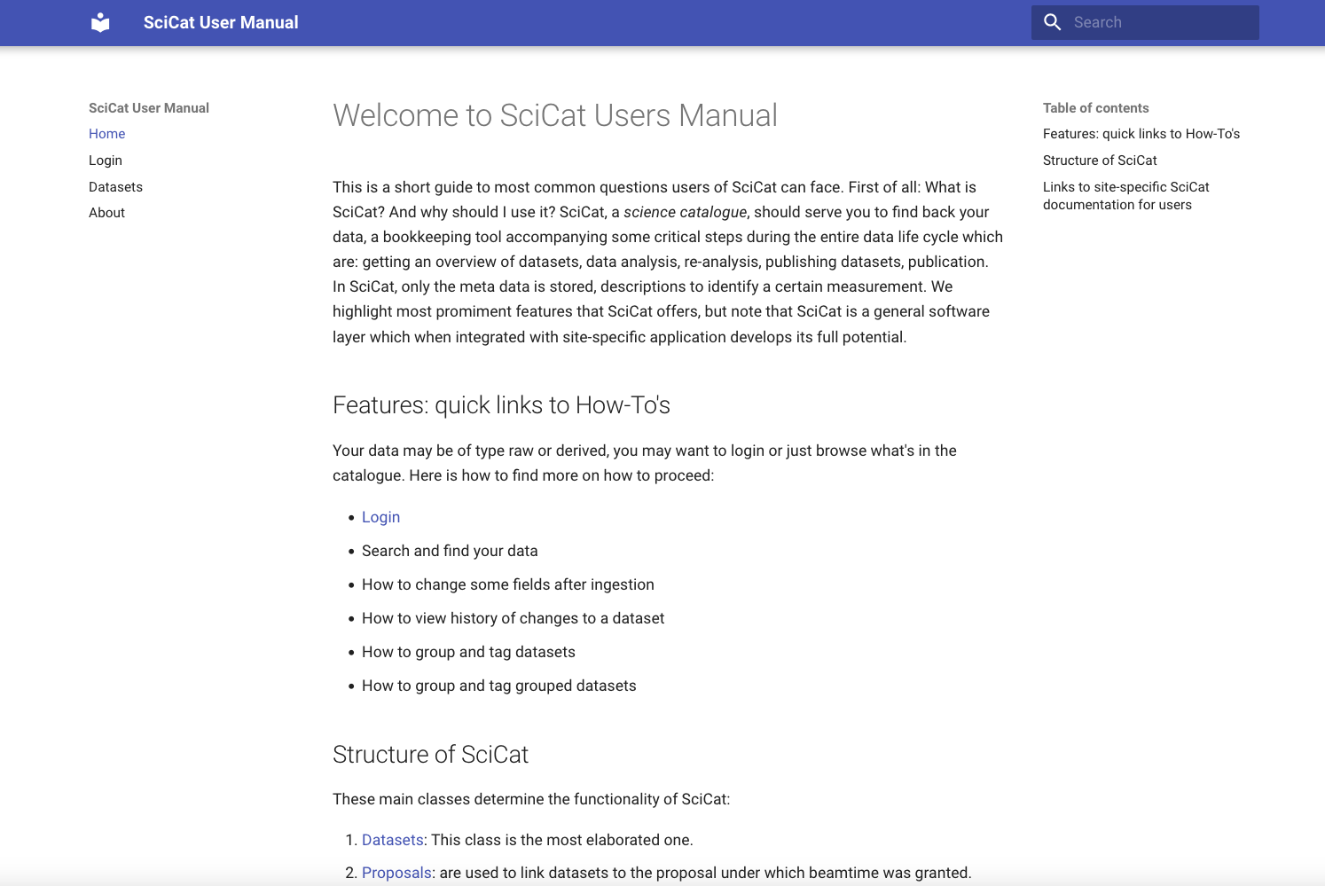
User documentation
Migration of official SciCat documentation for Users
Official User documentation: links are broken, page navigation broken, links to videos are broken, etc. Discussion started almost a year ago. Carlo did a great job to update documentation of scicatlive. Conclusion sofar: Have 3 categories of documentation: 1 User 2 Site-Admin/Operator 3 Developer.
repository in github
current view
local prelimary preview

Slide 5
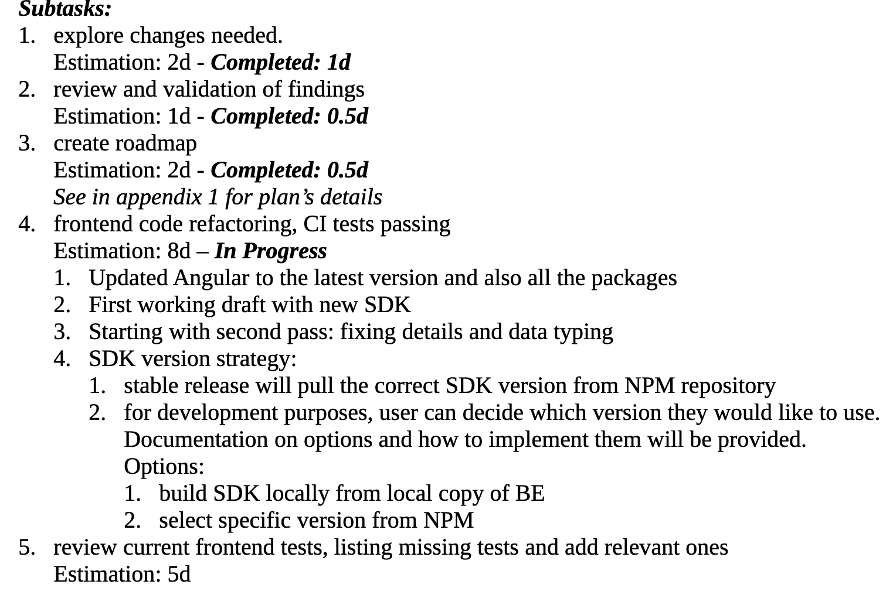
DAPHNE contribution to SciCat Development
first meeting with Max Friday
Plan was to start task 1 (18d),
see doc or agenda
Refactor frontend (FE) to use new autogenerated typescript SDK.
This will align FE to the current backend (BE) API code leveraging BE features and increasing maintainability. Produce stable release.
5 subtasks.
conclusion first week
- ahead of time wrt refactoring code
- tests to be defined (95% use cases, edge cases)

Slide 6
DOI status and plans
Since last report in pre-summer 2024
Several fronts:
Too big dataset for 1 DOI: with Johannes R we could reproduce the error, tried changing some configuration of the cluster, started trying ingesting to new scicat cluster where we can exclude disturbances from other processes. Need to do that more systematically.
Will meet Tim who started workflow of issuing DOIs with DataCite for his public datasets. Plan is to discuss the general workflow and setup how to design such a service using e.g. scicatlive. Evaluate other possibilities. Prototyping means for me
  We issue DOIs without direct data access, but providing info that data is available on request and details of contact
  We publish meta data of datasets of an entire beamtime first, without indicating which datasets are less useful while waiting for implementation of (-- as outcome of FS and L agreement)
      functionality to select and cluster a subset of datasets of a beamtime (user awareness condition of L)
      mapping more SciCat meta data fields according to DataCite (BE #1192)

Slide 7
Summary
Clear goal remains: DESY wants to offer a useful SciCat service to the user
Many fronts in working progress towards our goal
  probably there is much more behind the scenes I’m not aware of, esp. by FS/Linus P: need of regular exchanges.
  I experience good IT support (InFa, Systems, RIC).
DESY‘s involvement in SciCat developments is increasing
also pushed by DAPHNE involvement
  on-site travel forseen in cw 48 or 49 (between last and first week of this and next month resp.)
First ideas for 2025 features:
  Data access
  security of SciCat

