Slide 1
MAIA Neutron Studies Update

Slide 2
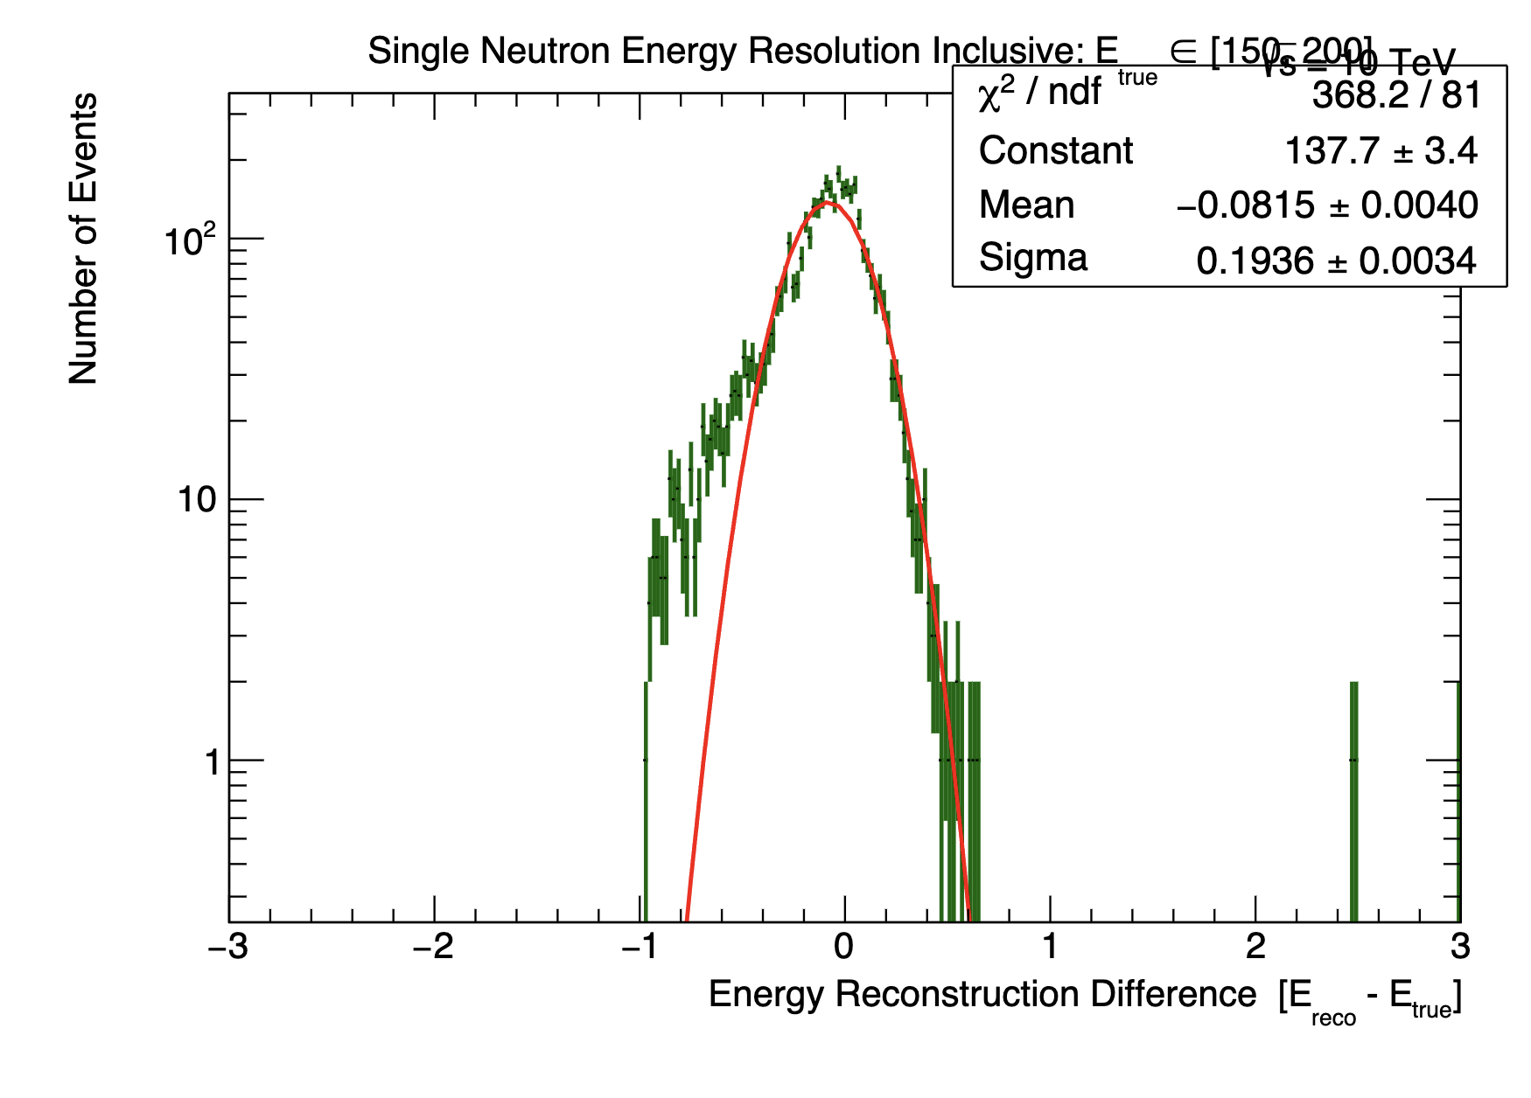
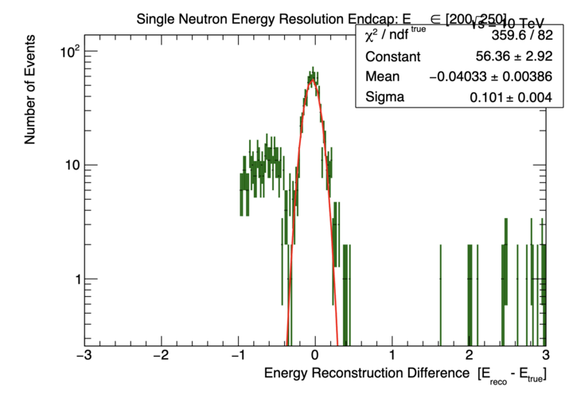
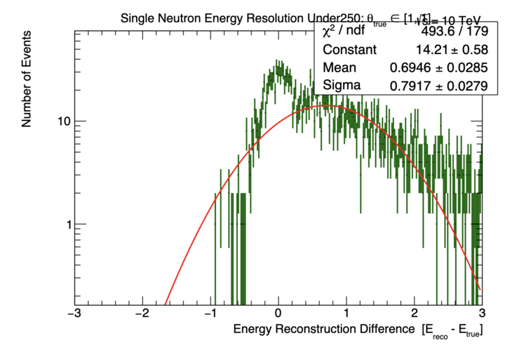
Non-gaussian fitting fix
New
Applying Tova’s suggestions
  Match all PFOs with energy > 5 GeV within dR < 0.1 of the generator neutron
  This fixes the bimodal distribution issue
  There is still some weirdness in the endcap and theta
Old

Slide 3
Energy resolution
There are still some minor fitting issues
  The new matching seems like a better approach
  Resolutions are pretty similar but more stable now and can go to much lower energies
New
Old

Slide 4
Energy response
New
Old
May need to recalibrate. Bad response at low E expected but is this ok?
Old
New

Slide 5
Efficiency
New
Old
High E decrease in efficiency seems strange to me
New
Old

Slide 6
Open questions
Moving forward:
  Should I apply a higher energy PFO cut?
    And also rerun with reco information (ensuring at least 1 neutron PFO is found)
  If I do rerun, should I create a calibration matrix?
  What is the paper timeline?
    I have the neutral hadrons section mostly done, but things will change with new results
  I am out of the country from the 22nd to the 5th so I wont be able to work as much

