Slide 1
Kick-off report to TA1 and TA2 DAPHNE members on DCS
DAPHNE4NFDI contribution to SciCat development
Regina Hinzmann u Nicolas Hayen (deputy)
Hamburg, 2024-11-04

Slide 2
SciCat development boost through left overs
How financial blessings are used
Bridget Murphy (CAU/DESY) spread the news to use unused project money early summer 2024.
We, the SciCat users (to-be site-admins, enduser), know about many missing features in SciCat.
A list of these features was drafted, consolidated, iterated to be workable and deliverable, esp. at NOBUGS.
This meeting is open to all DAPHNE members in concern (TA1 and TA2) and will take place on a regular basis.
Today is the first of its kind and the frequency‘s to be seen. For 2024 we plan another one in December on 16th, same hour and place.
If this is really not managable get in touch and we‘ll find a solution.
Our goal is to have SciCat used to its full potential and help each other to attain this goal! Please use this forum to talk to each other. Me and Nicolas will do our best to help out.
We benefit extremely from ESS experiences why we think SciCat is a good (only) solution in many ways.

Slide 3
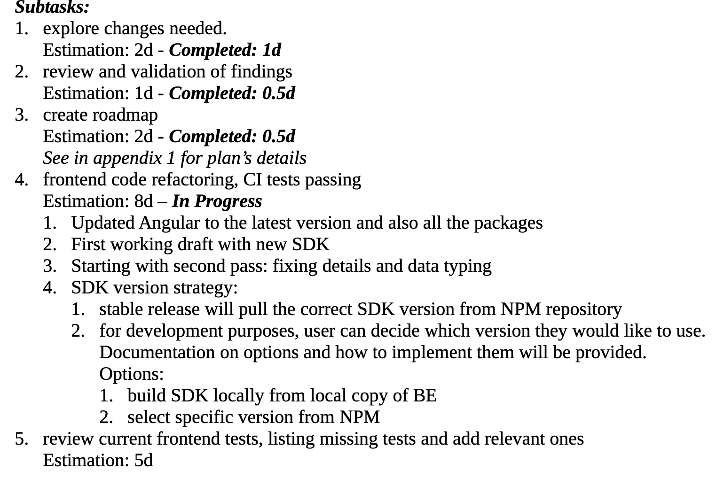
DAPHNE contribution to SciCat Development
first weekly meeting with Max Friday 2024-10-25
Plan: start with task 1 (18d) Refactor frontend (FE) to use new autogenerated typescript SDK. This will align FE to the current backend (BE) API code leveraging BE features and increasing maintainability. Produce stable release.
5 subtasks.
Conclusion first two weeks
ahead of time wrt refactoring code
refactoring task is wide, but synergies between Martin and Jay, make work highly efficient (4 PRs)
SDK demo scheduled next Friday (2024-11-08)
Next: tests to be defined (95% use cases, edge cases)

Slide 4
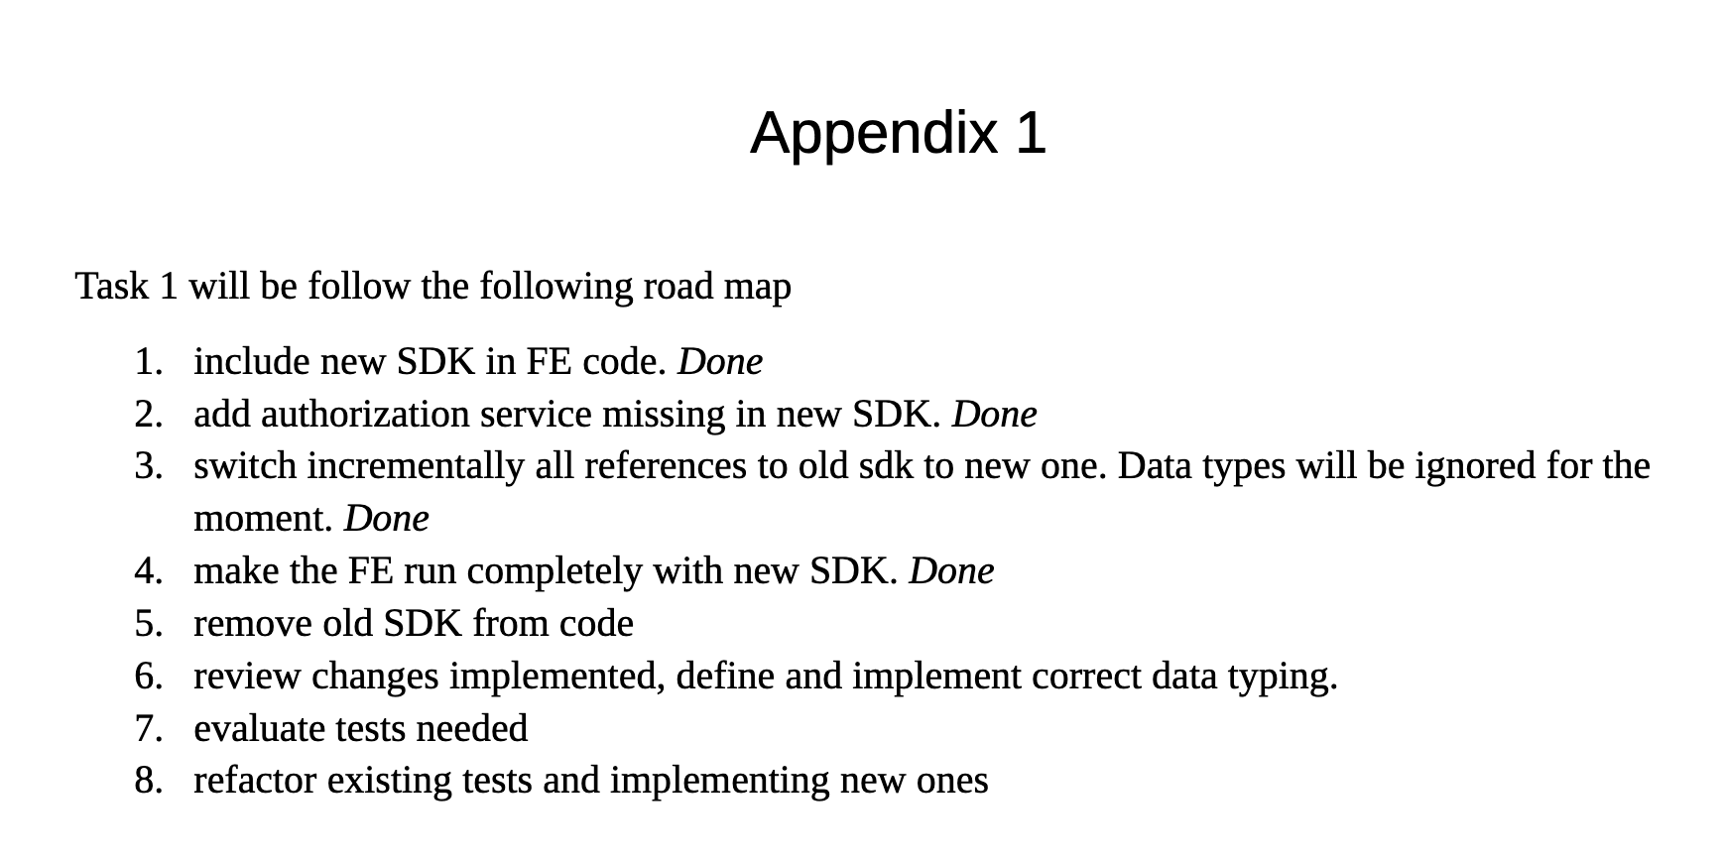
DAPHNE contribution to SciCat Development
roadmap SDK

Slide 5
Summary
DCS shall be our revived forum for SciCat at DAPHNE led by myself and Nicolas Hayen.
consolidated list is being worked on, start of contract 21st of October 2024, official end 31st of March 2025.
weekly reports to Max will be summarized in DCS meetings, next 16th of December 2024.
We benefit from a very good and established relationship between the individual players, ie. Martin T (Sigma Technology and ESS, Max and his team).
First task of the list is actively being worked on with good progress, demo will be given next Friday.

