Slide 1
Quantum Turbulence in Superfluid Helium and its Damping Effect on MAGO Cavity Oscillations

Slide 2
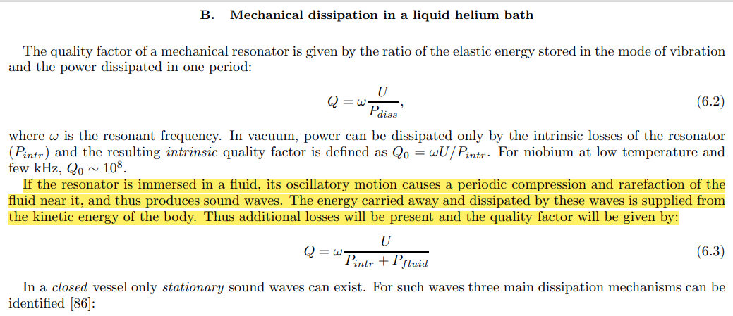
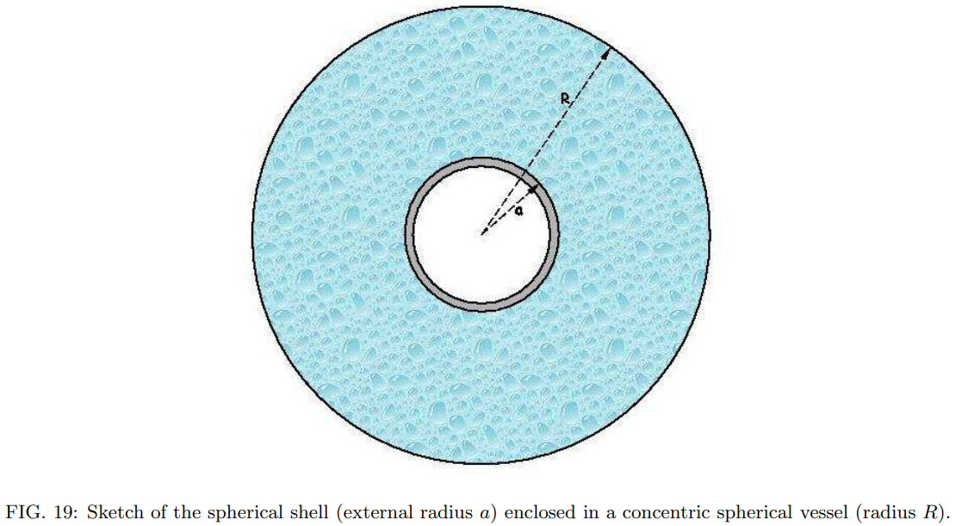
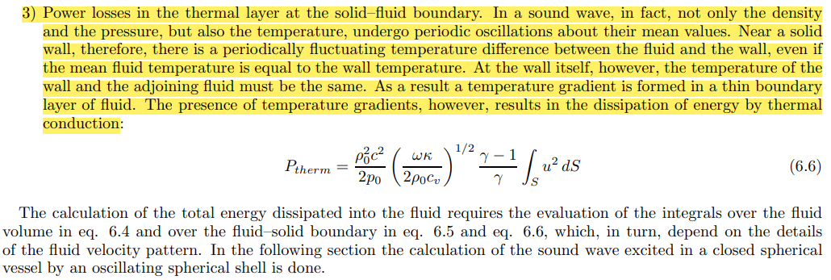
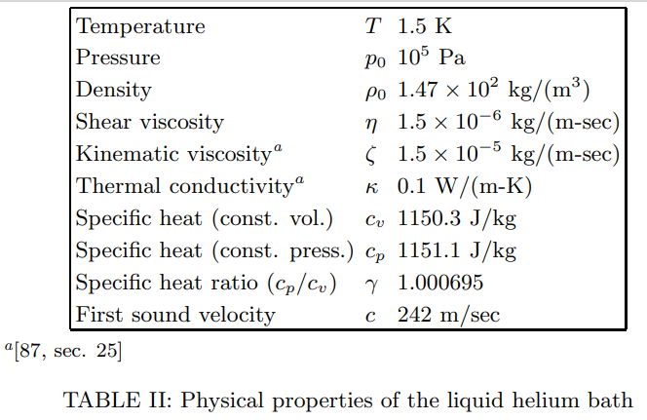
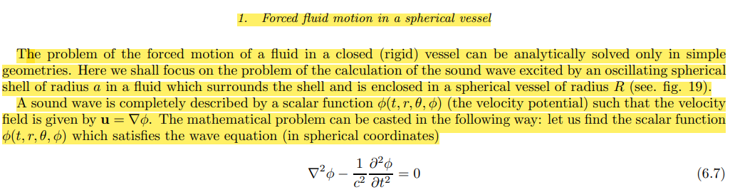
MAGO paper

Slide 3
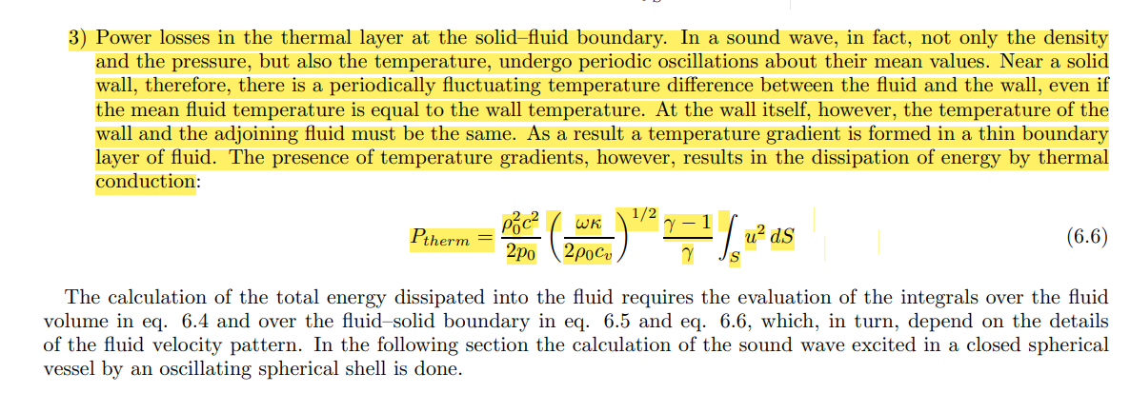

Slide 4
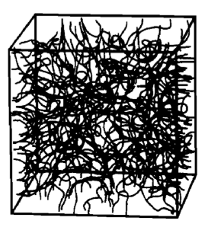
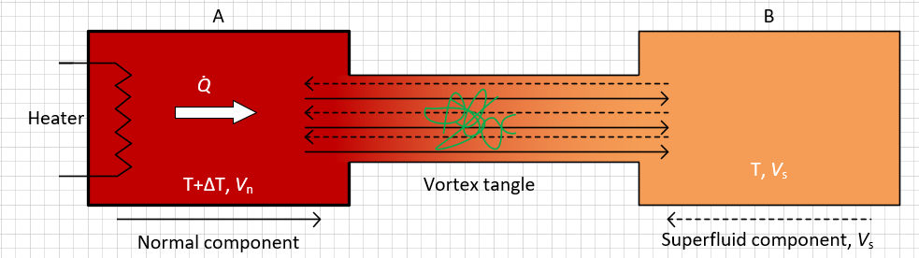
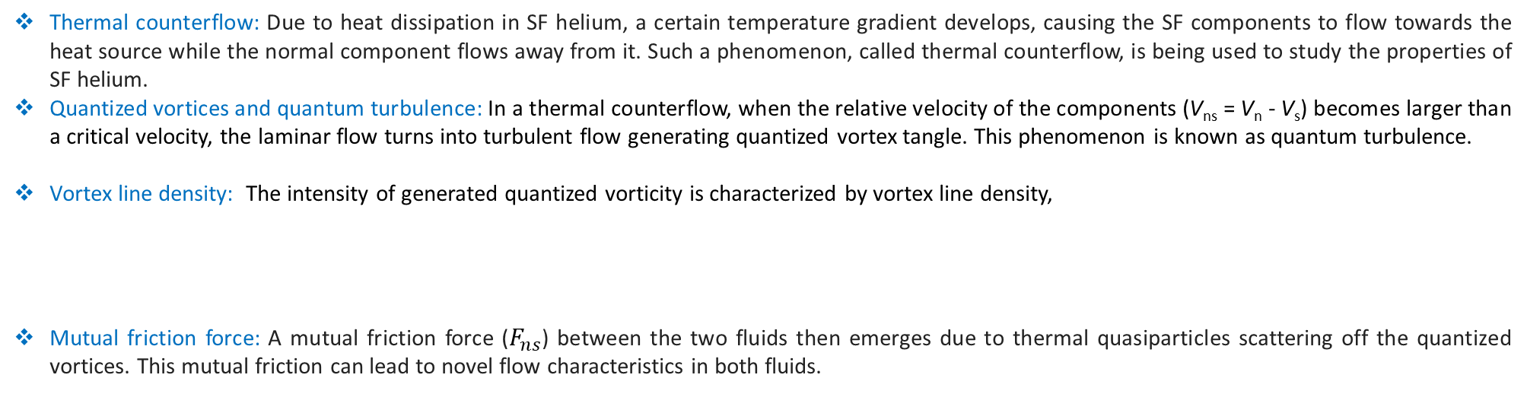
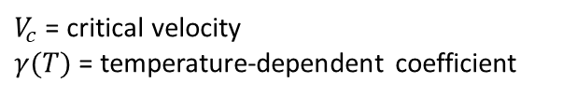

QT due to heat flux, vortex tangle ($L$), thermal counter flow ($V_{ns}$) and mutual friction force ($F_{ns}$)
Phys. Rev. B 38, 2398 (1988)
Thermal counterflow: Due to heat dissipation in SF helium, a certain temperature gradient develops, causing the SF components to flow towards the heat source while the normal component flows away from it. Such a phenomenon, called thermal counterflow, is being used to study the properties of SF helium.
Quantized vortices and quantum turbulence: In a thermal counterflow, when the relative velocity of the components (V_{ns} = V_{n} - V_{s}) becomes larger than a critical velocity, the laminar flow turns into turbulent flow generating quantized vortex tangle. This phenomenon is known as quantum turbulence.
Vortex line density: The intensity of generated quantized vorticity is characterized by vortex line density,
Mutual friction force: A mutual friction force ($F_{ns}$) between the two fluids then emerges due to thermal quasiparticles scattering off the quantized vortices. This mutual friction can lead to novel flow characteristics in both fluids.
$$L^{1/2}=γ(T)(V_{ns}−V_{c})$$
$V_{c}$ = critical velocity
$γ(T)$ = temperature-dependent coefficient
PRB 86, 134515 (2012)
J Low Temp Phys (2017) 188:119–189

Slide 5
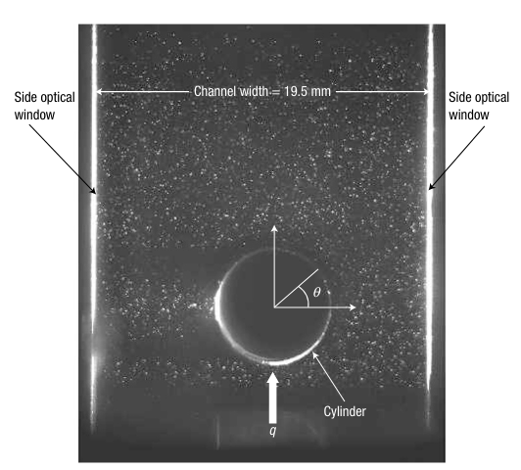
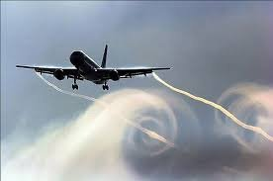
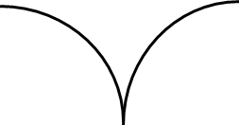
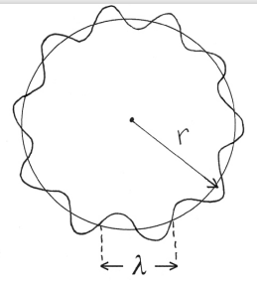
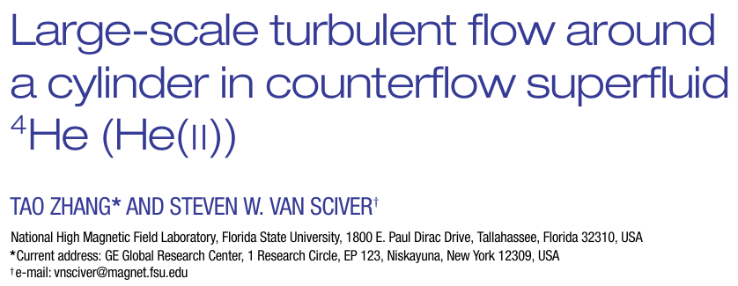
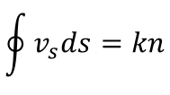
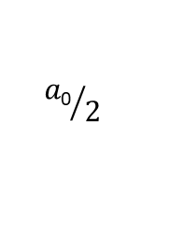







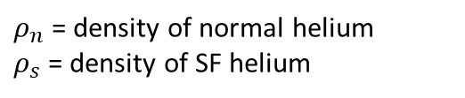
Vortex core and quantum of circulation ($k$)
Similar to vortices in type-II superconductors, quantized vortices in SF He consisting of circulating superfluid component around a normal core.
Core size very small!!!
a₀= 10⁻¹⁰ m
$$ρ_{s}$$
$$v_{s}$$
Total density:
$$ρ{=ρ}_{n}+ρ_{s}$$
$ρ_{n}$ = density of normal helium
$ρ_{s}$ = density of SF helium
Momentum density:
$$J=ρ_{s}v_{s}+ρ_{n}v_{n}$$
$m_{s}v_{s}=p=h/$λ
$$\oint{v_{s}ds}=kn$$
$(n$ = 0,1,2…)
$${a\text{0}}/2$$
Quantum of circulation: $κ = h/m$
For SF He, the vortex core diameter estimated from the nonlinear Schrödinger equation is $a$₀= 10⁻¹⁰ m and $κ$= 9.97 × 10⁻⁸ m² s⁻¹.
Physics - Uspekhi 66 (1) 59 - 89 (2023)

Slide 6
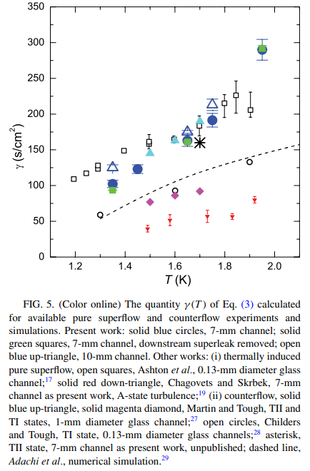



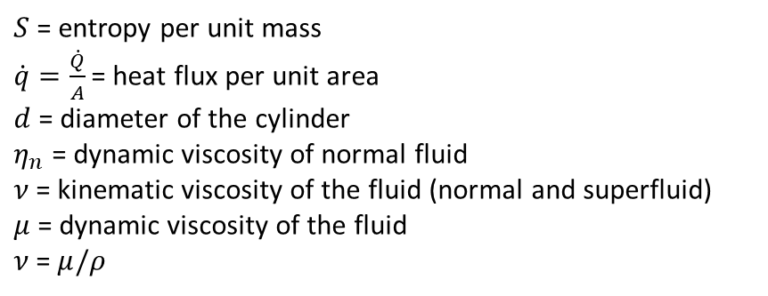





Reynolds number $Re$ versus vortex line density $L$
Total density:
$$ρ{=ρ}_{n}+ρ_{s}$$
Momentum density:
$$J=ρ_{s}V_{s}+ρ_{n}V_{n}$$
$J=$ 0
for a counter flow
Pressure gradient:
$$∇p=ρS∇T$$
J. Low Temp. Phys. 153, 162 (2008), PRF 3, 114701 (2018) and S. W. Van Sciver, Helium Cryogenics (2012)
$$V_{n}=\frac{\dot{q}}{ρ_{n}ST}$$
Normal velocity:
Counterflow velocity:
$$V_{ns}=V_{n}−V_{s}= \frac{\dot{q}}{ρ_{s}ST}$$
Reynolds number:
$$Re=\frac{V_{ns}d}{ν}=\frac{ρV_{ns}d}{μ}$$
Vortex line density
$$L^{1/2}=γ(T)(V_{ns}−V_{c})$$
PRB 86, 134515 (2012)
$S$ = entropy per unit mass
$\dot{q}=\frac{\dot{Q}}{A}$= heat flux per unit area
$d$= diameter of the cylinder
$η_{n}$ = dynamic viscosity of normal fluid
$ν$= kinematic viscosity of the fluid (normal and superfluid)
$μ$ = dynamic viscosity of the fluid
$ν$= $μ/ρ$

Slide 7
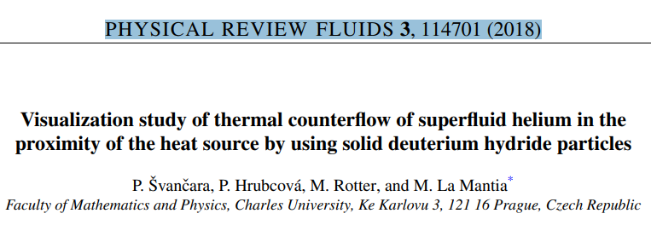
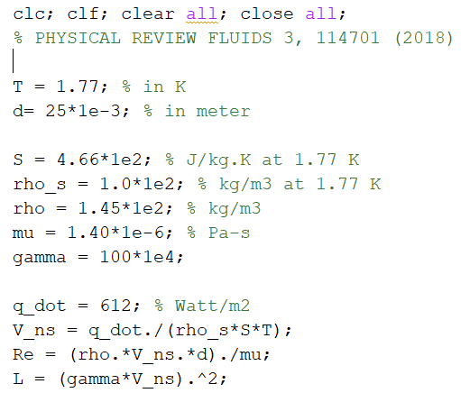
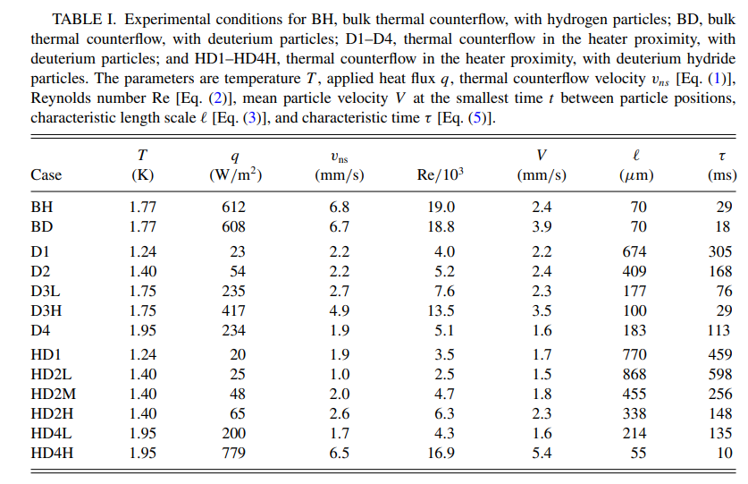
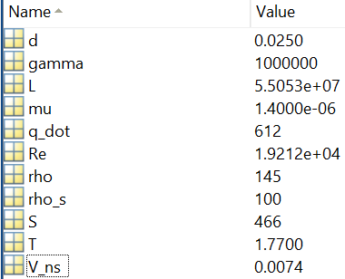
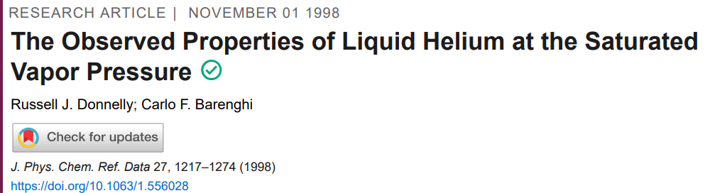
Taken from here

Slide 8
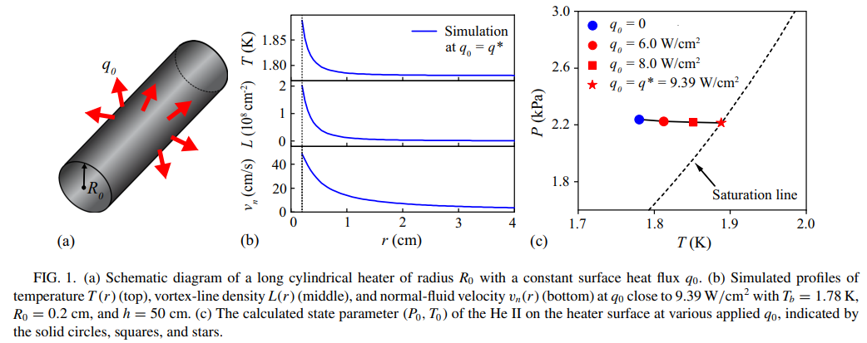
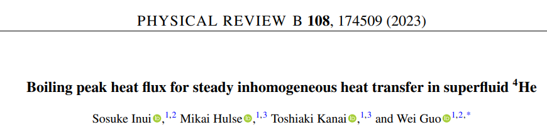

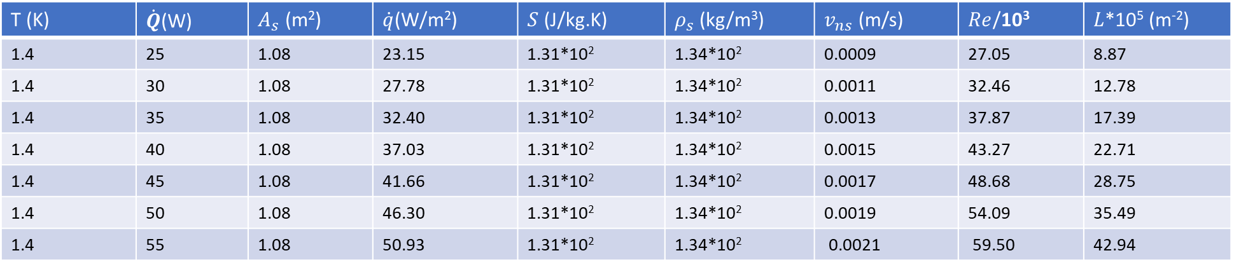


Reynolds number $Re$ versus vortex line density $L$
T (K) | $\dot{Q}$(W) | $A_{s}$ (m²) | $\dot{q}$(W/m²) | $S$(J/kg.K) | $ρ_{s}$ (kg/m³) | $v_{ns}$ (m/s) | $Re$/10³ | $L$*10⁵ (m⁻²)
1.4 | 25 | 1.08 | 23.15 | 1.31*10² | 1.34*10² | 0.0009 | 27.05 | 8.87
1.4 | 30 | 1.08 | 27.78 | 1.31*10² | 1.34*10² | 0.0011 | 32.46 | 12.78
1.4 | 35 | 1.08 | 32.40 | 1.31*10² | 1.34*10² | 0.0013 | 37.87 | 17.39
1.4 | 40 | 1.08 | 37.03 | 1.31*10² | 1.34*10² | 0.0015 | 43.27 | 22.71
1.4 | 45 | 1.08 | 41.66 | 1.31*10² | 1.34*10² | 0.0017 | 48.68 | 28.75
1.4 | 50 | 1.08 | 46.30 | 1.31*10² | 1.34*10² | 0.0019 | 54.09 | 35.49
1.4 | 55 | 1.08 | 50.93 | 1.31*10² | 1.34*10² | 0.0021 | 59.50 | 42.94
$\dot{q}$(W/m²)
$h$ = 1m
$r$ = 0.15m

Slide 9
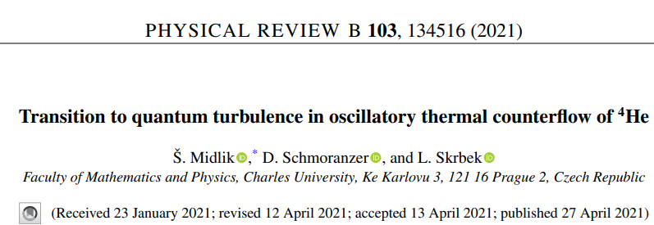
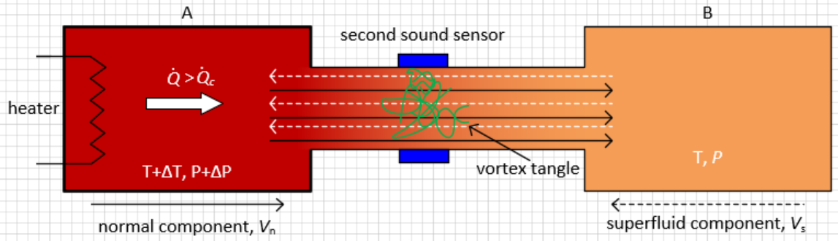
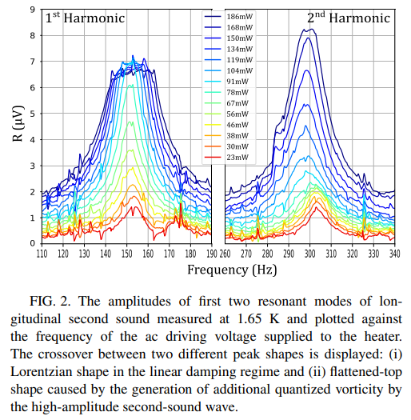
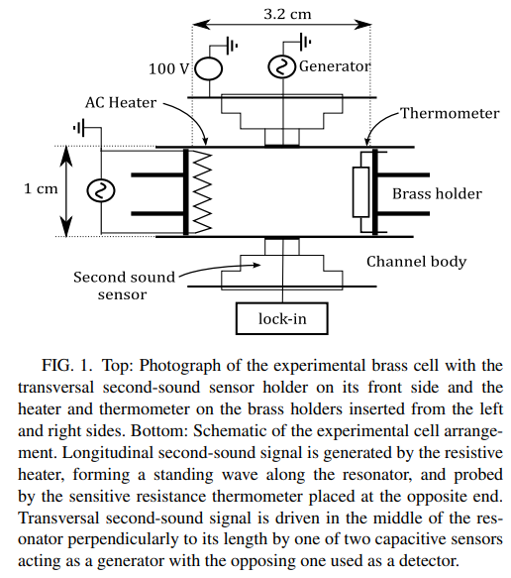

Slide 10
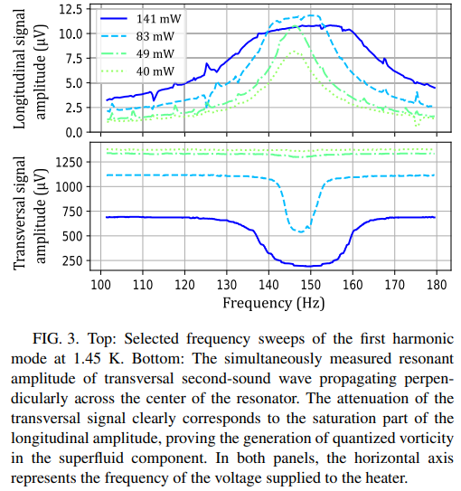
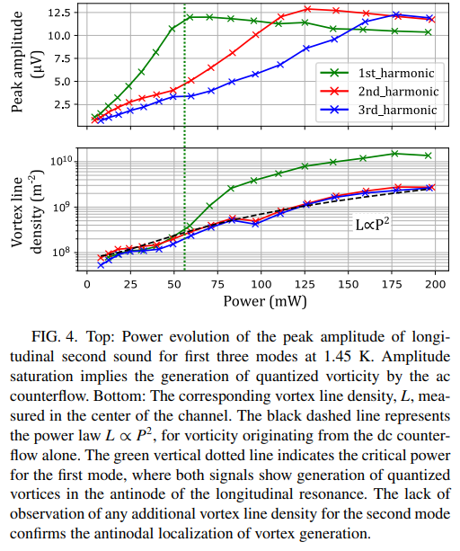
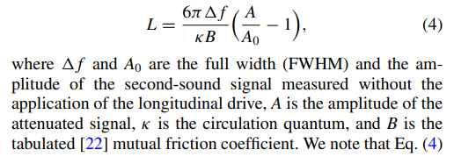

Slide 11
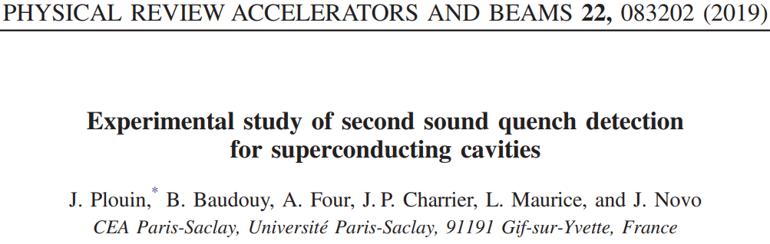
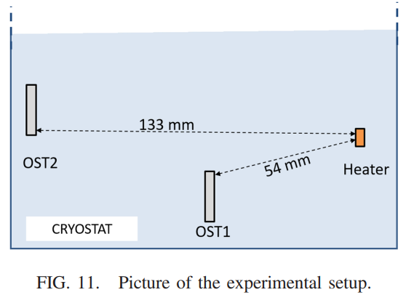
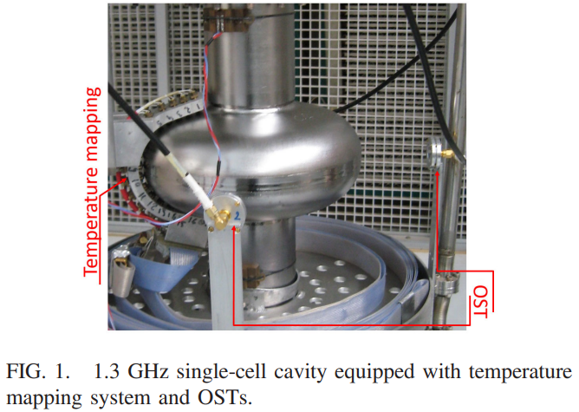
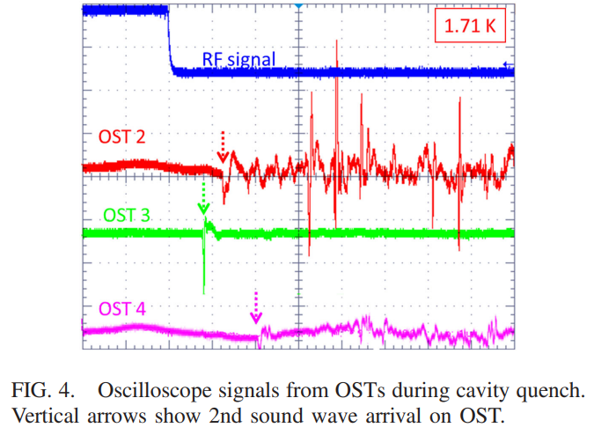

Slide 12
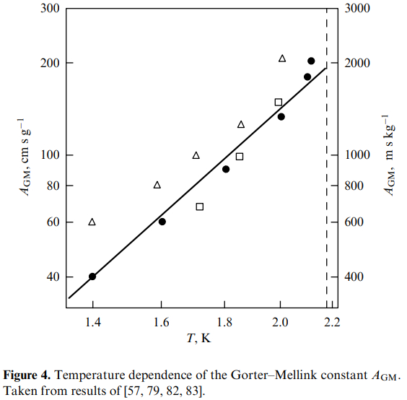







Mutual friction force per unit volume of He II ($F_{ns}$) during quantum turbulence
Two-fluid hydrodynamic model at high heat fluxes ($\dot{q}$ > ${\dot{q}}_{c})$ with developed quantum turbulence:
$$ρ_{s}\frac{∂V_{s}}{∂t}+(V_{s}⋅∇)V_{s}​ =−\frac{ρ_{s}}{ρ}∇p+ρ_{s}S∇T−F_{ns}$$
(Euler-like eq.)
J Low Temp Phys (2017) 188:119–189
$$ρ_{n}\frac{∂V_{n}}{∂t}+\left(V_{n}⋅∇\right)V_{n}​ =−\frac{ρ_{n}}{ρ}∇p−ρ_{s}S∇T+η_{n}∇^{2}V_{n}+F_{ns}$$
(Navier–Stokes eq.)
Gorter–Mellink mutual friction force between the two fluids per unit volume of He II:
$$F_{ns}=A_{GM}(T)ρ_{s}ρ_{n}{\left|V_{s}−V_{n}\right|}^{3}$$
Physics - Uspekhi 66 (1) 59 - 89 (2023)
$A_{GM}$= temperature dependent Gorter-Mellink constant
Gradients of pressure and temperature along a tube with diameter d:
$∇p$= $\frac{{32η}_{n}V_{n}}{d^{2}}$
$∇T$= $\frac{{32η}_{n}\dot{q}}{ρ^{2}S^{2}Td^{2}}+\frac{A_{GM}ρ_{n}}{S}{\left(\frac{\dot{q}}{ρ_{s}ST}\right)}^{m}$
$$m=3 \left(theory\right) and 3.4 (experiment)$$
viscous flow
turbulent flow
If we neglect the viscous term and consider 1D system:
$\frac{dT}{dx}$= $f(T, p){\left(\dot{q}\right)}^{m}$
$f(T, p)$ = $\frac{A_{GM}ρ_{n}}{S^{4}ρ_{s}^{3}T^{3}}$
Physics - Uspekhi 66 (1) 59 - 89 (2023) and Helium Cryogenics Book (2012)

Slide 13
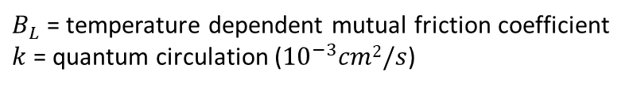

Mutual friction force per unit volume of He II ($F_{ns}$) during quantum turbulence
In terms of $V_{ns}$ and the vortex-line density $L$:
$$F_{ns}=\frac{k}{3}\frac{ρ_{s}ρ_{n}}{ρ}B_{L}(T)LV_{ns}$$
$B_{L}$ = temperature dependent mutual friction coefficient
$k$ = quantum circulation (${10}^{−3}cm2/s$)

