Slide 1
mERLin: materials enhanced ERL for increased sustainability
Márton Major, Amir Farhood, Alexey Arzumanov and Lambert Alff
Technical University of Darmstadt, Darmstadt, Germany
SuperSurfer kick-off meeting
DESY, Hamburg
2. December 2024

Slide 2
BMBF project plan / funding
Novel dual target sputtering process for energy-efficient SRF technology
Sustainable operation of electron accelerators
Combined electromagnetic-thermal numerical simulations considering layered surface structures

Slide 3
BMBF project plan / funding
Novel dual target sputtering process for energy-efficient SRF technology (not funded)
Sustainable operation of electron accelerators (not funded)
Combined electromagnetic-thermal numerical simulations considering layered surface structures (funded)

Slide 4
Novel dual target sputtering process for energy-efficient SRF technology
Coating of RF samples for the Quadrupole Resonator (QPR)
Realization of novel in-cavity dual target sputtering process
Inner coating of copper cavities
Performance tests on QPR samples and cavities
Coating of structures for the consortium partners (HOM antennae, QPR cups, samples)

Slide 5
Possible superconducting materials for RF cavities
Material | Critical Temp. T_{c} [K] | Normal-state resistivity ρ_{n} [μΩcm] | Critical Field H_{c}(0) [T] | Lower Critical field H_{c1}(0) [T] | Upper Critical field H_{c2}(0) [T] | Penetration depth λ(0) [nm] | Δ [meV] | Type
Nb | 9.23 | 2 | 0.2 | 0.18 | 0.28 | 40 | 1.5 | II
Pb | 7.2 |  | 0.08 | N/A | N/A | 48 |  | I
NbN | 16.2 | 70 | 0.23 | 0.02 | 15 | 200-350 | 2.6 | II, B1 comp.
NbTiN | 17.3 | 35 |  | 0.03 |  | 150-200 |  | II, B1 comp.
Nb₃Sn | 18 | 20 | 0.54 | 0.05 | 30 | 80-100 | 3.1 | II, A15
V₃Si | 17 |  |  |  | 24.5 | 179 |  | II, A15
Mo₃Re | 15 |  | 0.43 | 0.03 | 3.5 | 140 |  | II, A15
MgB₂ | 40 | 0.1-10 | 0.43 | 0.03 | 3.5-60 | 140 | 2.3/7.2 | II- 2 gaps
YBCO | 93 |  | 1.4 | 0.01 | 100 | 150 | 20 | d-wave
Pnictides | 30-55 |  | 0.5-0.9 | 30 | >100 | 200 | 10-20
Whistler 2015, SRF Tutorial - Pushing Nb Performance - A.-M. Valente-Feliciano

Slide 6
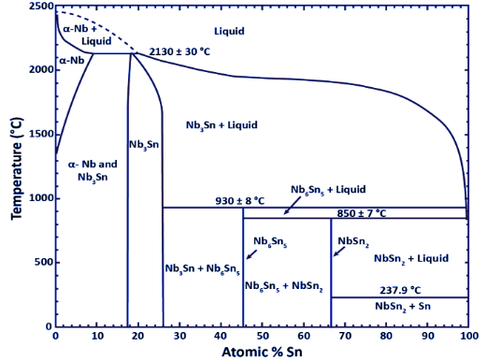
Nb-Sn phase diagram
Charlesworth JP, Macphail I, Madsen PE., Journal of Materials Science. 1970 Jul 1;5(7):580-603.

Slide 7
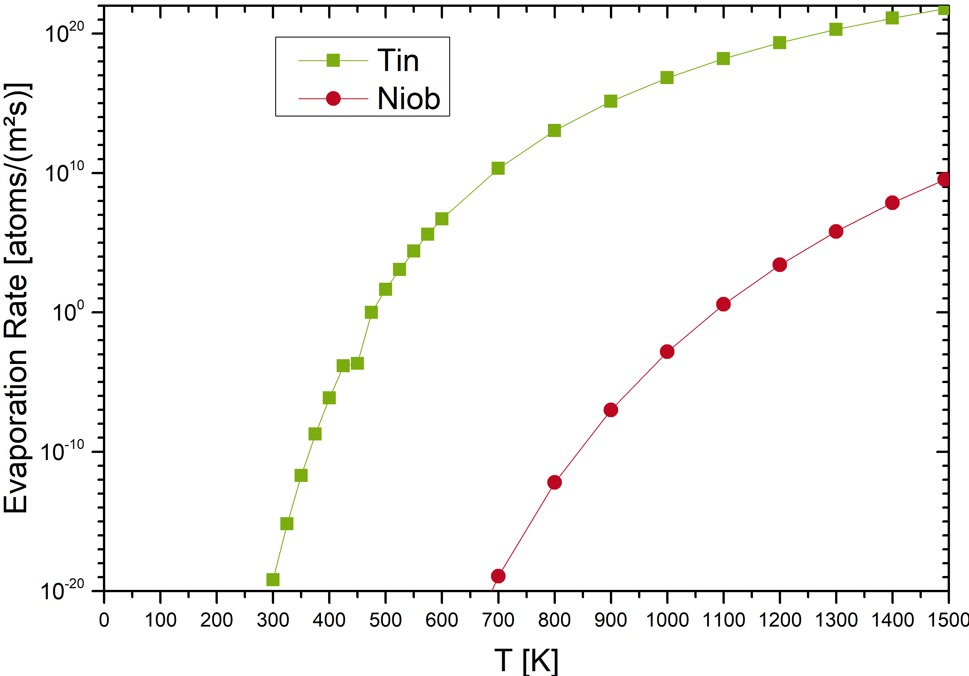
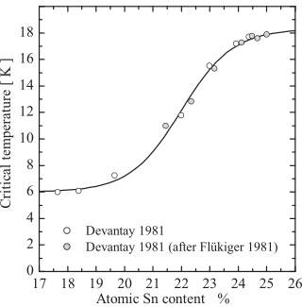
Challenge:
Vapor-pressure of Sn
Literature results for the critical temperature as
functions of Nb–Sn composition.
A Godeke 2006 Supercond. Sci. Technol. 19 R68

Slide 8
TU Darmstadt approach:
Nb₃Sn co-sputtering
Heater
Nb₃Sn
Substrate
Nb
MFC
Butterfly valve
Argon
Exhaust
Nb Target
Sn Target
Nils Schäfer

Slide 9
Nb₃Sn cavity roadmap
Optimization of the sputtering parameters (sputter power, substrate temperature, etc.) on fused silica substrate
Adaptation of the growth parameters (further optimization of growth temperature etc.) for copper substrate
Upscaling of the sputtering process to the cavity geometry:
  Optimizing the sputtering parameters for the new (larger) sputtering chamber
  Design and production of the mini double ring magnetron for cavity sputtering
  Inner coating of Cu cavities
N. Schäfer, N. Karabas, J. P. Palakkal, S. Petzold, M. Major, N. Pietralla, and L. Alff, Kinetically induced low-temperature synthesis of Nb₃Sn thin films, J. Appl. Phys. 128, 133902 (2020)
E. Barzi, B. C. Barish, R. A. Rimmer, A. Valente-Feliciano, C. M. Rey, W.A. Barletta, E. Nanni, M. Nasr, M. Ross, M. Schneider, S. Tantawi, P. B. Welander, E. I. Simakov, I. O. Usov, L. Alff, N. Karabas, M. Major, J. P. Palakkal, S. Petzold, N. Pietralla, N. Schäfer, A. Kikuchi, H. Hayano, H. Ito, S. Kashiwaji, H. Monjushiro, H. Hama, F. Hona, K. Umemori, K. Takahashi, T. Takahashi, Y. Kondo, K. Yamakawa, K. Kon, T. Kubo, An Impartial Perspective for Superconducting Nb₃Sn coated Copper RF Cavities for Future Accelerators, arXiv:2203.09718 [physics.acc-ph] (2022)
N. Schäfer, D. Günzing, T. Jiang, N. Karabas; A. Arzumanov, D. Motta-Meira, K. Ollefs, P. Komissinskiy, M. Major, M. Arnold, N. Pietralla, H. Wende, L. Molina-Luna, D. Lützenkirchen-Hecht, L. Alff, Role of kinetic energy on Nb₃Sn thin films by low-temperature co-sputtering, J. Appl. Phys. 134, 043903 (2023)

Slide 10
Physical properties of Nb₃Sn films grown on Cu – conclusions
The thin film synthesis results in Nb₃Sn layers with overall highly beneficial properties for their application as coatings in copper based SRF cavities.
At processing temperatures where copper diffusion is negligible, around 480 °C, a critical temperature of 16.8K can be achieved. At the same time, 𝐻_{𝑐1} is enhanced which enhances the applicable acceleration gradients. Low surface roughness and high mechanical stability further makes these coatings excellent candidates for cavity applications.
N. Schäfer et al. to be published

Slide 11
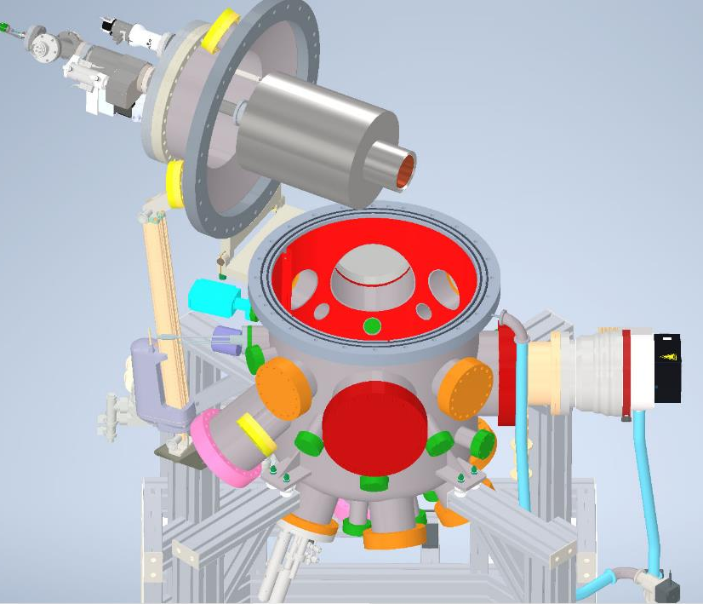
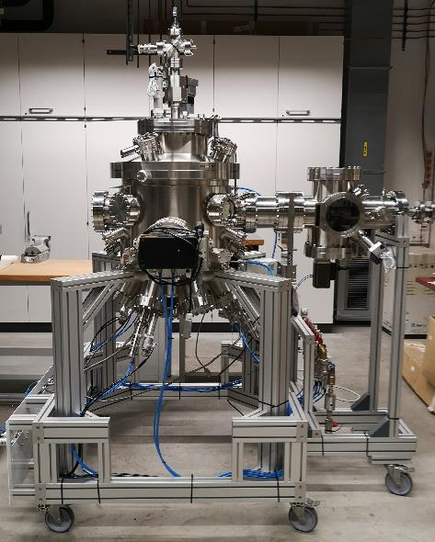
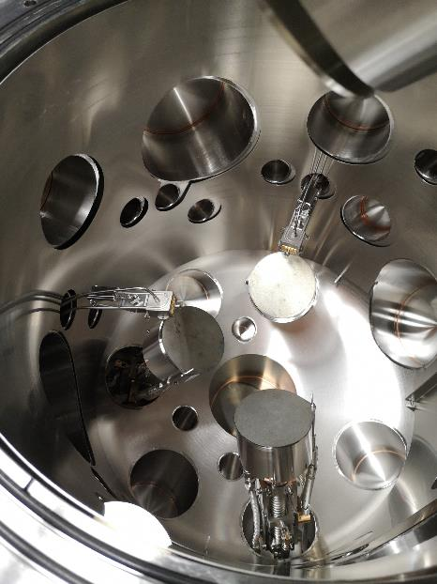
Upscaling to copper cavities

Slide 12
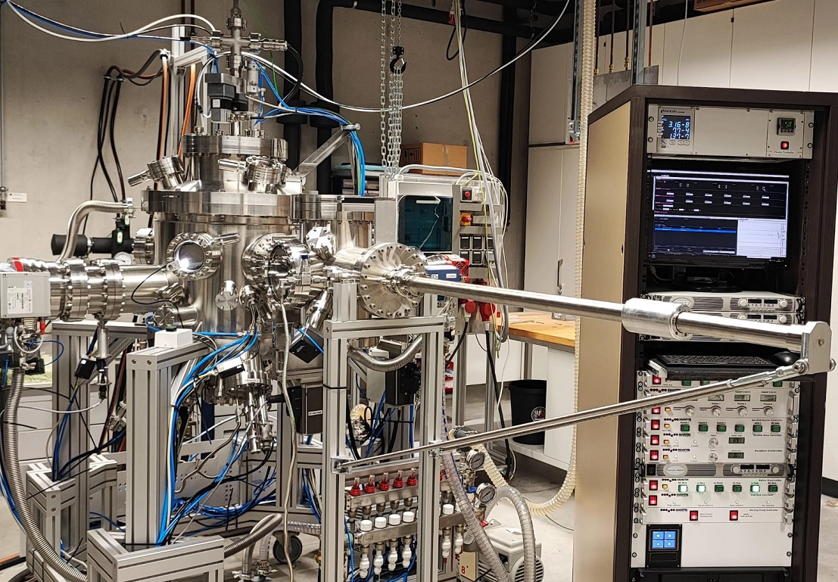
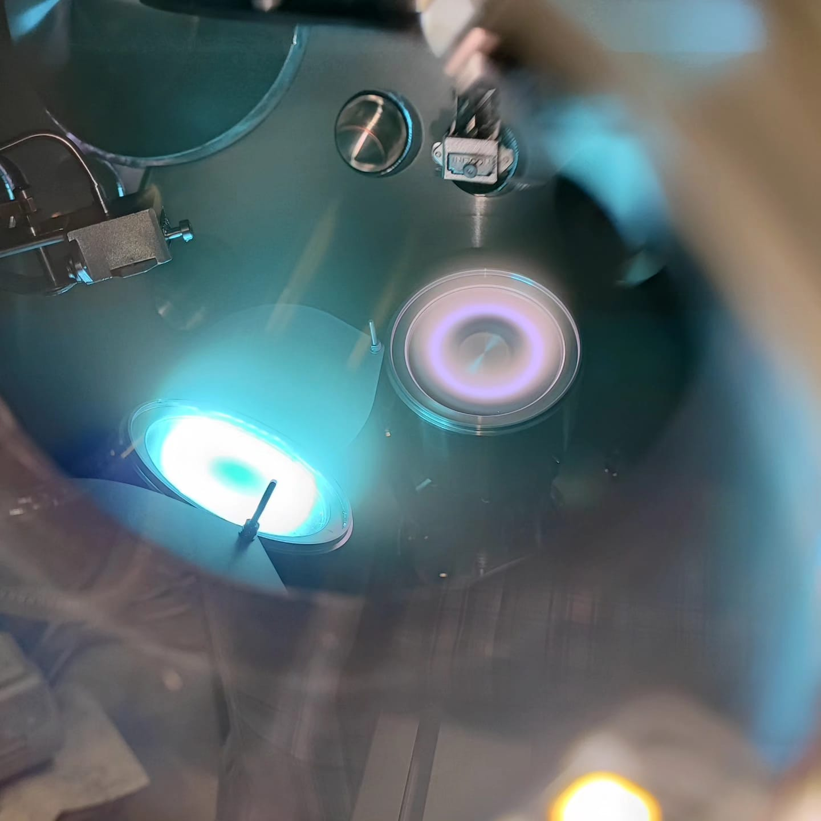
Upscaling to copper cavities
Alexey Arzumanov
Sn
Nb

Slide 13
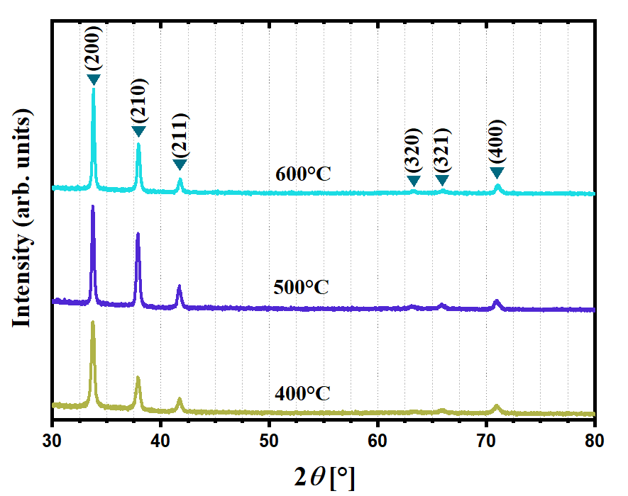
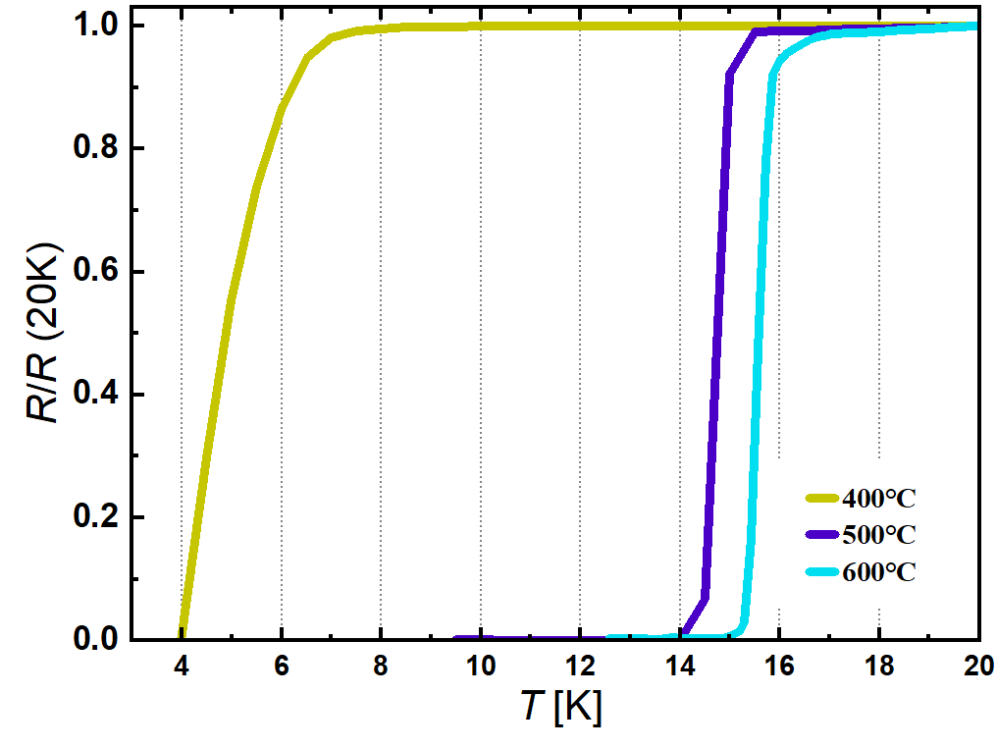
Upscaling to copper cavities
300 nm Nb₃Sn films grown at different substrate temperature on fused silica substrate
X-ray diffraction patterns
Resistivity normalized to the resistivity at 20 K
Sputtering parameters:
DC sputtering
I_{Nb} = 450 mA
I_{Sn} = 80 mA
T_{s} (°C) | 400 | 500 | 600
Nb (at%) | 74.9±1.6 | 74.6±0.4 | 74.0±0.4
Amir Farhood

Slide 14
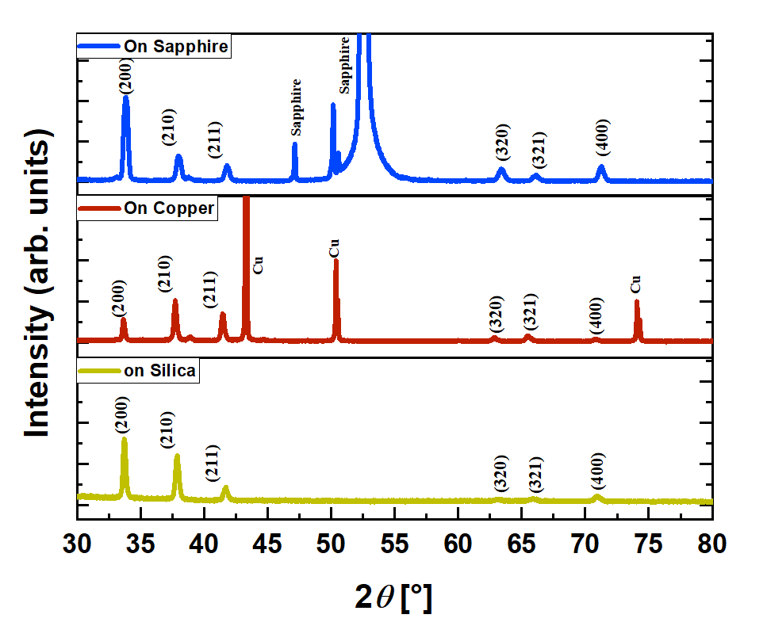
Nb₃Sn sputtered on substrates of fused silica, sapphire and copper at 500 ◦C to investigate the impact of substrate
(a)
(b)
a) XRD patterns of Nb₃Sn thin films grown on different substrates
b) Voltage normalized to the voltage at 20 K of thin films measured by coil amplitude method (Meissner effect)
Amir Farhood

Slide 15
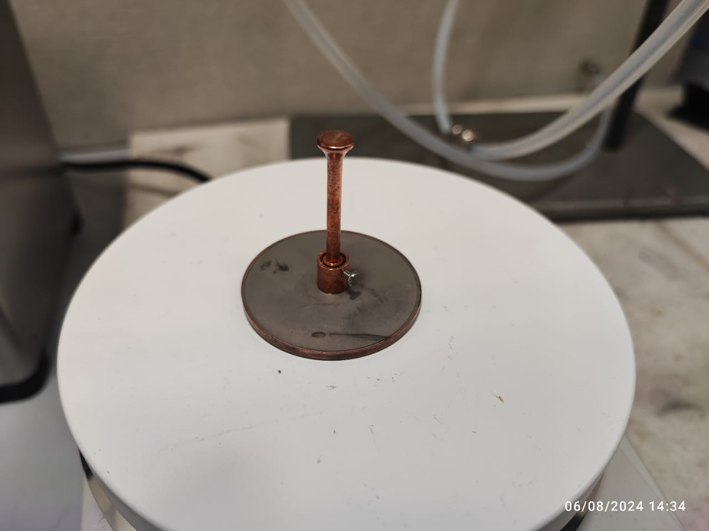
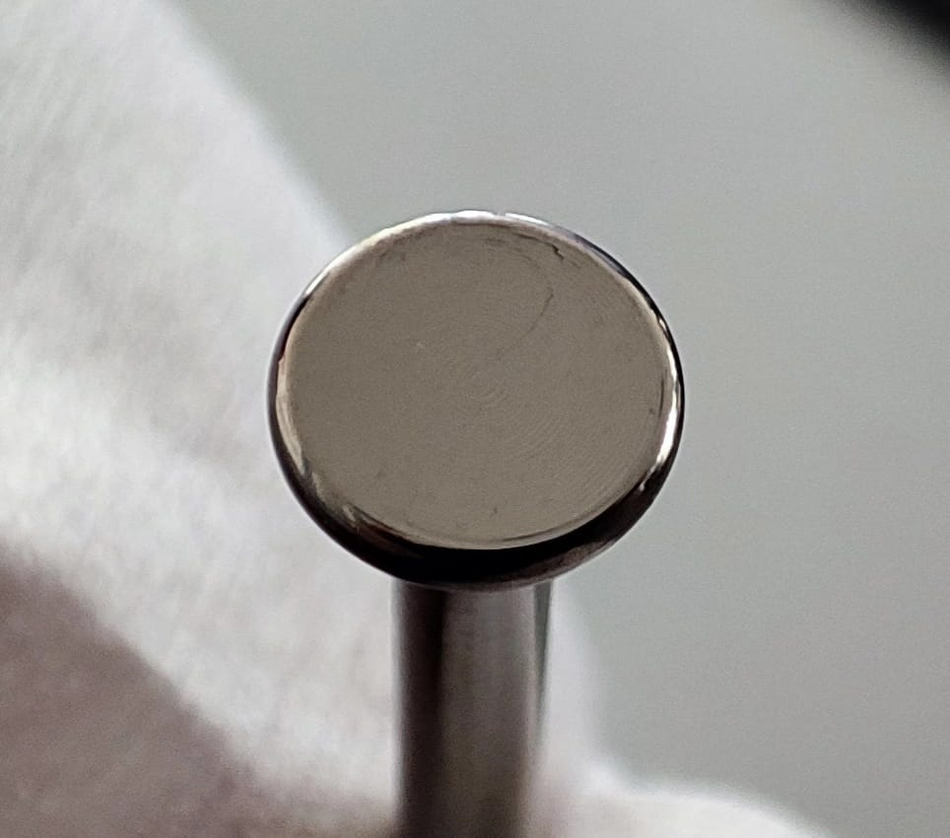
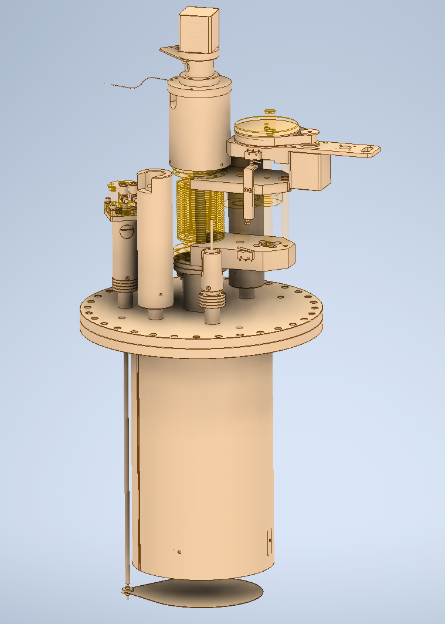
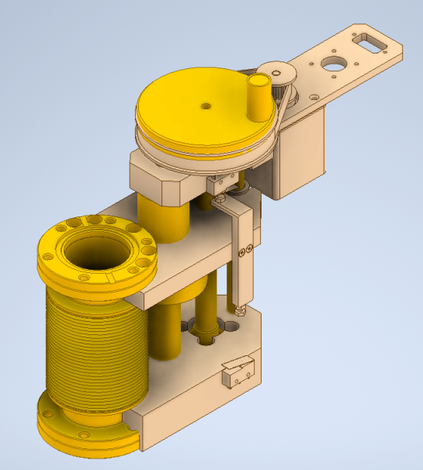
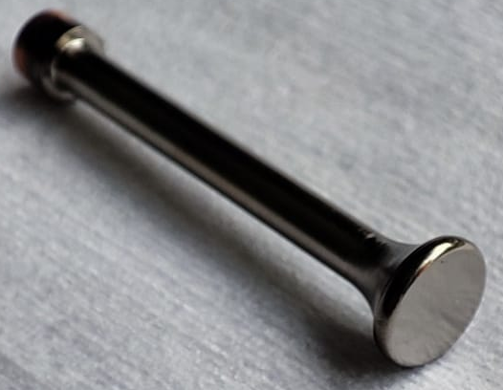
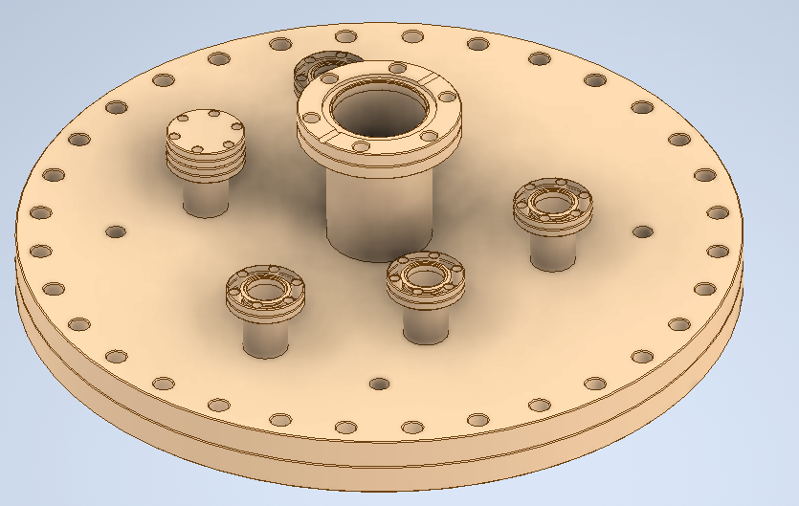
From the TOSCA collaboration
Disc coating (for Hamburg) – still ongoing
Antenna coating with Nb₃Sn (for Mainz) – still ongoing
New top cover with Z-shift for the antenna coating
Alexey Arzumanov

Slide 16
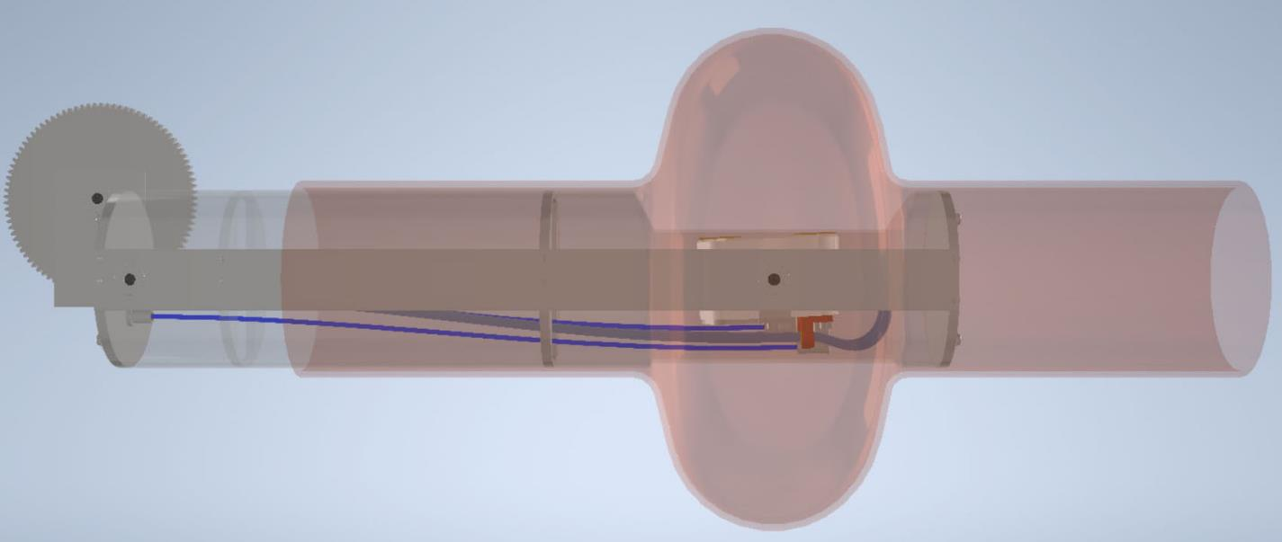
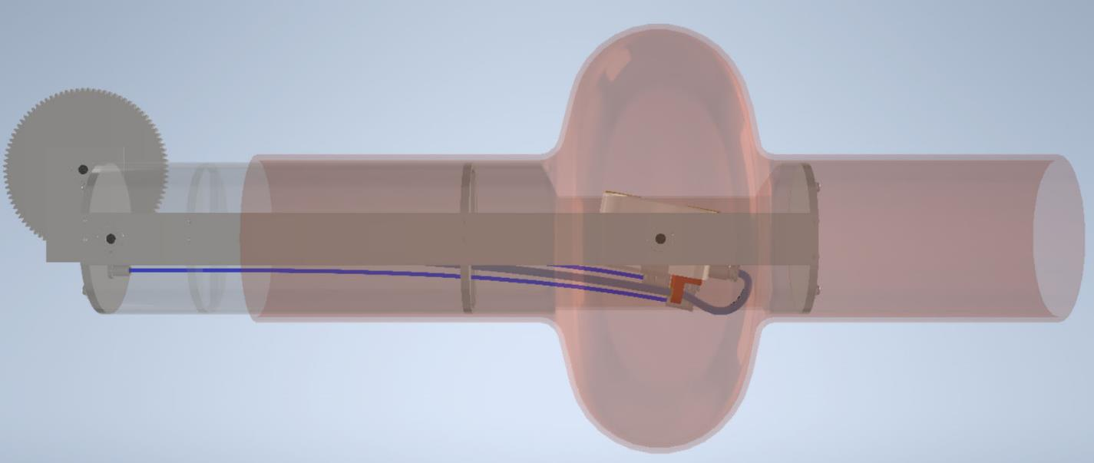
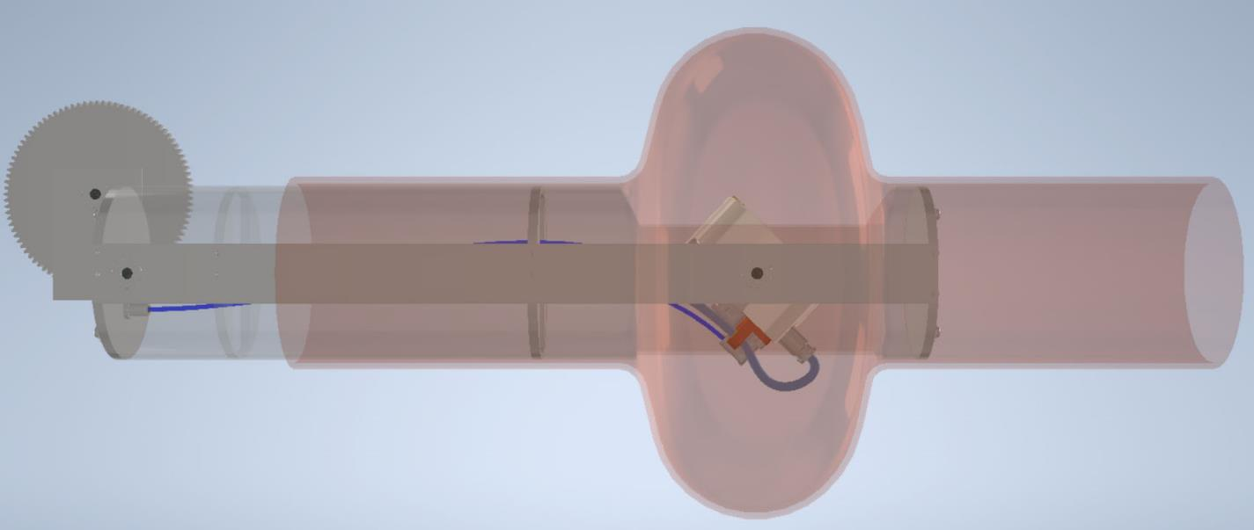

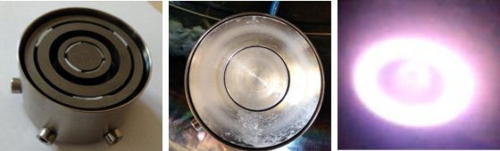
Cavity sputtering
Sputtering spot
In cooperation with Fraunhofer FEP, Dresden

Slide 17




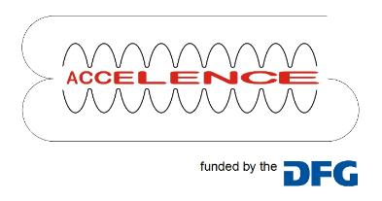


Acknowledgement
Christian Dietz
Sebastian Bruns
Nils Schäfer
Matthias Mahr
Philipp Komissinskiy
Jürgen Schreeck
Gabi Haindl
Norbert Pietralla
Michaela Arnold
Thank you for your attention!
Funded by BMBF Project 05H21RDRB1 and the German Research Foundation (DFG) through grant GRK2128 (AccelencE)

