Slide 1
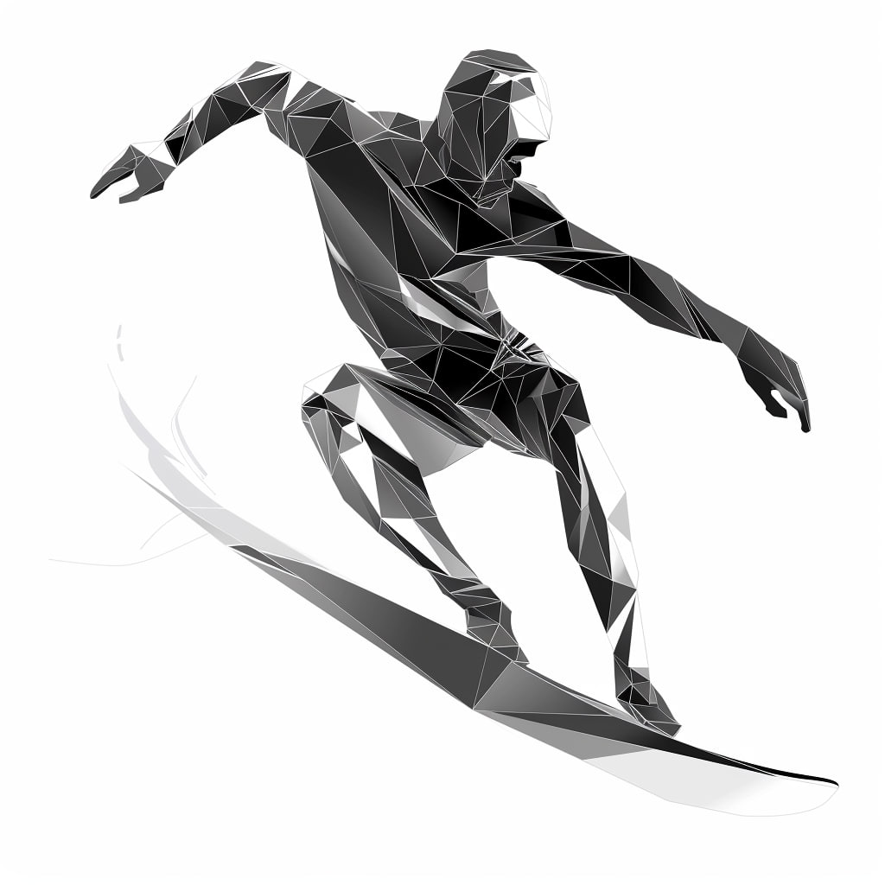
SuperSurfer Kick-Off
Credit: T. Stengler, JGU & Midjourney AI
Obviously my best strategy is to wait, listen, and learn.
2.12.2024
Wolfgang Hillert
U Hamburg

Slide 2
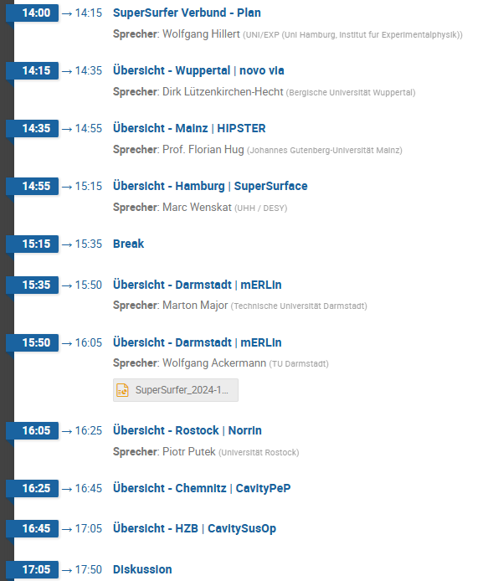







7 Partners
Ein neuer Partner ist dabei:
TU Chemnitz
Schwerpunkt Plasma-Elektropolieren

Slide 3
Aim for today: You know what to do for the next 6 months
What is your plan and what do you want to achieve?
  Lets discuss milestones and deliverables
  How can we help each other?
  What do you need from a partner?
The Kooperationsvertrag is nearly ready for signature and it will be done on-time
Please expect the request from PT.DESY for a first report in March/April next year
If anyone wants a guided tour later or go for Dinner tonight - inform Marc

