Slide 1

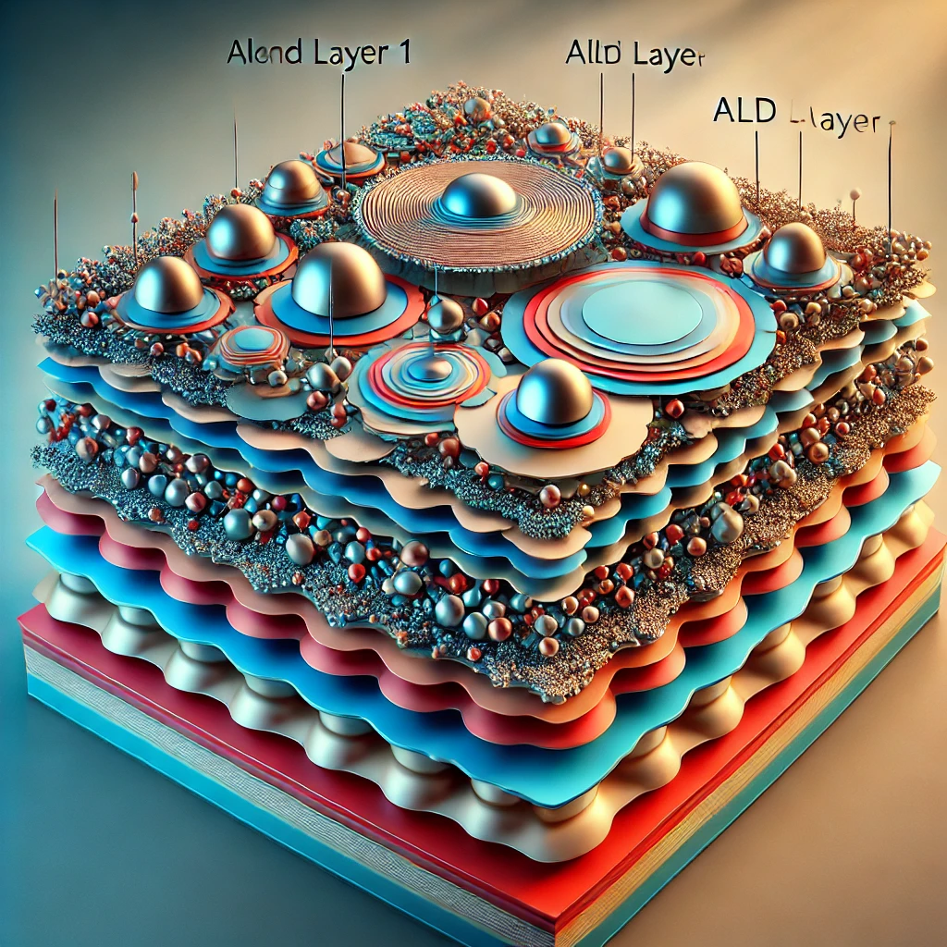
Superconducting and sustainable RF for improved Accelerator Efficiency
SuperSurface
Credit: T. Stengler, JGU & Midjourney AI
Created using AI-powered image generation by OpenAI DALL·E (2024).
2.12.2024
Marc Wenskat – on behalf of L. Preece, A. Zaidman, W. Hillert

Slide 2
What is our plan?
Three Workpackages
  WPA: Coating copper with high T_{c} superconductors / multilayers for 4K operation
    1PhD – Lea Preece
  WPB: Plasma Electropolishing
  WPC: Disordered Superconductor
    1 PhD – Artem Zaidman @ Nanolab

Slide 3
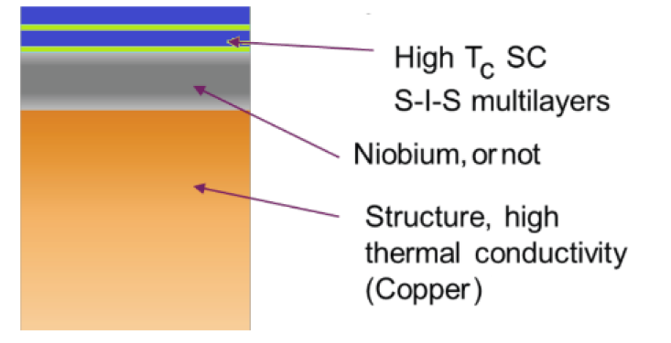
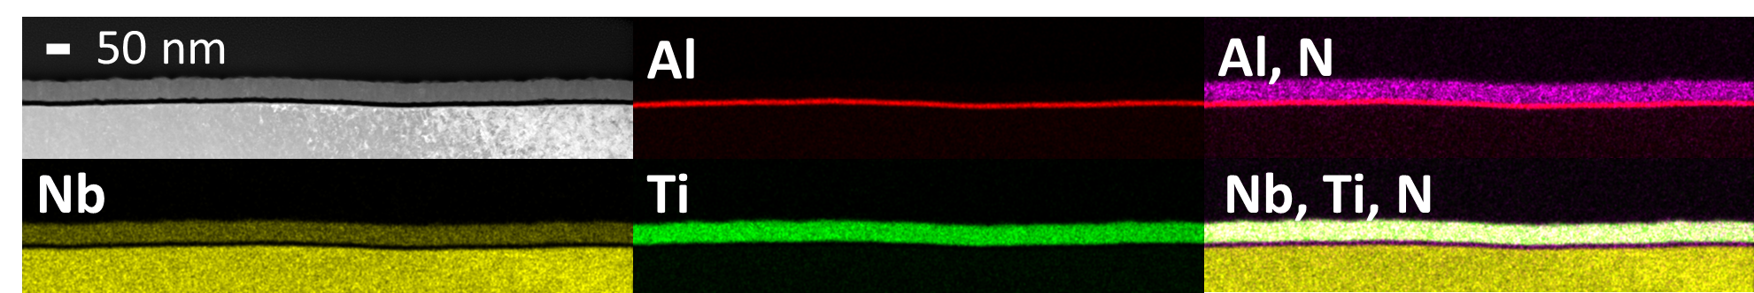
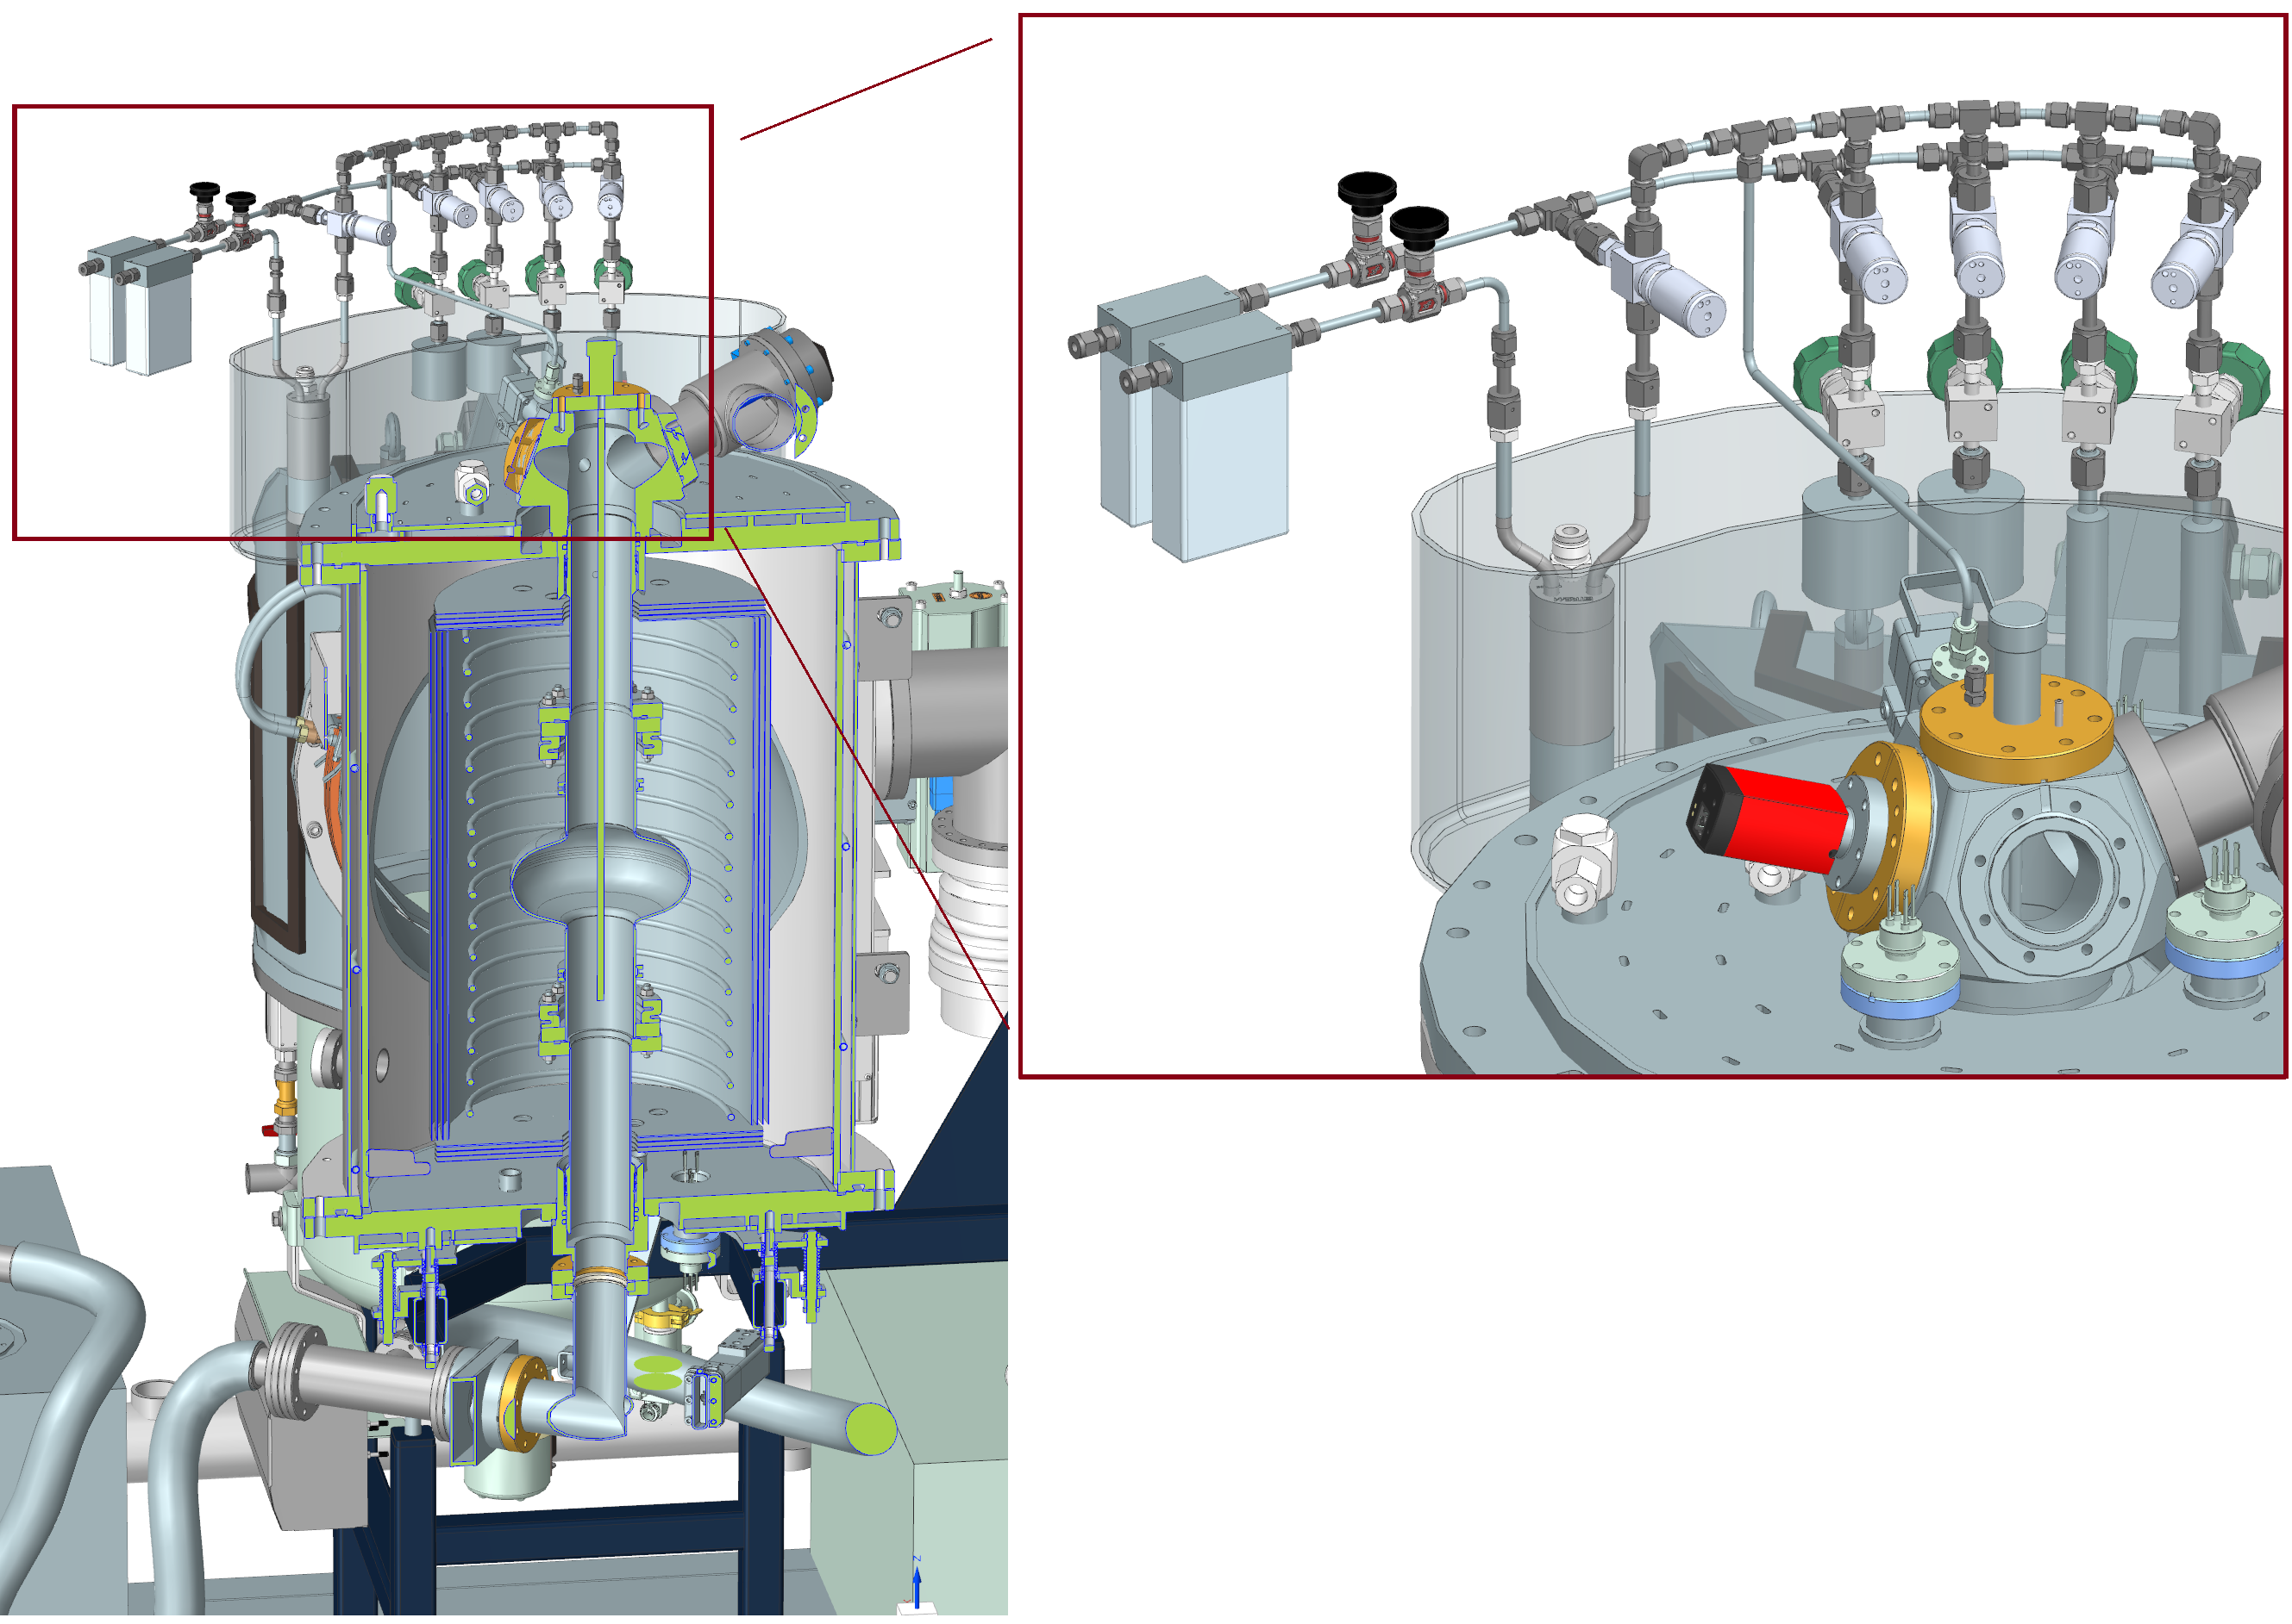

Copper coating with high T_{c} superconductors & multilayers for 4K operation
Cross-section of 50nm NbTiN and 15nm AlN on Nb by ALD
As-deposited T_{c} of NbTiN lower than T_{c} of Nb
Have to anneal at 900°C to achieve >14K
Find out why we need it
Need to tailor our process to avoid 900°C anneal
Laserannealing?

Slide 4
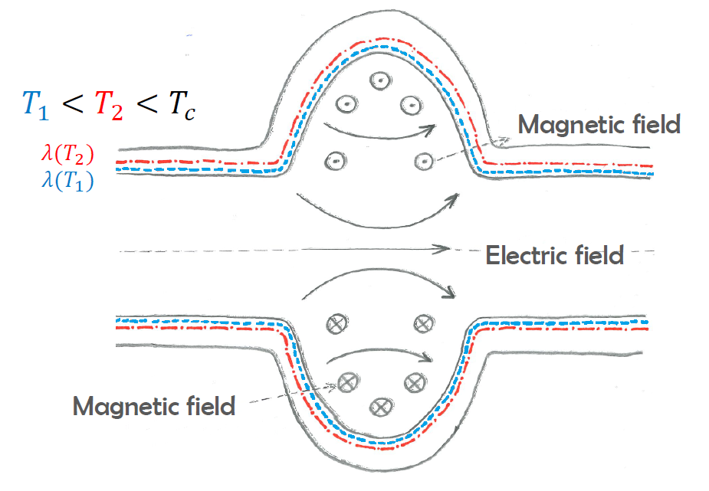
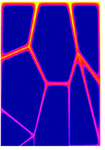

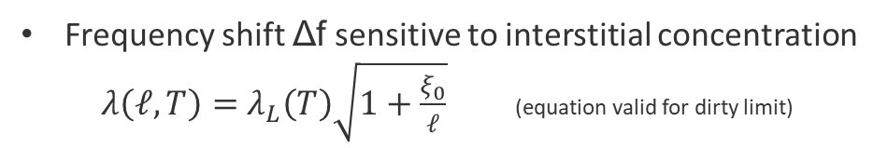

What information is encoded in f vs. T?
T_{c}
$$f_{tot}∝\frac{Γ}{λ\left(ℓ,T\right)}$$
Frequency shift Δf sensitive to interstitial concentration
$λ\left(ℓ,T\right)=$ $λ_{L}\left(T\right)\sqrt{1+\frac{ξ_{0}}{ℓ}}$ (equation valid for dirty limit)
Δf for EXFEL type cavities is typcially 5-6 kHz
More interstitials → larger Δf
T
j
Skin depth
$$λ\left(ℓ,T\right)$$

Slide 5
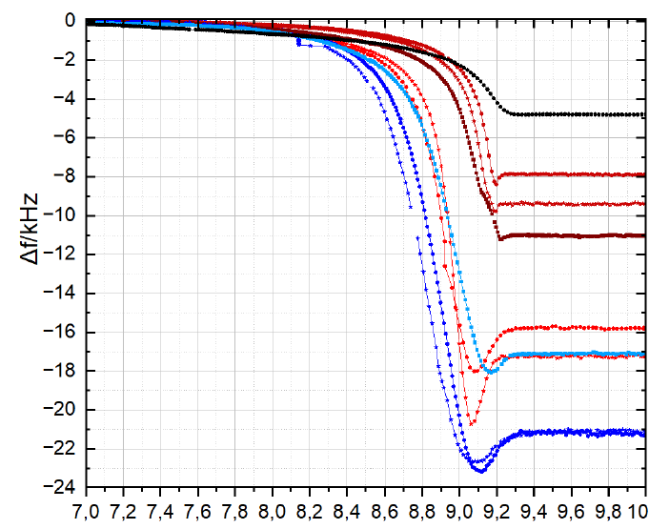
New effect: local minimum in fvT
f(T_{c}) = f(T_{end})
T_{end} ≈ 9K

Slide 6
Microscopic model for disordered superconductor
An increased oxygen concentration reduces T_{c} of Nb by 0.93K per 1 at.%
  to have a dip minimum at 9.1K we would need ≈ 0.2 at.%
  „end of dip“ around 9K ≈ 0.3 at.%
Solubility limit of O in Nb is 1 at.% @ 500°C and 0.33 at.% at 145°C
C diffusion speed in Nb along GB vary with GB orientation, increasing disorder by spatially varying concentration
→ Assume same is true for O: not homogenous distributed within the rf layer, but clusters with uneven O-concentration
→ Expect non-constant, spatially varying T_{c} reduction
→ Lowest T_{c} equal to the max. at.% concentration at RT (≈ 0.33 at.%)
→ Only locally saturated – not globally. If SIMS spot size ≈ multiple grains, obtained c_{O} below saturation limit
[Desorbo, W. Phys. Rev. 132 (1963): 107.]
[Benvenuti, C., et al. 10th SRF (2001): p441.]
[Kolchin, O.P., et al. Soviet Atomic Energy 45 (4) (1978): p999.]
[Dangwal Pandey, A., et al. Appl. Phys. Lett. 119(2021): 194102]
Notes:
1nm Nb2O5 can easily saturate several hundred nm of Nb!

Slide 7


Disordered superconductor show dip
T_{c,Nb}
[Barra, M., et al. SUST 18.3 (2005): 271.]
$$f_{tot}∝\frac{Γ}{λ\left(ℓ,T\right)}$$
Dip properties $∝$ cluster distribution causing current redistribution
<T_{c}>
T
j
Skin depth
T_{c} < T_{c,Nb}
T_{c} < T_{c,Nb}
$$λ\left(ℓ,T\right)$$

Slide 8
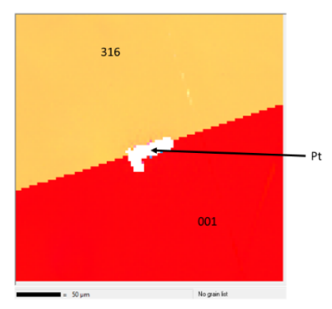
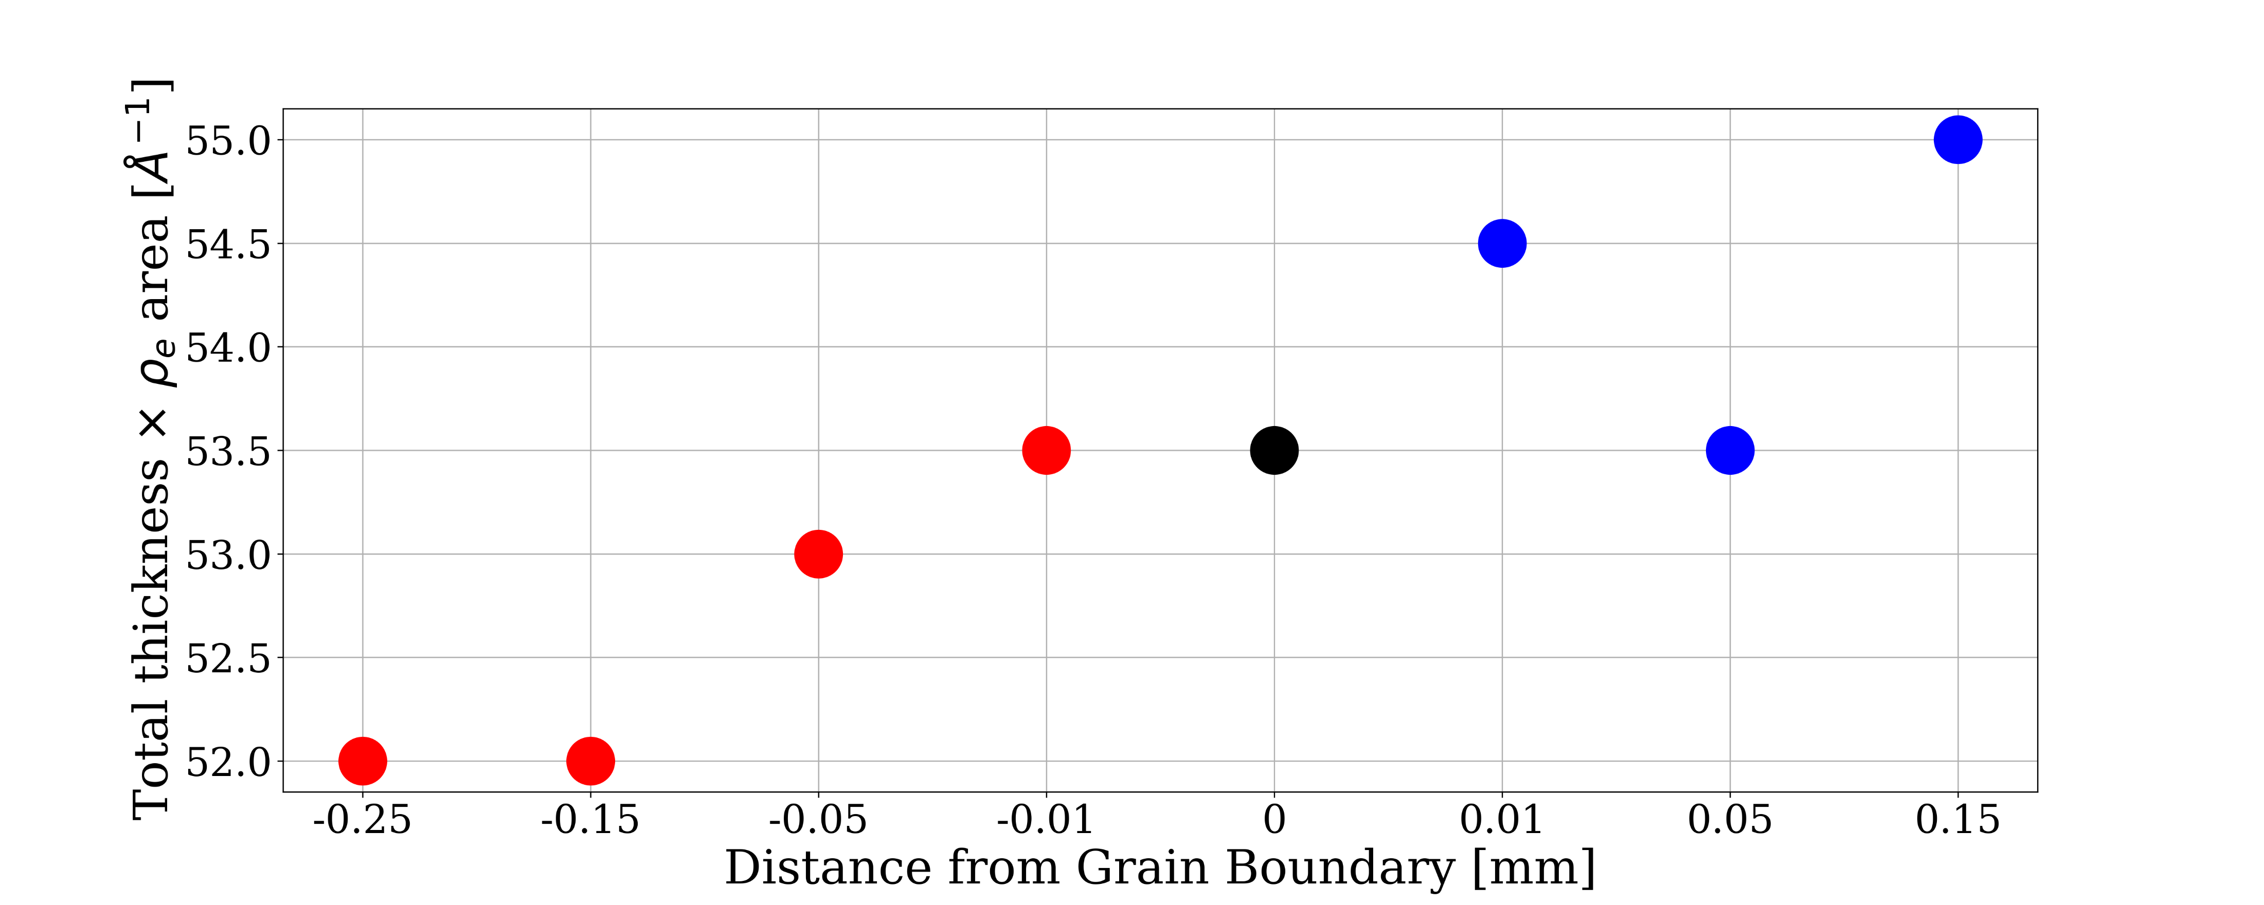
Oxide thickness as function of distance to GB
2-grain Nb

Slide 9

Plasma Electropolishing
Aim: Get rid of dangerous chemicals (HF!)
All expertise is at TU Chemnitz
We provide
  Samples (Nb & Cu)
  Surface analysis

Slide 10
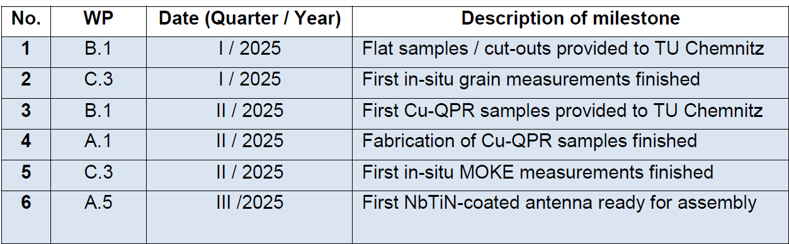
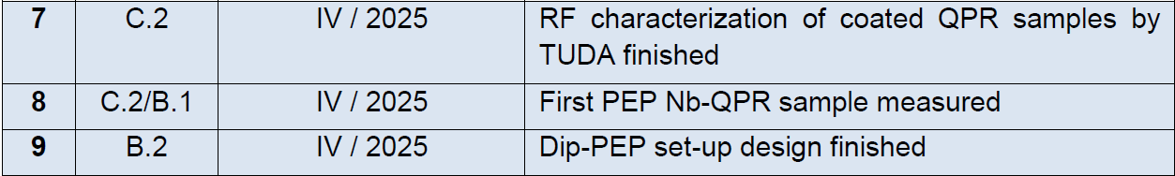
Milestones

