Slide 1
Numerical Simulations Considering Layered Surface Structures
Wolfgang Ackermann, Herbert De Gersem, Aaron Gobeyn
Institute for Accelerator Science and Electromagnetic Fields (TEMF), TU Darmstadt
BMBF - SuperSurfer
Kickoff - Meeting
Hamburg
December 2, 2024

Slide 2
Motivation
Superconducting Resonators
  TESLA Cavity
Niobium
Vacuum

Slide 3
Geometric Modeling
Superconducting Resonators
  TESLA Cavity
HOM Coupler
Niobium
Tube
FPC Coupler
HOM Coupler
Resonator and add-on Components

Slide 4
Geometric Modeling
Superconducting Resonators
  TESLA Cavity
Niobium
Vacuum

Slide 5
Geometric Modeling
Superconducting Resonators
  TESLA Cavity
Electromagnetic Field Penetration
~100 nm
Niobium Sheet
2.8 mm (3D)
Highly Conductive Material
Vacuum

Slide 6
Numerical Modeling
Superconducting Resonators
  TESLA Cavity
Electromagnetic Field Penetration
~100 nm
Niobium Sheet
2.8 mm (3D)
Naive Mesh
Vacuum

Slide 7
Numerical Modeling
Superconducting Resonators
  TESLA Cavity
Surface Impedance Boundary Condition
(2D)
Niobium Sheet
2.8 mm (3D)
Surface Mesh
Vacuum

Slide 8
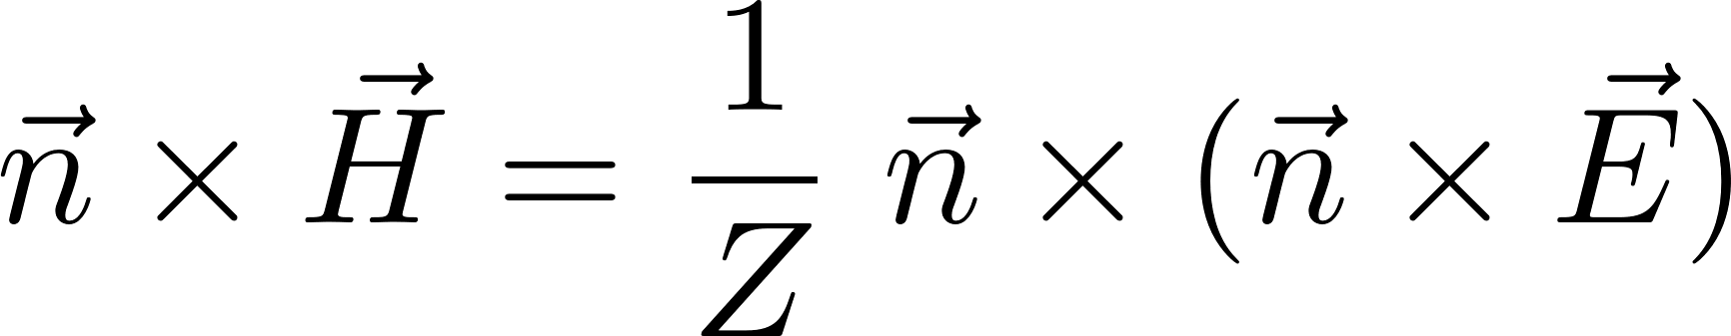
Numerical Modeling
Modeling of Highly Conductive Material
  Boundary Conditions
Modeling task
Electromagnetic field penetrates slightly into highly electrically conductive materials (volume mesh can not resolve this fact)
Replace Volume Mesh by SIBC
Leontovich Surface Impedance
(first order SIBC)

Slide 9
Numerical Modeling
Modeling of Niobium Metal Sheets and Insulators
  Considering Different Types of Surface Layers
Classical Modeling
PEC or SIBC
Classical Modeling
only for thick Layers
Bulk
Niobium
Bulk
Niobium
Pure Material,
No Additional Layer
Single
Surface Layer

Slide 10
Numerical Modeling
Modeling of Niobium Metal Sheets and Insulators
  Considering Different Types of Surface Layers
Classical Modeling only for thick Layers
Bulk
Niobium
Bulk
Niobium
Double
Surface Layer
Multiple
Surface Layer

Slide 11
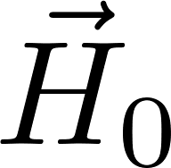
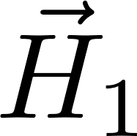
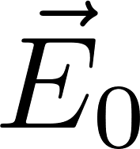
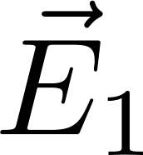
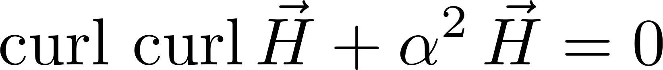
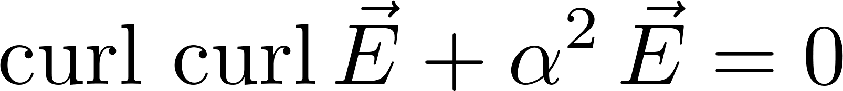
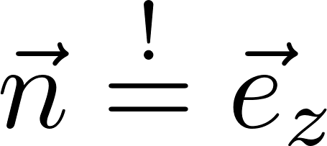
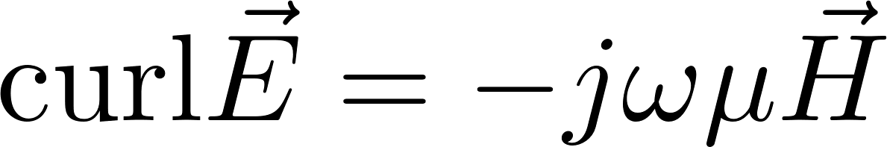
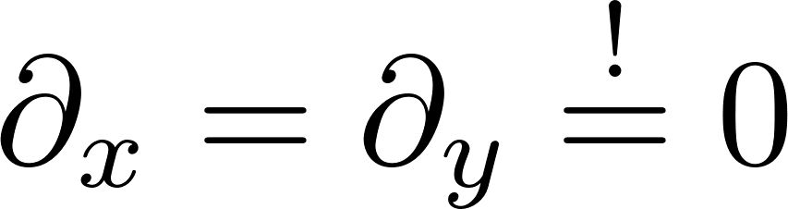
Theoretical Fundamentals
Analytic Solution for Fields in a Bulk Conductor
x
0
1
H
H=0
E
E=0
Vacuum
Bulk Conductor
0
z
Maxwell
Leontovich SIBC
Fields do not vary or vary slowly along the surface of the medium
or

Slide 12
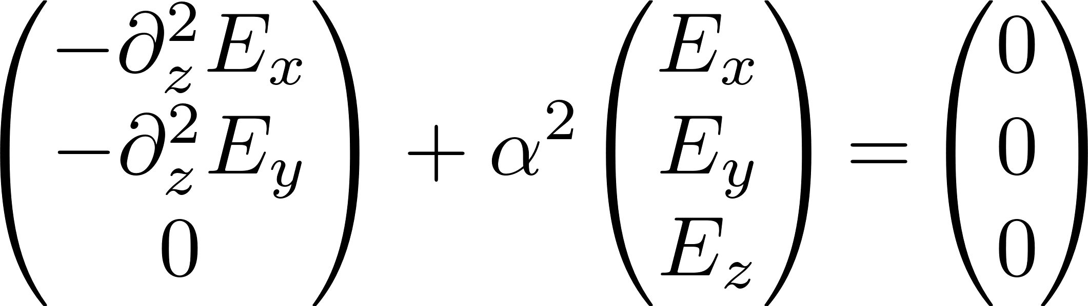
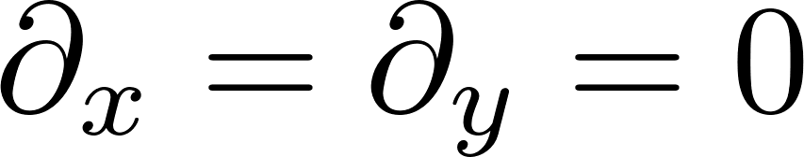
Theoretical Fundamentals
Analytic Solution for Fields in a Bulk Conductor
x
0
1
H
H=0
E
E=0
Vacuum
Bulk Conductor
0
z
Maxwell
or
Second order differential equation for scalar transverse field components, normal field component vanishes!

Slide 13
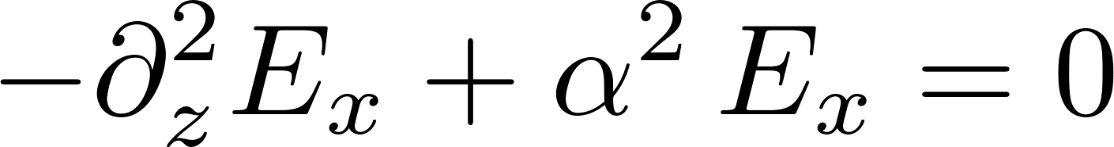
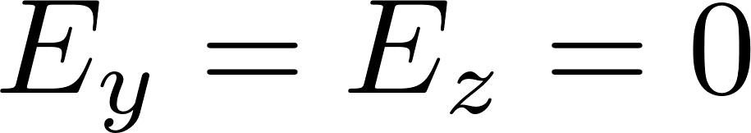
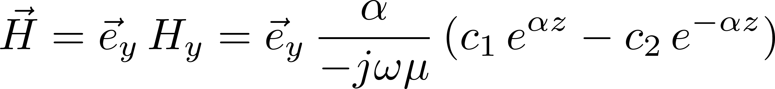
Theoretical Fundamentals
Analytic Solution for Fields in a Bulk Conductor
x
0
1
H
H=0
E
E=0
Vacuum
Bulk Conductor
0
z
Differential equation
Orientation of the local coordinate system
Boundary condition
0
0

Slide 14
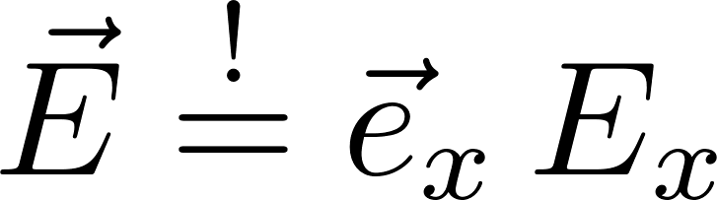
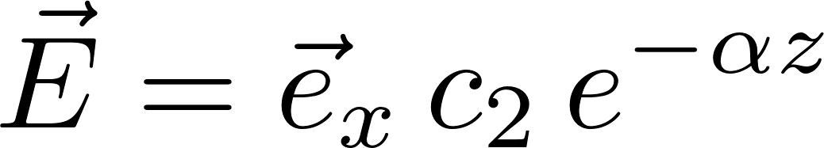
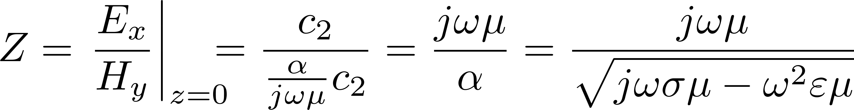
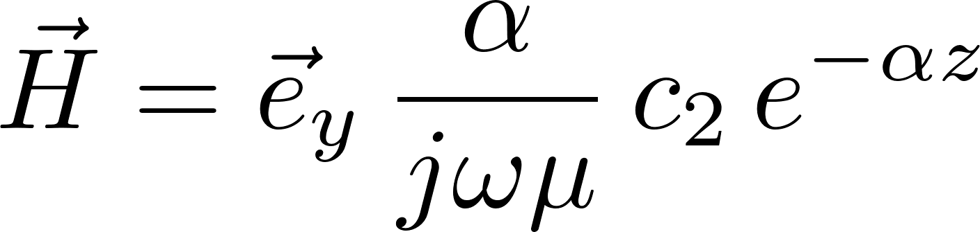
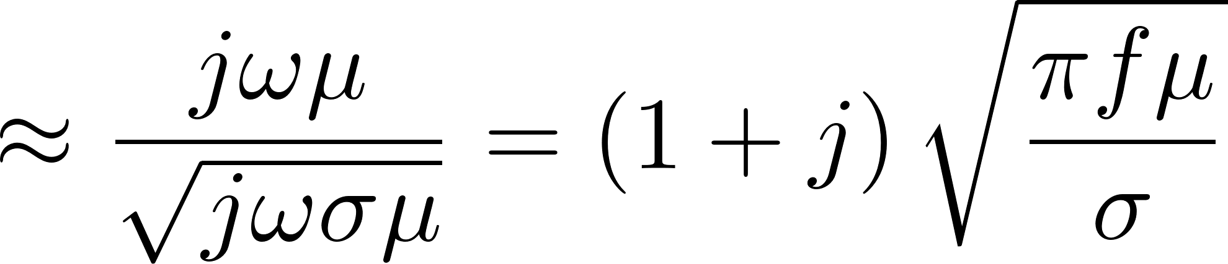

Theoretical Fundamentals
Analytic Solution for Fields in a Bulk Conductor
x
0
1
H
H=0
E
E=0
Vacuum
Bulk Conductor
0
Leontovich boundary condition
z
Surface impedance
small
Electromagnetic Field

Slide 15
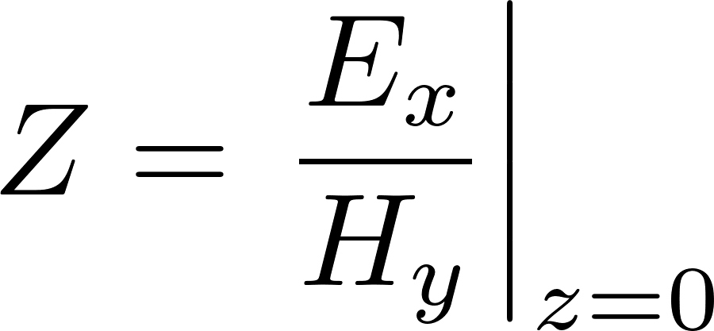
Theoretical Fundamentals
Analytic Solution for Fields in a Bulk Conductor
x
0
1
H=1
H=0
E
E=0
0
z
Maxwell
+
Ohm‘s Law
Vacuum
Bulk Conductor
Unknowns: 2 (solution of a second-order differential equation) = 2
Conditions H: 1 + 1 = 2
Conditions E: 0 + 0 = 0

Slide 16
Theoretical Fundamentals
Analytic Solution for Fields in a Layered Structure
x
0
1
2
3
H=1
H=0
E
E=0
0
z₁
z₂
z
Leontovich boundary condition
Maxwell
+
2 Fluid Model
Maxwell
+
Ohm‘s Law
Maxwell
+
2 Fluid Model
Vacuum
Niobium
Insulator
Bulk Niobium
Unknowns: 2 + 2 + 2 = 6
Conditions H: 1 + 1 + 1 + 1 = 4
Conditions E: 0 + 1 + 1 + 0 = 2

Slide 17
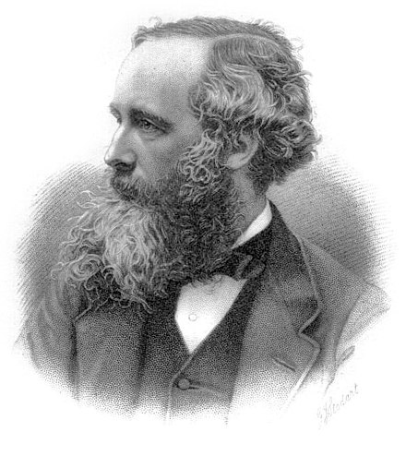
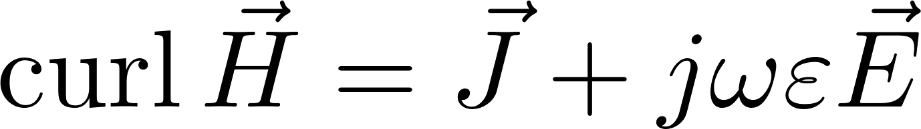
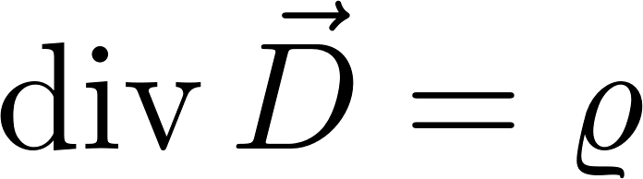
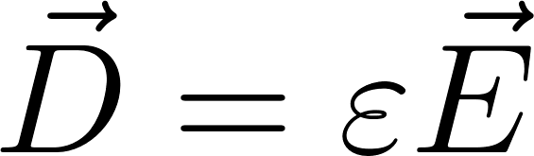
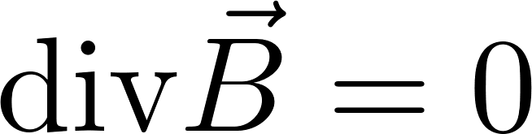
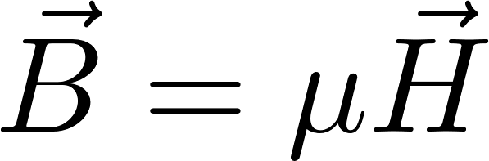
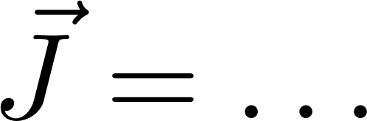
Theoretical Fundamentals
Superconducting Resonators
  James Clerk Maxwell
  Leontovich
  Boundary Condition
https://de.wikipedia.org/wiki/James_Clerk_Maxwell
Incorporation of the SIBC
into the finite element method

Slide 18
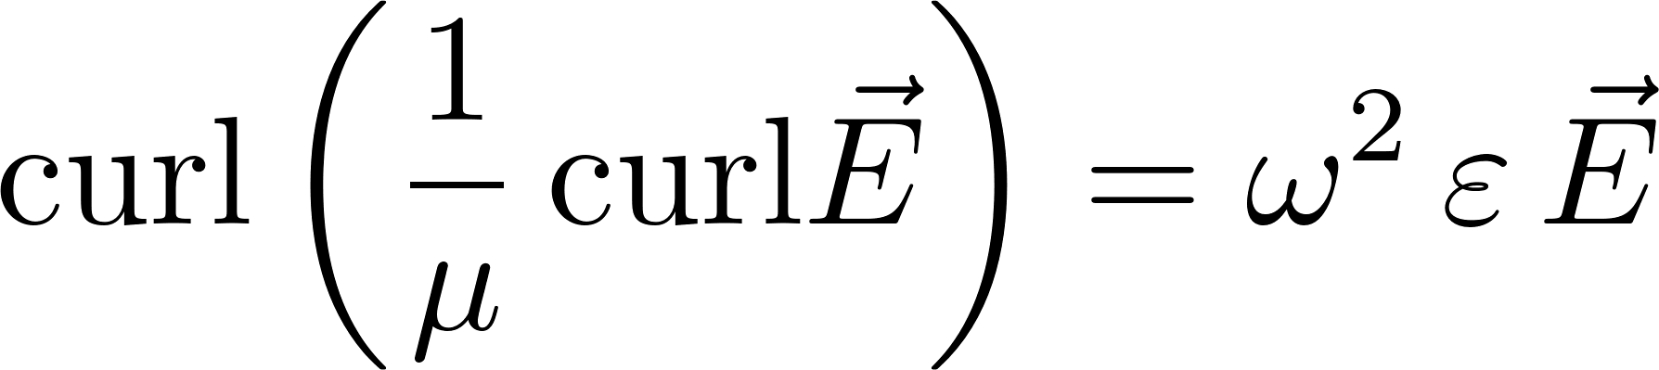
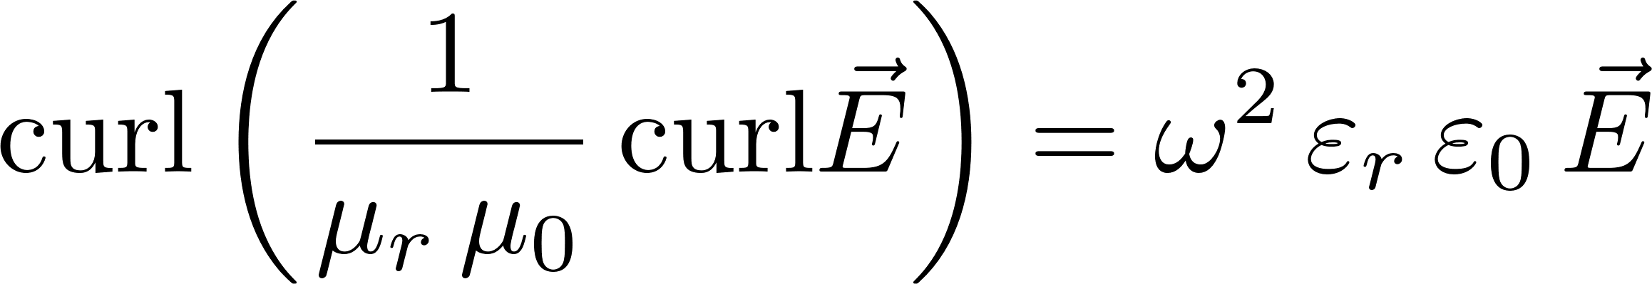
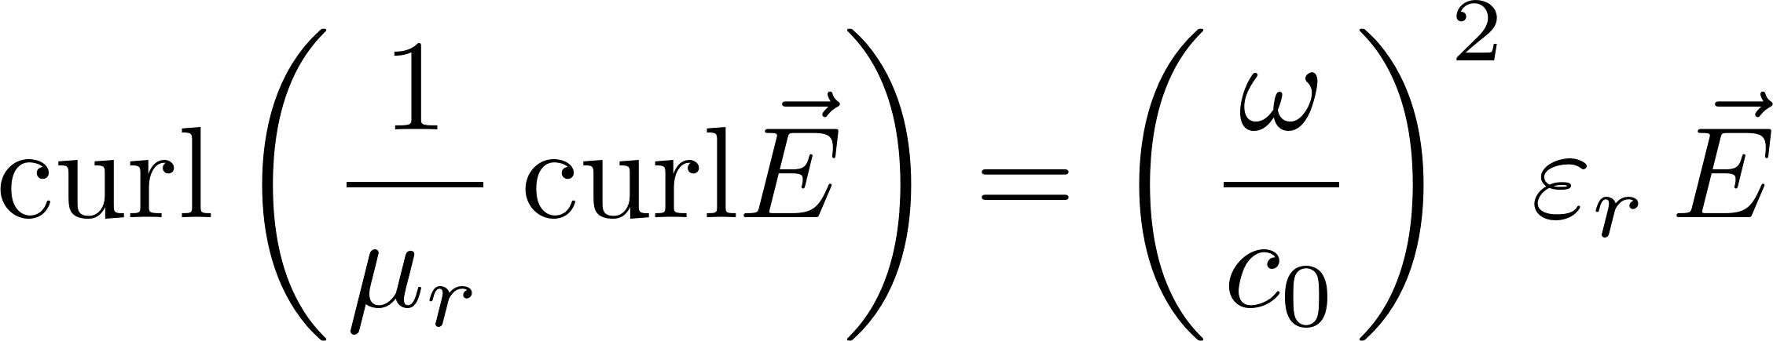
Theoretical Fundamentals
Determination of the Electromagnetic Field
  Finite Element Method
Faraday‘s Law
0
Ampere‘s Law
Elimination of the
magnetic field strength
Double-curl equation for
the electric field strength

Slide 19
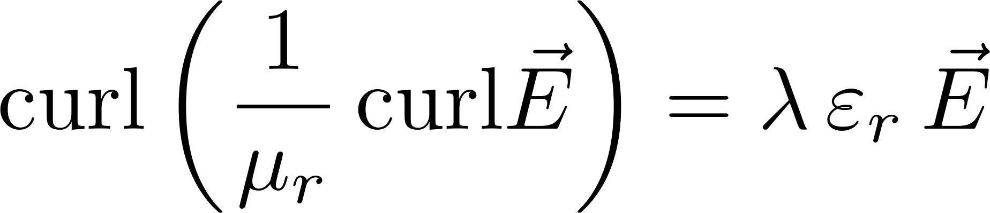
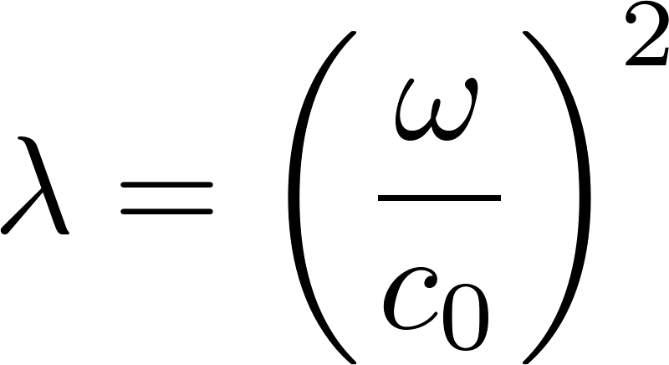
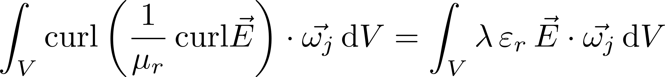
Theoretical Fundamentals
Determination of the Electromagnetic Field
  Finite Element Method
Double-curl equation for
the electric field strength
Weak formulation
Partial integration

Slide 20
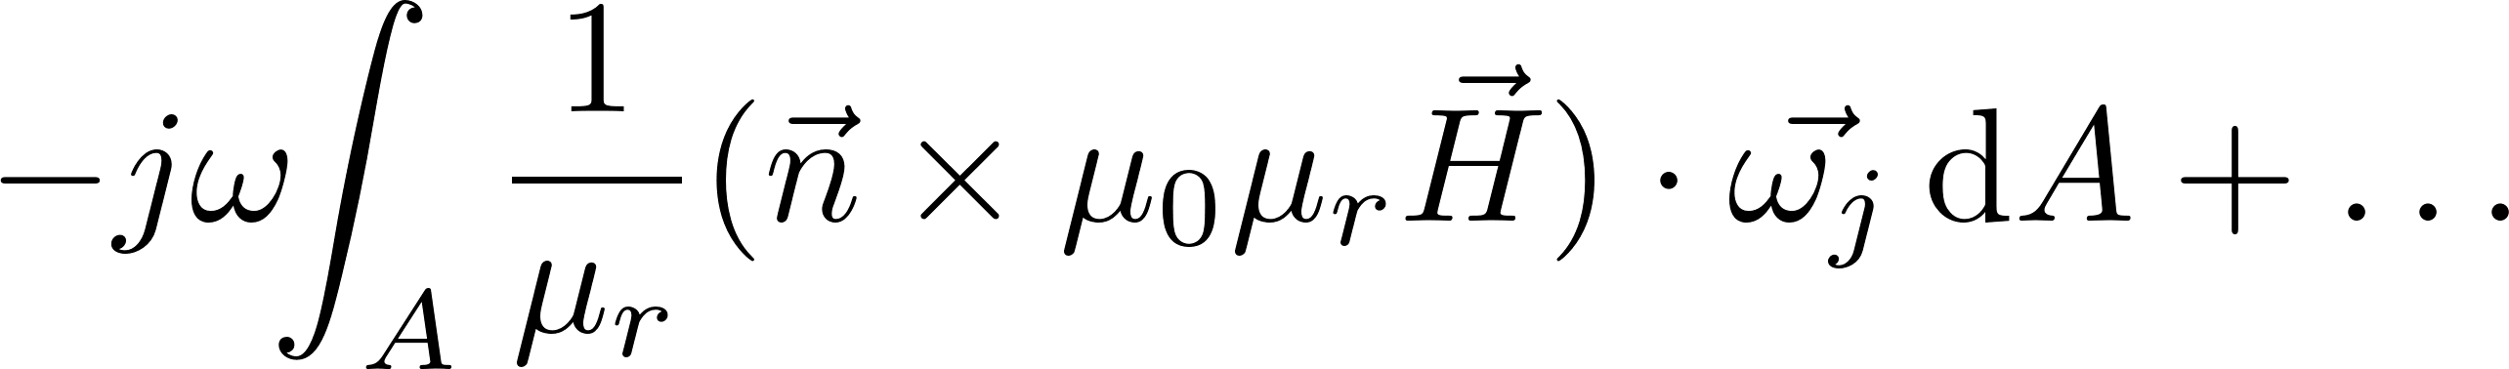
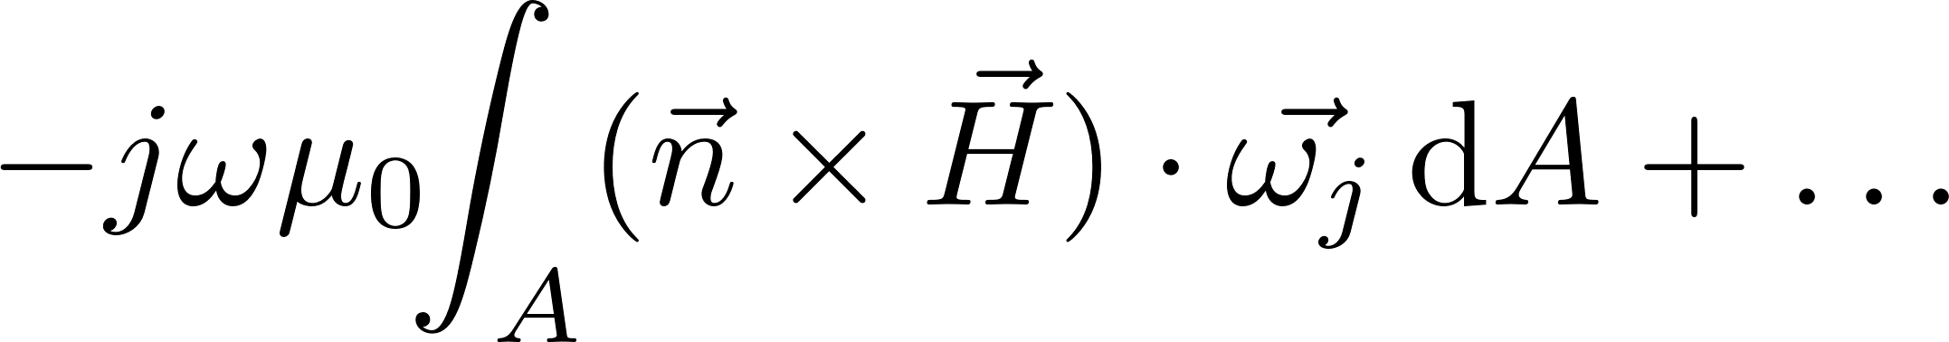
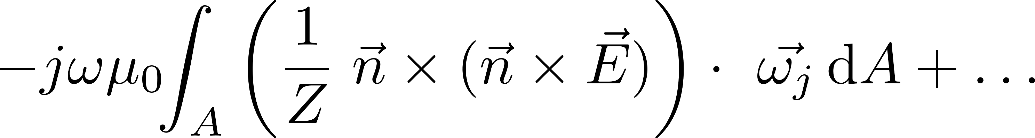
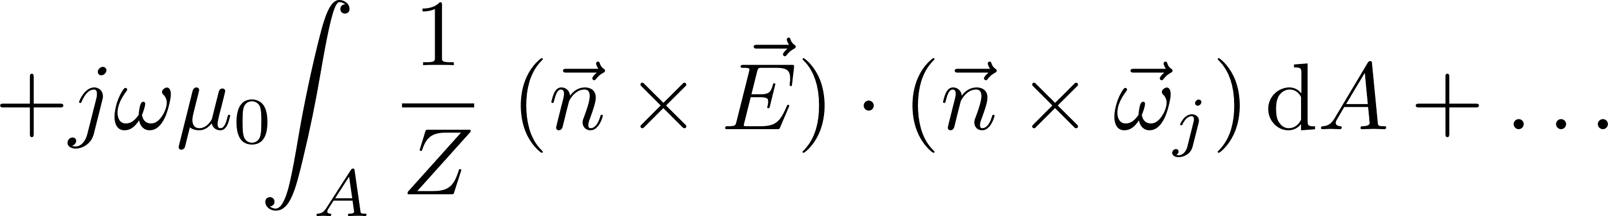
Theoretical Fundamentals
Determination of the Electromagnetic Field
  Finite Element Method
insert Faraday’s law
insert Leontowich’s BC

Slide 21
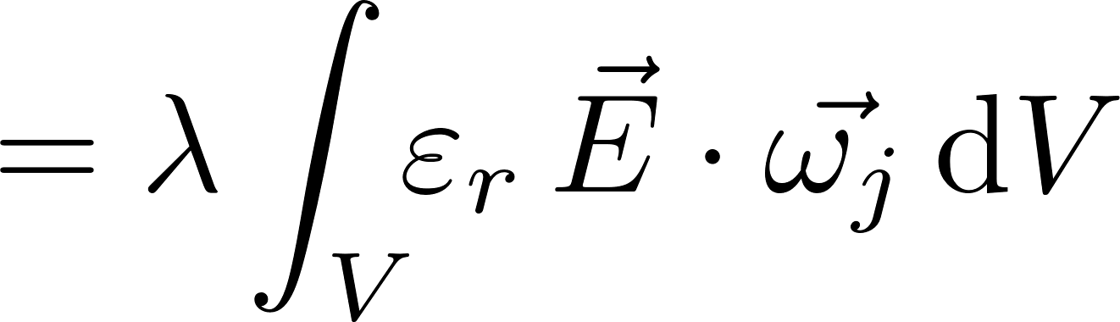
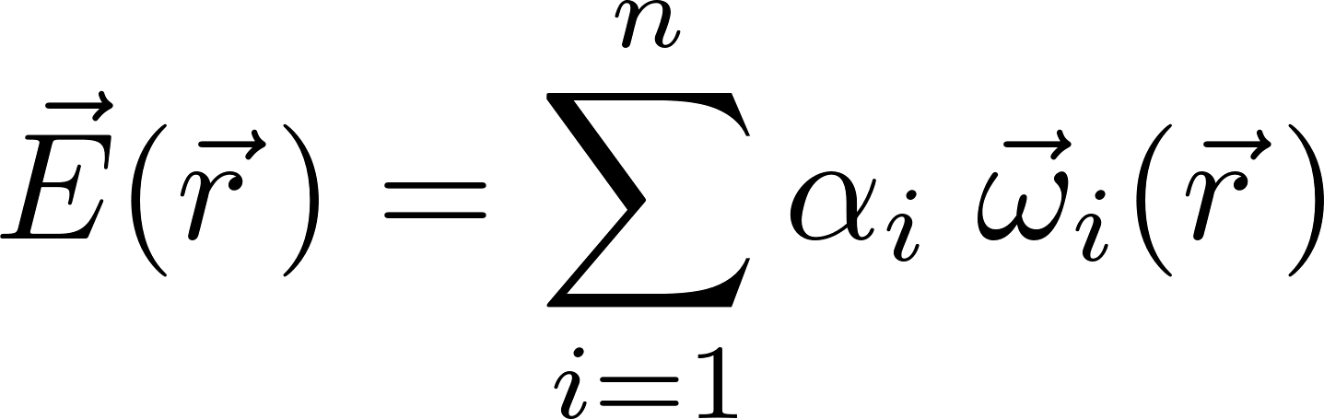
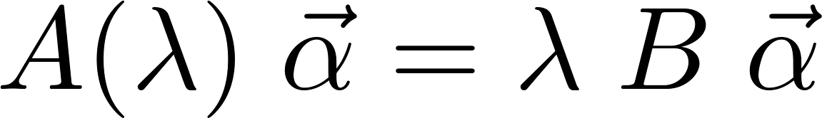
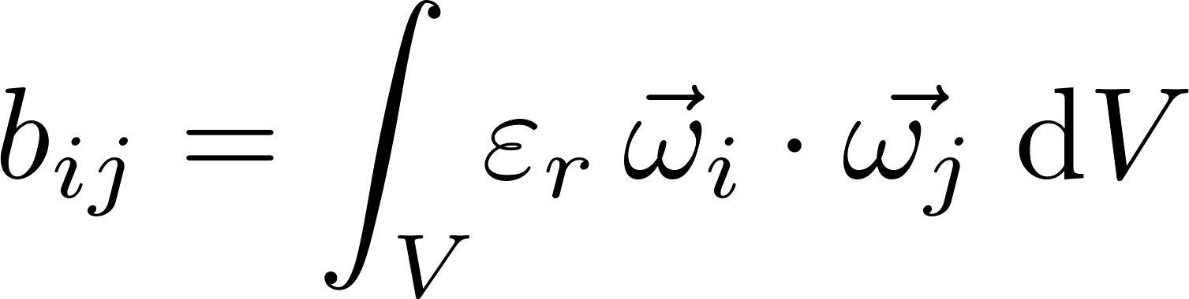
Theoretical Fundamentals
Determination of the Electromagnetic Field
  Finite Element Method
Generalized Nonlinear
Eigenvalue Equation
Tangentially Continuous
Basis Functions
Stiffness matrix
Mass matrix

Slide 22
Road Map
Overall Goal of the Subproject
  This subproject aims at developing surface models for accurately modeling thin, layered and lossy coatings of next-generation accelerator cavities.
  Considering thin, multilayer coatings with nonlinear, temperature-dependent material parameters.
  Work: Spatially distributed impedance boundary condition.
  Combined electromagnetic-eigenmode and thermal-field simulations.
  Evaluate the performance of entire, technically relevant accelerator cavities equipped with novel coatings.

Slide 23
Road Map
Work Plan
  Excerpt from the application
ü
ü
ü
started
û
û

Slide 24
End

