Slide 1
European XFEL
Mid-Term Accelerator Developments
STFC-DESY-XFEL Collaboration Meeting
5.12.2024
Hamburg
Winni Decking
MXL, DESY

Slide 2

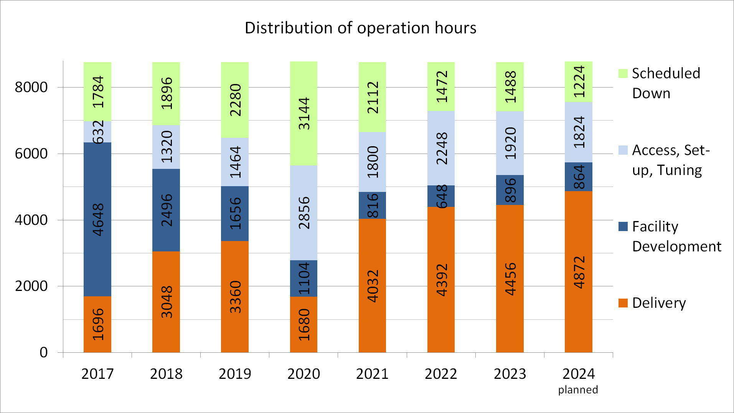
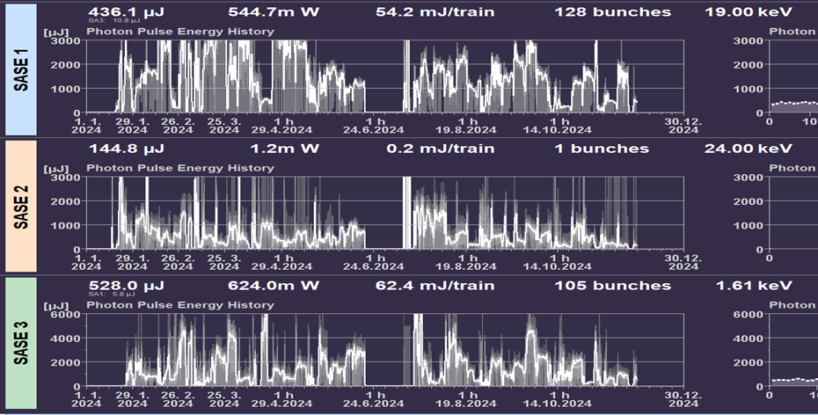

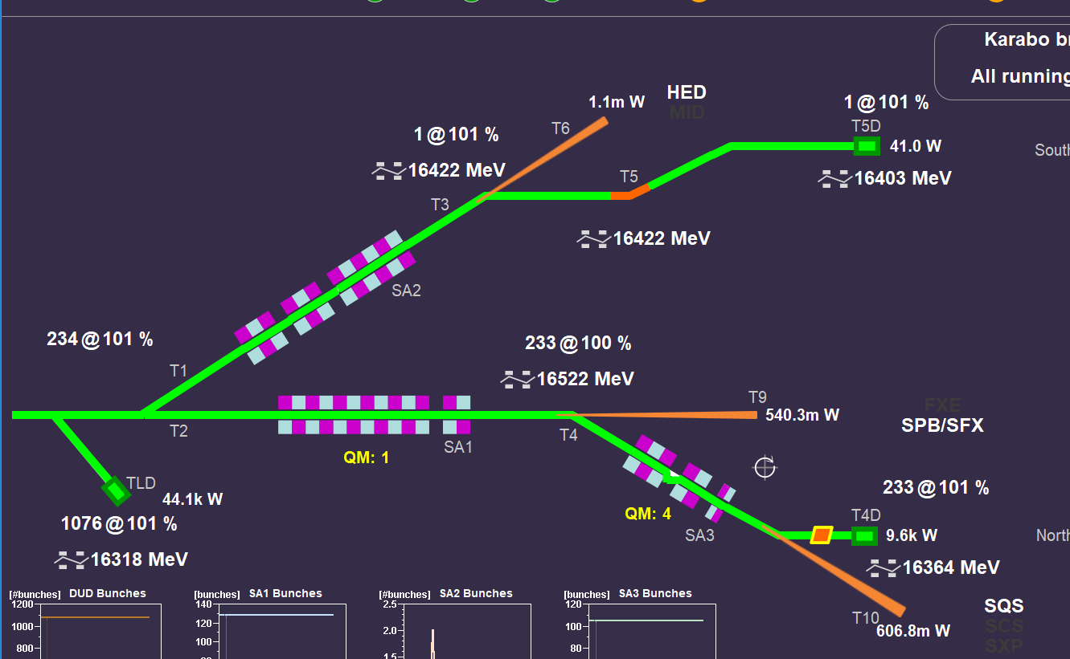
In operation since 2017
About 6500 h/year accelerator operation
> 4500 h/year X-ray delivery
Fully parallel operation of three FEL sources (since 2019) , about 10.000 h/year scheduled user experiments
Record stability, intensities, photon energy reach
FEL intensities
1 year

Slide 3
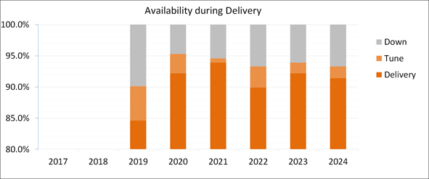
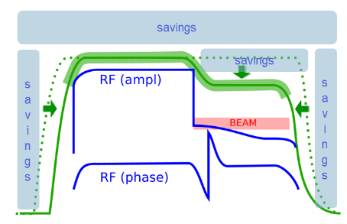
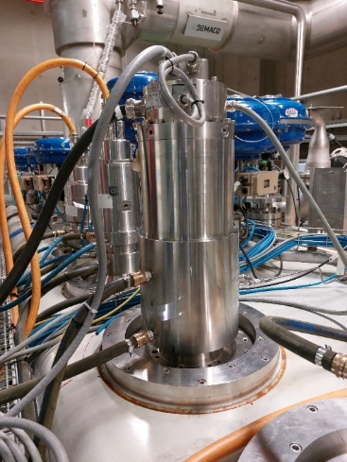
Reliable and sustainable operation
High overall system availability (> 90 %)
  Diligence
  Rigorous quality management
  Continuous development and improvement
Efficient and customized operation
  Intelligent controls
  Close collaboration with photon users
Example: Development of alternative cold compressor motor together with manufacturer
Example: Optimized power consumption
New magnetic bearings in operation since summer 2024
Shape modulator pulse based on operations needs
Only possible with highly automated RF regulation
Failure of motor bearings root cause for longest down-times
0.5 to 1 MW saving depending on operation mode

Slide 4
European XFEL Facility Roadmap
Strategy 2030 – Two-level strategy
“Harvesting Science and developing opportunities”
It is essential to prioritize and focus
“Upgrade Path”
2024–2029
2030⁺
MID-TERM DEVELOPMENTS
FACILITY UPGRADE
2022–2030
HARVESTING
2017–2021
STARTUP

Slide 5
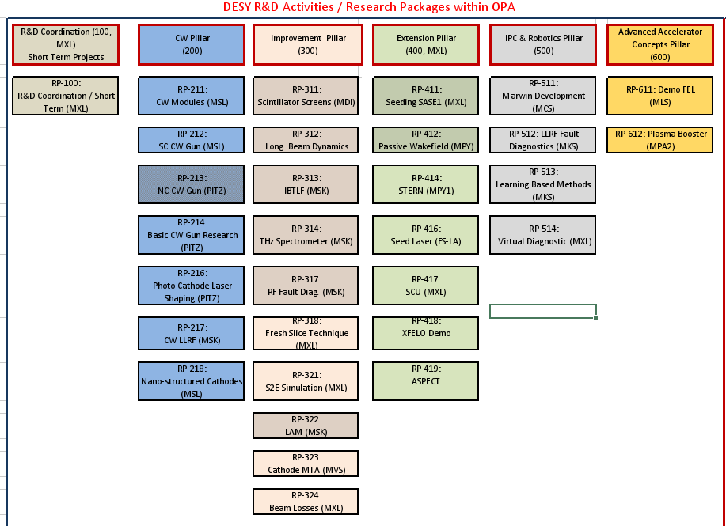
Research and Development Program
Competitive accelerator R&D program supported by European XFEL operation funds
About 40 FTE and 2 Meuro invest per year
supports tmid- and long-term strategic goals of European XFEL
  Facility Improvement (diagnostics, feedbacks, components)
  Extending facility capabilities (wavelength range, pulse length, spectral brightness, novel sources)
  Exploring SRF technology (next slide)
  Intelligent process control and robotics
  Advanced accelerator concepts
Closely linked to Helmholtz ARD ST1,3,4

Slide 6
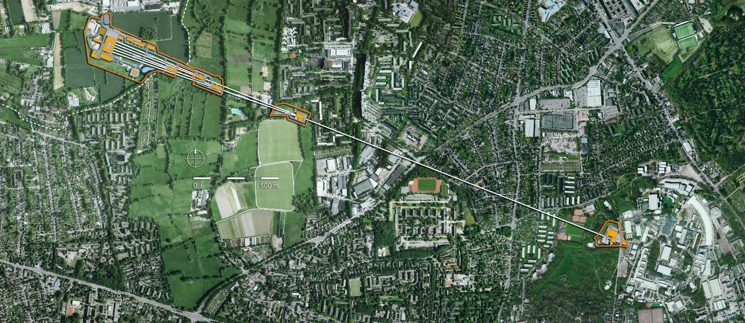
Extending the capabilities of European XFEL – Installations 2017-now
SASE3
APPLE-X
SASE3
Delay Line
Trans. Kicker Systems
Pulse compressor
Trans. Kicker Systems
Pulse compressor
Trans. Kicker Systems
Pulse compressor
Beam Arrival Time Feedback
Beam Arrival Time Feedback
SASE2 HXRSS
Long. Diagnostics
streaker
Beam Regions
NEPAL-X Injector Laser
fs Generation
ASPECT
Wiggler
Chirper.
2K He Plant
New compressor motors
Long. Diagnostics
Pulse compressor

Slide 7
Extending the capabilities of the European XFEL:
Long installation and maintenance period 2025
Post-SASE1/3
Passive streaker for longitudinal diagnostics
SASE3
Optical delay line
Pre-SASE1/3
Magnetic chicanes for long. phase space manipulation
Post SASE2
THZ generation
SASE1
Hard X-ray self-seeding and
two-colour operation
SASE2
Extension of undulator section by 50 m and preparation of infrastructure for installation of up to six 5 m long superconducting undulators
Injector
Novel Gun for extension of pulse length by 30%
Cryogenic preparation for installation of future superconducting CW gun
Accelerator
Linear accelerator warmed up for extensive maintenance of He pressure vessels
Facility
Extended maintenance and refurbishment of infrastructures and technical subsystems

Slide 8
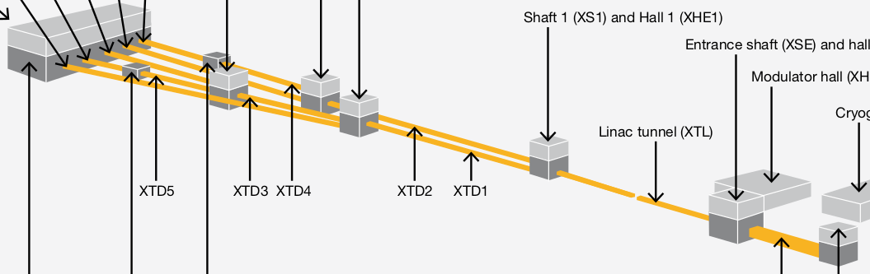
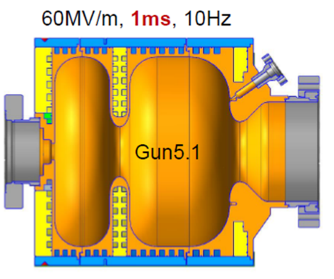
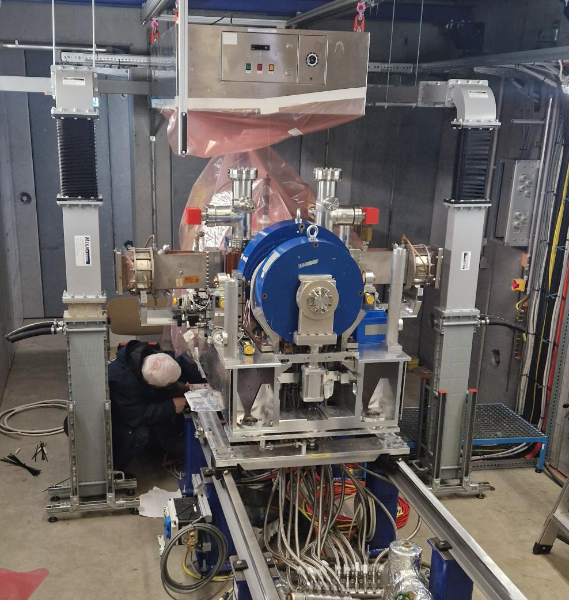
Replace XFEL Gun
new RF Gun of type 5 developmment is completed
  longer RF pulse
  double RF window design
  RF probe in gun body
  improved cathode spring design
  improved cooling
production of needed guns (incl. spares) is on-going
  new conditioning stand FALCO in operation since Q2/2024
LIMP2025 tasks:
  remove Gun4
  reconstruct RF distribution to accomodate 2 window set-up
  install Gun5
  update control system
  optimize laser beam line

Slide 9
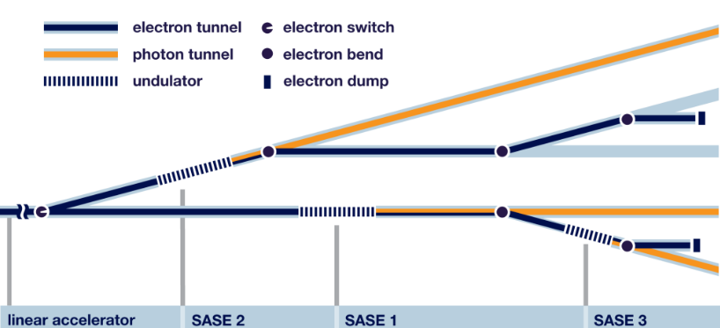
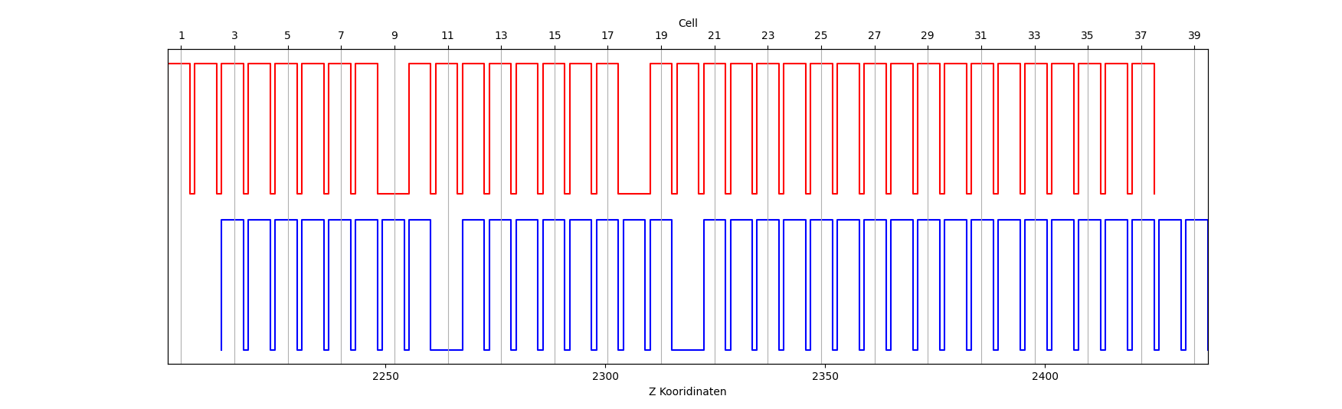
SASE2 and SCU Undulator Updates and Modifications
SASE2 Current Installation
Permanent Magnet Undulator System
Diagnostic Dechirper
prepare space in front of SASE2 undulator for future hardware and optics for beam manipulation
  options could be
    ASPECT wiggler for atto-second generation
    de-chirper
LIMP2025 tasks:
  move cells 1 and 2 to end of PMU section
  move 2 self-seeding chicanes to restore devision of undulator
Cell Number
1
11
21
31
39
now
after 2025
2250 m
2300 m
2350 m
2400 m
SASE2 After 2025 Shutdown Installation
Permanent Magnet Undulator System
S-PRESSO
Diagnostic Dechirper
Lattice Update for FESTA

Slide 10
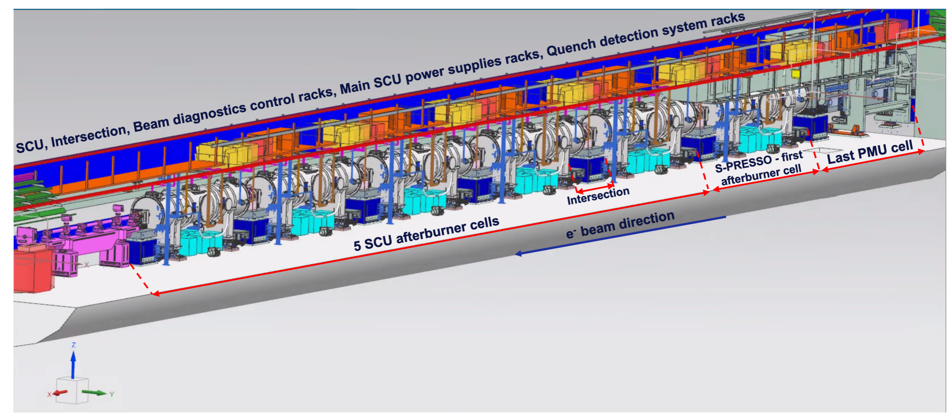
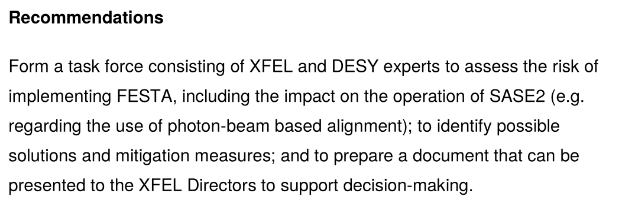
Anticipated Final SCU Configuration (pending Council Approval)
Task force is being set-up
but did not yet start to work

Slide 11
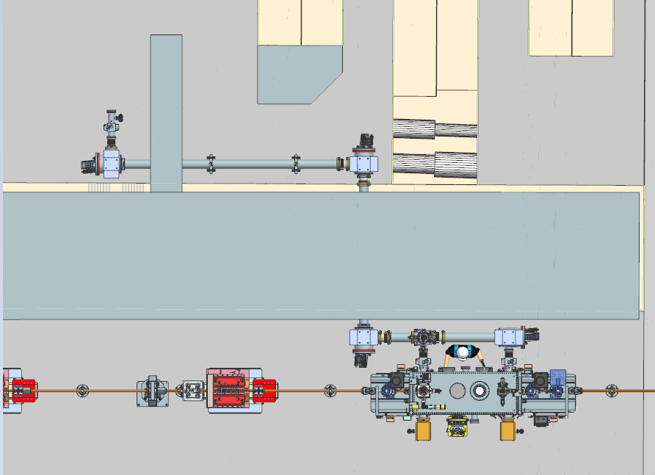
STERN Installations
STERN: Superradiant Terahertz Radiation geNeration using di-electric narrow tubes
  e.g. using atomic layer deposition developed at DESY with UHH; currently being characterized with laser-based THz setup
  or waveguide based approach
Tasks during LIMP2025:
  update the lattice to accomodate main STERN chamber
    chamber is under construction
  install THz beam line to experimental station for THz characterization
    station design on-going; no installation is planned in 2025
exp.
station
e-beam

Slide 12
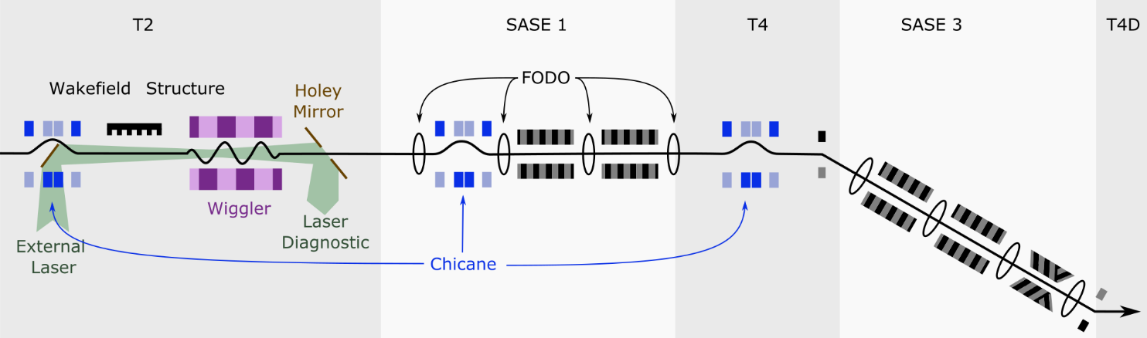
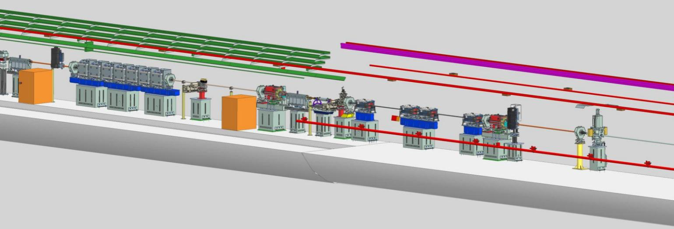
SASE1 Modifications and Updates
complete (laser-less) ASPECT set-up in front of SASE1 undulator
  installation of chicane
  update general infrastructure (e.g. cooling)
modify water pipe routing to accommodate laser beam line
install HXRSS chicane in SASE1 cell 17
ASPECT chicane installation also in front of SASE3
3D model SASE1 after LIMP2025

Slide 13
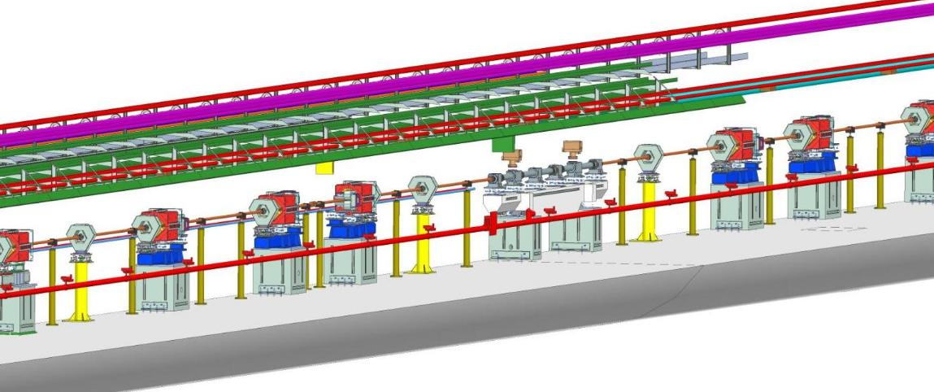
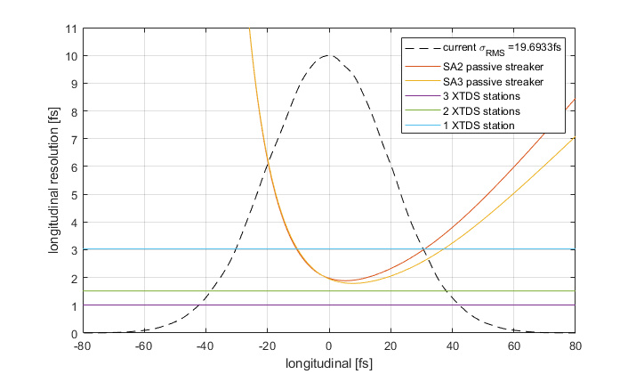
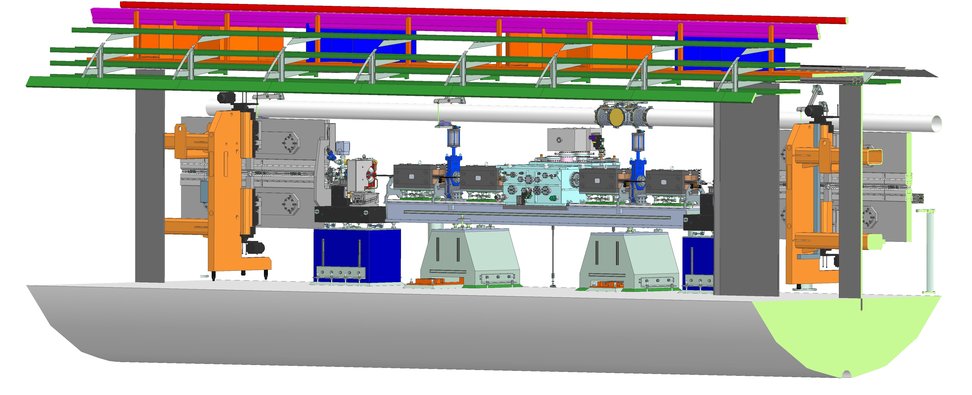
SASE3 Section Modifications and Updates
installation of a passive streaker for long. phase space measurement also behind SASE3
install Optical Delay Line in SASE3, cell 13
‘Streaker’ Lattice compatible with later installation of active transverse deflecting system
streaker integration after SASE3
Longitudinal resolution for
Passive streaker
X-band TDS
ODL integration

Slide 14
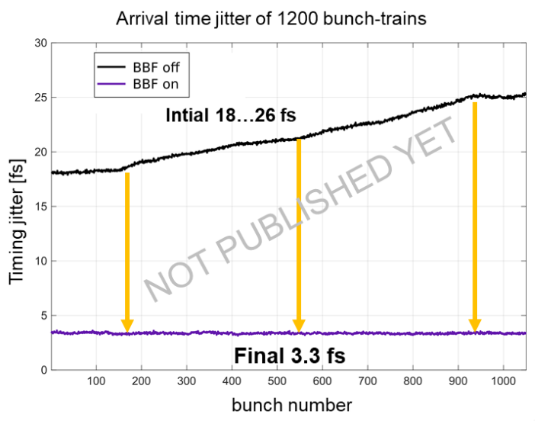
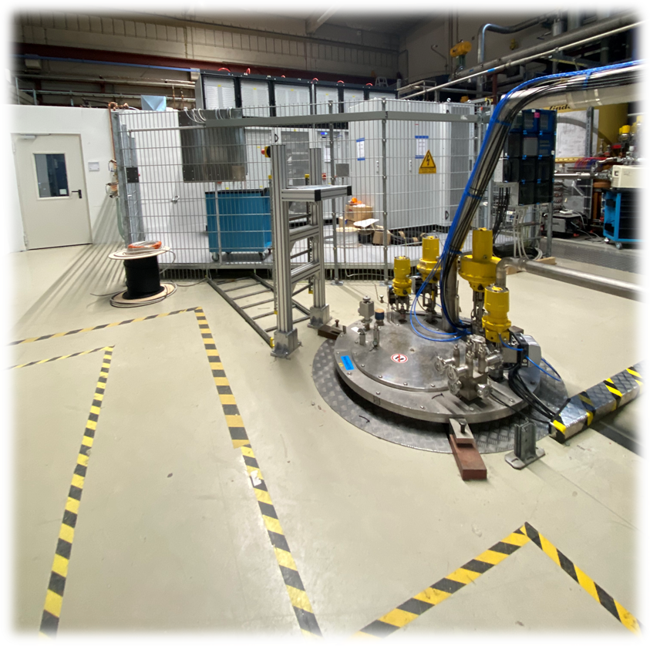
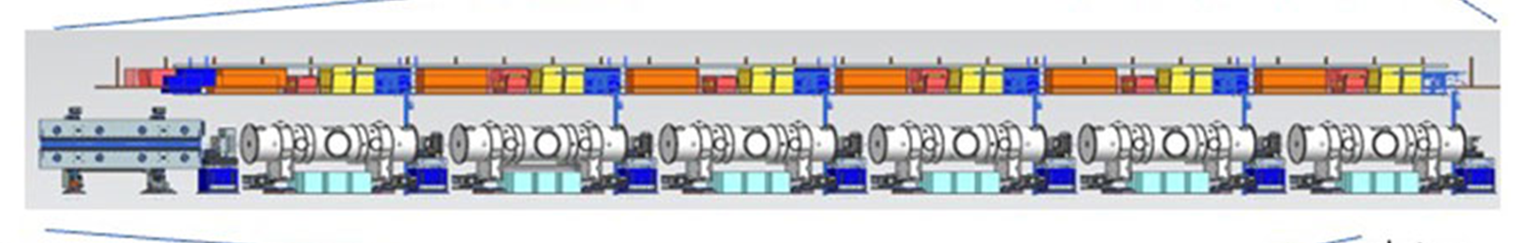

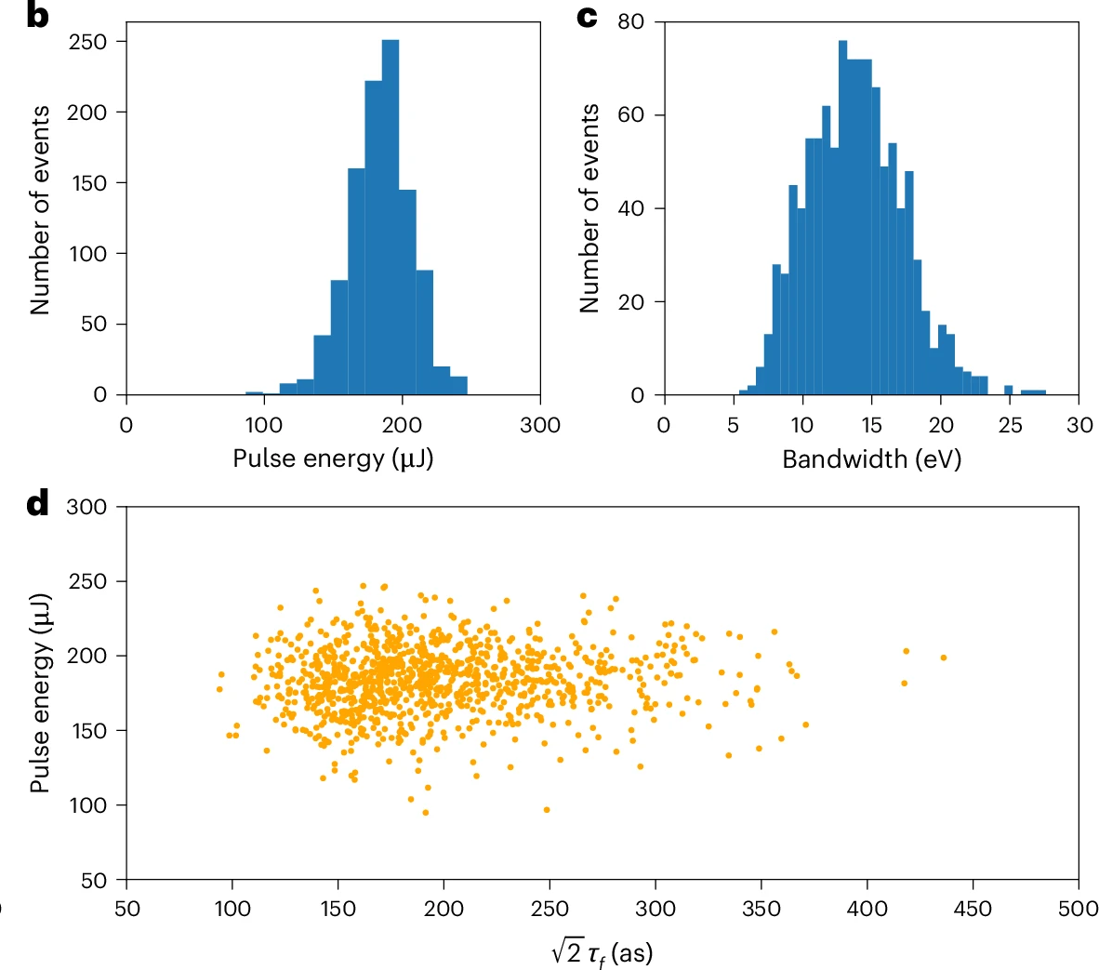
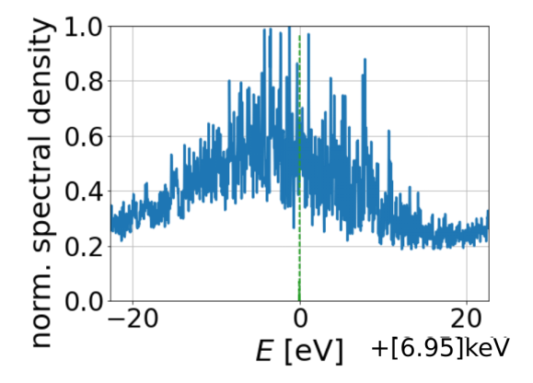
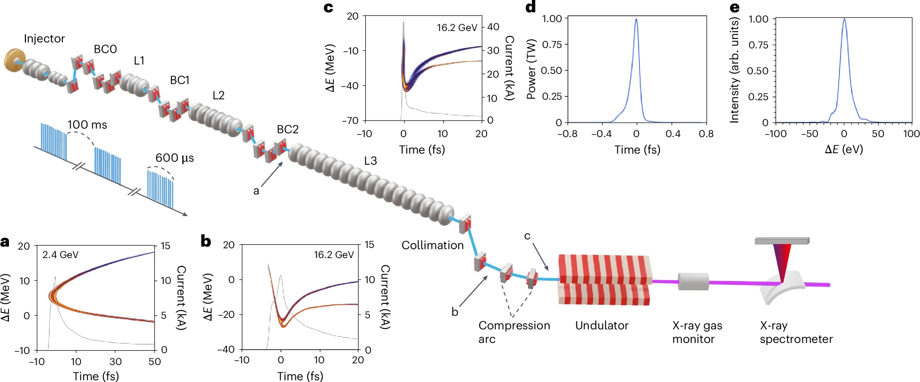
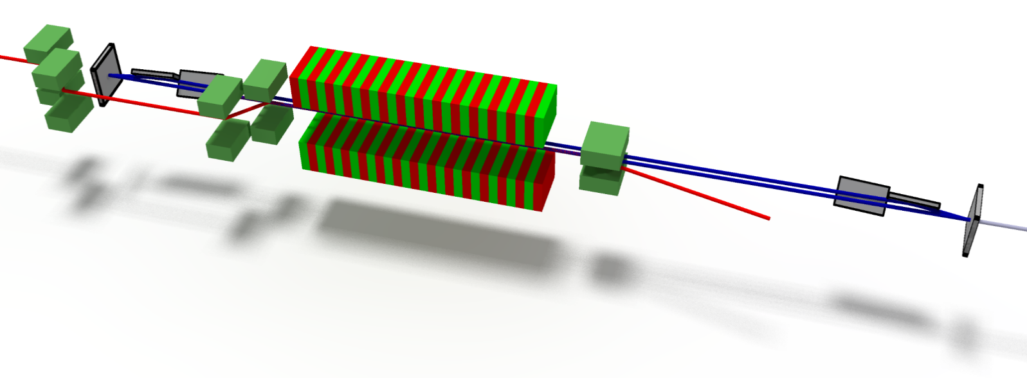
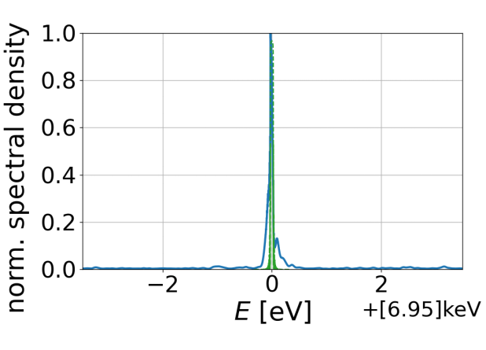
Research and Development Program - Highlights
  Increasing
  Stability:
  Single Digit fs
  Stabilization
  Increasing Photon Energy:
  Superconducting Undulators
  R&D by XFEL with DESY support
  To be installed 2026-28
  Increase photon energy to 50 keV
  Test Area DESY Hall3
  Increasing Brightness:
  Attosecond Hard X-rays
  Reducing Bandwidth:
  XFEL Oscillator
  Simulations
  Test installation
  Commissioning ongoing

Slide 15
Next years at the European XFEL accelerator
Survive the 2025 maintenance ;-)
Further explore short pulse options (ASPECT), eventually install better longitudinal diagnostics, positive R56 before SASE1, … (Marc Guetg)
Install superconducting undulators and see how that works (Shan Liu, Ye Chen, Frank Brinker)
Commission SASE1 HXRSS (Shan Liu)
Explore THz generation (Francois Lemery)
Oscillate in the DEMO-XFELO (Patrick Rauer) and push further
Explore capabilities of new laser system (pulse shaping, charge variation, twin bunches) (Ye Chen, Marc Guetg)
Understand beam physics better, commission virtual and combined diagnostics, prepare for HDC parameters (Sergey Tomin, Igor Zagorodnov, Ye Chen, Marc Guetg)
Efficient operation and optimization (Matthias Scholz)
Explore different modes of bunch distribution (fully interleaved vs. beam regions)

