Slide 1
Possible Extension: SASE4/5
Marc Guetg for the SASE4/5 team

Slide 2
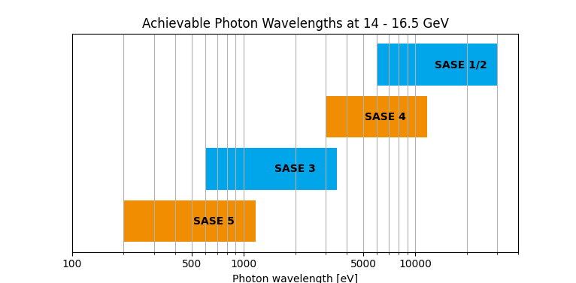
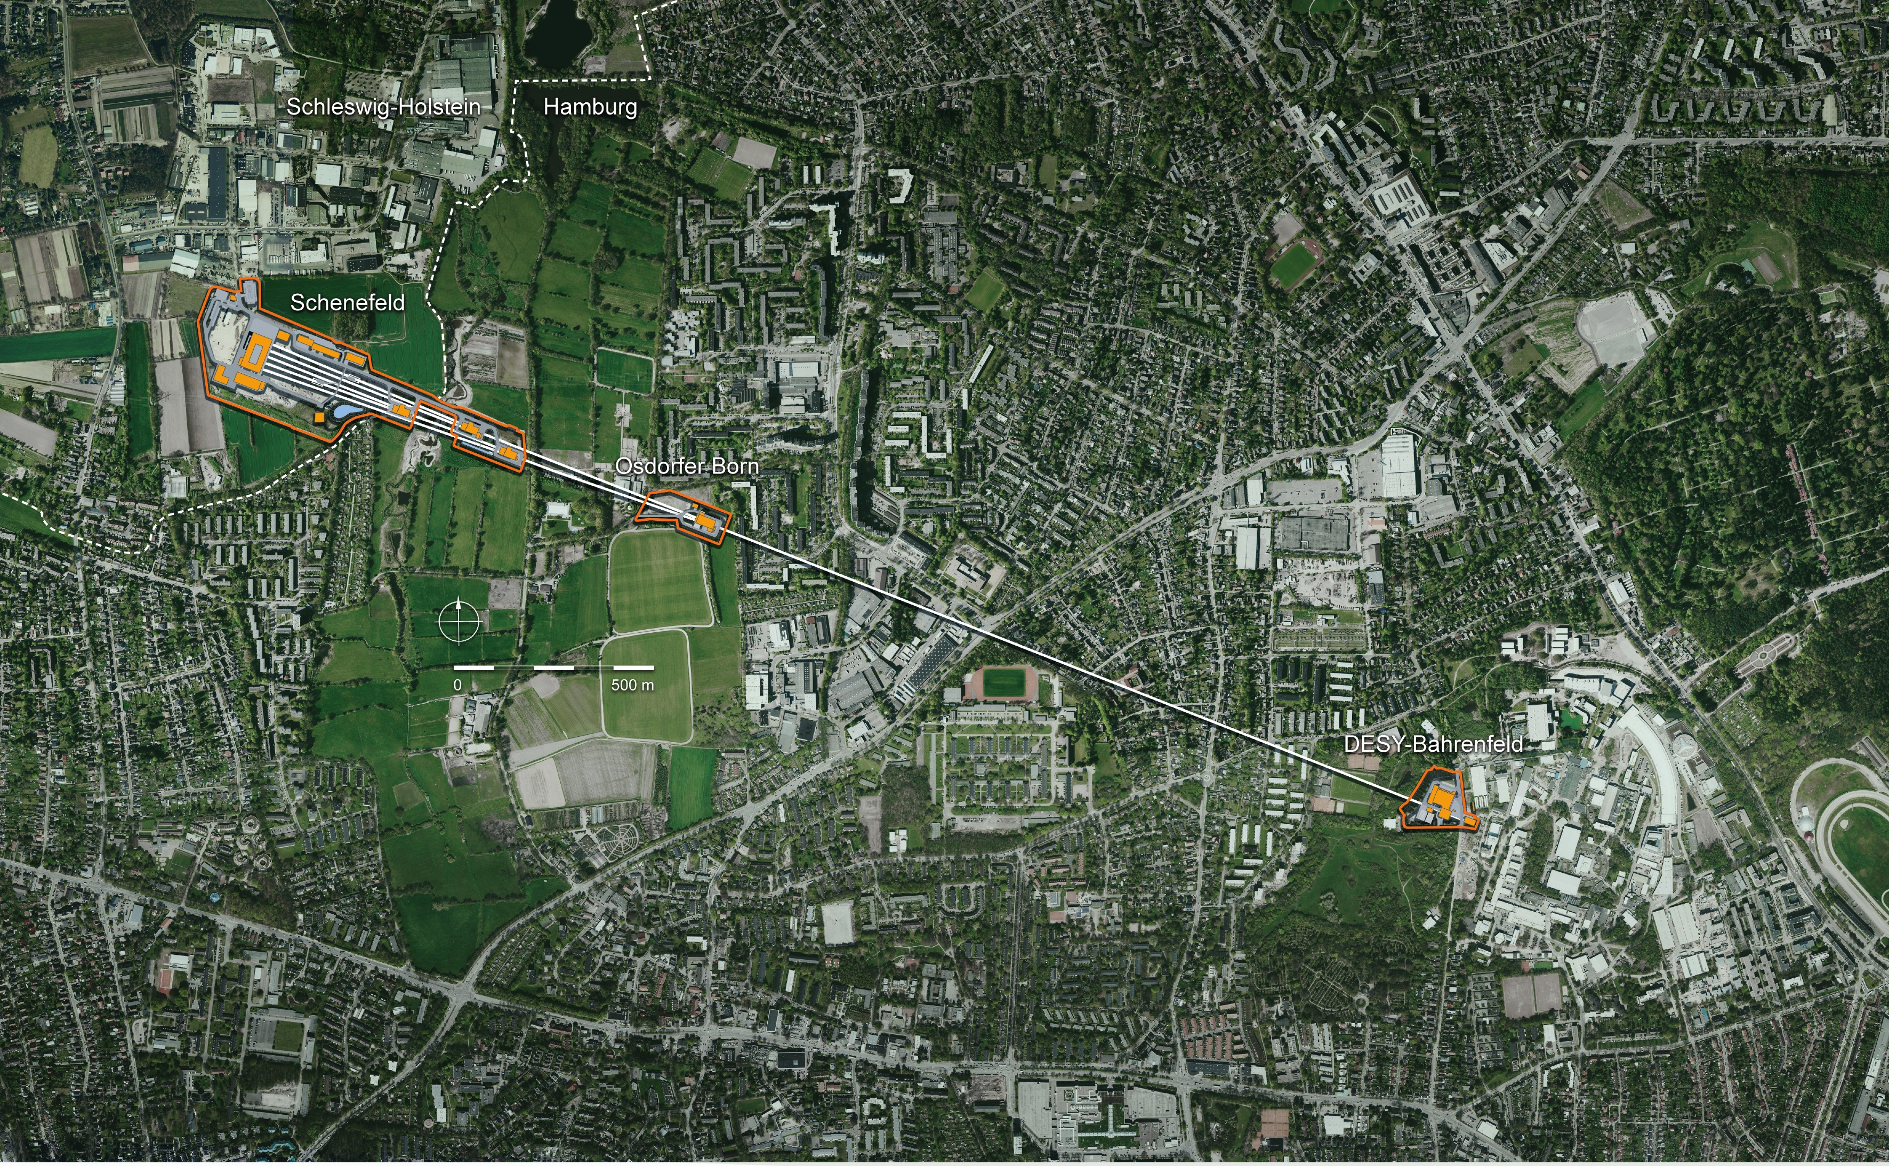
EuXFEL – Possible Extension of Photon Beamlines
Possible mid-term upgrade: SASE 4 & SASE 5
  About 100 m per undulator line
  Reserved space for experimental hutches exists
  Allows for continuous photon energy coverage
Possible long-term upgrade: Second Fan
  Potentially doubles the reach of the facility
  Requires major civil engineering

Slide 3
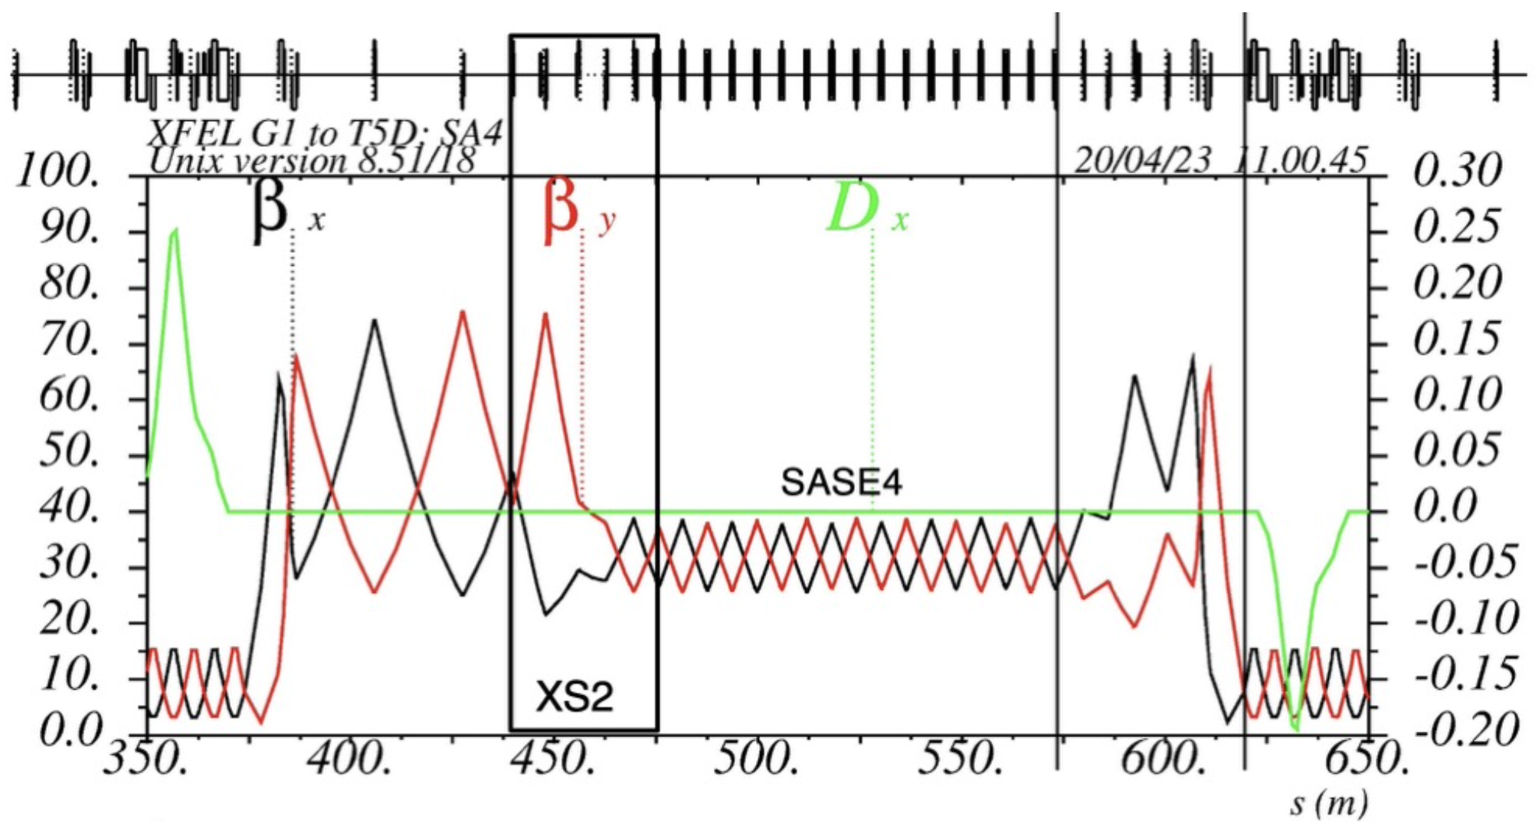
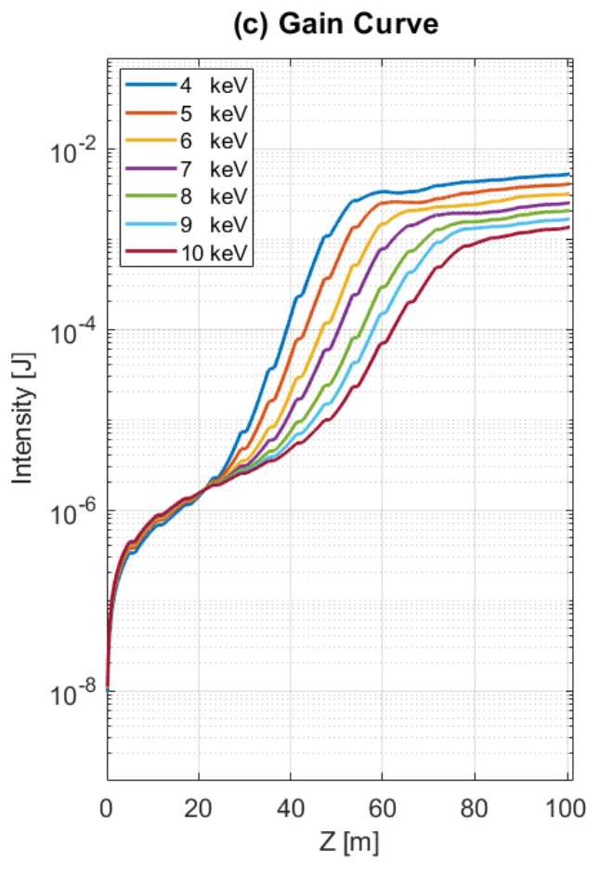
SASE 4
Surrounding shaft buildings limit the available space
Could serve x-rays 10+ keV
Deteriorating effects from SASE2 and T3 arc are acceptable
  Will become problematic for higher photon energies
Severely limited for “two-color options”
  HXRSS
  Multi-stage
  Two-color

Slide 4
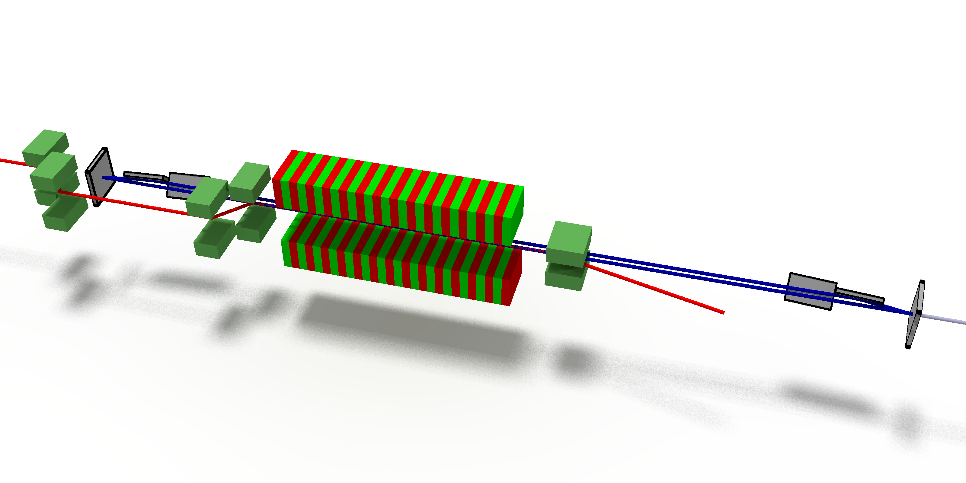
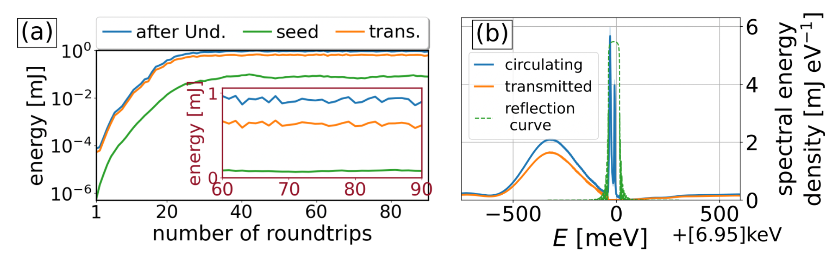
SASE 4 – Cavity Based FEL
Available space likely sufficient
Would offer a potentially unique source
  ~10x brightness compared to HXRSS
Demonstrator (7 keV) is currently being commissioned in SASE1
Simulation Results for several round trips
Curtesy of Patrick Rauer

Slide 5
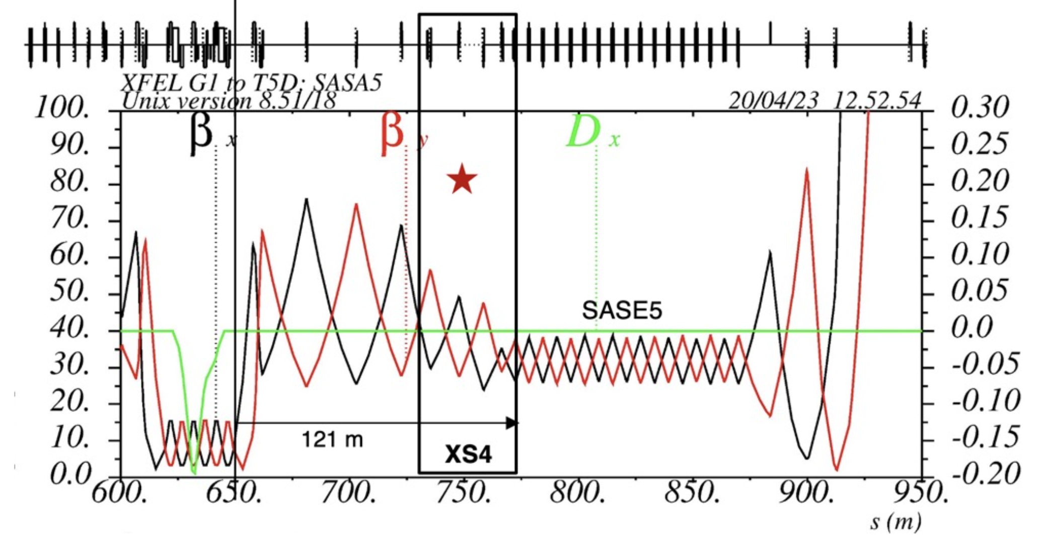
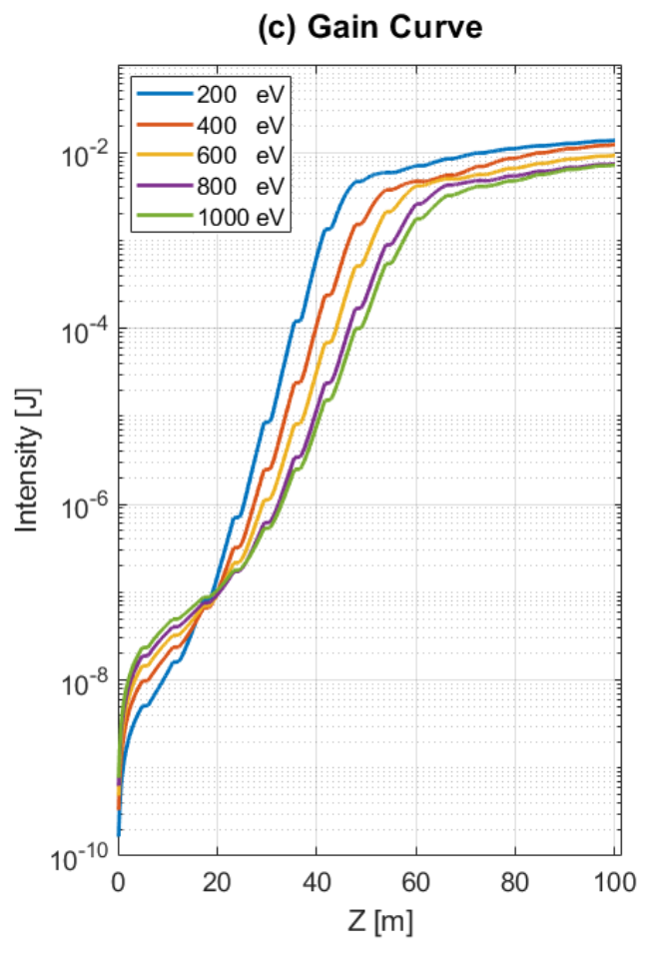
SASE 5
Surrounding shaft building and the beam dump limited the available space
Could serve the very soft x-ray regime
Deteriorating effects from previous beamlines are acceptable at low photon energies
Very K values might require method to reduce background from SASE2 & SASE4
Two-color options might be possible
Gain length might improve with helical undulators

Slide 6
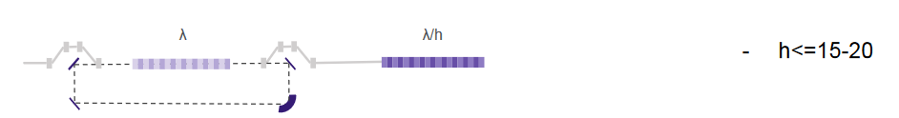
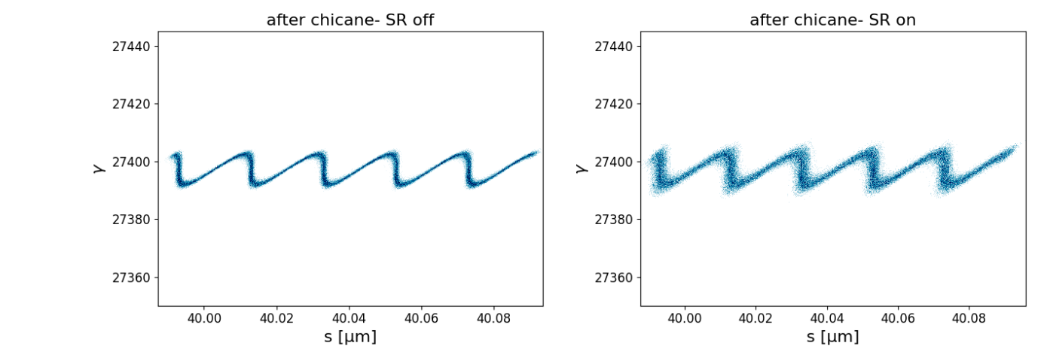
SASE5 – Coherence Control
SXRSS at SASE5 could in principle work for higher photon energies
  Further studies are required
HGHG could potentially be feasible for SASE5, thereby allowing external seeding
EEHG is likely not feasible due to quantum diffusion effects

Slide 7
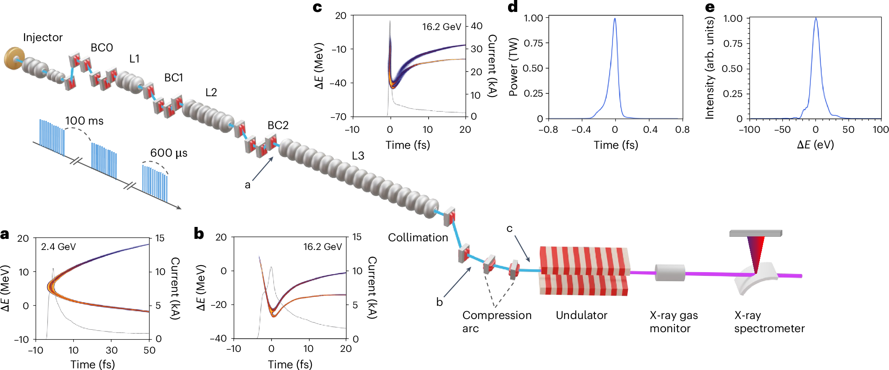
Attosecond Pulse Generation with Self-chirping
Positive R₅₆ from the T3 and T5 chicane together with non-linear compression can produce extremely short pulses
Already utilized in SASE2 & SASE3
  Could also work for SASE4 & SASE5
J.Yan et al, Terawatt-attosecond hard X-ray free-electron laser at high repetition rate, https://www.nature.com/articles/s41566-024-01566-0

Slide 8
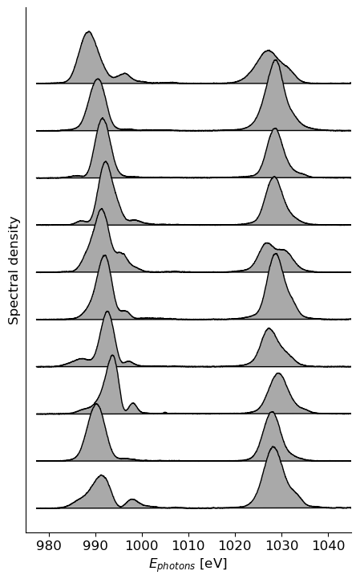
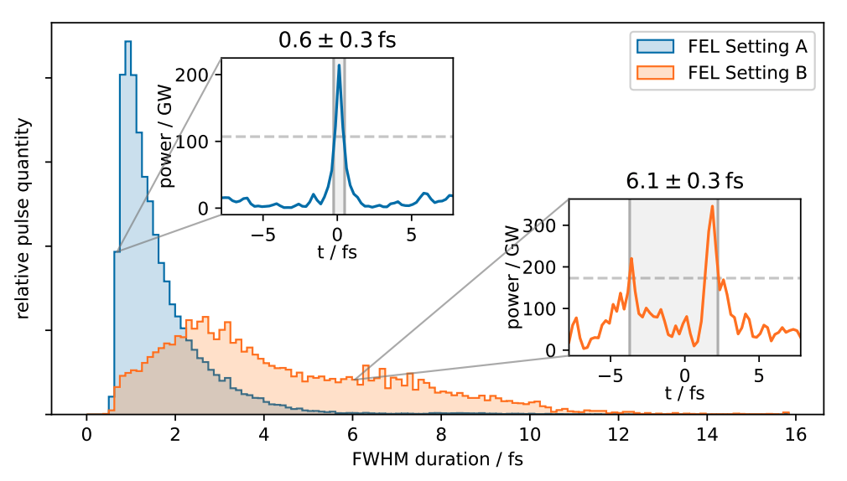
Attosecond Pulse Generation with Self-chirping
Was utilized for several user soft x-ray deliveries and one hard x-ray
  Two-color atto-seconds (soft)
  Polarization control (soft)
Sub fs-pulses have been confirmed for both cases
Angular Streaking Result for 1 keV
L. Funke et al, Capturing Nonlinear Electron Dynamics with Fully characterized Attosecond X-ray Pulses, https://doi.org/10.48550/arXiv.2408.03858

Slide 9
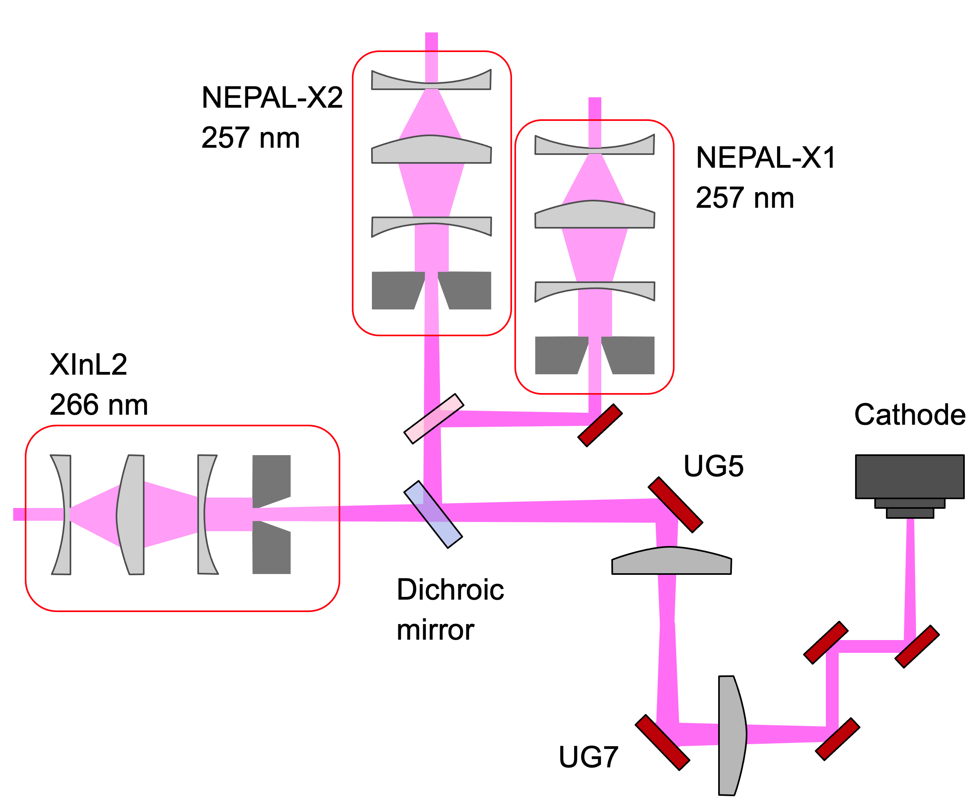
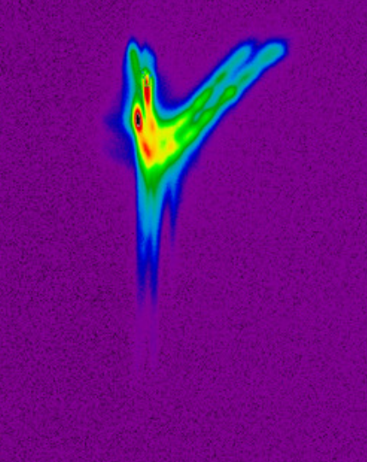
Twin Pulses
Twin Pulses offer an opportunity for two-color operation at larger delays
  Multiples of 770 ps
  Smaller delays (fs level) are tough to achieve
Initial experiment at SASE2 produced 2x1.5 mJ @ 9keV with 770 ps separation
ErUM Proposal with Uni Siegen

Slide 10
Summary
SASE 4/5 are a possible mid-term upgrade for EuXFEL
  Would increase the wavelength reach
  Decrease operational complexity
  Stretch the operational envelope of the facility
Possible operation modes
  SASE
  Short-Pulses
  Coherence control
  Twin-Pulses

