Slide 1
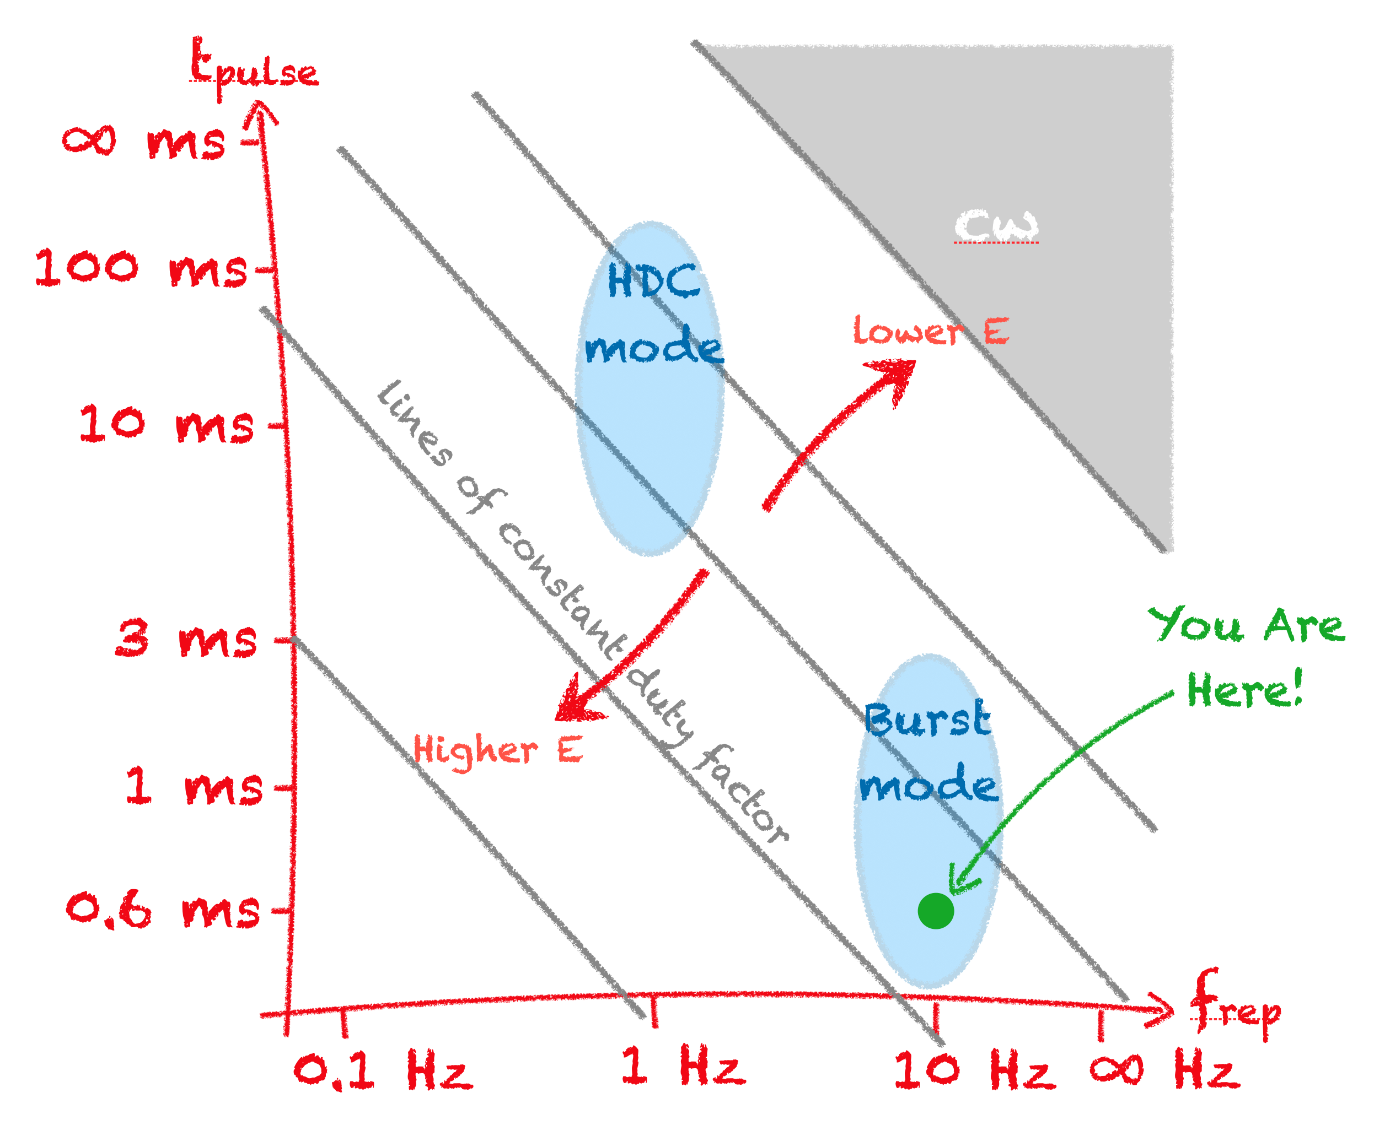
XFEL High-Duty-Cycle Upgrade
Nick Walker (DESY)
for the XFEL-HDC team
DESY-STFC-XFEL meeting
5.12.2024

Slide 2
CW/HDC XFEL: Where have we been? We’re are we going?
Towards a future major CW upgrade for XFEL Accelerator
Scope and parameters
Supporting R&D
Operations flexibility (➞High Duty Cycle)
getting back to higher energies
Intermediate deliverable:
Publication of a CDR-like report in 2026
2022
1st Workshop Nov 2022 (Jork)
2nd Workshop 20-23 March 2023 (Jork)
3rd Workshop 21-22 November 2023 (Jork)
4th Workshop 8-9 October 2024 (Hamburg)
2023
2024
Feasibility and Options Study

Slide 3

Original CW upgrade proposal (canonical upgrade)
Injector
1.3 GHz module
3.9 GHz 3rd harm.
L1
4 modules
(1 RF station)
L2
12 modules
(3 RF stations)
L3
80 modules
(20 RF stations)
SASE2
A2
A3
A4
A5
A6
A25
A1
AH1
SASE1
SASE3

Slide 4
Original CW upgrade proposal (canonical upgrade)
Injector
1.3 GHz module
3.9 GHz 3rd harm.
L1
4 modules
(1 RF station)
L2
12 modules
(3 RF stations)
L3
96 modules
(24 RF stations)
SASE2
A6
A29
A6
A25
AH1
SASE1
SASE3

Slide 5
Original CW upgrade proposal (canonical upgrade)
Injector
1.3 GHz module
3.9 GHz 3rd harm.
L1
4 modules
(1 RF station)
L2
12 modules
(3 RF stations)
L3
96 modules
(24 RF stations)
SASE2
A6
A29
A2
A3
A4
A5
A6
A25
AH1
A1
AH1
SASE1
SASE3
CW optimized modules
CW photo injector
CW 3.9-GHz system
2nd cryo plant (2.5 kW ➔ 5 kW)

Slide 6
Original CW upgrade proposal (canonical upgrade)
Injector
1.3 GHz module
3.9 GHz 3rd harm.
L1
4 modules
(1 RF station)
L2
12 modules
(3 RF stations)
L3
96 modules
(24 RF stations)
SASE2
A6
A29
A2
A3
A4
A5
A6
A25
AH1
A1
AH1
SASE1
SASE3
CW optimized modules
CW photo injector
CW 3.9-GHz system
2nd cryo plant (2.5 kW ➔ 5 kW)
Low peak power rf system
(does not permit 17.5 GeV at low d.c.)

Slide 7
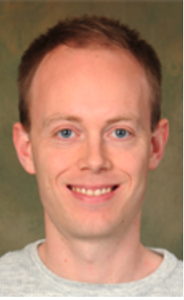
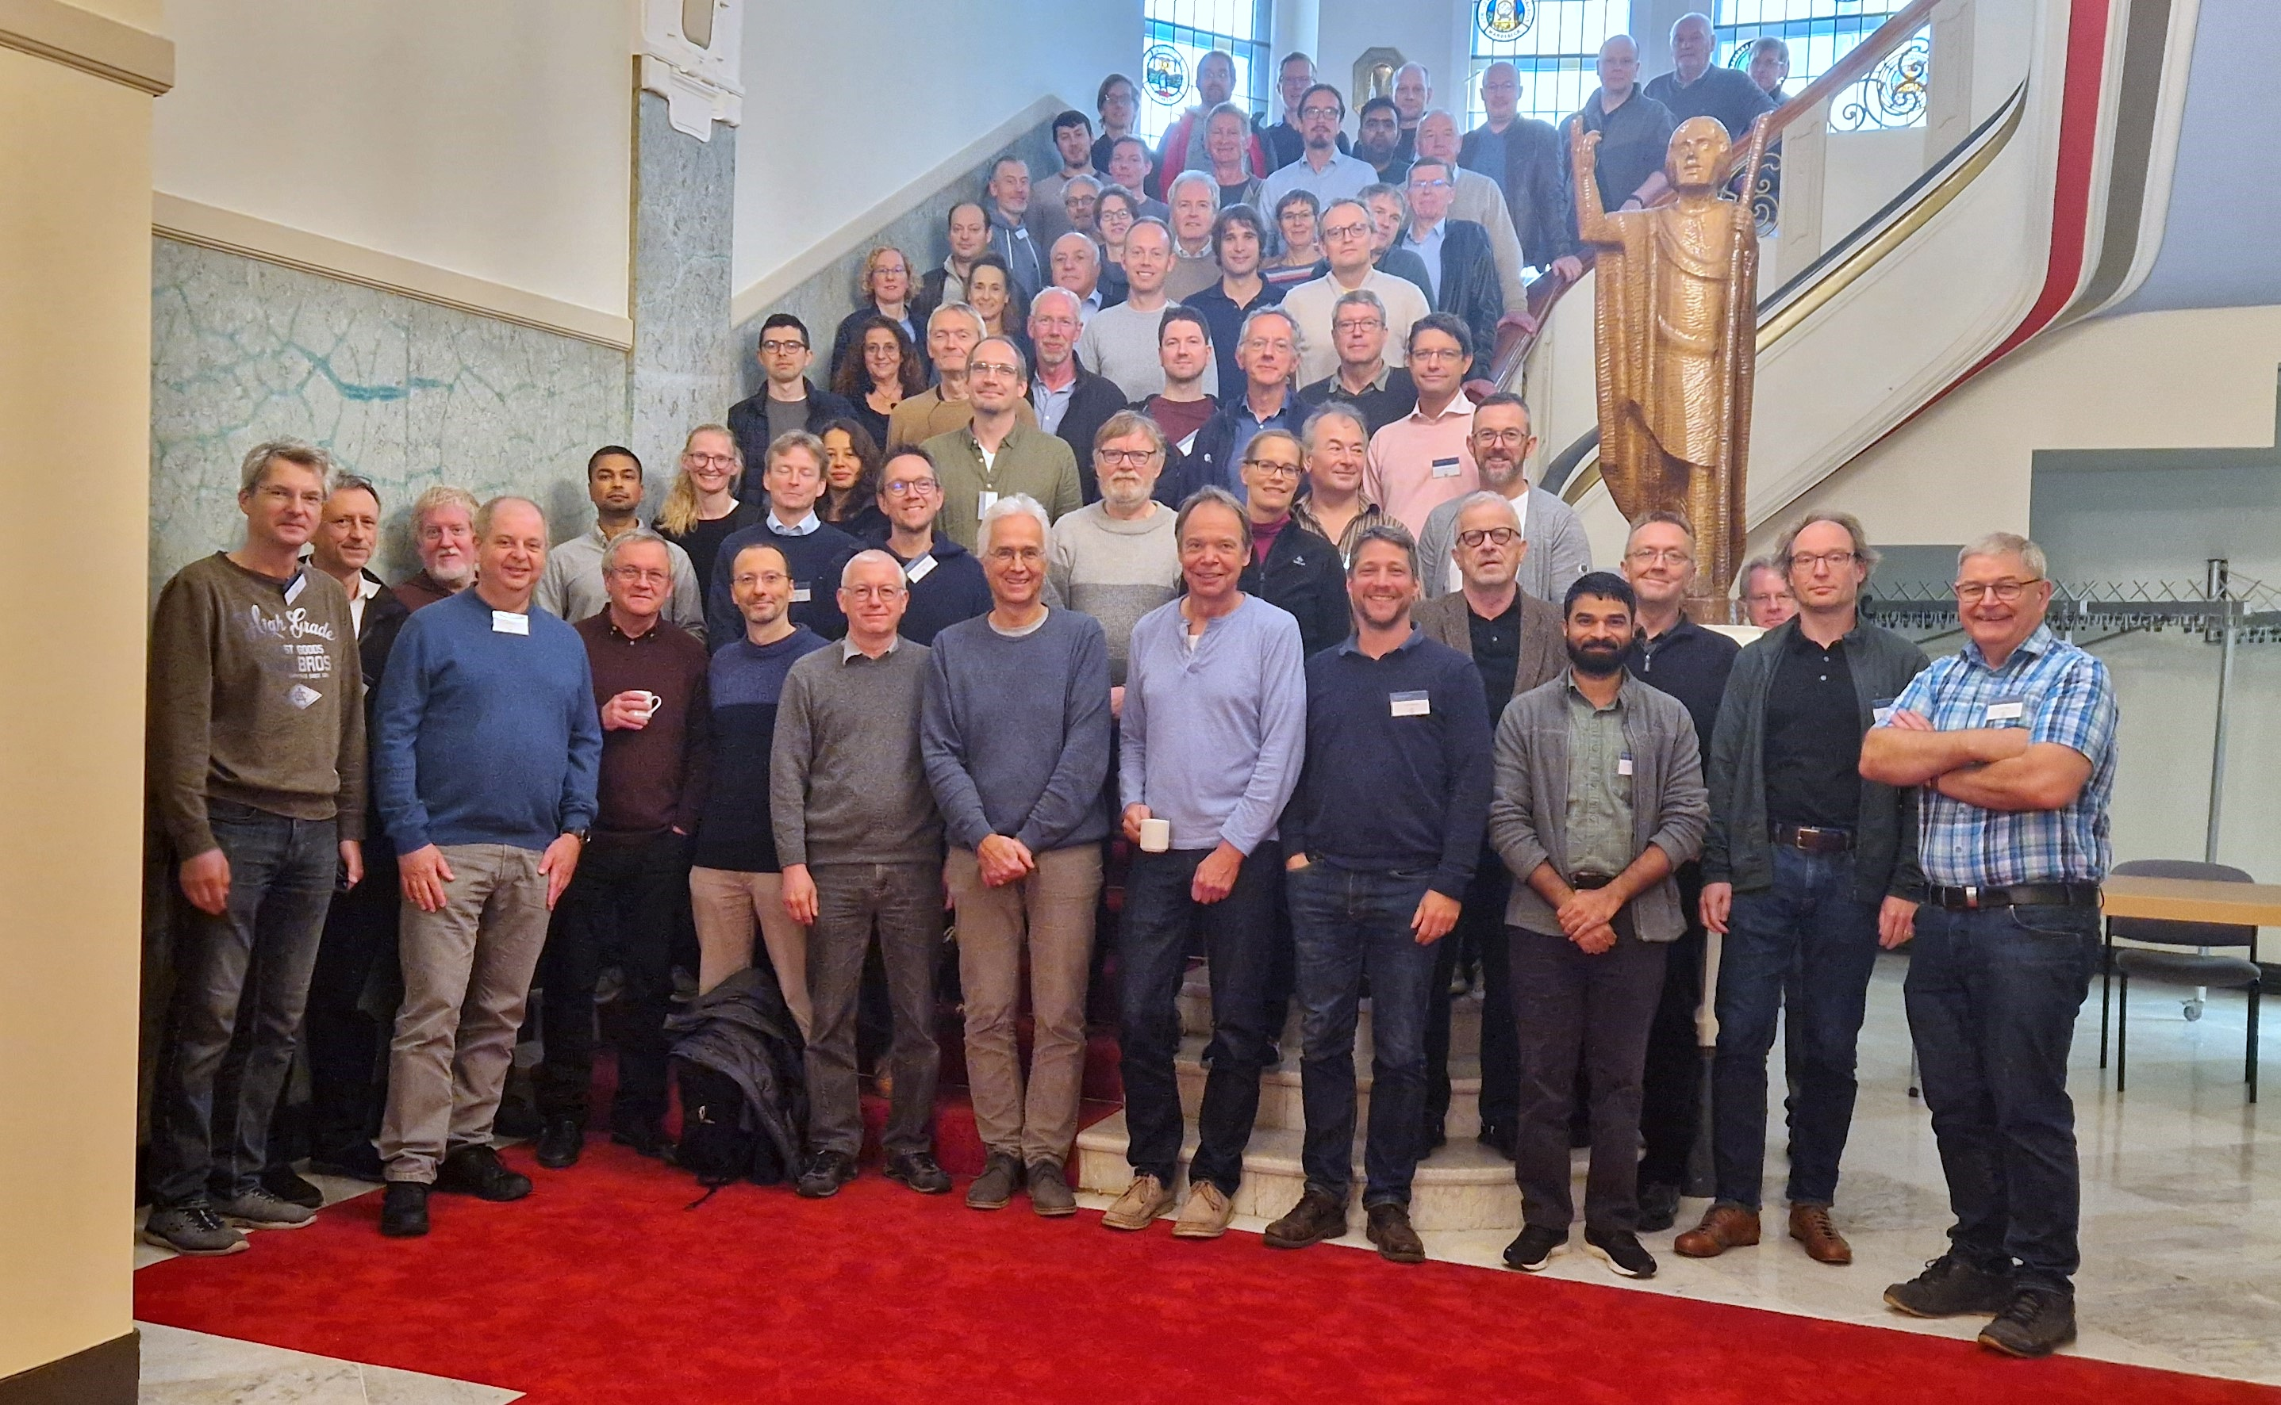
4th Workshop (8-9.10.2024 Hamburg)
A meeting of the minds
DESY: 50 participants
XFEL: 20 participants
Special Guest Appearance!
First discussions with detectors concerning proposed machine parameters
Focus on defining technical solutions options
  To be included in the FOS report (➜ early 2026)
  To be further developed over the next year
Understanding (and communicating) what is feasible
Working groups:
Parameters and photon user requirements
RF solutions
Cryo solutions
CW Injector
1.3 GHz SRF
Controls and Timing
Diagnostics and Feedbacks
Flexible operations
HDC Detectors

Slide 8
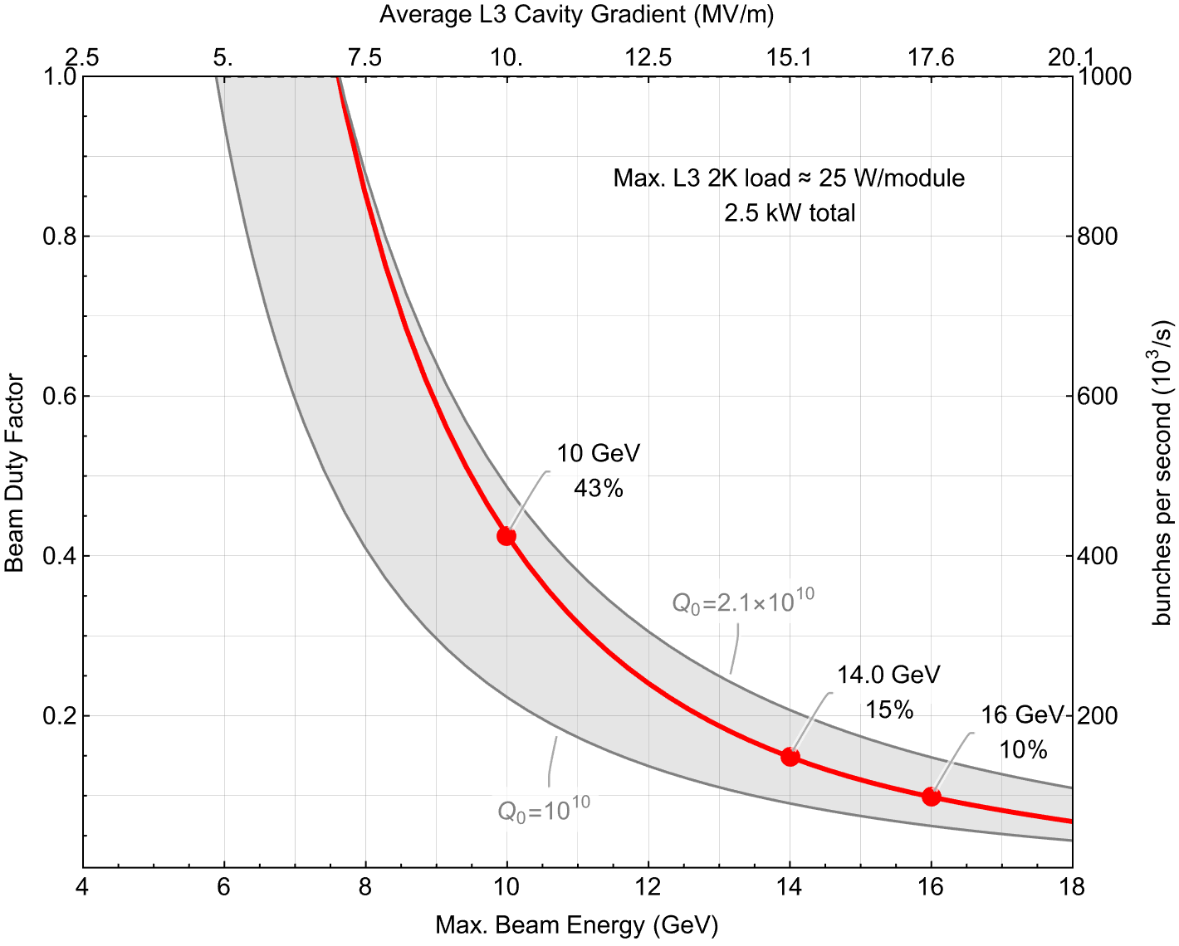
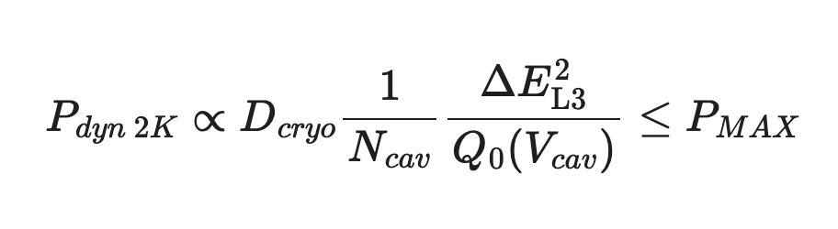
The HDC concept: constant average cryogenic 2K load
◉
7 GeV
CW
Maximum (electron) energy is defined (constrained!) by our existing linac

Slide 9
The HDC concept: constant average cryogenic 2K load
We are constrained by our existing linac
◉
7 GeV
CW
Characterising our existing (CW/HDC) LINAC performance remains a challenge

Slide 10
The HDC concept: constant average cryogenic 2K load
We are constrained by our existing linac
◉
7 GeV
CW
Parameter scenarios for photon user discussions
(USE cases)

Slide 11
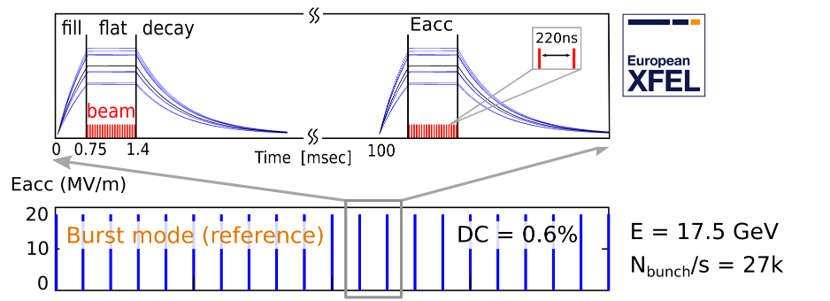
What does HDC really look like?
TODAY
Notes:
Is it confusing that the animated gif shows longer pulses without reducing the gradient….

Slide 12
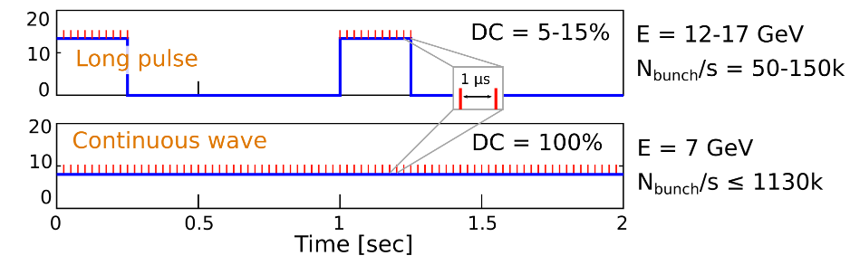
What does HDC really look like?
TODAY
High Duty Cycle (HDC)
Notes:
Is it confusing that the animated gif shows longer pulses without reducing the gradient….

Slide 13

What does HDC really look like?
TODAY
1 Hz pulse rep rate
High Duty Cycle (HDC)
Notes:
Is it confusing that the animated gif shows longer pulses without reducing the gradient….

Slide 14
What does HDC really look like?
TODAY
1 Hz pulse rep rate
We will plan a 1-Hz study to see what works (and what doesn’t!)
High Duty Cycle (HDC)
Notes:
Is it confusing that the animated gif shows longer pulses without reducing the gradient….

Slide 15
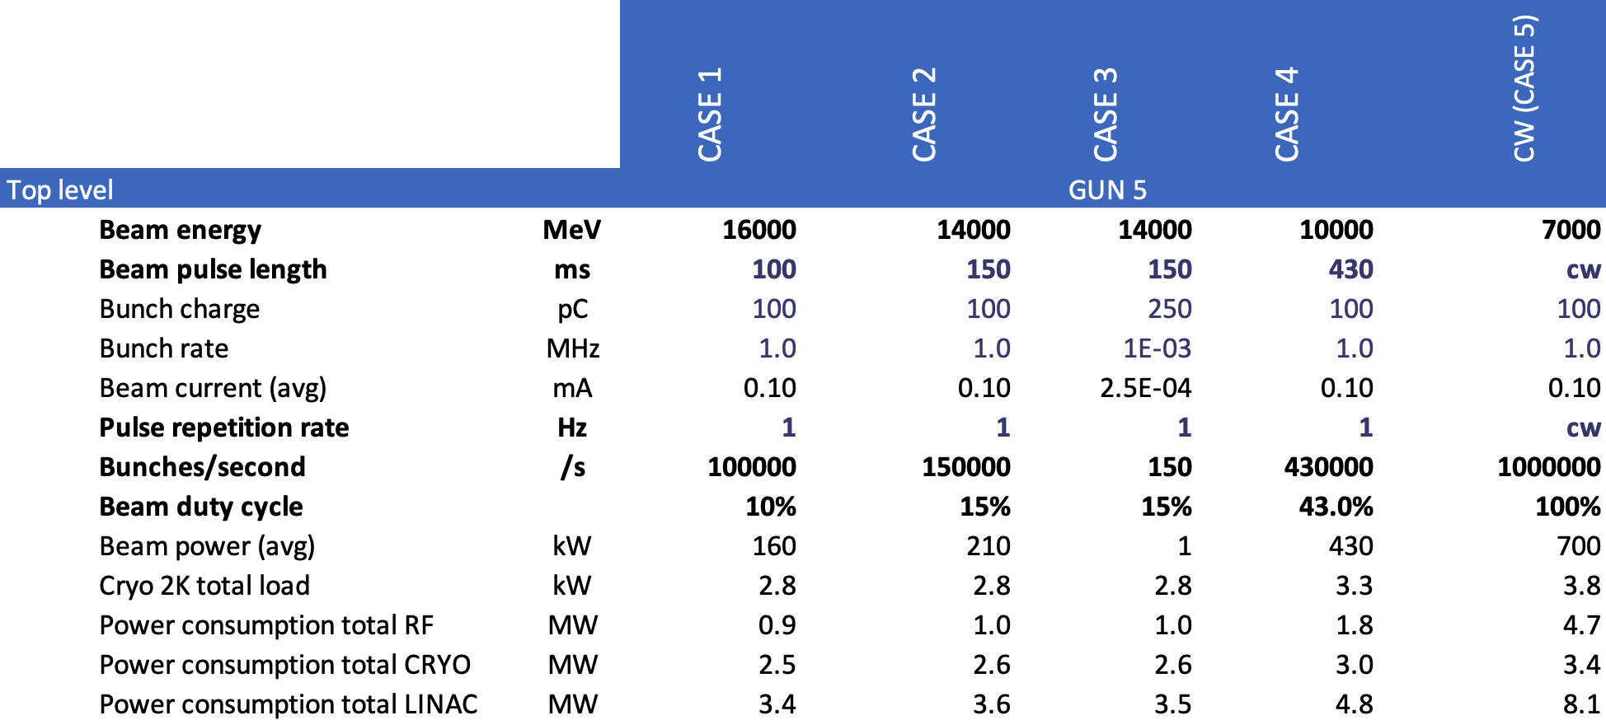
HDC Parameter Scenarios
For further study ➜ Feasibility and Options Study
All variations on the proposed CW upgrade

Slide 16
HDC Parameter Scenarios
For further study ➜ Feasibility and Options Study
Assumes second injector (GUN-5)
All variations on the proposed CW upgrade
superimposed on ‘standard’ HDC mode (or even CW)

Slide 17
Workshop Outcome of high-level science cases
courtesy of Harald Sinn
highlighting is mine
Important: More time separation between bunches + More bunches
Need more time separation:
  (Current max) 4.5 MHz is too fast for many auxiliary techniques (sample recovery, THz + very short laser excitations, detectors with small pixels, ion time of flight times, ...)
  Today 1.1 MHz - 2.2 MHz is routine rep-rate in burst mode, but for the majority of experiments 100 kHz equal spacing pulse delivery (CW) would be ideal
  The class of experiments that would benefit most are on ‘delicate’ samples: Viscous flow of complex molecules, solid state samples often related to societal challenges (energy generation & storage, medical research, catalysts)
Need more bunches:
  Today many ‘first’ experiments are proof-of-principle experiments, where the samples are ‘overexcited’ by pump laser to detect signal
  With (many) more pulses (x25 or more) in HDC mode, samples could be studied in ‘natural’ excited state or on realistic concentrations

Slide 18
Other outcomes of discussion with instruments
courtesy of Harald Sinn
highlighting is mine
Preferred working point 14-16 GeV + 11 GeV (soft). 7 GeV (full CW) would address new science areas (‘tender’ X-rays, water-window), which would need to be developed.
It is crucial for many experiments to have > 1 mJ/pulse (imaging, non-linear, ...)
Special modes (2-color, seeding, attosecond pulses, ...) are crucial for overall impact of science program
Some experiments still need ‘special’ pulse delivery, e.g. 4.5 MHz or 250pC (or higher). For this, a second normal-conducting injector may be very useful.
One should evaluate, if occasional switching back to burst mode may be worth the effort (e.g. for high photon energy experiments with 20 GeV linac operation)
Strong interest in fast kicker solutions between SASE1/2 (already before upgrade)

Slide 19
Preferred rep-rates from instruments (input to detector session)
courtesy of Harald Sinn
XPCS
Extreme conditions,
MHz microscopy
What photon people want
Plasma, Fusion
Delicate, closer-to-reality samples. Rep-rate limited by sample recovery,
THz, PP-Laser,as-Lasers, sample injector, ...
(10 MHz)
1 kHz
100 kHz
1 MHz
4.5 MHz
1.3 GHz
Frequency

Slide 20
Technical Scope of HDC Upgrade Proposal ➜ FOS report
Workshop output: Main challenges and issues understood!
Options for further study (issues!)
  Cryogenic solution – understanding existing LINAC performance
  RF Solutions – possibly area with most ramifications
    Choice of CW amplifier
    Precision LLRF control
    Tunnel space and compatibility with existing ‘burst mode’
    Efficiency and sustainability (aka AC power)
  CW-optimised 1.3-GHz cryomodule development
  SRF Photo-injector development
And not forgetting
  Controls system and timing
  Fast kicker systems
  Diagnostics and feedback systems
cost drivers
Performance critical
Should not be forgotten!

Slide 21
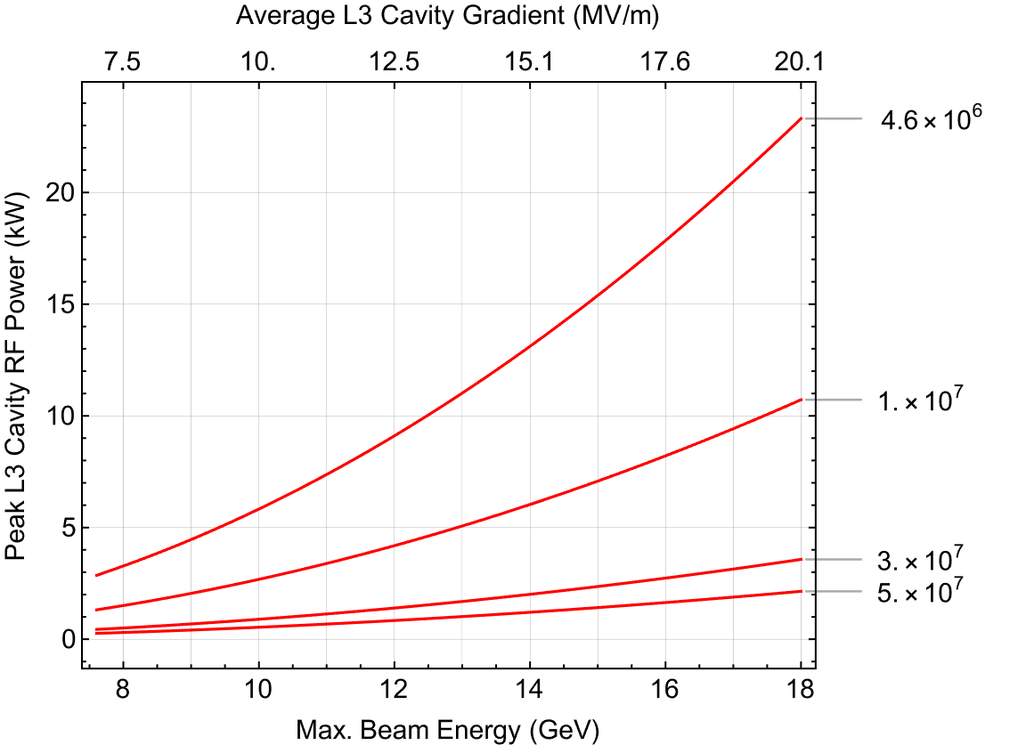
RF Solutions
Q_{L}
RF Power (& Control)
Peak power and control bandwidth
CW klystron (or IOT)
Q_{L} = 4.6×10⁶ – current XFEL value
Q_{L} = 1×10⁷ – XFEL max
Q_{L} = 5×10⁷ – HDC parameter tables assumption
(on-going R&D)
SSA single-cavity
Higher Q_{L} ➜ Lower RF power ➜ lower AC power consumption 🙂
Keep kW / cavity low → Affordable!
Higher Q_{L} ➜ Smaller Δf ➜ challenging RF control ☹️
Nothing is for free!

Slide 22
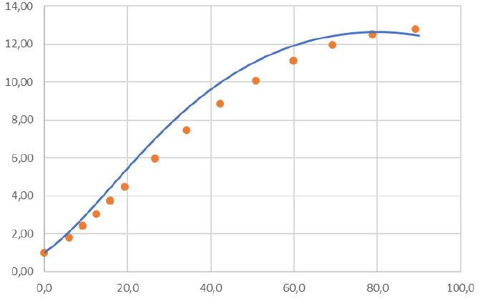
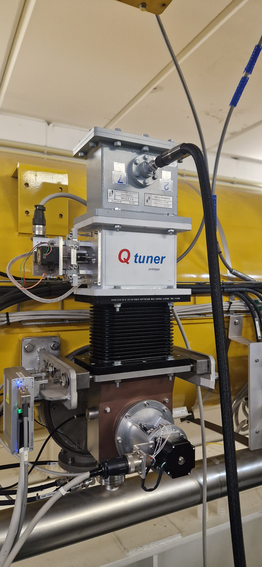
RF Solutions
Qext tuner
RF Power (& Control)
Q_{ext} scale factor
Peak power and control bandwidth
Q_{L} = 4.6×10⁶ – current XFEL value
Q_{L} = 1×10⁷ – XFEL max
Q_{L} = 5×10⁷ – HDC parameter tables assumption
(on-going R&D)
the “fix”
Motor tuning (mm)
low power test ✅
High power tests coming soon
Higher Q_{L} ➜ Lower RF power ➜ lower AC power consumption 🙂
Higher Q_{L} ➜ Smaller Δf ➜ challenging RF control ☹️
Nothing is for free!

Slide 23
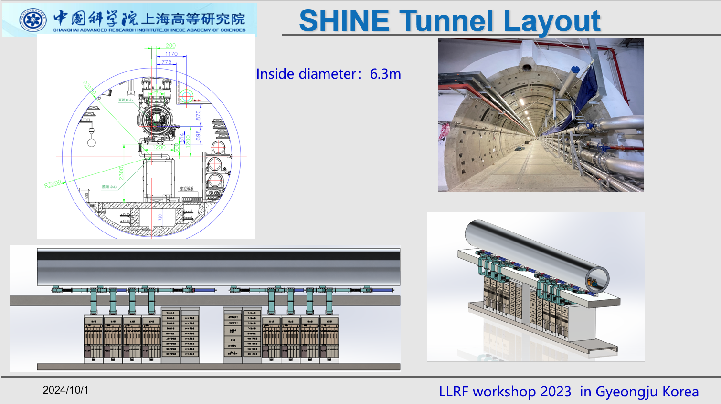
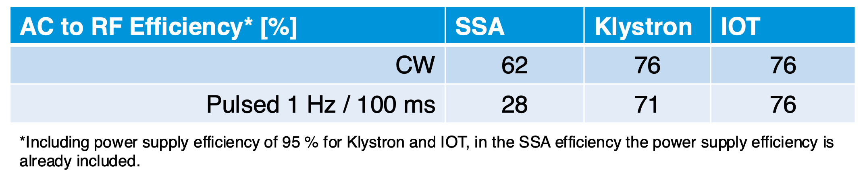
RF Solutions (an example of options)
Several options. All requiring further study | R&D
LLRF control
  Very high Q_{ext} (>10⁷)
  Single-cavity regulation
    MANY (900!) amplifiers in tunnel
    high Q_{ext} less challenging
  Vector-Sum control
    Less sources in tunnel
    high Q_{ext} very challenging!
CW RF power source
  SSA
  IOT (→ SLAC R&D)
  KLYSTRON
SHINE-like solution with SSA
**
> 65% **
** based on GaN technology

Slide 24
❓
Premium real estate in the XFEL tunnel
Goodbye burst mode?

Slide 25
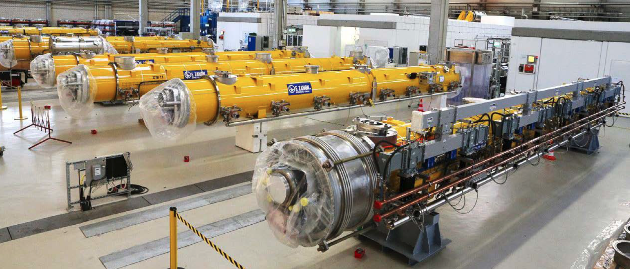
Parameter scenarios RF: upgraded linac
16 new CW-ready cryomodules
Bunch compressor linacs require higher gradients!
16 new 1.3-GHz modules (L1/L2 upgrade)
Gradient | MV/m | 20 (28 max)
Q₀ |  | 3×10¹⁰
Q_{load} |  | 6×10⁷
RF power / cavity | kW | 3
2K Cryo load / module | W | 110
SRF cavity technology (cf L3 CW: 7 MV/m @ 2×10¹⁰)
Coupler design
Cryomodule design (two-phase pipe) (cf L3 25W per module)
Similar to LCLS-II HE and SHINE
nb average operational numbers
Notes:
Consider minimum requirements
Experience from LCLS-II and LCLS-II(HE)

Slide 26
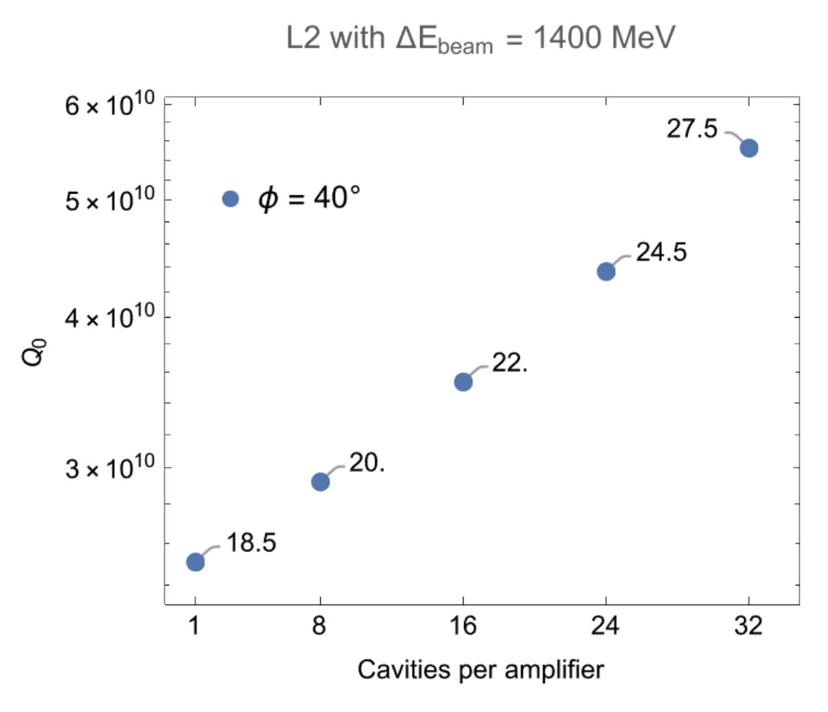
Parameter scenarios RF: upgraded linac
16 new CW-ready cryomodules
CW-Ready 1.3-GHz SRF cryomodules
Bunch compressor linacs require higher gradients!
16 new 1.3-GHz modules (L1/L2 upgrade)
Gradient | MV/m | 20 (28 max)
Q₀ |  | 3×10¹⁰
Q_{load} |  | 6×10⁷
RF power / cavity | kW | 3
2K Cryo load / module | W | 110
Influenced by required ENERGY MARGIN for Availability
Notes:
Consider minimum requirements
Experience from LCLS-II and LCLS-II(HE)

Slide 27
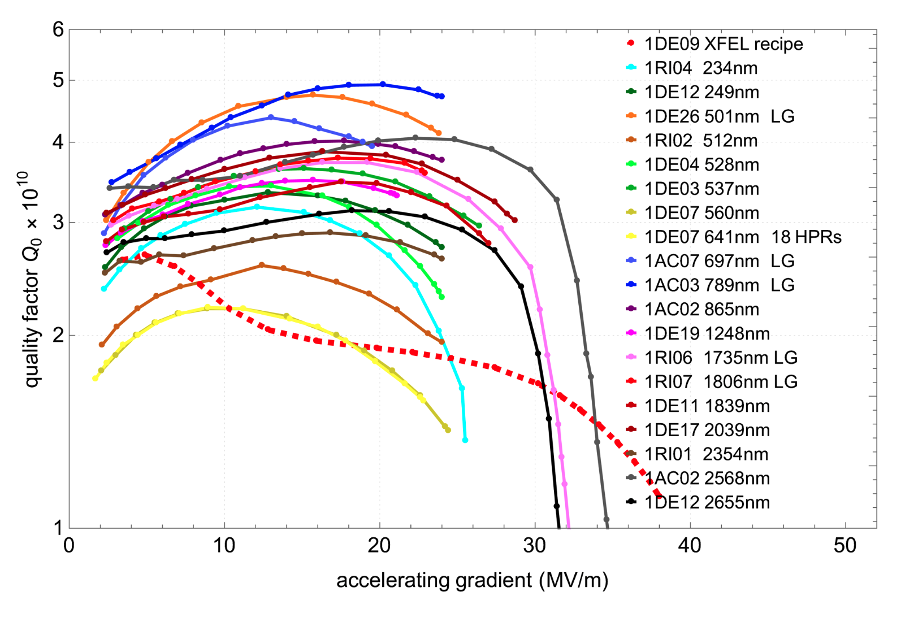
CW SRF development
single cell
DESY – Low-T bake looks promising
LCLS-II | LCLS-II-HE | SHINE
  World wide development of high-Q₀ SRF for CW operation
For XFEL we want high gradients too!
DESY R&D into so-called “Low-T bake” recipe
  e.g. 3 hours @ 300° C
Next step – transfer to nine cell
  New cavity procurement
  Specifications being prepared
  Tendering expected Q2 of 2025
    10 cavities
🎯
XFEL recipe
In parallel – CM development
  Design modifications for CW operation
  ~120 W / module 2K load
  Coupler design
➜ Road map for CW-ready prototype cryomodule

Slide 28
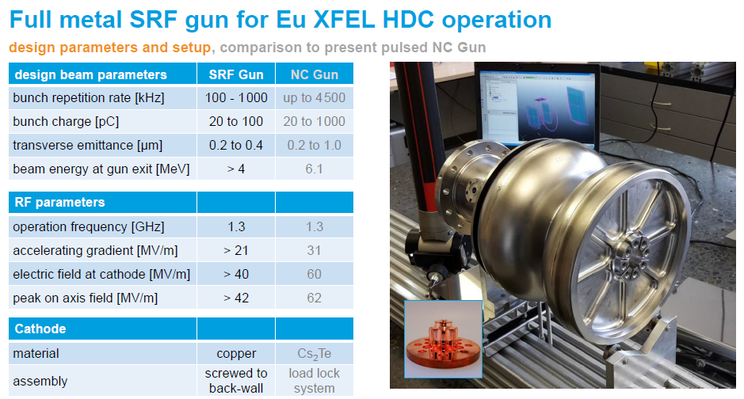
courtesy of Elmar Vogel
courtesy of Elmar Vogel

Slide 29
New Injector Test Stand (Ts4i)

Slide 30
The Feasibility and Options (FOS) Report
Milestone report on the way to a complete proposal
Detailed technical ‘snapshot’ of proposed XFEL accelerator upgrade
Scope
  Baseline upgrade and (user) parameter space
  Technical options (variants)
    Comparisons (pros and cons)
R&D status
  ‘State of play’ results in support of options
  Roadmap / scope of remaining ‘risk mitigating’ R&D
Cost estimate(s) (separate document)
(some sort of) Risk Register
Should form the basis for a future upgrade proposal
Emphasis on ‘options’ important
(understanding the trade-offs)
A clear path forward
- further studies and R&D

Slide 31
Towards the Feasibility and Options Study (FAOS)
TODAY
Consolidate FOS baseline options
Prepare technical materials
Cost & Schedule impact
5th Workshop Spring 2025 (1-2 day DESY)
6th Workshop Autumn 2025 (2 day Jork)
Publication FOS report
2025
Review FOS baseline options
FOS writing
Further studies as needed
Complete cost and schedule analysis
Technical review of draft FOS
2026
Final editing
Cost and schedule review

