Slide 1
Laser Pulse Arrival Time Monitor: Developments and Measurements
Sub-15 fs Jitter After Multi-Pass Cell Compression at the Beamline FL23 of the FLASH Facility
Anne-Laure Calendron, on behalf of the LbSync, LAS Teams (Development of LAM) and FS-LA (Meas. FLASH)
Hamburg, 05.12.2024

Slide 2
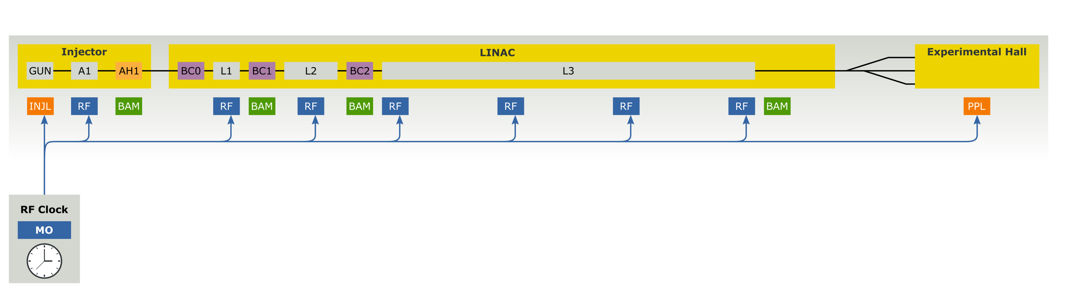
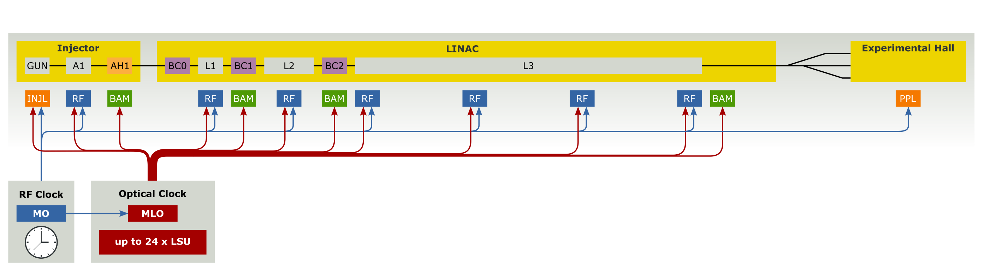
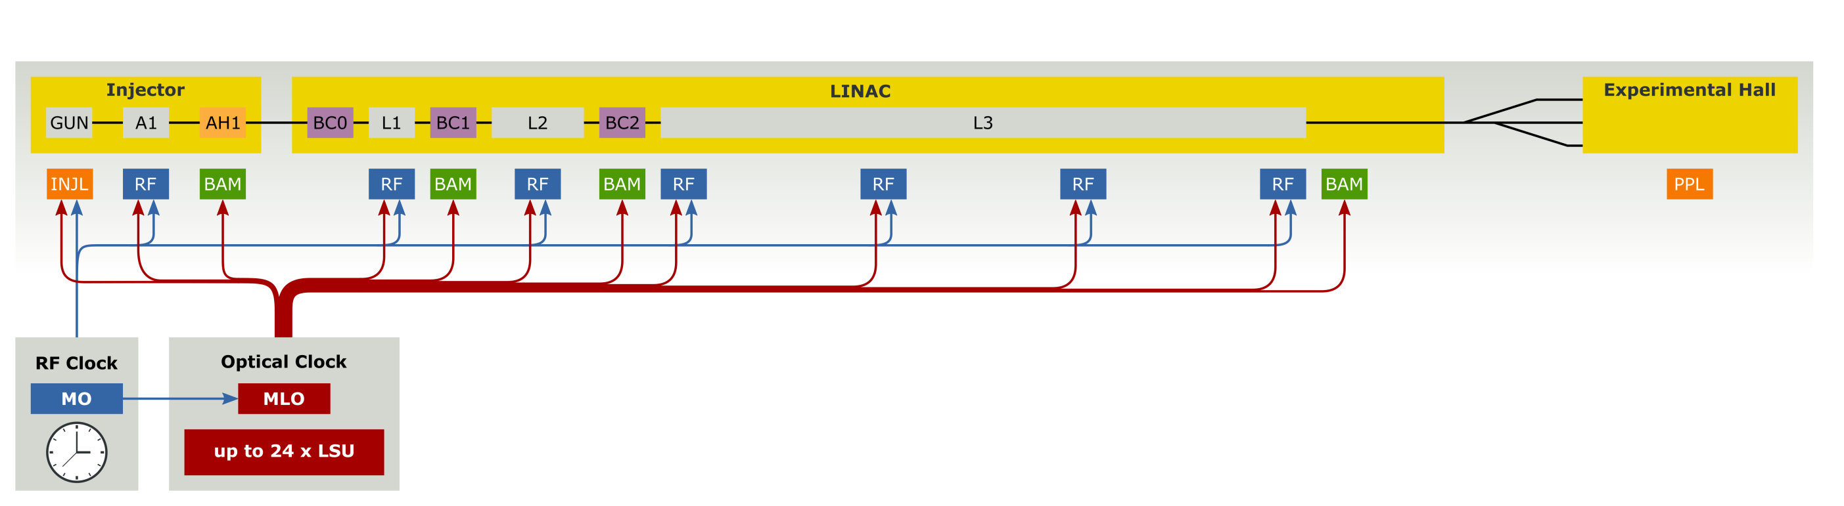
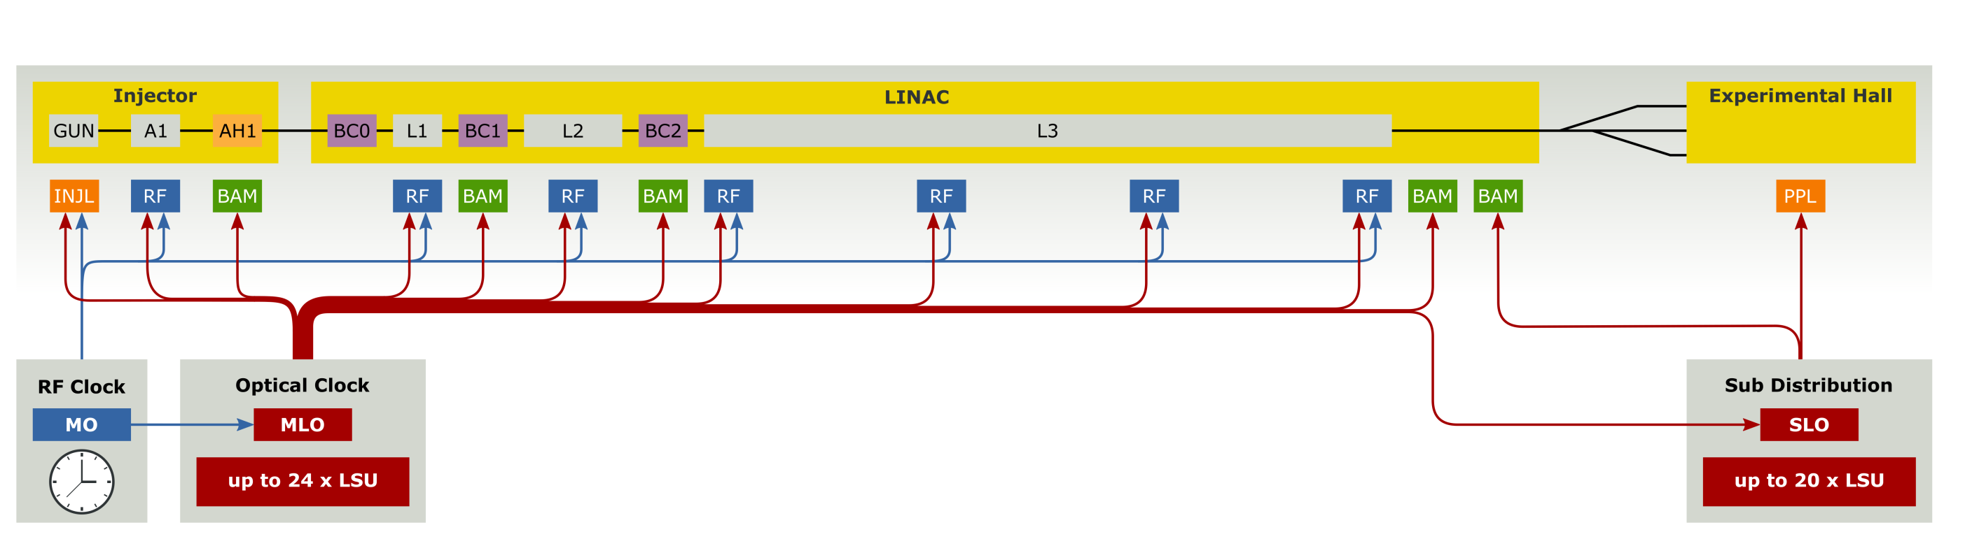
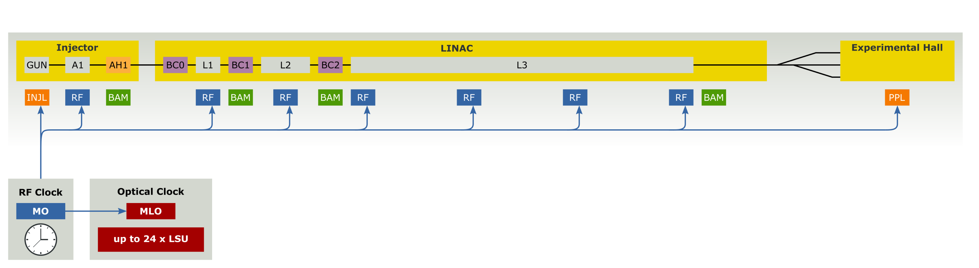
Optical Synchronization System at EuXFEL
World-wide Unique Large-Scale 24/7 Operation
LAM
Total opt. links in operation = 34
optical reference (Main Laser Oscillator, MLO) tightly locked to RF Main Oscillator (MO),
distributed via length-stabilized optical fiber links and used for
  Laser locking (injector, pump-probe, …)
  RF re-synchronization (REFM-OPT)
  Bunch Arrival time Monitors (BAM)
  Laser-pulse Arrival time Monitors (LAM)

Slide 3
LAM vs. PAM
LAM
Measurement of the optical laser arrival time against an optical reference
Not a direct measurement
But all experiments can have one
PAM
Direct measurement of optical laser against photon arrival time
But: not all experiments can have one (due to usage of X-ray beam)

Slide 4
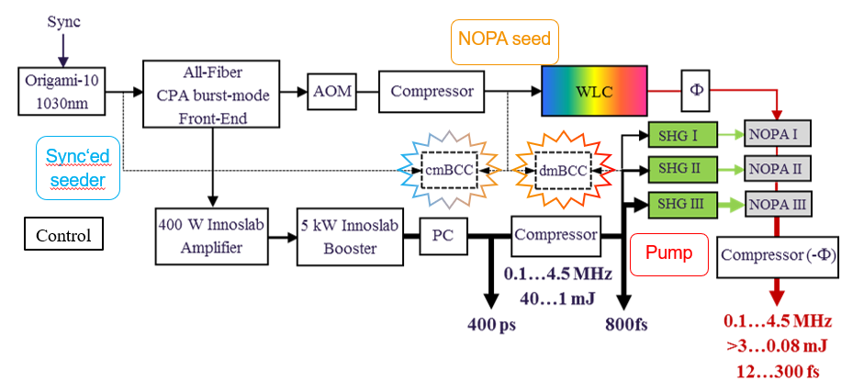
PPL synchronization
Transport to ILH and EH
Non linear conversion stages

Slide 5
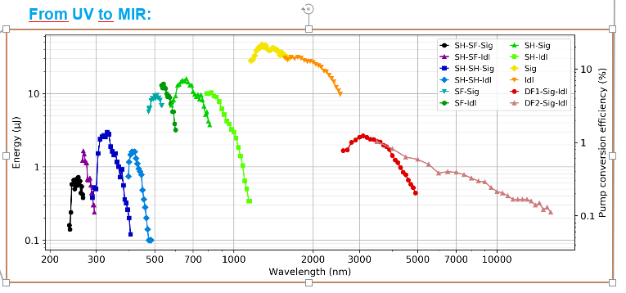
Challenges: experimental conditions
Large spectral coverage
Fundamentals: 800 nm and 1030 nm
SHG, THG, FHG: 400 nm, 266 nm, 515 nm, 343 nm, 258 nm
NOPA, SFG, DFG, e.g. with Topas:

Slide 6
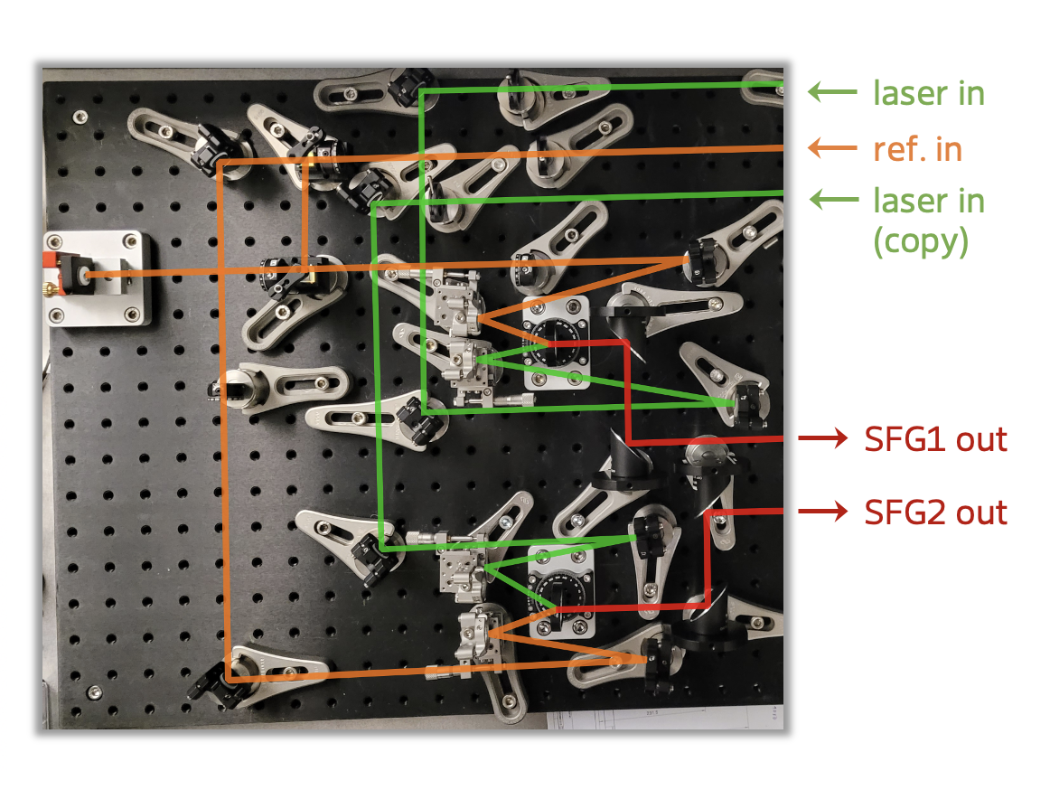
Development of the 2 Crystal OXC
* Optical design
*
* Automation: server

Slide 7
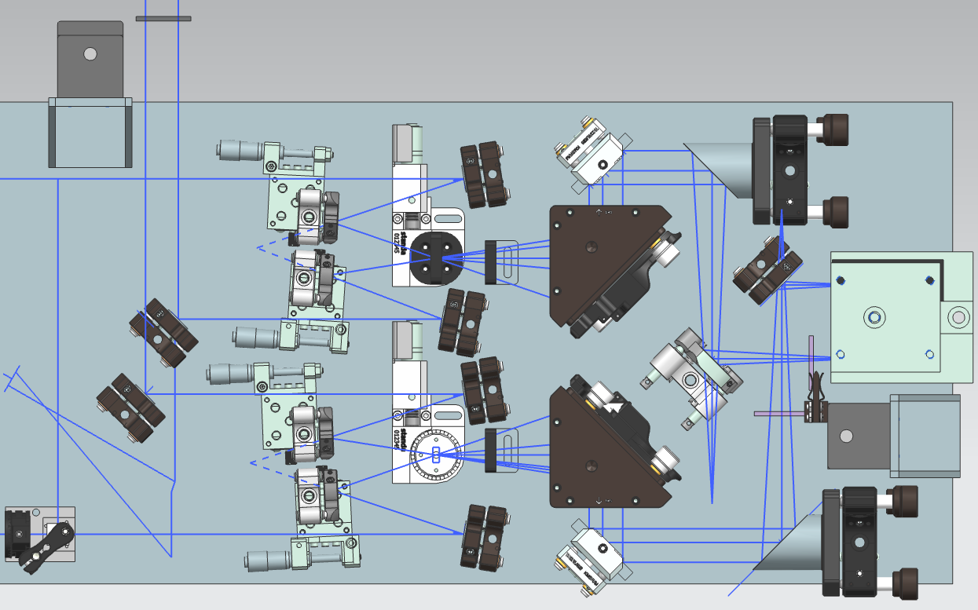
Development of the 2 Crystal OXC – CAD on-going
Preliminary

Slide 8
On-Site Measurements

Slide 9
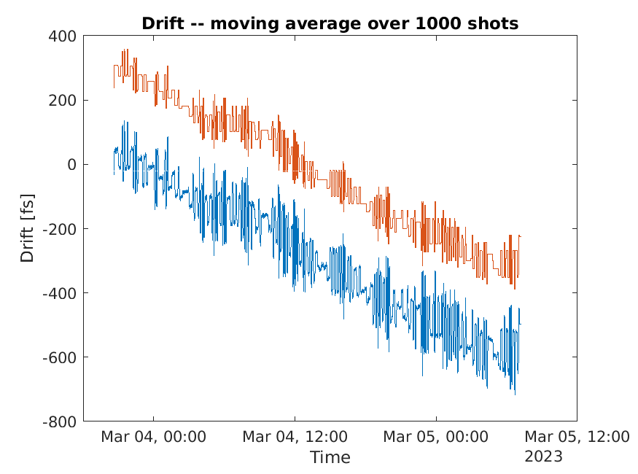
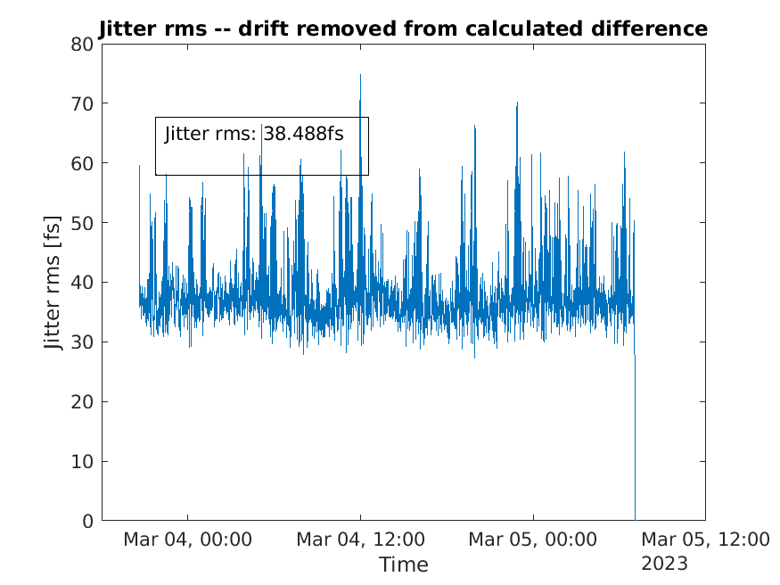
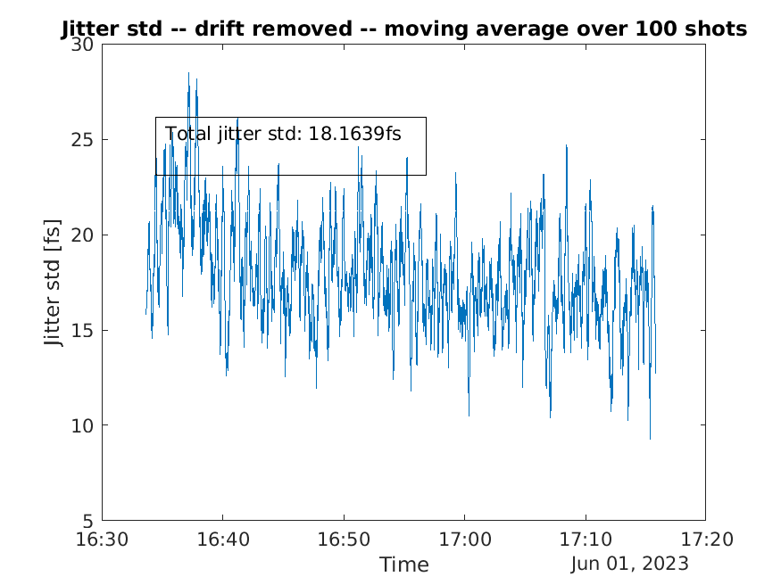
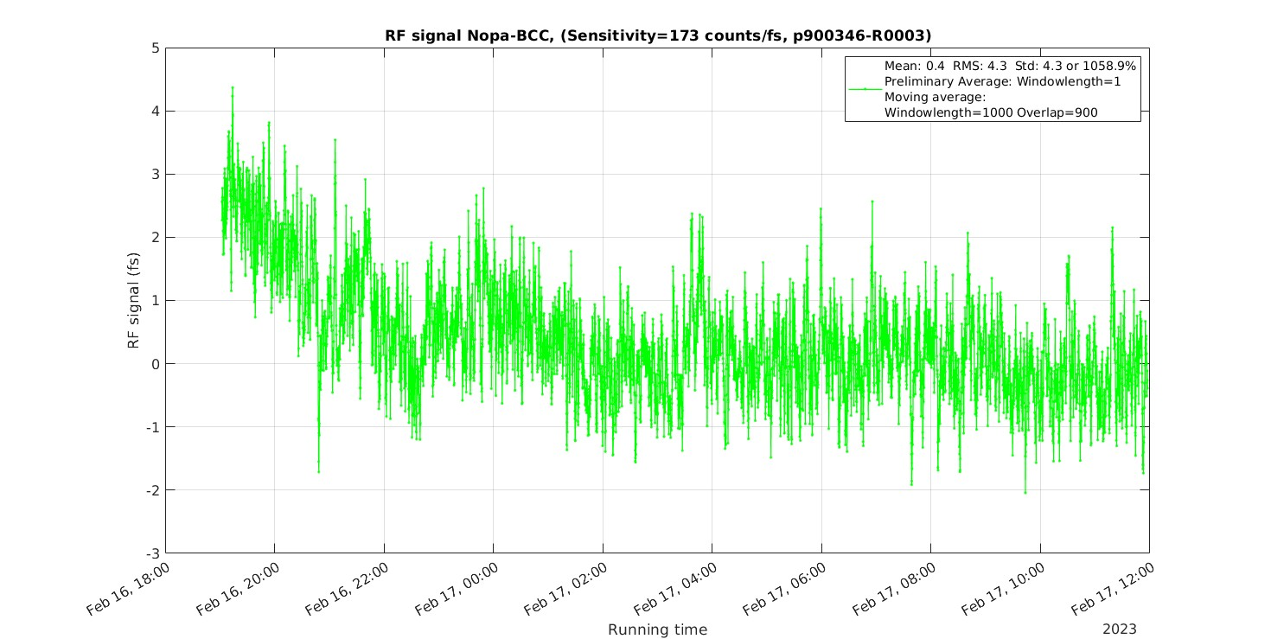
XFEL: Results at the MID Instrument
Measurements with NOPA BCC always showed low drifts and jitter
LAM measured ~700 fs drift over 30 h, and 20-40 fs jitter (std)
Large drifts → t0 of experiments changes during run → issue

Slide 10
FLASH FL23 measurements (slides presented at ASSL2025)

Slide 11
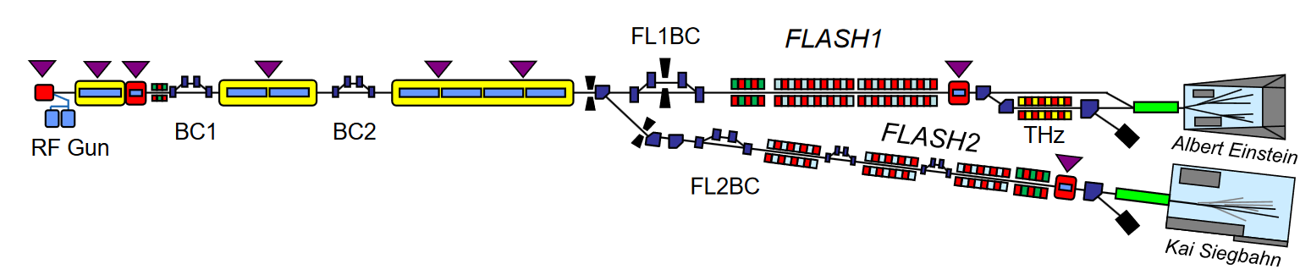
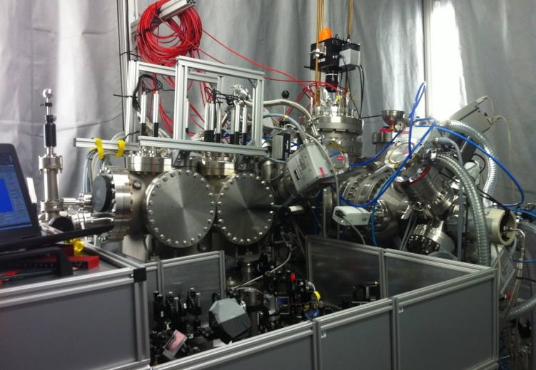
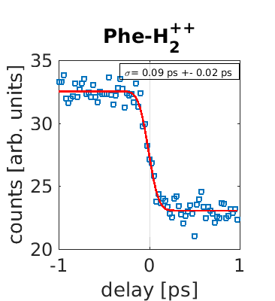
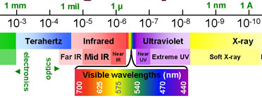
Free-Electron LASer Hamburg: FLASH
315 m
Heading Copy
Copy derferecus mint esequiam corepelenet aute dolesti aerorio minctotat.
Essunt qui aut ipsamusandae sunt am ut officiatus maxim quo molesti oriatii ssedit, untiunt.
Quantum Materials
excitation of specific lattice, spin and electron
degrees of freedom
THz and MIR
Chemistry,
Energy Science
Electronic excitations
visible and UV
Functional Materials,
Complex molecules with distinct reaction centers
Element specific excitations (XUV/Soft x-rays)
FEL
pulse
Laser
pulse
images courtesy of Nora Schirmel, Skirmantas Alisauskas
Notes:
FLASH Facility, FLASH Hall, Science case and requirements on jitter
Electron acceleration up to 1GeV, then undulators and soft-Xray generation

Slide 12
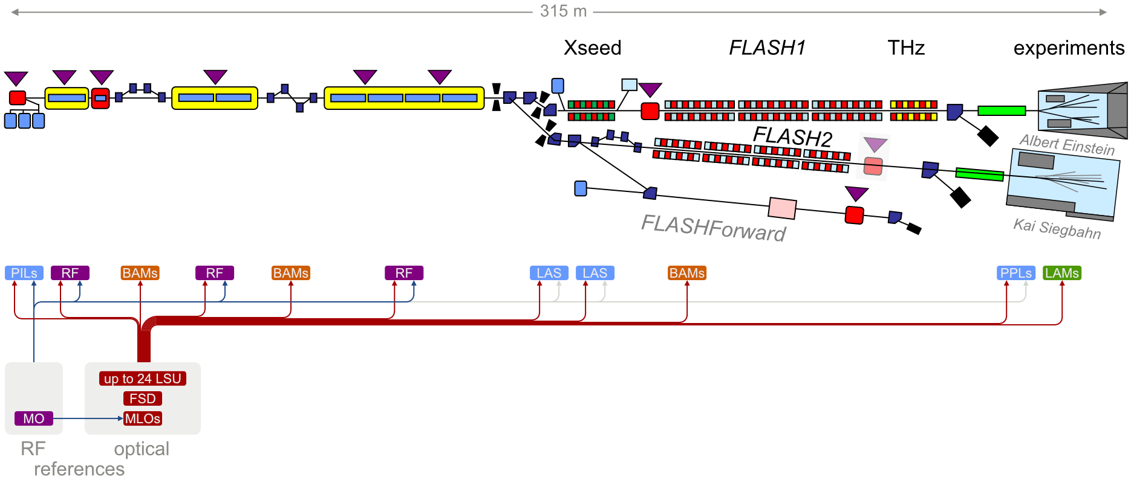
Overview of the Synchronization System at FLASH
State FLASH 2020
2 reference lasers in 1 lab
17 stabilized fibre links
25 client systems (BAM, REFM-OPT, lasers, LAM)
slide courtesy of Sebastian Schulz
Notes:
I will not go into details, but it is a complex system, and till now mainly the accelerator itself is stabilized, as well as the oscillator of the laser system. The precise timing synchronization is brought by a network of fiber links stabilized in length, all fed by a Main Laser Oscillator synchronized to a Master RF oscillator. Recently the transport of the PPL beam has been stabilized in its arrival time. Let‘s see the PPL and its sync more closely.

Slide 13
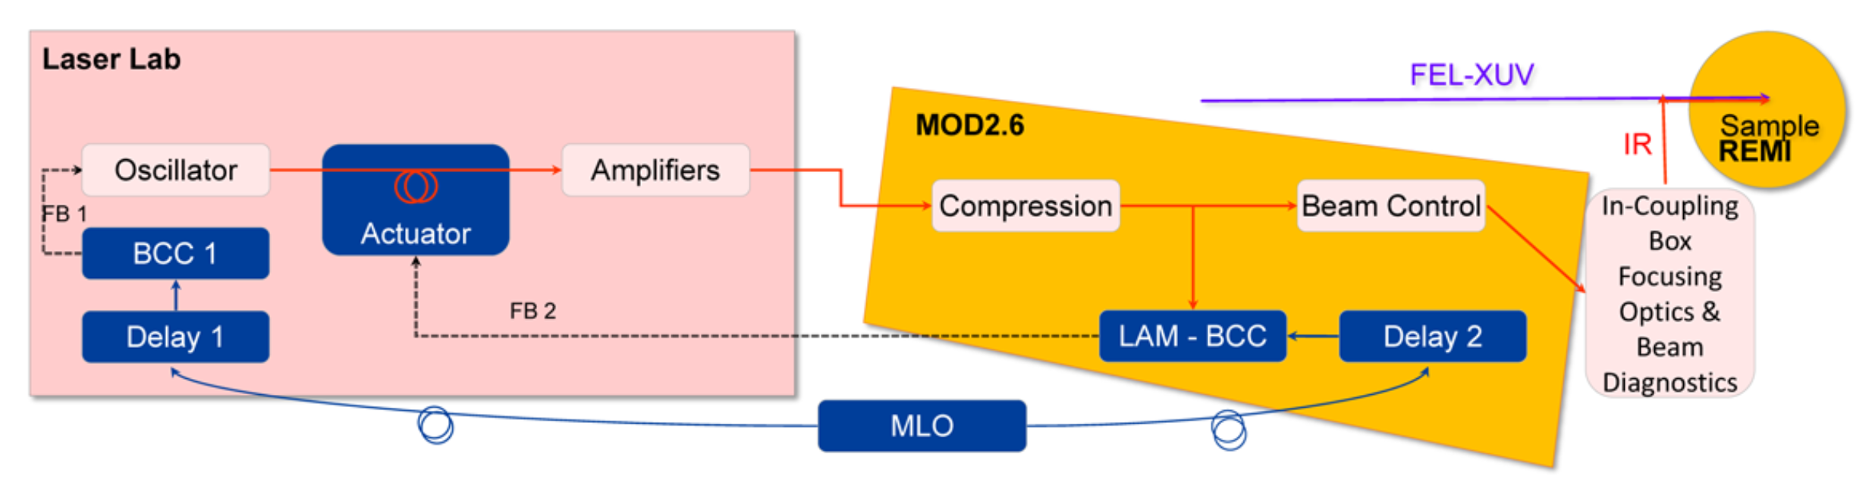
PP-Laser: Overview, Synchronization and Transport
~40 m beam transport
MOD 2.3
Amp. + MPC
PPL: 2 options:
OPCPA (800nm, 15-50fs, 10-15% efficiency)
MPC (1030nm, <100fs, >85% efficiency)
Key features of the ps CPA system:
Yb:fiber and Yb:YAG amplifiers
Repetition rate between 50 kHz and 1 MHz
Laser laboratory environmentally stable (Temperature and relative humidity)
50 kHz to 1 MHz
Adapted from Atia-tul-noor et al., Opt. Express 32(4), 6597-6608 (2024)
Notes:
PPL is versatile, with either OPCPA or MPC after the ps amplifiers. Here we concentrate on the performances of the MPC, as they are installed at several facilities. Advantages are mainly the higher throughput than the OPCPAs.
Ps- CPA system, located in the laser lab, with the MPC. The compressor is located in the MOD, closer to the experimental overlap with FEL
40m transport roughly between the MPC and the experiment, leading to drifts and jitter. The PPL itself is located in a lab controlled in temperature and humidity.
Let‘s look at the ps-CPA system: …
And now the MPC -> next slide

Slide 14
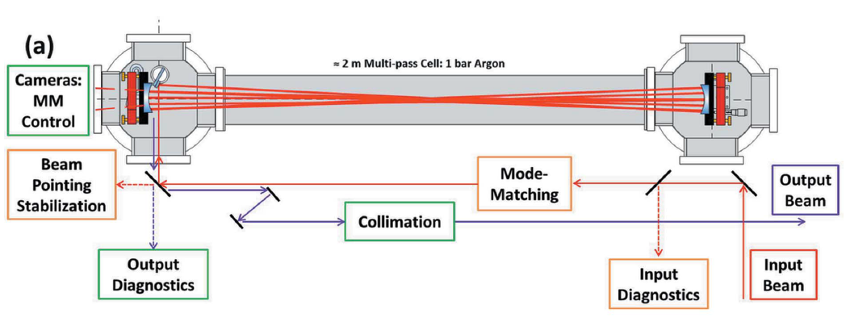
Pump-probe Laser of FLASH 2
Pulse Compression via Multi-Pass Cell from 1 ps to ~60 fs
Parameter | Yb:YAG Laser | MPC Output
Pulse energy (single-pulse) | 3 mJ | 2.5 mJ
Pulse duration | ~ 1000 fs | 80 fs
Central wavelength | 1030 nm | 1030 nm
Energy stability (10min) | 0.3 % rms | 0.5 % rms
Key features of the Multi-Pass Cell:
2 m long
Few mJ pulse spectral broadening in gas (2.9 bar argon)
Compression factor: up to 37
MPC transmission ~85%
Repetition rate: 100 kHz
D. Herriott and H. J. Schulte, Appl. Opt. 4 (1965).
First experimental spectral broadening results: J. Schulte et al., Opt. Lett. 41 (2016).
Patent: A. Vernaleken et al., DE 102014007159B4 (2017).
Pictures: A.-L. Viotti et al., Optica 9, 197 (2022).
Viotti et al., J. Synchrotron Rad. (2021). 28, 36–43

Slide 15
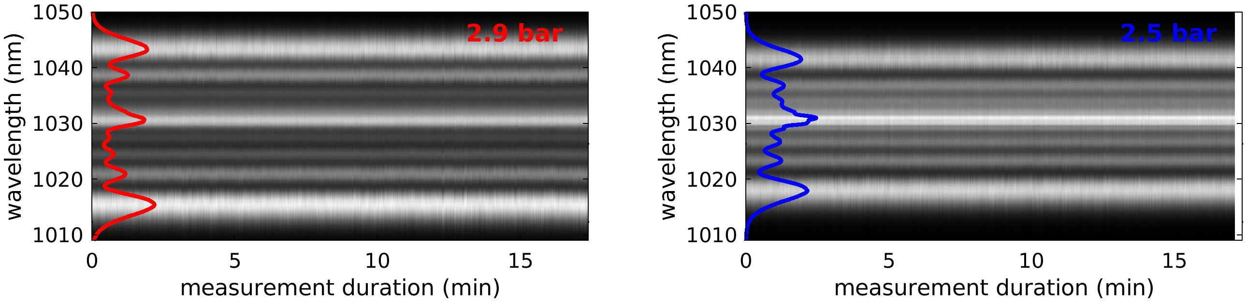
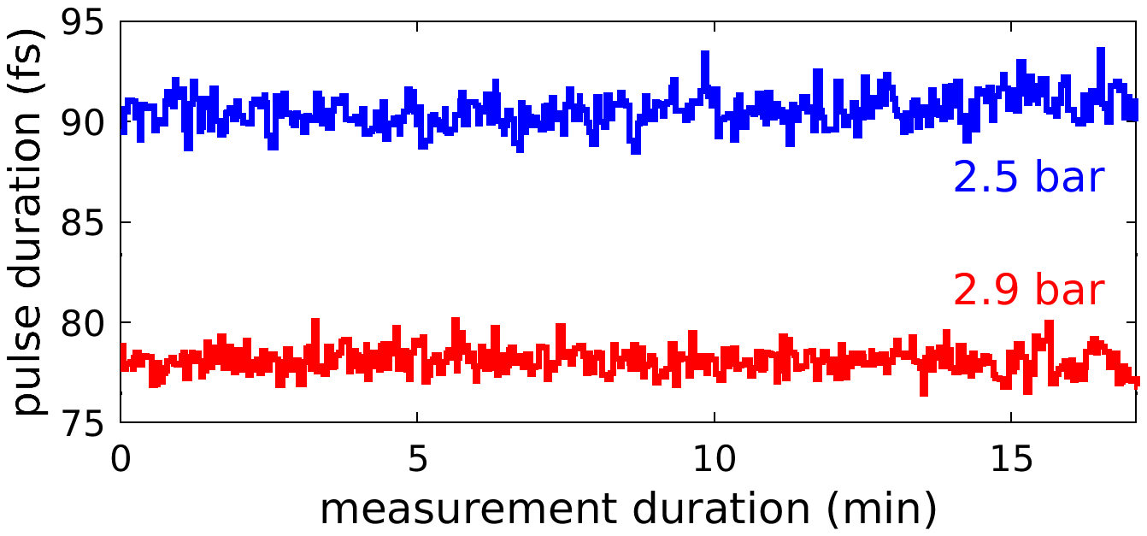
Pulse-resolved Measurements over the Burst
Experimental Conditions: 2.9 bar vs. 2.5 bar Ar

Slide 16
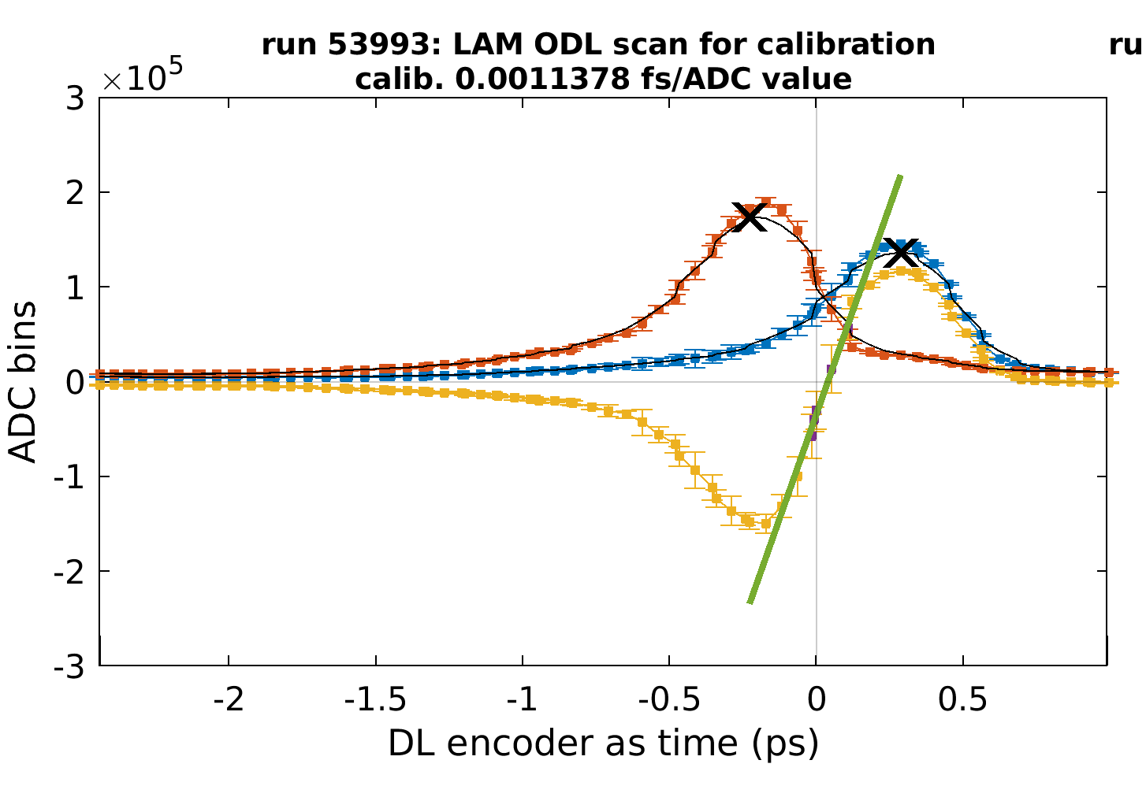
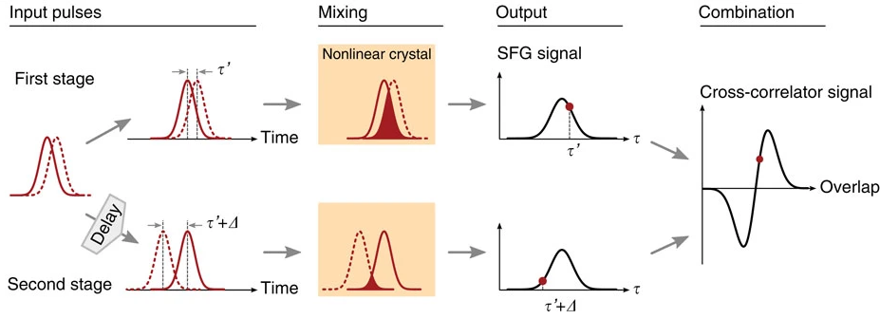
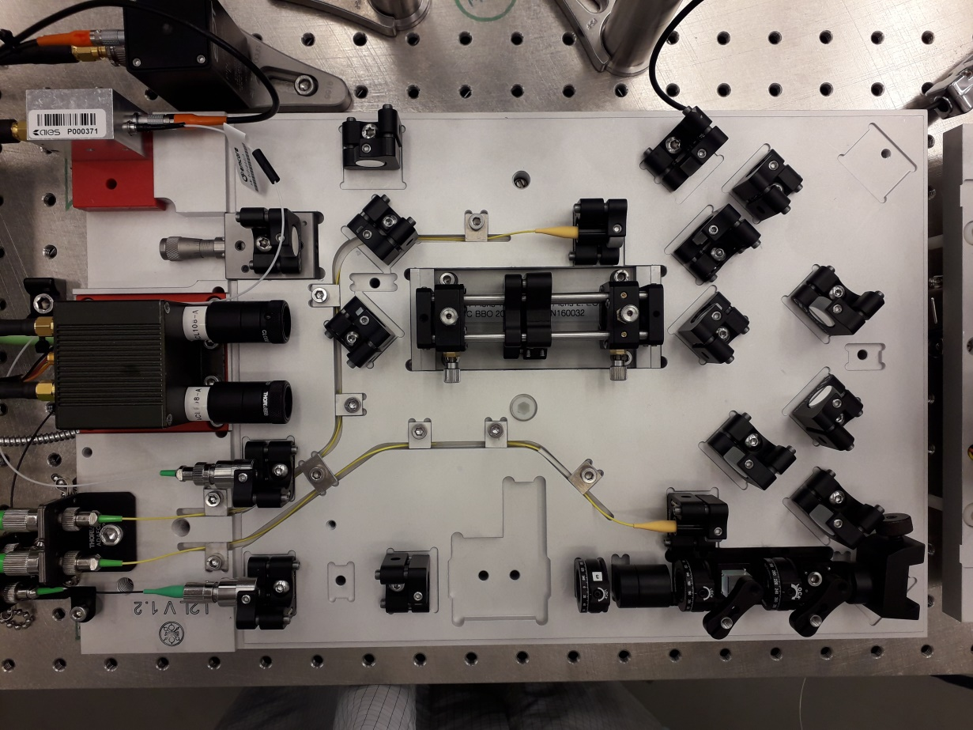
Laser Arrival time Monitor (LAM)
Amp. + MPC
MOD 2.3
Reference Fiber Links
Fiber link parameters:
Stability | Typ. 0.5fs
Central wavelength | 1550 nm
Energy / pulse | 23 pJ
Repetition rate | 216 MHz
Notes:
First we will investigate the long-term drifts, as these as crucial for the experiments

Slide 17
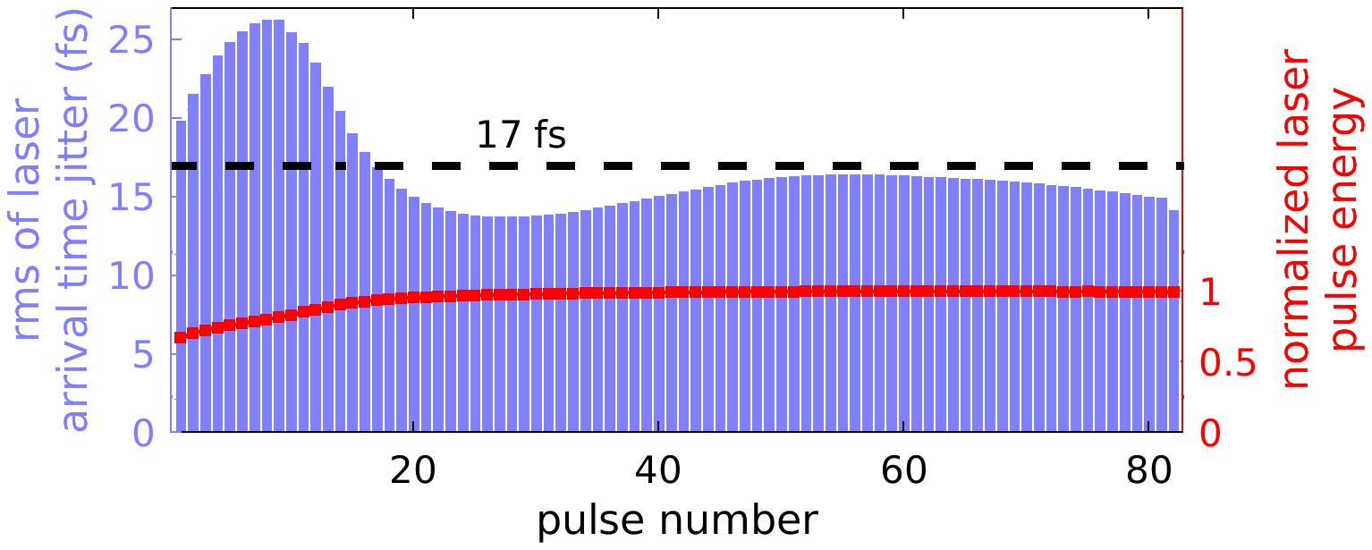
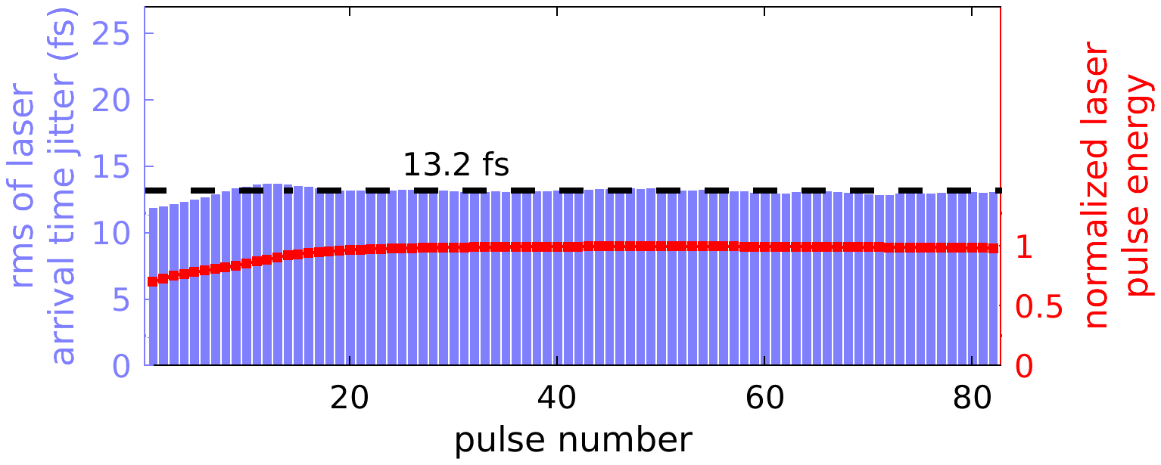
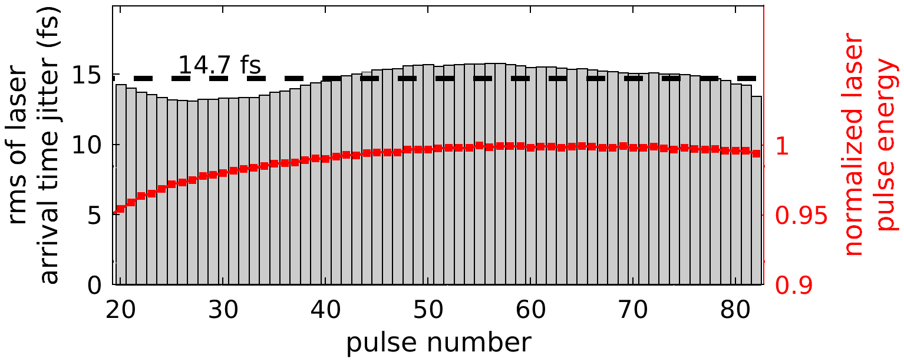
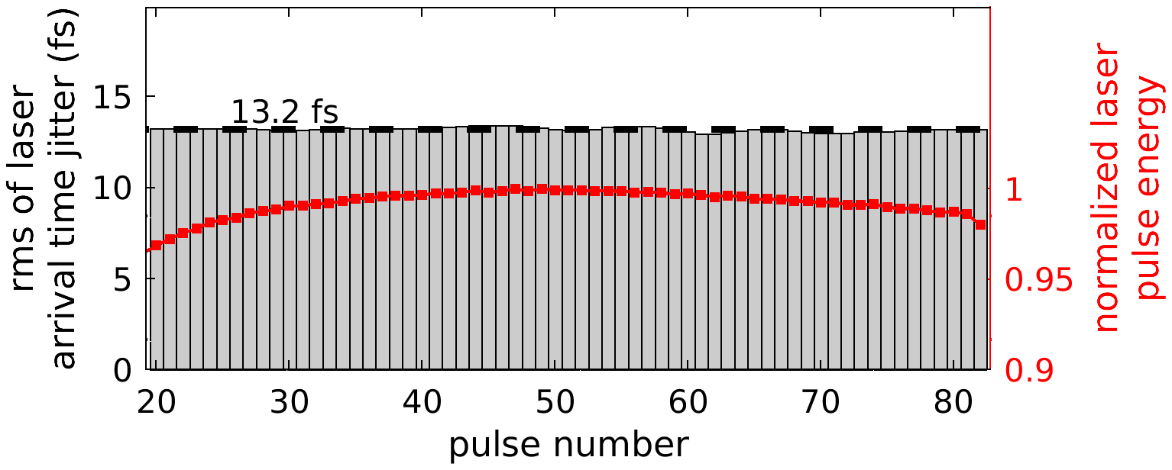
Pulse-resolved Measurements over the Burst
Changed experimental conditions: 2.9 bar vs. 2.5 bar Argon
2.9 bar
2.5 bar
Notes:
More measurements needed to double-check that the change of the shape over the burst is really coming from the change in gaz pressure, or whether some other parameters played a role.

Slide 18
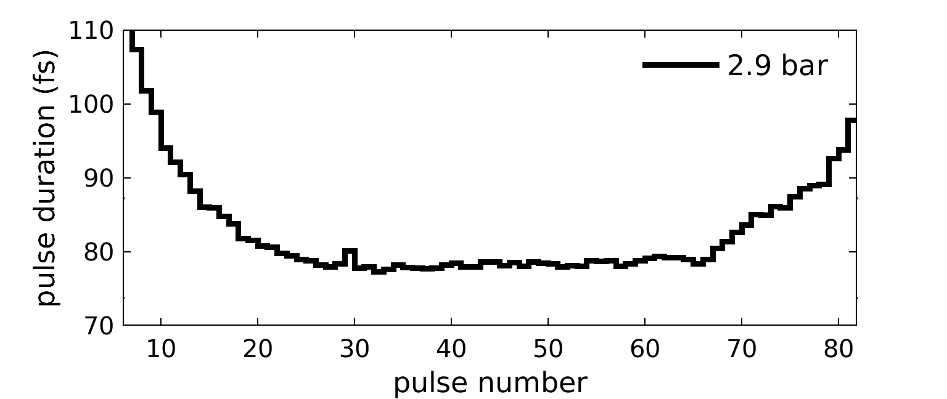
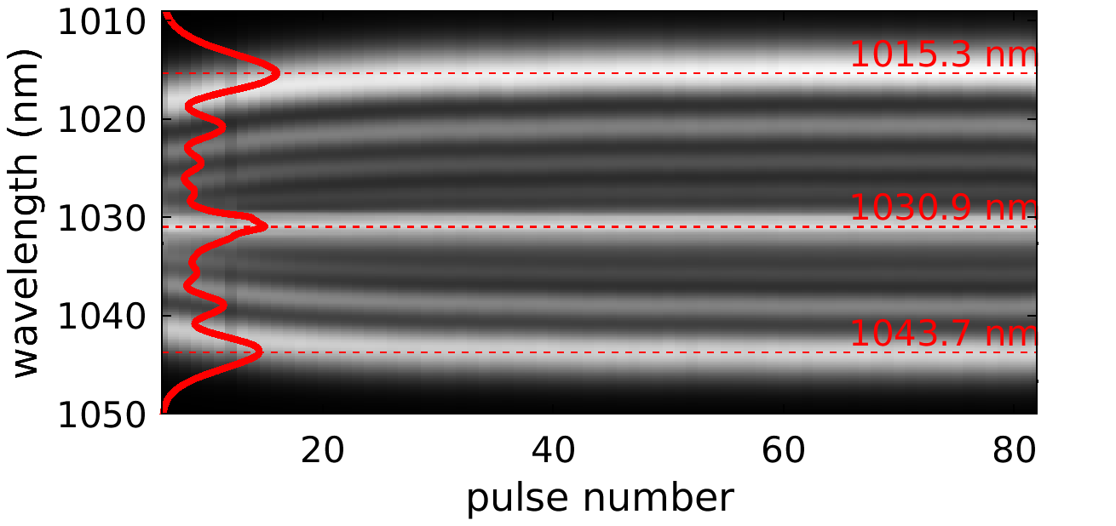
Pulse-resolved Measurements over the Burst
Pulse resolved Evolution of Pulse Duration and Spectrum

Slide 19
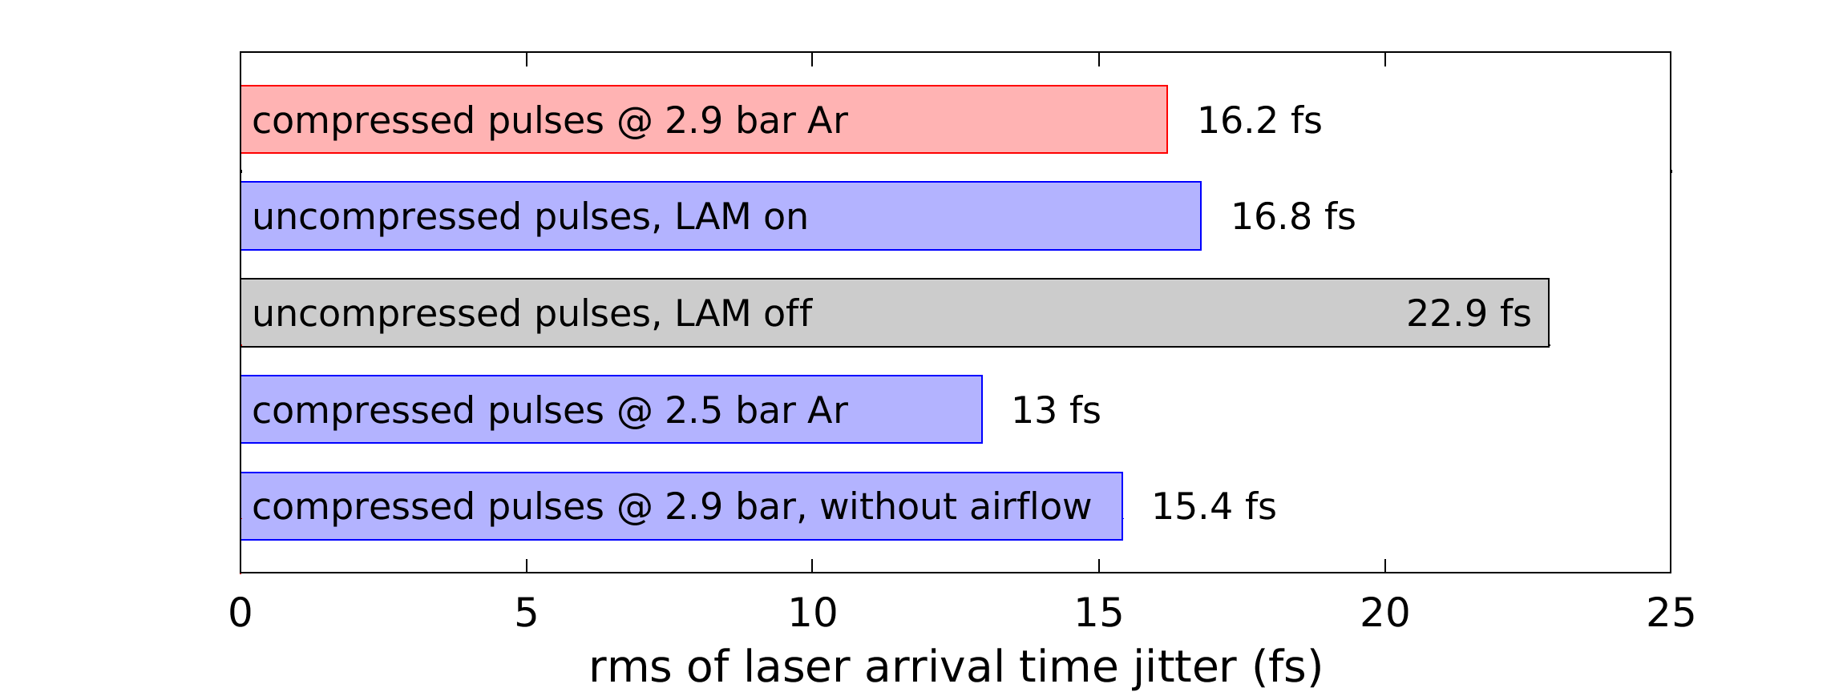
Variation of the Experimental Settings of the MPC
Typ. Operation point of the MPC
rms calculated over 10min
Here the best 10 min
Notes:
rms calculated over 10min
Here the best 10 min
Worst 10 min: max. 13% worse (unoptimized compressor)

Slide 20
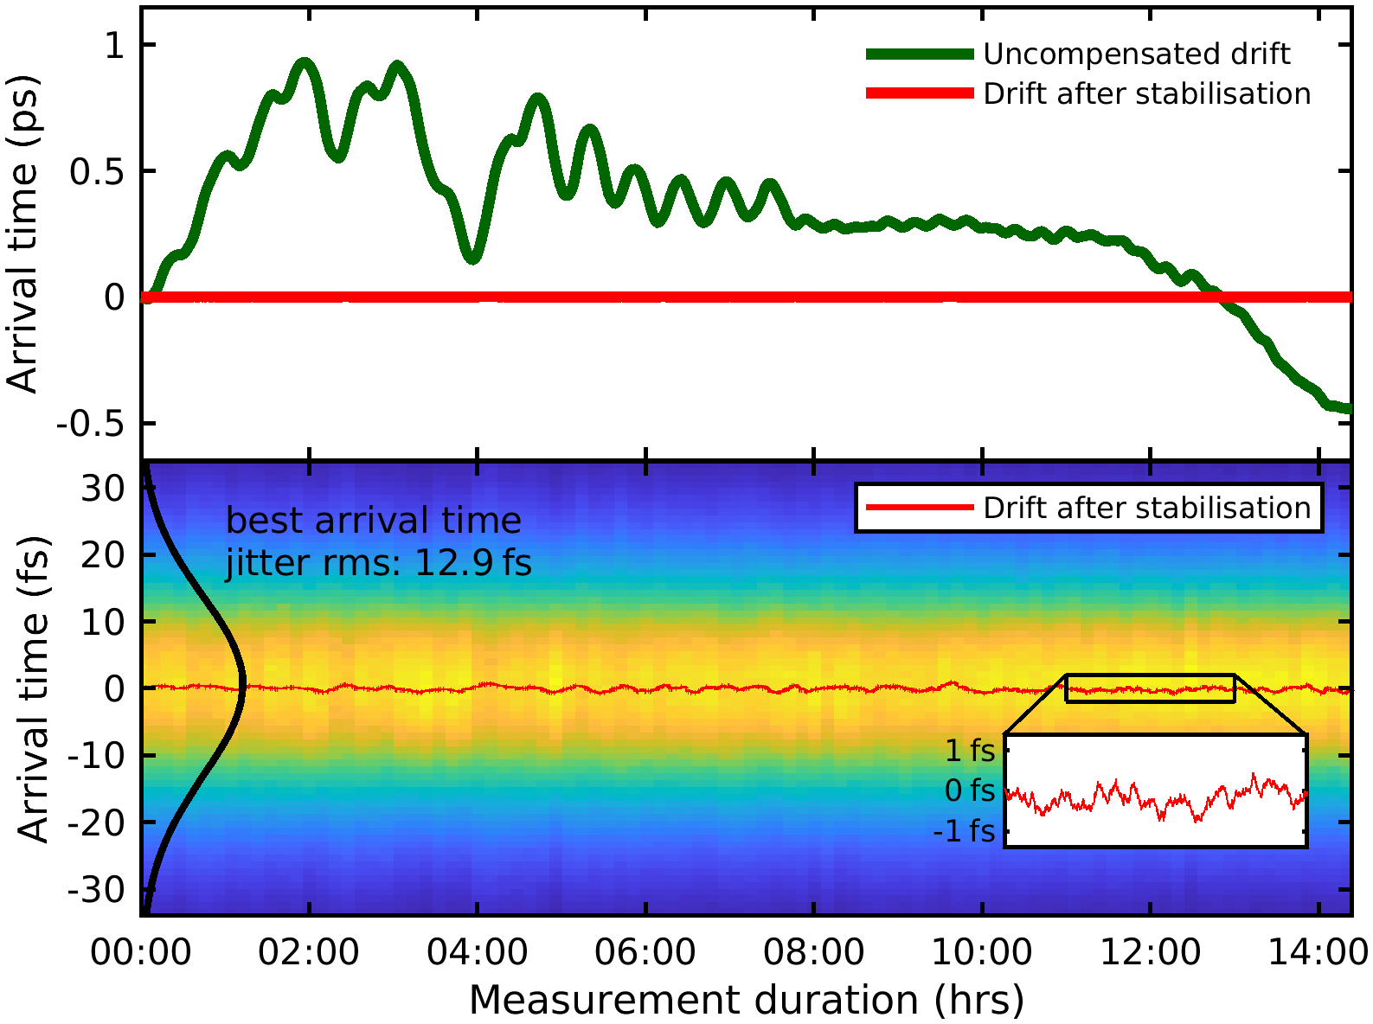
Long-term Measurements
MOD 2.3
Amp. + MPC
Drift of the Arrival Time of the Burst
Reference Fiber Links
Drift over 15 h duration: ~1.5 ps
After compensation: ~1 fs remaining
Great improvement for the pump-probe experiments
Improved time resolution
Ease of handling and finding overlapp with X-Rays
Jitter: ~13 fs (rms)

Slide 21
Conclusions and Outlook
On the way to <10 fs Experimental Resolution
Measurements of the jitter and drifts after a multi-pass cell realized at the FLASH facility
Observation of up to 1.5 ps drift within 15 h, removed with feedback
Jitter: <15 fs
→ Same order of magnitude than observations after the amplifier
Intra-burst: arrival time seems depending on the experimental conditions of the MPC
→ To be further investigated
A LAM is highly valuable for users!
  Finding and fixing t0
  Arrival time along the burst known and usable for data sorting

Slide 22
Thank you
LbSync
David Schwickert
Sebastian Schulz
Nick Kschuev
Falco Zummack
Thorsten Lamb
Matthias Felber
LAS (EuXFEL
Ulrike Wegner
Moritz Emons
Radu Costin-Saraceanu
Max Lederer
...
FS-LA
Skirmantas Alisauskas
Huseyin Cankaya
Ayhan Tallahi
Giovani Cirmi

Slide 23
Thank you
Anne-Laure Calendron
DESY (MSK group)
anne-laure.calendron@desy.de
+49 40 8998 2056

