Slide 1
DESY Placement Debrief
Jonathan Christie
05/12/2024

Slide 2
Contents
Placement overview
Weeks 1 – 2: Two-colour balanced optical cross-correlator
Experiment setup and results
Next steps for BOXCs at Daresbury
Weeks 3 – 7: All-colour laser arrival monitor
Motivation and principle of operation
Experiment setup
Testing and results
Next steps for all-colour LAM

Slide 3
About me
Postgraduate research associate at University of Liverpool, started June 2024.
PhD project focused on optical synchronisation of pulsed lasers:
Two-colour, fibre-coupled balanced optical cross-correlator,
Construction of BOXCs and stabilised timing links.
Research into externally-injected laser wakefield acceleration:
Simulations of LWFA driven by Yb:Fibre laser pulses,
Externally-injected LWFA experiment at Daresbury (November 2021).

Slide 4
Placement overview
7-week placement (01/09 – 18/10) at DESY.
Collaboration between UK XFEL and DESY/EuXFEL on laser arrival monitors (LAMs).
Working with the MSK LbSync group.
MSK: Maschine Strahlkontrollen (Accelerator Beam Controls).
LbSync: Laser-based Synchronisation.

Slide 5
Weeks 1 – 2: Two-colour balanced optical cross-correlator (BOXC)
Notes:
Was meant to work on LAM from the start of placement, but was unable to due to delays in lab renovations, so started with setting up a standard two-colour BOXC and associated control systems to get familiar with their equipment and software

Slide 6
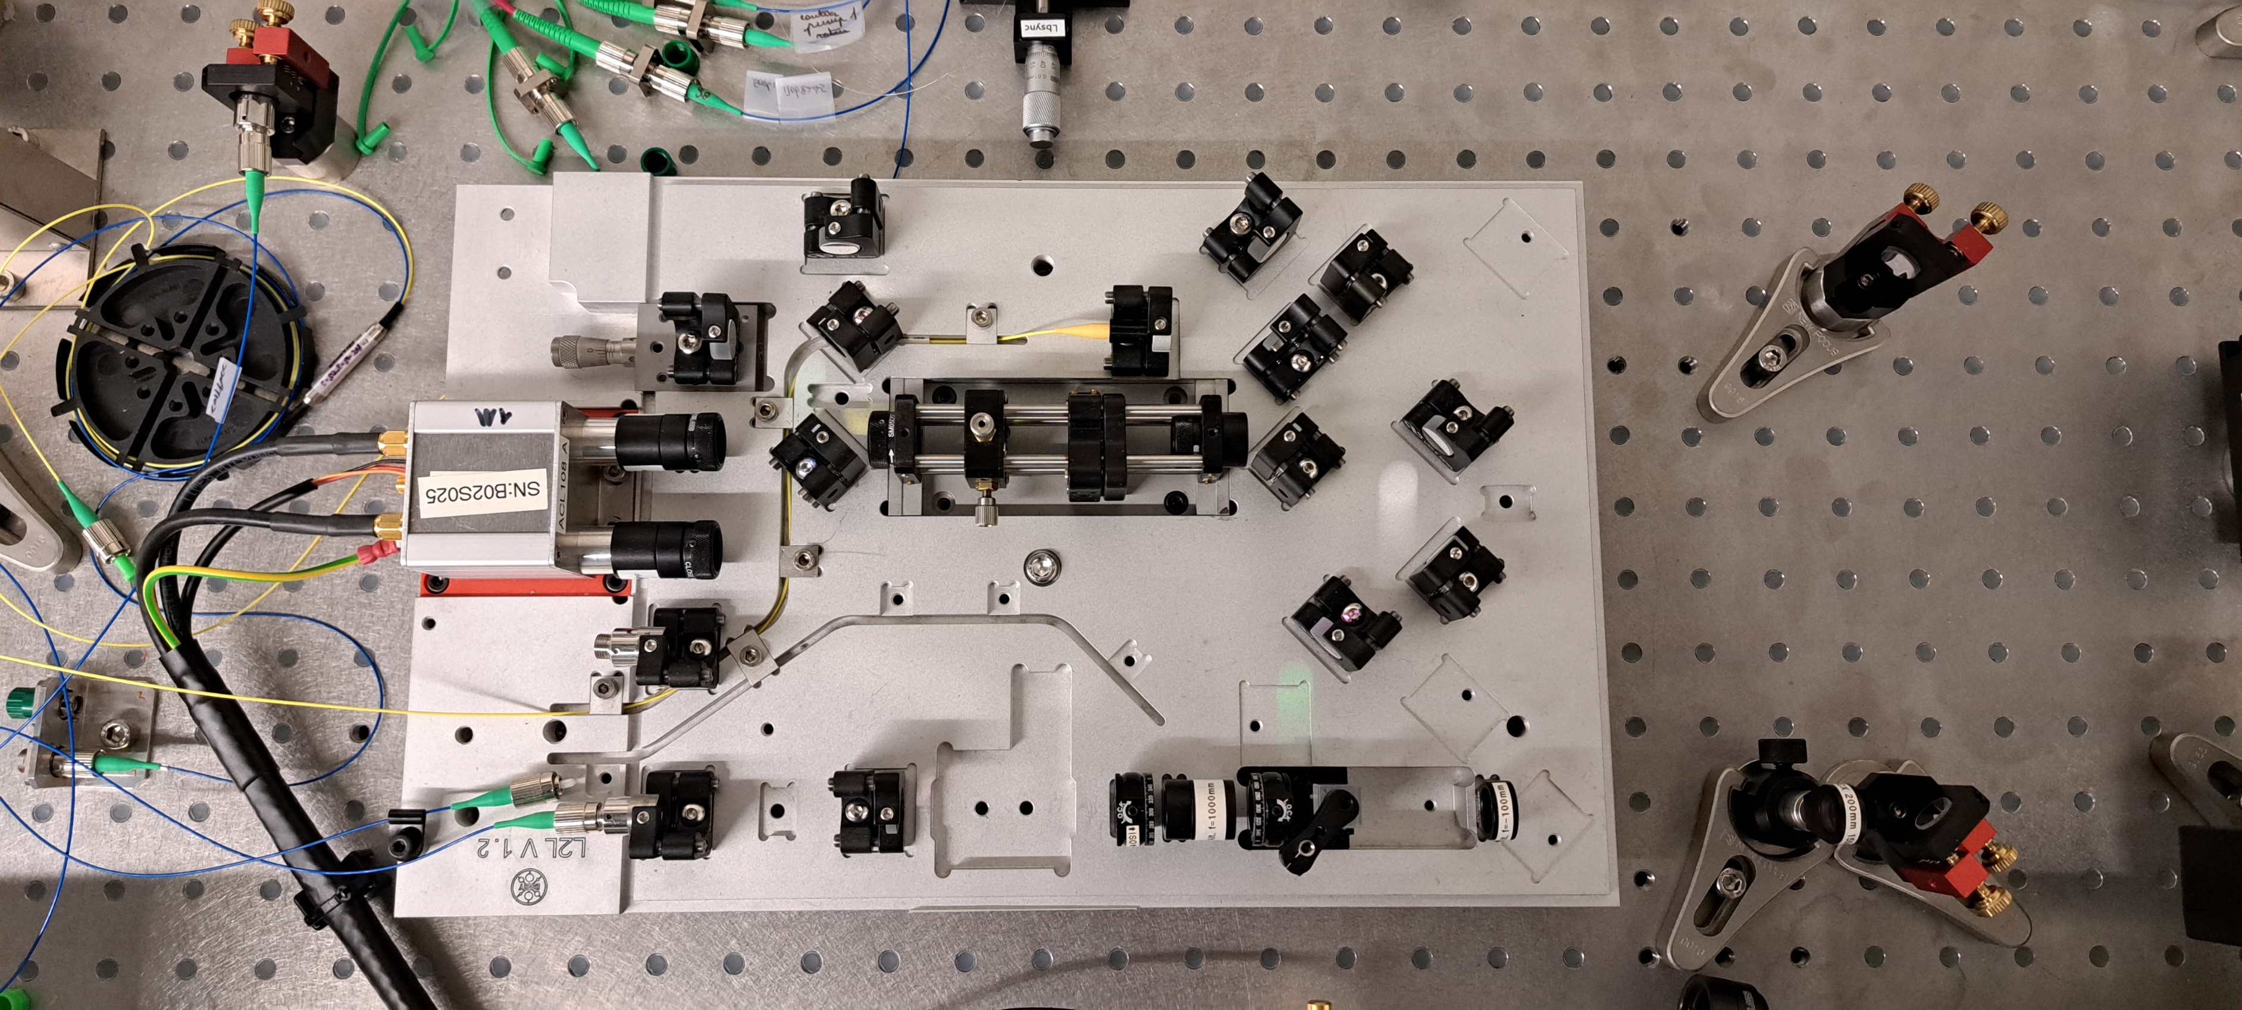
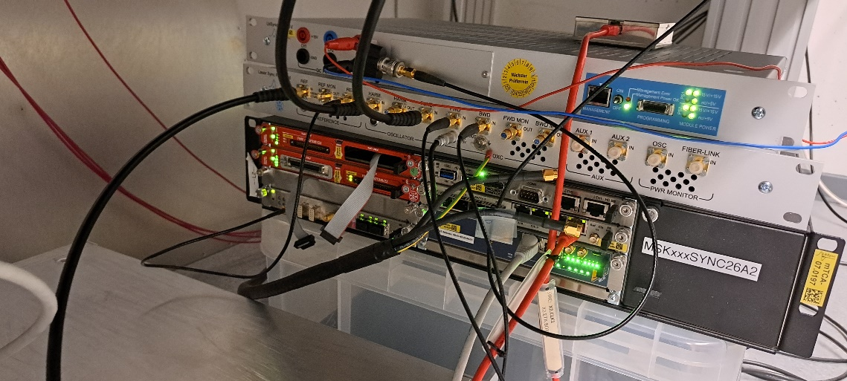
Experiment setup and results
Worked on setting up and aligning a two-colour free-space BOXC.
Sum-frequency generation between 1550 nm and 1030 nm using barium borate (BBO).
Calibration curve sensitivity of ~1 mV/fs.
Used BOXC to phase-lock lasers together, compared timing jitter between RF and optical phase-locking (bandwidth of 10 Hz – 10 MHz).
RF timing jitter: ~50 fs.
BOXC timing jitter: ~20 fs.
Relatively high BOXC timing jitter due to external noise (e.g. fans from synchronisation crate, environmental fluctuations).

Slide 7
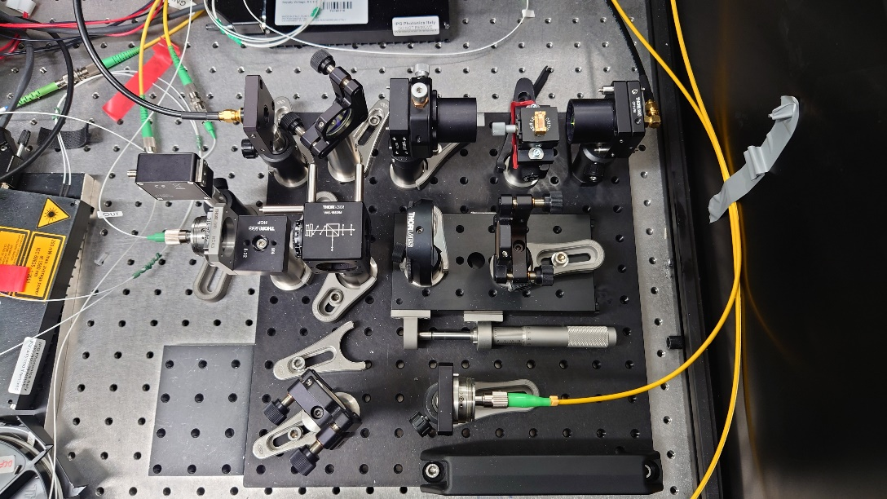
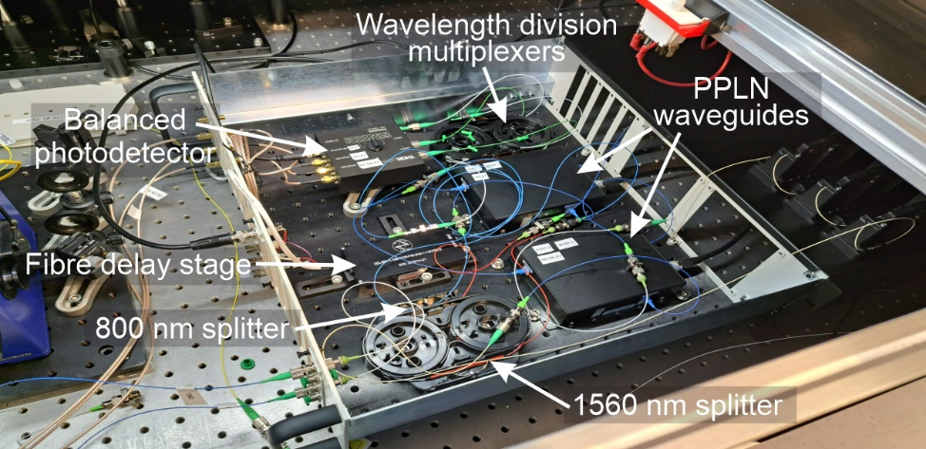
Next steps for BOXCs at Daresbury
Our group is looking at improving the design of the one-colour and two-colour BOXCs for UK XFEL.
Current BOXC components are free-standing.
Difficult to set up and align.
Variation in BOXC component positions.
Currently focused on caged-optic designs, but also considering machined breadboards.
Found it very simple to align two-colour BOXC at DESY.
Ensures uniformity between BOXCs.
R&D on fibre-coupled two-colour BOXC designs.
Set up phase-lock loop and measure integrated timing jitter, long-term drift etc.
Could integrate into UK XFEL if performance is significantly greater than free-space BOXCs.

Slide 8
Weeks 3 – 7: All-colour laser arrival monitor

Slide 9
Motivation
UK XFEL and EuXFEL require few-femtosecond synchronisation of a wide range of laser wavelengths (10 nm – 10 μm) to the X-ray pulses for user experiments.
Need to monitor laser pulse arrival time at IP to counteract drifts due to laser pulse transport, amplification etc.
Will use laser arrival monitors (LAMs) based upon balanced optical cross-correlators (BOXCs) to synchronise laser source and optical master oscillator (OMO).
Current BOXCs are limited to synchronisation of one wavelength to the OMO.
Synchronising each wavelength of interest to the OMO would require tens of LAMs.
Very challenging to align every LAM, difficult to swap between laser wavelengths.
All-colour BOXCs would greatly reduce number of LAMs required.
Would allow for synchronisation of multiple laser wavelengths to the OMO by a single LAM.

Slide 10
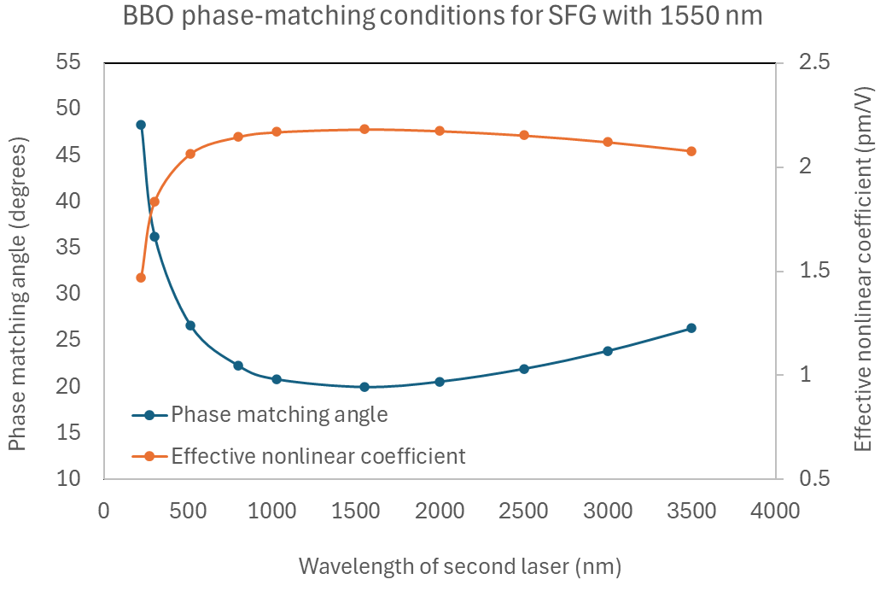
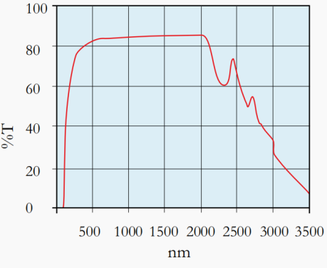
Principle of operation
All-colour LAM at DESY based upon noncollinear Type-1 (ooe) SFG between 1550 nm and 1030/515 nm.
Noncollinear design chosen so that SFG is spatially separated from input beams.
BBO is used due to its wide transmission spectrum (~190 – 3500 nm) and phase-matchable range (~410 – 3500 nm).
Can satisfy different phase-matching conditions by rotating the BBO crystal.
1550 nm
Focusing mirrors
SFG
BBO
1030/
515 nm

Slide 11
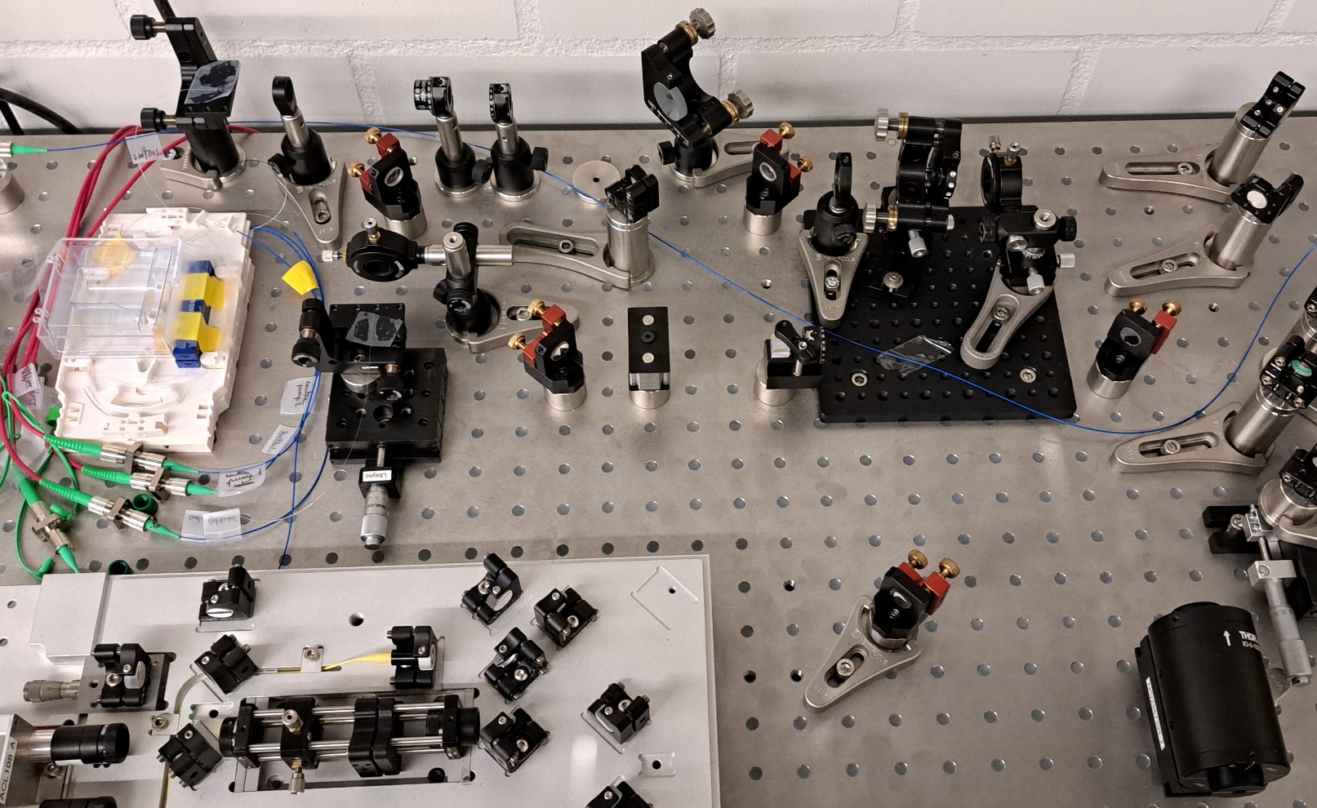
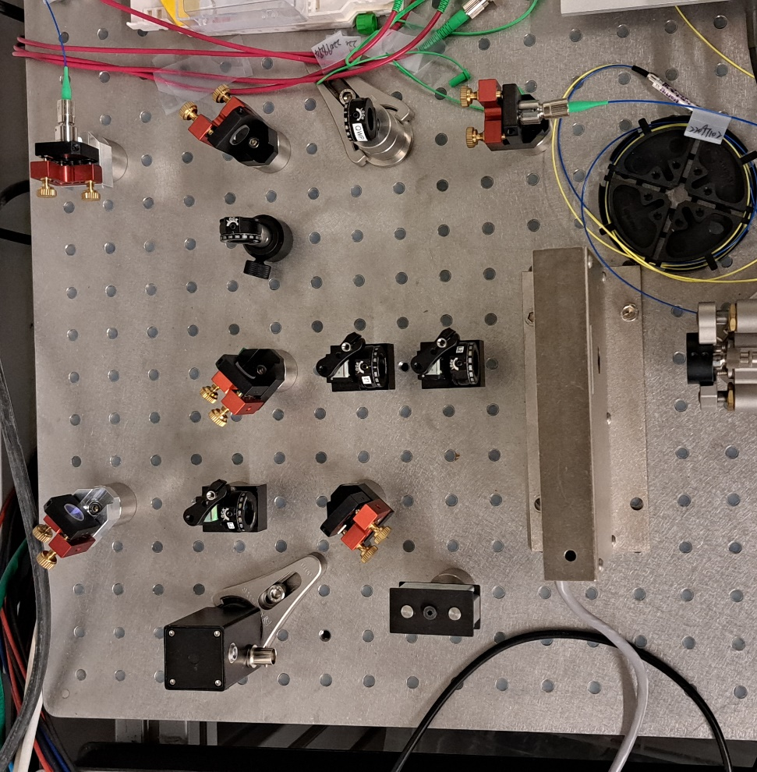
Experiment setup: amplifying the 1030 nm
The 515 nm pulses are currently generated from second-harmonic generation (SHG) of 1030 nm using BBO.
However, the 1030 nm oscillator output is not strong enough to generate sufficient 515 nm power through SHG.
1030 nm pulses are coupled into Yb-doped fibre amplifier from DK Photonics.
Increases power from 86 mW to ~300 mW.
1550 nm pulses are coupled into polarisation-maintaining fibre and propagated to the LAM.
To LAM
YDFA
To TCBOXC
1030 nm
To LAM
To TCBOXC
1550 nm
11

Slide 12
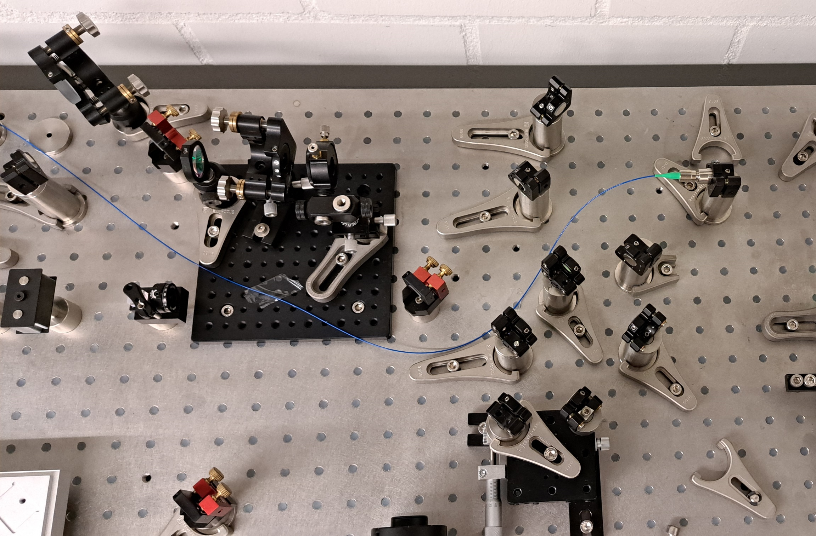
Experiment setup: generating the 515 nm
The amplified 1030 nm pulses are focused into a BBO crystal, generating 515 nm SHG pulses that propagate collinearly.
The 1030 and 515 nm pulses are split and recombined with dichroic mirrors.
The 1030 nm pulses are sent to a delay stage before recombination.
1030 nm in
BBO
1030 nm & 515 nm out
To LAM
1550 nm out, to LAM
Dichroic mirrors
12
Notes:
Couldn’t measure the 515nm power as we didn’t have a suitable power meter/detector
Delay stage allows for fine-tuning of the optical path length so that the 1030 nm and 515 nm pulses are temporally overlapped at the LAM nonlinear crystals.

Slide 13
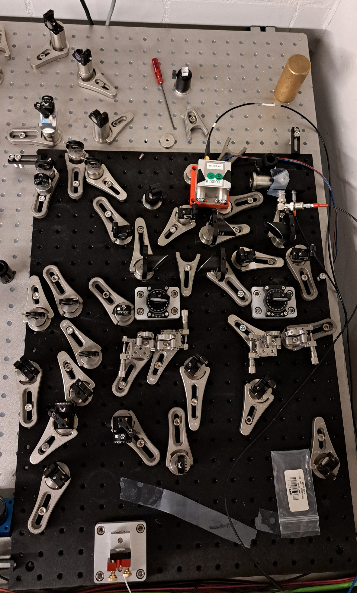
Experiment setup: all-colour LAM
1030/515 nm in
1550 nm
The 1030 and 515 nm pulses are split ~50/50 by a polarising beamsplitter cube (PBC) and focused on BBO crystals mounted on rotation mounts.
Two-crystal design chosen as it is difficult to reflect and refocus the beams back into the same crystal.
The 1550 nm pulses are also split ~50/50 and sent to separate crystals.
One 1550 nm section is sent to a piezo delay stage to allow for fine-tuning of the 1550 nm arrival time.
~35 mW of 1030 nm and ~45 mW of 1550 nm at the BBO crystals.
SFG pulses are generated and focused into a balanced photodetector using off-axis parabolic mirrors.
1550 nm in
1030 nm and 515 nm
SFG (619 nm and 387 nm)
13

Slide 14
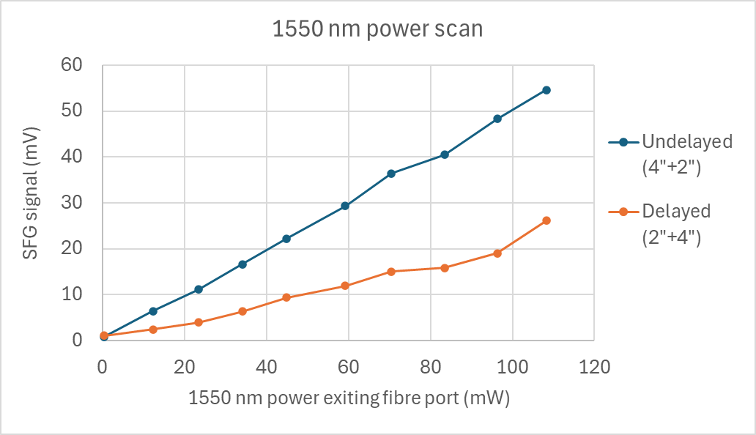
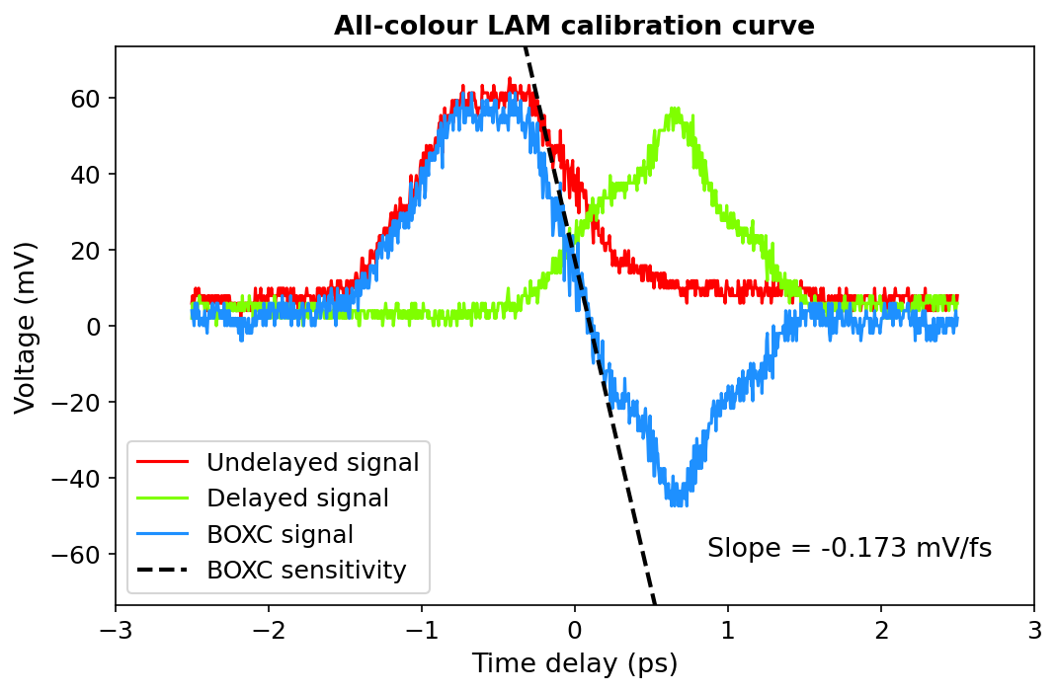
Testing and results
Obtained a BOXC calibration curve, measured SFG signal against 1550 nm power for the 1550/1030 nm interaction.
Could not set up the 1550/515 nm SFG interaction due to late start working on LAM and length of setup.
Maximum SFG signal of 54.6 mV obtained.
SFG signal follows roughly linear trend with 1550 nm power.
Achieved a calibration curve sensitivity of 0.173 mV/fs.
Can be improved with optimisations to alignment, spatial overlap etc.
14
Notes:
DESY group achieved a maximum SFG signal of 162 mV for the same input 1030 nm and 1550 nm power. Potential for a calibration curve sensitivity of >0.5 mV/fs, comparable to free-space BOXC I worked on earlier in placement.

Slide 15
Next steps for all-colour LAM
Daresbury:
Construct all-colour LAM at Daresbury based upon DESY prototype.
Possible different designs/layouts?
Discuss possible locations for LAM in UK XFEL.
Look into developing LAMs for different wavelengths.
< 500 nm for PI laser and UV sources, > 3500 nm for IR sources.
Different nonlinear crystals required.
DESY:
Continue collaborating with all-colour LAM prototype.
Meetings, further placements etc.
Set up 1550 nm and 515 nm interaction, measure sensitivity.
Test LAM with different wavelengths within BBO phase-matching range (e.g. 800 nm).
Implement phase-lock loop using all-colour LAM, measure jitter and drift at different wavelengths.

Slide 16
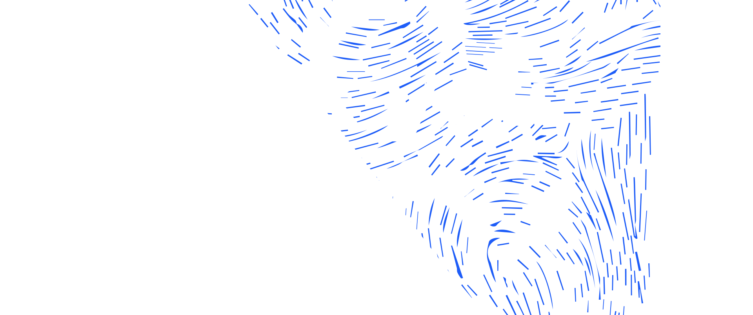
Science and Technology Facilities Council
@STFC_matters
Science and Technology Facilities Council

Slide 17
Overview of Progress

Slide 18
BOXC setup: forward pass
1550 nm
1030 nm
1030 nm
SFG (619 nm)
SFG
1550 nm

Slide 19
BOXC setup: reverse pass
1550 nm
1030 nm
SFG (619 nm)
SFG

Slide 22
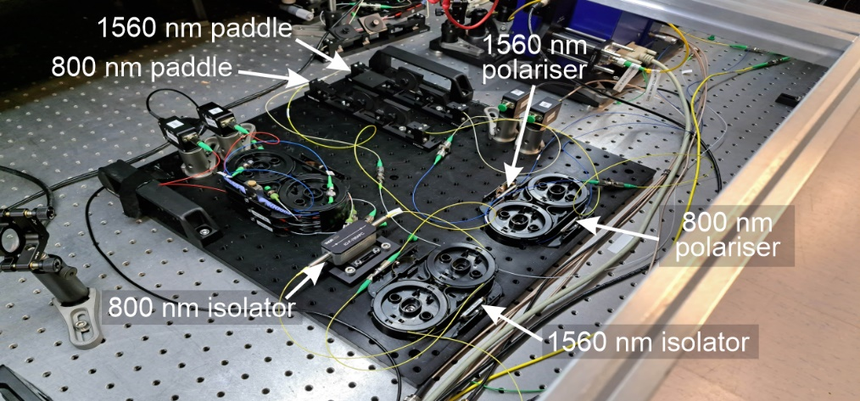
Two-colour fibre-coupled BOXC
Worked on developing a two-colour, fibre-coupled BOXC for my PhD project:
Sum-frequency generation between 1560 nm OMO and 800 nm seed laser for high-power laser system.
Based upon fibre-coupled periodically-poled lithium niobate (PPLN) waveguides.
Sensitivity of 5.1 mV/fs, up to 5 times greater than comparable free-space coupled BOXCs.

