Slide 1
Synchronisation
Session summary, 05.12.24

Slide 2
Summary of session
Review of collaboration to date
  Discussion on ideas and areas to continue and strengthen this
Discussion of new collaboration topics
  DESY/EuXFEL mid-term sync plans – framing for what we can do in the coming months/years
  UK XFEL – discussion around <1 fs synchronisation challenge – useful opinions for UK XFEL CDOA, and we won’t be short of more ideas in the future!

Slide 3
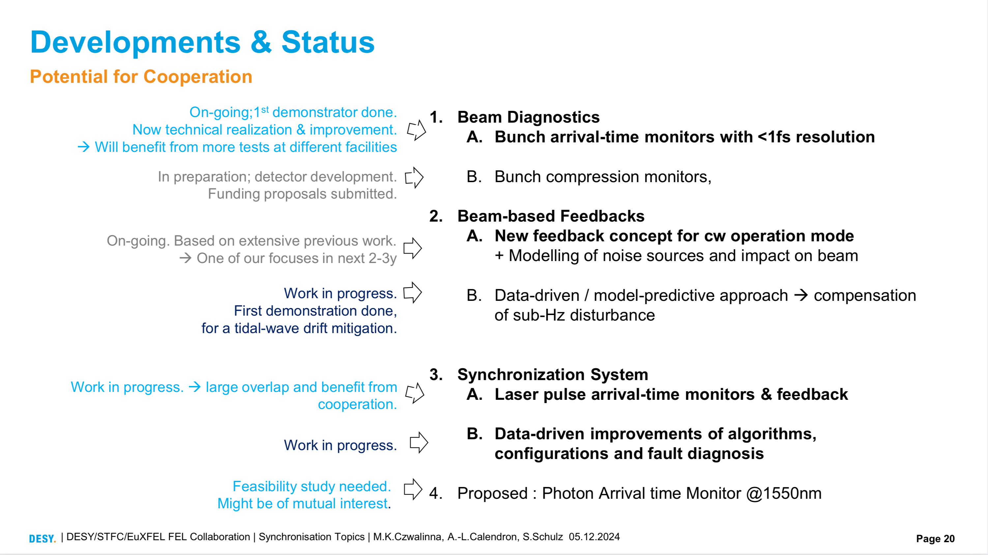

Slide 4
Ideas and actions discussed
Topic area | Idea
Laser arrival monitors | All-fibre implementation (design and build) Optimised engineering design, automatisation (design and control) All-colour development platform at Daresbury Return placement to DESY/EuXFEL to continue progress Application on FEBE laser Possible CLF interaction (HiLuX) – tbc
Beam arrival and bunch compression monitors | Tests of high sensitivity BAM at CLARA Explore possible application for RUEDI diffraction BCM improvements (design, CLARA input)
Beam-based feedback | Concept and modelling for 1 MHz CW beam stabilisation Data-driven/predictive approach for seismic/microseismic effects
Photon arrival monitor | 1550 nm implementation (design)

