Slide 1
EuXFEL Longitudinal Phase Space Diagnostics & Opportunities for Collaboration with UK Colleagues
Stuart Walker, Sergey Tomin, Igor Zagorodnov, Nina Golubeva, Matthias Scholz, Winfried Decking, Bolko Beutner, Erion Gjonaj, Ye Chen
DESY-STFC-XFEL Collaboration Meeting 2024, DESY, Hamburg, 5.12.2024

Slide 2
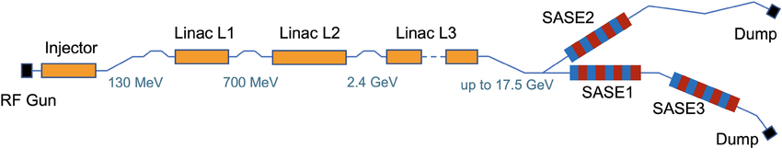
The EuXFEL’s Longitudinal Phase Space Diagnostics
Overview
One transverse deflecting structure (TDS) in the injector, and one after BC2
HXRSS in SA2, attosecond SA2 and SA3, two colors and so on, wish recent pushes to more special modes
Crucial to know longitudinal beam dynamics:
  to deliver the best performance
  to decrease machine setup time
  because novel modes are particularly sensitive to LPS variation
Passive streaker
BC0 BC1 BC2
CRISP
TDS
Passive streaker 2026
TDS
Dump
Dump
Dump

Slide 3
Overview
Slice energy spread (SES)
  Microbunching instability (MBI) and intrabeam scattering (IBS) contributions to SES observed in the EuXFEL injector
  Possible areas of collaboration
    Similar experiments at CLARA?
Collective effects and validation
  Space charge & wake fields in the injector
  Where to next?
  Start-to-end simulation of standard working point and crosschecking with measurements
State of the transverse deflecting structures (TDSs)
UK colleagues' participation in our experiments and vice versa
  Discussion

Slide 4
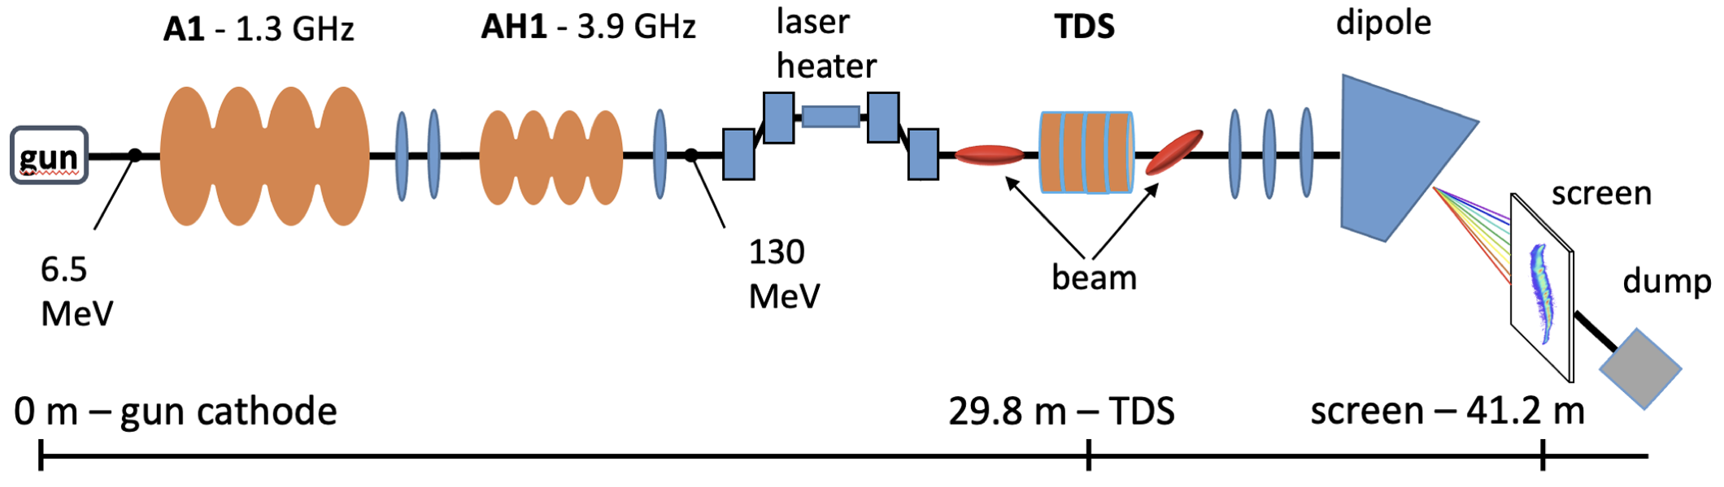
The EuXFEL Injector

Slide 5
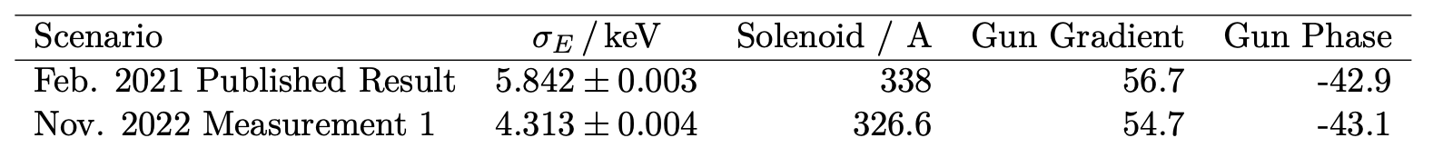
Slice Energy Spread
We have measured the slice energy spread in the injector several times since 2021, starting with [1]
Expected result based on conventional (ASTRA) simulations is ~0.5 keV
Additionally fell between 2021 and 2022 (possible cause: cathode replacement)
We wrote a code for the control room to do these measurements quickly (~ few minutes vs ~1 hour before)
Contribution to ongoing discussion regarding the impact of IBS and MBI on SES in similar facilities (SwissFEL, FERMI)
[1] Accurate measurement of uncorrelated energy spread in electron beam, S. Tomin et al.
https://doi.org/10.1103/PhysRevAccelBeams.24.064201

Slide 6
Impact of MBI (?) on Slice Energy Spread in the Injector
Laser Heater Chicane R₅₆ Scan
We scanned the Laser Heater Chicane R₅₆ in the injector
Strong dependence of R₅₆ on the injector SES
Minimal impact of choice of laser
TODO: beam dynamics simulations (MBI? One to one simulations…?)

Slide 7
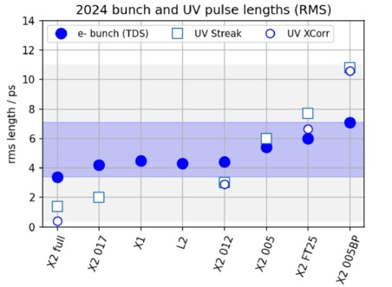
Future SES Studies—Opportunities for Collaboration
Energy Spread and Charge Density
We can vary the charge density with our NEPAL laser:
  Keep bunch charge constant and vary the laser pulse length (2ps–25ps possible)
  Effect of IBS would be observable
Measure SES in the injector and at full compression (after BC2)—we get the combined impact of multiple BCs on MBI and distance on IBS
Question for our friends in the UK: what sort of SES measurements can we do with CLARA and what sort of parameter space can we explore—optics, charge, bunch length, path length, etc…
Courtesy of YE CHEN

Slide 8
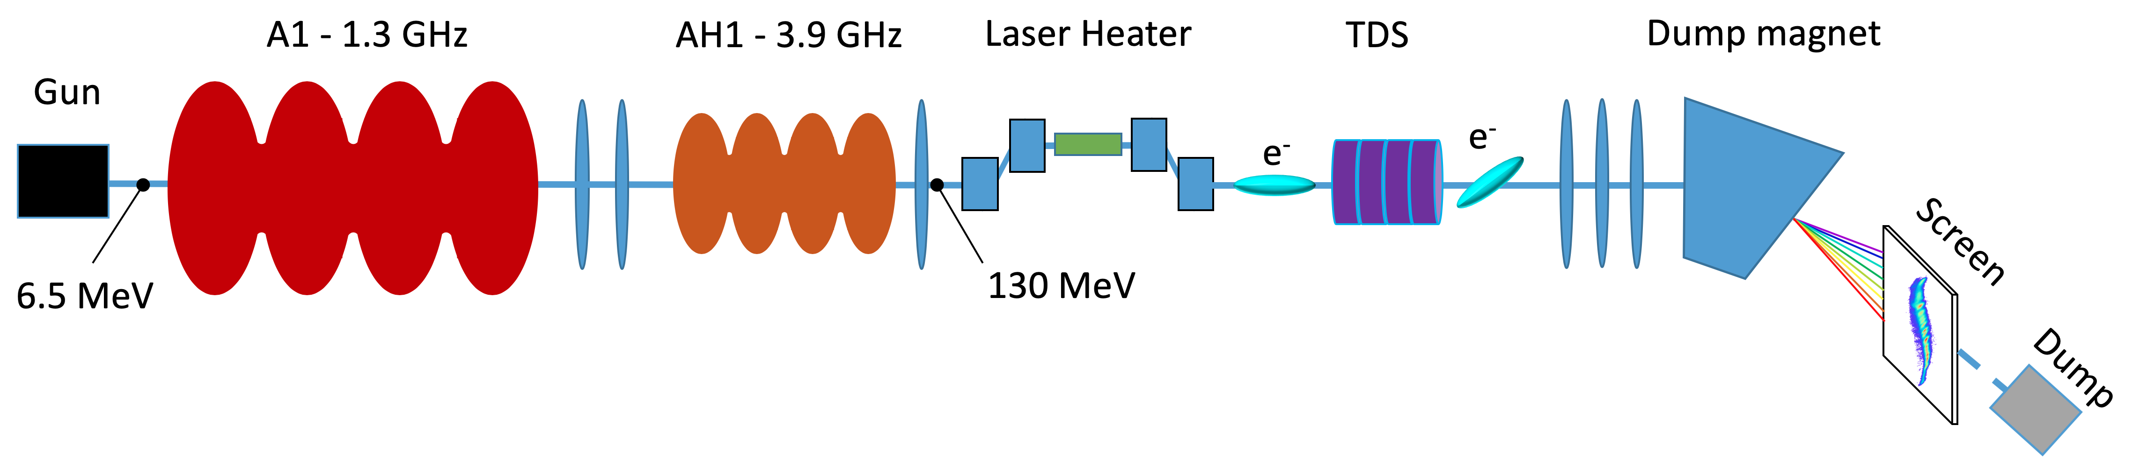
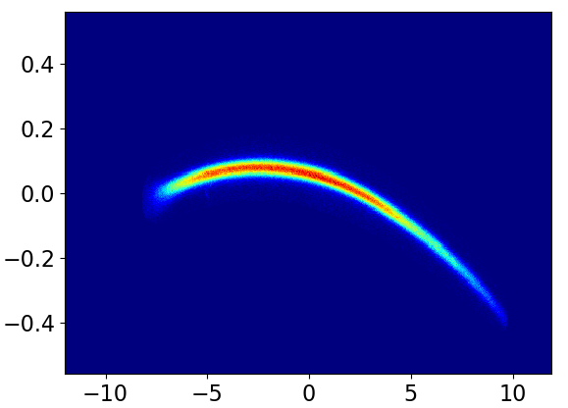


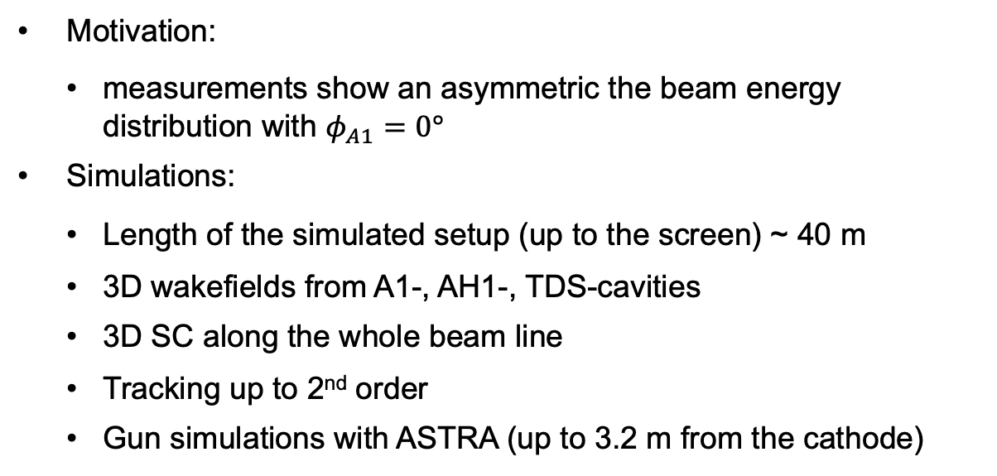
Modeling and measurement of collective effects in the Injector
Motivation:
  measurements show an asymmetric the beam energy distribution with $φ_{A1}=0°$
Simulations:
  Length of the simulated setup (up to the screen) ~ 40 m
  3D wakefields from A1-, AH1-, TDS-cavities
  3D SC along the whole beam line
  Tracking up to 2nd order
  Gun simulations with ASTRA (up to 3.2 m from the cathode)
$∆p_{z}$[MeV/c]
Measured, on-crest in A1
$t$[ps]
Experimental validation of collective effects modelling at injector section of X-ray free-electron laser, 2021, Zagorodnov et al.
https://doi.org/10.1016/j.nima.2021.165111

Slide 9
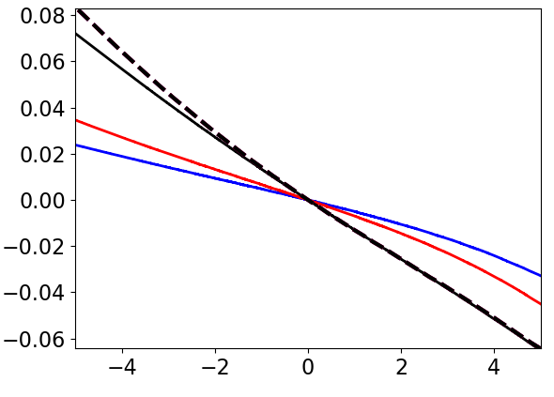



Modeling and measurement of collective effects in the Injector
$∆p_{z}$ [MeV/c]
SC & wakes
$$φ_{gun}=2^{o}$$
Validated SC & Wakes in the injector at lowest energies.
Bunch length is long in injector—CSR not a consideration here and yet to be crosschecked.
  Worth investing time into CSR simulation + measurement?
With MBI and IBS, then we can say we have a good description of the machine.
measured
SC
w/o
$t$[ps]
Experimental validation of collective effects modelling at injector section of X-ray free-electron laser, 2021, Zagorodnov et al.
https://doi.org/10.1016/j.nima.2021.165111

Slide 10
Modelling and measurements
Opportunities for collaboration
Validate models further down stream: BC2 TDS, passive streakers, CRISP, …
New postdoc (Bianca) will start working on this soon
A good model of the accelerator will enable better surrogate models and virtual diagnostics
The sum of the whole is greater than the parts—we expect that as we further develop diagnostics software, these stations will complement each other (e.g. downstream reconstructing passive streaker with TDS/Crisp data—see Sergey’s talk)
Passive streaker
CRISP
TDS
Passive streaker (from 2025)
TDS

Slide 11
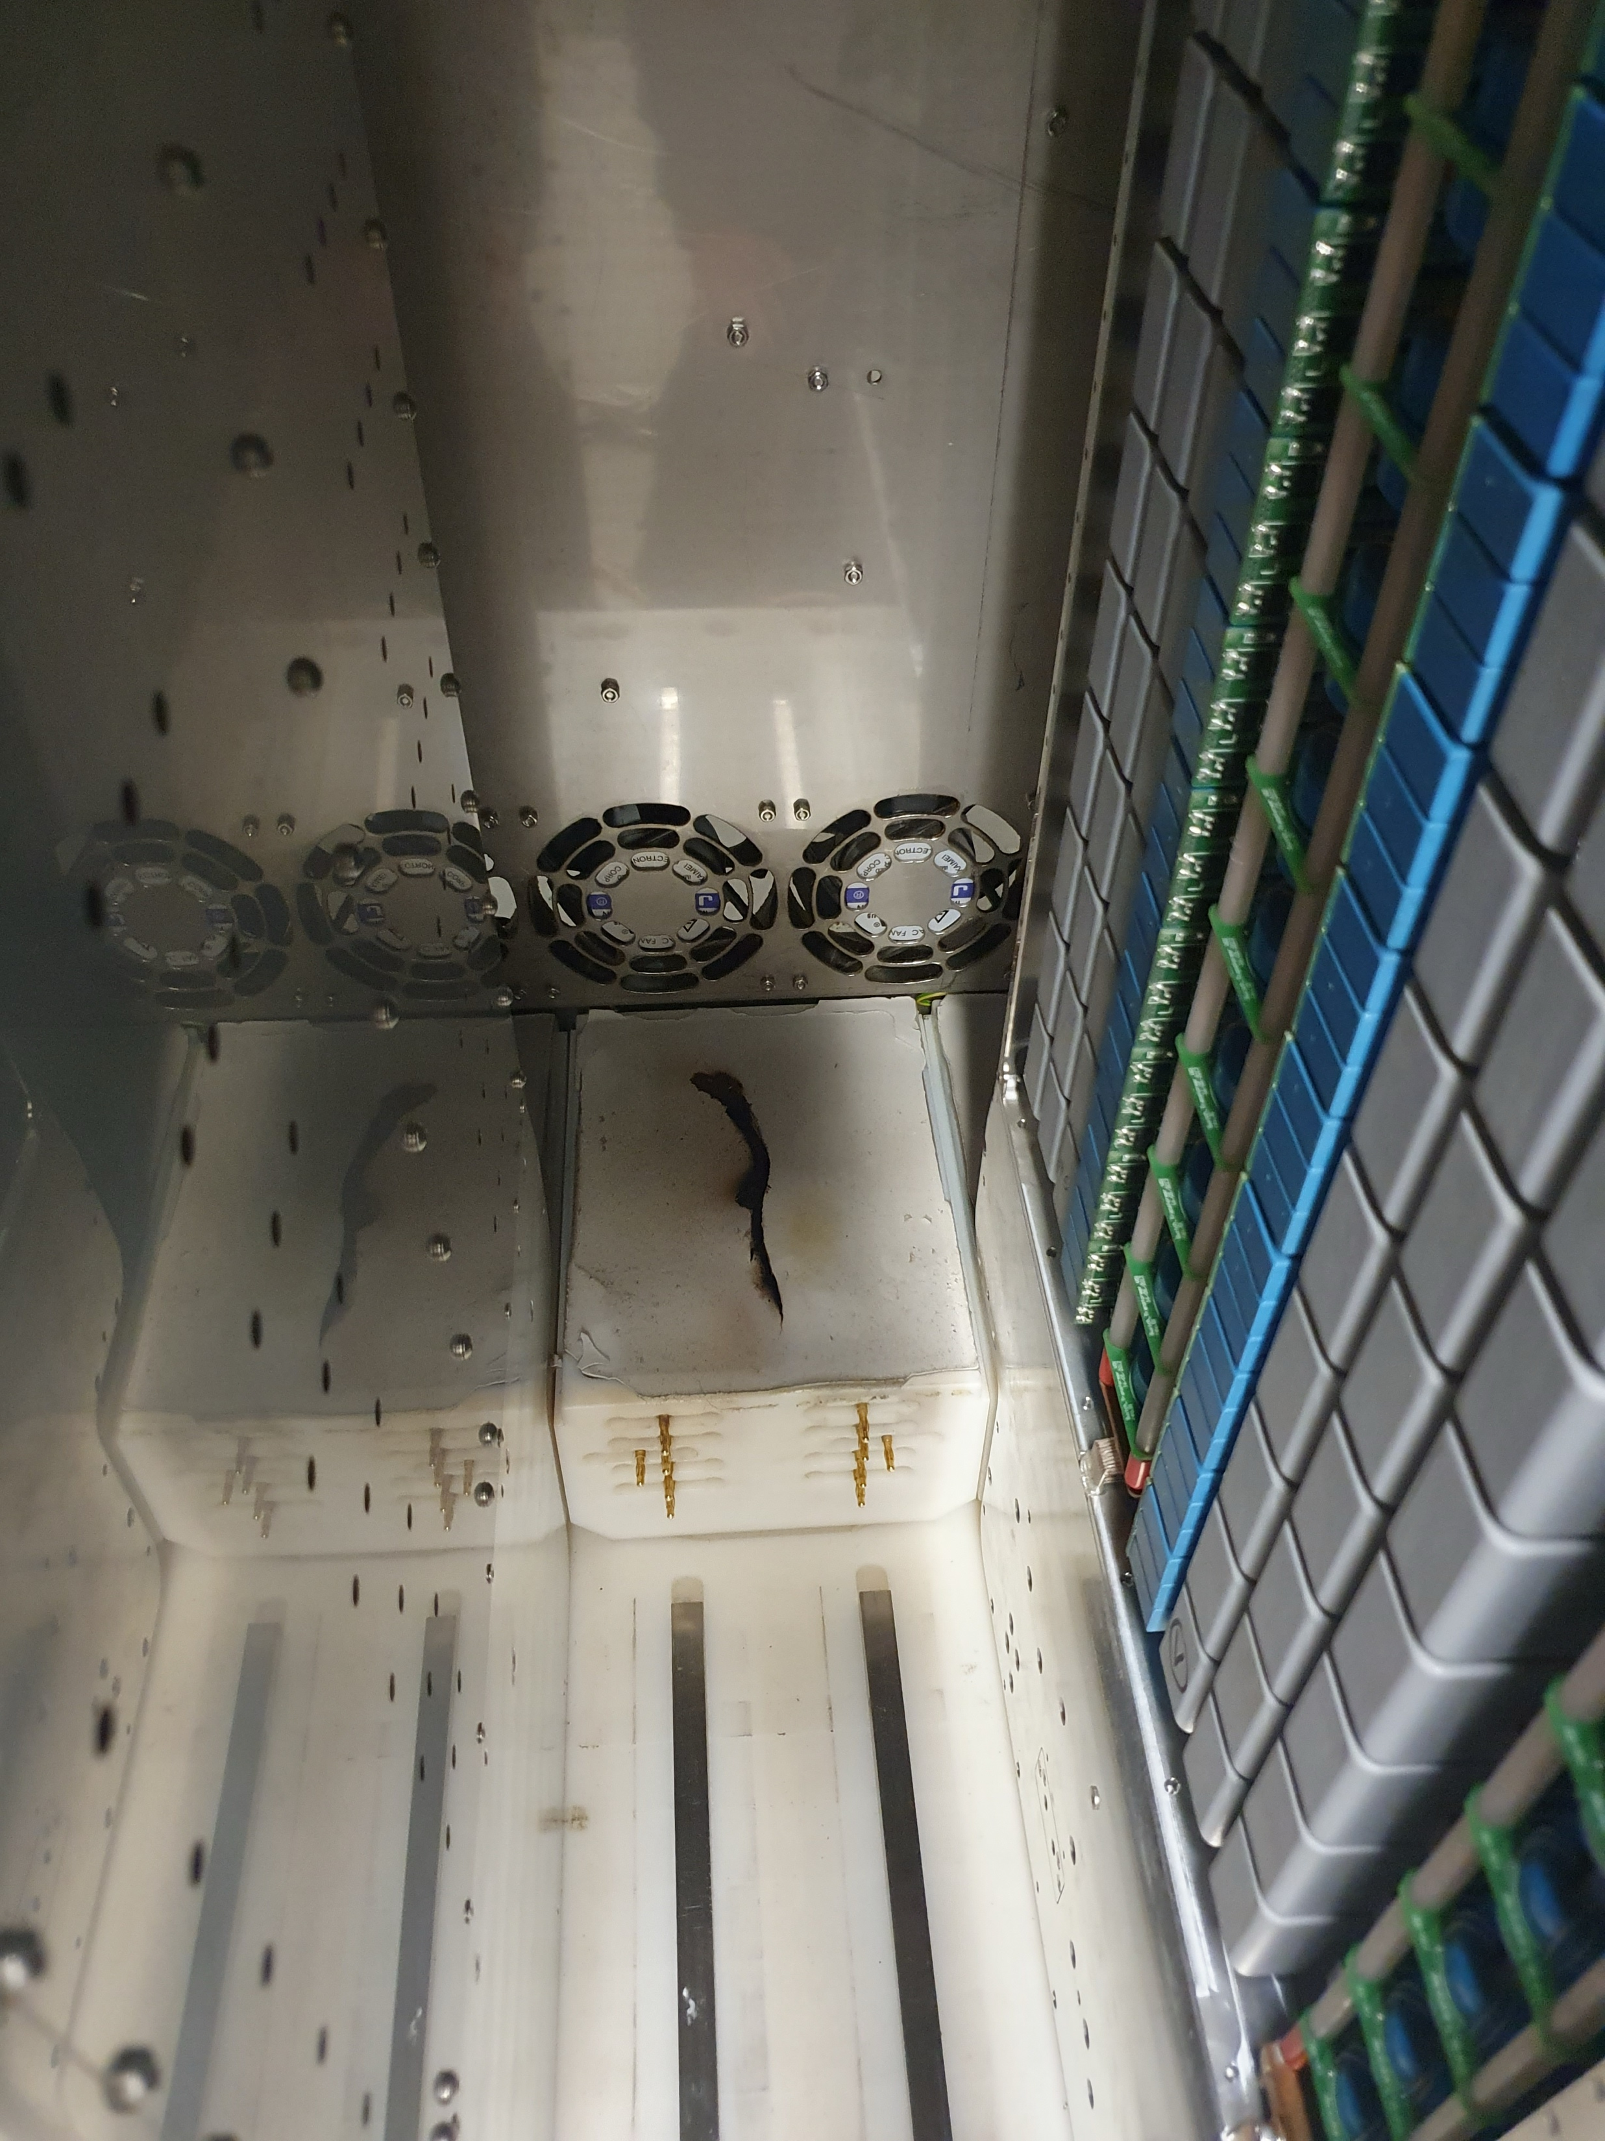
The State of the TDSs at the EuXFEL
Injector TDS
  The modulator caught on fire earlier in the year. After a downtime of 2+ months, we borrowed a TDS modulator from another machine here at DESY
BC2 TDS (post full compression)
  We attempted to upgrade the pulse compressor in Winter 2023 to boost time resolution by up to factor 2
    Since then, the BC2 TDS has not worked
  After much testing and by our colleagues, we expect to have it streaking again in early 2025
BC2 TDS
The modulator after the 🔥🔥🔥
Injector TDS
Notes:
Injector resolution: ~200fs
BC2 resolution: ~8fs (down to ~4 with upgrade)

Slide 12
Conclusion
We have a number of ongoing projects measuring and modelling the LPS in the EuXFEL
Particular points of interest from our side that we are open to collaboration on:
  The microbunching instability
  Intrabeam scattering
  High resolution energy spread measurements
  Validating our simulation results with measured LPS along the machine from the injector down to the undulators
From your side that we are also interested in hearing more about:
  Your LPS measurement opportunities at your facilities
    What region of parameter space you can cover and how it complements existing measurements elsewhere
  Getting directly involved with each other’s measurements

