Slide 1
Online Dechirper LPS Reconstruction & Virtual diagnostics
Sergey Tomin
DESY
DESY-STFC-XFEL collaboration meeting, December 5-6, 2024

Slide 2
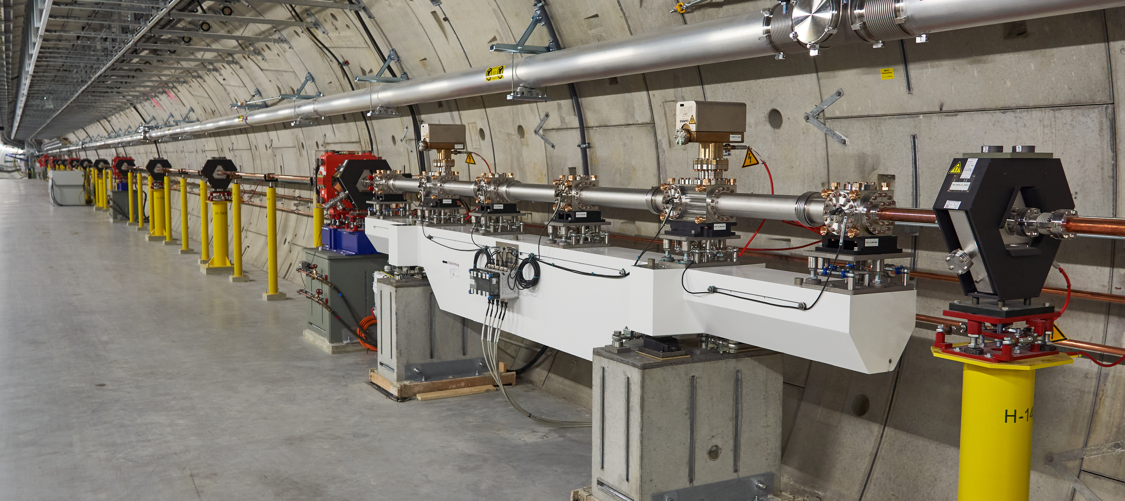
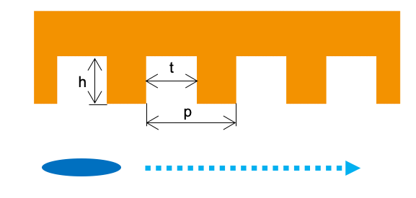
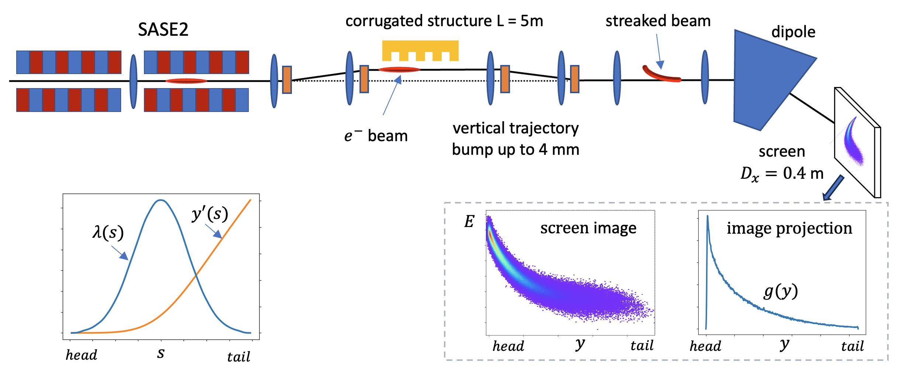
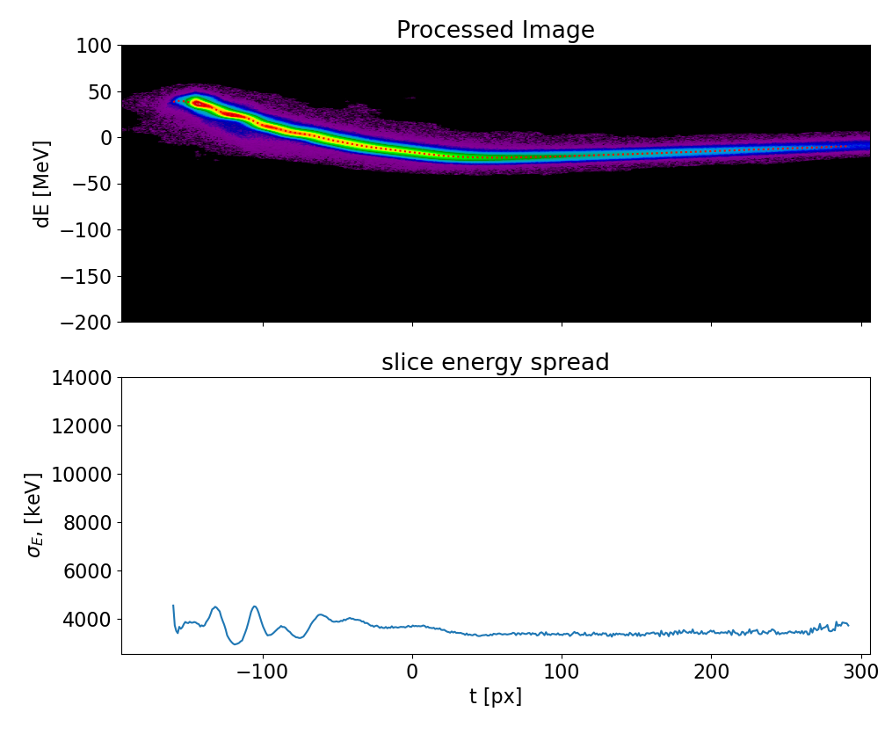
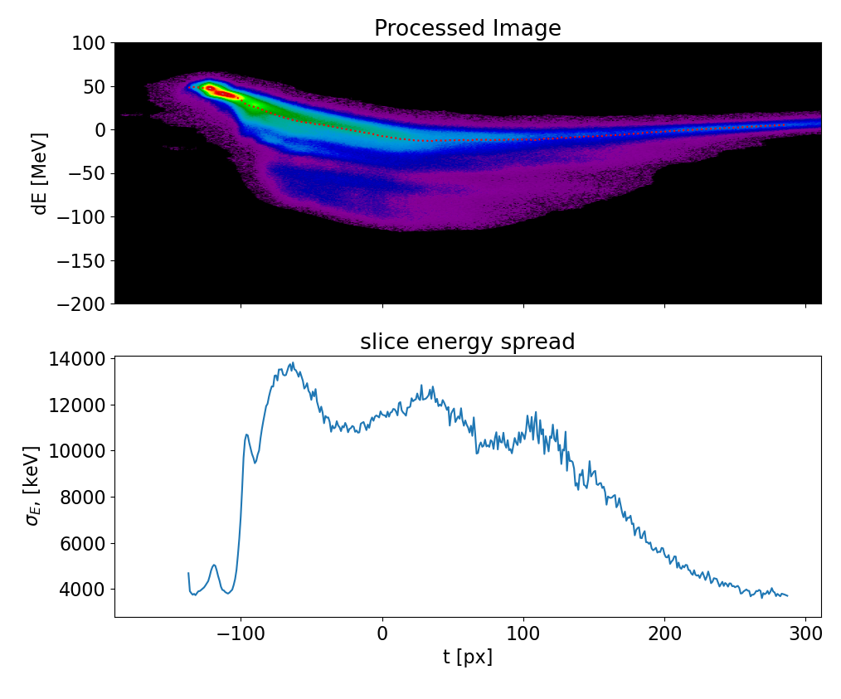
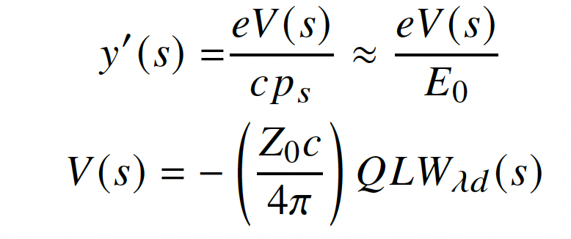
LPS diagnostics based on passive streaker
Passive streaker
(2025)
h [mm] | t [mm] | p [mm]
0.5 | 0.25 | 0.5
SASE OFF
SASE ON

Slide 3
Offline reconstruction algorithm
Record the current profile measured by CRISP and the vertical beam center of mass on the screen before and after the streaking.
Perform passive streaker macroparticle tracking simulations using the measured current profile. Vary d (distance between beam and corrugated pate) until the simulated center of mass shift matches the recorded center of mass shift
Compute the impact of the wakefield kick at the position of the beam screen, using the transverse dipole wakefield potential and the R34 beam transport matrix element.
P. Dijkstal, W. Qin, and S.Tomin, Longitudinal phase space diagnostics with a nonmovable corrugated passive wakefield streaker. PRAB 27, 050702 (2024)

Slide 4
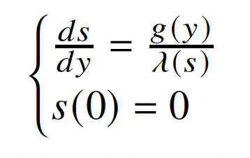
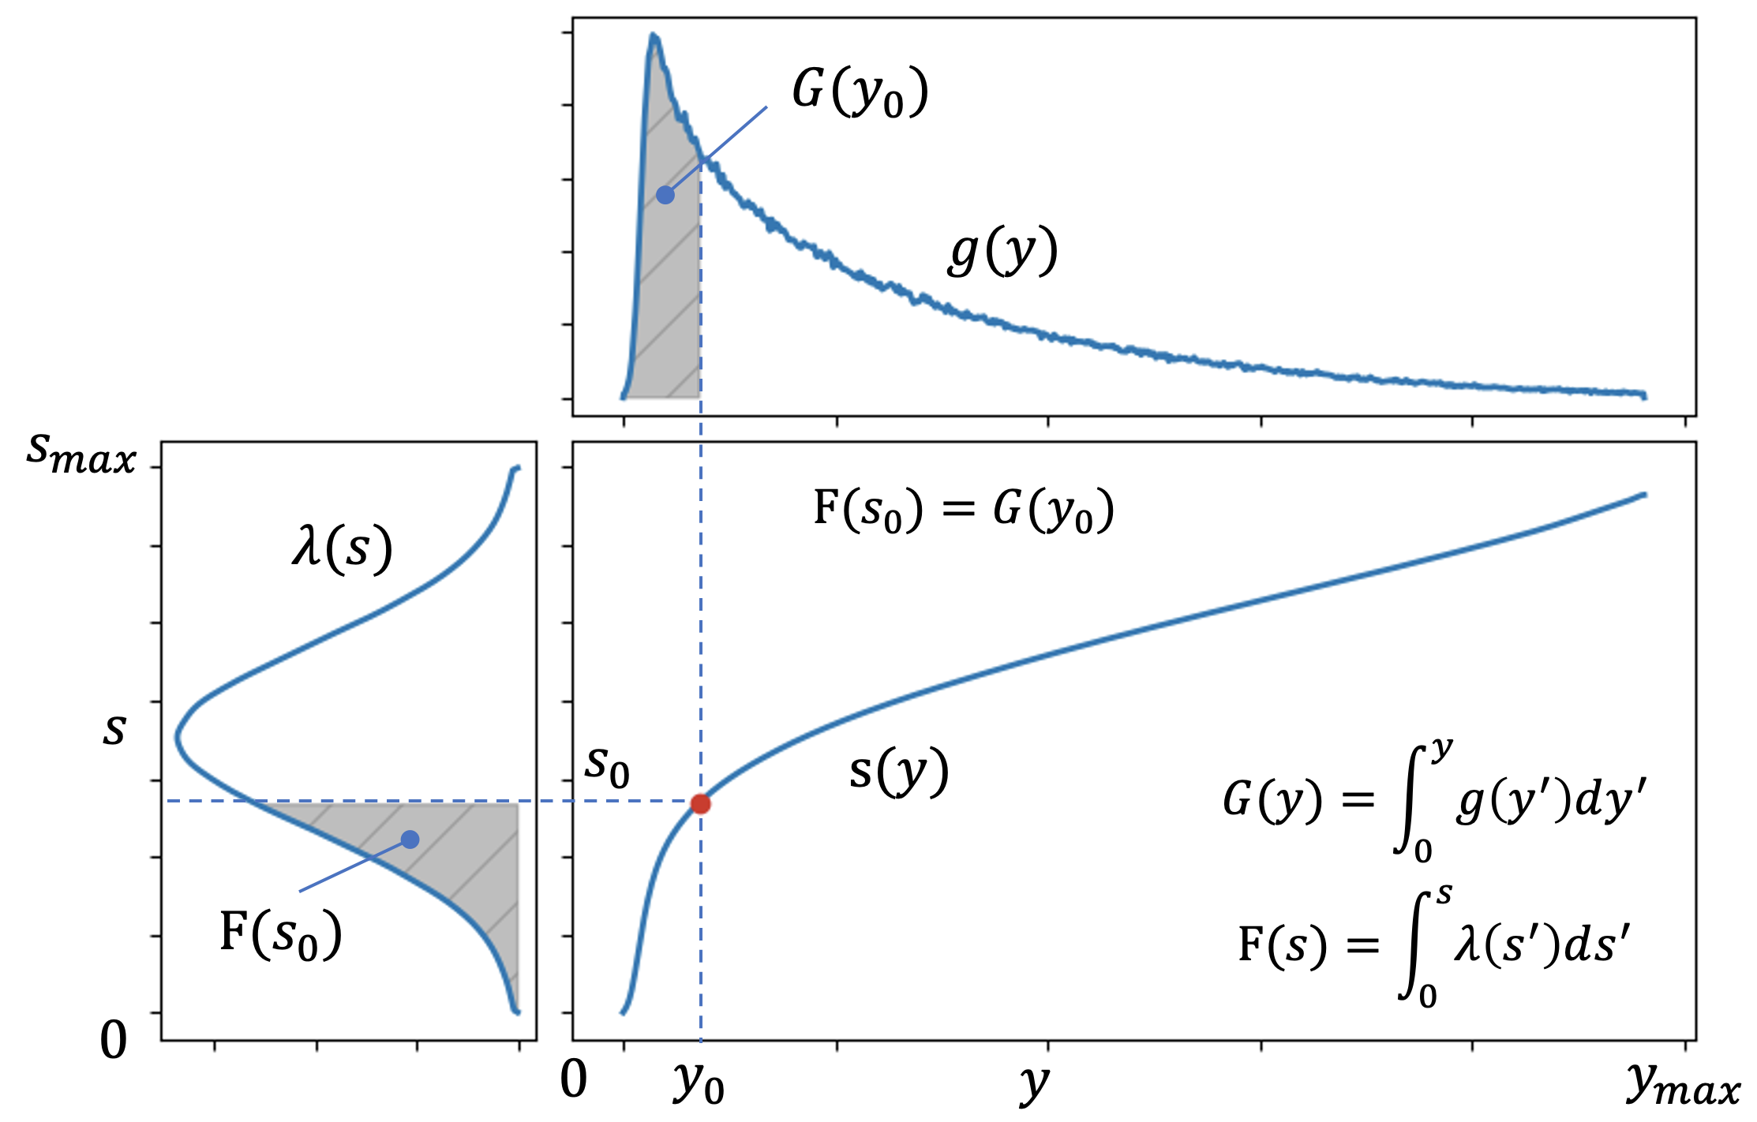
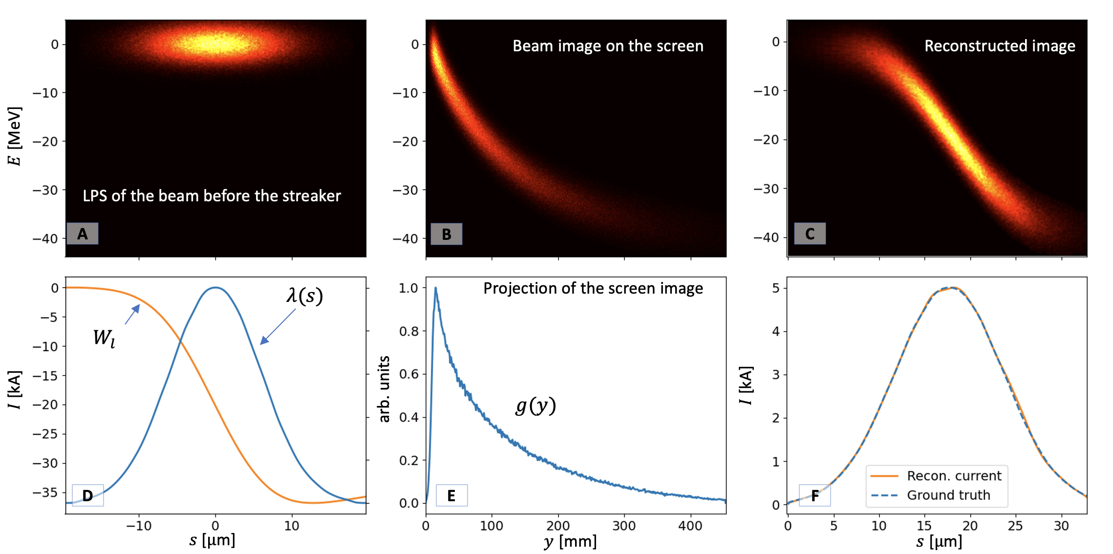
A fast method for online reconstruction
To find transformation s(y) we need to solve differential equations:
If the current profile is known, e.g. CRISP current reconstruction, the transformation 𝑠(𝑦) can be deduced using the following approach
Example with ideal gaussian beam
Dechirper image projection
Measured/reconstructed current profile
The wakefield-induced energy chirp can be removed, but it requires iterations.
S. Tomin, I. Zagorodnov, A Method For Passive Streaker LPS Reconstruction, FEL2024

Slide 5
Passive streaker tool improvements
Video from BKR
Online reconstruction. Video from BKR
CRISP reconstruction limitations:
Low resolution ~ 6 fs
Too noisy signal for low current < 1kA
Not possible to resolve beam head-tail orientation

Slide 6
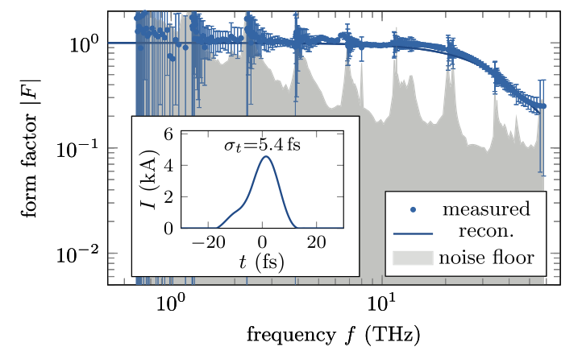
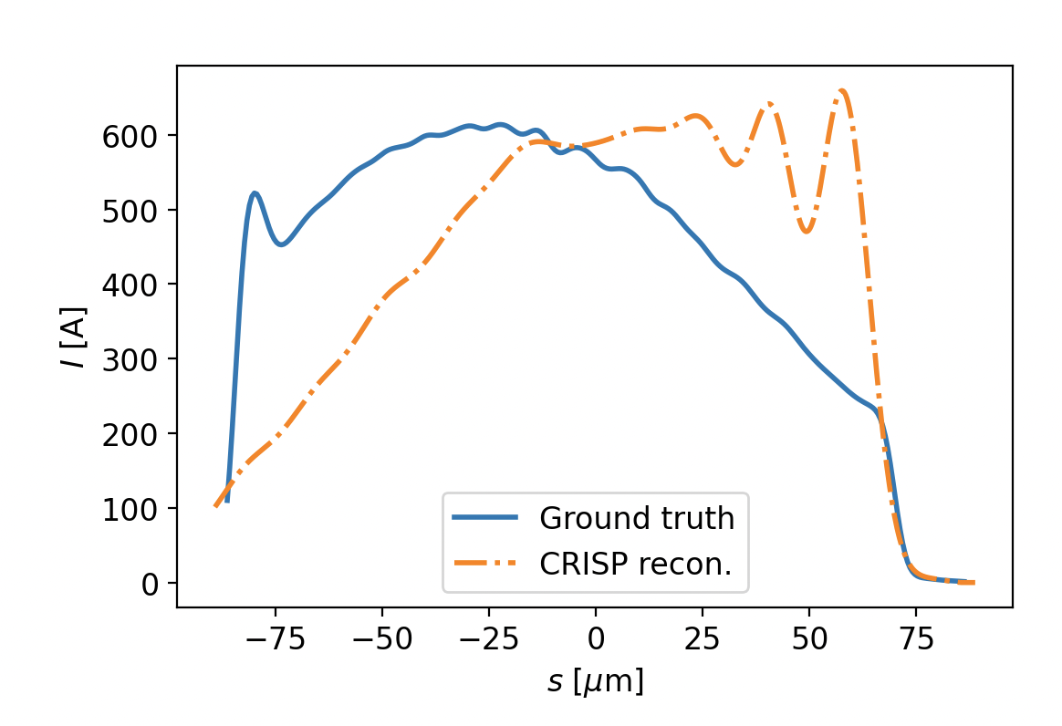
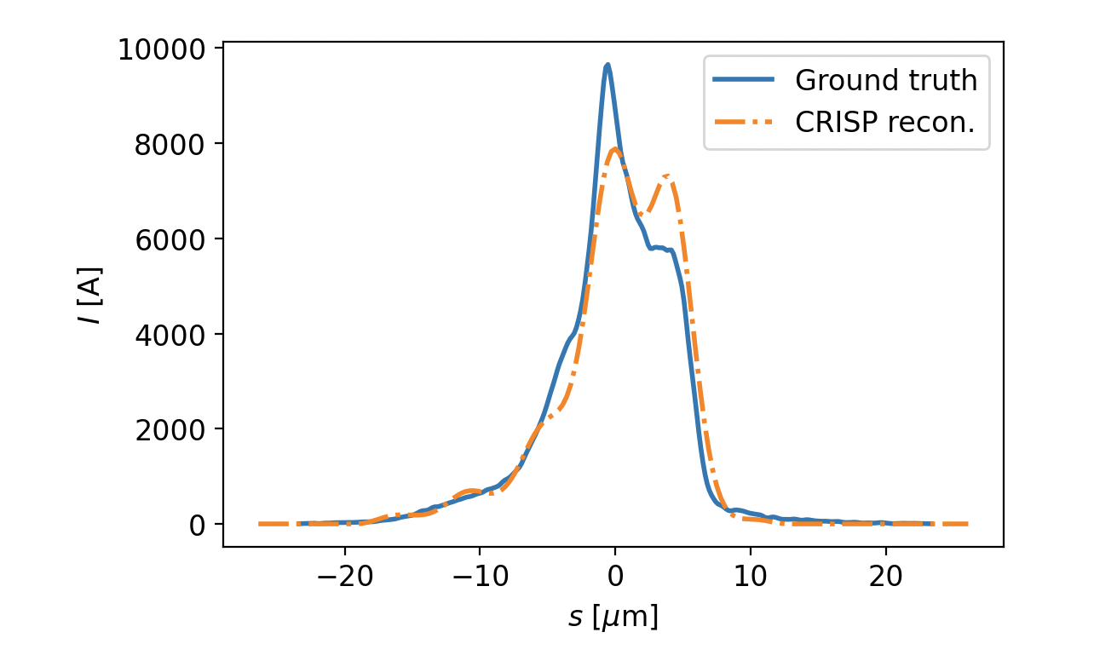
CRISP reconstruction limitations
Beam head and tail cannot be distinguished due to the missing phase in CRISP signal
Loss factor (mean energy loss) is the same for both cases
Undulator taper compensates energy loss for lasing slice
CRISP reconstruction resolution is > 6fs
Noisy signal for low current
N. Lockmann et al, PRAB 23, 112801 (2020)
Time resolution limitation
Signal to noise ration limitation
Energy loss for center of mass: 75 and 53 keV/m.
For maximum current: 73 and 68 keV/m

Slide 7
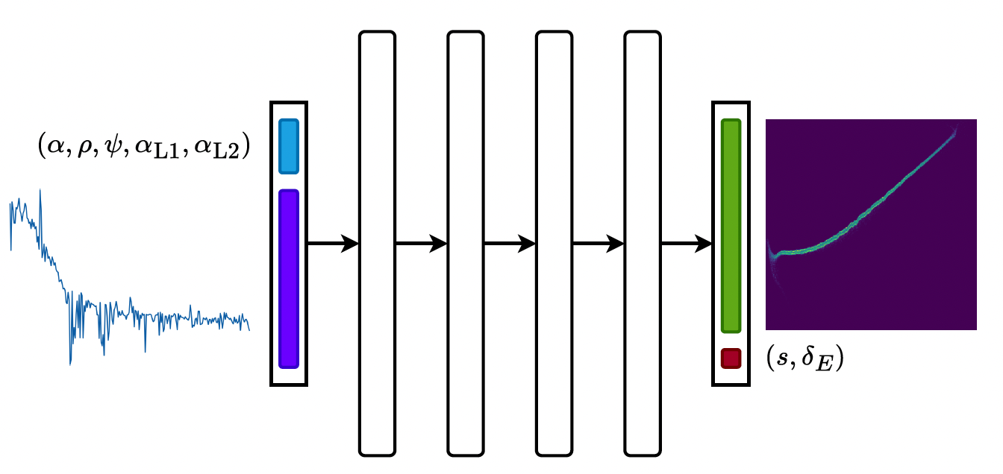
NN for LPS prediction
NN network was trained:
Input: CRISP form factor + RF parameters
Output: LPS
This approach works better then CRISP reconstruction
J. Kaiser, A. Eichler, S. Tomin, Z. Zhu, Machine Learning for Combined Scalar and Spectral Longitudinal Phase Space Reconstruction, IPAC23.

Slide 8
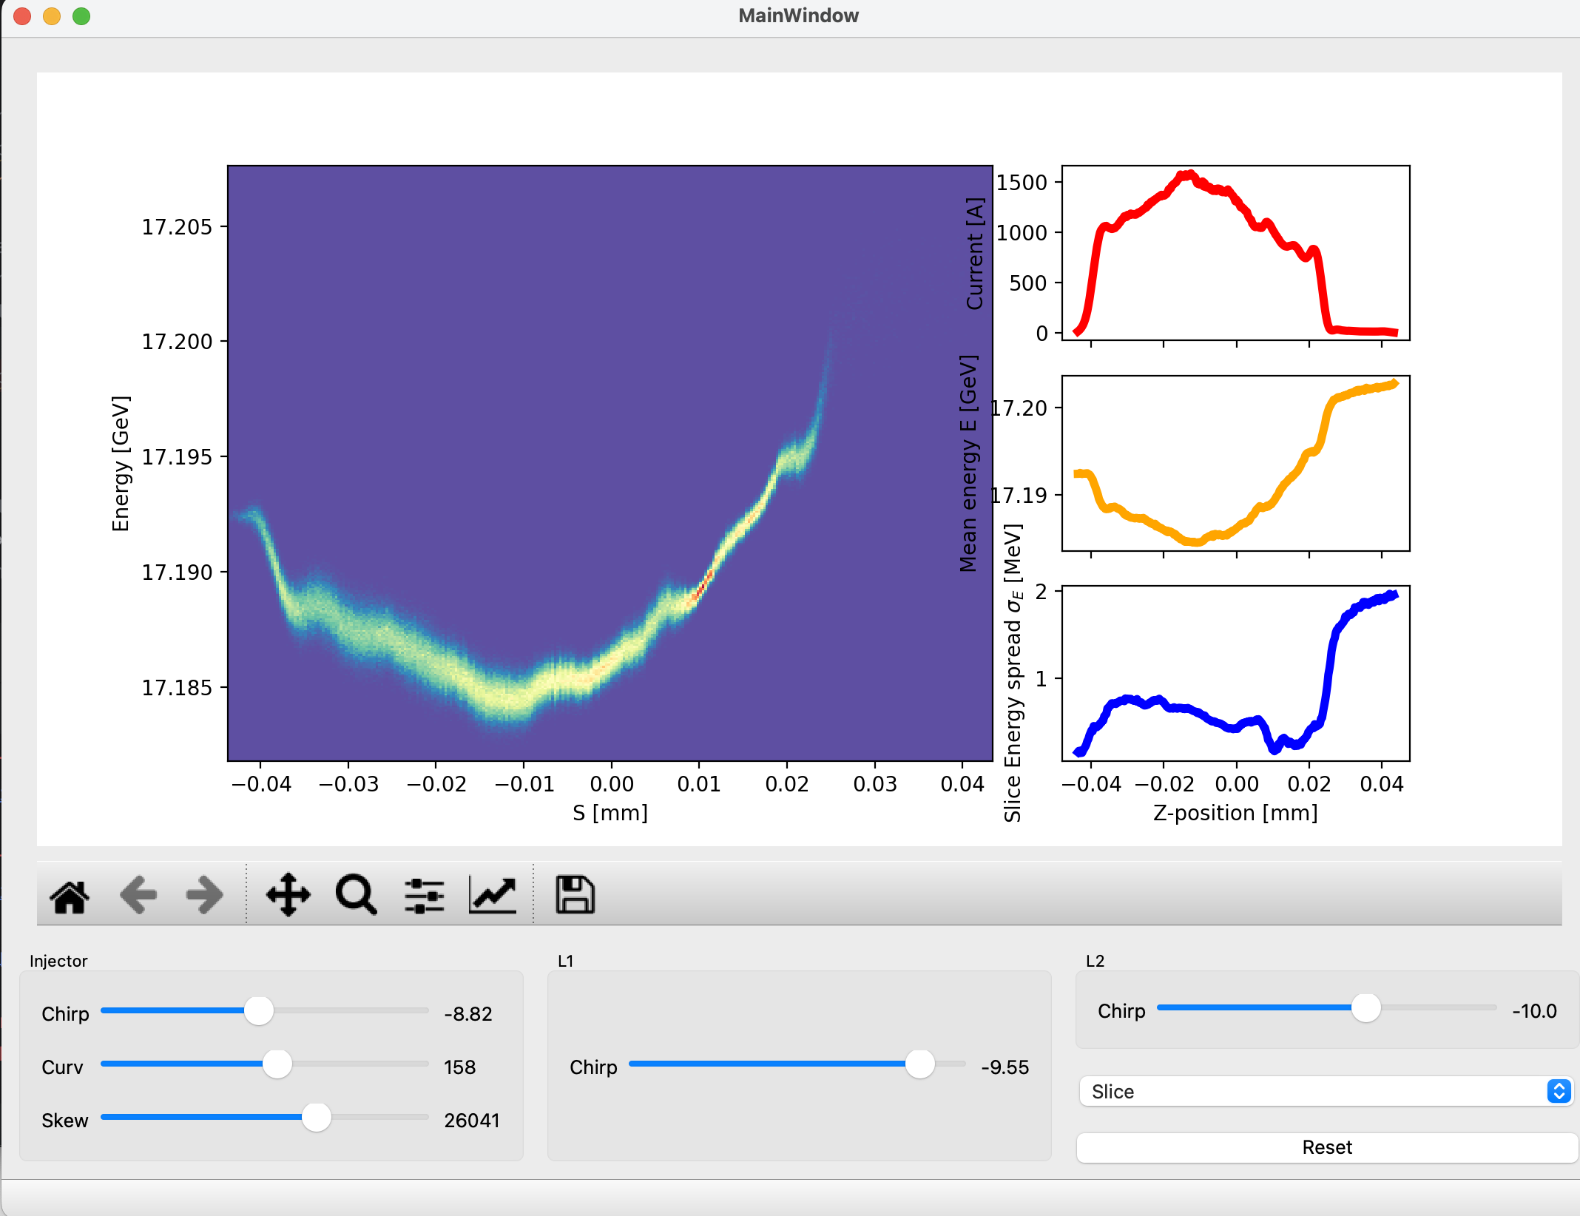
Next steps and possible topics for collaboration
ML-Based Current Reconstruction
Develop a ML model for current reconstruction. Less CPU-intensive training. Might be more suitable as a starting point.
Surrogate Model for EuXFEL Simulations
Potentially useful for LPS estimation in the BKR.
ML-Based Dechirper LPS Reconstruction
Explore a “pure” ML-based reconstruction approach as an alternative to the algorithmic methods.
ML-Based LPS Prediction for BKR Applications
Develop a ML model for predicting the LPS for use in the BKR.
Z. H. Zhu, S. Tomin, J. Kaiser, Application of Machine Learning in Longitudinal Phase Space Prediction at the European XFEL, FEL22

