Slide 1
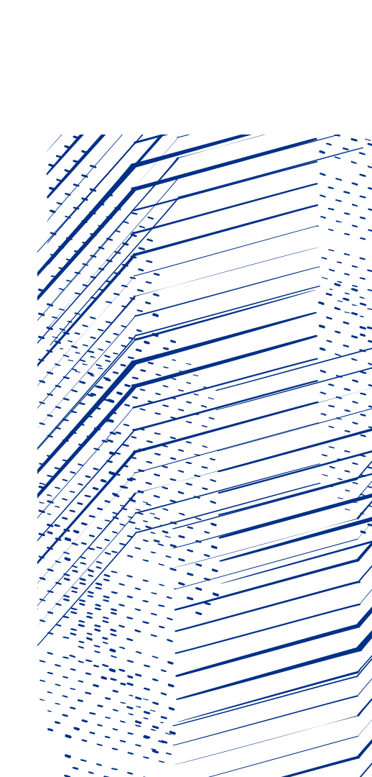
DESY-STFC XFEL
Collaboration Meeting
05/12/2024
Beam Dynamics
(UK-XFEL WP4 - High Energy Beam)
Peter Williams
xfel.ac.uk

Slide 2
UK-XFEL Conceptual Design High Energy Beam Dynamics Update Summary
A few more details additional to those presented by Dave Dunning this morning…
Personal thought: as the project has developed it has become clear that the priority is “synchrotron-like operation”, meaning driving down the cost-per-user-experiment by running multiple XFELs simultaneously. These XFELs will operate at different wavelengths, using different FEL schemes simultaneously. This determines the overarching philosophy…
Linac must support semi-arbitrary bunch patterns consisting of different charges:
75 pC @ e.g. 2/3 of the 1 MHz rep rate to 8 GeV
150 pC @ e.g. 1/3 of the 1 MHz rep rate to 8 GeV
(300 pC potential swap-out of 150 pC bunches above)
600 pC @ 100 Hz driving matter-in-extreme-conditions (MEC) station at 12 GeV – booster or not? TBD
Flexible compression concept – we allow for differential compression of the above bunches simultaneously
Flexible distribution concept – using modular CSR-compensated spreader, either mostly RF separator based to allow injector-to-FEL selection through timing only, or mostly magnetic kicker based. My own preference thus far is RF.

Slide 3
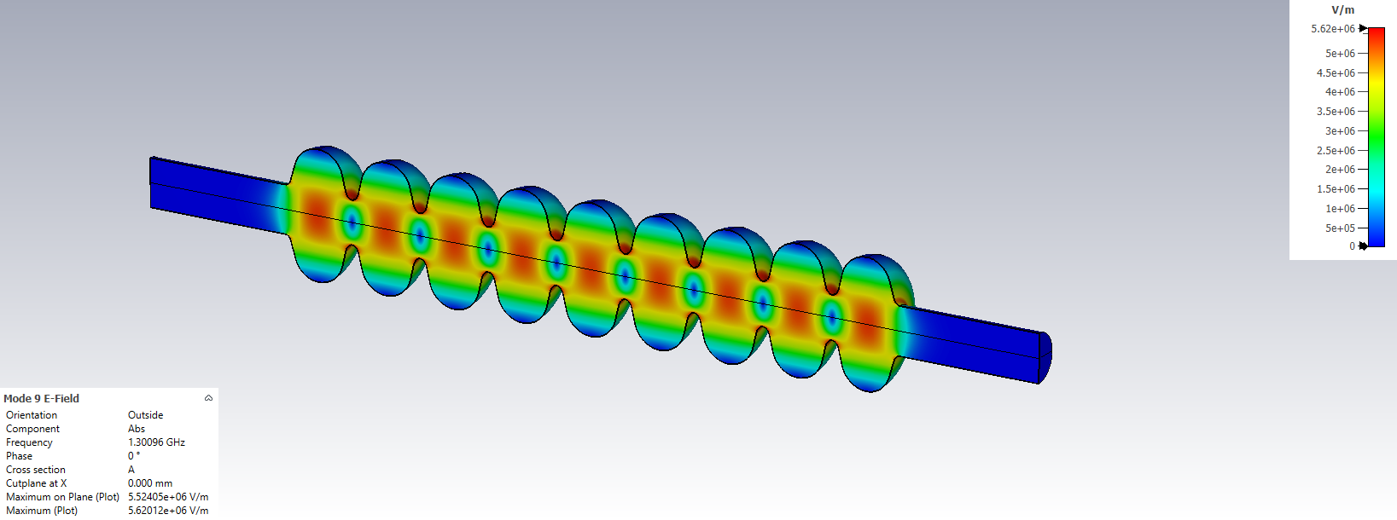
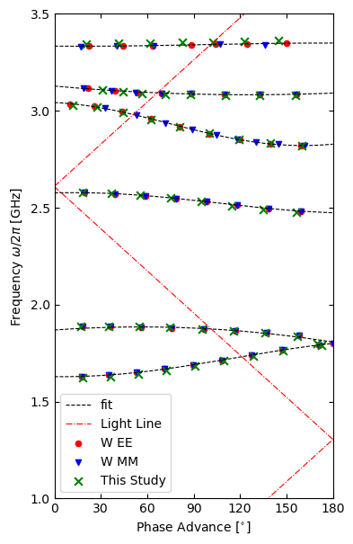
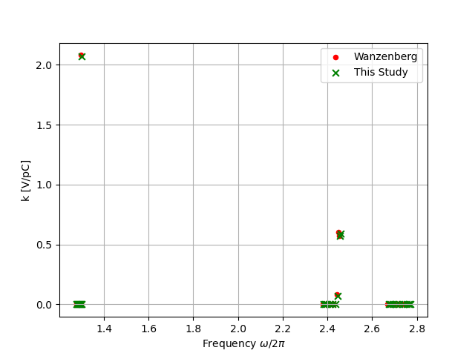
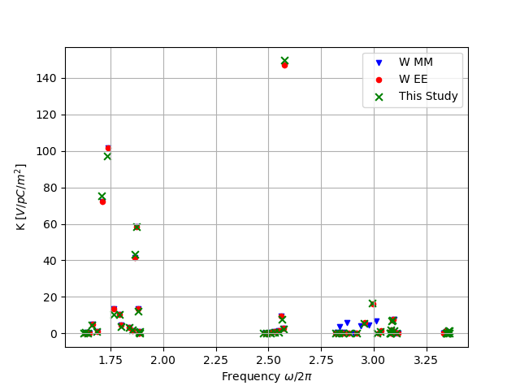
UK-XFEL BD: Linac Wakefields – Tony Gilfellon
Linac must support semi-arbitrary bunch patterns consisting of different charges:
75 pC @ e.g. 2/3 of the 1 MHz rep rate to 8 GeV
150 pC @ e.g. 1/3 of the 1 MHz rep rate to 8 GeV
(300 pC potential swap-out of 150 pC bunches above)
600 pC @ 100 Hz driving matter-in-extreme-conditions (MEC) station at 12 GeV – booster or not? TBD
Baseline TESLA-type structure - but also will assess for cost comparison purposes (only!), gain by using re-entrant geometry, also by using thin-film.
CST model constructed and benchmarked against R. Wanzenburg (2001)
Accelerating π-mode in the TESLA 9-cell Cavity
Frequency vs. loss factor for the first 3 monopole mode passbands
Frequency vs. kick factor for the first 6 dipole mode passbands
Brillouin Diagram for the first 6 dipole modes of the TESLA 9-cell Cavity
Wanzenberg, R. (2001) Monopole, dipole and quadrupole passbands of the TESLA 9-cell cavity. Available at: http://cds.cern.ch/record/533324.record/533324.

Slide 4
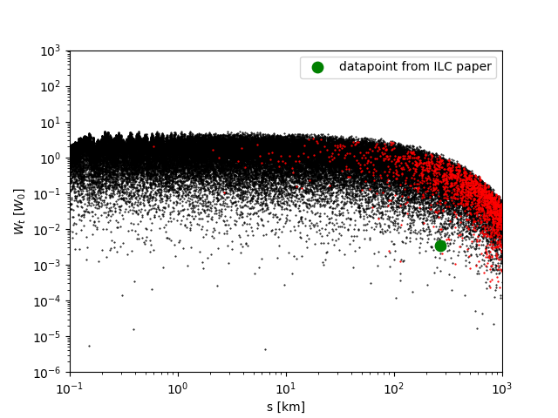
UK-XFEL BD: Linac Wakefields – Tony Gilfellon
Unloaded quality factors and kick factors for the first 2 dipole mode passbands of the Brillouin diagram – modes 6 & 7, and 13 & 14 are the modes closest to the light line, therefore have the highest kick factors
Firstly, use this to calculate transverse long-range wake potential for evenly spaced, equally charged bunches:
where s = 100m to 1000km, Q₀ (fundamental) = 10⁶, |W₀ |= 14.07 V / pC / m², bunch spacing = 1μs (1 MHz)
Repeat, but with formula modified to model non-uniform bunch charge patterns. Then, use PLACET2 with both transverse and longitudinal long-range wake potentials to compare uniform vs non-uniform bunch charge patterns.
$$W\left(s\right)=2Im\left\{\sum_{n=1}^{N}{K_{n}e^{\frac{iω_{n}s}{c}}}e^{−\frac{ω_{n}s}{2Q_{n}c}}\right\}U(s)$$
Mode | f [GHz] | Q_{n} x 10⁵ | K_{n} [V/pC/m²]
1 | 1.6291 | 7.15 | 0.0023
2 | 1.6369 | 7.17 | 0.074
3 | 1.6497 | 7.21 | 0.0022
4 | 1.6671 | 7.25 | 0.4337
5 | 1.6885 | 7.27 | 0.0804
6 | 1.7129 | 7.26 | 6.3874
7 | 1.7392 | 7.21 | 8.9731
8 | 1.7656 | 7.06 | 1.2057
9 | 1.7912 | 6.86 | 0.9303
10 | 1.8005 | 6.1 | 0.4077
11 | 1.8391 | 8.47 | 0.2814
12 | 1.8535 | 7.89 | 0.1525
13 | 1.865 | 7.63 | 3.6722
14 | 1.8736 | 7.49 | 5.1755
15 | 1.8795 | 7.39 | 1.2088
16 | 1.8834 | 7.33 | 0.0234
17 | 1.8858 | 7.29 | 0.0934
18 | 1.8871 | 7.27 | 0.0019
Black data: Unmitigated transverse wake potential at arbitrary time delays of up to 334 us.
Red data: Unmitigated transverse wake potential for uniform charge bunches @ 1 MHz rep. rate
To gain idea of potential mitigation of re-entrant SC cavities, the green datapoint was taken from ILC study
Jones, R.M. and Glasman, C. HIGHER ORDER MODE WAKEFIELD SIMULATIONS AND BEAM DYNAMICS SIMULATIONS IN THE ILC MAIN LINACS. Available at: http://www.lns.cornelll.edu/Research/AP/SRF/We

Slide 5
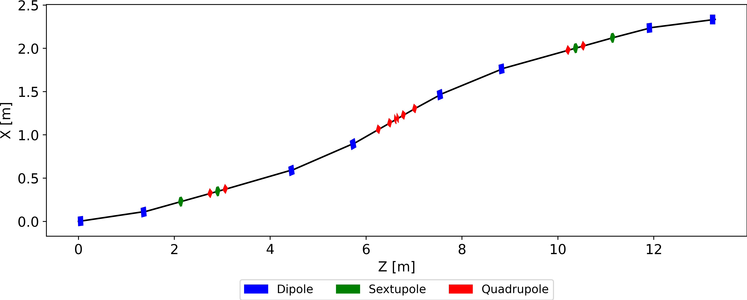
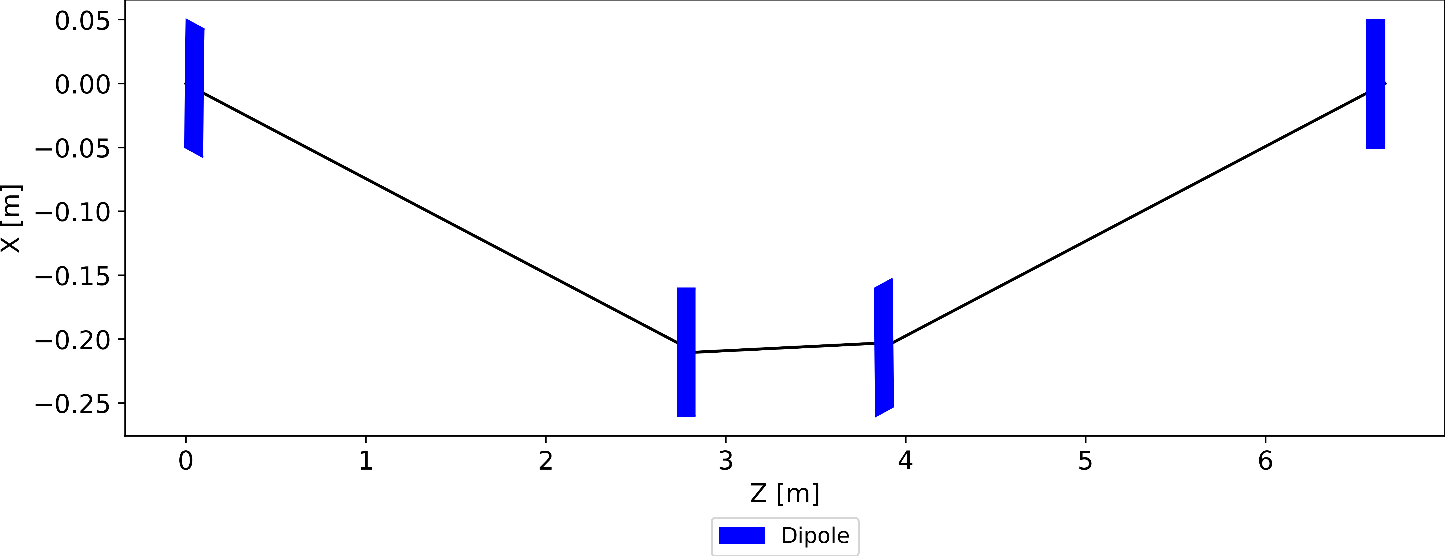
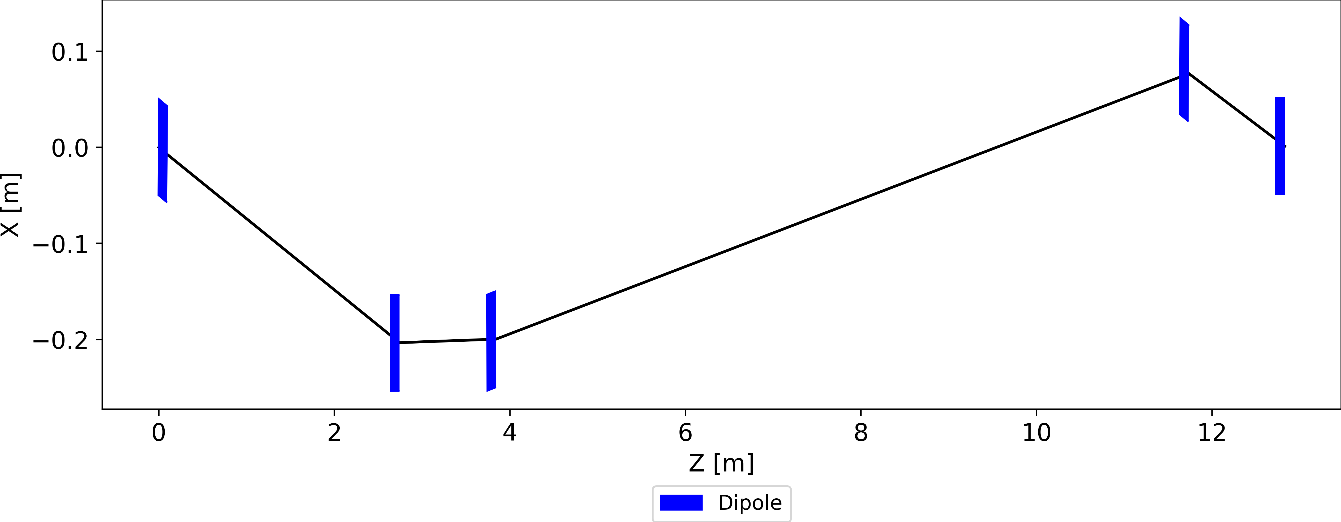
Arc vs Chicane Bunch Compression
Olivia Karlberg started a study focusing on compression jitter.
(Karlberg, O., Curbis, F., Thorin, S., & Werin, S. The MAX IV linac as X-ray FEL injector: Comparison of two compression schemes. FEL13)
Adam Dixon, Peter Williams et.al has taken the concept further, now focusing on compression choices for the UKXFEL...
Arc Compression
0 < R56
0 < T566. Self-linearising.
Coherent synchrotron radiation induced emittance growth mitigation by π-phase advance between achromats.
4 dipole chicane compression
R56 < 0
0 < T566. Requires harmonic linearisation.
5-bend chicane / Asymmetric S-chicane
(Khan and Raubenheimer. Phys rev. AB 25, 090701 (2022)) / Fancong Zeng, Yi Jiao, Weihang Liu, and Cheng-Ying Tsai, e-Print: 2403.06101 [physics.acc-ph]
R56 < 0
0 < T566. Requires harmonic linearisation.
Coherent synchrotron radiation induced emittance growth mitigation from geometry of chicane.

Slide 6
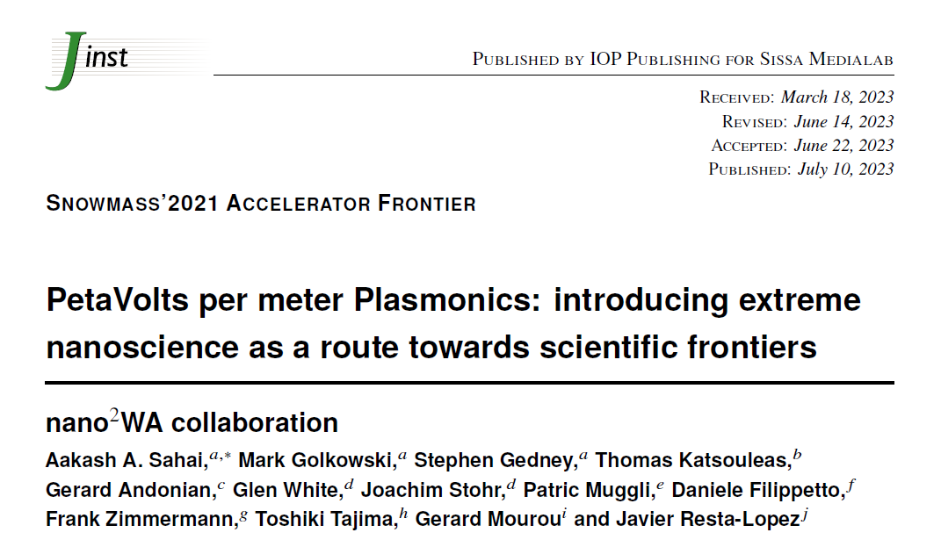
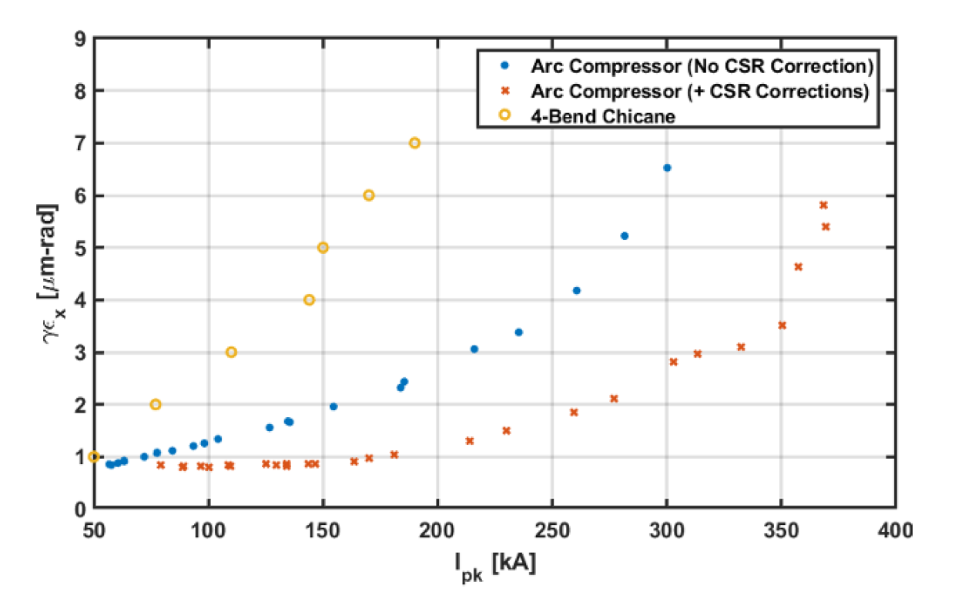
Aside: This has been noticed for more extreme compression in plasmas
Arcs are better wherever CSR dominates, it’s the same physics
nanoWA collaboration looking at generating “extreme” electron beams from “Plasmons” – quantised version of classical plasma oscillations in conduction band electrons in metallic lattices
They consider compressing to 100’s kA with arc and chicane systems:
“4-bend chicane – there is no mechanism for cancelling CSR emittance growth”
“5-bend chicane – expected performance of CSR cancellation at the ~10% level, insufficient for our purposes”
“arc compressor – blue / red curves show performance without / with sextupole optimization… both a significant improvement over 4-bend chicane”

Slide 7
Benefits of arc compression - + my comments
No church towers, horns in the head and tail of the bunch. For arc compression, the horn is in the center, and is the actual lasing part – relevant for UK-XFEL
No need for harmonic cavity - relevant, but we will need anyway for seeding / self-seeding.
Linac wakes contribute to the chirp -> less off crest phase to get the same chirp -> more energy per linac section – less relevant for UK-XFEL
No emittance degradation caused by the horn radiating towards the center of the bunch – the horn from arc compression is in the center and is the lasing part of the bunch. “We don’t have any towers irradiating our usable area because the single tower IS the usable peak which makes all the difference.” – relevant for UK-XFEL
No CSR hitting the bunch center from a horn means reduction in charge jitter induced energy jitter. Reduces arrival time jitter. – relevant for UK-XFEL
Magic angle – reduces arrival time jitter – relevant for UK-XFEL
The arc compression technique easily produce very short pulses. Most of the accelerated bunch is within the usable center peak. – relevant for UK-XFEL

Slide 8
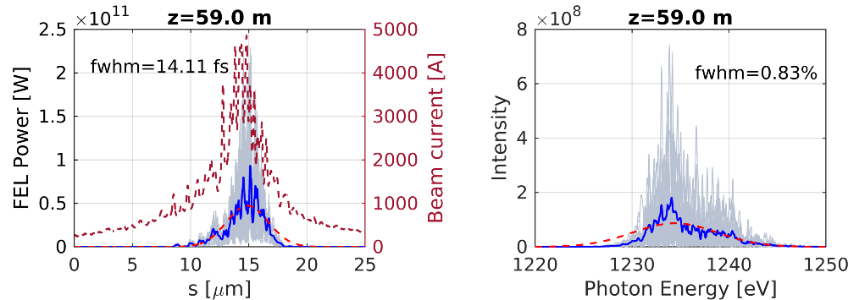
Drawbacks of arc compression + my comments
Chromatic effects – in the current MAX IV compressors there is only one family of sextupoles – second order momentum compaction closure and linearization are not independent. – fix with more families
Longer – but not necessarily translating the beamline – not significant in context of larger UK-XFEL facility
Residual energy chirp – the wakes in the linac work towards larger chirp, not to reduce it as for chicane compressors. Not a big problem for SASE. – UK-XFEL higher energy so less relevant, but still don’t use for self-seeded modes
S.A.S.E.
“long” pulse -- 1 A
short pulse - - 1 B
Francesca Curbis FEL chapter of SXL CDR https://www.maxiv.lu.se/beamlines-accelerators/accelerators/soft-x-ray-laser
De-chirping may be possible with dielectric waveguide – or by using variable bunch compressors!

Slide 9
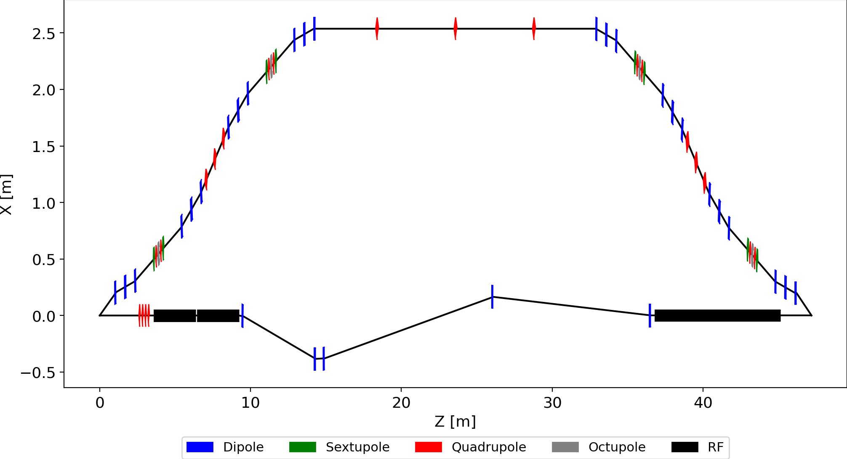
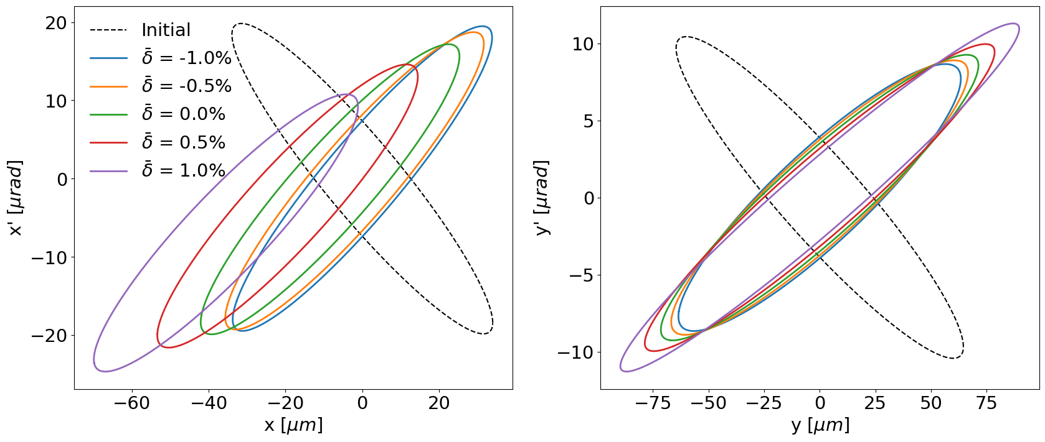
UK-XFEL BD: Flexible Compression - Adam Dixon + Alex Brynes, Andy Wolski, PW
UK-XFEL Linac Compression Simulations: 8 GeV with BC1 @ 270 MeV, BC2 @ 2.1 GeV
Propose both compressors have two paths – one chicane-like, one arc-like
Separate / recombine bunches: If only 600 pC (MEC) bunches benefit from arc only 100 Hz required → magnetic kicker. If other FELs at ~100 kHz RF separators
Chicane comprises 5-dipole variable CSR compensated layout – reducible to 4-dipole for risk mitigation
Arc comprises 4 variable (R₅₆, path length) double bend achromats with sext / oct chromatic correction, phase advances pi-matched to cancel CSR
Variable path length allows for differential phases to be seen by bunches traversing the two paths in subsequent linac sections – necessary for different charges
Illustration of BC1: T₅₆₆ of arc compressor is the correct sign to linearise longitudinal phase space without harmonic RF, therefore bypassed
Harmonic lineariser
Compensating linac regain energy lost
Particle ellipses tracked through BC1 with different initial energy offsets. Symmetric 4-bend chicane and asymmetric 5-bend chicane are achromatic to third-order. Arcs introduce chromaticity in transverse coordinates, however particles with large energy spread don't form the central current spike so the FEL doesn’t care…
All compression scheme are either all arc, or all chicane, i.e. R₅₆ same sign in both BC1 and BC2, i.e. chirp-flipping is not proposed. Found no advantage.

Slide 10
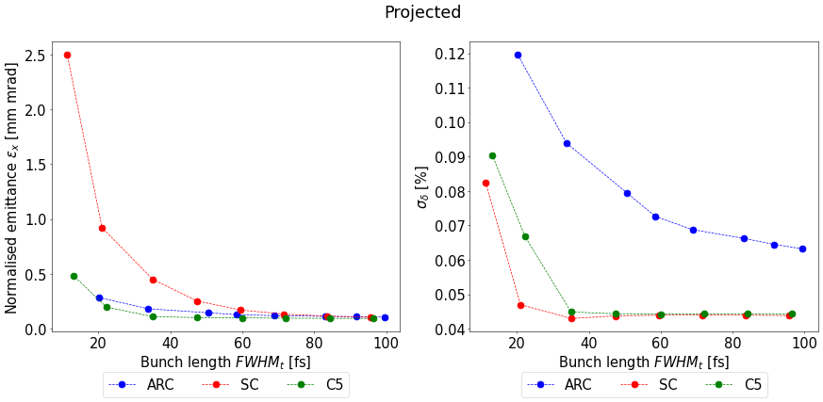
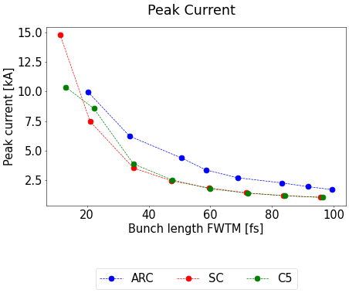
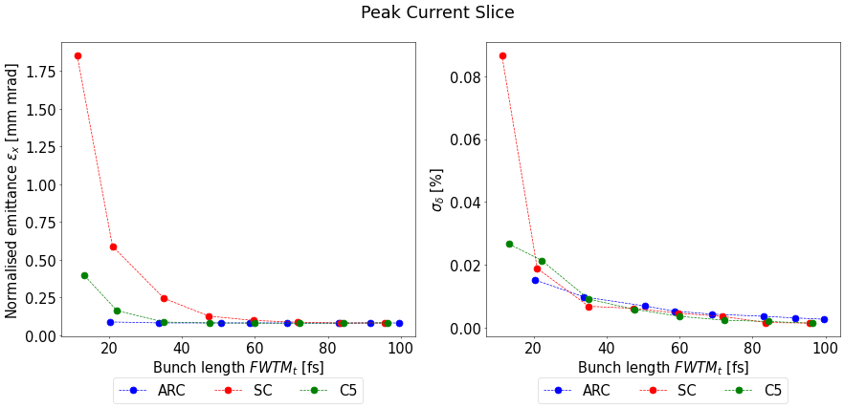
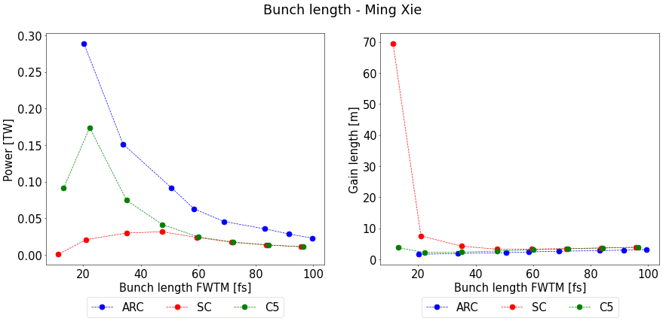
UK-XFEL BD: Flexible Compression - Adam Dixon
Compression scan for 75 pC bunches:
Arc = Variable 4 DBA (CSR compensated)
SC = Symmetric 4-dipole chicane (for comparison and risk mitigation
C5 = Asymmetric 5-dipole chicane (CSR compensated)

Slide 11
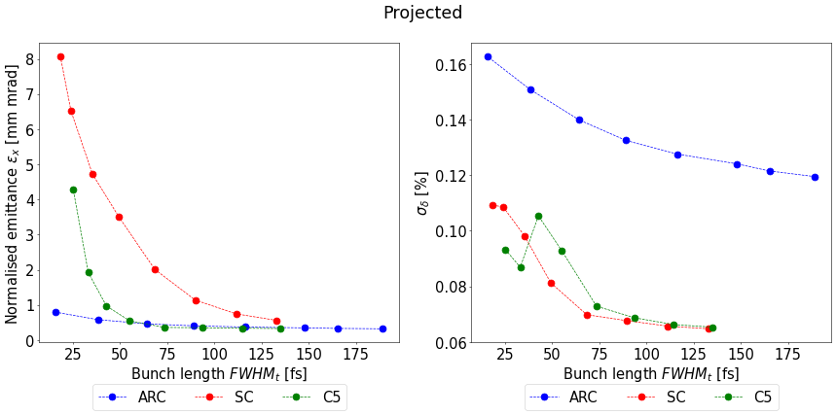
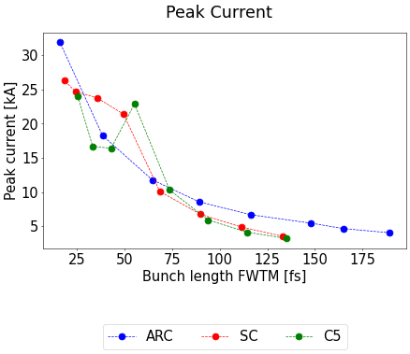
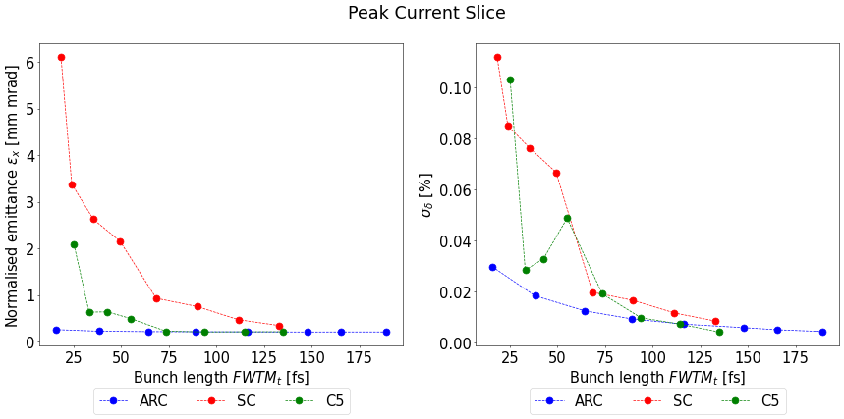
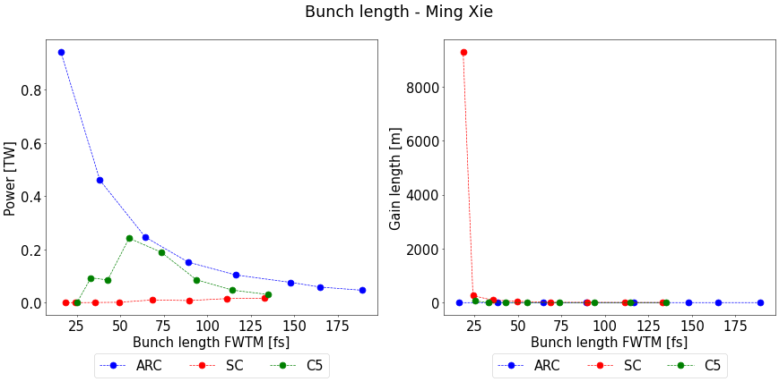
UK-XFEL BD: Flexible Compression - Adam Dixon
Compression scan for 300 pC bunches:
Arc = Variable 4 DBA (CSR compensated)
SC = Symmetric 4-dipole chicane (for comparison and risk mitigation
C5 = Asymmetric 5-dipole chicane (CSR compensated)

Slide 12
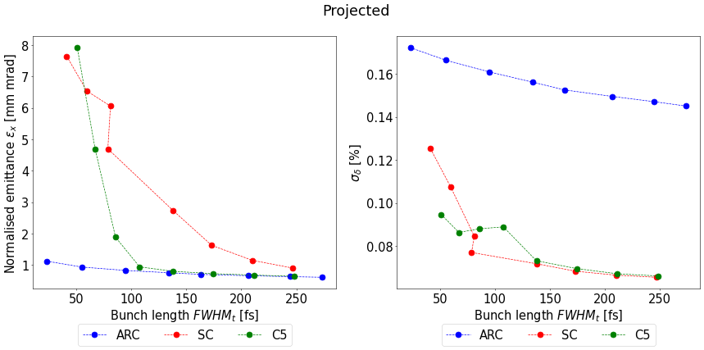
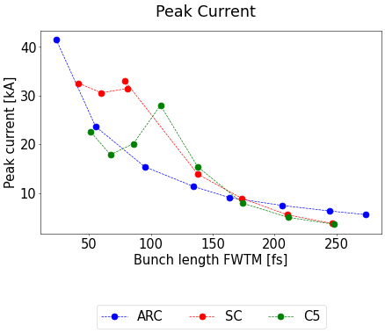
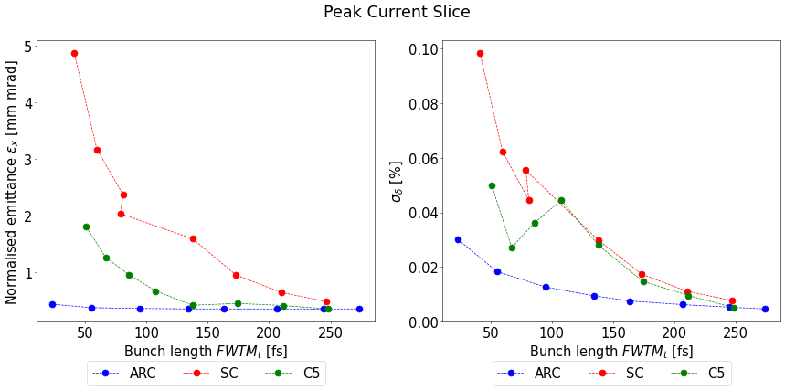
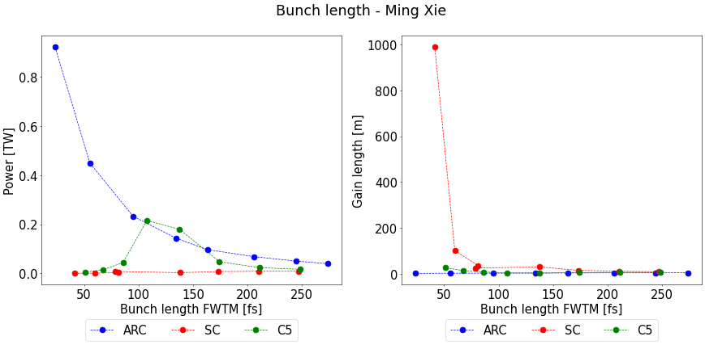
UK-XFEL BD: Flexible Compression - Adam Dixon
Compression scan for 600 pC bunches:
Arc = Variable 4 DBA (CSR compensated)
SC = Symmetric 4-dipole chicane (for comparison and risk mitigation
C5 = Asymmetric 5-dipole chicane (CSR compensated)

Slide 13
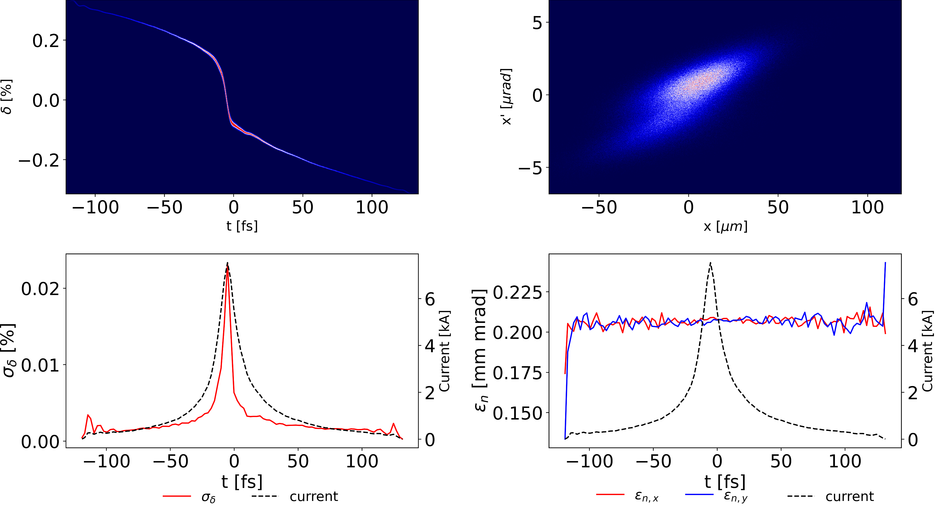
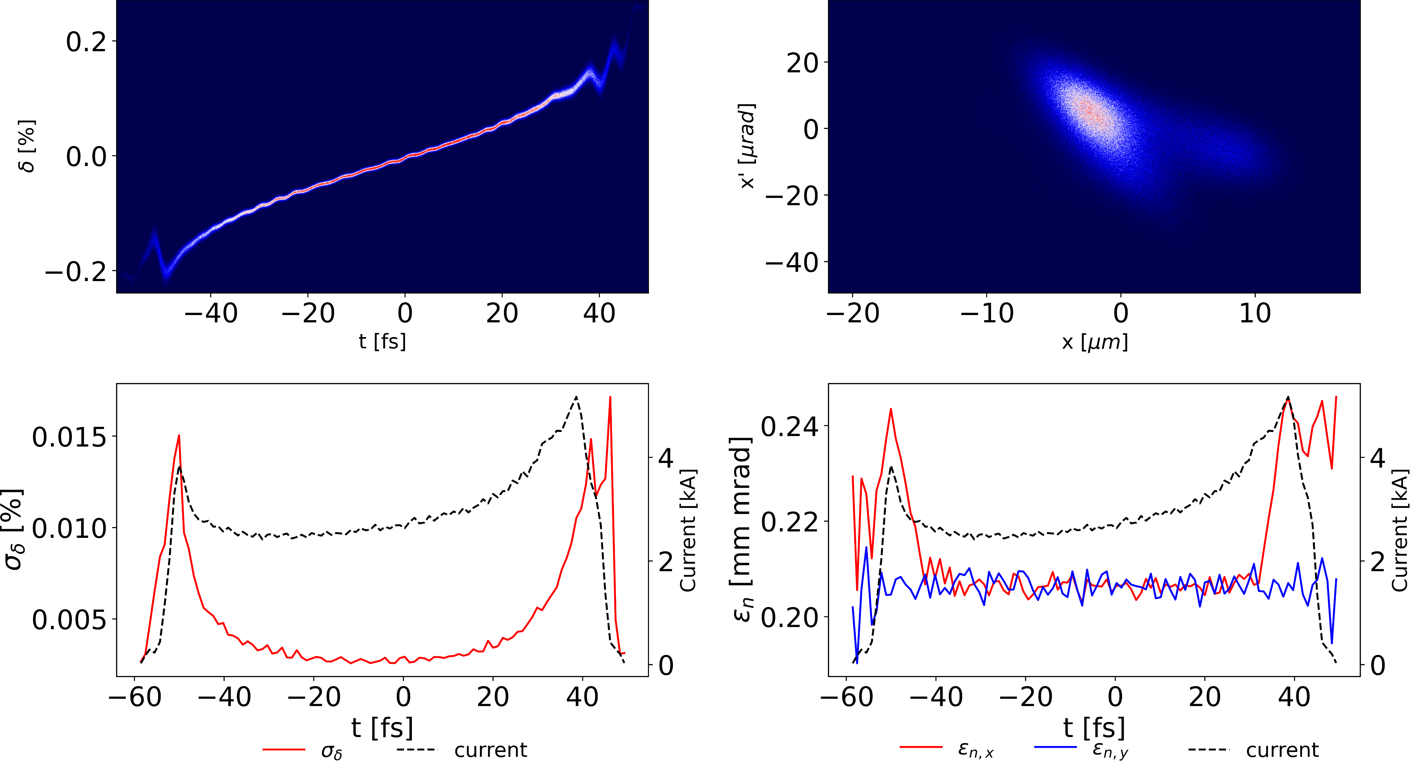
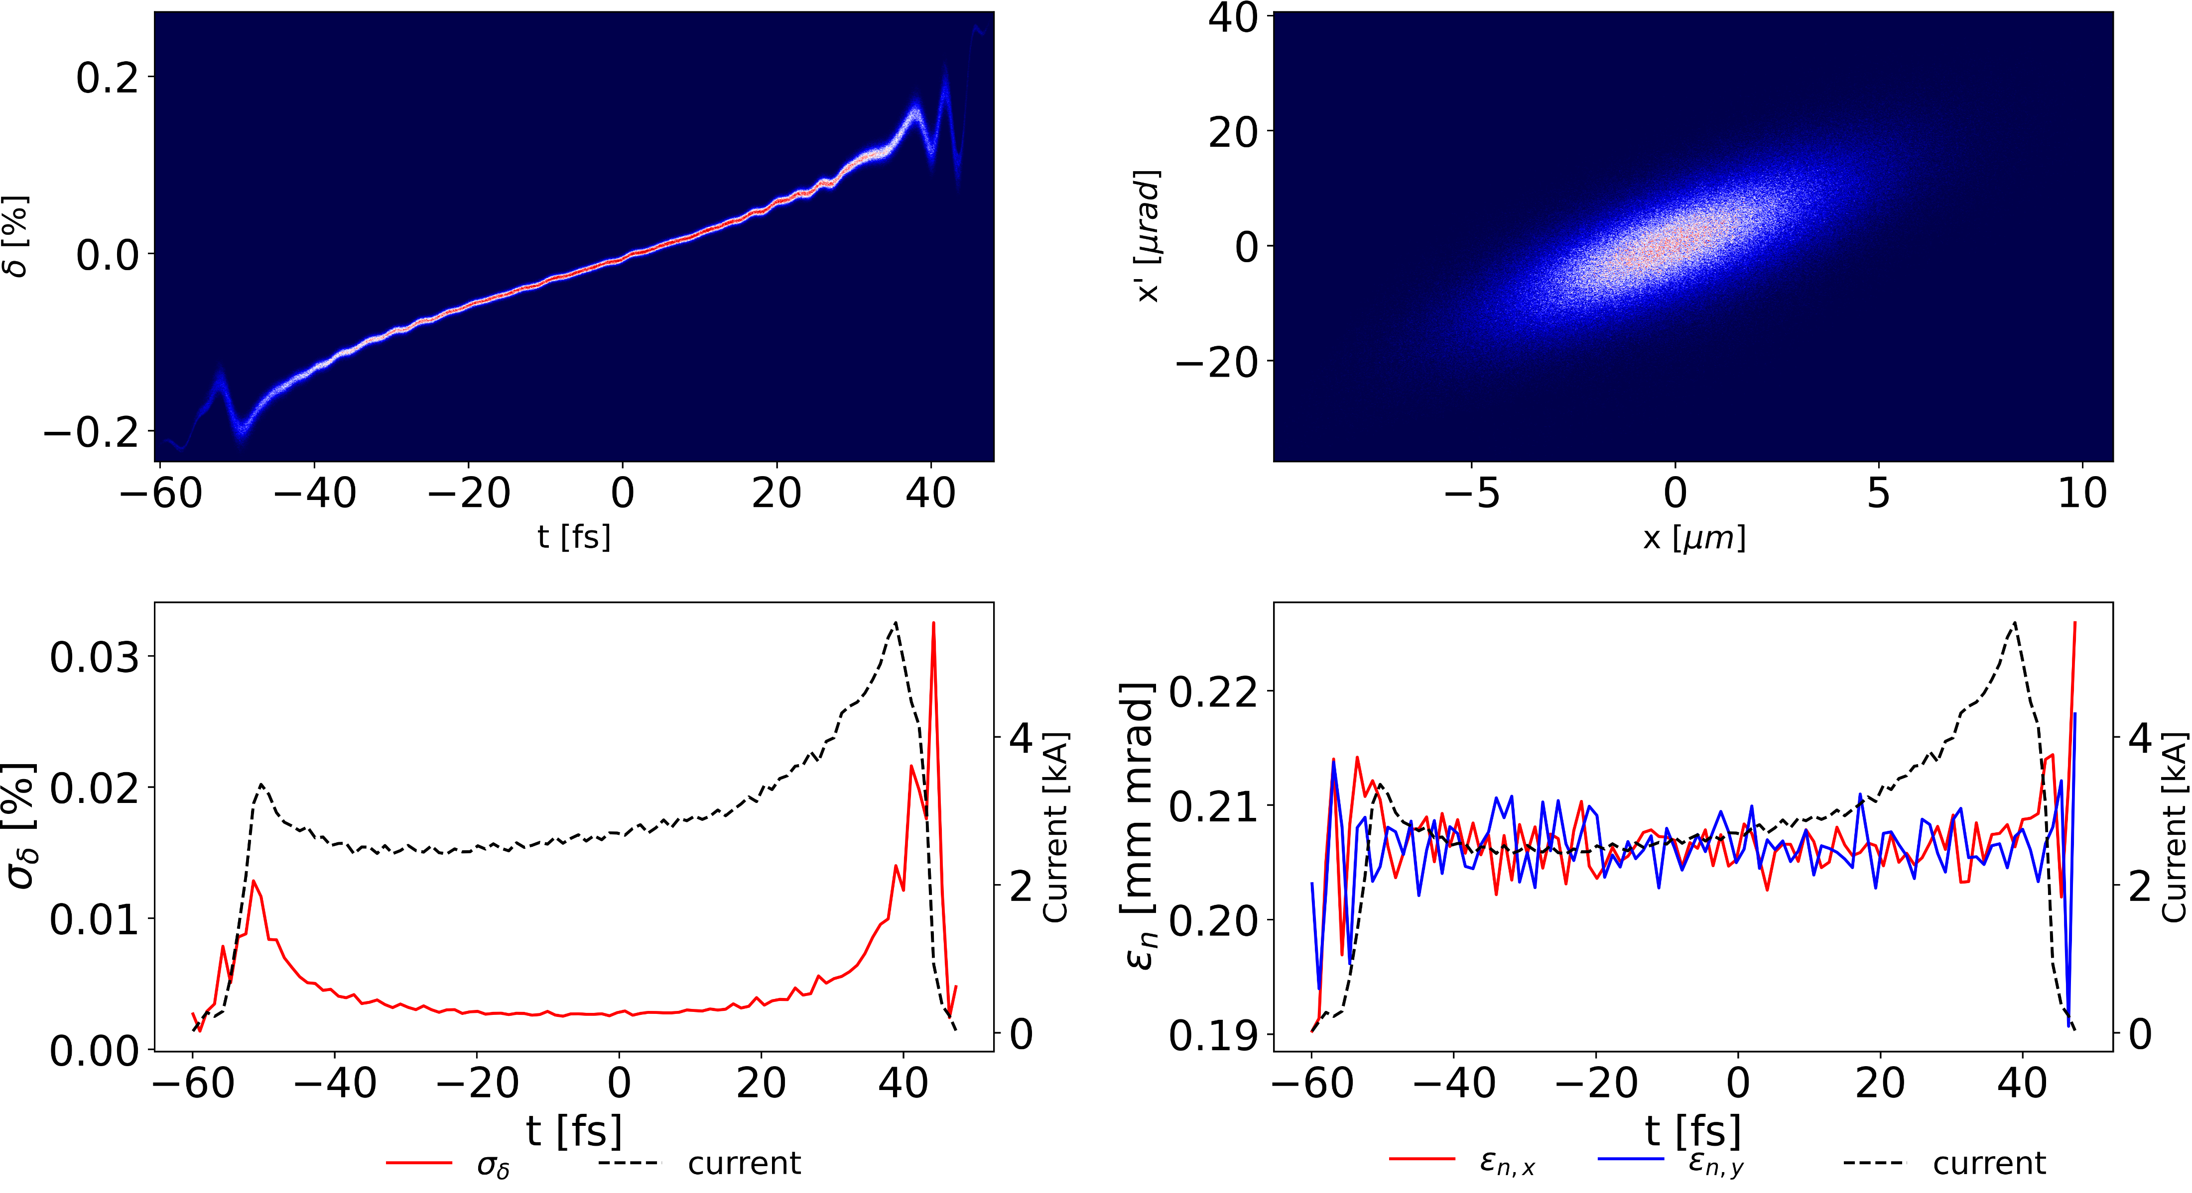
UK-XFEL BD: Flexible Compression - Adam Dixon
Phase spaces on entrance to FEL for GENESIS comparison at 300 pC compressed to 100 fs FWHM for SC & C5, same peak current for Arc.
Undulator period = 1.6 cm, undulator parameter a_{W} = 0.9485 and photon energy 20 keV
Arc = Variable 4 DBA (CSR compensated)
SC = Symmetric 4-dipole chicane (for comparison and risk mitigation
C5 = Asymmetric 5-dipole chicane (CSR compensated)
Arc
SC
C5

Slide 14
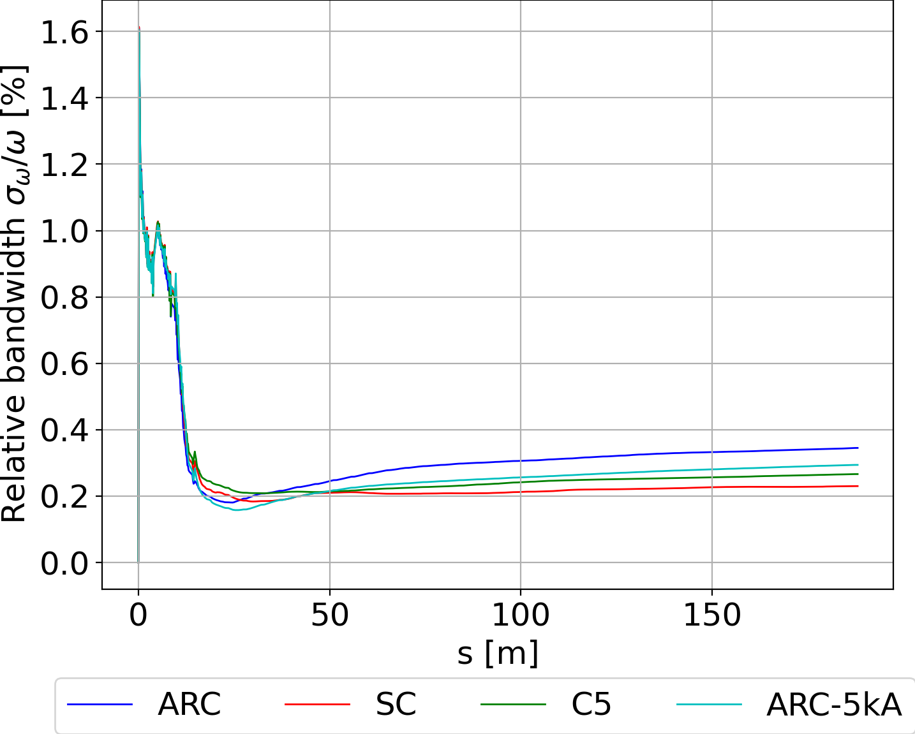
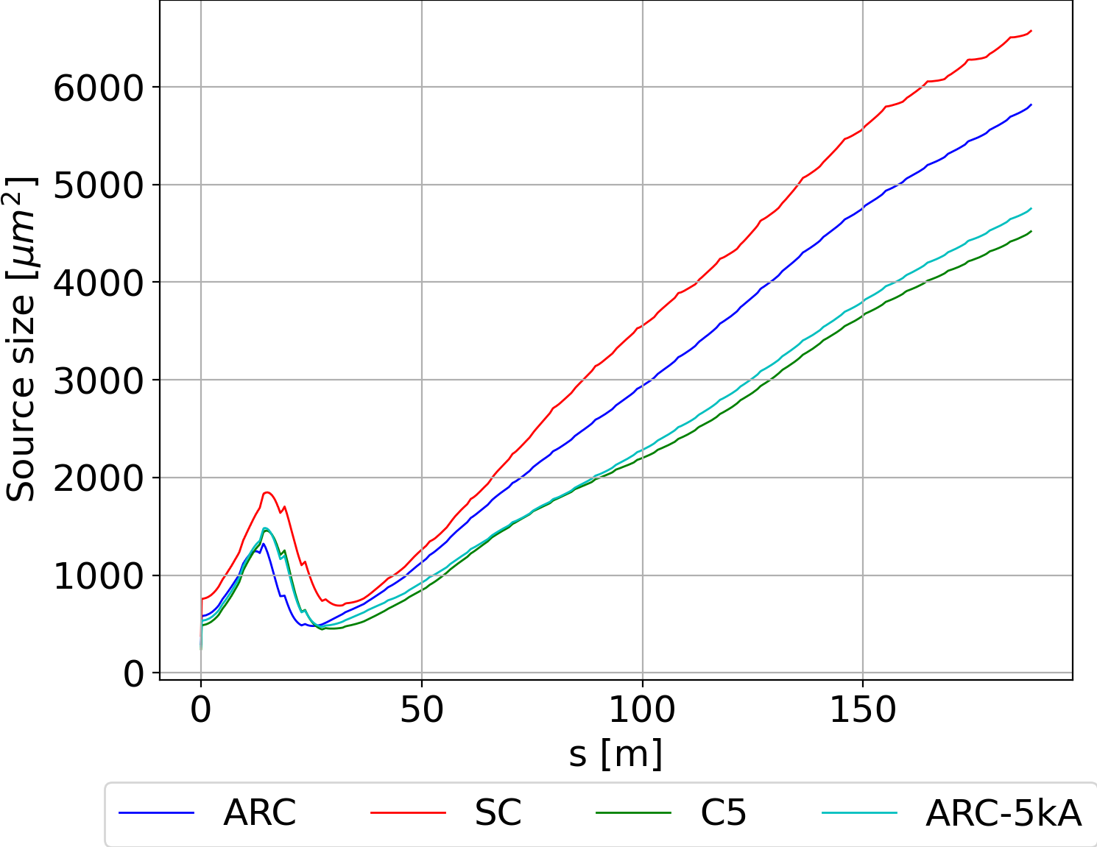
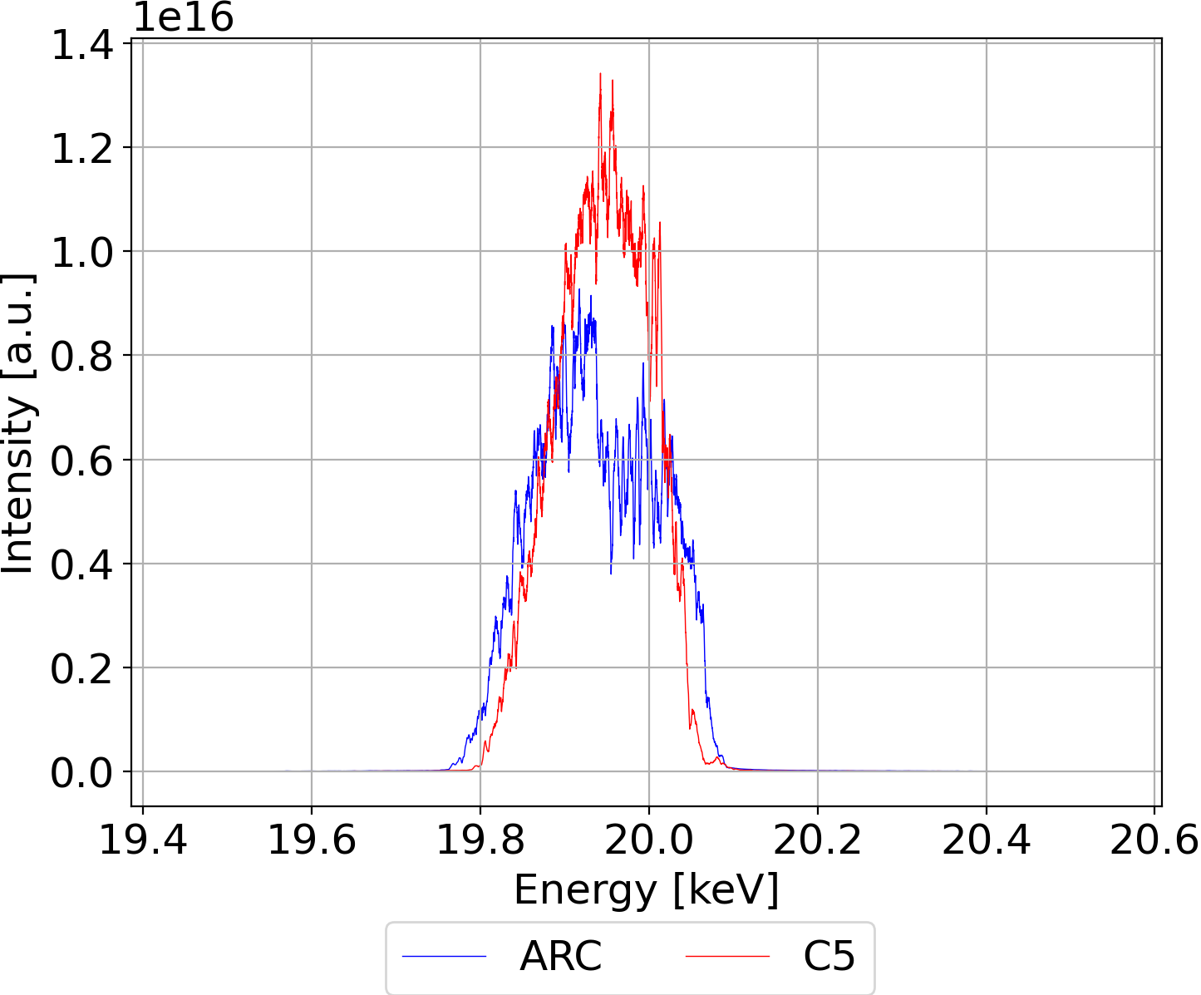
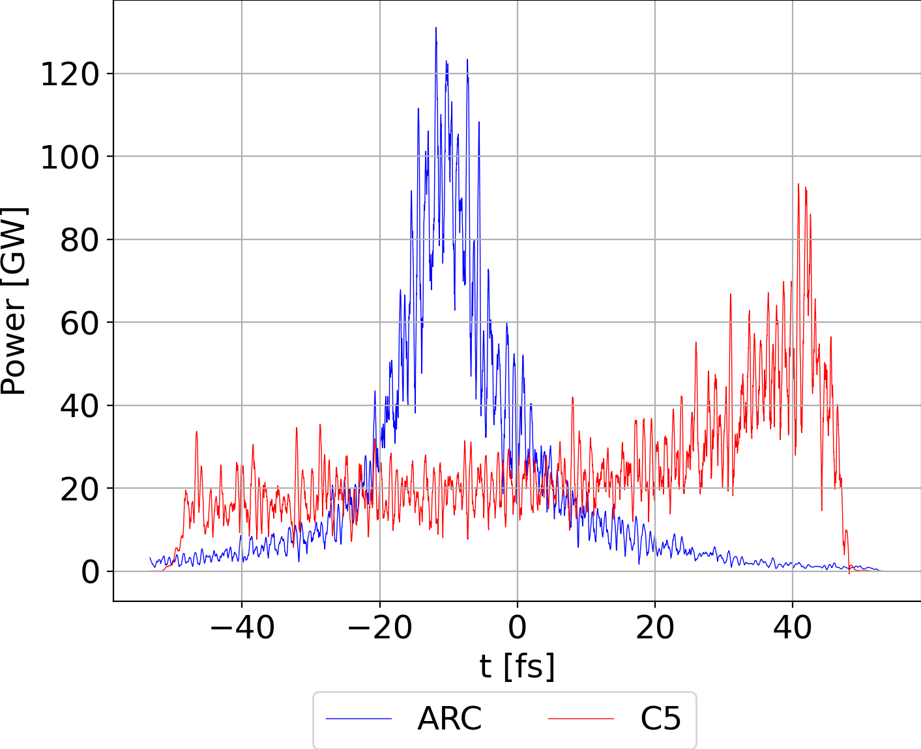
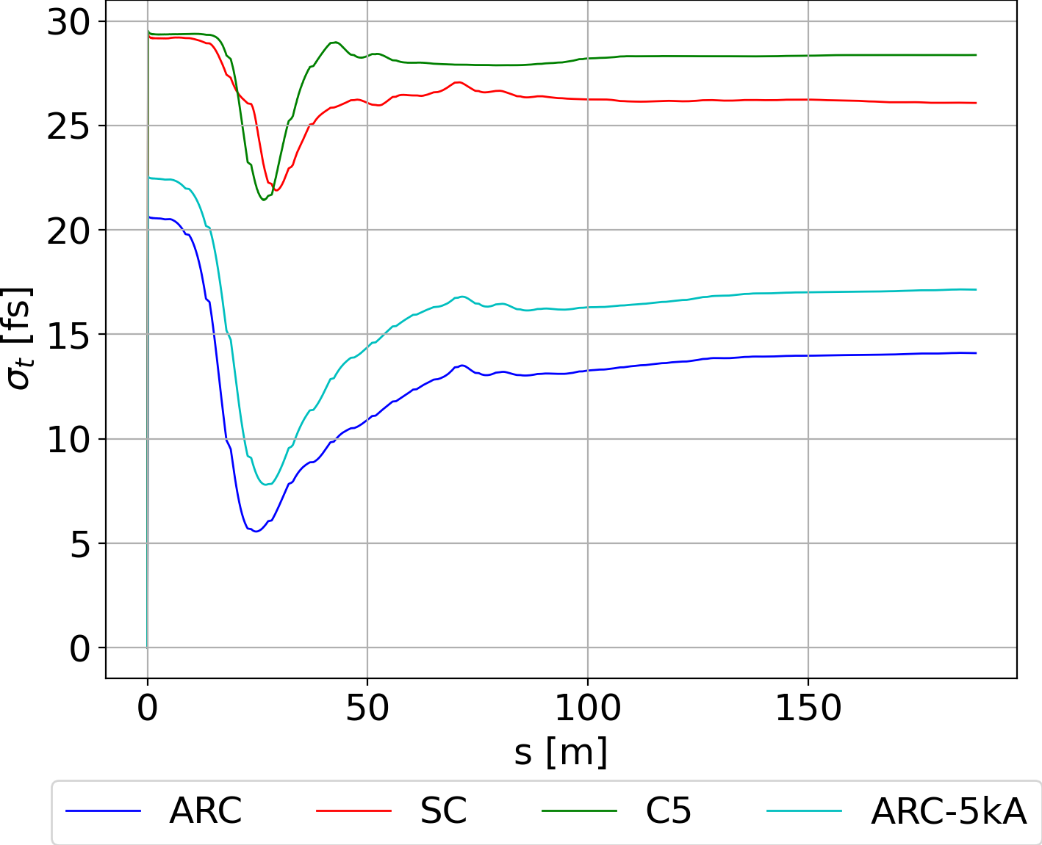
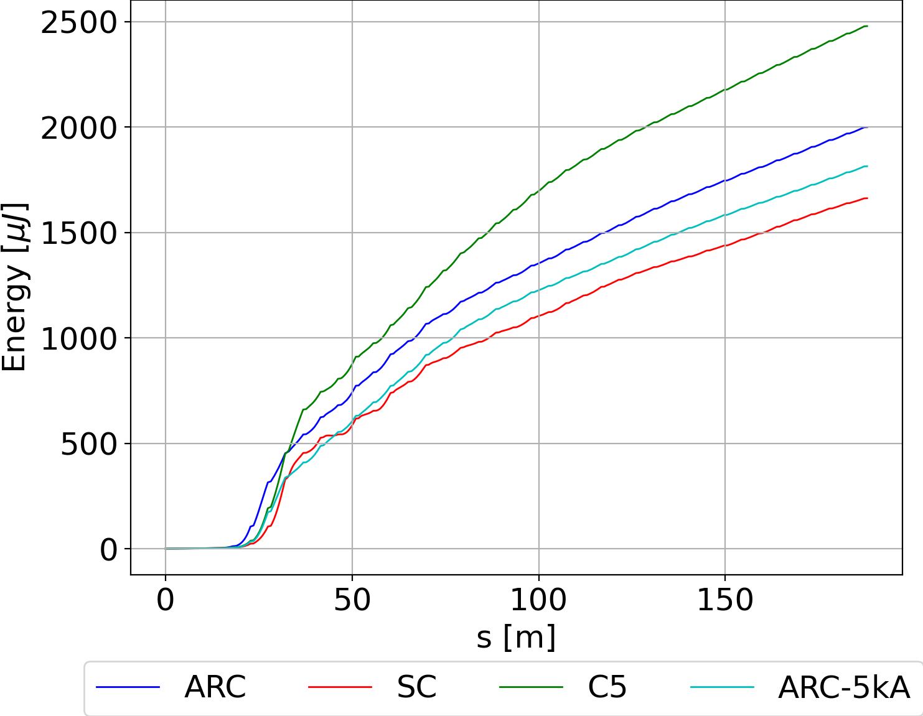
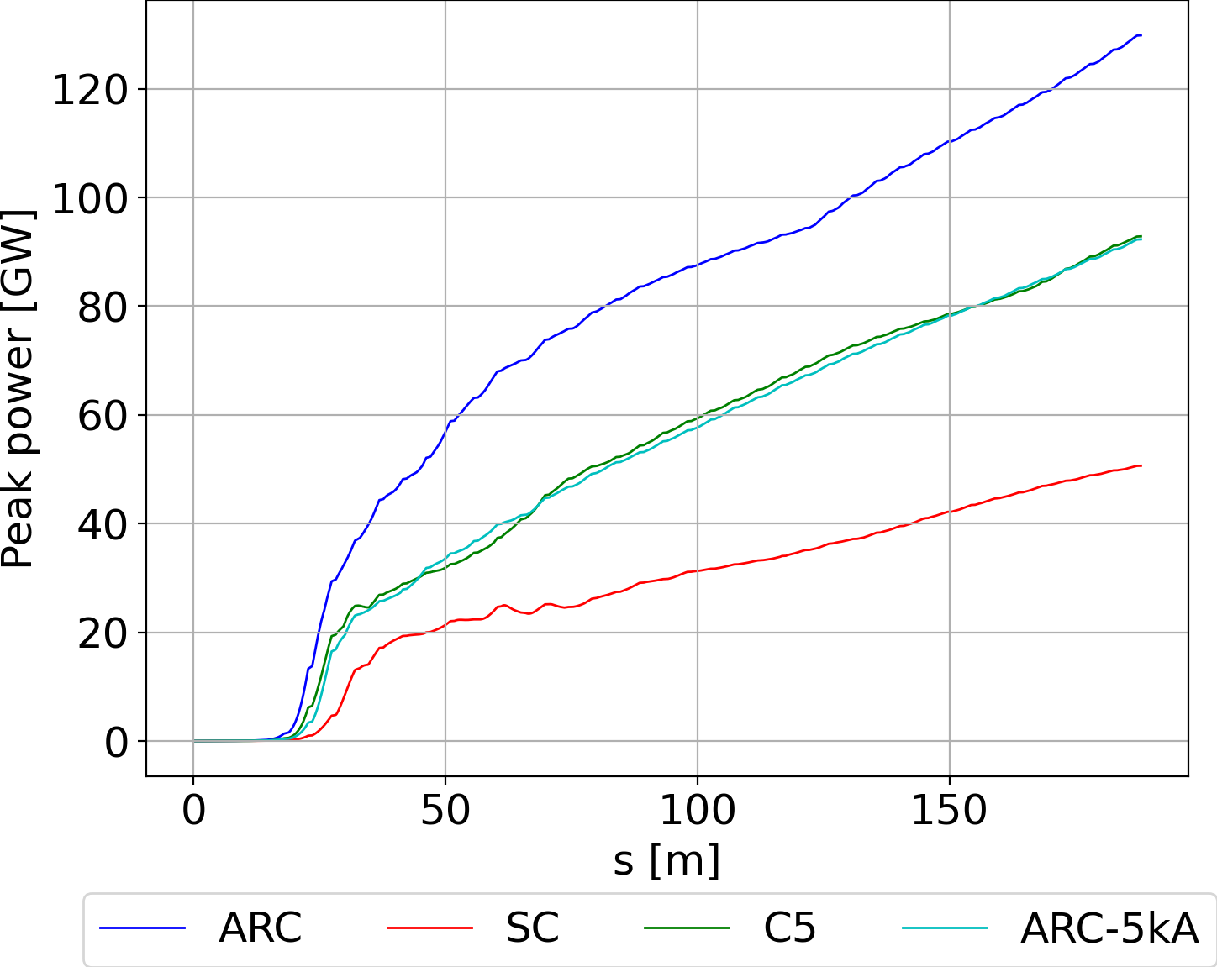
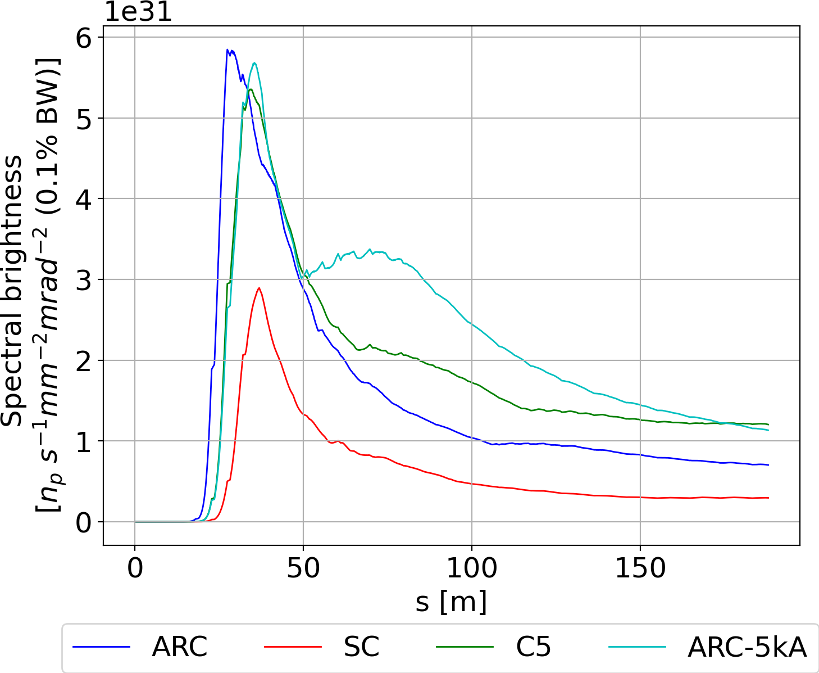
UK-XFEL BD: Flexible Compression - Adam Dixon
Phase spaces on entrance to FEL for GENESIS comparison at 300 pC compressed to 100 fs FWHM for SC & C5, same peak current for Arc.
Undulator period = 1.6 cm, undulator parameter a_{W} = 0.9485 and photon energy 20 keV

Slide 15
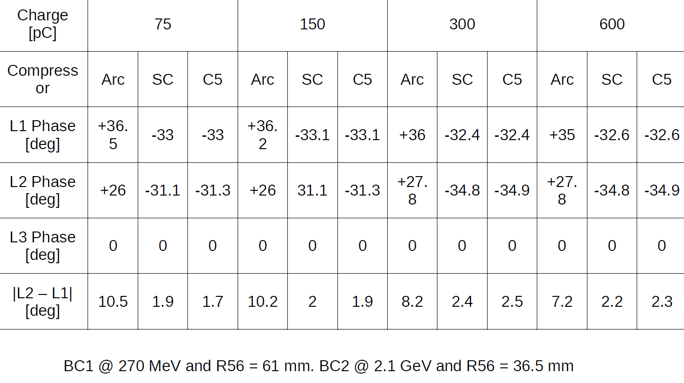
UK-XFEL BD: Flexible Compression - Adam Dixon
Different optimal phases along the linac for the different charges…
Because of the flatter phase space, probably within tolerance for SC / C5, definitely not for arc

Slide 16
Summary: Flexible Bunch Compression for UK-XFEL
Our 6 different FEL schemes benefit from different compression schemes (Eu-XFEL and SHINE also recognise)
The difference is in linac phase and R56 (which can be of different sign)
A simple 4-dipole bunch compressor is deficient in terms of emittance degradation due to CSR
This emittance degradation can be cured by EITHER a 5-dipole / asymmetric chicane OR by arcs
In order to allow for optimal compression in ALL FELs simultaneously, we propose a flexible bunch compressor system that allows differential choice of linac phase and / or R56 (magnitude and sign)
This takes the form of kicker separation / recombination of bunches between two beam paths – one traversing 4 DBA arcs with variable path length and R56 – and one traversing a variable 5-dipole chicane which is reducible to simple 4-dipole chicane
At BC1 the arc path will bypass a harmonic lineariser and linac section, at BC2 nothing is bypassed
Comparison with MBI underway…

Slide 17
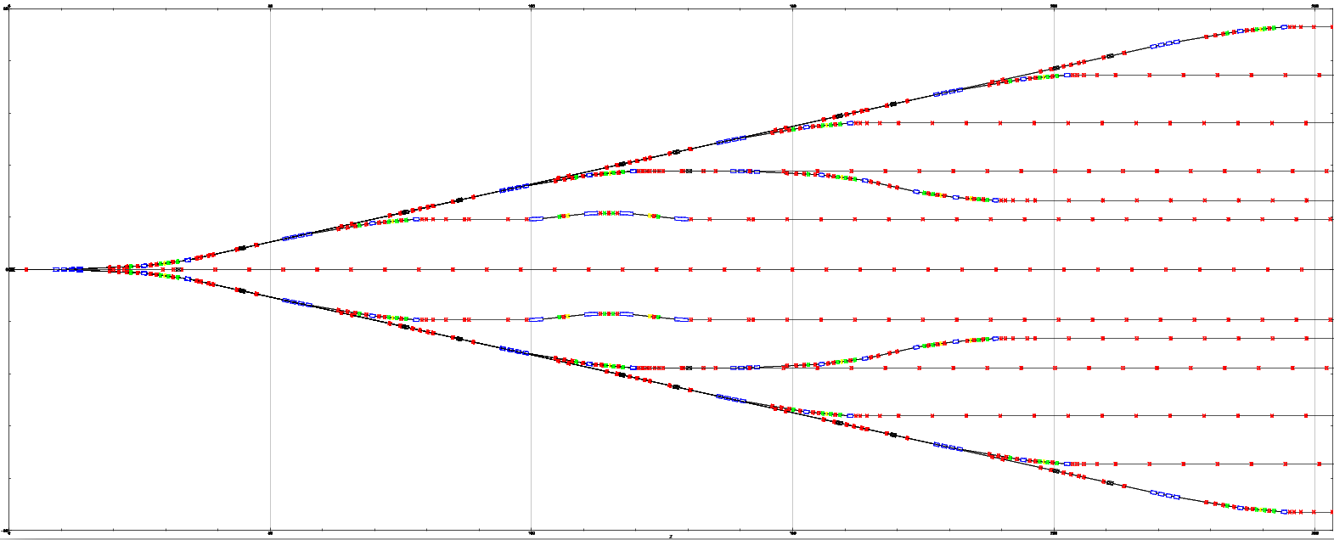
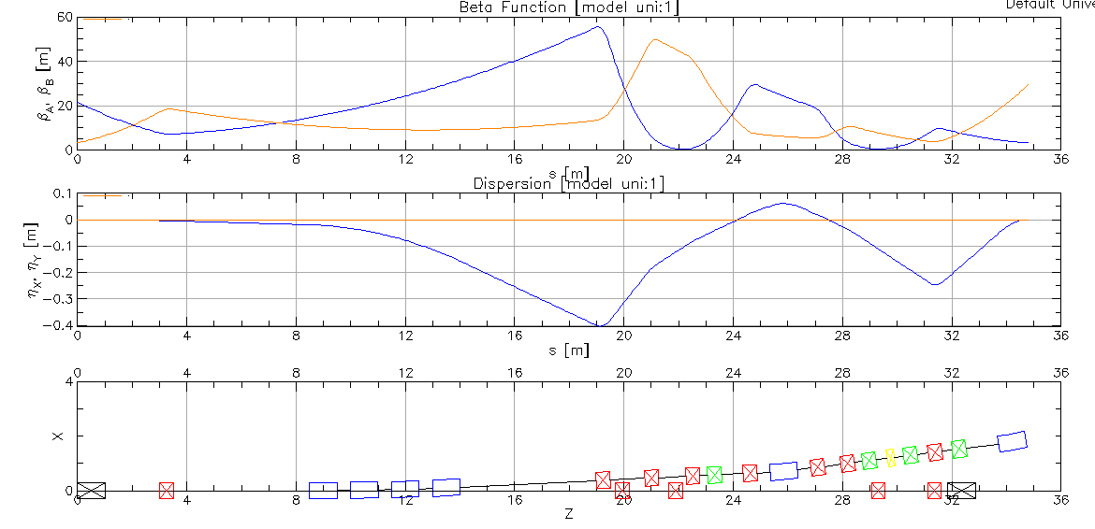
UK-XFEL BD: Switchyard Design - Andrew Potter + Andy Wolski, Frank Jackson, PW
Layout:
FEL lines separated by 8m
Two-colour lines separated by 3m
250 m long, 90 m wide, dictated by end station layout
Modular Design Philosophy:
Split into multiple subsections (e.g. Septums, Triple Bend Achromat, Chicane)
Each subsection must independently satisfy beam dynamics requirements
Entire switchyard then satisfies beam dynamics requirements, no matter what order subsections are arranged
Easy changing between layout options

Slide 18
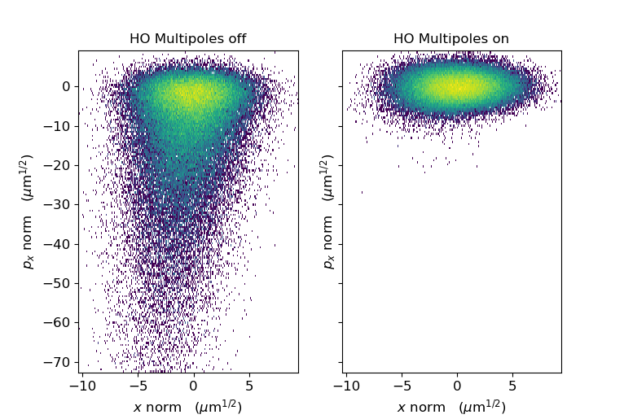
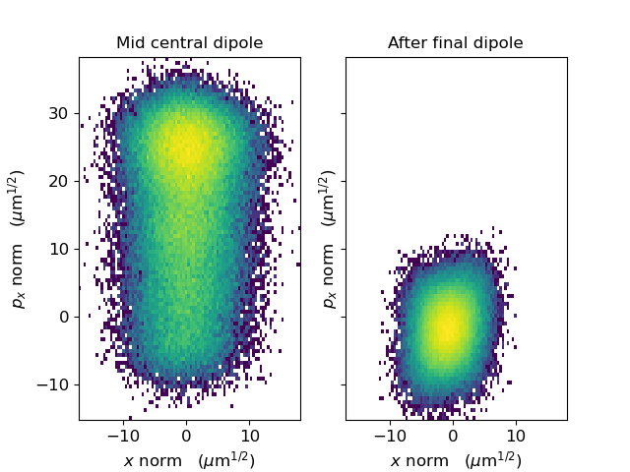
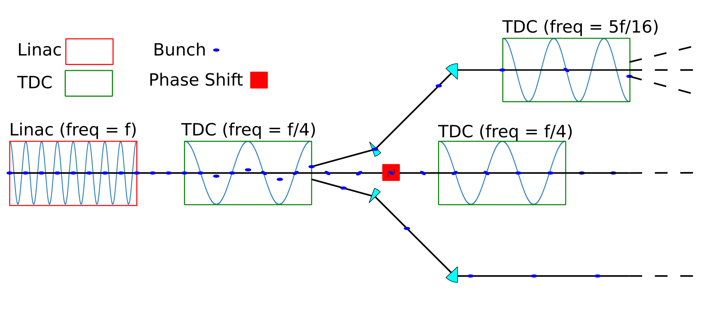
UK-XFEL BD: Switchyard Design - Andrew Potter
Beam Dynamics Requirements:
No overlapping components after septum bends
Realistic magnet strengths
Lattice functions remain relatively low (max ~ 100)
Dispersion and dispersion gradient cancelled
Isochronous + T566, T166, T266, U1666, U2666 all cancelled
CSR kicks cancel
MHz Distribution:
Debate over whether to use conventional magnetic kickers or RF separators throughout
Two-colour (from separate FEL’s) require RF anyway as magnetic not fast enough
Head-tail tilt on straight ahead lines cancelled with second cavity
Cancellation of non-linear dispersion in TBA
Cancellation of CSR kicks in TBA

Slide 19
UK-XFEL Conceptual Design High Energy Beam Dynamics Update Summary
A few more details additional to those presented by Dave Dunning this morning…
Personal thought: as the project has developed it has become clear that the priority is “synchrotron-like operation”, meaning driving down the cost-per-user-experiment by running multiple XFELs simultaneously. These XFELs will operate at different wavelengths, using different FEL schemes simultaneously. This determines the overarching philosophy…
Linac must support semi-arbitrary bunch patterns consisting of different charges:
75 pC @ e.g. 2/3 of the 1 MHz rep rate to 8 GeV
150 pC @ e.g. 1/3 of the 1 MHz rep rate to 8 GeV
(300 pC potential swap-out of 150 pC bunches above)
600 pC @ 100 Hz driving matter-in-extreme-conditions (MEC) station at 12 GeV – booster or not? TBD
Flexible compression concept – we allow for differential compression of the above bunches simultaneously
Flexible distribution concept – using modular CSR-compensated spreader, either mostly RF separator based to allow injector-to-FEL selection through timing only, or mostly magnetic kicker based. My own preference thus far is RF.

