Slide 1
UK XFEL
Low Energy Beamline
DESY, 5 December 2024
Boris Militsyn on behalf of LEB team
xfel.ac.uk

Slide 2
UKXFEL Low Energy Beamline
Laser3
U6
U5
Laser1
Laser2
U4
Injector1
Booster1
U3
U2
Merger
Main Linac
U1
Injector2
Booster2
Main function of the Low Energy Beam line is generation of the electron bunches with required charge, brightness and temporal structure and acceleration them to the energy of emittance dominated regime for injection into the main linac
Necessity of operation with two bunches with different charges following with a repetition rate of 100’s kHz motivated for design of LEB consisting of two independent injectors and boosters operating alternately
The bunches are injected into the main linac with a merger
For two FEL operation regime injectors are driven by two different lasers alternately with required frequency in opposite phases delivering pulses with necessary parameters for every FEL mode in two separate beamlines
For pump-probe experiment the probe injector delivers beam with delay of ~0.77 ns (RF period of L-band) relative to the injector driving pump FEL or vice versa.
Laser1
Laser2
Laser3

Slide 3
There we are
LEB consists of two alternatively operated identical injectors delivering beams with different bunch charge. Beam accelerated to the energy of emittance dominated regime and injected into the main linac with a merger.
Generation of the beam:
Beam is generated by VHF photocathode gun operating with Cs₂Te photocathode illuminated by UV laser pulse with a length of 10 degrees of gun RF phase. Kinetic beam energy is about 1 MeV.
Generated bunch is compressed to the length, required for injection into the main linac, with a 2 stage compressor:
Subharmonic velocity buncher
Subharmonic booster following with Magnetic compressor or ballistic compression
Following compression beam is accelerated to the of emittance dominated regime
Alternative injection of the beam into the main linac is provided with a combined magnetic-RF deflector.

Slide 4
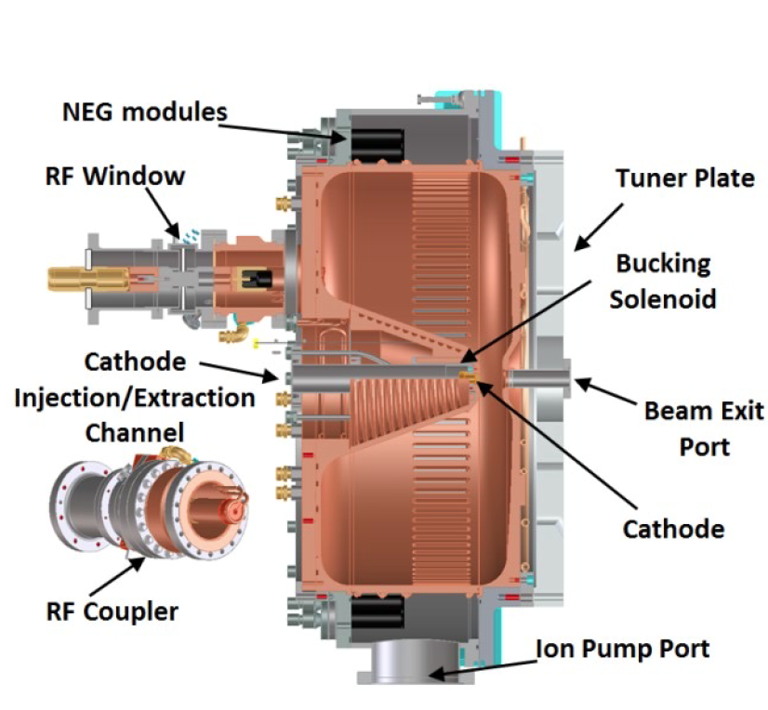
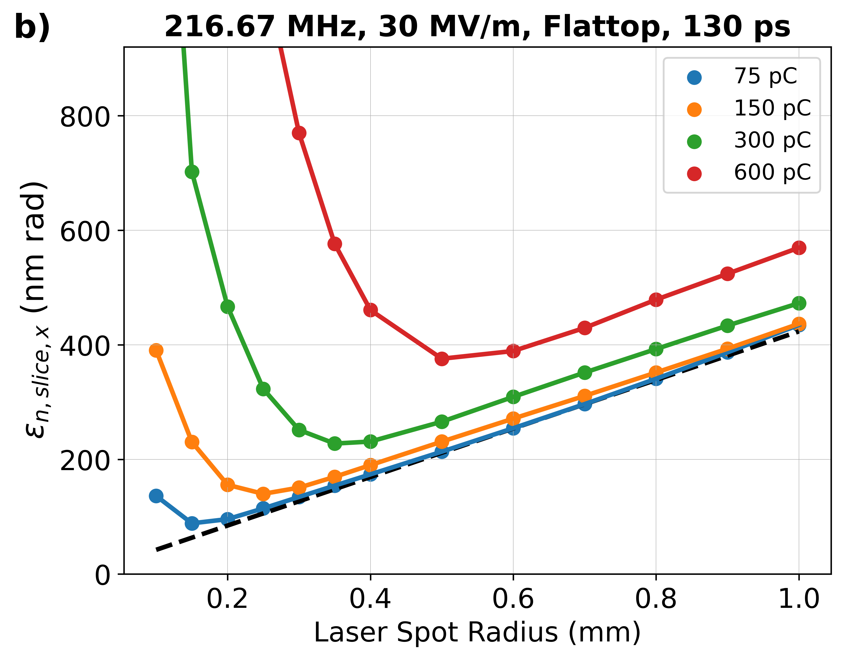
Generation of the beam with 217 MHz VHF gun operating with Cs₂Te photocathode
LCLS-II NCRF gun
*- slice emittance calculated at emittance compensation point

Slide 5
Photocathode Options for a UK XFEL
¹ Characterisation of Yttrium photoemissive properties planned
² Capital bid submitted to fund a multi-wavelength QE monitoring system
³ Capital bid submitted to fund additional deposition sources
⁴ Preliminary MEIS data implies Cs implantation at 5 keV. Promising
⁵ QE enhancement & WF reduction demonstrated. Further work needed
⁶ Research programme into bi-alkali metal photocathodes planned
Courtesy Lee Jones
* Illumination Wavelengths: Ti:Sapp fundamental ω ~ 790 nm / 2ω ~ 395 nm / 3ω ~ 263 nm
Nd:YVO₄ fundamental ω ~ 1064 nm / 2ω ~ 532 nm / 3ω ~ 355 nm / 4ω ~ 266 nm

Slide 6
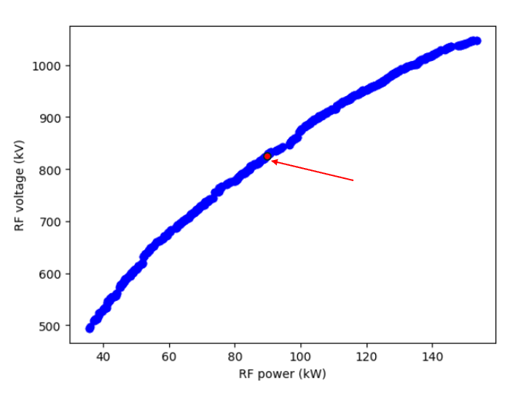
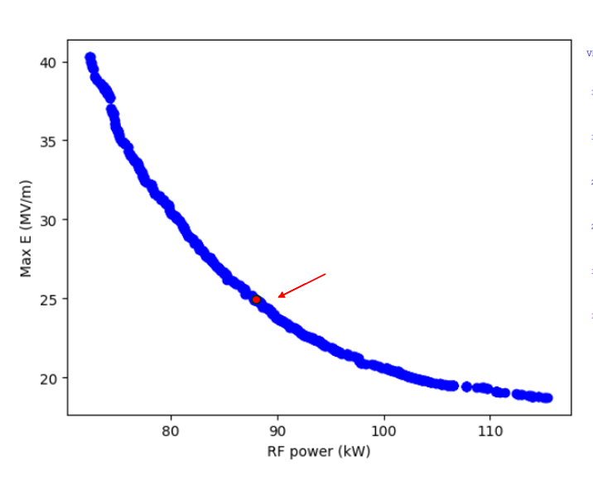
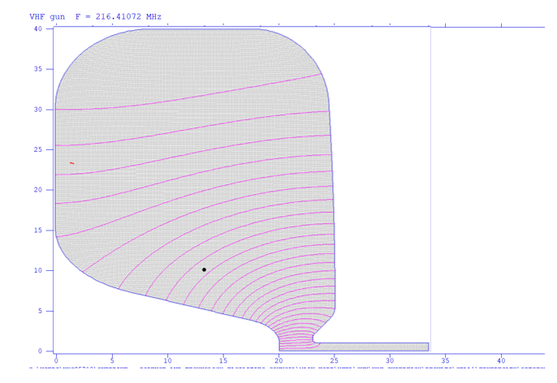
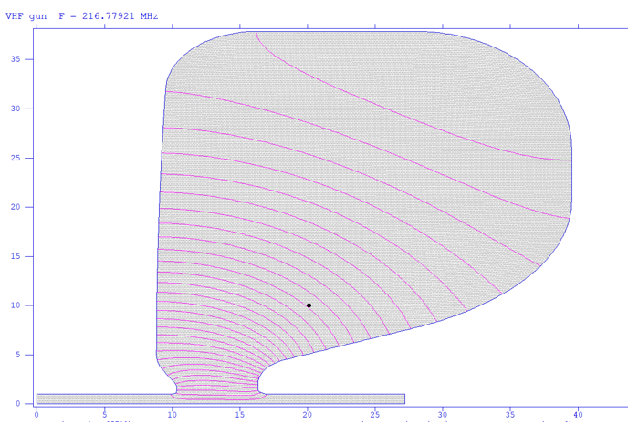
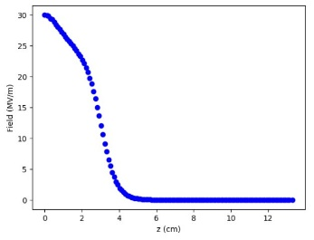
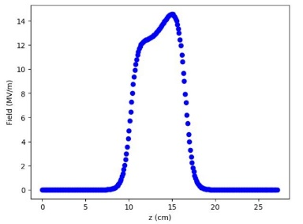
Two cell gun (cells optimised separately)
Chosen design. Conservative surface field
Chosen design. 90 kW RF power limit due to RF technology constraints.
Courtesy Louise Cowie
RF voltage = 826 kV
RF voltage = 870kV

Slide 7
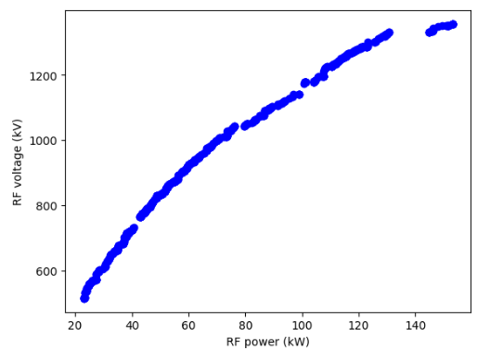
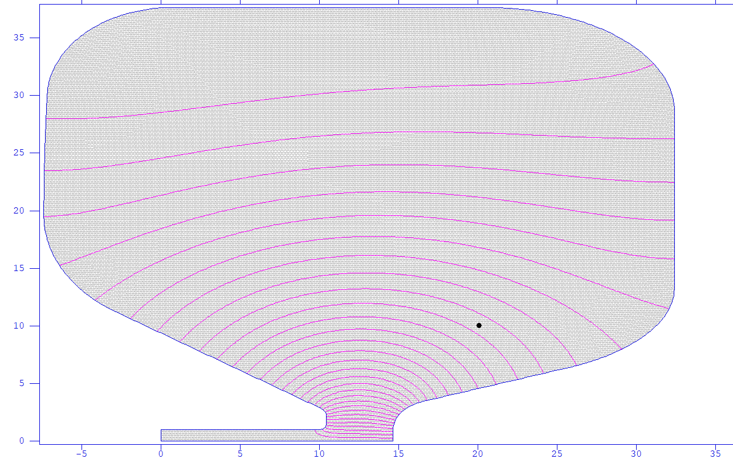
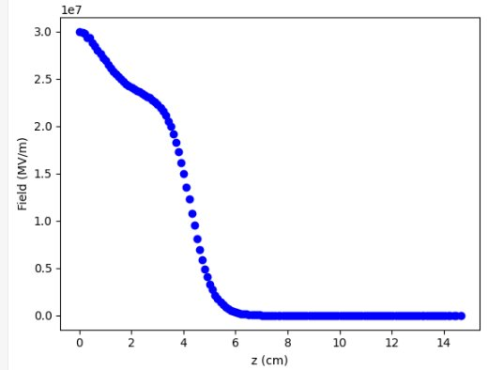
Single cell relaxed geometry
90 kW power chosen
RF voltage = 1100 kV
Courtesy Louise Cowie

Slide 8
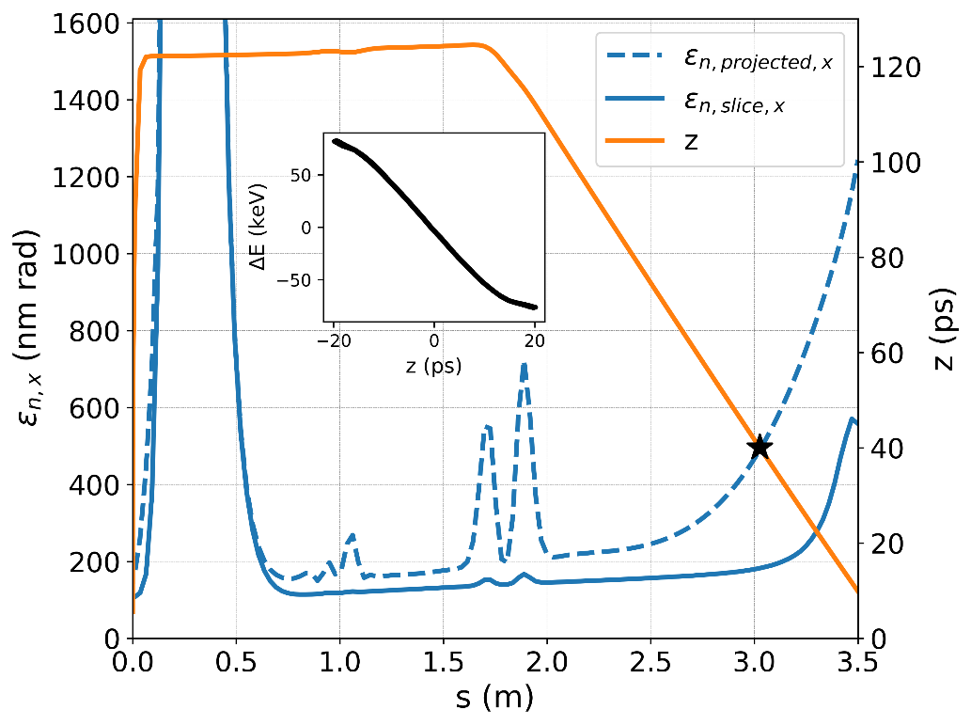
Photocathode gun and velocity bunch compressor
Subharmonic SRF booster consisting of 4-5 independently fed cavities allowing additional bunch compression and acceleration of the beam to the energy of about 5-7 MeV
Bunch length at the exit of the booster should be 20-40 ps for injection into subharmonic booster/accelerator

Slide 9
650 MHz Buncher Cavity Design (CST)
The design originated from the paper,
T. Takahashi et. al, “Development of a 1.3-GHz Buncher Cavity for the Compact ERL”, THPRI045, IPAC 2014, Dresden, Germany nd has not been fully optimised yet.
Field distributions are obtained for 1 Joule of total energy in the cavity.
unit : mm
30º
Principal Parameters | Values
Resonant frequency | 651.66 MHz
R_{sh}/Q (for β = v/c =1) | 232.8 Ω
R_{sh}/Q (for β = v/c =0.863) | 194.73 Ω
R_{sh}/Q (for β = v/c =0.824) | 181.79 Ω
Shunt impedance R_{sh} (for β = v/c =1) | 8.21 MΩ
Unloaded-Q (Q₀) | 35270
E_{peak} | 7.96 MV/m
Voltage | 1.25 MV
E-field
H-field
Courtesy Fatih Yaman
RF field at the centre of the cavity

Slide 10
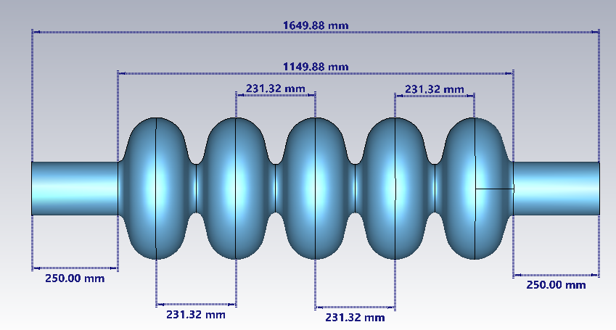
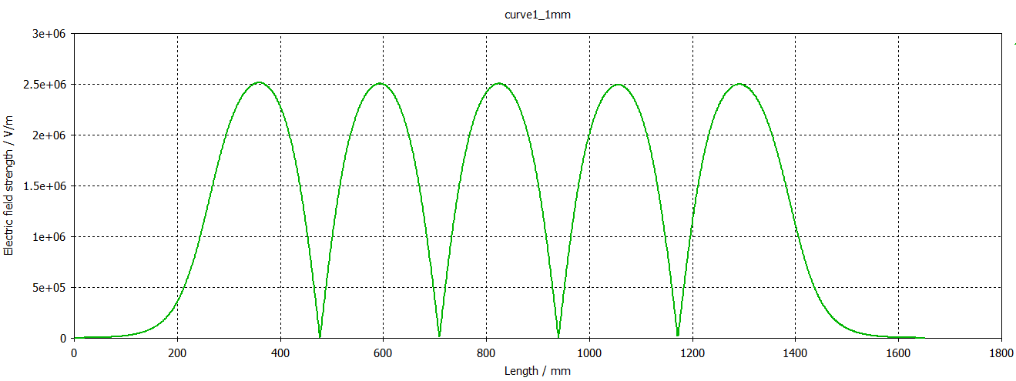
Conceptual design of the 650 MHz SRF accelerator cavity (CST model)
Courtesy Fatih Yaman

Slide 11
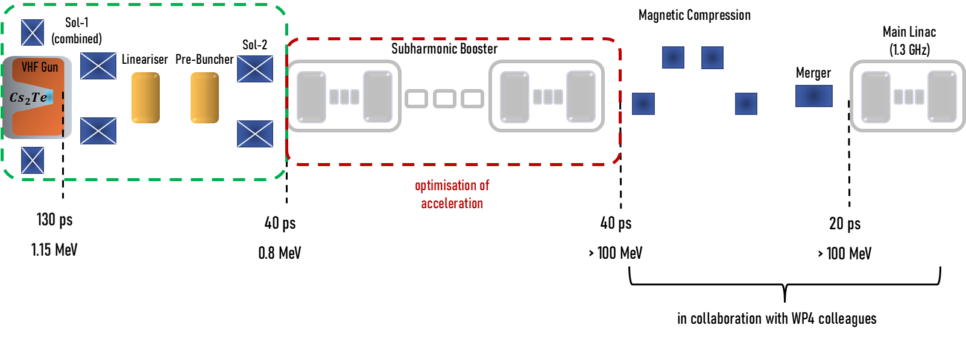
Velocity bunching
Ballistic compression
Acceleration until emittance dominated regime
Injection into main linac
Velocity bunching
Acceleration until emittance dominated regime
Magnetic compression
Injection into main linac
Courtesy Can Davut

Slide 12
LEB – Bunch parameters for different compression options
* The results shown for Design-I are before the magnetic compression scheme applied. ** Initial emittance results indicate the values at the emittance compensation point after the gun.
*** Initial emittance values vary due to different gun solenoid strengths considering the initial beam size for different bunch charges. **** Lineariser hasn’t been used in high bunch charge (300-600 pC) simulations.
Courtesy Can Davut

Slide 13
More work to be done
Conceptual design of the VHF gun
Conceptual design of the photocathode drive laser
Conceptual design of the subharmonic booster
Design of the second stage of the compression
Design of the magnetic compressor
Design of the merger
S2E simulation and global optimisation of LEB
Emittance balance at the entrance of the main linac
Beam diagnostic

Slide 14
Acknowledgement
Ben Hounsell, ASTeC
Can Davut, The University of Manchester
Dave Dunning, ASTeC
Fatih Yaman, ASTeC
Julian McKenzie, ASTeC
Lee Jones, ASTeC
Louise Cowie, ASTeC
Neil Thompson, ASTeC
Oznur Apsimon, The University of Manchester
Peter Williams, ASTeC
Suzanna Percival, ASTeC

Slide 15
Thank you
xfel.ac.uk
@STFC_Matters @UKXFEL

