Slide 1
Polycrystalline Copper Photocathode Samples: DESY Collaboration Update December 2024
Credit: Lee Jones; Hugh Churn (Copper Characterisation); Chris Benjamin (Niobium Characterisation)

Slide 2
Objectives for Photocathode R&D:
Characterise performance of polycrystalline and single-crystal samples
Goal to reach QE > 1E-4
Assess performance differences for polycrystalline Cu subjected to a range of cleaning processes (BPS172, HPR, Plasma, Dry Ice etc.) measuring:
QE;
MTE as a function of illumination wavelength;
Spectral response.
Investigate (negative ?) impact of BPS172 treatment on Nb

Slide 3
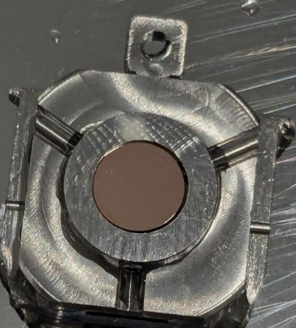
Samples Tested (so far …..)
Cu(Poly) – Acetone
20 minute acetone ultrasonic bath, 5 minute ultrasonic IPA bath, dried with dry nitrogen
XPS and QE data collected
Cu(Poly) – High Pressure Rinsed (HPR)
High pressure rinsed – exposed to air for ~40 minutes prior to loading into UHV
XPS and QE data collected
TESS photoemission data collected
Cu(Poly) – BPS172 Sample 1
20 minute 10% BPS172 ultrasonic bath, 10 minute deionised water ultrasonic bath, dried with dry nitrogen
XPS and QE data collected before and after a 30 minute* 155°C† heat.
Cu(Poly) – BPS172 Sample 2
20 minute 10% BPS172 ultrasonic bath, 10 minute deionised water ultrasonic bath, dried with dry nitrogen
XPS and QE data collected before and after successive heating steps:
30 min, 2 hours, 3 days at 55°C
30 min, 2 hours, 2 days at 75°C
30 min, 2 hours, 2 days at 95°C
30 min at 155°C
Typical polycrystalline copper in an Omicron sample holder
* Times exclude ramping.
† Quoted temperatures are from the manipulator thermocouple. This reads low. 155°C is estimated to be around 260°C from a prior calibration. Lower thermocouple temperatures fall outside the calibration range.

Slide 4
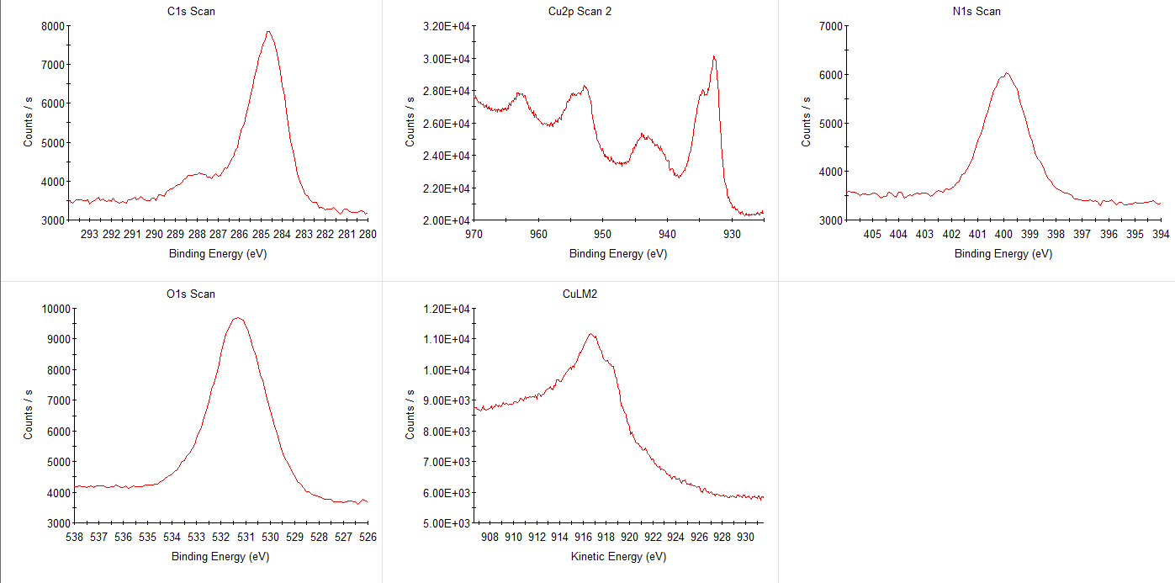
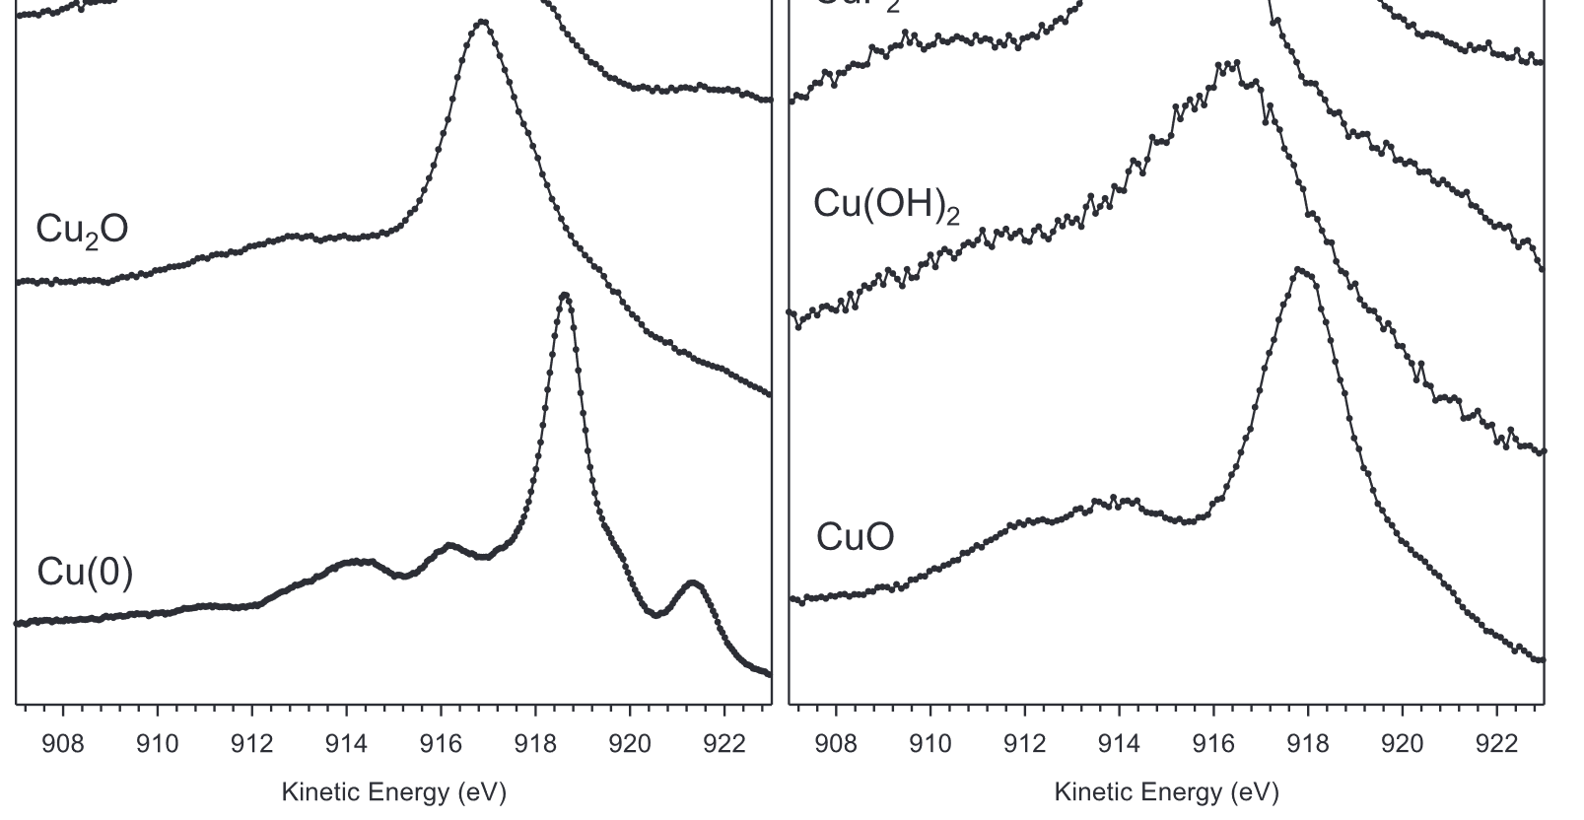
Cu(Poly) – Acetone: As Loaded
Species | Atomic Percentage (%)
Cu | 21.0
O | 22.4
C | 43.5
N | 13.1
Cu(0) and Cu(I)
Cu(II)
QE ~ 2.3 x 10⁻⁶
Cu(I) auger
Cu(II) auger
XPS shows strong presence of CuO and Cu₂O, i.e., Cu(I) and Cu(II), so the resulting QE is very low.
Cu L₃M_{4,5}M_{4,5} spectra for (left) Cu(0), Cu(I) species, mineral samples, and (right) Cu(II) species. Surf. Interface Anal. 2017, 49, 1325–1334

Slide 5
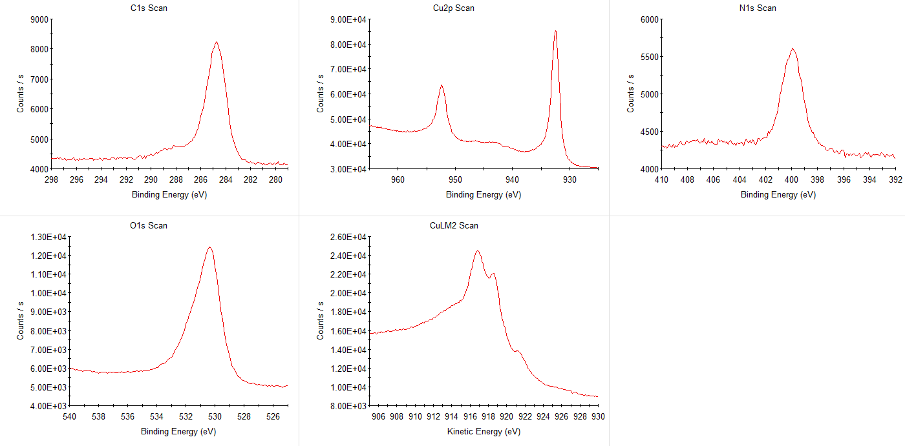
Cu(Poly) – HPR: As Loaded
Species | Atomic Percentage (%)
Cu | 44.4
O | 20.4
C | 29.4
N | 5.8
Cu(0) and Cu(I)
QE ~ 4.4 x 10⁻⁶
Cu(I) auger
Cu(0) auger
XPS shows high quantities of Cu₂O (in the Cu LMM), but no CuO.
Resulting QE is very low, but higher than acetone treated copper.
Cu L₃M_{4,5}M_{4,5} spectra for (left) Cu(0), Cu(I) species, mineral samples, and (right) Cu(II) species. Surf. Interface Anal. 2017, 49, 1325–1334

Slide 6
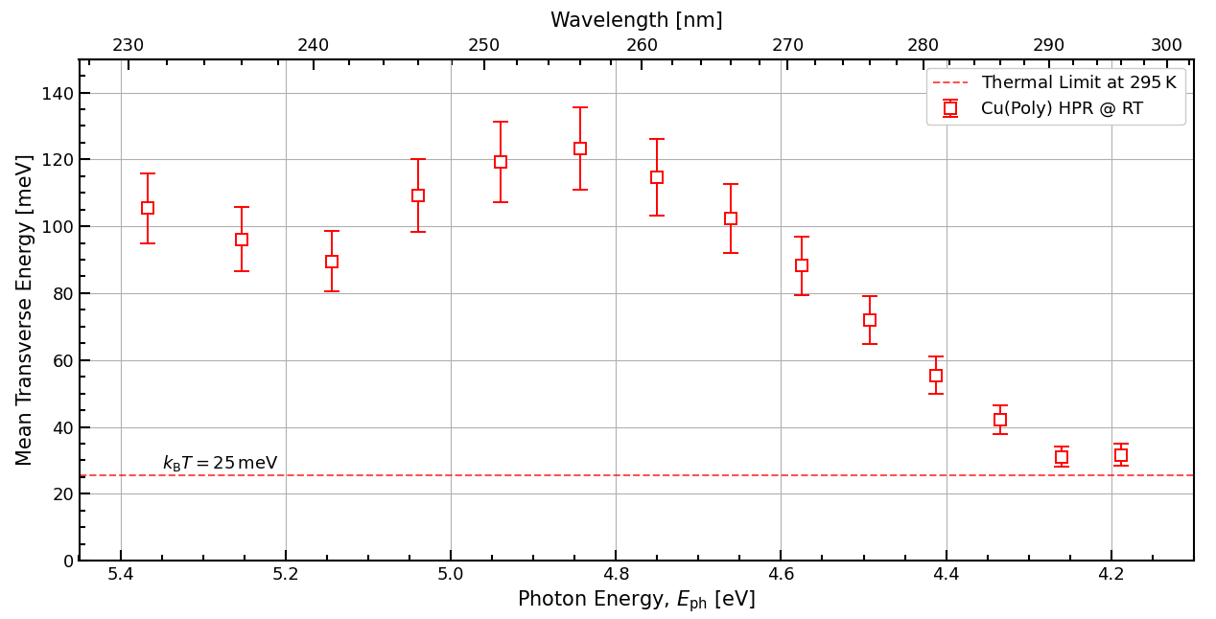
MTE & Spectral Response for Cu(Poly) - HPR

Slide 7
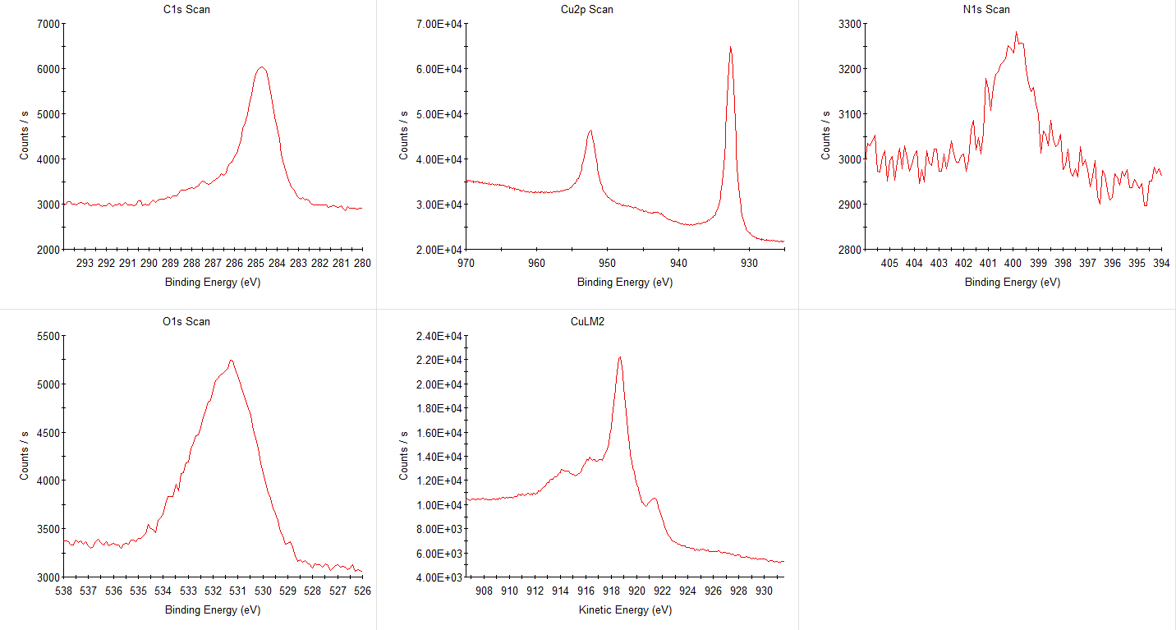
Cu(Poly) – BPS172 1: As Loaded
Species | Atomic Percentage (%)
Cu | 52.0
O | 11.3
C | 34.5
N | 2.2
QE ~ 7.7 x 10⁻⁶
Cu(0) auger
XPS, notably the Cu LMM, shows metallic copper with perhaps very small amounts of Cu₂O present. QE higher than HPR and acetone treated samples
Cu L₃M_{4,5}M_{4,5} spectra for (left) Cu(0), Cu(I) species, mineral samples, and (right) Cu(II) species. Surf. Interface Anal. 2017, 49, 1325–1334

Slide 8
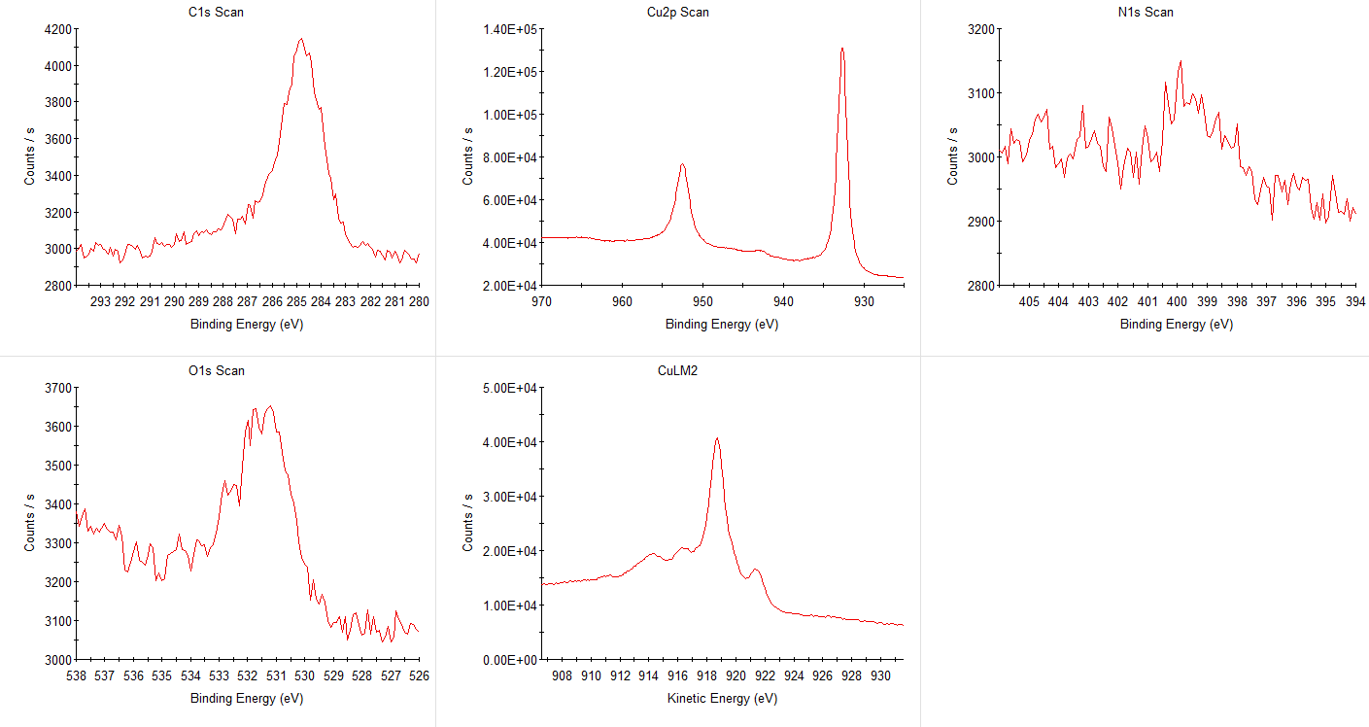
Cu(Poly) – BPS172 1: Heated
Species | Atomic Percentage (%)
Cu | 87.8
O | 1.6
C | 10.6
N | trace
QE ~ 1.6 x 10⁻⁴
Cu(0) auger
XPS, notably the Cu LMM, shows metallic copper. Surface oxygen and carbon noticeably reduced. QE greatly increased.
Cu L₃M_{4,5}M_{4,5} spectra for (left) Cu(0), Cu(I) species, mineral samples, and (right) Cu(II) species. Surf. Interface Anal. 2017, 49, 1325–1334

Slide 9
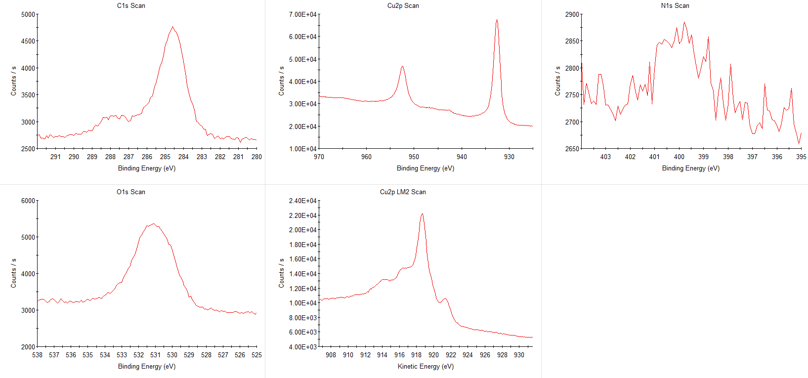
Cu(Poly) – BPS172 2: As Loaded
Species | Atomic Percentage (%)
Cu | 59.9
O | 13.3
C | 25.5
N | 1.3
QE ~ 4.2 x 10⁻⁶
Cu(0) auger
Cu(I) bump
XPS, notably the Cu LMM, shows metallic copper with signs of more Cu₂O present than the 1st BPS172 sample.
Cu L₃M_{4,5}M_{4,5} spectra for (left) Cu(0), Cu(I) species, mineral samples, and (right) Cu(II) species. Surf. Interface Anal. 2017, 49, 1325–1334

Slide 10
Cu(Poly) – BPS172 2: Heating – Selected Steps
As Loaded
2 hr @ 55°C
2 hr @ 75°C
2 hr @ 95°C
30 min @ 155°C
Cu
13.3%
11.9%
7.3%
4.5%
2.1%
O
25.5%
20.9%
15.8%
11.8%
8.8%
C

Slide 11
Cu(Poly) – BPS172 2: Heating, XPS Summary

Slide 12
QE Summary - Cu(Poly) Samples with λ = 266 nm

Slide 13
Cu(Poly) – BPS172 2: Heating, XPS Summary
QE
4E-6
6E-6
1E-5
3E-5
4E-5
6E-5
1E-4
1E-4
1E-4
2E-4
2E-4

Slide 14
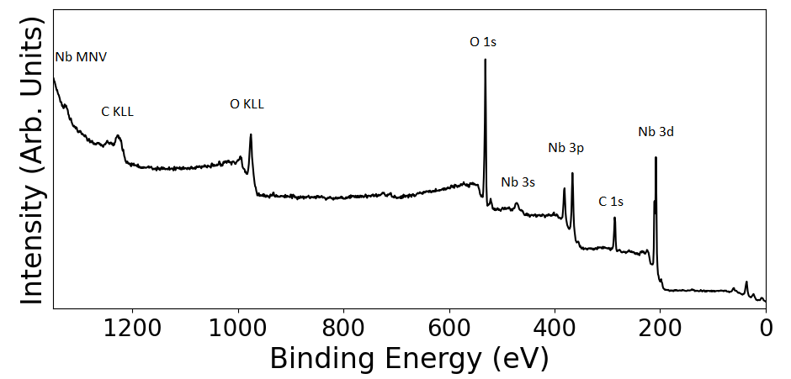
Surface Resistance of Nb Exposed to BPS172
A brief report of the Nb sample:
The samples were mechanically polished (by Kemet) in late June 2024 (roughness < 100 nm);
The Nb was stored at atmosphere in a membrane sample box before BPS 172 treatment;
The Nb will definitely have a native oxide layer;
Preparation - 10 min in BPS172 solution in ultrasonic bath followed by 10 min in ultra-pure water;
The as-loaded XPS shows a large amounts of carbon & oxygen, and the niobium is in a pentoxide state;

Slide 15
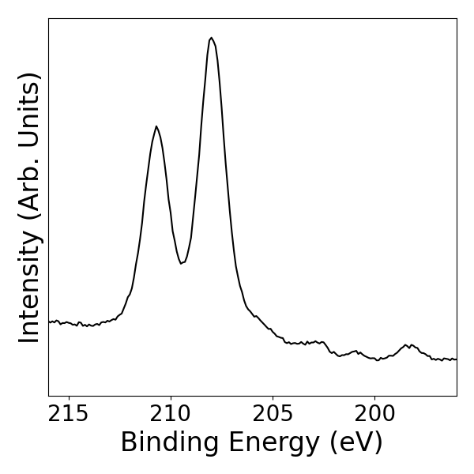
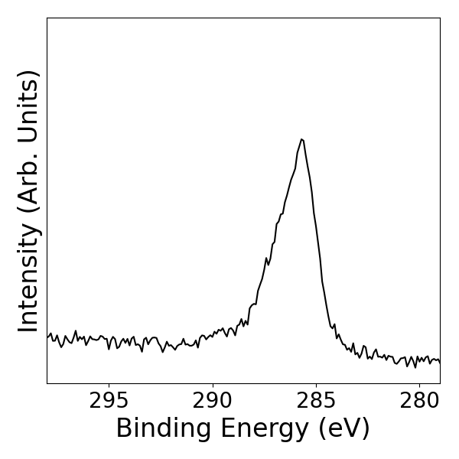
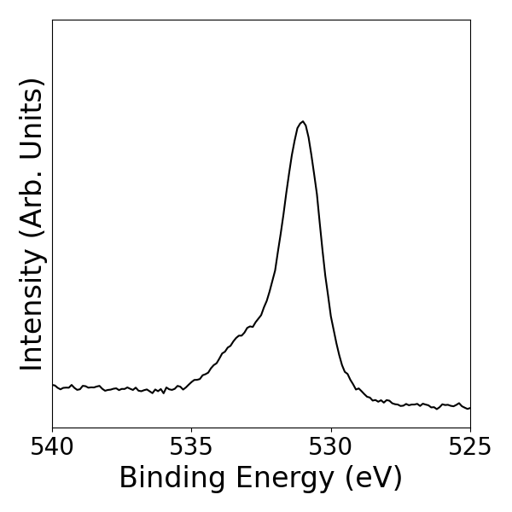
Surface Resistance of Nb Exposed to BPS172
A brief report of the Nb sample:
The samples were mechanically polished (by Kemet) in late June 2024 (roughness < 100 nm);
The Nb was stored at atmosphere in a membrane sample box before BPS 172 treatment;
The Nb will definitely have a native oxide layer;
Preparation - 10 min in BPS172 solution in ultrasonic bath followed by 10 min in ultra-pure water;
The as-loaded XPS shows a large amounts of carbon & oxygen, and the niobium is in a pentoxide state;
https://www.xpsfitting.com/2009/04/niobium.html?m=1

Slide 16
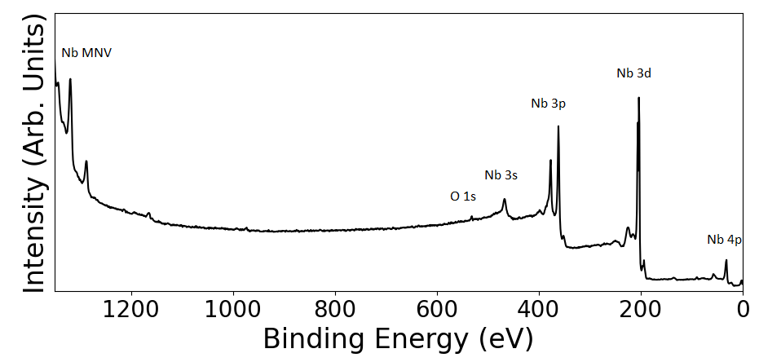
Surface Resistance of Nb Exposed to BPS172
A brief report of the Nb sample:
The samples were mechanically polished (by Kemet) in late June 2024 (roughness < 100 nm);
The Nb was stored at atmosphere in a membrane sample box before BPS 172 treatment;
After sputtering with 2.5 keV Kr⁺ ions for 4 hours, the niobium is in a metallic state;
There are trace amounts of carbon and oxygen remaining;
Overall, the BPS 172 didn’t have any obvious negative effect, chemically speaking.

Slide 17
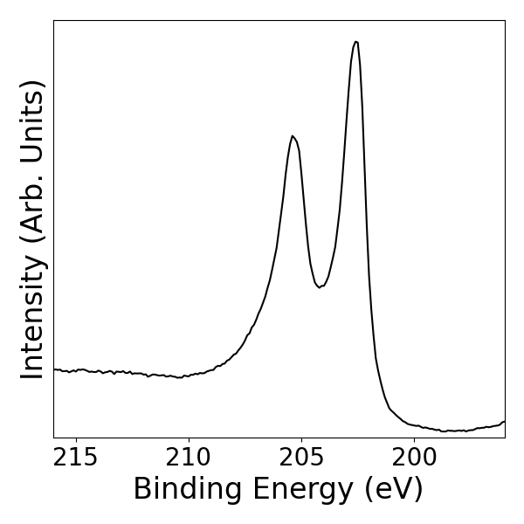
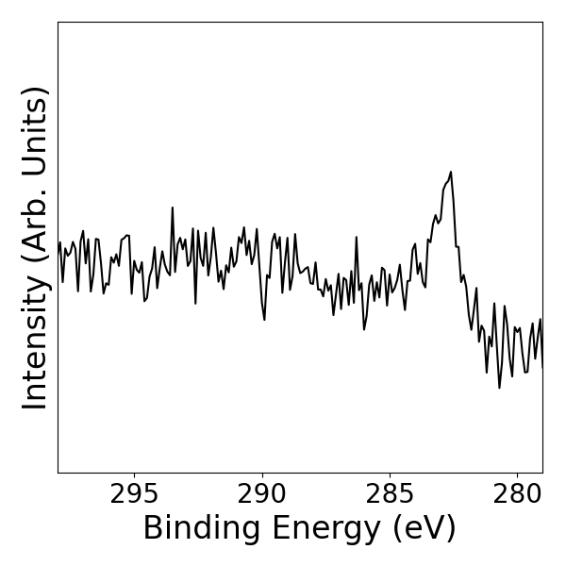
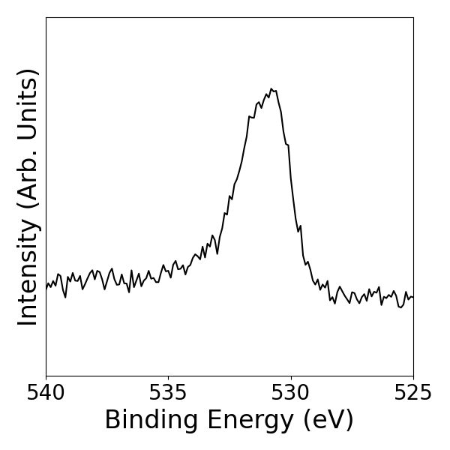
Surface Resistance of Nb Exposed to BPS172
A brief report of the Nb sample:
The samples were mechanically polished (by Kemet) in late June 2024 (roughness < 100 nm);
The Nb was stored at atmosphere in a membrane sample box before BPS 172 treatment;
After sputtering with 2.5 keV Kr⁺ ions for 4 hours, the niobium is in a metallic state;
There are trace amounts of carbon and oxygen remaining;
Overall, the BPS 172 didn’t have any obvious negative effect, chemically speaking.
https://www.xpsfitting.com/2009/04/niobium.html?m=1

Slide 18
Future Aims in our Photocathode R&D:
Characterise performance of polycrystalline and single-crystal samples
Goal to reach QE > 1E-4
Assess performance differences for polycrystalline Cu subjected to a range of cleaning processes (BPS172, HPR, Plasma, Dry Ice etc.) measuring:
QE;
MTE as a function of illumination wavelength;
Spectral response.
Measure surface resistance of Nb exposed to BPS172 treatment;
At room temperature and in the cryogenic regime (once the cold head is repaired);
Investigate effect (if any) of BPS172 treatment on indium;
Cu(Poly) BPS172 Sample 3;
Further experiments on Cu(Poly) to investigate performance characteristics following:
BPS172 treatment followed by HPR;
Argon plasma cleaning;
Dry ice cleaning.

