Slide 1
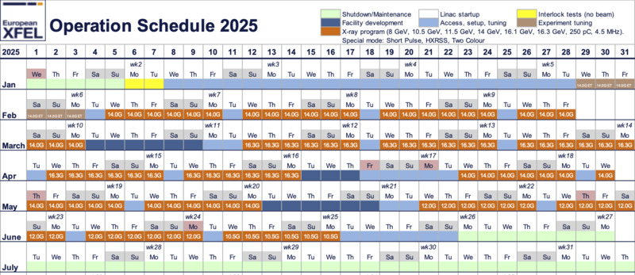
Aims for the Session and next steps. Peter/Sergey.
By the end of the session, it would be great to address the following questions:
Are we interested in conducting LPS measurements at CLARA to validate collective effects? - Yes
If yes, can we plan and do these experiments next year? – Explore possibility of contributing at correct stage of CLARA commissioning. Dedicated time after commissioning?
What types of experiments would you be interested in participating in at the EuXFEL?
Beam dynamics, FEL? – Beam dynamics and FEL (to be clarified further)
Nature of the contribution? Observation, data analysis, machine operation, modelling, other? –
Potential contributions could include all mentioned above activities.
There is an option to work onsite at DESY for an extended period (more than 1–2 weeks) to participate in planning, simulation, measurements, and data analysis. Identify STFC staff interested in participating
However, note that EuXFEL will undergo a long maintenance period starting in mid-June (ideal opportunity for further visit to DESY by STFC and potentially higher level funders?). Before that, there are only 2.5 weeks of machine study time available – Sergey to consider appropriateness / preparation required for participation of STFC staff?.
OCELOT IBS/MBI models prospective implementation. What is the state of your modelling efforts in this direction? How might we incorporate it into our simulation framework?
Alex has already implemented IBS and MBI effects in an OCELOT fork. The next steps are to merge this work into the main OCELOT branch, before conduct testing with Reptile (in collaboration with Erion), and develop unit tests.
Virtual diagnostics
Opportunities for a shared/common library/pipeline/framework for training models/visualization/validation?
Collaboration with Andy on virtual diagnostics is expected to progress once a PhD student begins working at the University of Liverpool.
Toby has agreed to test his algorithmic method for reconstruction of LPS images obtained with dechirper. Toby will mentor new student with Andy W.

