Slide 1







CALO5D
Calorimetry in five dimensions
First Face-to-Face Project Meeting December 2024
KIT Karlsruhe

Slide 2
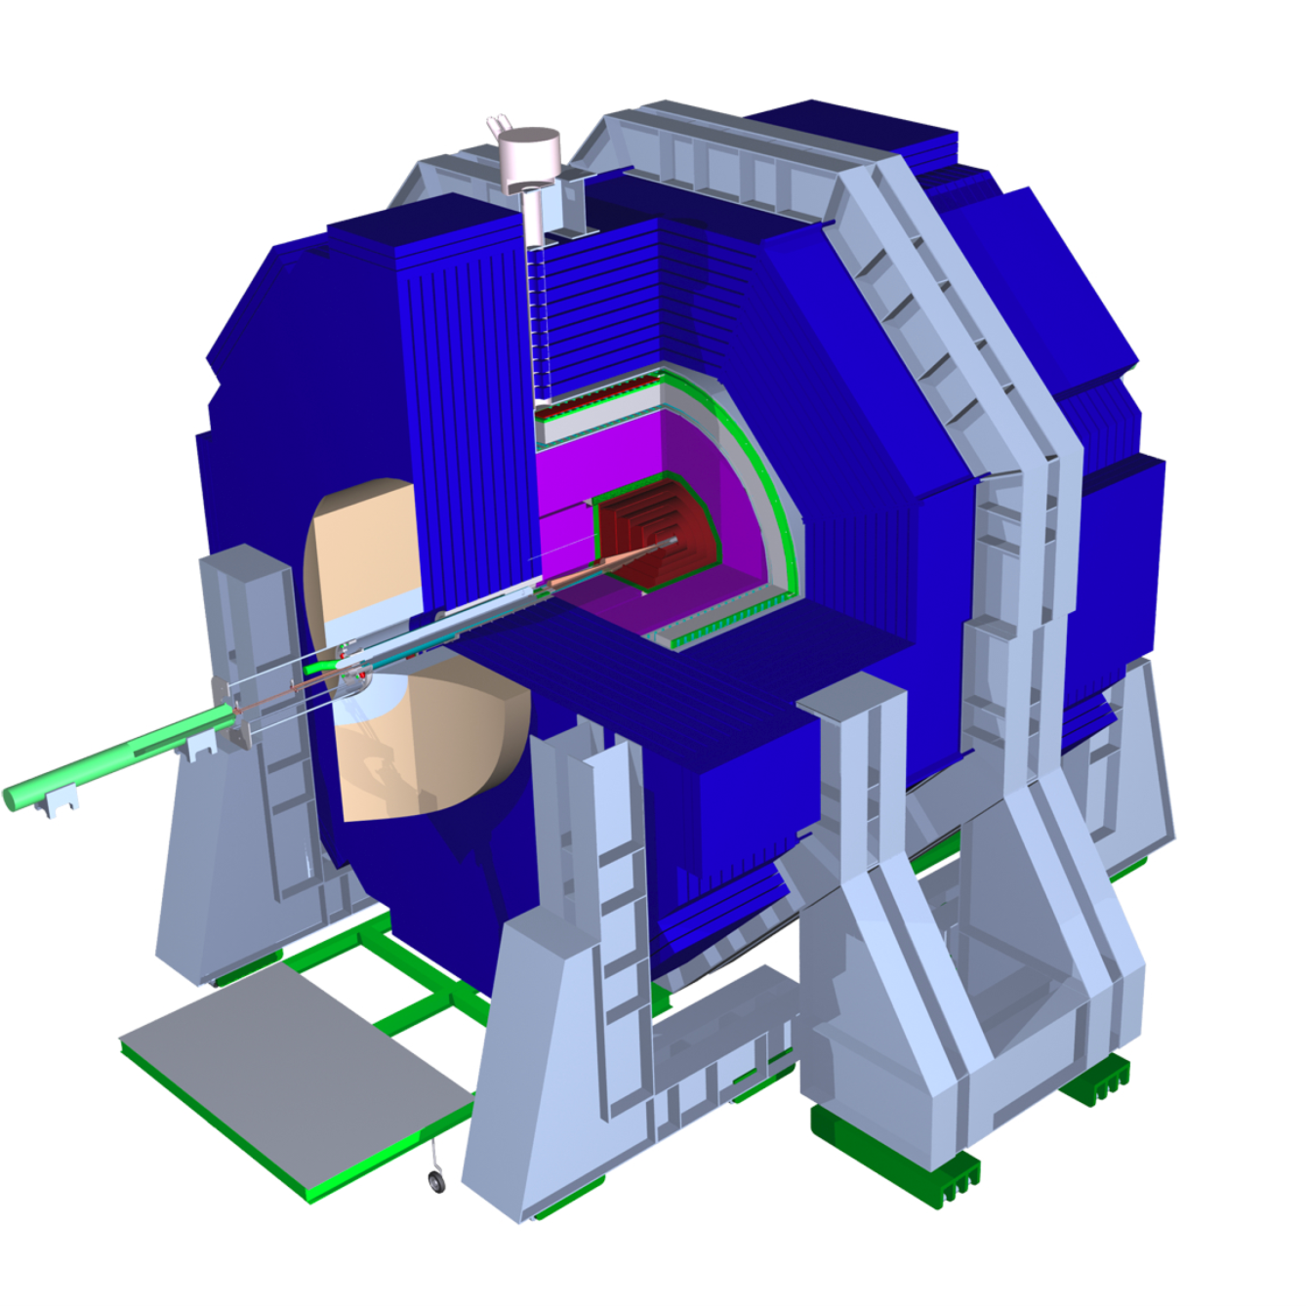
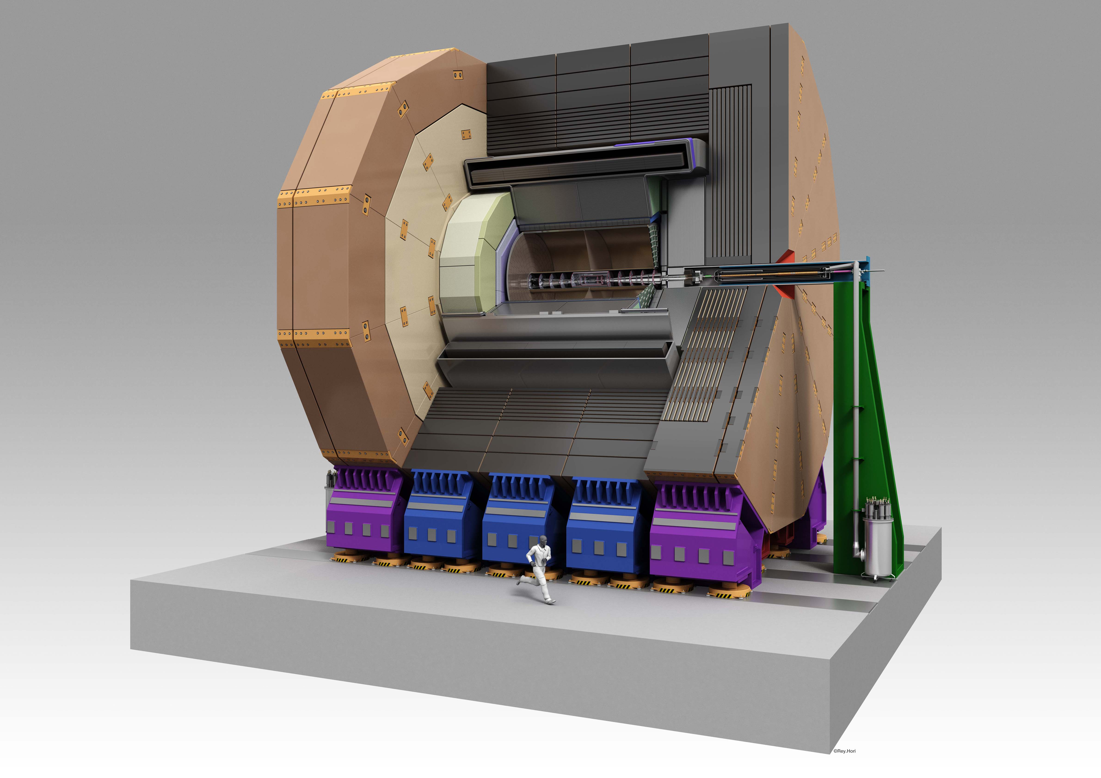
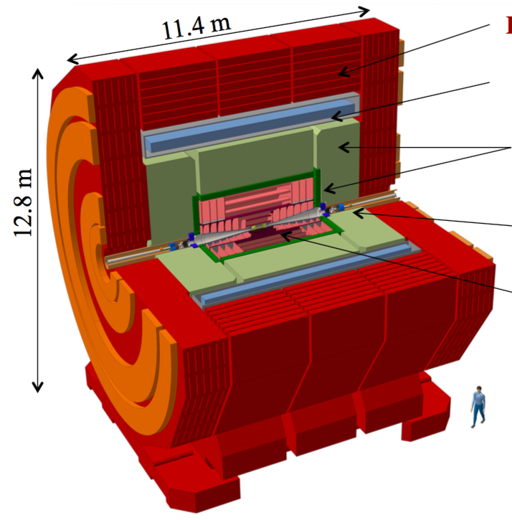
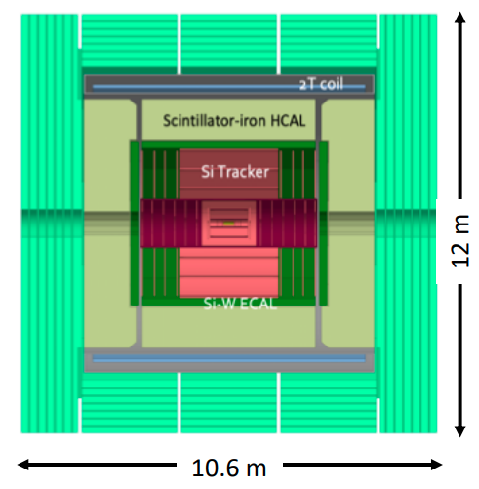
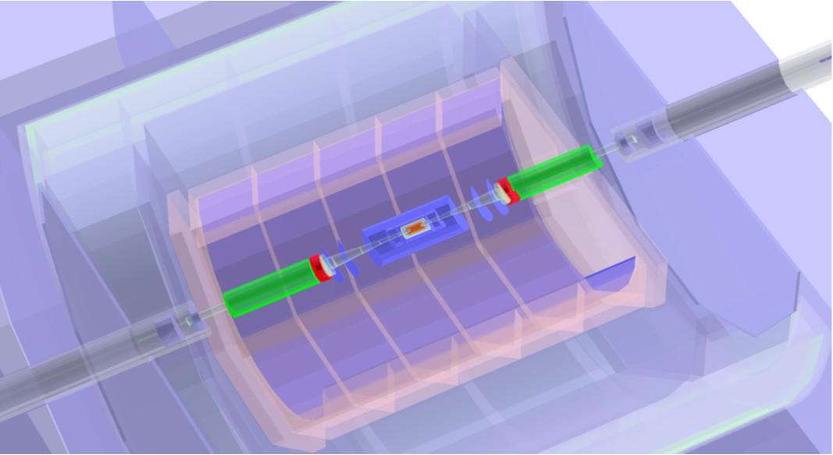
Detector systems – Target projects
Detectors for Higgs Factories
<number>
Notes:
<number>

Slide 3
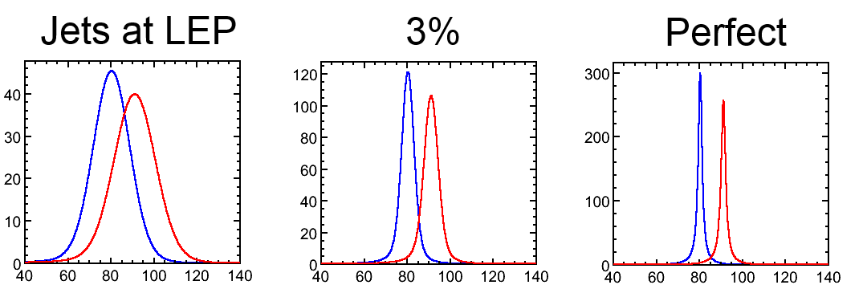
Detector requirements in high energy e+e- collision
Examples:
W Fusion with final state neutrinos requires
reconstruction of H decays into jets
Jet energy resolution of ~3% for a clean W/Z separation
M. Thomson
Slide: F. Richard at International Linear Collider – A worldwide event
<number>
Notes:
<number>

Slide 4
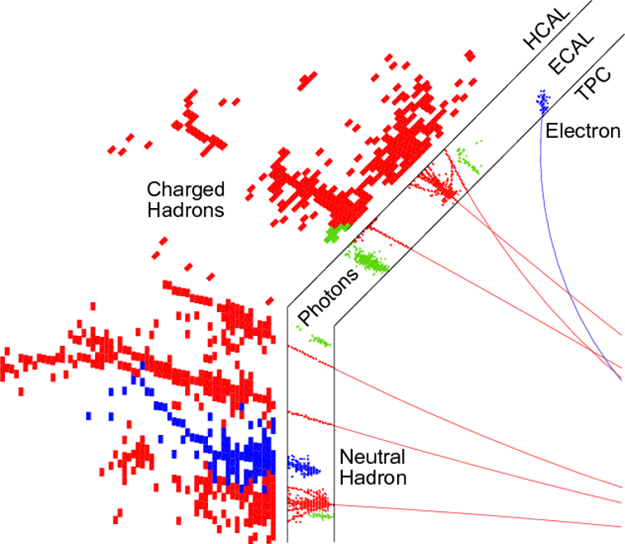
Particle Flow Detector
Base measurement as much as possible on measurement of charged particles in tracking devices
Separate of signals by charged and neutral particles in highly granular calorimeters
Typical cell size ~1cm3
Available information: Position and amplitude of energy deposit -> 4D
Complicated topology
by (hadronic) showers
Overlap between showers
compromises correct
assignment of calo hits
⇒ Confusion Term
Need to minimize the confusion
term as much as possible !!!
ECAL =
Electromagnetic
Calorimeter
Expertise by French Groups
HCAL =
Electromagnetic
Calorimeter
Expertise by Gernan Groups
L
Notes:
<number>

Slide 5
Time as 5th information ?
A look to 2030 make resolutions between 20ps and 100ps at system level realistic assumptions
  -> Time resolution at the level of cell size (1cm = 30ps x c)
At which level: 1 MIP or Multi-MIP?
For which purpose ?
  Mitigation of pile-up (basically all high rate experiments)
  Support of PFA – unchartered territory
    Overall excellent time resolution
    A few layers with excellent time resolution
A topic on which calorimetry has to make up it's mind
  Remember also that time resolution comes at a price -> High(er) power consumption and (maybe)
higher noise levels
CALO5D will address these questions in a consistent way
?
?
<number>
Notes:
<number>

Slide 6
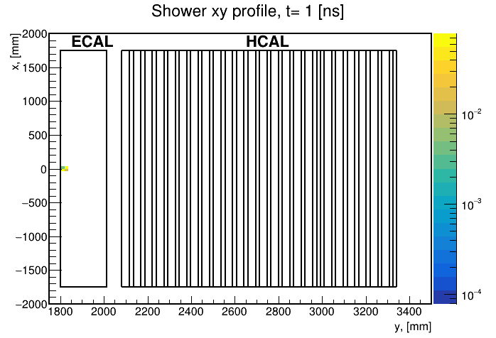
Turning films of interactions with matter
Timing allows for disentangling different stages
of a particle shower
In case of multiparticle event one may be able to
follow particles until they overlap
CALO5D will exploit information provided by
highly granular calorimeters with modern
machine learning tools
Combining the expertise of Frencn and German
groups is instrumental for success
Y. Padniuk, Master student
Technical University of Kiyv
<number>
Notes:
<number>

Slide 7
CALO5D – Organigramme (as included in proposal)
Project Coordination [WP 1]
Lucia Masetti (JGU), Roman Pöschl (IJCLab)
Was “good guess” at time or proposal
writing
  A number of things have changed since
    Yuichi has finished his thesis
    Dirk officially DMLAB
  (should not be a problem)
    JGU PhD is now JGU-PD
    Melike has joined on different funding
  source
    Other?
May want to revise organigramme
e.g. for webpage
  Eventually official documents like reports
  Discussion during these days
Steering Committee
Vincent Boudry (LLR), Katja Krüger (DESY),
Frank Simon (KIT)
+
Project Coordinators
WP 2: Implementation of Timing in Calorimeter Simulation
Coordinator:
J.C. Brient (LLR)
Members:
V. Boudry (LLR, SiECAL Simulation)
Y. Okugawa
(IJCLab, SiECAL Simulation)
IJCLab-PD (SiECAL Simulation)
M. S. Robles Manzano
(JGU, AHCAL Simulation)
A. Hadef (JGU, AHCAL Simulation)
WP 3: Particle Flow with Timing
Coordinator:
K. Krüger (DESY)
Members:
H. Videau (LLR, PFlowS)
S. Chlingaryan (KIT,
PFlowS)
LLR-PD (PFlowS)
KIT-PD → Uli (PFlowS)
D Rousseau (IJCLab, PFlowML).
F. Hummer (KIT,
PFLowML)
V. Boudry (LLR, PFlowML)
JGU-PhD → JGU PD Bohdan (PFlowML)
IJCLab-PhD → Xin (PfFowML)
WP 5: Implications for Detector Design
Coordinator:
F. Simon (KIT)
Members:
M. Balzer (KIT)
R. Pöschl (IJCLab)
IJCLab-PD
M. Caselle (KIT)
K. Krüger (DESY)
F. Sefkow (DESY)
WP 4: Impact on
Key Physics Processes
Coordinator:
D. Zerwas (IJCLab)
Members:
J.C. Brient
(LLR, Higgs Prod.)
Uli (Higgs-Prod.)
JGU-PhD → JGU
PD Bohdan (Higgs Prod.)
LLR-PD (Higgs. Prod.)
IJCLab-PhD → Xin
(Weak Boson Prod.)
F. Richard (IJCLab,
Weak Boson Prod.)
<number>
Notes:
<number>

Slide 8
CALO5D – Workpackages and Delivrables
Work Package 1: Management
  Deliverable (Month 3): Project Webpage (M3)
Work Package 2 : Implementation of Timing in Calorimeter Simulation (Lead LLR)
  Deliverable (Month 12): Documented algorithms that implement timing in the simulation of granular
calorimeters.
Work Package 3: Particle Flow with Timing (Lead DESY)
  Classical cut based PFA and application of Machine Learning
  Deliverable (Month 30): Improved particle flow algorithms using space-time and energy information.
Work Package 4: Impact on Key Physics Processes (Lead IJClab)
  Higgs Boson prodiuction and weak boson production
  Deliverable (Month 36): Demonstrate the benefit for the physics analyses from improved PFA and
hence from timing. The results will be presented in the form of scientific documents such as pre-prints
or conference proceedings.
Work Package 5: Implications for Detector Design (Lead KIT)
  Deliverable (Month 36): The deliverable of this task is a scientific document in the form of an arXiv pre-
print that summarises hardware requirements for the realisation of a detector that meets the timing
requirements formulated in Work Packages 3 and 4.
<number>
Notes:
<number>

Slide 9
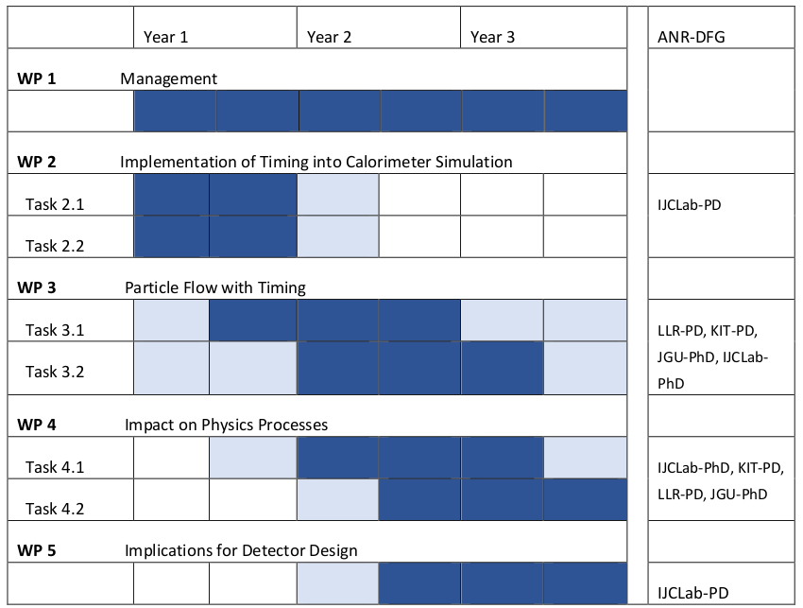
CALO5D – Timeplan
Three years project
Official Start March 1st 2024
Real start rather 1st of September
First half year mainly spent with recruiting
Postdocs and PhD Student
  Welcome Xin, Melike, Uli, Bohdan
  Still not quite finished
    i.e. LLR Postdoc arrives “these days”
    IJCLab Postdoc in Spring 2025
Webpage exists
Digitisation has at least started
<number>
Notes:
<number>

Slide 10
First CALO5D F2F Meeting
First get together
  Purpose is to finally ramp up the project
  Get concrete working plan for next months
  See presentations at this meeting
Taking stock of already existing tools
  Webpage hosted by KIT (https://www.ipe.kit.edu/english/projects_3594.php)
    Thanks Melike
    Question, can one get “calo5d” in url?
    See also next page
    Should be “vitrine” of project
    Organisation, Results …
  Gitlab repository (https://gitlab.in2p3.fr/calo5d) hosted by in2p3
    See next-to-next page
    Thanks Vincent
    Should be central place for
  documentation
    (Software tools) developed by project
      How to link best to general software packages?
  Indico space (https://indico.desy.de/category/1107/)
  Computing tools
    NAF at DESY (e.g. access to ILD simulation)
    Openstack of IJCLab Virtual Data and UPSaclay Mesocentre Ruche
    Other tools ?
    Should have discussion on Computing Tools
    Role of local and non-local (DESY NAF, CC IN2P3, grid including vo) computing facilities
<number>
Notes:
<number>

Slide 11
CALO5D – Competences and Context
Our competences
  Expertise on Particle Flow
  Deep knowledge on the two types of calorimeters
  Hardware, simulation and data analysis
  Expertise on machine learning
  Expertise on event reconstruction and physics analyses
Context
  We are not the first who apply ML to event reconstruction including timing
  Recap at this meeting
  However, our competences listed above should allow us to make it better, more realistic
  Proximity to hardware experts should allow for “quick” transfer of results to hardware design
<number>
Notes:
<number>

Slide 12
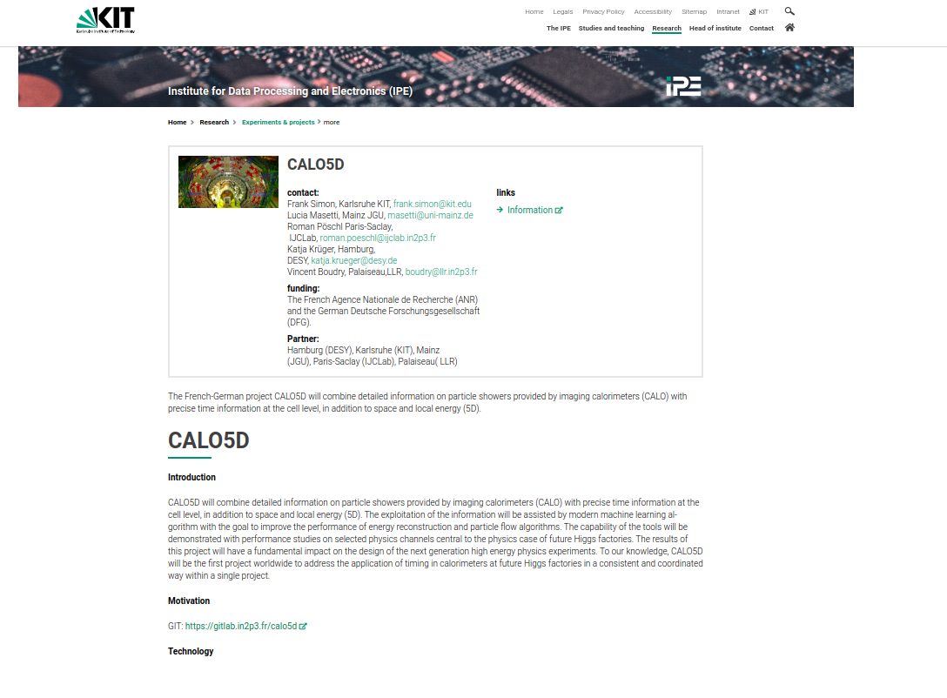
CALO5D Web Page
<number>
Notes:
<number>

Slide 13
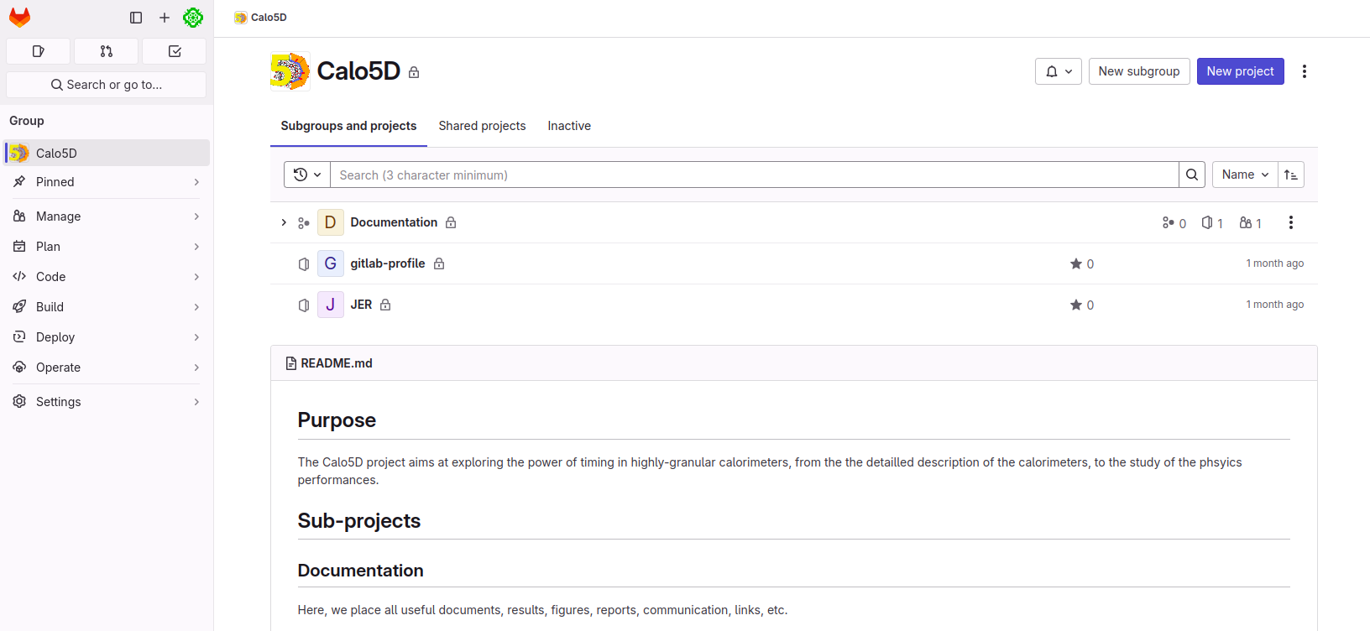
CALO5D - GitLab
<number>
Notes:
<number>

Slide 14
Backup

Slide 15
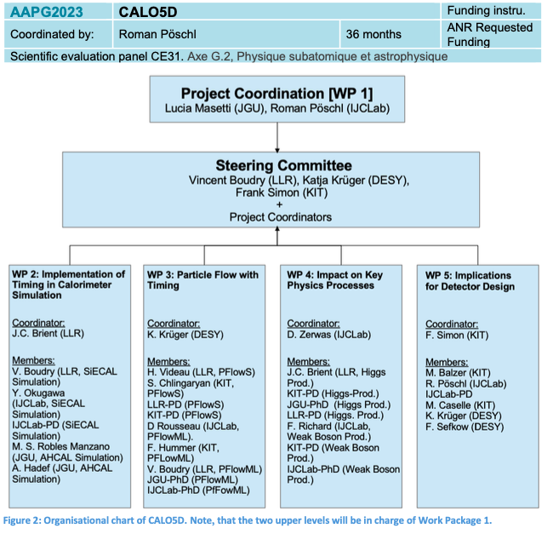
CALO5D
Joined French ANR – German DFG Project (PRCI) on “CALOrimetry in 5 Dimensions
  Mainly postdocs, PhD Students and missions
<number>
Notes:
<number>

