Slide 1
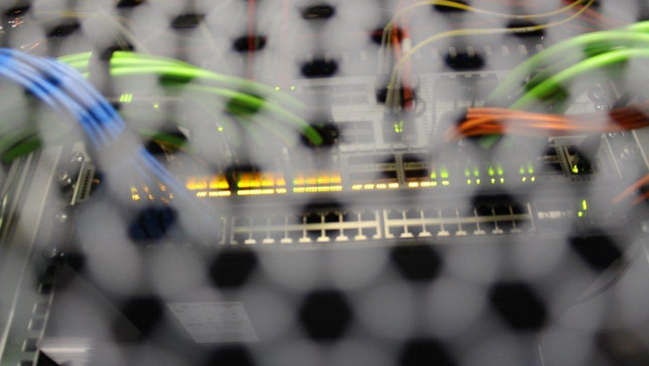
Life Cycle Assessment of IT infrastructure
Martin Möller
Shaping the Digital Future of ErUM Research: Sustainability & Ethics
Aachen, 30 July 2025
Foto: Jens Gröger

Slide 2
Agenda
Profile of the Öko-Institut
1
Kapitelüberschrift
Basic principles of Life Cycle Assessment
2
3
Life Cycle Assessment of the digital supply chain
4
Real-life results
Summary and conclusions
5

Slide 3
Agenda
Profile of the Öko-Institut
1
Kapitelüberschrift
Basic principles of Life Cycle Assessment
2
3
Life Cycle Assessment of the digital supply chain
4
Real-life results
Summary and conclusions
5

Slide 4
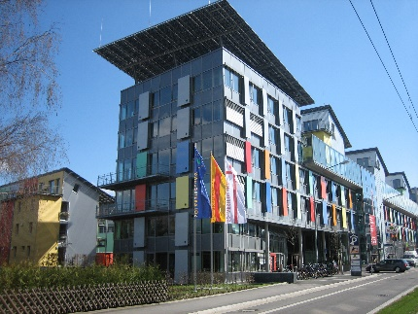
Our Profile
We are one of Europe’s leading research and consultancy institutes for a sustainable future.
  Non-profit association founded in 1977
  Offices in Freiburg, Darmstadt and Berlin
  210 staff members
  500 projects each year
  Clients: European Union, national and state-level ministries, companies, foundations and non-governmental organizations
Energy transition
Just transition
Green mobility
Production / consumption
Resources transition
Environmental law
Digitalisation
Nuclear technology
Land-use transition

Slide 5

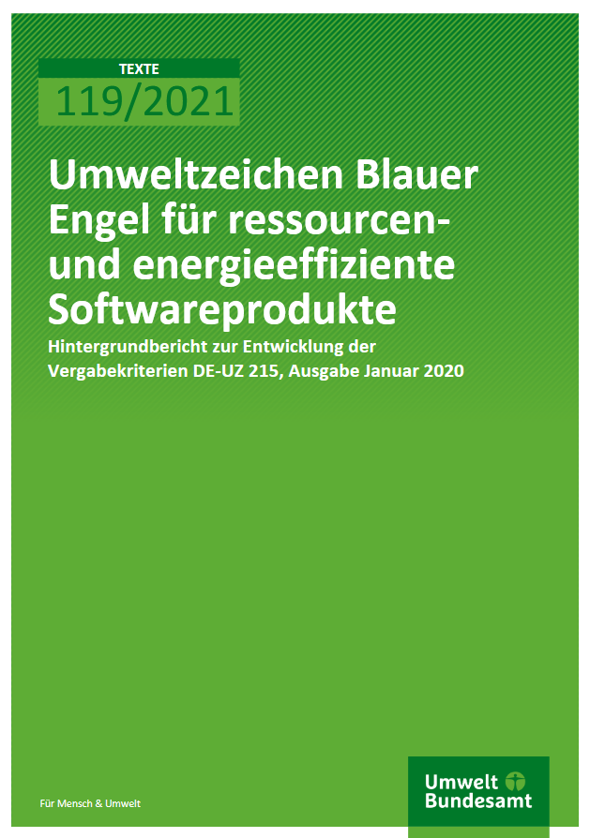



Key references within the context of IT infrastructure / digital services

Slide 6
Agenda
Profile of the Öko-Institut
1
Basic principles of Life Cycle Assessment
2
3
Life Cycle Assessment of the digital supply chain
4
Real-life results
Summary and conclusions
5

Slide 7
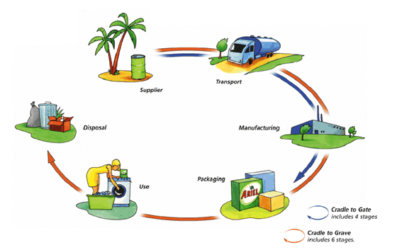
What is Life Cycle Assessment?
  Life Cycle Assessment is a systematic analysis of the environmental impacts of a product or service during their entire life cycle.
input
from
nature
emissions
into
nature

Slide 8
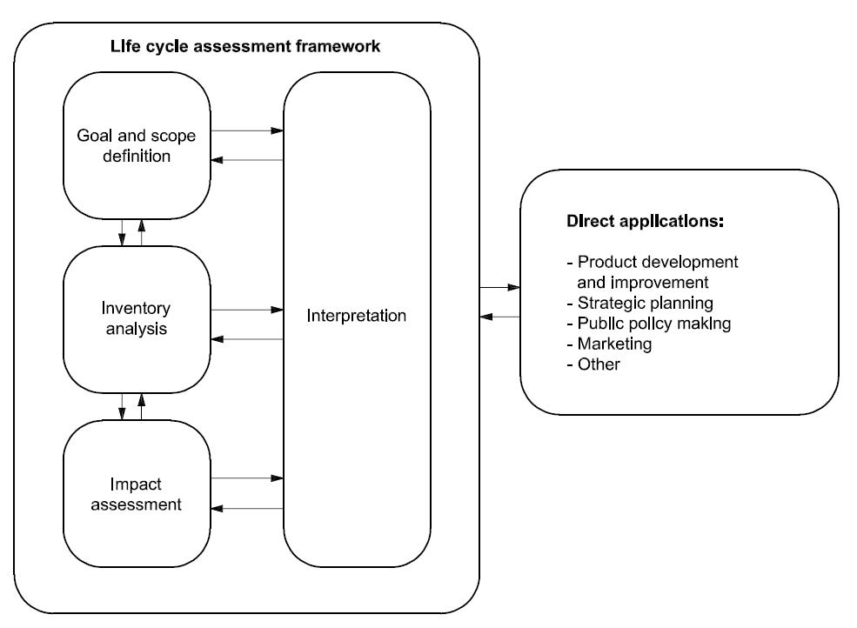
Methodological framework for life cycle assessment:
Stages of a LCA (according to ISO 14040)
Source: ISO 14040

Slide 9
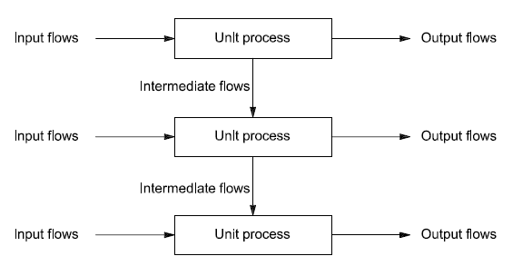
Unit process as the central building block for inventory modelling
?
?
Source: ISO 14040

Slide 10







Overview of major data bases and modelling tools
Data bases:
Modelling tools:

Slide 11
Relevant impact categories and impact indicators
  Global Warming Potential (GWP): measure of greenhouse gases [kg CO₂ equivalents]
  that quantifies the environmental impact potential of climate change
      If the assessment is limited to the GWP as the only impact category, it is a Carbon Footprint according to ISO 14067.
  Abiotic Depletion Potential (ADP): measures the use of mineral and metallic raw materials, weighted according to their availability in relation to antimony [kg Sb equivalents]
  Cumulated Energy Demand (CED): primary energy demand [MJ] that was used to provide a form of energy or for a process
  Water: volume specification that evaluates the water consumption taking into account water availability [m³ world equivalents].
  (…)

Slide 12
Agenda
Profile of the Öko-Institut
1
Kapitelüberschrift
Basic principles of Life Cycle Assessment
2
3
Life Cycle Assessment of the digital supply chain
4
Real-life results
Summary and conclusions
5

Slide 13
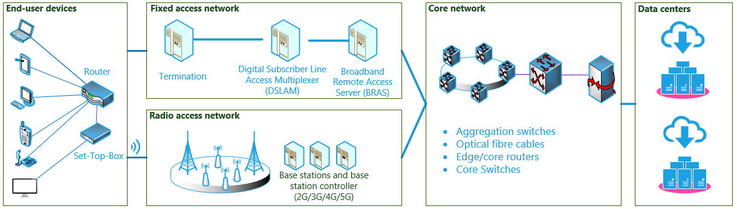
Concept of the „digital supply chain“
Source: Gröger et al. (2024)
  When using digital services, electronic components are employed along the entire digital supply chain
Gröger et al. (2024): https://ecodigit.de/en/home/publications#c103126

Slide 14
Allocation of environmental impacts via utilised digital basic resources (I)
  Digital services utilise the electronic components along the ‘digital supply chain’ only partially.
  The environmental impacts of the hardware must therefore be allocated proportionately to the digital service.
  Allocation: partitioning the input or output flows between the product system under study and one or more other product systems
  Allocation criteria of the life cycle assessment according to ISO 14044
    Physical relationships (e.g. weight, volume)
    Economic value of co-products
  Allocation via ‘digital basic resources’ (DBR) according to the eco:digit methodology paper
    Hardware provides DBR as part of the provided physical digital work (DW = DBR * t)
    Digital services utilise the DBR over a certain period of time and with a certain intensity

Slide 15




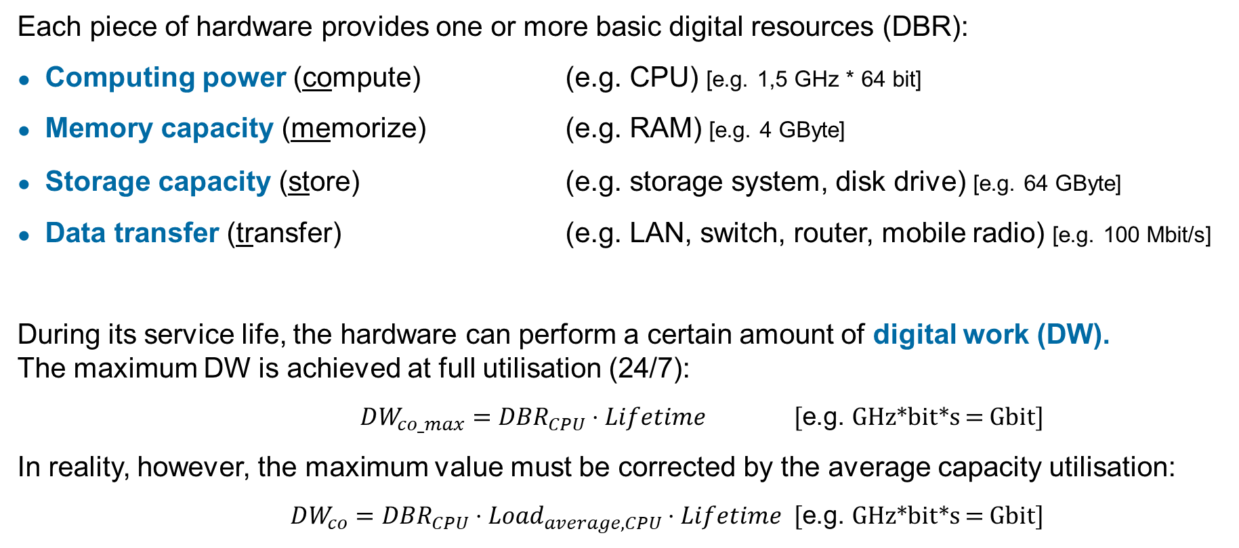
Allocation of environmental impacts via utilised digital basic resources (II)
  Each piece of hardware provides one or more basic digital resources (DBR):
  Computing power (compute) (e.g. CPU) [e.g. 1,5 GHz * 64 bit]
  Memory capacity (memorize) (e.g. RAM) [e.g. 4 GByte]
  Storage capacity (store) (e.g. storage system, disk drive) [e.g. 64 GByte]
  Data transfer (transfer) (e.g. LAN, switch, router, mobile radio) [e.g. 100 Mbit/s]
  During its service life, the hardware can perform a certain amount of digital work (DW).
  The maximum DW is achieved at full utilisation (24/7):
  $DW_{co_max}={DBR}_{CPU}⋅Lifetime$ [e.g. GHz*bit*s = Gbit]
  In reality, however, the maximum value must be corrected by the average capacity utilisation:
  $DW_{co}={DBR}_{CPU}⋅Load_{average,CPU}⋅Lifetime$ [e.g. GHz*bit*s = Gbit]

Slide 16

Differentiation of environmental impacts in ‘embedded’ and ‘use phase’
Manufacturing effort: one-off
  Embedded emissions: environmental impacts associated with the manufacture of hardware
      Have to be determined once by LCA
      and then allocated over the service life
  Use phase emissions: environmental impacts caused by the use of hardware, in particular due to its associated power consumption
      One-time measurement of power consumption, correlation with the digital work performed,
      thereafter only logging of CPU, RAM, HDD and
      network during software execution
Power consumption during use: continuous

Slide 17
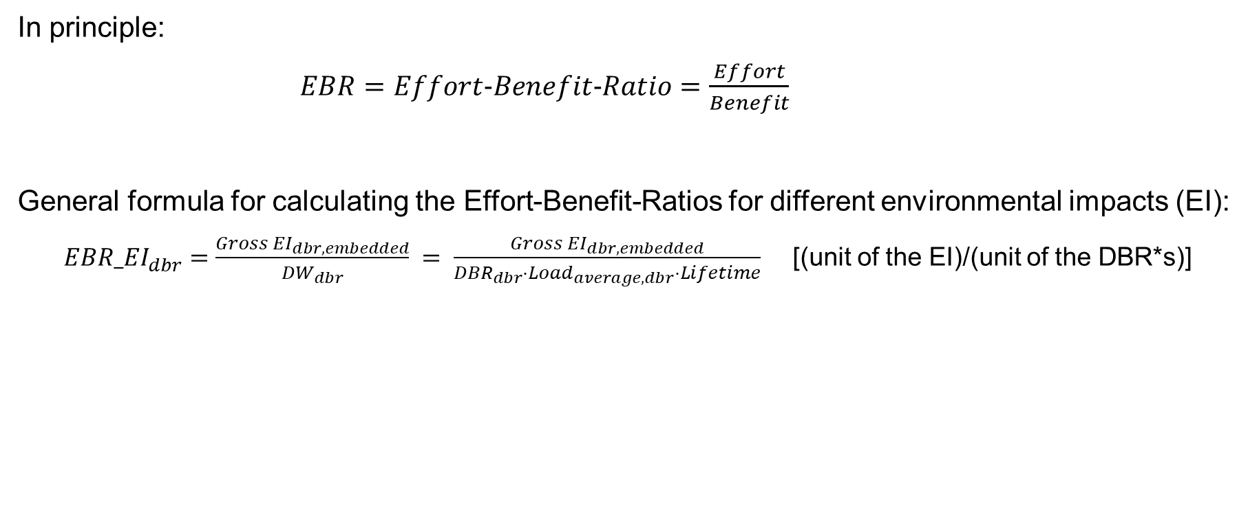
Calculation of the environmental impact per digital work as ‘Effort-Benefit-Ratio’ (EBR)
  In principle:
  $EBR=Effort−Benefit−Ratio=\frac{Effort}{Benefit}$
  General formula for calculating the Effort-Benefit-Ratios for different environmental impacts (EI):
  $EBR{_EI}_{dbr}=\frac{Gross {EI}_{dbr,embedded}}{{DW}_{dbr}} = \frac{Gross {EI}_{dbr,embedded}}{{DBR}_{dbr}⋅Load_{average,dbr}⋅Lifetime}$ [(unit of the EI)/(unit of the DBR*s)]
Environmental impact indicator | compute | memorize | store | transfer
CED | EBR_CED_{co} | EBR_CED_{me} | EBR_CED_{st} | EBR_CED_{tr}
GWP | EBR_GWP_{co} | EBR_GWP_{me} | EBR_GWP_{st} | EBR_GWP_{tr}
ADP | EBR_ADP_{co} | EBR_ADP_{me} | EBR_ADP_{st} | EBR_ADP_{tr}
Water | EBR_Water_{co} | EBR_Water_{me} | EBR_Water_{st} | EBR_Water_{tr}

Slide 18
Agenda
Profile of the Öko-Institut
1
Kapitelüberschrift
Basic principles of Life Cycle Assessment
2
3
Life Cycle Assessment of the digital supply chain
4
Real-life results
Summary and conclusions
5

Slide 19
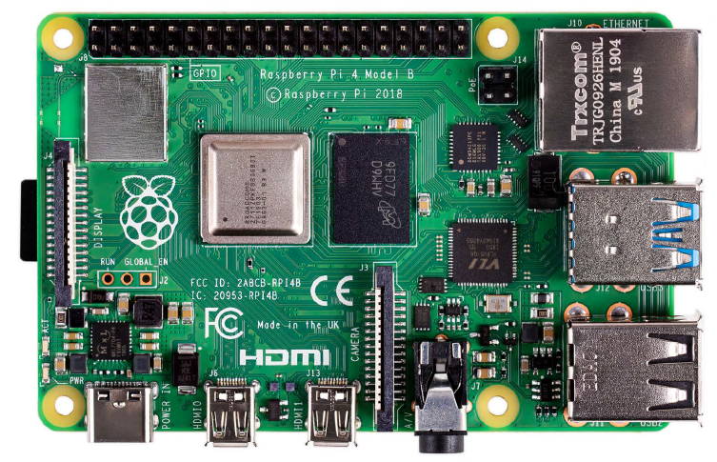
Example: Embedded emissions of a Raspberry Pi 4
Model B, 4 GByte RAM

Slide 20
Example: Use phase energy demand of a Raspberry Pi 4
Power consumption | P_idle | P_max | P_average
P_CPU | 1.0 W | 5.0 W | 1.8 W
P_RAM | 1.0 W | 1.0 W | 1.0 W
P_SSD | 0.9 W | 0.9 W | 0.9 W
P_NW | 0.1 W | 0.1 W | 0.1 W
P_total | 3.0 W | 7.0 W | 3.8 W
  Similar procedure as for the environmental impact of manufacturing the hardware
  Difference: The electrical power consumption is measured for the different DBR and an EBR is calculated using the power consumption as effort.
  Advantage: The power consumption can be converted into the various environmental impacts depending on the current electricity mix.
Example Raspberry Pi 4:
EBR_P_co 0.094 W/(GHz*bit)
EBR_P_me 0.833 W/(Gigabyte)
EBR_P_st 0.028 W/(Gigabyte)
EBR_P_tr 0.050 W/(Megabit/s)
Energy use during software execution (24h)
E_co | 3.60E-02 | kWh
E_me | 4.00E-03 | kWh
E_st | 1.08E-02 | kWh
E_tr | 1.20E-03 | kWh
E_total | 5.20E-02 | kWh
Notes:
.

Slide 21
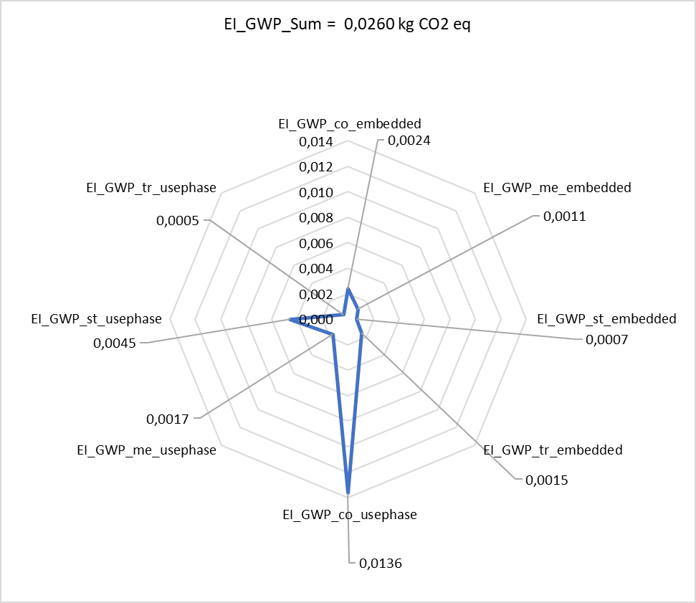
Example: GWP results for software application
EI_GWP_co_embedded | 0,0024 | kg CO2 eq
EI_GWP_me_embedded | 0,0011 | kg CO2 eq
EI_GWP_st_embedded | 0,0007 | kg CO2 eq
EI_GWP_tr_embedded | 0,0015 | kg CO2 eq
EI_GWP_embedded | 0,0056 | kg CO2 eq
EI_GWP_co_usephase | 0,0136 | kg CO2 eq
EI_GWP_me_usephase | 0,0017 | kg CO2 eq
EI_GWP_st_usephase | 0,0045 | kg CO2 eq
EI_GWP_tr_usephase | 0,0005 | kg CO2 eq
EI_GWP_usephase | 0,0204 | kg CO2 eq
EI_GWP_Sum | 0,0260 | kg CO2 eq

Slide 22
Figures on the environmental impact of AI tools
  ChatGPT-3 generated 552 tons of CO₂ equivalents during training
  (Patterson et al. 2021)
  One Google search causes 1.5g CO₂ equivalents (Gröger 2020)
  One ChatGPT query causes 4.3g CO₂ equivalents (Hollingworth 2025)
  AI has the potential to (almost) triple the carbon footprint!
  By 2040, digital devices and services could account for half of household electricity demand (IEA 2017)
Patterson et al. (2021): https://doi.org/10.48550/arXiv.2104.10350
Gröger (2020): https://www.oeko.de/en/blog/the-carbon-footprint-of-our-digital-lifestyles/
Hollingworth (2025): https://www.cyberdaily.au/security/11942-chatgpt-produces-an-estimated-4-32-grams-of-co-for-every-query
IEA (2017): https://iea.blob.core.windows.net/assets/b1e6600c-4e40-4d9c-809d-1d1724c763d5/DigitalizationandEnergy3.pdf

Slide 23
Agenda
Profile of the Öko-Institut
1
Kapitelüberschrift
Basic principles of Life Cycle Assessment
2
3
Life Cycle Assessment of the digital supply chain
4
Real-life example
Summary and conclusions
5

Slide 24
Some take-home messages
  The general methodological approach for determining the environmental footprint is described in detail in international standards (especially ISO 14040/44 and ISO 14067).
  The environmental footprint of IT infrastructure has to take into account the whole
  digital supply chain and needs to be differentiated between the embedded and use phase emissions.
  In order to calculate the environmental footprint, both embedded and use phase emissions have to be allocated via defining digital basic resources.
  For data acquisition and processing, both commercial as well as free databases and modelling tools are available.
  When designing and using digital services, we have to consider efficiency, consistency, and sufficiency.

Slide 25
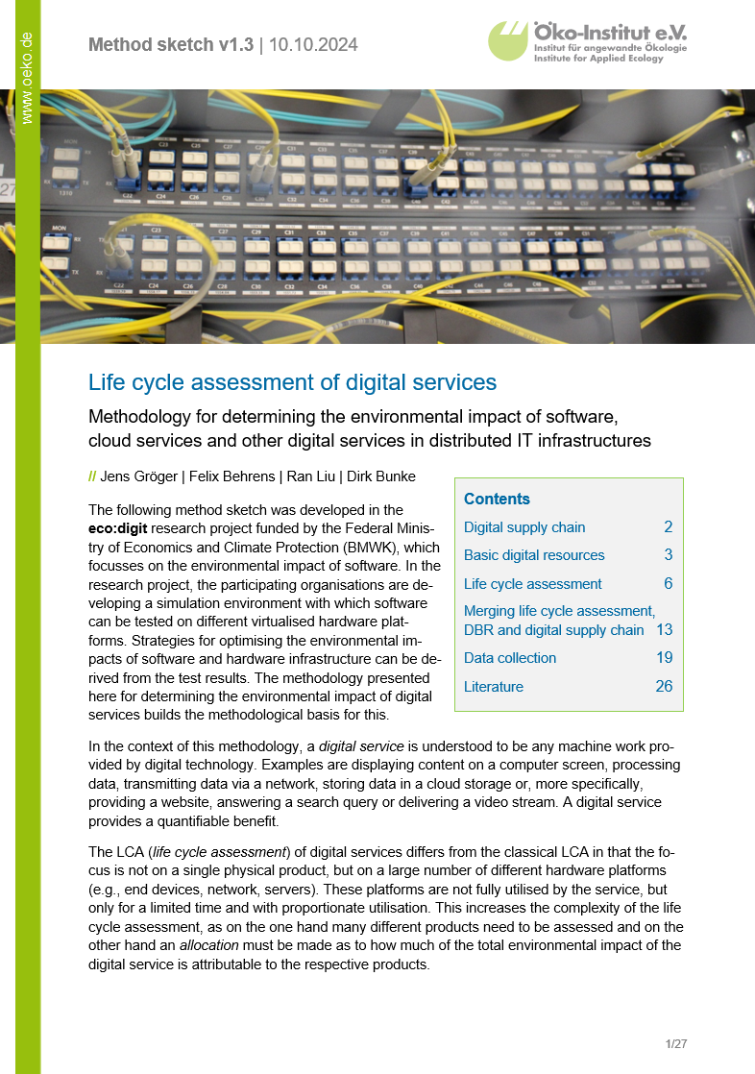
Further information
  eco:digit method outline: Life cycle assessment of digital services https://ecodigit.de/en/home/publications#c103126
  eco:digit spreadsheet calculation: Exemplary application of formulas
  https://ecodigit.de/en/home/publications#c103126
  Umweltzeichen Blauer Engel für ressourcen- und energieeffiziente
  Softwareprodukte
  https://www.umweltbundesamt.de/publikationen/umweltzeichen-blauer-engel-
  fuer-ressourcen
  Öko-Institut Podcast - Episode 16: Nachhaltigkeit durch Digitalisierung?
  https://www.oeko.de/podcast/nachhaltigkeit-durch-digitalisierung/
  Öko-Institut Podcast - Episode 29: Wie nachhaltig ist Künstliche Intelligenz?
  https://www.oeko.de/podcast/wie-nachhaltig-ist-kuenstliche-intelligenz/
  Digital GreenTech Podcast - Episode 6: Nachhaltigkeit von Digitalisierung messen?
  https://digitalgreentech.de/aktuelles/detail/podcast-episode-6

Slide 26



Thank you very much for your attention!
Do you have any questions?
Notes:
.

Slide 27
Scoping is key:
Distinction between three effect levels
Direct effects
Direct resource and energy requirements of the digitalization technologies, including upstream processes such as hardware manufacturing and energy supply
Indirect effects
Impact of digitalization technologies on the sustainability performance of other (existing) product/service systems
Systemic effects
Impact of digitalization technologies on production, work and consumption patterns
as well as on values, mission statements, etc.
Source: own illustration based on Kampffmeyer & Gensch (2019)
Kampffmeyer & Gensch (2019): https://www.oeko.de/fileadmin/oekodoc/WP-Konsum-Digitalisierung.pdf

Slide 28
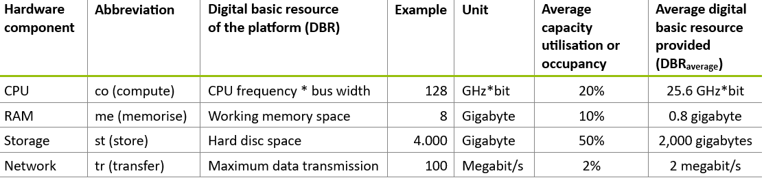
Exemplary digital basic resources of a platform
Source: Gröger et al. (2024)
For the sake of simplicity, CPU frequency * bus width was selected as the performance indicator for the digital basic resource compute in the table. Other performance indicators such as floating operations per second (FLOPS) or the use of linear CPU benchmarks, which can be collected on all platforms, would also be feasible.
Gröger et al. (2024): https://ecodigit.de/en/home/publications#c103126

Slide 29
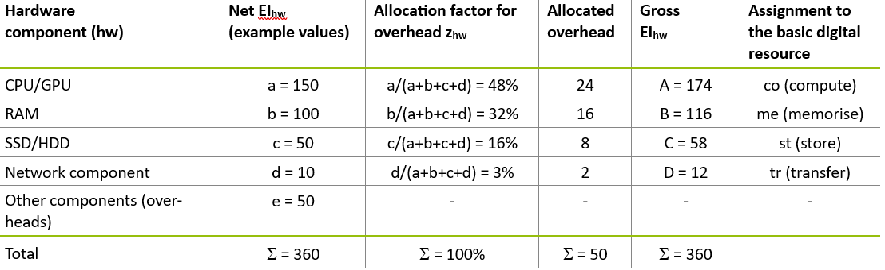
Allocation of overhead components to the different digital basic resources
Source: Gröger et al. (2024)
Gröger et al. (2024): https://ecodigit.de/en/home/publications#c103126

Slide 30
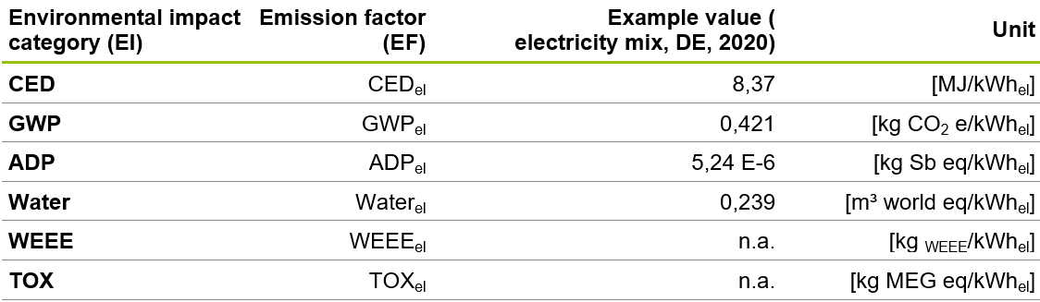
Emission factors for electrical energy
Source: Gröger et al. (2024)
Gröger et al. (2024): https://ecodigit.de/en/home/publications#c103126

Slide 31
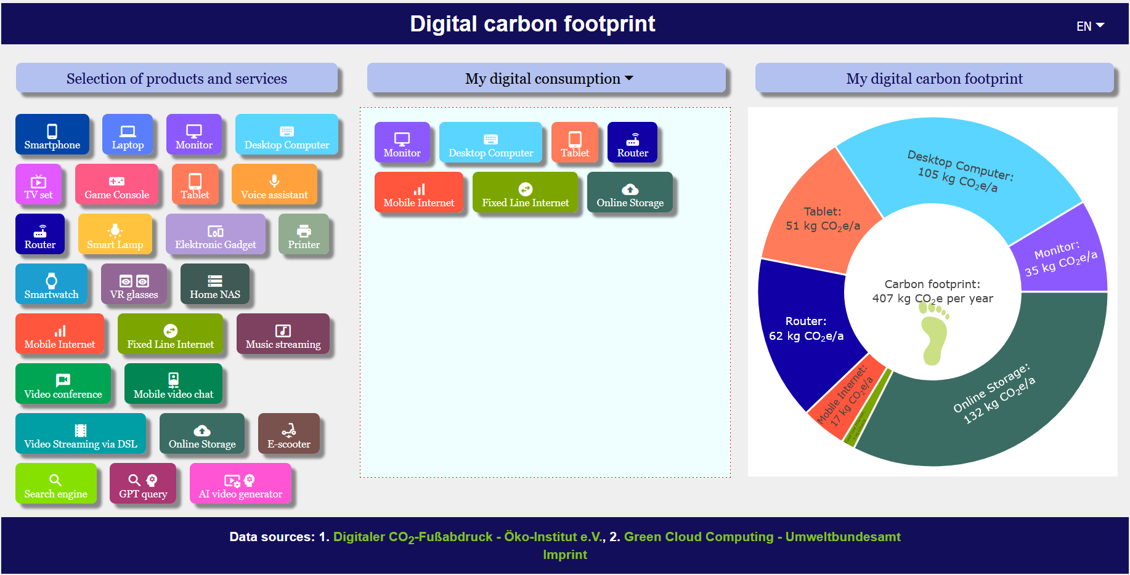
Web-based tool for calculating the CO₂ footprint of the manufacture and use of digital devices / services
  https://www.digitalcarbonfootprint.eu/

