Slide 1
Dechirper longitudinal phase space (LPS) measurements for beginners
Sergey Tomin
DESY
Operator Training, 11.12.2024

Slide 2
Disclaimer
LPS measurements with the post-SASE2 dechirper are easy to perform and relatively safe for the machine.
Always save the machine file before conducting measurements or making any changes to the machine. This is a good practice!
Minimize beam usage to reduce radiation load.
Note: Passive streaker = dechirper = corrugated structure = wakefield structure = chirper.

Slide 3
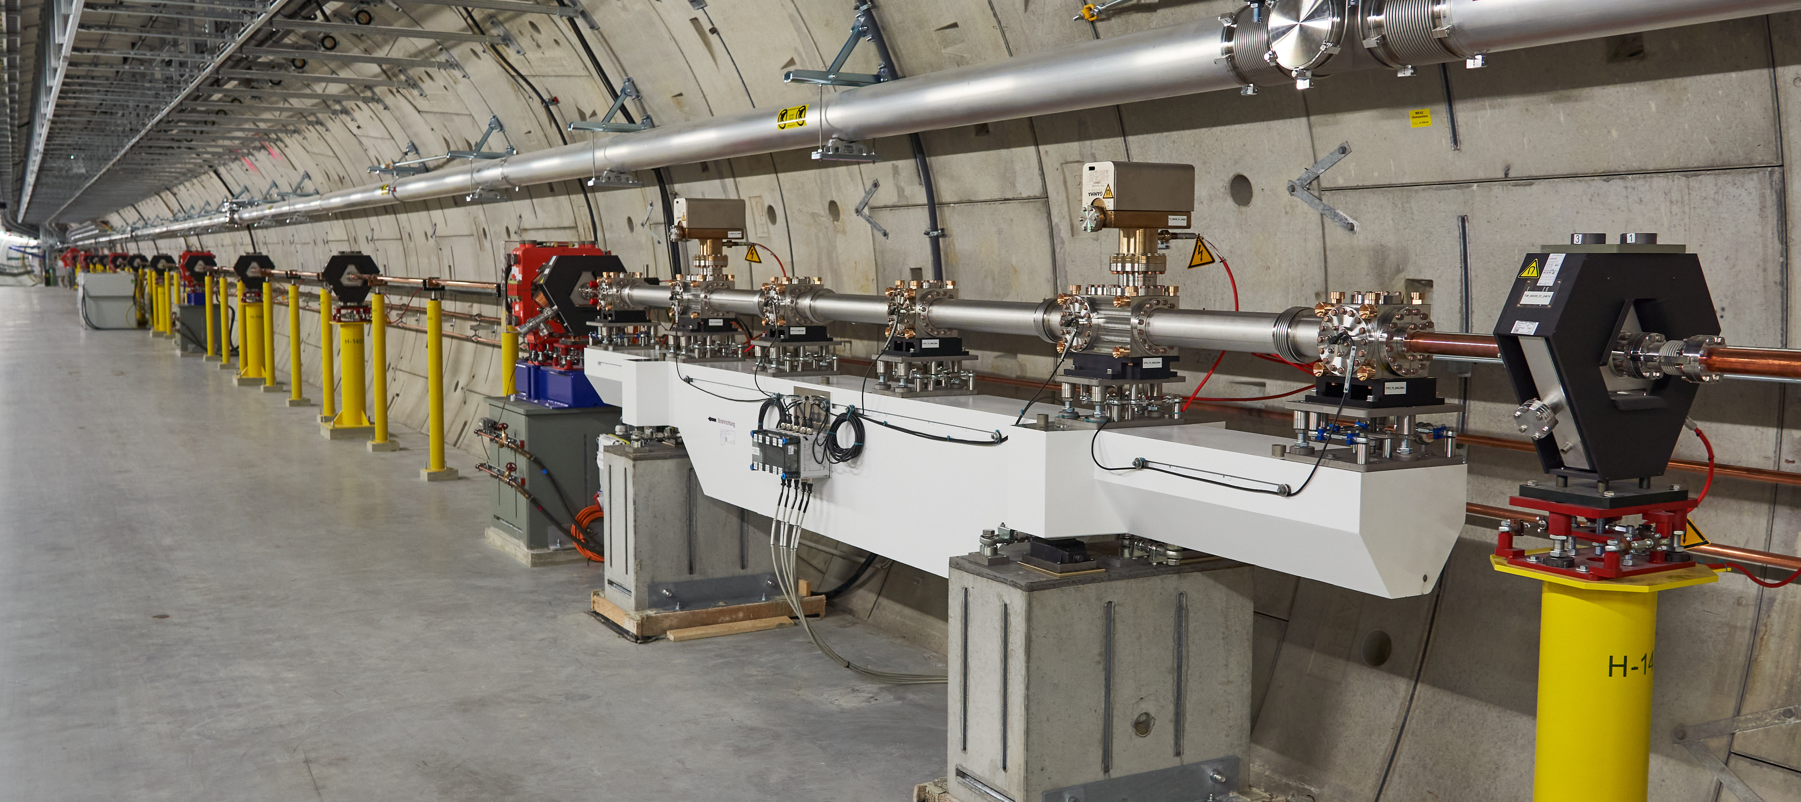
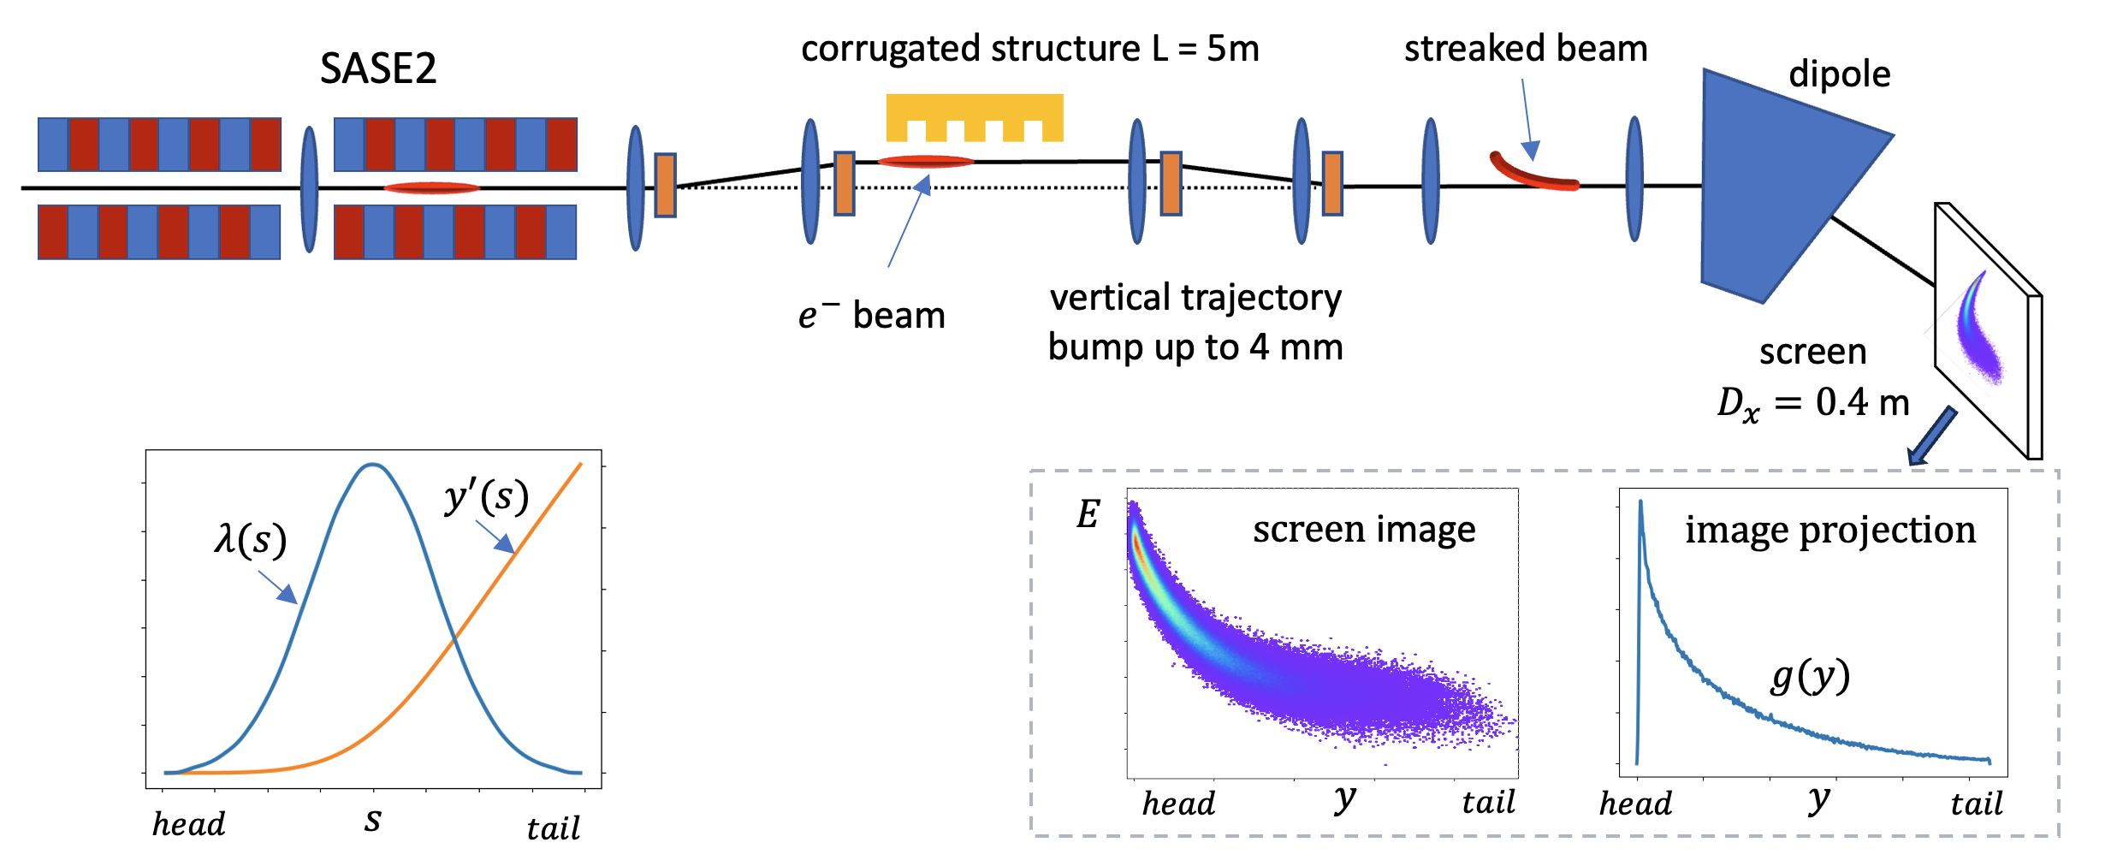
Short introduction into passive streaker LPS measurement

Slide 4
What systems/devices we change or can potentially change during usage of the dechirper tool. Or how to restore the machine manually
Correctors in the T3 section (after SA2) and the last air coils in SA2: These correctors are used to create a bump and adjust the beam to get a better spot on the screen.
Quadrupoles in the T3 section: Beam optics are adjusted here.
Screen OTRC.2560.T3 Can be still in
Corrector CFX.2154.T1 in front of SA2. We suppress SASE with this corrector
Orbit FBs SA2 and T5D can be switched off
Number of bunches in SA2 branch. Likely to be set to 0.
Bunch pattern – restore 1 Hz operation
Only if measuring dispersion! (not part of the standard procedure)
CL energy FB
A24 or A25 table/scalar mode and voltage

Slide 5
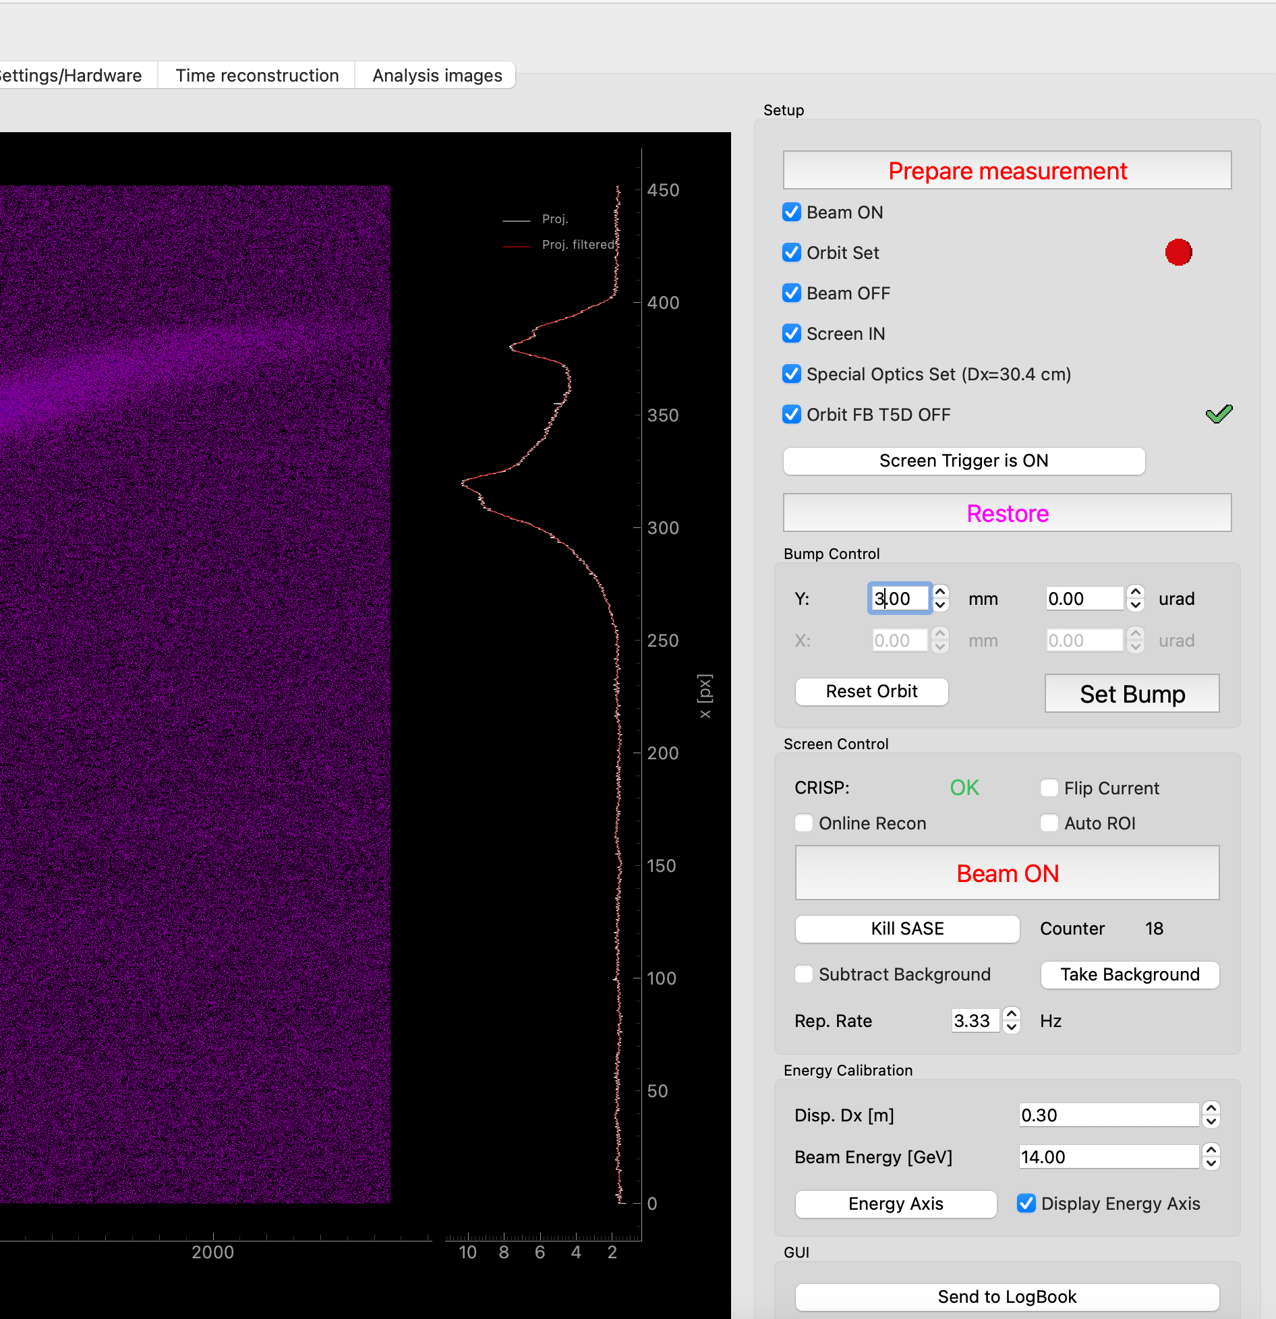
How to start measurements
1
Update CRISP
Save machine file
Set 1 bunch in SA2
Open dechirper tool
Click “Prepare measurements”
The tool adjusts the orbit, inserts and powers the screen, and applies special optics.
You might need to acknowledge that the orbit is not optimal and the screen is not yet powered (this may require a bit more time).
Using the bunch pattern builder, set 3 Hz in the SA2 branch.
Click “Beam ON” button. You should see unstreak beam
Adjust bump amplitude. 2 mm is good starting point. Around 3 mm is our usual bump amplitude
Done!
2
3
4

Slide 6
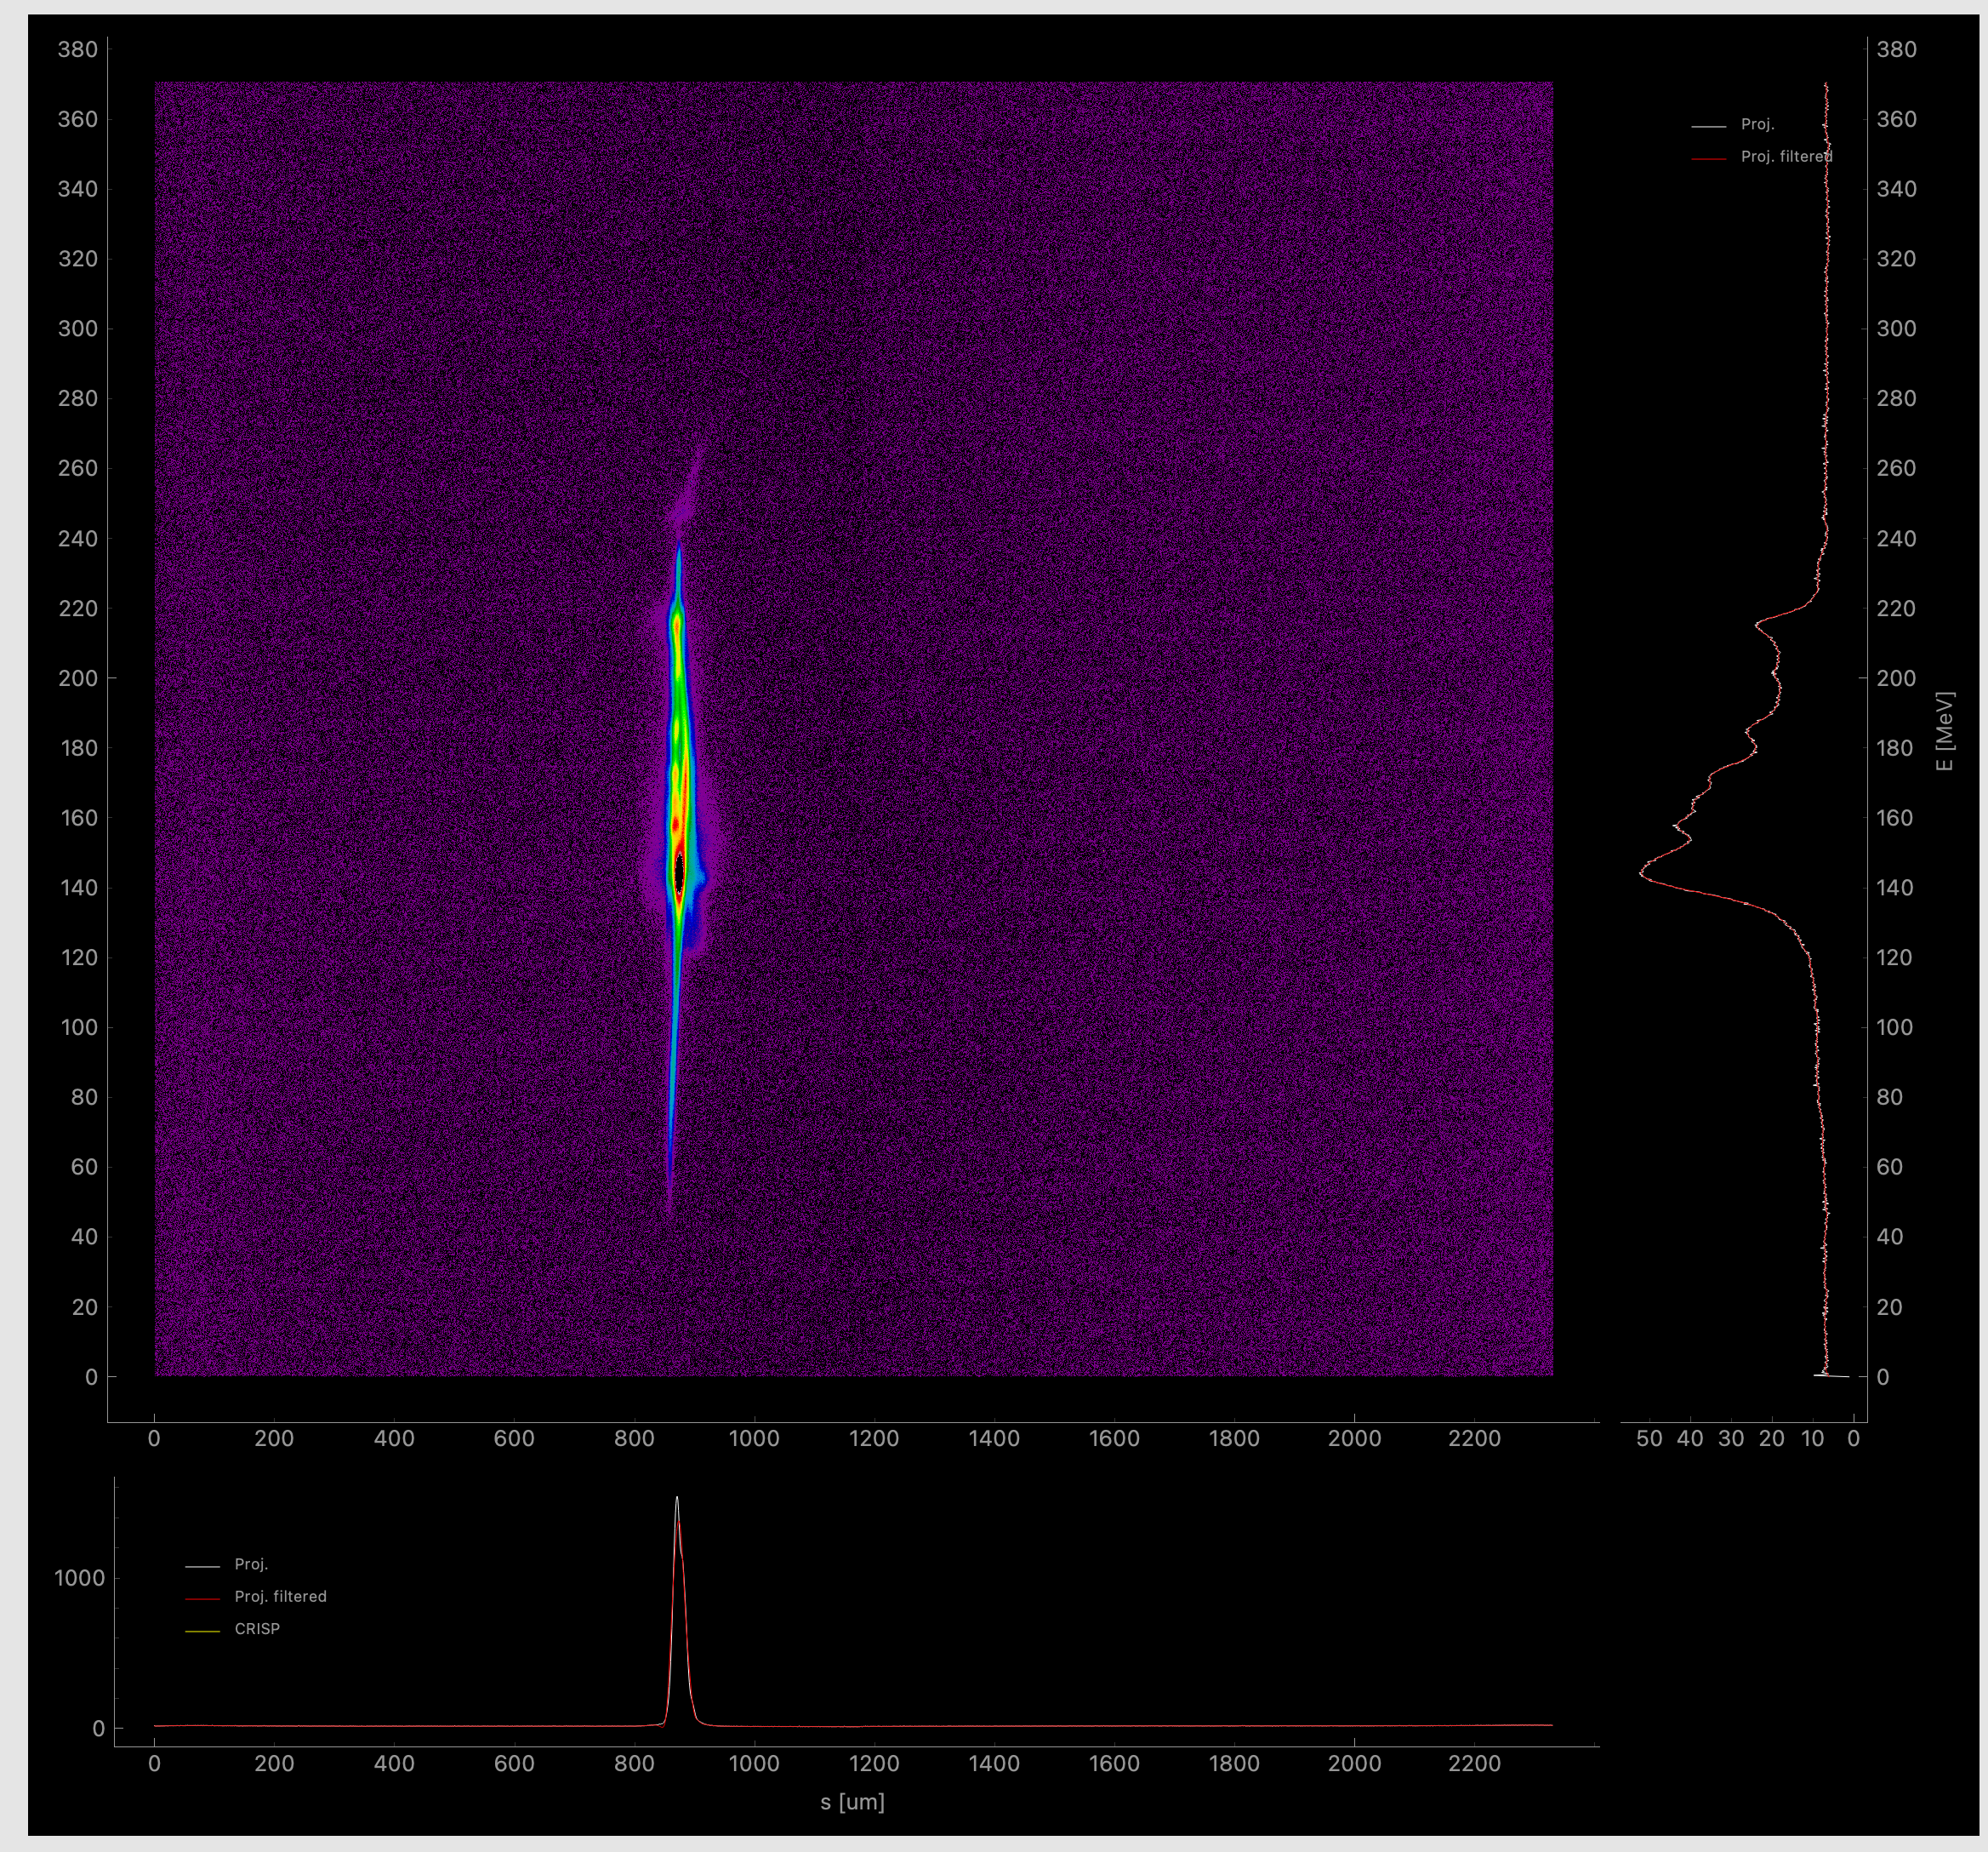
How to start measurements
Unstreaked beam – no bump
1
Update CRISP
Save machine file
Set 1 bunch in SA2
Open dechirper tool
Click “Prepare measurements”
The tool adjusts the orbit, inserts and powers the screen, and applies special optics.
You might need to acknowledge that the orbit is not optimal and the screen is not yet powered (this may require a bit more time).
Using the bunch pattern builder, set 3 Hz in the SA2 branch.
Click “Beam ON” button. You should see unstreak beam
Adjust bump amplitude. 2 mm is good starting point. Around 3 mm is our usual bump amplitude
Done!
2
3
4

Slide 7
Need more details?

Slide 8
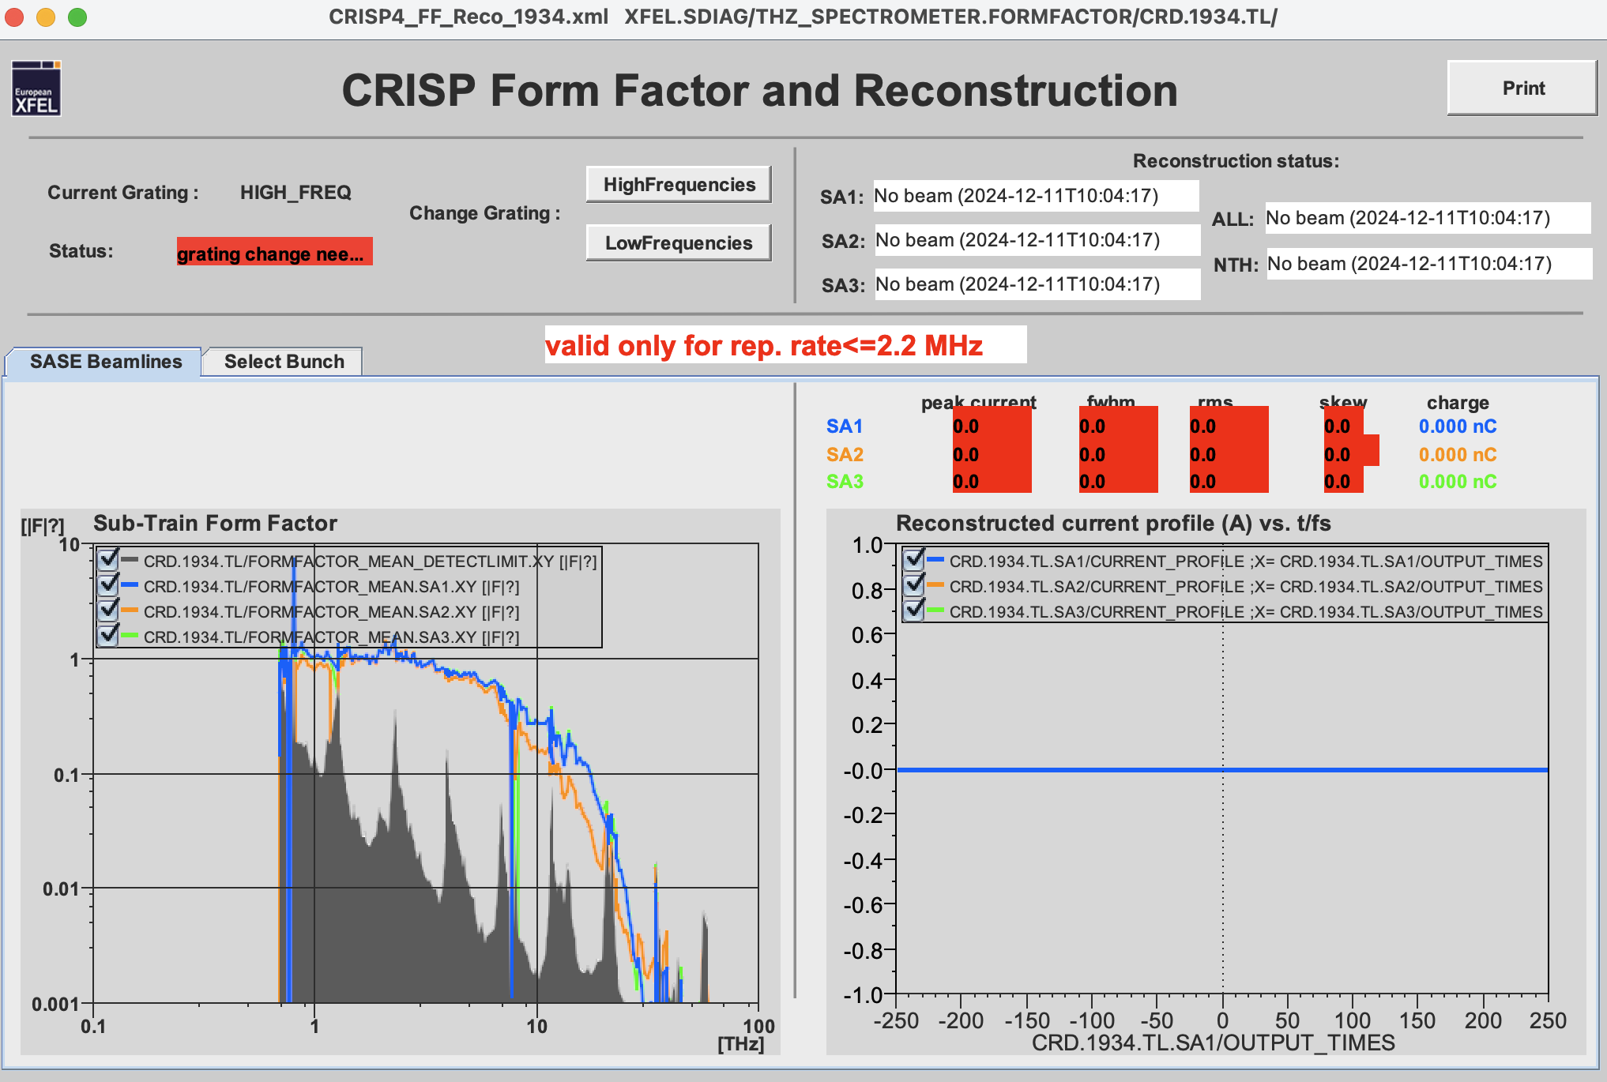
How to update CRISP
4
1
3
2
Press Low Frequencies and wait
Current Grating: LOW_FREQ
Press High Frequencies and wait
Current Grating: HIGH_FREQ
Whole procedure will take about couple of minutes

Slide 9
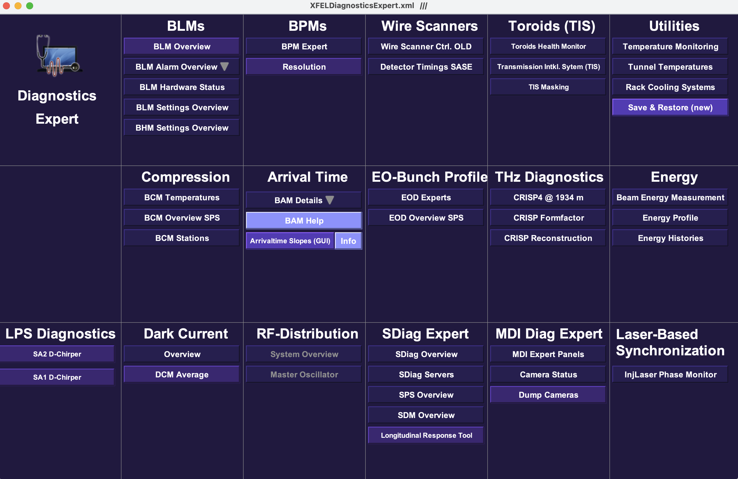
How to open Dechirper tool
1
2
3

Slide 10
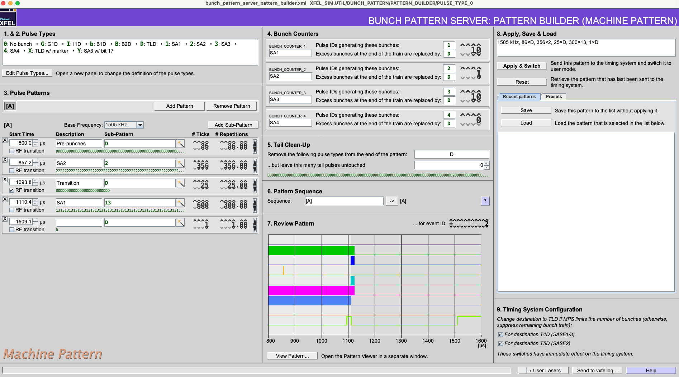
How to make 3 Hz
Set 1 bunch in SA2 brunch
Open bunch pattern builder
Press Add Pattern

Slide 11
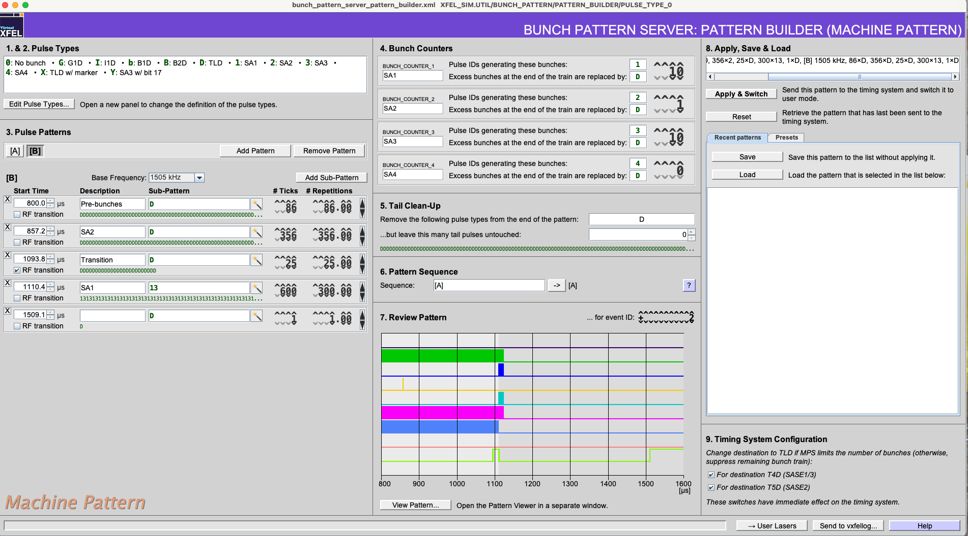
How to make 3 Hz
Set 1 bunch in SA2 brunch
Open bunch pattern builder
Add pattern
In B Pattern set D instead of 2

Slide 12
How to make 3 Hz
Set 1 bunch in SA2 brunch
Open bunch pattern builder
Add pattern
In B Pattern set D instead of 2
Set new Pattern Sequence [A] 2 [B]
Apply & Switch

Slide 13
Passive streaker tool improvements
Video from BKR
Online reconstruction. Video from BKR

