Slide 1
WELCOME
ELBEX kickoff meeting
Ties Behnke, Louis Helary, Ruth Jacobs

Slide 2
The meeting: some organizational details
Today:
Presentation of the project, discussion of the planned work and role of partners
Interaction with our project office
Discussion of the more formal aspects of the project
Today:
Status of the beamline design
Scientific opportunities with ELBEX
High density QED
Plasma acceleration
Detector physics
Dinner
Common dinner starting at 19:00 hours downtown in the Hamburg Harbour City

Slide 3
The meeting: some organizational details
Today:
Presentation of the project, discussion of the planned work and role of partners
Interaction with our project office
Discussion of the more formal aspects of the project
Today:
Status of the beamline design
Scientific opportunities with ELBEX
High density QED
Plasma acceleration
Detector physics
Seminar Room 1
FLASH Seminar Room
Dinner
Common dinner starting at 19:00 hours downtown in the Hamburg Harbour City

Slide 4
Dinner Location
Strickers Kehr Wieder Spitze, Am Sandtorkai 77, 22457 Hamburg
How to get there:
Bus Number 1 (Bhf Altona) from DESY to S Bahn Station Othmarschen
Then S1 (Poppenbuettel) to Landungsbruecken, U3 (Wandsbek) to Baumwall, Walk for 5 min

Slide 6
ELBEX: An Introduction

Slide 7
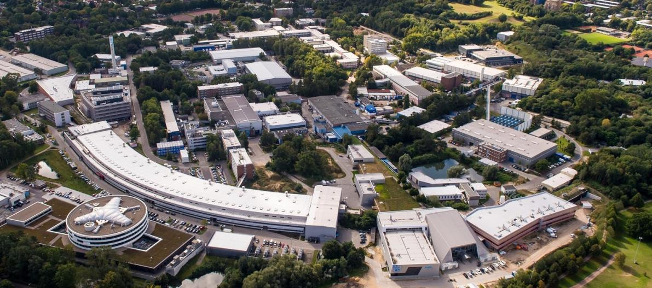
DESY
We are here
DESY operates and develops the accelerator

Slide 8
DESY in numbers

Slide 9
ELBEX: The Project
Project proposed to the EU in 2022
Project approved by the EU in January 2024
Rescoping negotiations between partners and EU finished in summer 2024
Contract formally started January 1, 2025

Slide 10
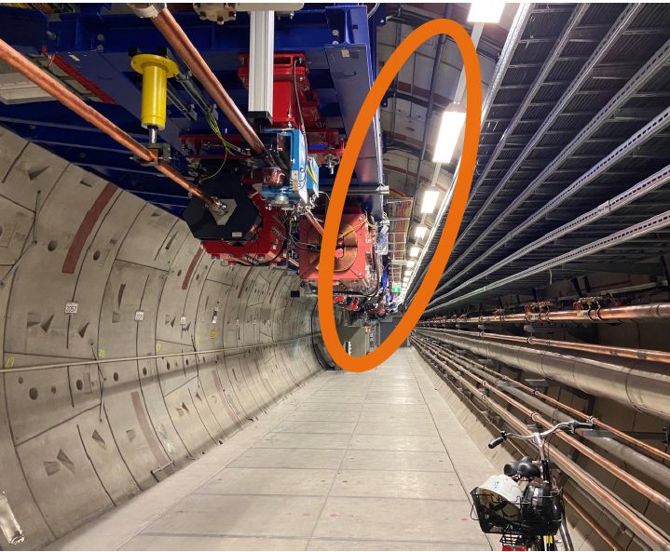
ELBEX: An Electron Beamline at the EU XFEL
Partners:
DESY (lead)
EU-XFEL
INFN: beam-dumps
CSIC: instrumentation
Manchester: beam parameters
Total project size: 5.4 Mio EUR
Of which funded by the EU: 4.3 Mio EUR
Installation of the beamline will depend on the granting of an extended access time in 2028+ by the EU-XFEL, for which the EU-XFEL schedule will need to be changed

Slide 11
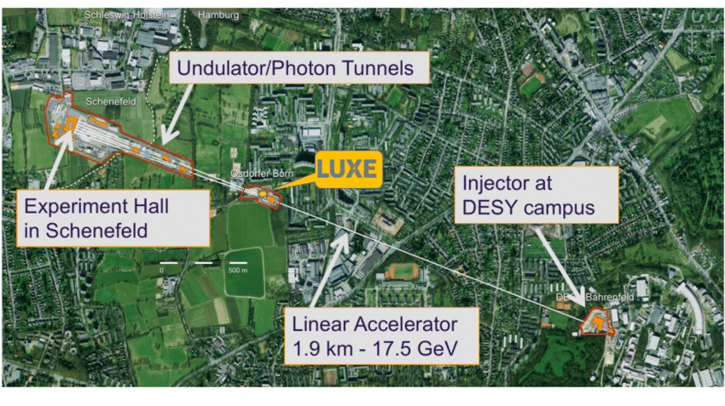
ELBEX @ EuXFEL
ELBEX
Kickoff meeting

Slide 12
ELBEX official start on Jan 1, 2025

Slide 13
ELBEX Formation: Rescoping
Original Scope of ELBEX
Design, Build and Install an extracted beamline at the EU-XFEL
Solution: Re-scoping of ELBEX
Problem: the Installation needs an extended shutdown of EU-XFEL
Due to the late approval, planning to include ELBEX in the planned shutdown 2025 shutdown could not be integrated into the schedule any more.
Key components cannot be delivered any more on time
Currently there are no approved plans (yet) to schedule another longer shutdown
ELBEX as a projects does not promise any more the installation of the beamline within the scope of the project.
ELBEX will design, prepare and test as much as possible the beamline, and negotiate with the EuXFEL an installation plan
ELBEX has the ambition to install the beamline around 2028, but there are no commitments to this date

Slide 14
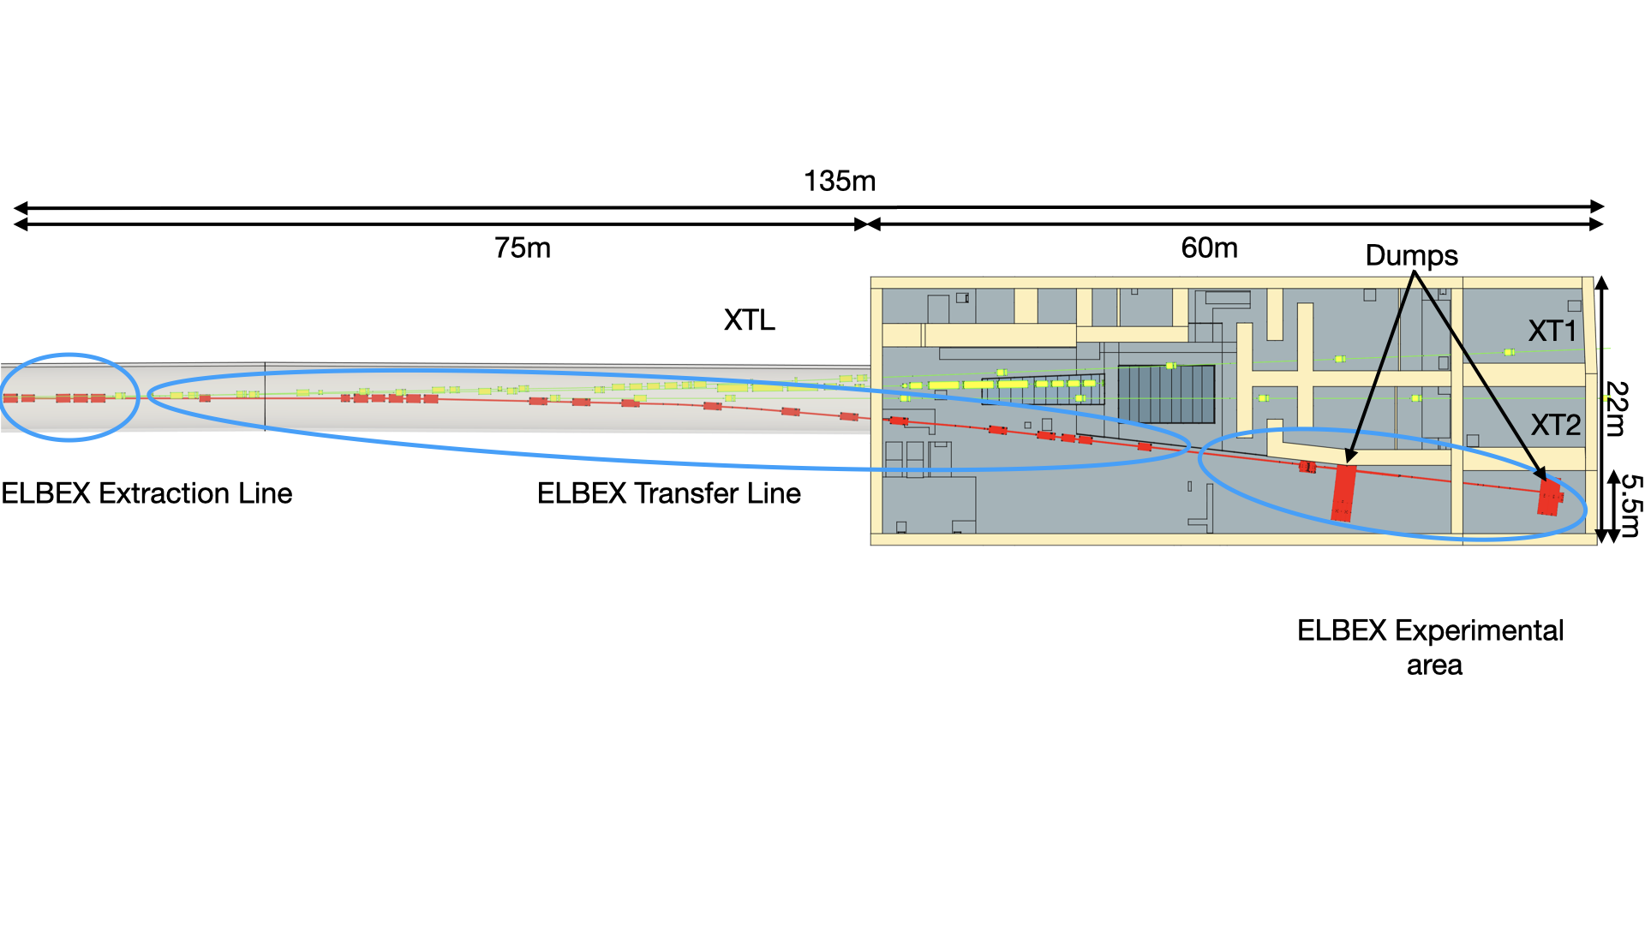
Why ELBEX
ELBEX, once installed, will deliver up to 17.5 GeV extracted electron beam
Very high quality beam due to the very high quality of the XFEL beam
Beam will be delivered into an experimental area
Operation of ELBEX will not impact the operation of EuXFEL for its main users

Slide 15
Parameters of the ELBEX beam
ELBEX Beam

Slide 16
ELBEX: International Competition
Unique potential through high energy extracted electron beam
ELBEX offers the opportunity to develop a European facility with scientific opportunities in many fields and around twice the energy of the facet beam
Comparable only to Facet-II at SLAC

Slide 17
The ELBEX concept
Position ELBEX as an infrastructure with access given to user experiments
Unique beam parameters are interesting to a broad range of users
Ensure highest scientific standards by peer review of user proposals
Challenge
Complex access restrict turn-over of users
Complex infrastructure require tight integration of users into the operation and development of the facility
Access scheme will be more typical to HEP experiment than usual photon science experiment
Opportunity
Exciting science opportunities
Open EuXFEL for a new user community

Slide 18
ELBEX scientific target community
High density QED:
LUXE experiment: study QED at the Schwinger limit
Fundamental science
Relevant to future accelerators, future colliders (beam beam interaction)
Astrophysically interesting regime
Searches of new physics
Beam-dump like experiment
Connection to the on-site DESY Axion program
Accelerator physics
Opportunities to use the exracted beam for studies of novel acceleration methods
“boosting” of the electron beam
Detector physics
Radiation studies (em radiation) of components
High-energy single particle studies of detector Components

Slide 19
The Goals of ELBEX
Design of the ELBEX beam
Finalise the design of the beamline (see also talk by Daniel tomorrow)
Develop a complete planning of the beamline and the installation procedures and schedule
Procure the beamline elements
Prepare the tendering of the key components
Procure the beamline components in-house, with partners, and from industry
Test and commission as much as possible beam-line elements and systems
Develop, together with Eu-XFEL, an installation scenario and plan and work towards approval of this
Work out further the science case of ELBEX
Build a user community
Support the design and schedule for first-time users of ELBEX

Slide 20
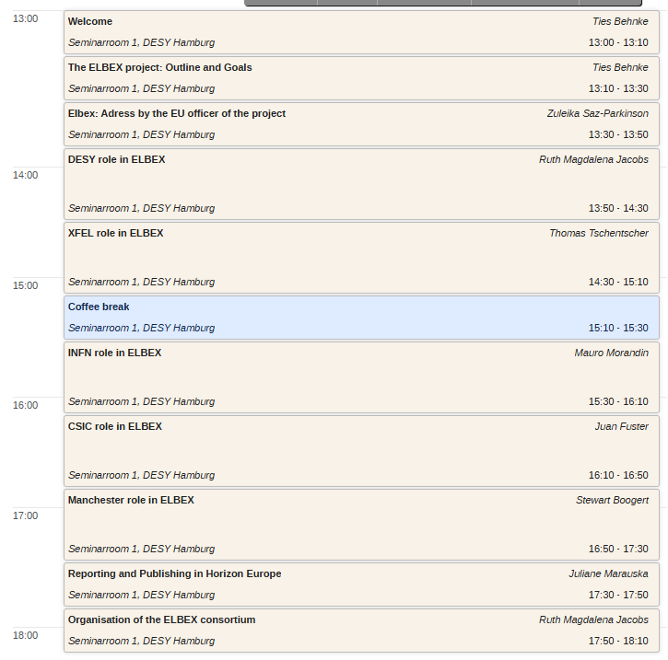
The Kickoff on Monday

Slide 21
The Kickoff on Tuesday

