Slide 1
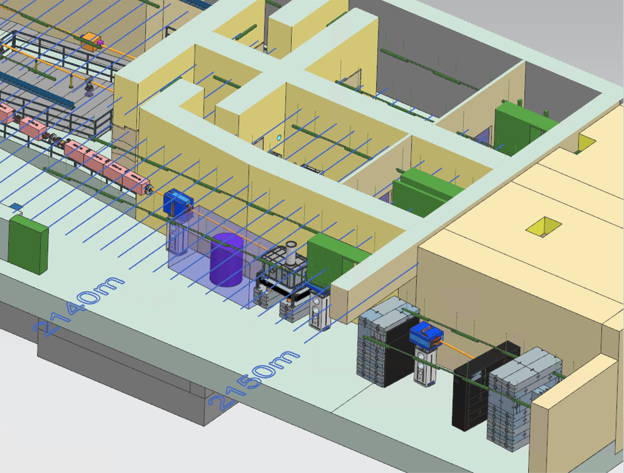
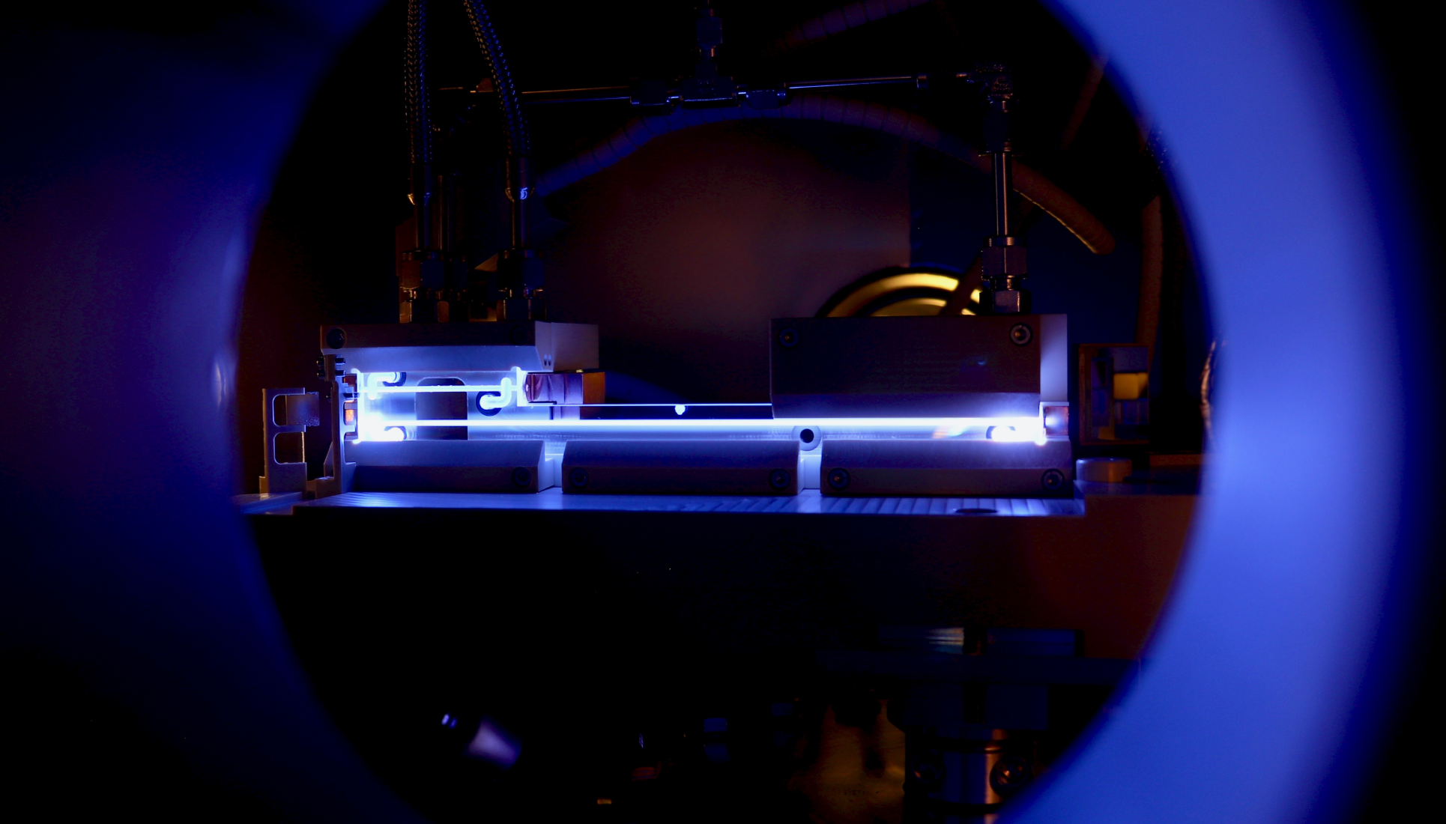
Plasma Acceleration R&D Opportunities at ELBEX.
Possible R&D Opportunities for Plasma Acceleration at the ELBEX facility
Benno List
DESY
ELBEX Consortium Meeting 28.1.2025

Slide 2
Experimental Area in XS1 as Multi Purpose Testbed Facility
ELBEX: Extracted Lepton Beam at the European XFEL
ELBEX: A user facility to conduct experiments with single bunches extracted from the European XFEL
Electron bunches: 8-17GeV, 1pC, 10Hz, 5x5x40μm³
5.5x30m² underground experimental area
Strong laser
Interaction chamber(s) for plasma and laser-beam interaction
Spectrometer for beam characterisation
Can these features be utilized for novel acceleration R&D, esp. PWFA and LWFA?
Split bunch option for plasma experiments?
Quantity | Unit | XFEL | FLASH
Energy | GeV | 8 – 17.5 | 0.35-1.25
Bunch Charge | nC | 0.25 - 1 | 2 / 0.12
Norm. emittance | mm*mrad | 1.4 | 0.8
Bunch length | μm | 40 | 60-80
Spot size | μm² | 5-10 | 60 x 20
Repetition rate | Hz | 10 | 1 / 5 / 10

Slide 3
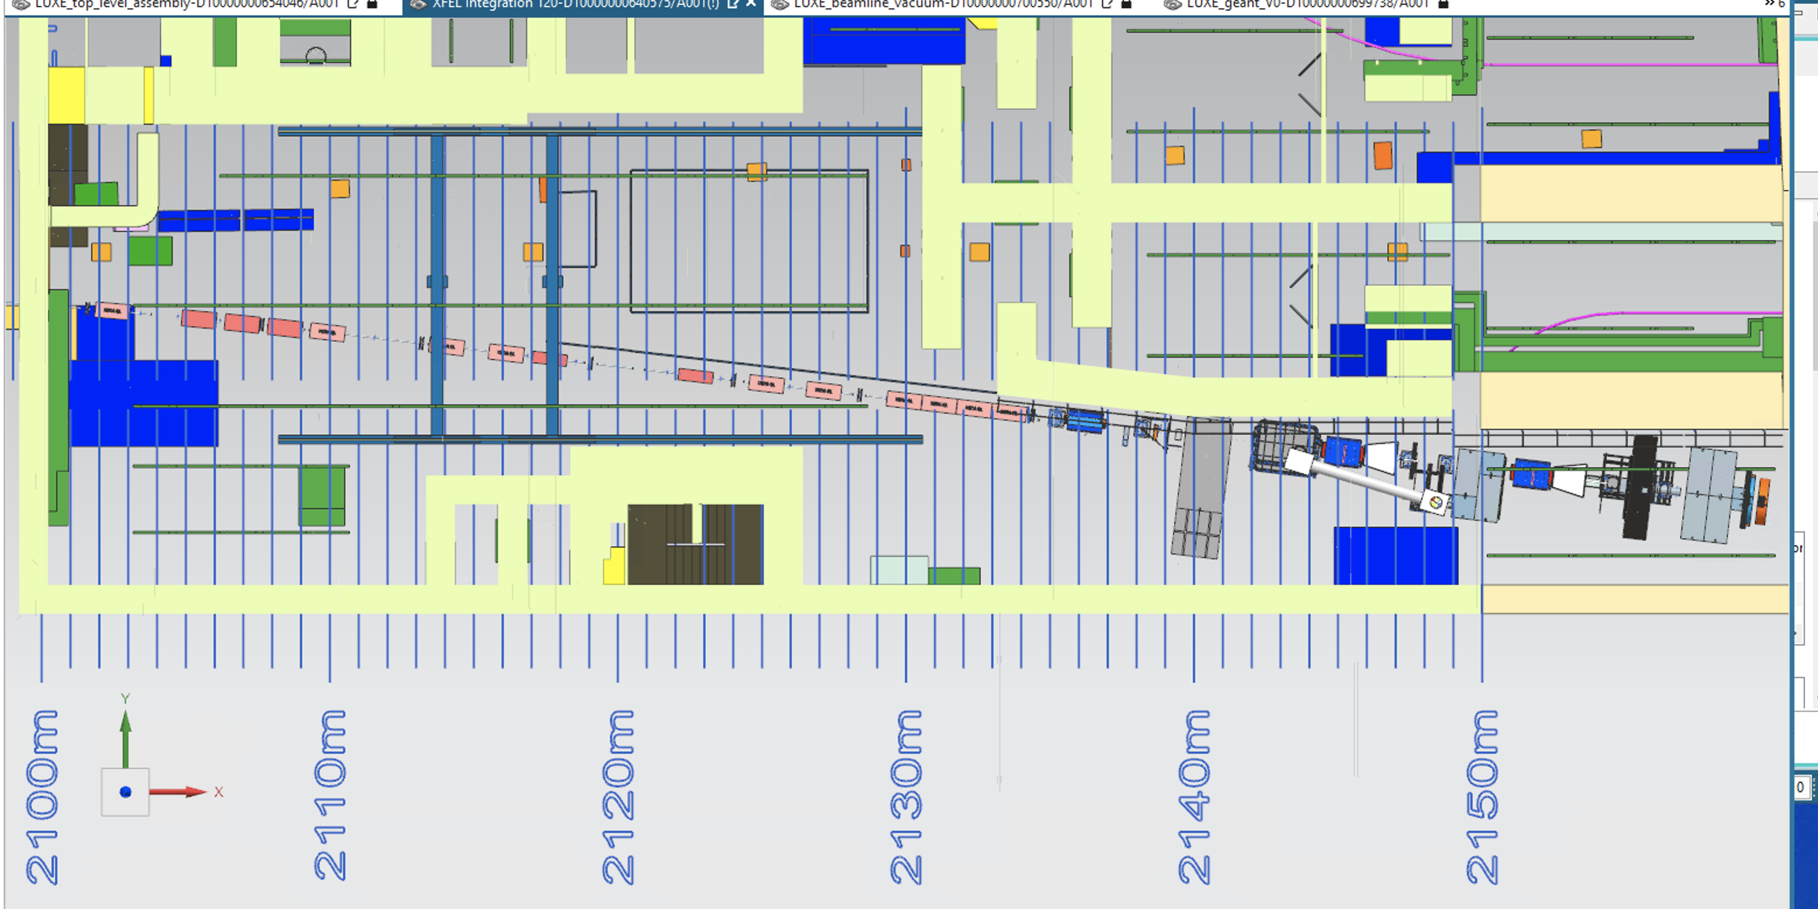
Possible Space for a Plasma Experiment at ELBEX
Sharing space with LUXE
Installation of plasma cell in front of LUXE experimental area for co-existence: (up to 5m space available)
8-17GeV beam energy: study multi-GeV energy transfer regime for XFEL booster and HALHF -> unique opportunity
LWPA experiment: Accelerate XFEL bunch with laser-driven plasma?
Demonstrate injection & synchronisation of witness beam
Demonstrate potential to stage laser plasma cells in multi-GeV regime
Plasma Experiment
LUXE

Slide 4
Bunch Splitting for PWFA
Beam driven plasma requires split bunches (~30um = 100fs bunch separation)
Synergy with ongoing split bunch project for SASE beams -> split beams relevant for photon science users
Investigate
Split bunch generation: modifications to the electron gun
Beam dynamics (transport through injector, bunch compressors, linac)
Split bunch characterisation (TDS)
Split bunch collimation
Longitudinal bunch charge distribution shaping
P. Gonzales-Caminal, DESY-THESIS-2022-015 doi:10.3204/PUBDB-2022-03578

Slide 5
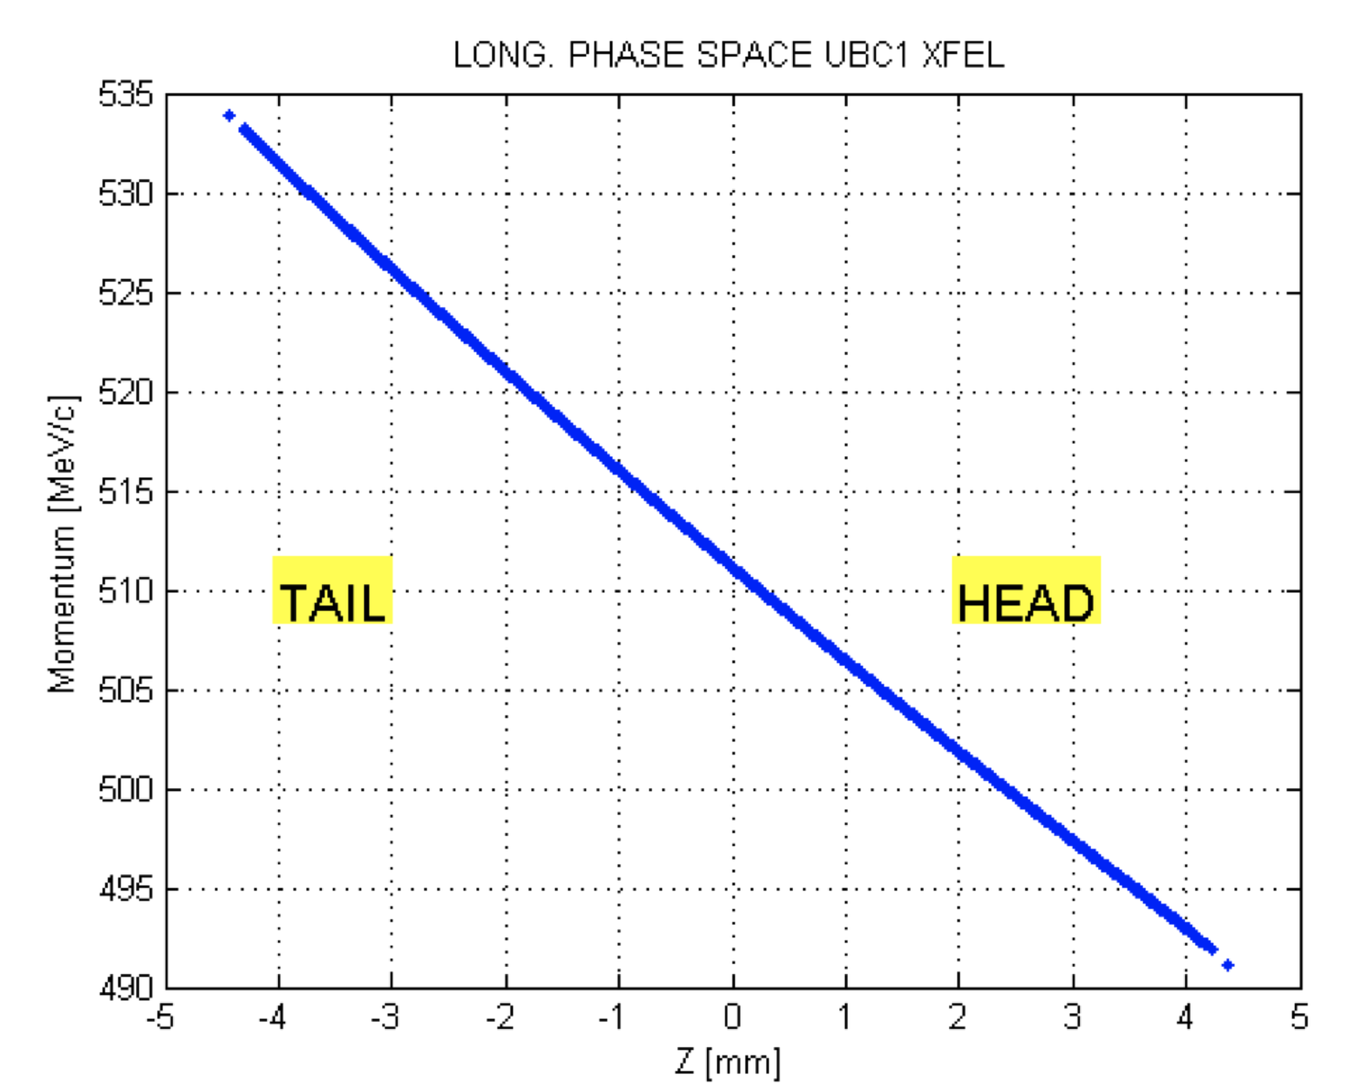
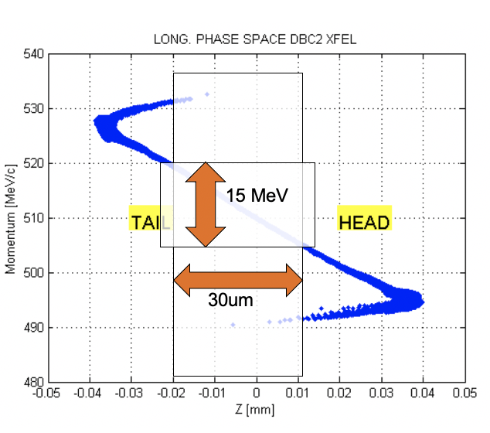
Bunch splitting at the gun?
Question: Can longitudinal XFEL bunch profile be manipulated to generate a split beam?
Generate a double laser pulse with a ~10ps gap at the gun?
Is that gap preserved during transport?
Which current density can be achieved?
Before BC1
40 MeV
3mm = 10ps
After BC2
80um = 0.27ps
250pC/0.27ps => 925 A
9mm = 30ps
https://www.desy.de/xfel-beam/data/bc/ele-ubc1.pdf

Slide 6
A Possible Plasma Experimentation Area
Coexistence between LUXE and PWFA possible: use 5m space in front of LUXE
Requires
Re-optimisation of T20 optics for more optics flexibility (possibly additional quadrupoles to shift focus?)
Re-optimisation of LUXE Compton setup (movable electron dump)
Opportunities:
Diagnostics beamline (spectrometer dipoles) of LUXE for plasma beam characterisation
Large space available (5m long, >2m wide)
LUXE laser system – opportunities for LWFA?
PWFA
LUXE Target Chamber

Slide 7
Space at LUXE
5m space
Cherenkov detector
Electron dump

Slide 8
Closeup of Region around Electron Dump

Slide 9
Closeup of LUXE experiment region

Slide 10
Open questions and outlook
What is the science case PWFA experiment with 8-16 GeV electrons?
Operating permit: 20GeV -> sufficient for 8GeV energy doubler
Proof of principle of controlled multi-GeV energy gains in regime relevant for an XFEL energy doubler
Are repetition rates (10Hz) enough? Or Mini-trains (10 bunches at 4.5MHz at 1Hz?)
Is LUXE diagnostics suitable / upgradeable?
How well can beam be characterised with existing XFEL diagnostics? does that require dedicated running?
Is there a possibility and a case for LWFA?
Laser acceleration with external beam injected
What would be added value in relation to other plasma activities at XFEL
Status of split bunch plans for photon science, capabilities of XFEL injector (current and future)
Accessibility: How can accessibility restrictions due to XFEL operation be overcome?
Remote operation
Challenging, but possibly also interesting
Possible requirements with influence on ELBEX design should be investigated with priority
Dump requirements and design
Spectrometer design
Instrumentation
Focussing scheme

