Slide 1
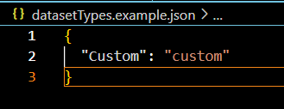
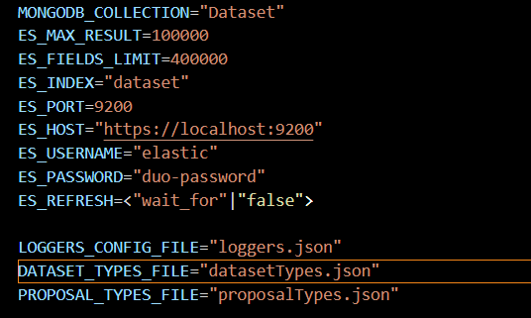
Hands on task: Custom dataset types
Dataset instances have a type; up to now only Raw or Derived
New capability: Definition of custom types
  Definitions by .env variable or default in „datasetTypes.json“
  Raw and Derived are always available
Use case example: Dataset collections

Slide 2
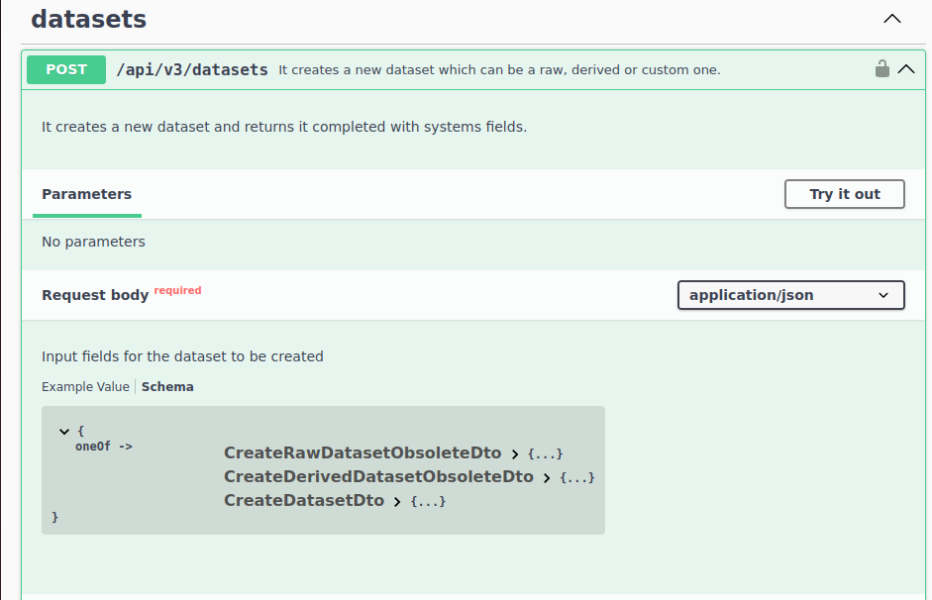
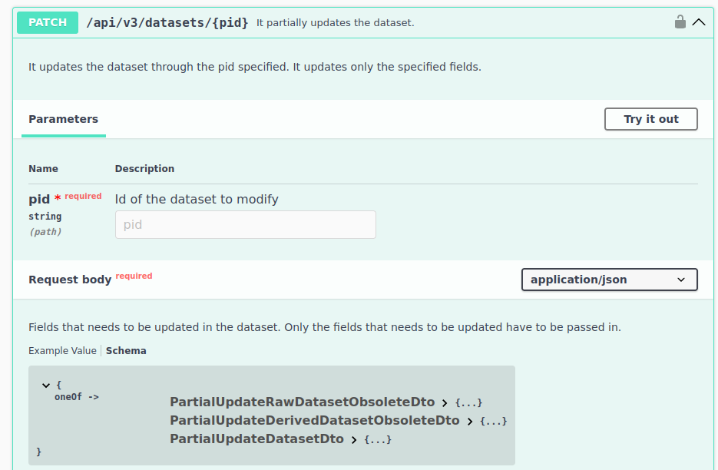
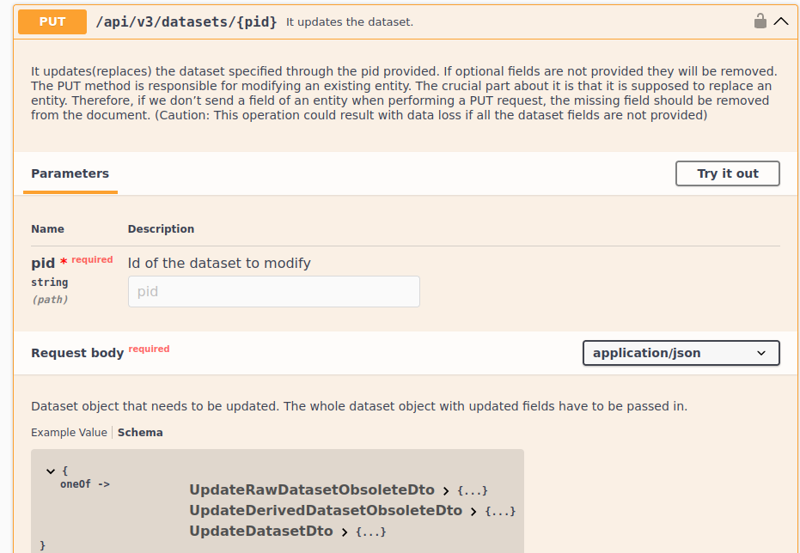
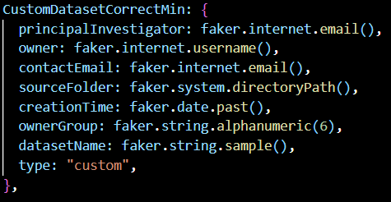
Hands on task: Custom dataset types
Interface: Custom types require adherence to new unified API schema
Old formats remain available for now
Planned API v4 will sunset obsolete formats

