Slide 1
EMBL
European Molecular Biology Laboratory
Gergely Papp
Head of Instrumentation
EMBL Grenoble

Slide 2
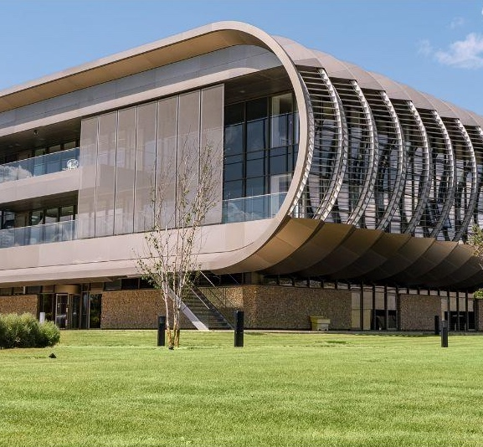
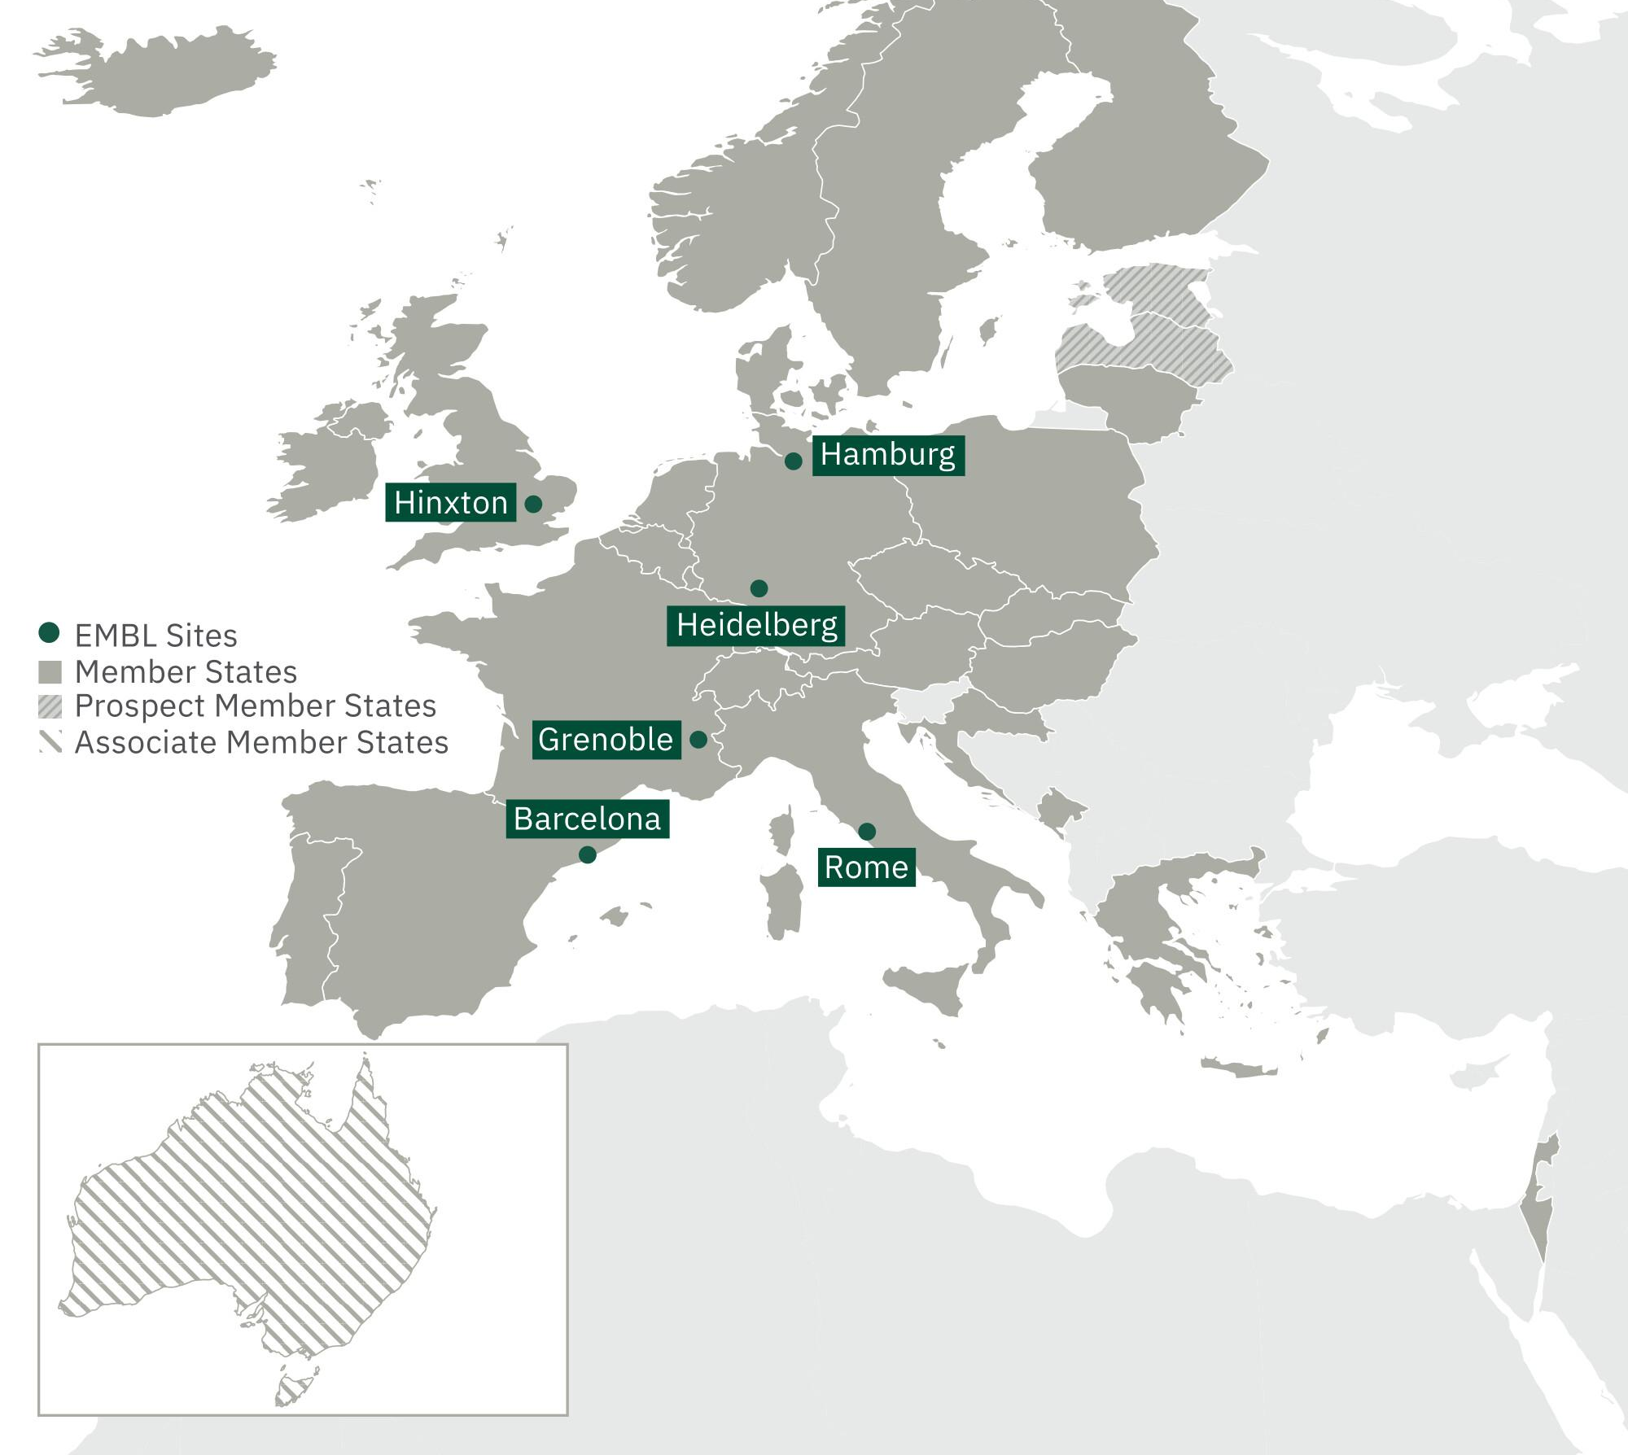
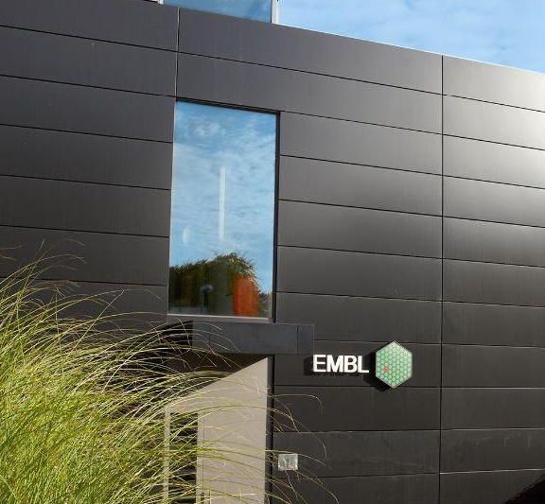
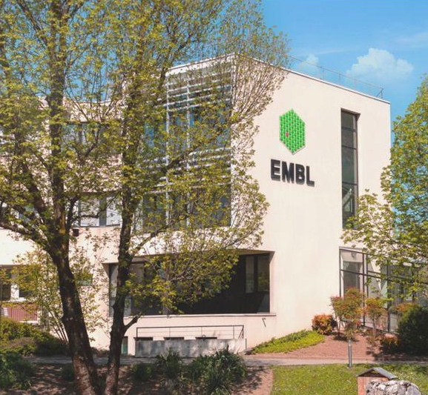
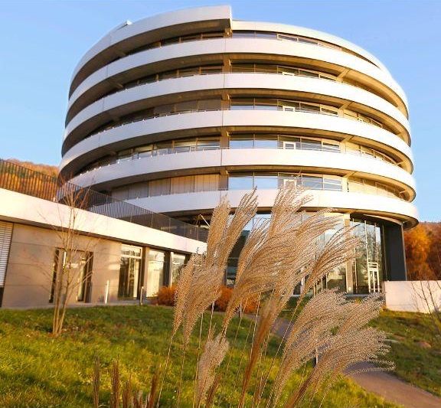
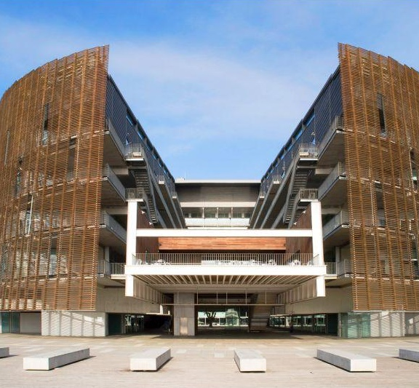
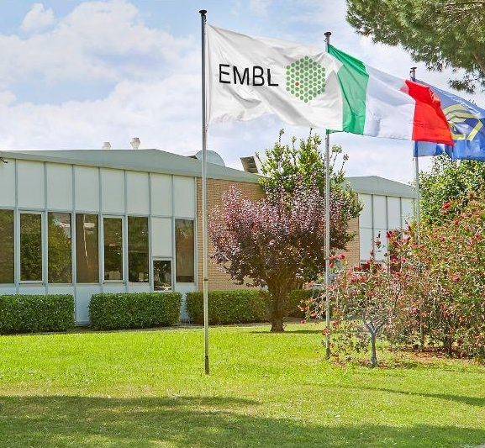
Six sites with 2000 People, 29 member states
EMBL-EBI
Bioinformatics
Hamburg
Structural biology
Grenoble
Structural biology
Heidelberg
Life sciences
Barcelona
Tissue biology and disease modelling
Rome
Epigenetics and neurobiology
Notes:
EMBL’s activities are distributed across six sites in Europe and carried out by 2,000 staff and fellows
All sites have strong research and service components, although activities relating to all of EMBL’s five missions take place at all six sites
EMBL Heidelberg
EMBL’s headquarters are based at EMBL’s largest site, in Heidelberg
At EMBL Heidelberg there are four research units that span life science research areas:
Structural and computational biology
Genome biology
Cell biology and biophysics
Developmental biology
Additionally, many of EMBL’s Core Facilities and the EMBL Imaging Centre are based in Heidelberg
The Advanced Training Centre (ATC) [pictured] houses many of EMBL’s raining activities
Many activities related to EMBL’s innovation and translation mission are housed in Heidelberg, including EMBLEM, EMBL’s tech transfer arm.
Many of EMBL’s central functions are also located in Heidelberg
EMBL’s European Bioinformatics Institute (EMBL-EBI)
EMBL-EBI is based in Hinxton, near Cambridge in the UK, and is EMBL’s second largest site
EMBL-EBI is purely computational and undertakes computational research on the Wellcome Genome Campus
This site also maintains the world’s most comprehensive range of freely available and up-to-date molecular data resources
Training at EMBL-EBI focuses on in-person and freely available online bioinformatics training
EMBL Hamburg
EMBL Hamburg is based on the German Electron Synchrotron (DESY) campus
EMBL Hamburg aims to harness the enormous potential of synchrotron radiation for applications in the life sciences.
EMBL Hamburg research focuses on structure-function relationships of infection biology
The beamlines at EMBL Hamburg enable researchers to visualise biological structures at the molecular level
EMBL Grenoble
EMBL Grenoble is based on the European Photon and Neutron (EPN) campus
The research at EMBL Grenoble is focussed on RNA biology, and human viral, parasite and bacterial pathogens.
In collaboration with the ESRF, EMBL Grenoble runs several high throughput beamlines for users to visualise biological structures at the molecular level
EMBL Rome
EMBL Rome is located on the Adriano Buzzati-Traverso campus in Monterotondo, near Rome
EMBL Rome’s research focuses on epigenetics and neurobiology
It also provides users with access to core facilities and in vivo gene editing tools
EMBL Barcelona
EMBL Barcelona is the newest of EMBL’s sites, officially opening in 2017
It is located on the PRBB campus in central Barcelona
Researchers at EMBL Barcelona focus on tissue biology and disease modelling
The Mesoscopic Imaging Facility, located at the site supports researchers with this focus.

Slide 3
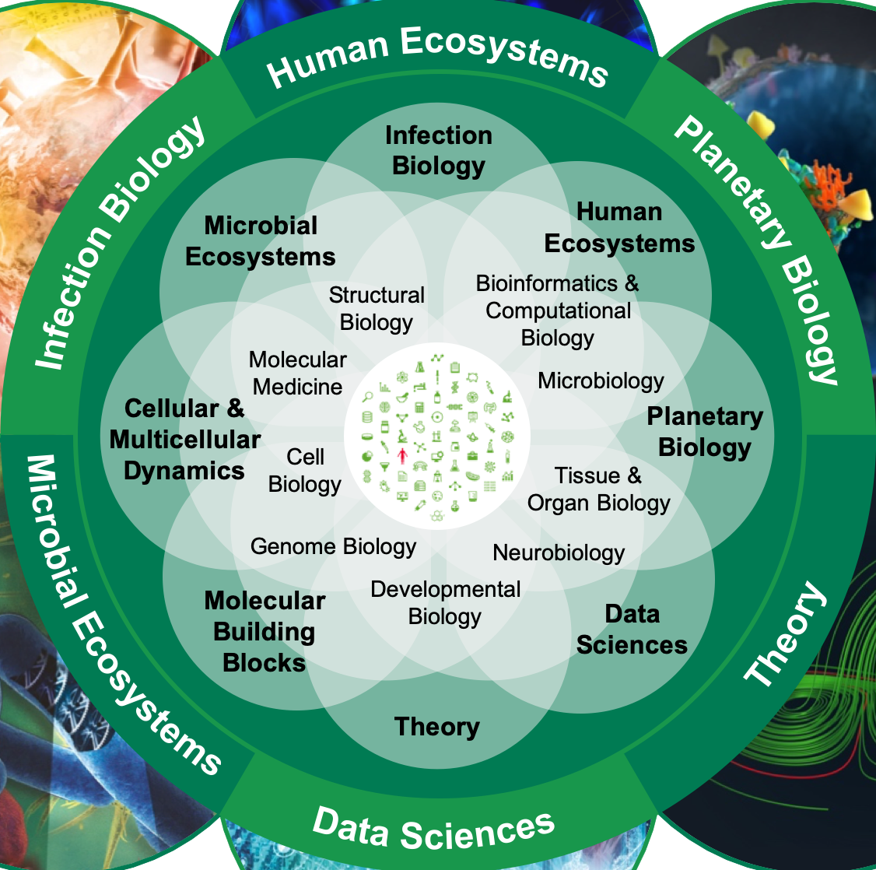
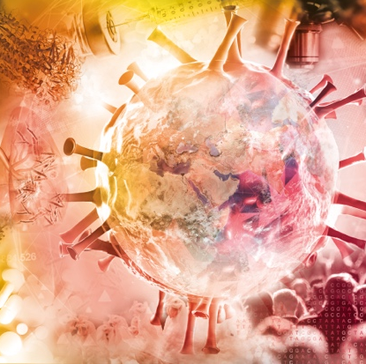
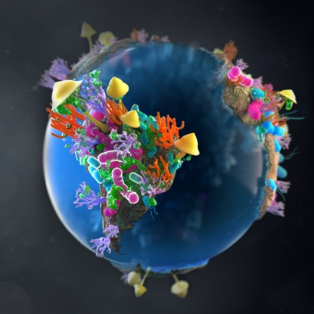
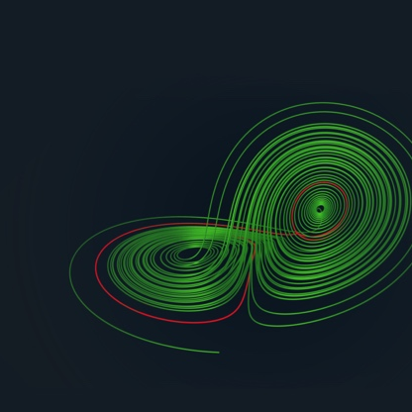
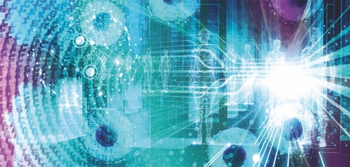
Molecules to Ecosystems & Transversal themes

Slide 4
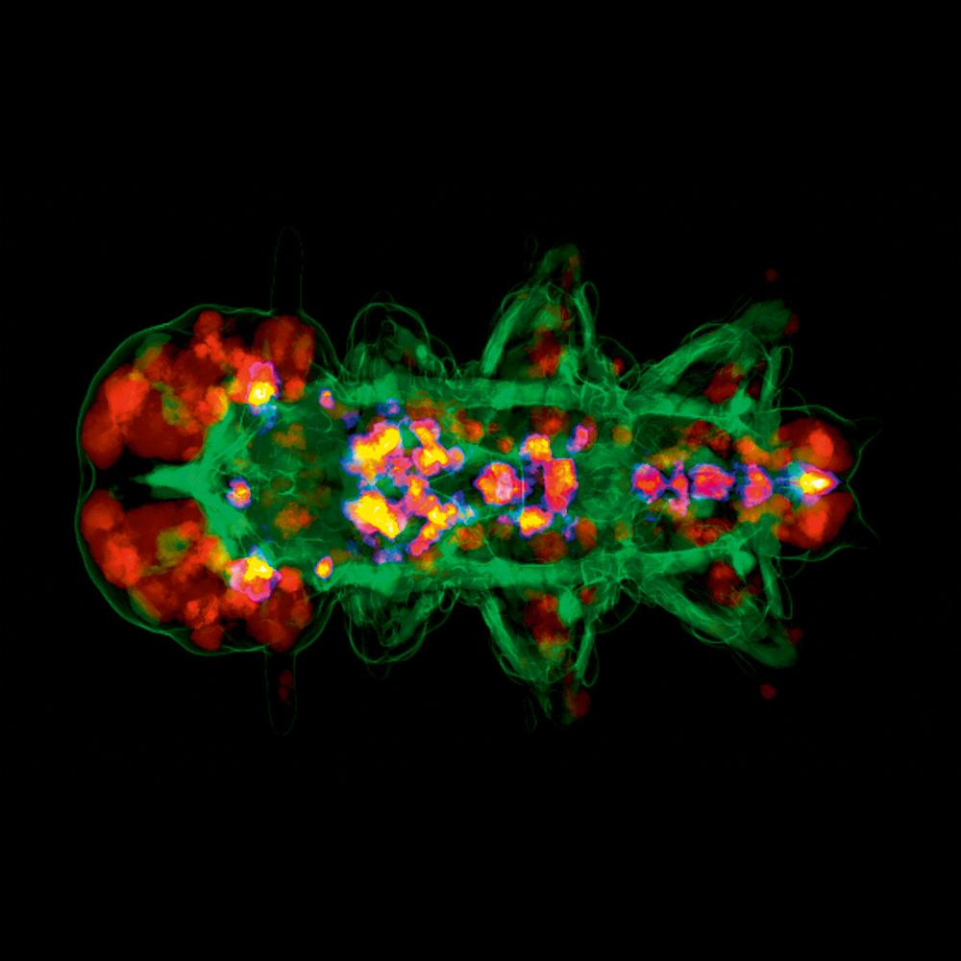
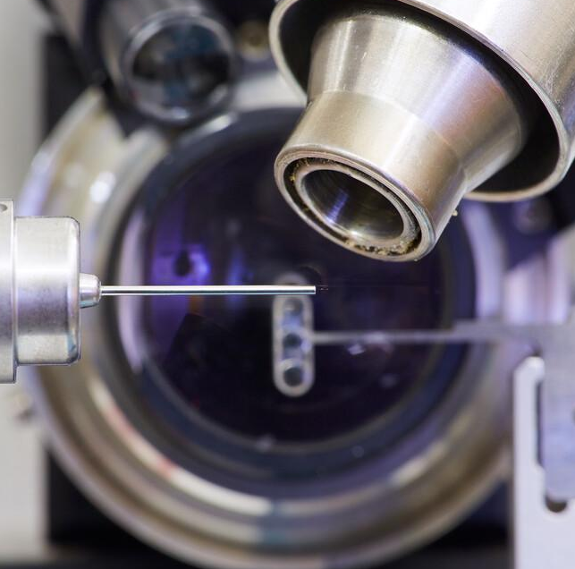
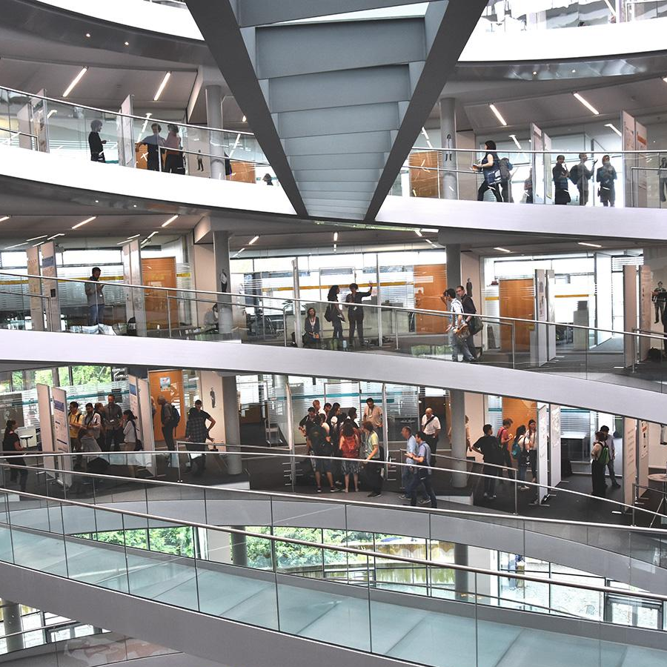
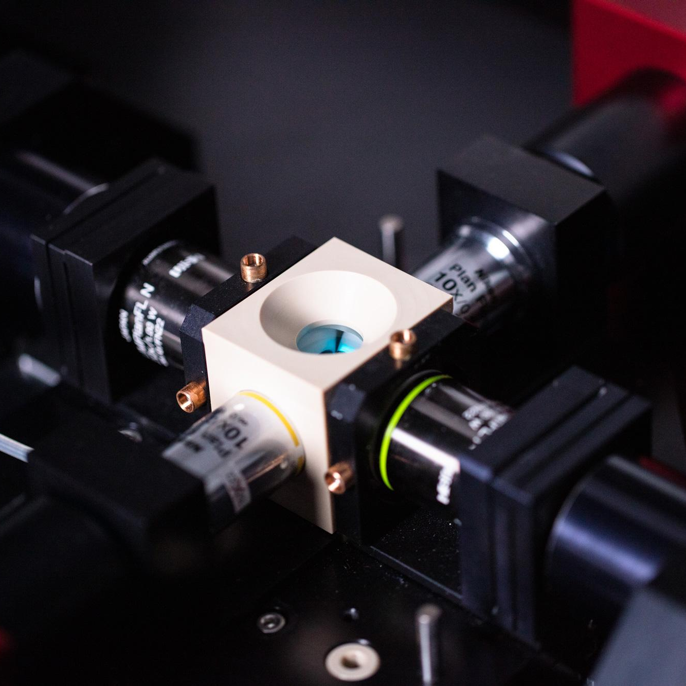
EMBL’s missions
Excellent research
Scientific services
Advanced
training
Innovation and translation
Integrating
life sciences
To perform fundamental research in molecular biology
To offer vital services to scientists in the member states and the world
To train scientists, students, and visitors at all levels
To actively engage in technology transfer and industry relations
To coordinate and integrate European life science research
Wandzik et al. Cell 2020
Notes:
- EMBL is the leading hub for fundamental research in the life sciences in Europe
- We also provide different scientific services for other scientists
- Researchers at EMBL also constantly work on developing new innovative technologies which are key to paving the way to new discoveries.

Slide 5
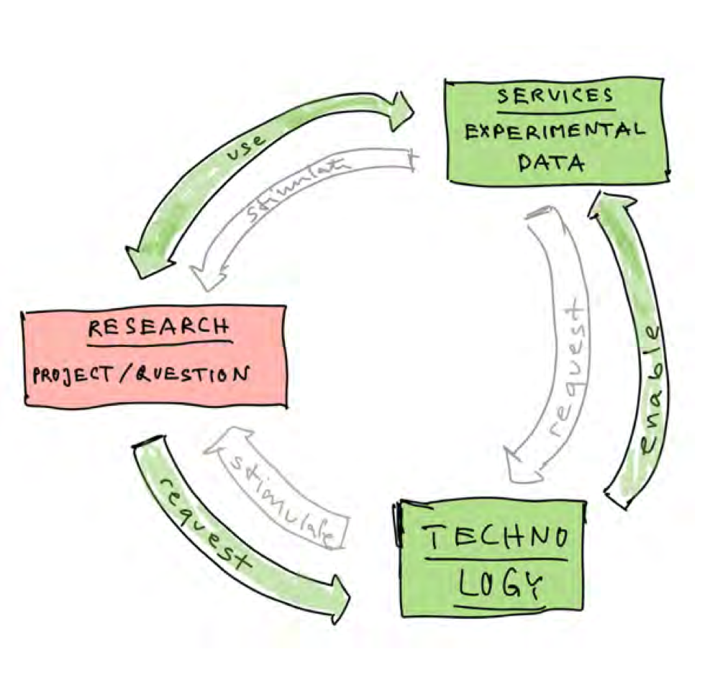
Research-service-technology virtuous cycle

Slide 6
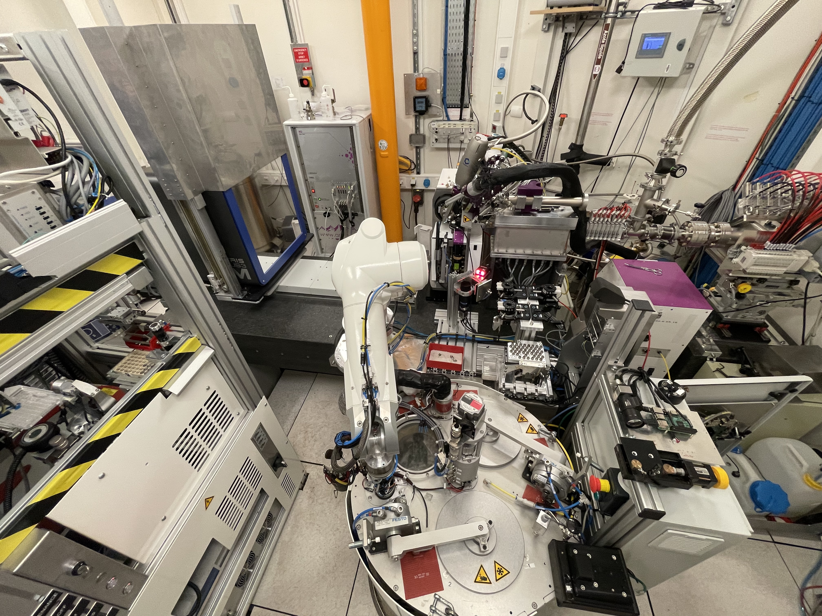
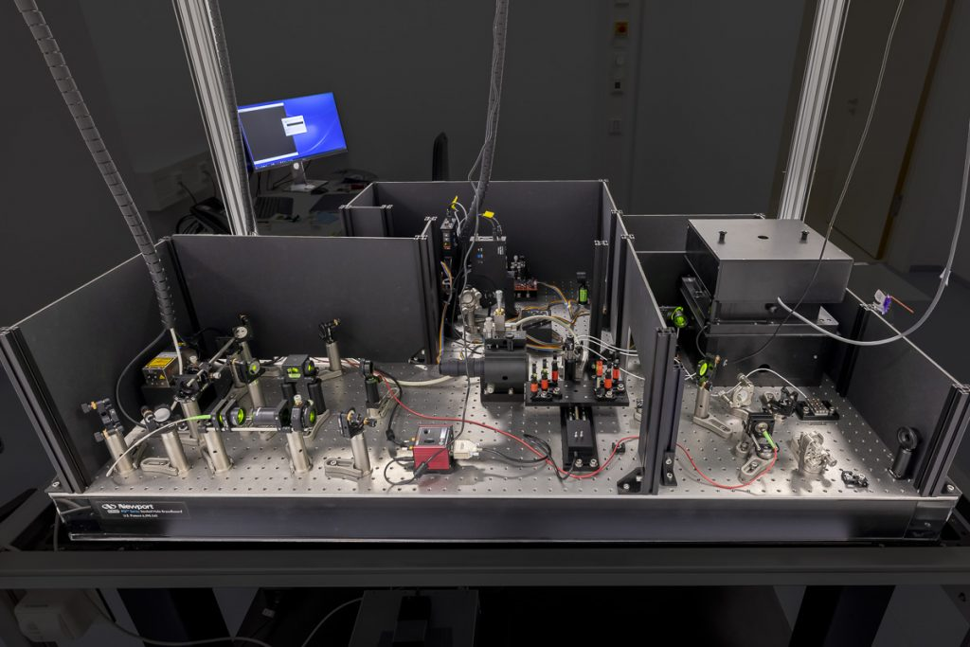
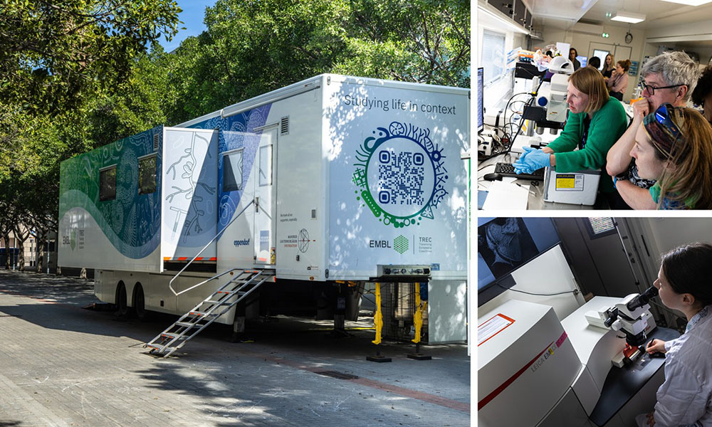
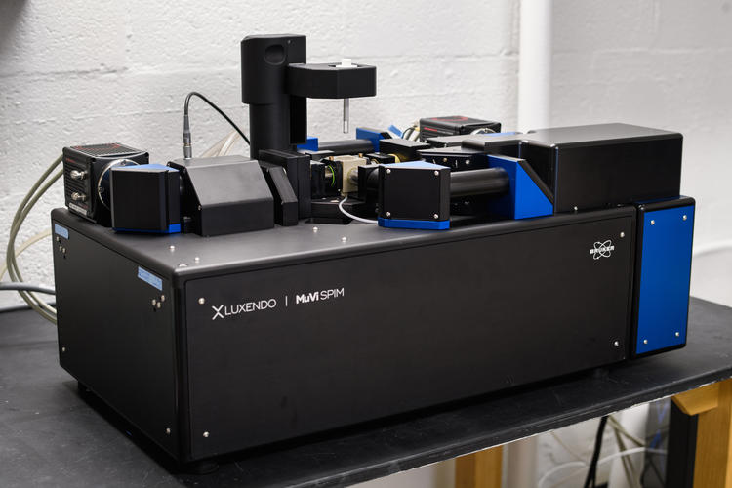
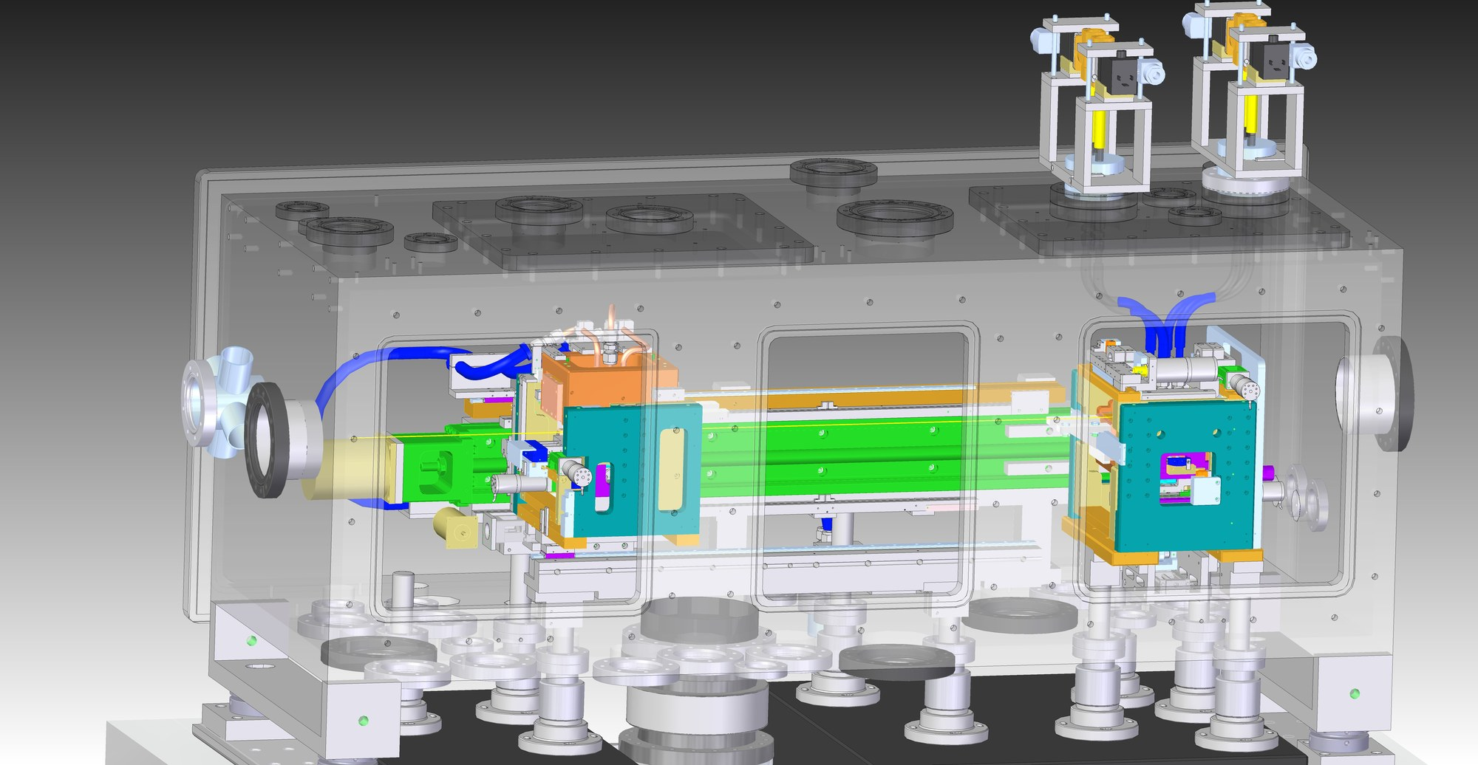
Systems engineering examples at EMBL
Synchrotron instrumentation
Light Microscopy
Mobile Labs
EMBL Grenoble:
Cryogenic sample changer
Precision goniometer
Crystat harvester
etc.
EMBL Heidelberg
3D - Single Molecule Localisation Microscope
ESRF Massif 1
EMBL Heidelberg - Luxendo
Selective Plane Illumination Microscope
EMBL Hamburg
Double-Multilayer Monochromator
Advanced Mobile Laboratory
DESY P12

Slide 7
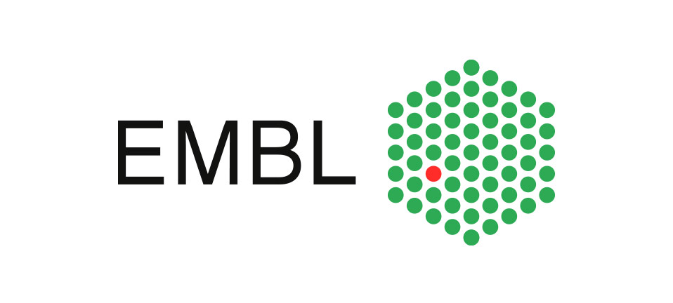
Thank you

