Slide 1
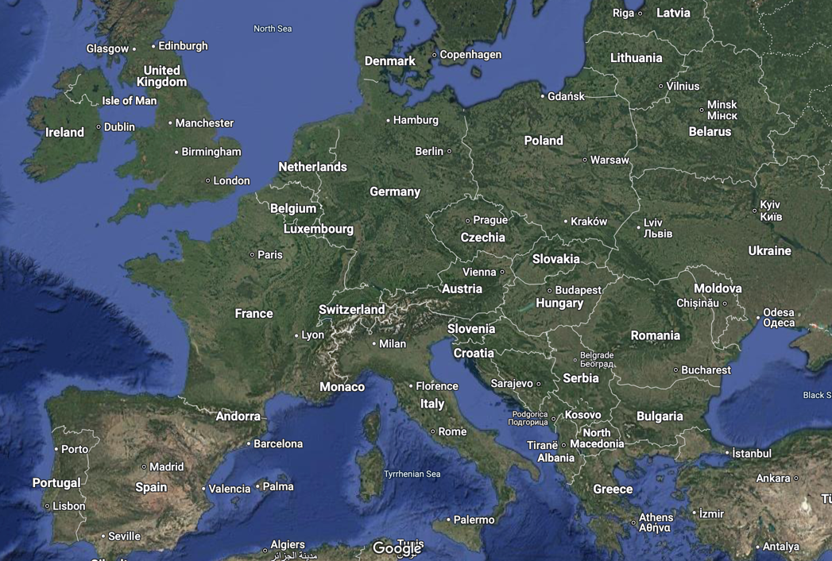
A brief intro to CERN: European Centre for Particle Physics
Dave Barney, CERN

Slide 2
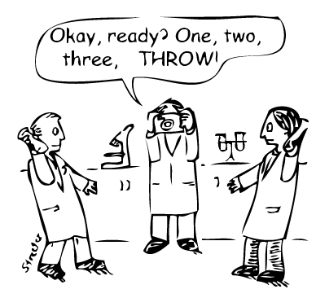
CERN basics
Smash things together and see what happens!
Accelerators: smash things together (protons, electrons, heavy ions e.g. Pb)
Detectors: see what happens
CERN as institute (around 2300 employees):
- is responsible for developing, providing and operating the accelerators
- hosts the experiments (=detectors + collaborations)
- takes part in the experiments
Accelerator and Technology Sector (ATS) includes: see presentation by Per-Olof Friman
- Engineering department: inc. Accelerator Coordination & Eng., Mechanical & Materials Eng., Information Management…
- Technology department: inc. Magnets, Superconductors & Cryostats, Cryogenics, Machine Protection & Electrical Integrity…
Research and Computing Sector (RCS) includes: see presentation by Thomas French
- Experimental Physics department: hosts 12000 users, develop electronics & detector technologies + participate to experiments

Slide 3
CERN’s present flagship: Large Hadron Collider
CMS
LHC: 27km circumference
LHCb
ALICE
ATLAS

Slide 4
The Large Hadron Collider
27km circumference
Particles lap 11245 times/second
Nearly 10000 magnets inc.
~1200 superconducting dipoles
~400 superconducting quadrupoles
Cooled to 1.9K (world’s largest cryogenic installation)
About 800 GWh per year

Slide 5
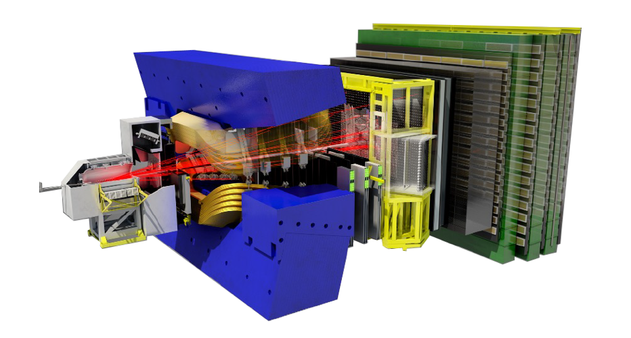
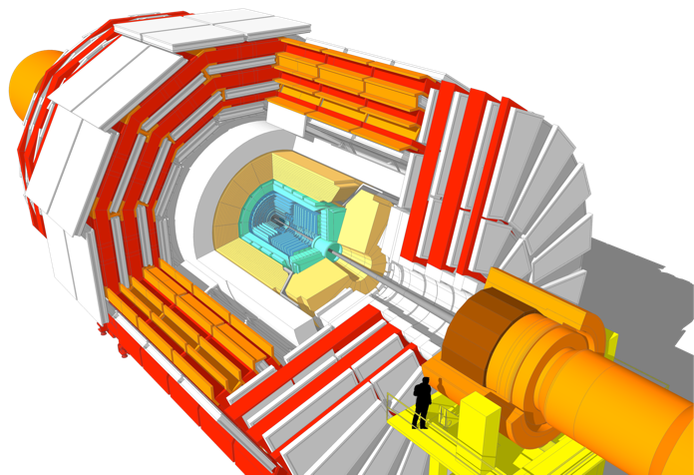
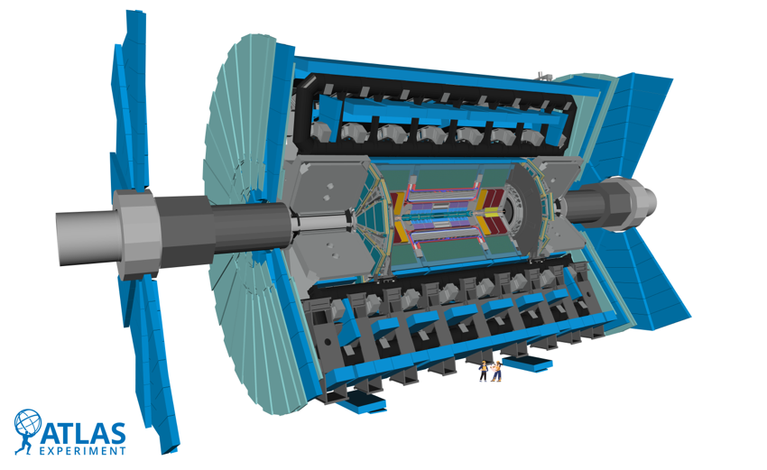
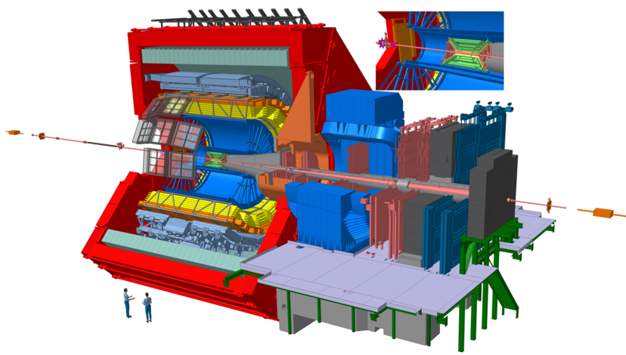
The four main LHC detectors
CMS
General purpose
Discovery detector
LHCb
Looking for CP violation (why is there no antimatter?)
ATLAS
General purpose
Discovery detector
ALICE
Studying heavy-ion collisions (early Universe)

Slide 6
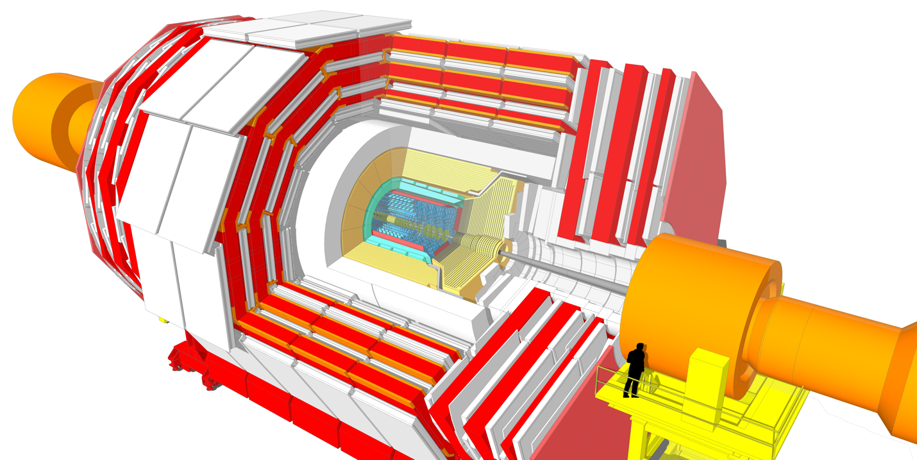
CMS
Compact Muon Solenoid
General purpose
Discovery detector
Around 6100 people
Inc. 1000 engineers (mech, elec)
Operational since 2008
Will operate until 2041
14000 tonnes
4T superconducting solenoid → liquid He cryogenics
~200 million detector channels → ~1 MW power dissipation; optical/electrical cables
Several sub-detectors operate at -30 degrees C → bi-phase CO₂ cooling
Components up to 1700 tonnes can be moved with mm precision

