Slide 1
The Institut Laue-Langevin

Slide 2
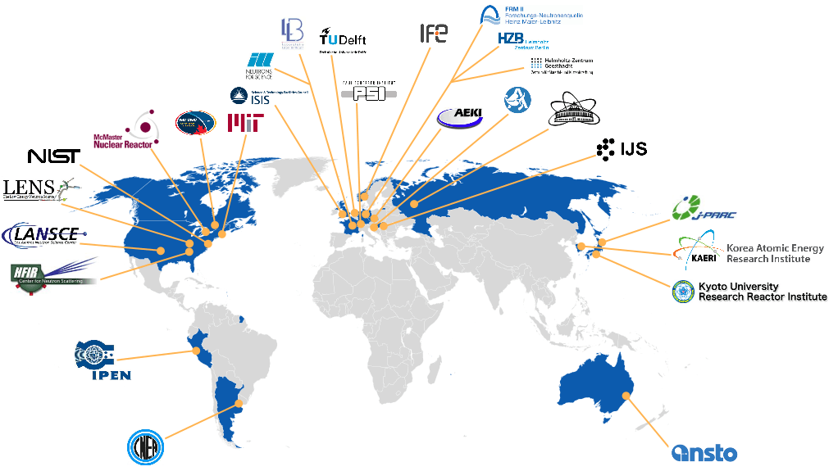
Institut Laue-Langevin - Founded In 1967
World leader in neutron science and technology
The ILL is the most intense neutron source in the world, at the service of international scientists, to carry out scientific research at the frontiers' of modern science.
Notes:
2

Slide 3
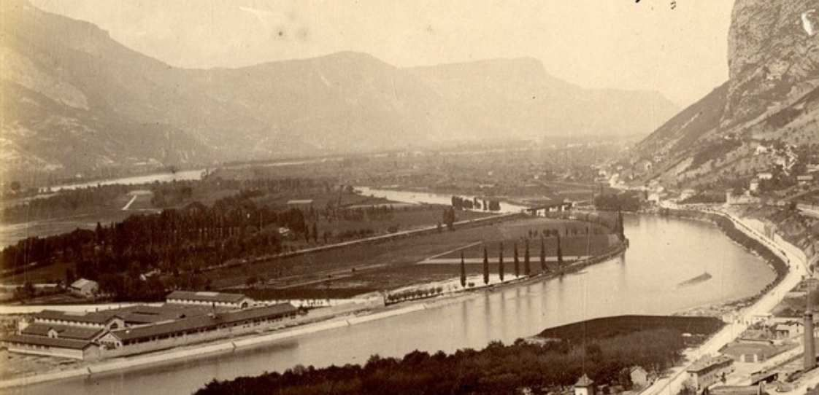
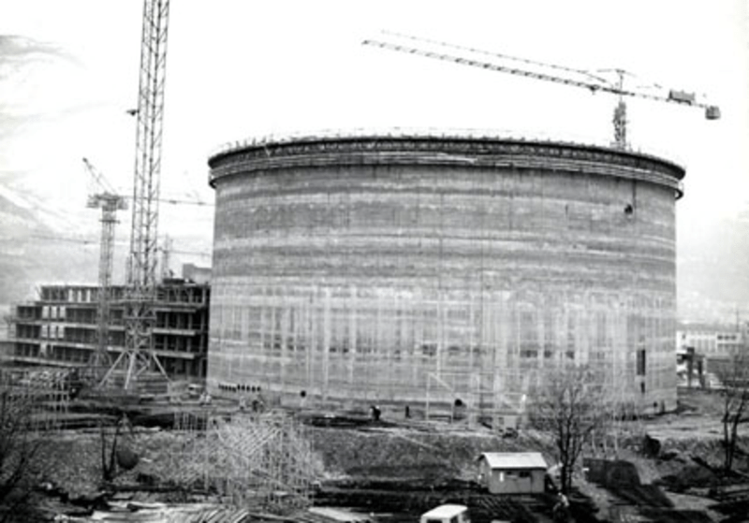
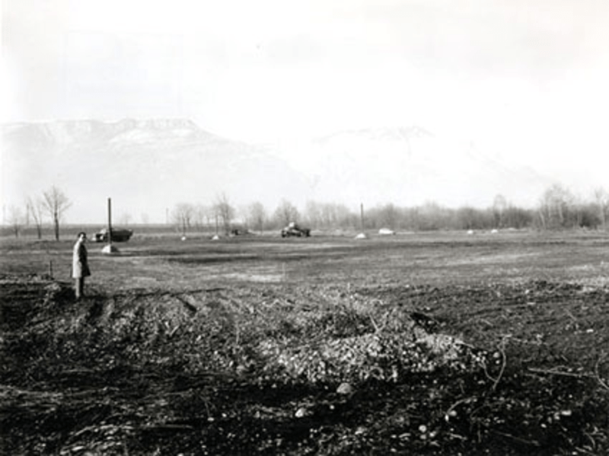
58 Years Ago …
Notes:
3

Slide 4
The ILL Stakeholders
The advent of the scientific members continues the process.
Close to one Billion € of capital investment
An annual budget of approximately 90 M€
A highly qualified workforce of about 500 people
Notes:
4

Slide 5
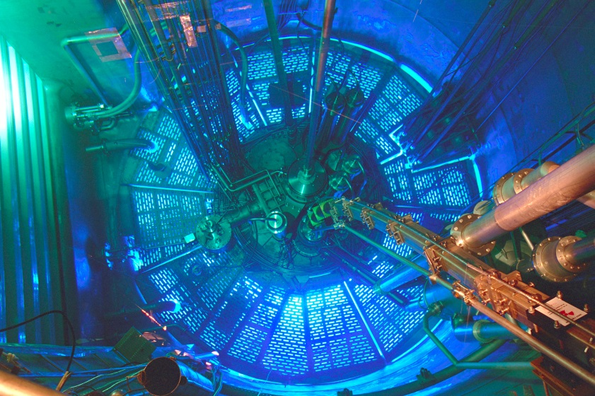
The ILL Reactor
Notes:
5

Slide 6
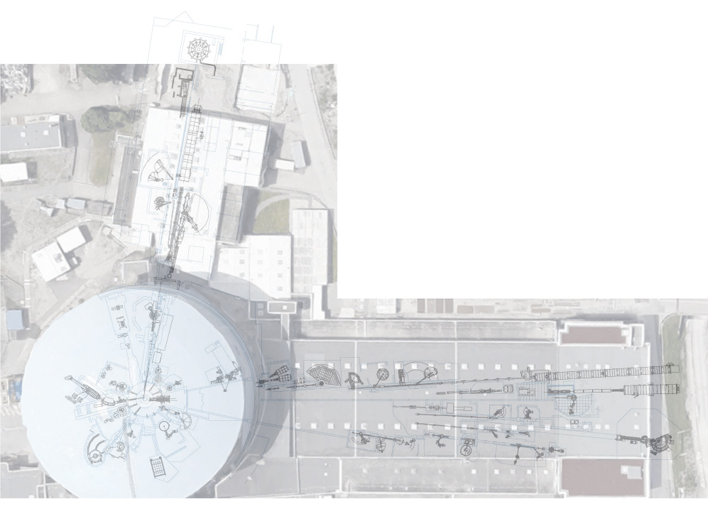
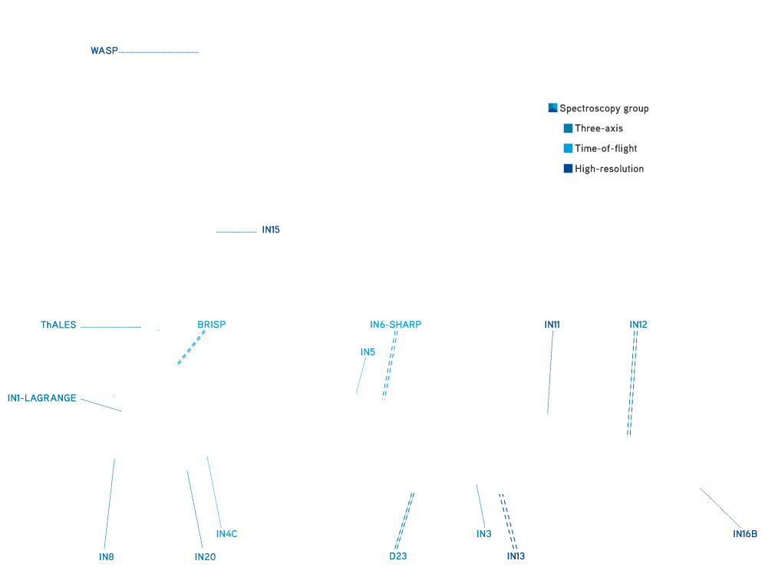
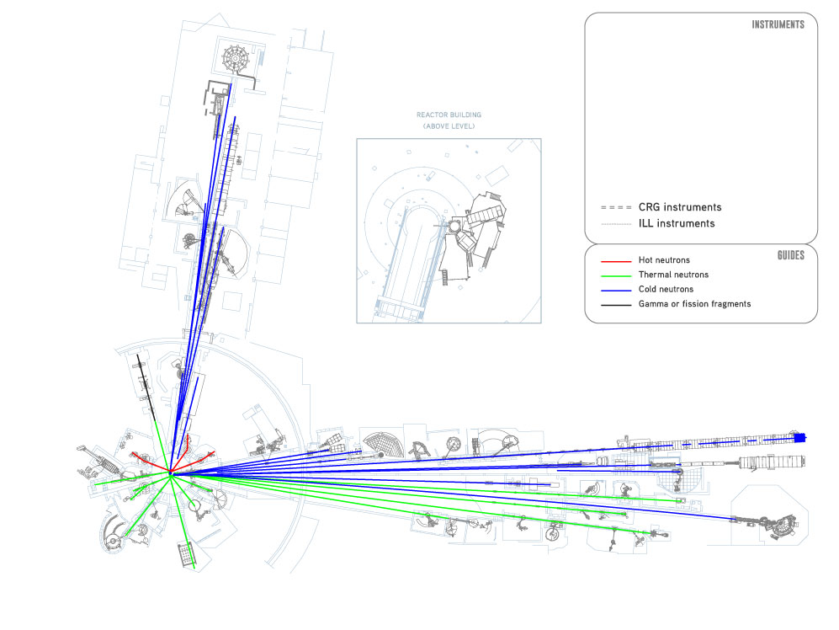
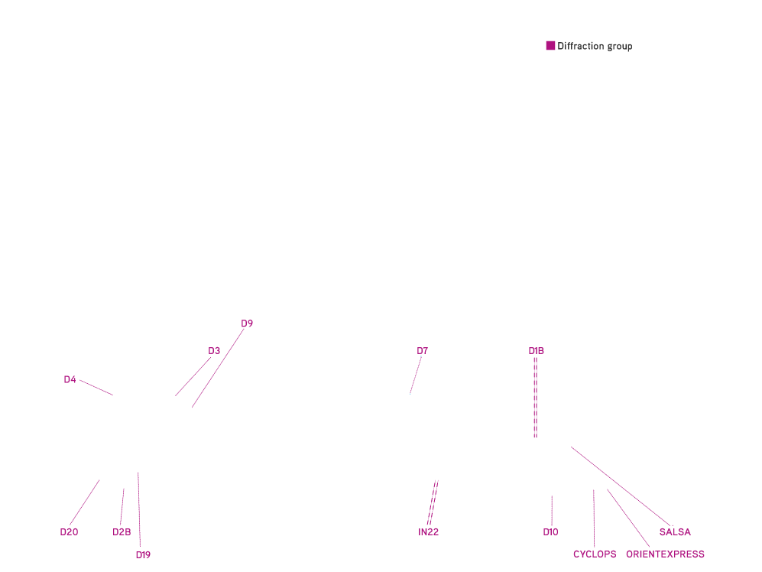
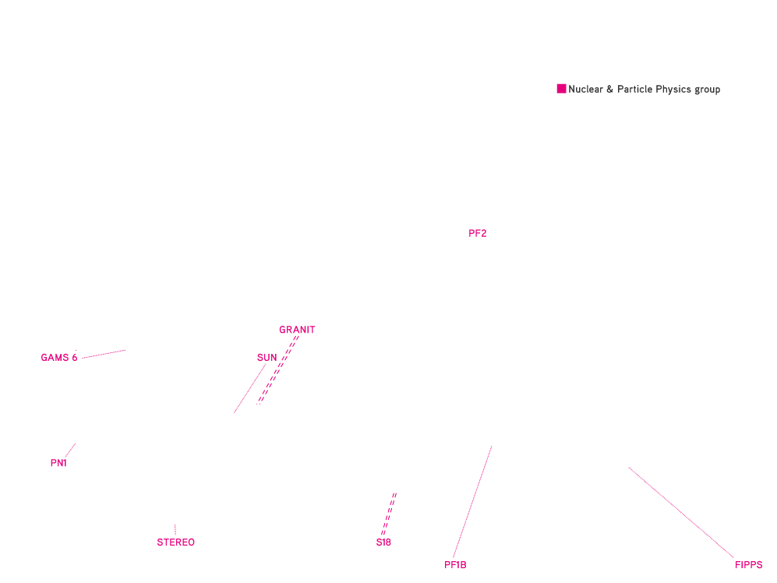
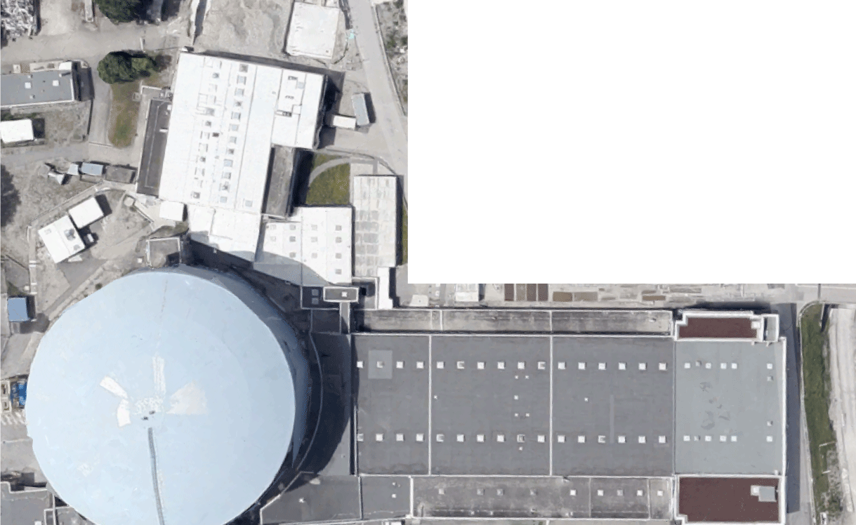
The Instrument Suite
Notes:
6

Slide 7
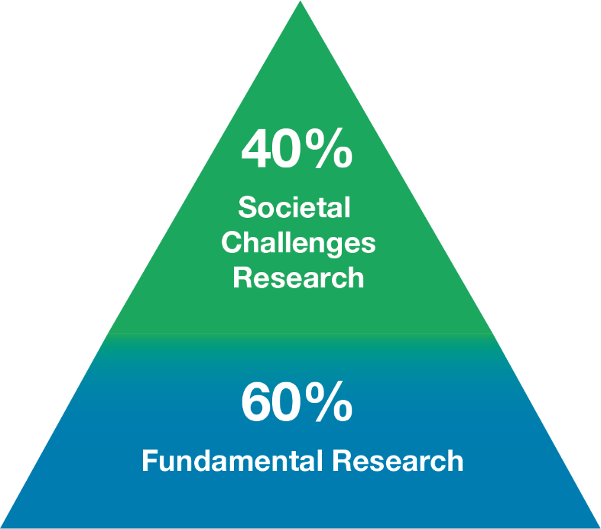
Key Figures
1400 users from an active community of 12 000 scientists
850 experiments/year
650 publications/year
65 countries
42 instruments + 10 CRG
4 cycles of 50 days/year
Notes:
7

Slide 8
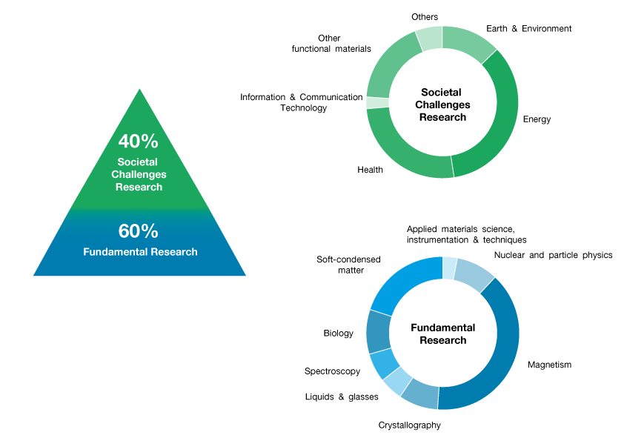
Research Areas
As per accepted proposals
Notes:
8

