Slide 1

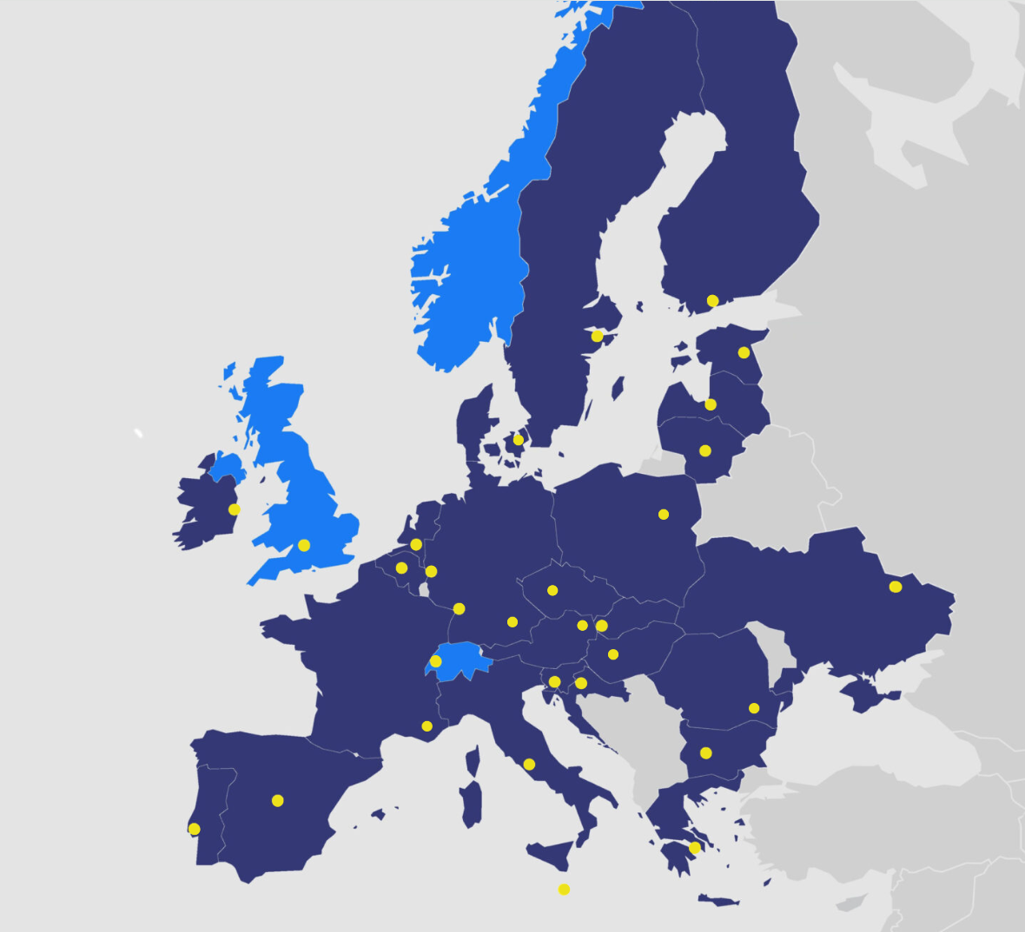
Programme Management Unit
EUROfusion supports and funds fusion research activities on behalf of the European Commission’s Euratom programme.
All EU Member States plus Switzerland have joined the EUROfusion agreement involving 29 fusion laboratories and numerous Third Parties.
Their combined effort will achieve the ultimate goal: fusion electricity by 2050
ITER

Slide 2
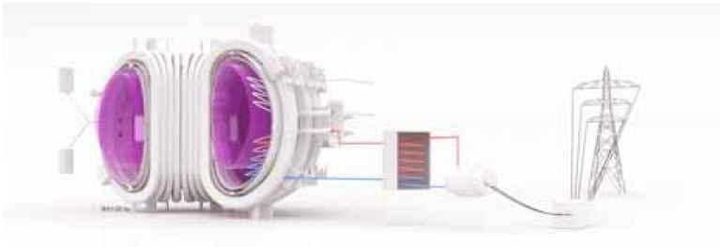
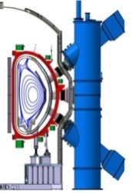
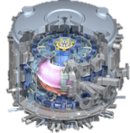
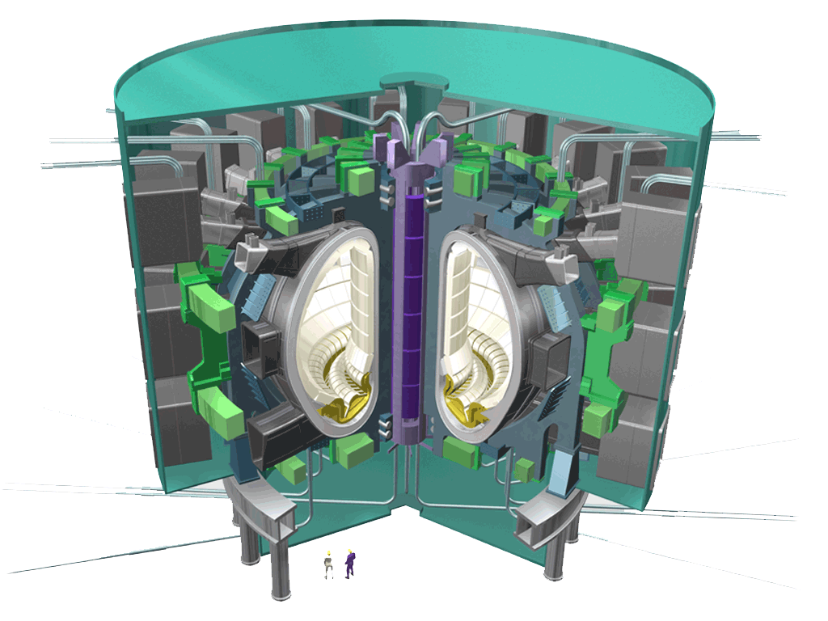
Roadmap towards fusion electricity
Fusion is practical, attractive
Power Plant
JT-60SA
ITER
DEMO
Fusion is feasible
Fusion is plausible
Fusion is commercially exploited
~2020
Operation
~2030
~2050
Fusion facilities around the world

