Slide 1
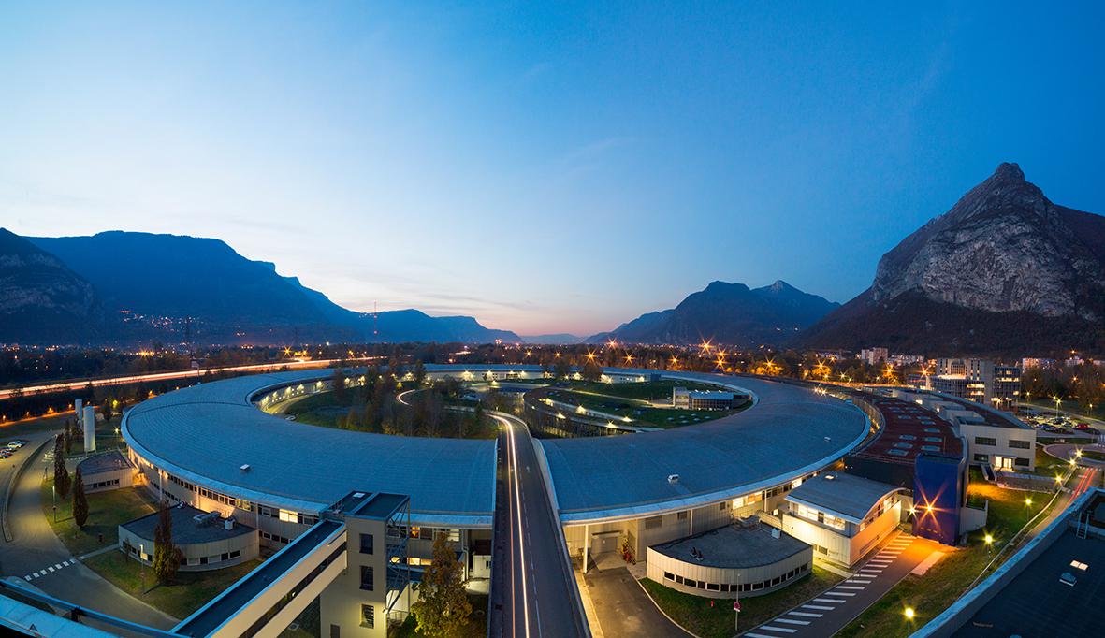
European Synchrotron Radiation Facility Overview
V.A. Solé – Instrumentation Services & Developments Division

Slide 2
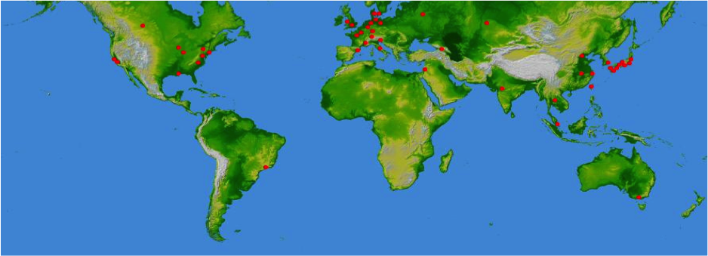
Synchrotron Sources
http://www.lightsources.org
Page 2

Slide 3
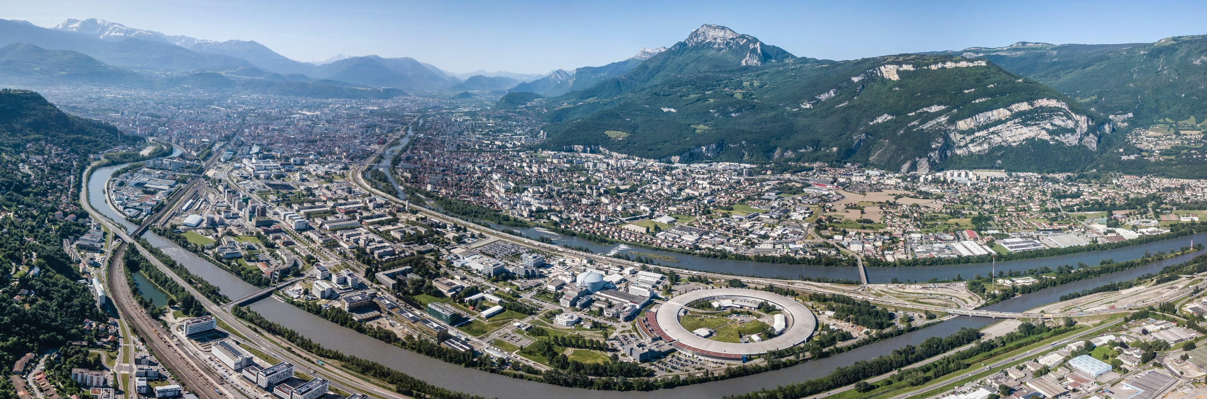
30+ years at the heart of the GIANT innovation campus in Grenoble, France
3 EU research institutes, members of EIROforum and the Institute for Structural Biology, at the heart of GIANT, the campus of Innovation (Grenoble Innovation for Advanced New Technologies)
The most powerful research reactor and the brightest synchrotron
Common research and training platforms
Page 3

Slide 4
Production of Synchrotron Radiation
Classical case
v << c
Relativistic case
v ~ c
orbit
orbit
Centripetal
acceleration
Isotropic emission
Emission concentrated
within a narrow forward cone
E_{e} = 6 GeV (ESRF)
mc² = 511keV
₌ 10⁻⁴ rad = a few 10⁻³ deg
Page 4

Slide 5
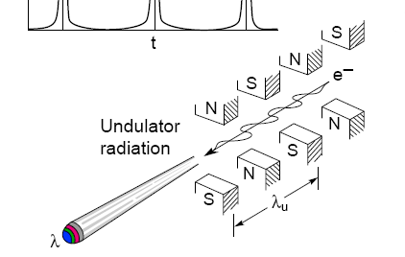
Insertion Devices
In a wiggler or an undulator, electrons travel through a periodic magnetic
structure.
The magnetic field B varies sinusoidally and is in the vertical direction:
Electron motion is also sinusoidal and lies in the horizontal plane. An important parameter characterizing the electron motion is characterized by
the deflection parameter K
K=0.934 _{u} [cm] B₀ [T]
The maximum angular deflection of the orbit is Κ/γ
K < 1 Undulator regime radiation from different periods interferes coherently
→ strong interference phenomena
K >> 1 Wiggler regime
radiation from different parts of the electron trajectory adds incoherently
→ interference effects are less important
Page 5

Slide 6
ESRF VALUES AND MISSIONS
Bring nations together through science
Pioneer synchrotron science and serve the international community for the advancement of knowledge and to address global societal challenges
Design, construct, operate and develop state-of-the-art X-ray facilities and provide value to all partner countries: new scientific opportunities, new technology
Foster the use of X-rays by industry from partner countries to strengthen its competitiveness
Train and inspire the young generation of scientists, engineers and technical staff
ESRF-Extremely Brilliant Source
Driving EU science and technology
to the benefit of society

Slide 7
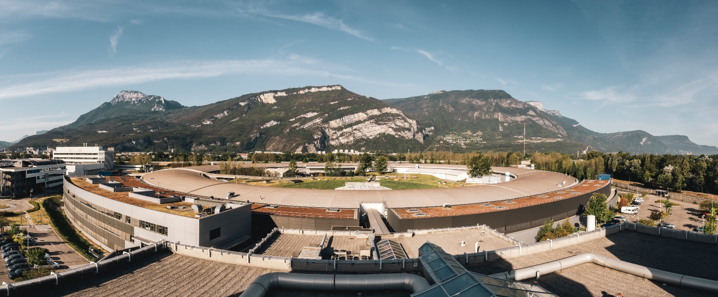
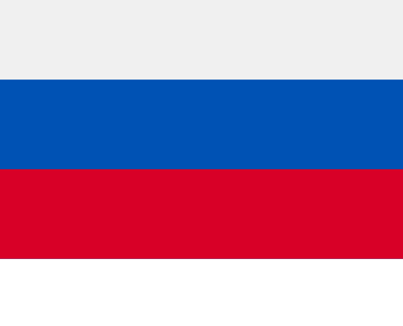
ESRF: BRINGING NATIONS TOGETHER, Pioneering synchrotron science
19 PARTNER COUNTRIES
13 MEMBER STATES
France | 27.5%
Germany | 24.0%
Italy | 13.2%
United Kingdom | 10.5%
Russia | 6.0%
Benesync (Belgium, The Netherlands) | 5.8%
Nordsync (Denmark, Finland, Norway, Sweden) | 5.0%
Spain | 4.0%
Switzerland | 4.0%
74 000 USERS FROM MORE THAN 60 COUNTRIES
6 GeV
34 + 12
2
6 ASSOCIATE COUNTRIES
Austria | 1.75%
Israel | 1.75%
Poland | 1.00%
Portugal | 1.00%
Czech Republic | 0.60%
South Africa | 0.30%
74 000 USERS FROM MORE THAN 60 COUNTRIES
Synchrotron
Beamlines
(public + CRG)
CryoEM
10 000
4 + 2
2 000
10
30%
Scientific visitors each year
Nobel prizes to ESRF users
Scientific publications/year
ERC grants based on ESRF-EBS
Of research
with industry
Page 7

Slide 8
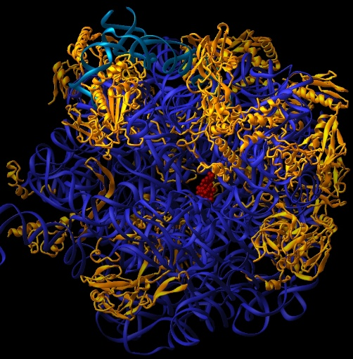
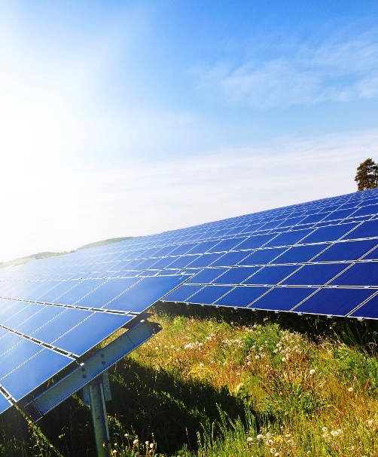
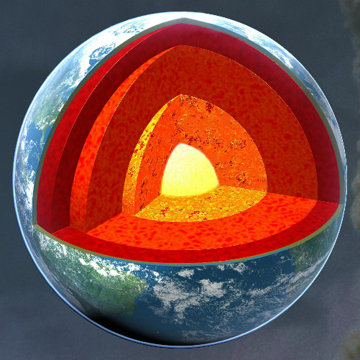
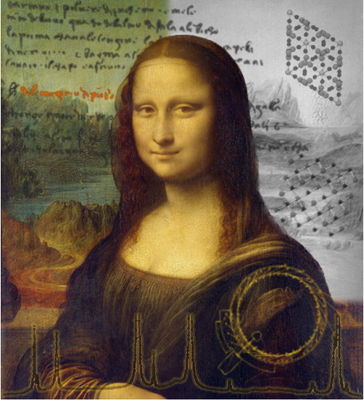
ESRF: a giant microscope for fundamental, applied & industrial research
ESRF- EBS
EXTREMELY BRILLIANT SOURCE
A change of paradigm for synchrotron X-ray science
A new insights into the complexity of matter from the atomic to the macroscopic scales
HEALTH & BIOLOGY
ENERGY & ENVIRONMENT
MICROELECTRONICS
CHEMISTRY & CATALYSIS
AEROSPACE
EXTREME CONDITIONS
FOOD SAFETY
ADVANCED MATERIALS
CULTURAL HERITAGE
Page 8

Slide 9
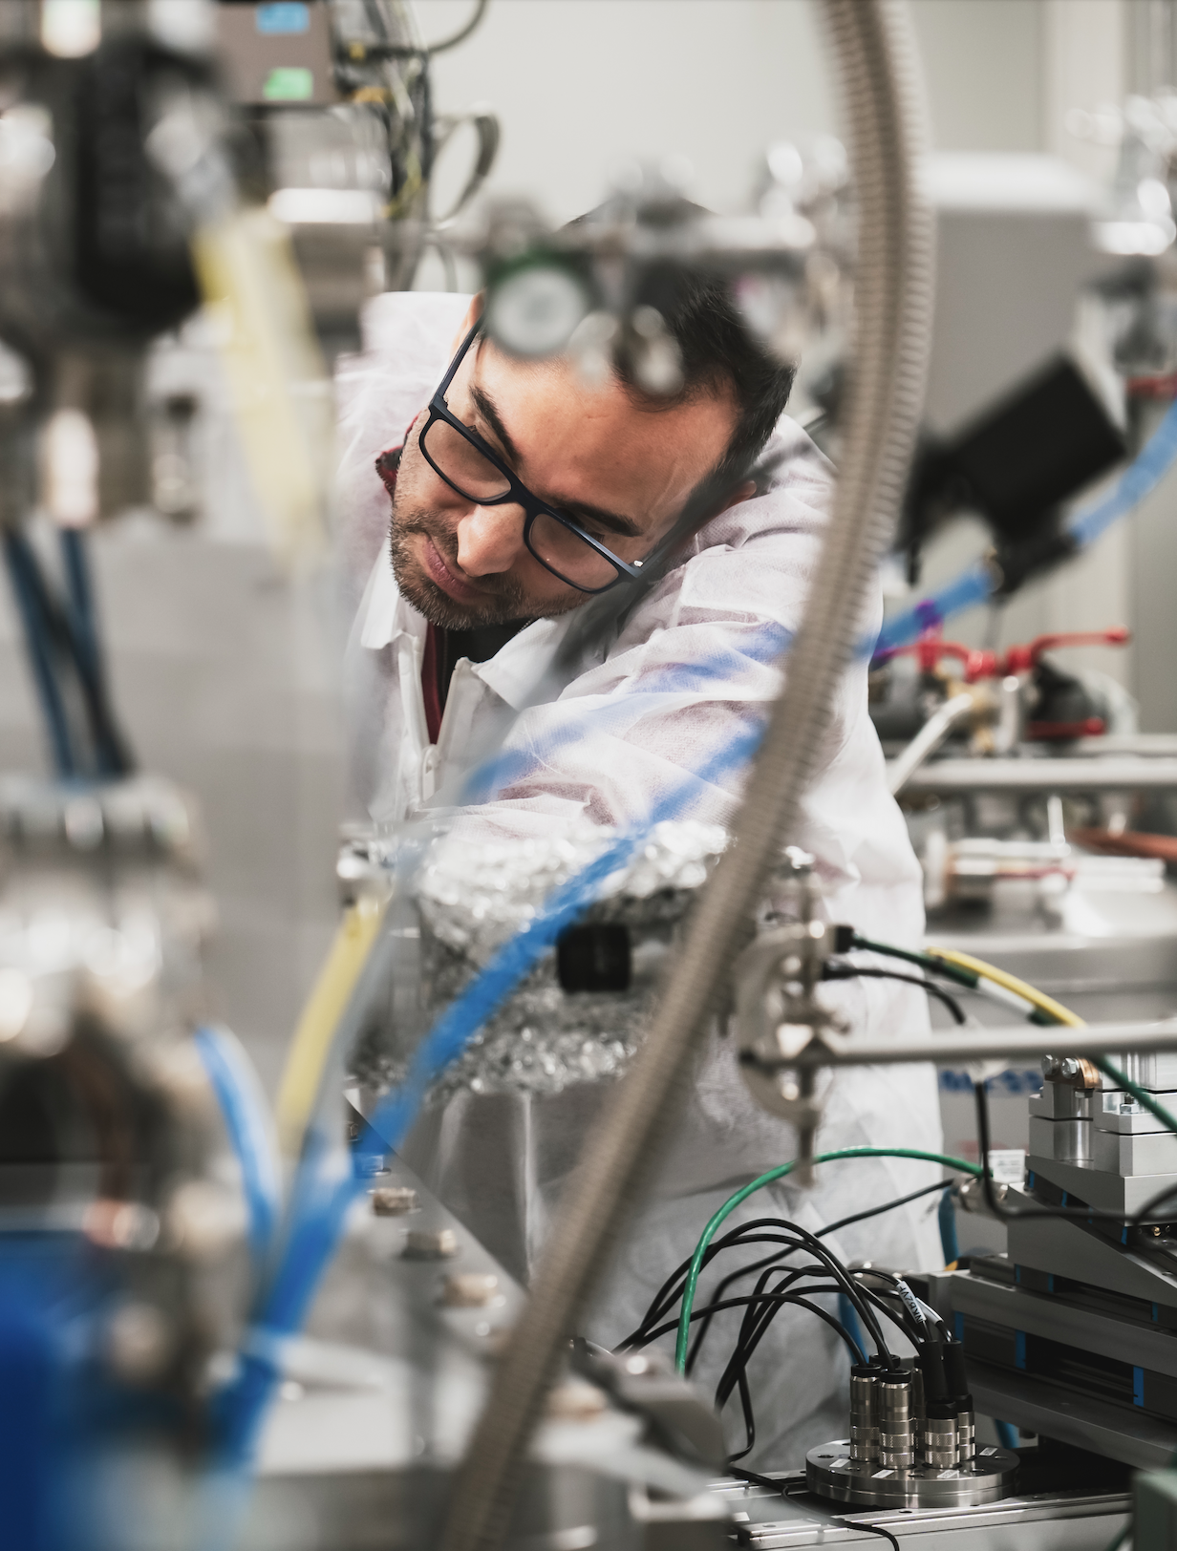
FOOD SAFETY: TOWARDS CROPS SECURITY
FINDING WAYS OF SECURING CROPS WITHOUT DAMAGING THE ENVIRONMENT
A team from La Trobe University (Australia), Aarhus University (Denmark), the Universidad Politécnica de Madrid (Spain) and the ESRF has identified a genetic « off switch » that shut down the process in which legume plants convert atmospheric nitrogen into nutrients.
It could be key to understanding how to increase the crop’s capacity to convert nitrogen from the air and improve soil quality.
The team used X-ray fluorescence on ID21 to track the distribution of zinc in the root nodules of Lotus plants in low-nitrate soils and in nitrate-rich soils.
Lin et al., Nature 2024, 26 June 2024

Slide 10
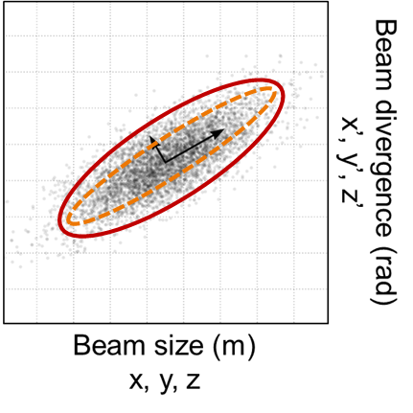
The Figure of Merit of a Light Source: BRILLIANCE
Brilliance or Spectral Brightness (flux density in phase space) is an invariant quantity in statistical mechanics, so that no optical technique can improve it.
XFEL
photons/s/mm²/mrad²/0.1%BW
10²⁵
4th generation
ESRF-EBS
Ultra Low Emittance Storage Rings
ESRF (2014)
10²⁰
3rd generation
10²⁰
ESRF (1994)
undulator
Emittance ε = size x divergence
m x rad
10¹⁵
2nd generation
wiggler
1st generation
10¹⁰
X-ray tubes
10⁵
1900 1920 1940 1960 1980 2000 2020
Year

Slide 11
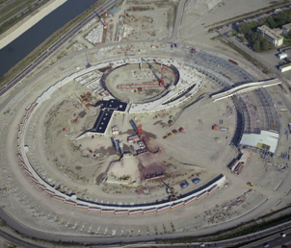
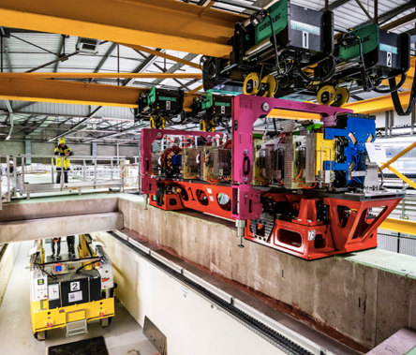
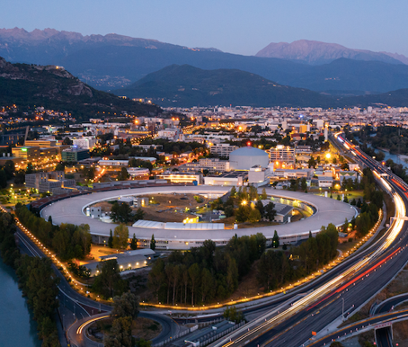
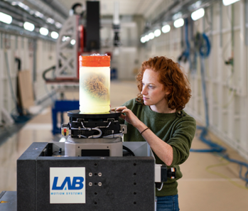
1994 - 2024: pioneering synchrotron science, advancing knowledge
1988-1994 - USM-1994
1 JANUARY 2009
25 AUGUST 2020
MAY 2024
ESRF, the first 3rd-generation synchrotron: 11 European countries joining forces to open a new vista in synchrotron science
ESRF UPGRADE PROGRAMME (2009-2022) launched by the ESRF’s 21 partner countries.
UP PHASE-I delivered in 2015 on time and within the budget
Delivery of ESRF-Extremely Brilliant source (EBS), a game changer: the first of a new generation of high-brilliance X-ray source
30 years of operation
4 years of successful operation of ESRF-EBS
BRINGING NATIONS TOGETHER TO ENABLE SCIENTIFIC EXCELLENCE AND TO ADDRESS GLOBAL CHALLENGES

Slide 12
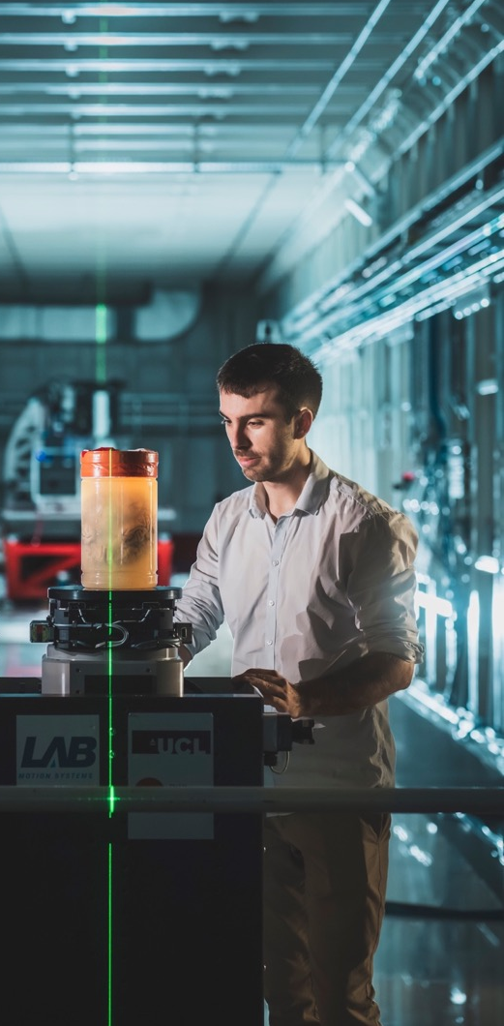
ESRF-EBS: The Human organ Atlas project
A REVOLUTION FOR BIO-IMAGING
UNDERSTANDING HUMAN DISEASES THANKS TO A NEW INSIGHT
INTO OUR BODY
https://human-organ-atlas.esrf.eu/
An open-access database developed as part of the EU project PaNOSC
Already over 40 groups worldwide collaborating to provide samples and utilise/share the results

Slide 13
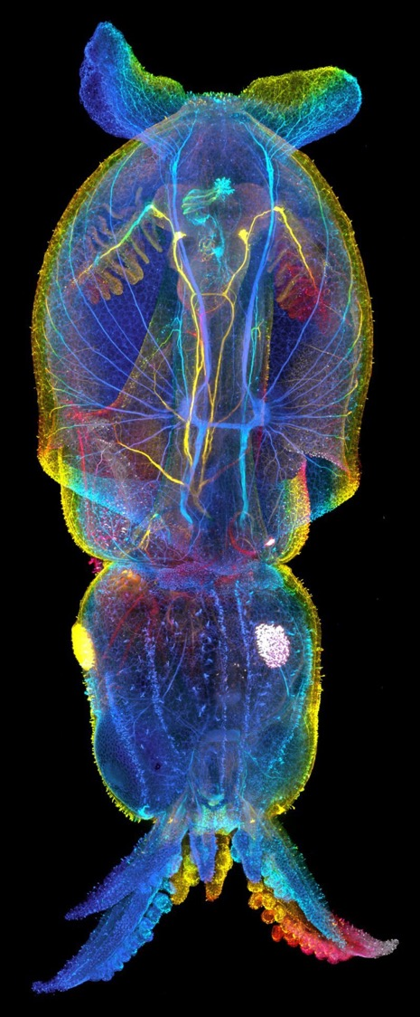
EBS NEW SCIENCE: CONNECTOMICS
THE MOST COMPLETE ORGANISM IMAGED ENTIRELY TO DATE AT THE NANOSCALE
Complete neural wiring of a squid captured thanks to ID16A nano-imaging beamline
6 days of continuous imaging
14TB of data
‘We are here at the ESRF thanks to Alexandra Pacureanu’s ERC work on a leg of a vinegar fly on ID16A. This had a huge impact in the field and completely changed the perception of what is possible with this technique and how it can benefit connectomics.’
Albert Cardona, researcher at the MRC LMB in Cambridge
Cardona Lab MRC Cambridge

Slide 14
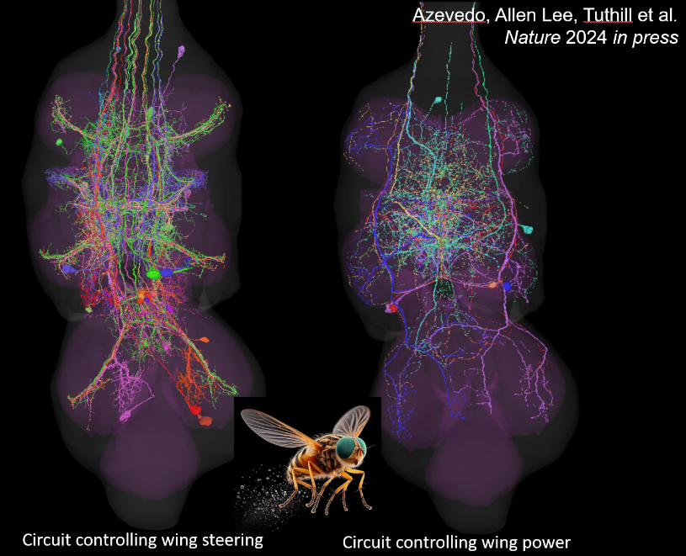
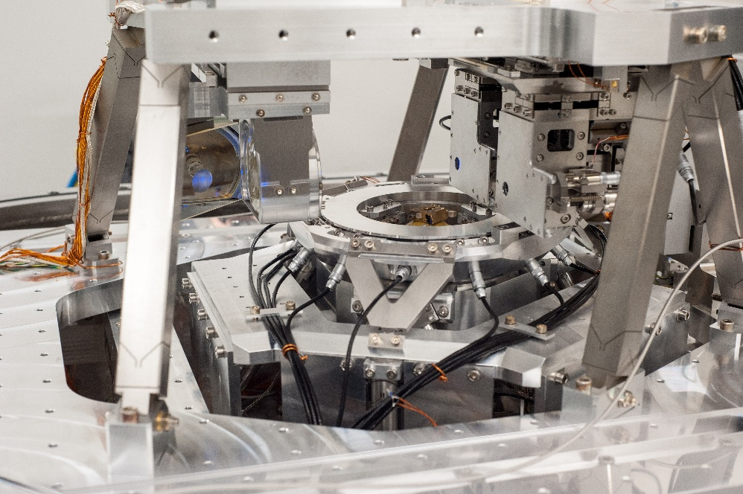
DCM – MECHANICAL ARCHITECTURE
Engineering Challenges Ahead – The CoNnectomics Case
ID16A endstation :
Closed loop control of movement
Sensor (capacitive + interferometers)
→ Real-time controller (speedgoat)
→ actuator (piezostack)
Achieved performance :
20nm resolution @ 5µm/s (scanning)
20nm resolution @ 0.5°/s (tomo)
Connectomics
Scale-up to mammalians
Addressing grand challenges :
1mm³ @20nm in days
Whole mouse brain in 2 months
Throughput and automation
© P Cloetens, A Pacureanu
Challenges for the future ID18 nano-tomo beamline:
Increase scanning speed x 100 (500µm/s, 50°/s)
with same or better resolution ~10nm
Mechatronics approach imperative :
System integration of mechanic / software / electronic.
Use of a real time control system
Design must include dynamic effects in model

Slide 15
THANKS FOR YOUR ATTENTION

