Slide 1

Complexity management:
The role of MBSE and Dependency Structure Matrices
Torben Beernaert, Tim Wilschut
EIROforum Systems Engineering workshop | Feb 5, 2025

Slide 2
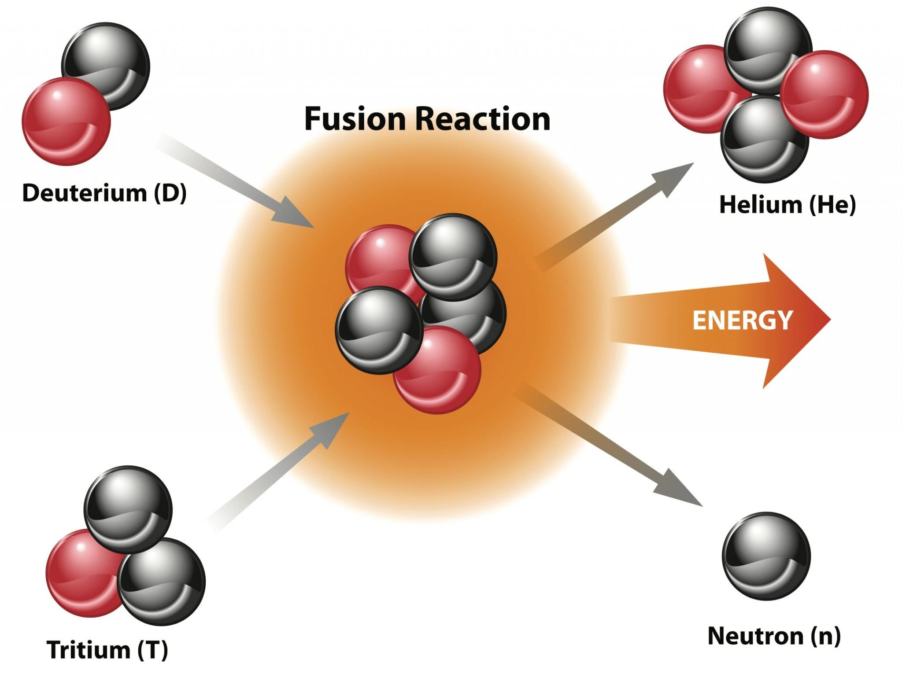
Clear objective

Slide 3
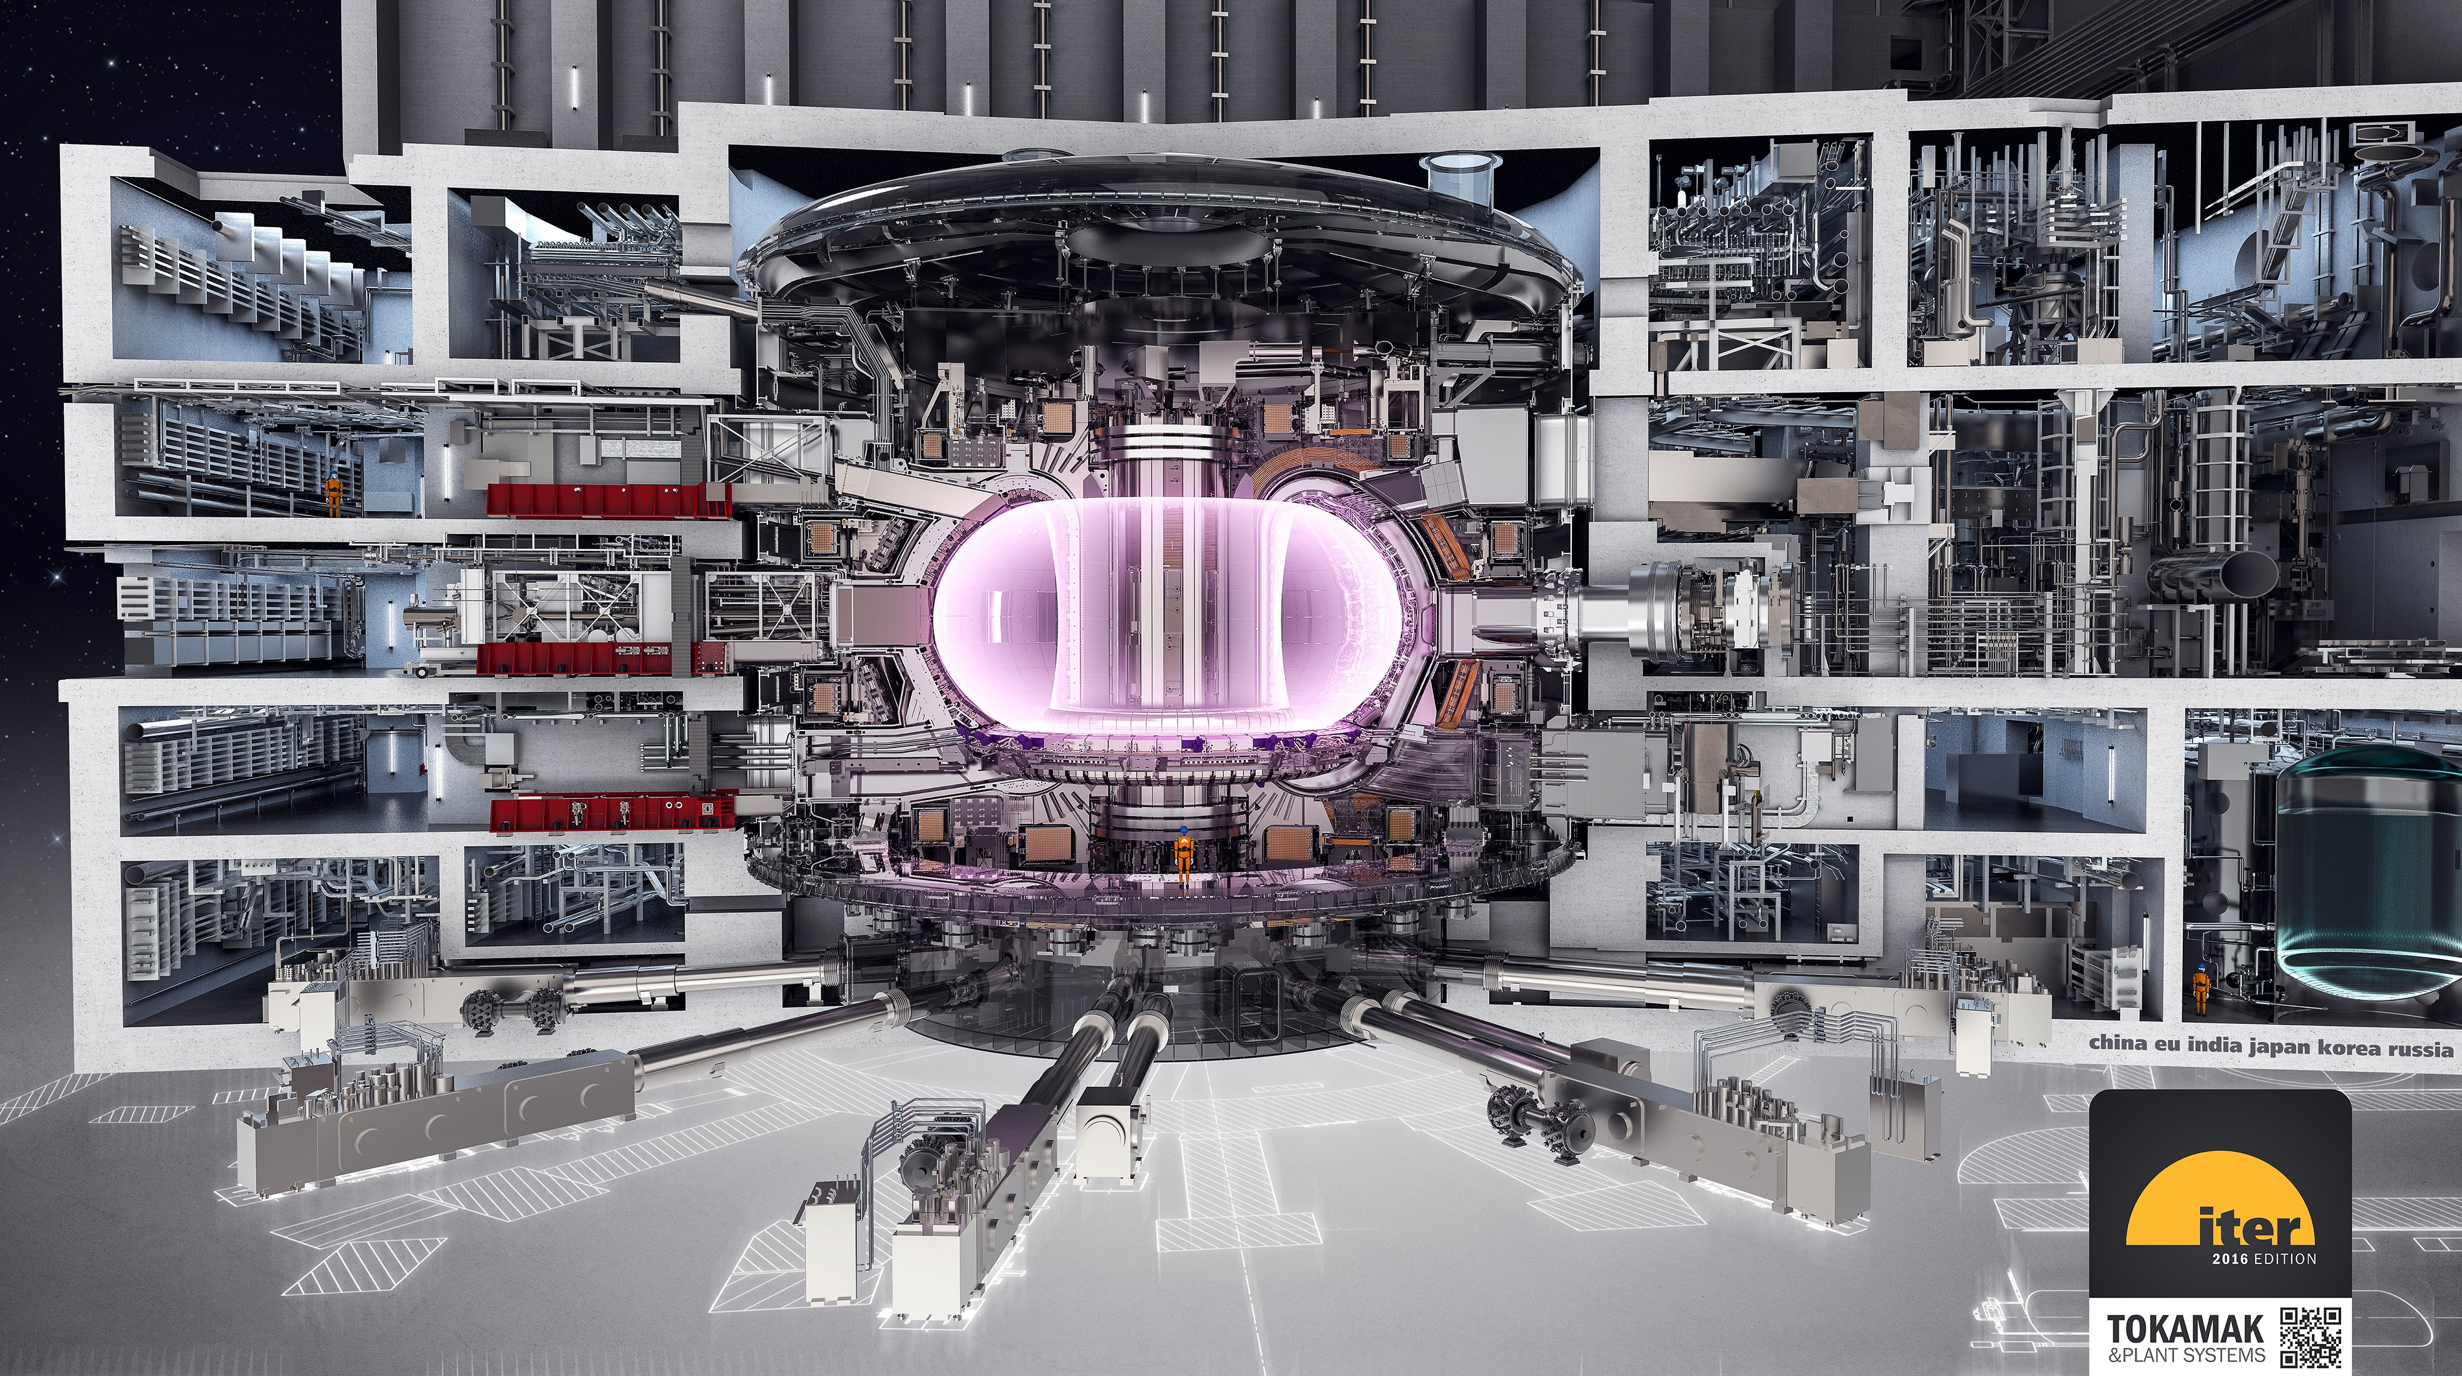
Complex machine

Slide 4
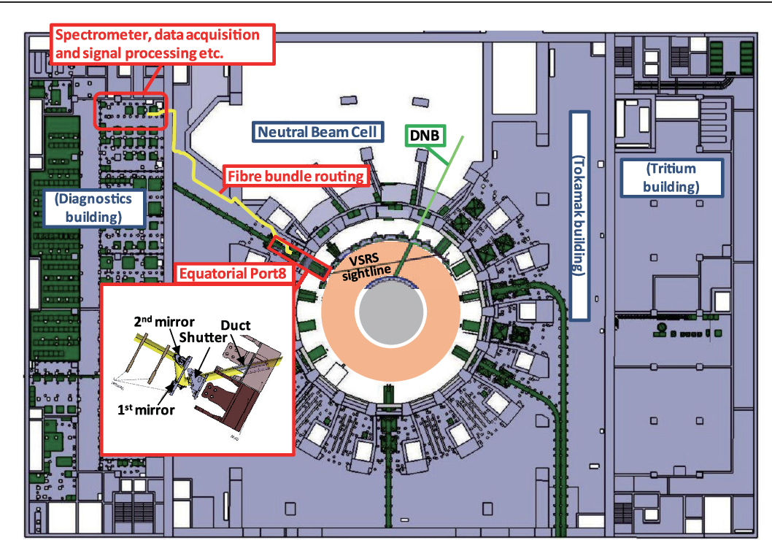
Visible Spectroscopy Reference System (VSRS)

Slide 5
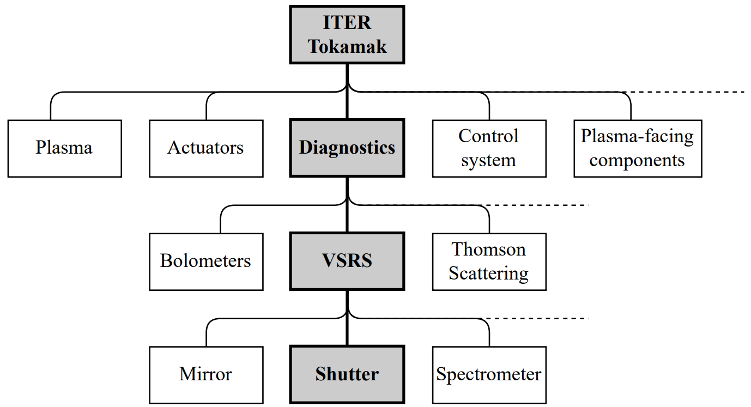
Vertical integration

Slide 6
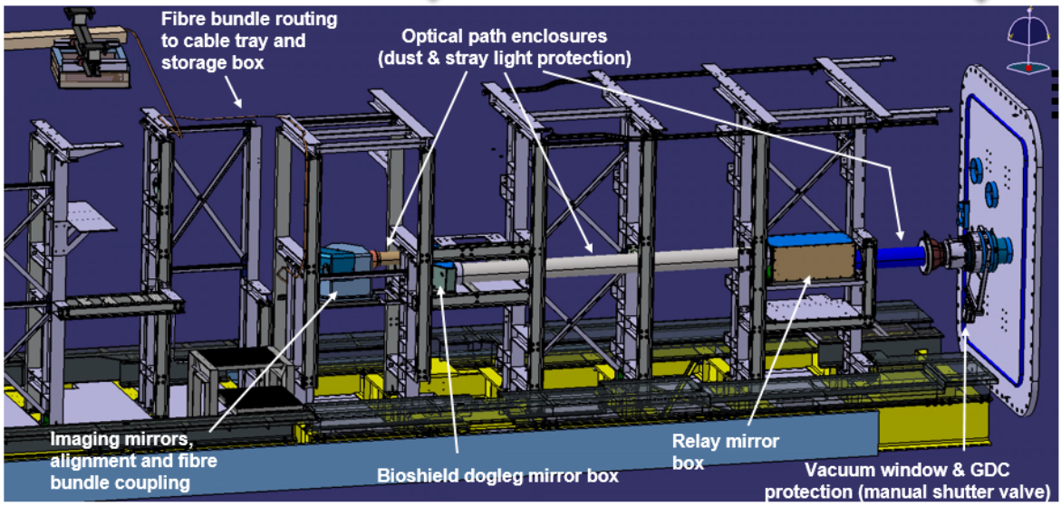
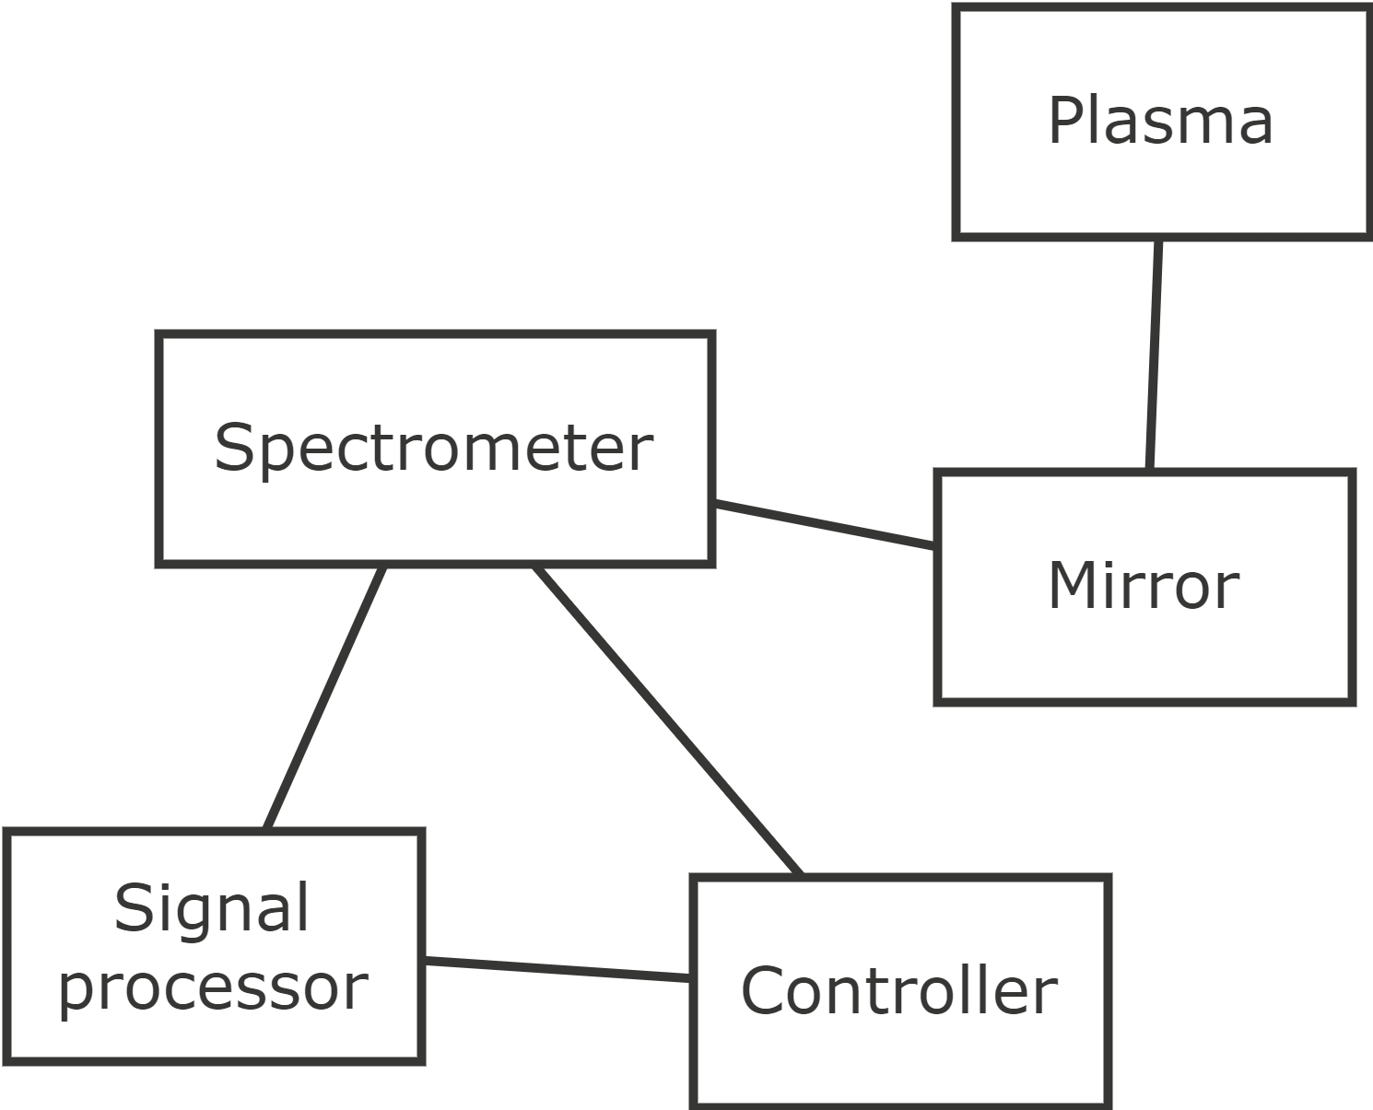
Lateral integration

Slide 7
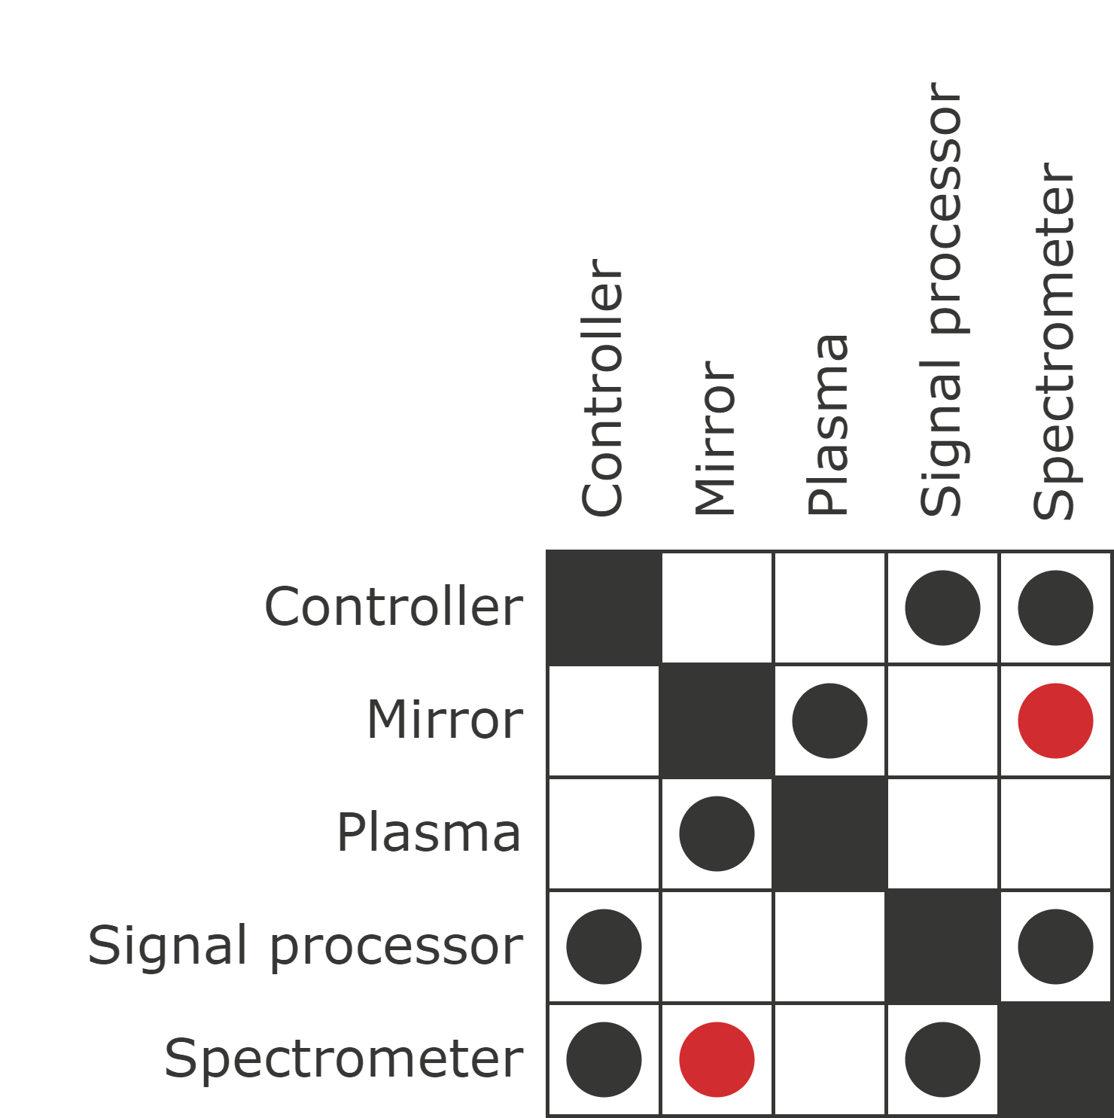
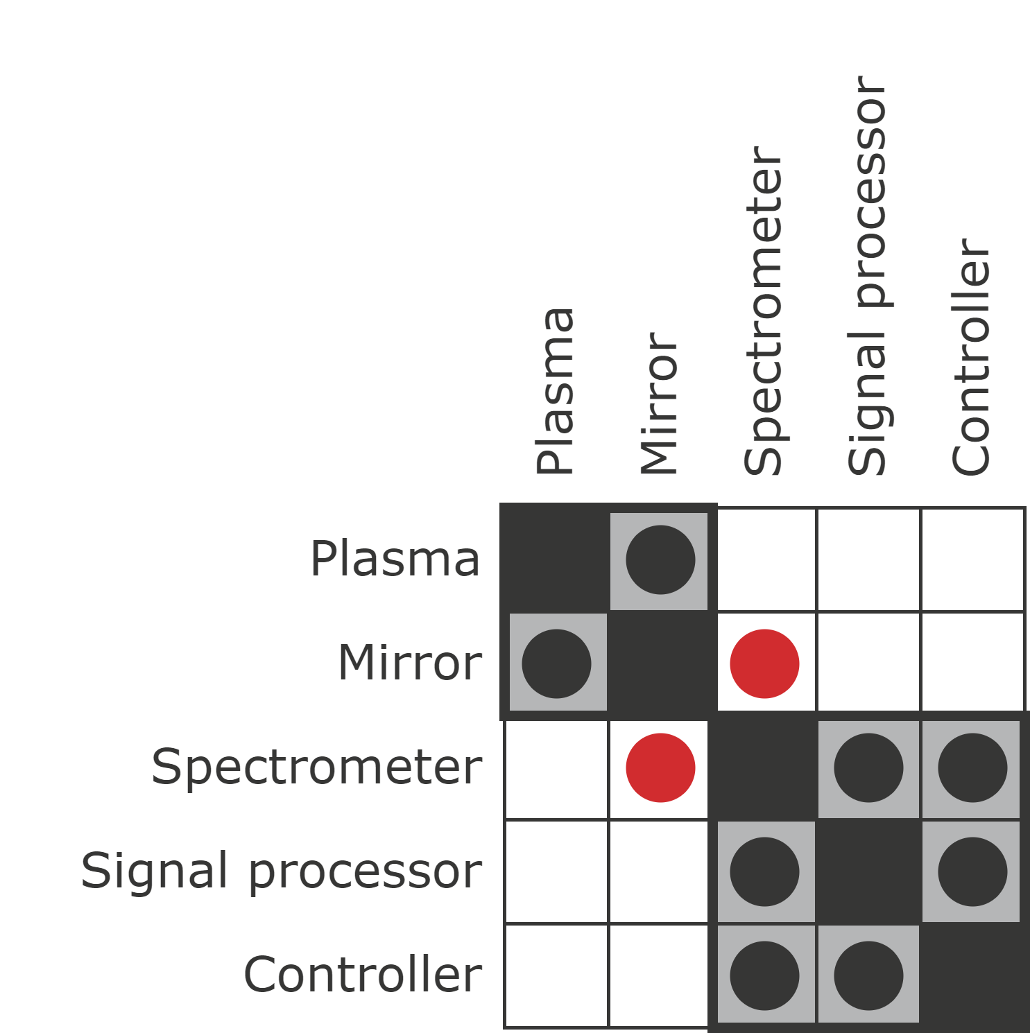
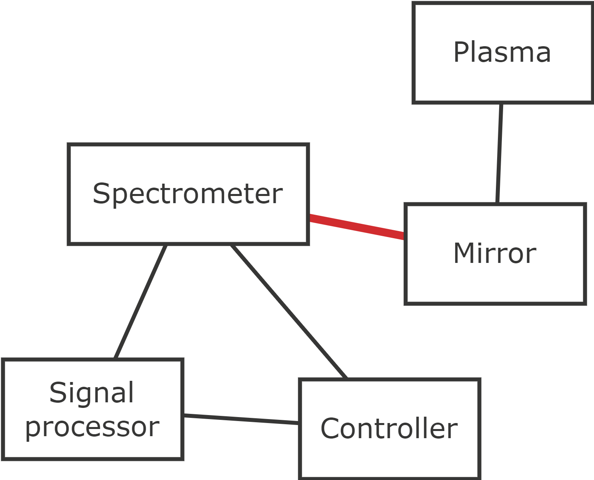
Dependency Structure Matrix (DSM)

Slide 8
Dependency Structure Matrix (DSM)

Slide 9
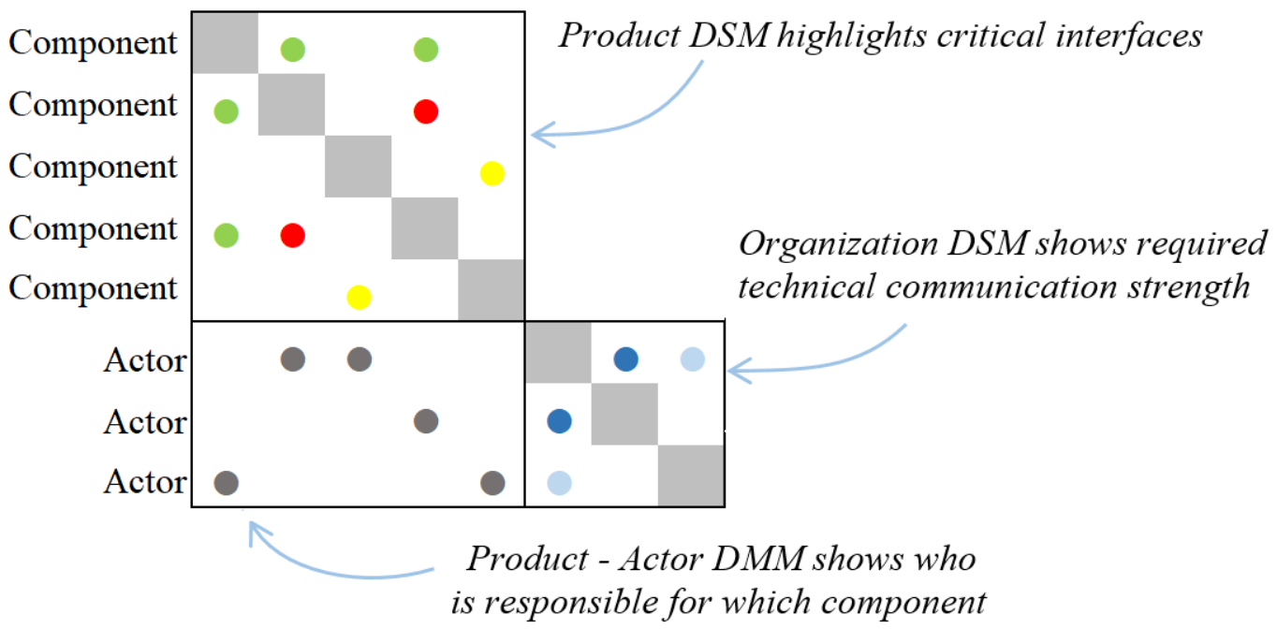
Organizational complexity

Slide 10
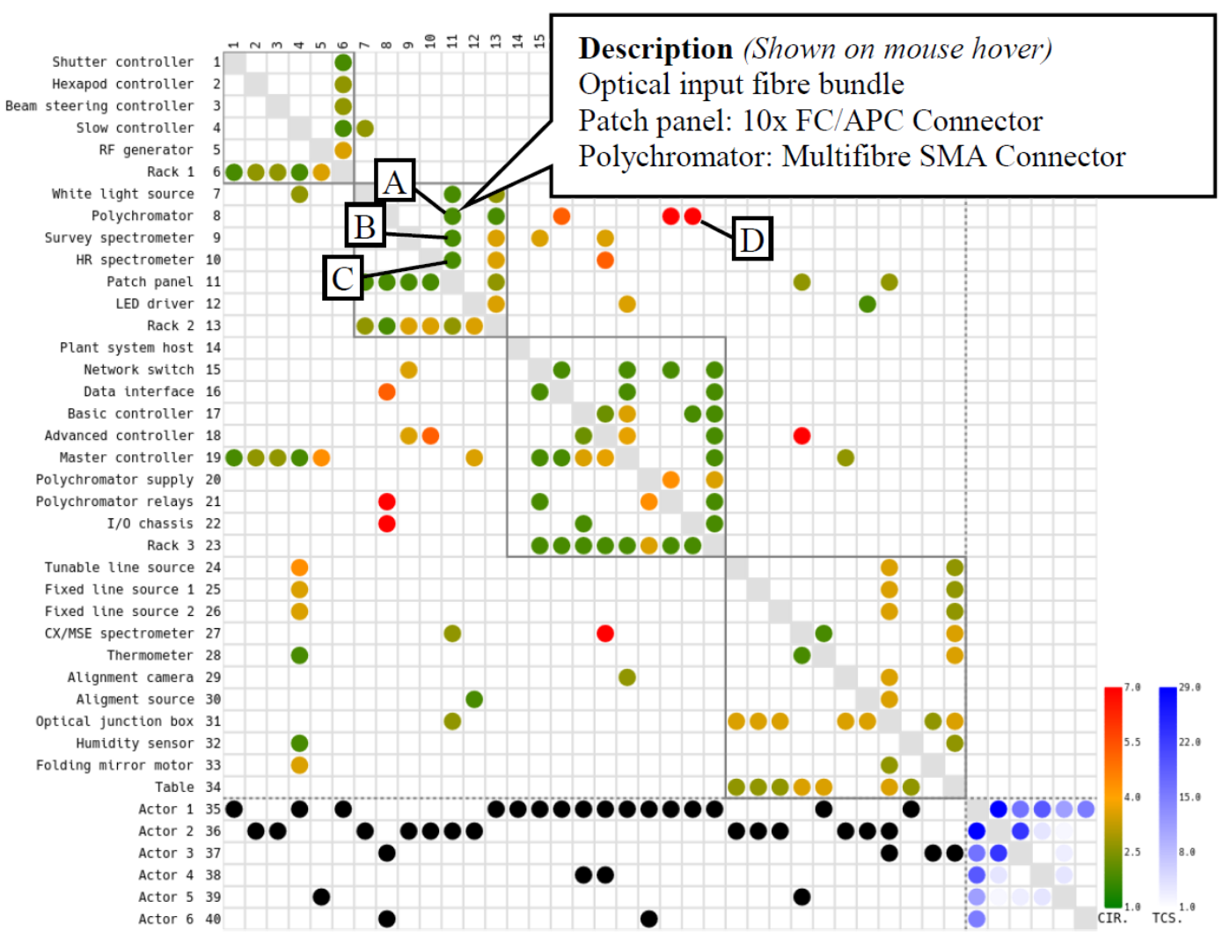
Organizational complexity

Slide 11
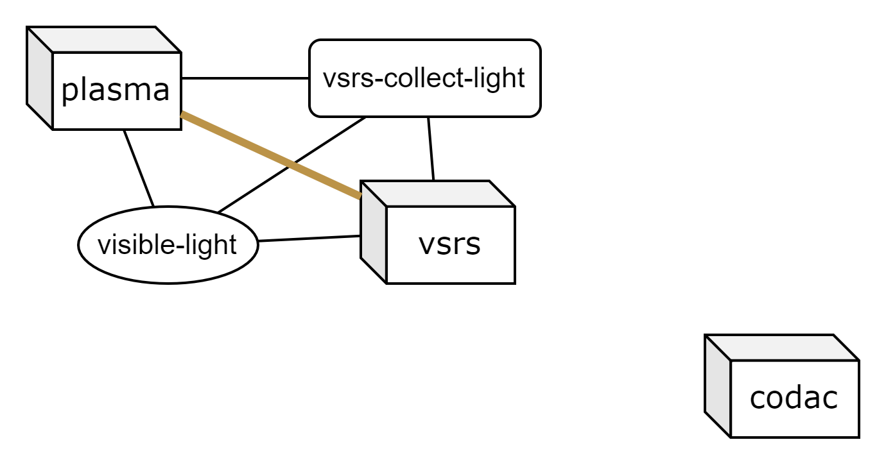
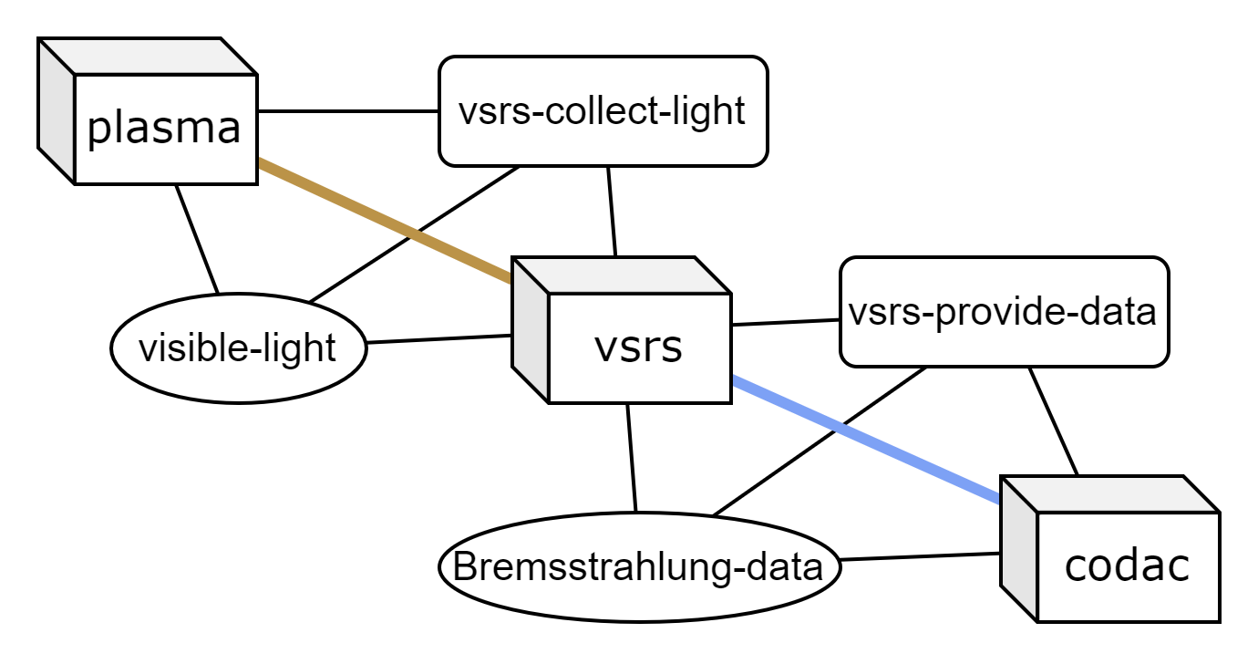
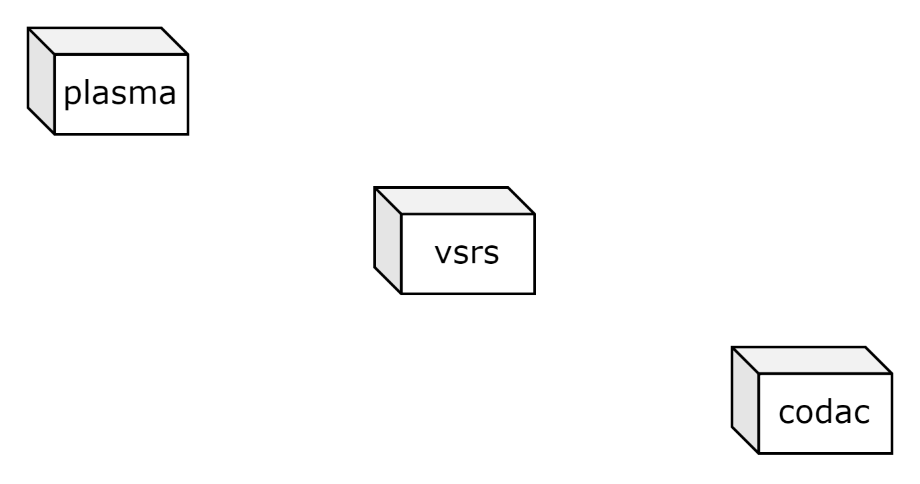
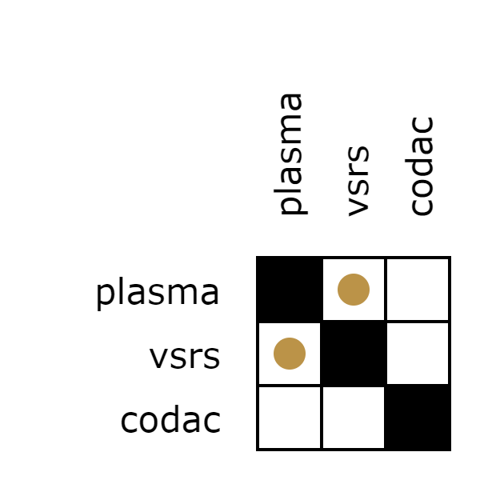
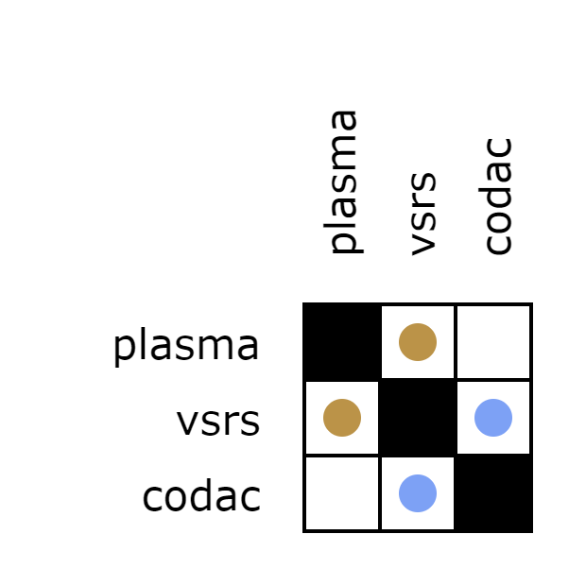
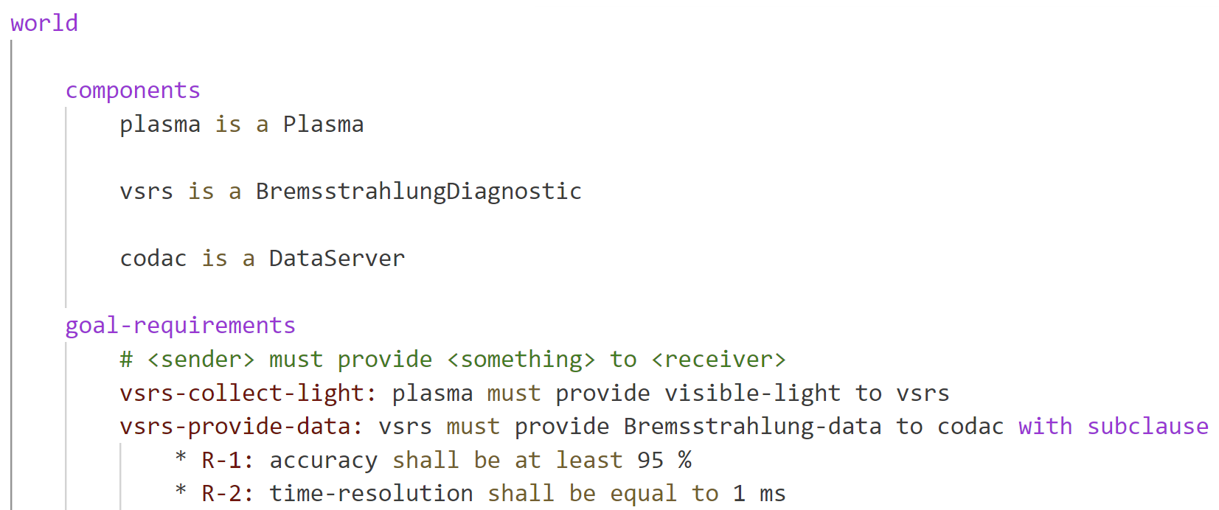
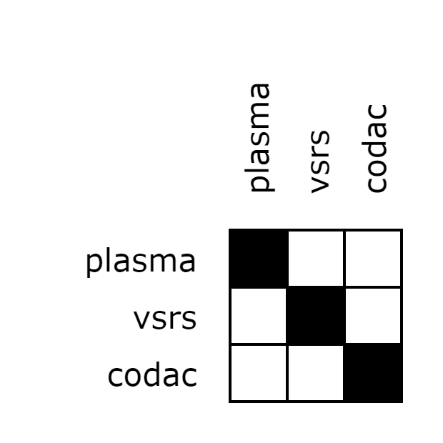
Elephant Specification Language (ESL)

Slide 12
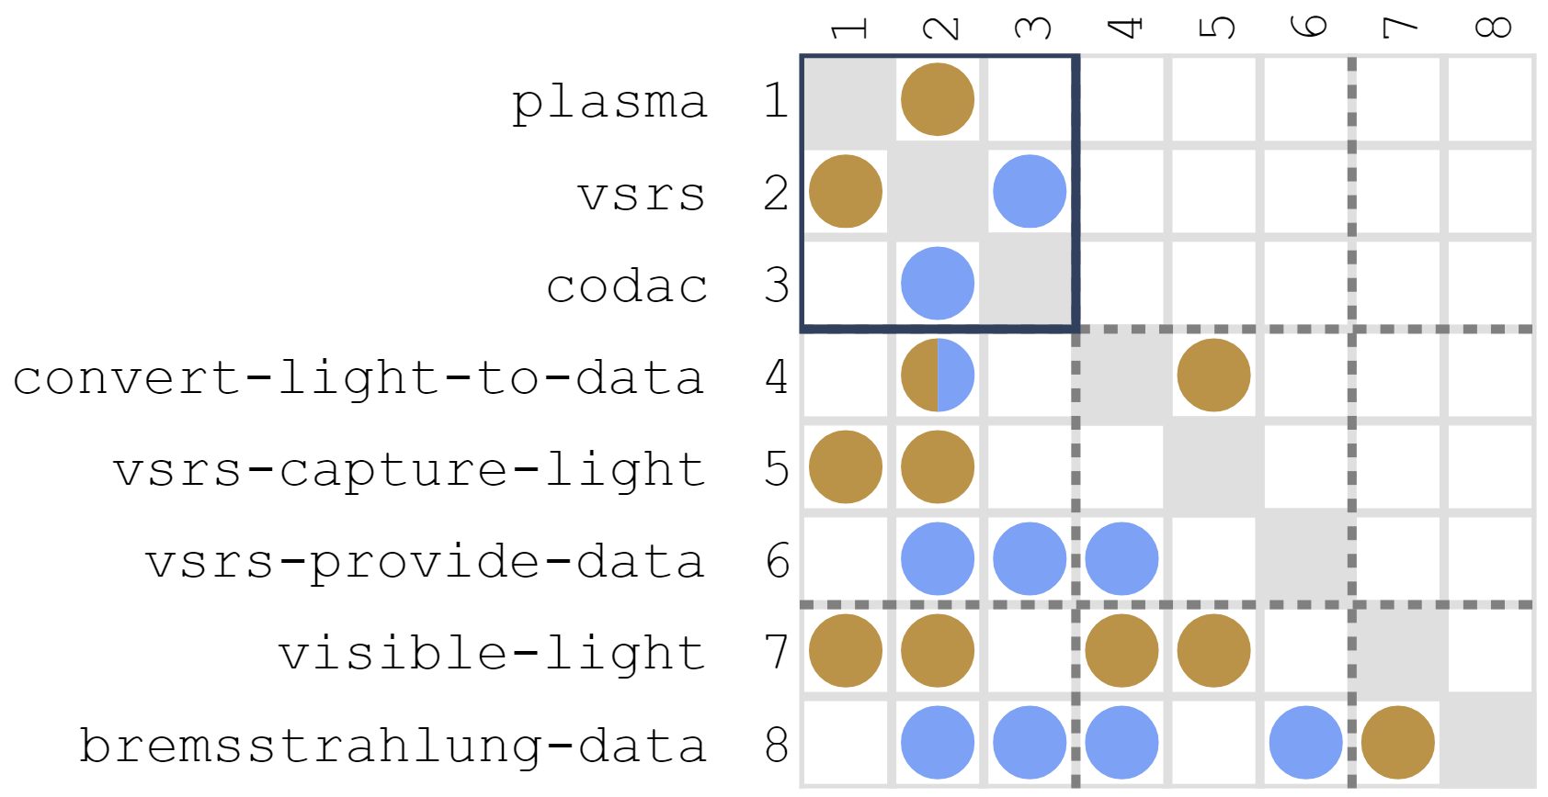
Elephant Specification Language (ESL)

Slide 13
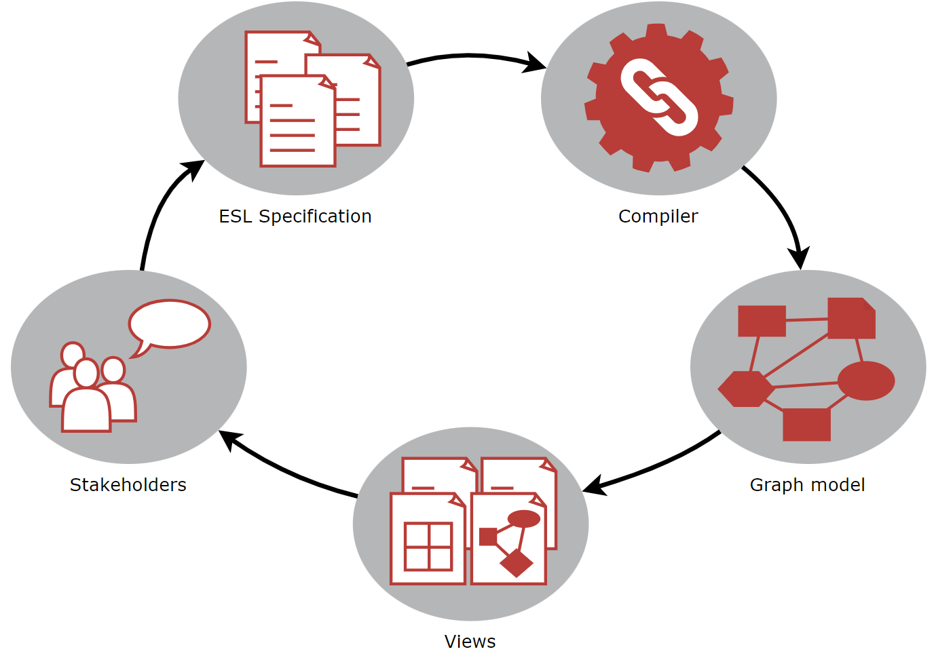
Model-Based Systems Engineering (MBSE)

Slide 14
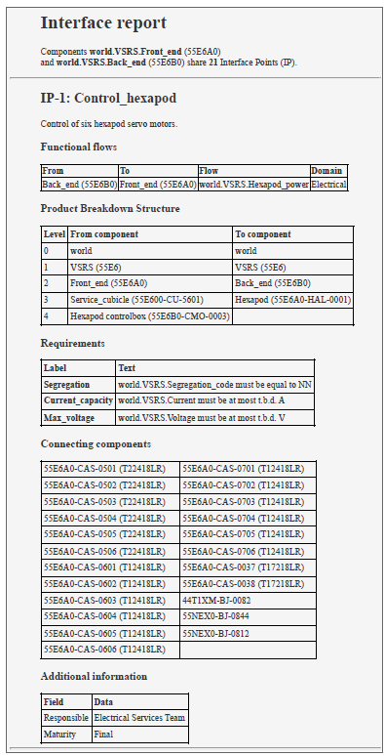
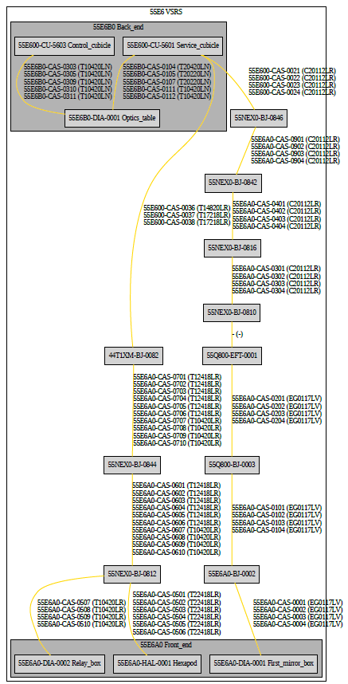
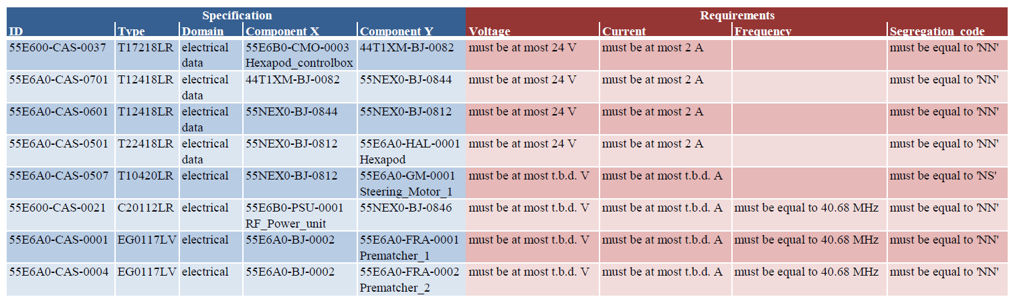
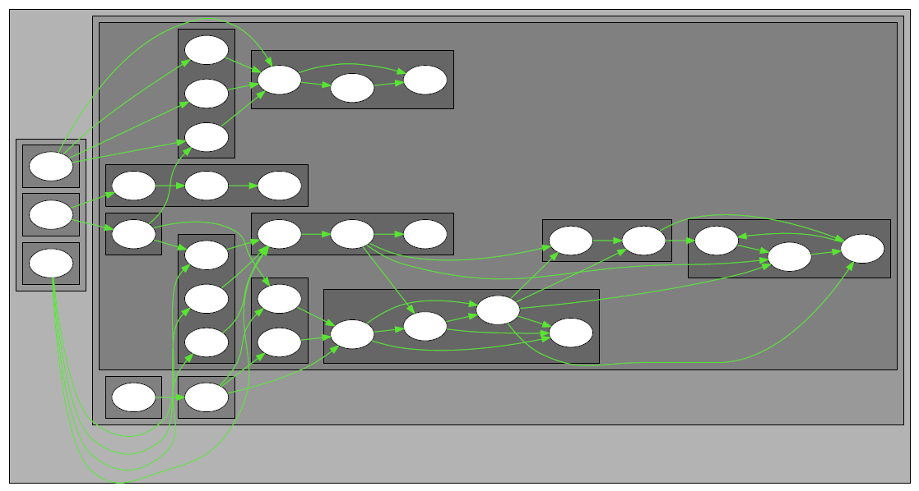
Views for every occasion

Slide 15
Takeaways
Nuclear fusion reactors are complex
Manage technical and organizational interfaces
DSM techniques provide structure and overview
MBSE + ESL for effective design management
Applications in fusion diagnostics, plasma control and beyond
Demonstration in Breakout Session I: Tools, Processes & Collaboration

Slide 16
Further reading
Elephant Specification Language
Wilschut, T. et al. (2024). Bridging the gap between requirements engineering and systems architecting: The Elephant Specification Language. Design Science.
VSRS
Beernaert, T. F. et al. (2024). Multi-Level Architecture Modelling and Analysis: The Case for Model-Based Systems Engineering of Fusion Diagnostics. Fusion Engineering and Design.
Beernaert, T.F. et al. (2022). Challenges Of Big-Science: A Matrix-Based Interface Model To Manage Technical Integration Risks In Multi-Organizational Engineering Projects. Proceedings of the 24th International DSM Conference (DSM 2022), Eindhoven, The Netherlands
DSM & MBSE in fusion
Beernaert, T.F. (2024). Discovering the Potential of Dependency Structure Modelling for Fusion Systems Engineering. PhD Thesis, Eindhoven University of Technology

Slide 17
Complexity management:
The role of MBSE and Dependency Structure Matrices
Torben Beernaert, Tim Wilschut
EIROforum Systems Engineering workshop | Feb 5, 2025

