Slide 1
Streamlining Systems Engineering
EMBL Hamburg Instrumentation Team's Approach
Enrique Rodríguez García
Mechanical and mechatronics engineer
EIROforum IWG Workshop on Systems Engineering – 05/02/2025

Slide 2
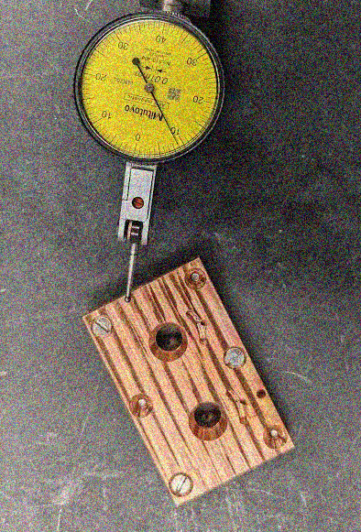
Introduction
Systems engineering is traditionally applied to large-scale projects, but systems engineering principles can also benefit small teams and smaller projects.
This presentation explores how we apply these principles to the engineering design of new instruments at EMBL Hamburg Instrumentation, highlighting both the advantages and the challenges.
Our team's diverse responsibilities range from new instrument design to maintaining the three EMBL beamlines at DESY.

Slide 3
Team overview
EMBL Hamburg Instrumentation Team members involved in design
2 mechanical technicians.
1 electrical technician.
1 control and software engineer.
1 mechanical and mechatronics engineer.

Slide 4
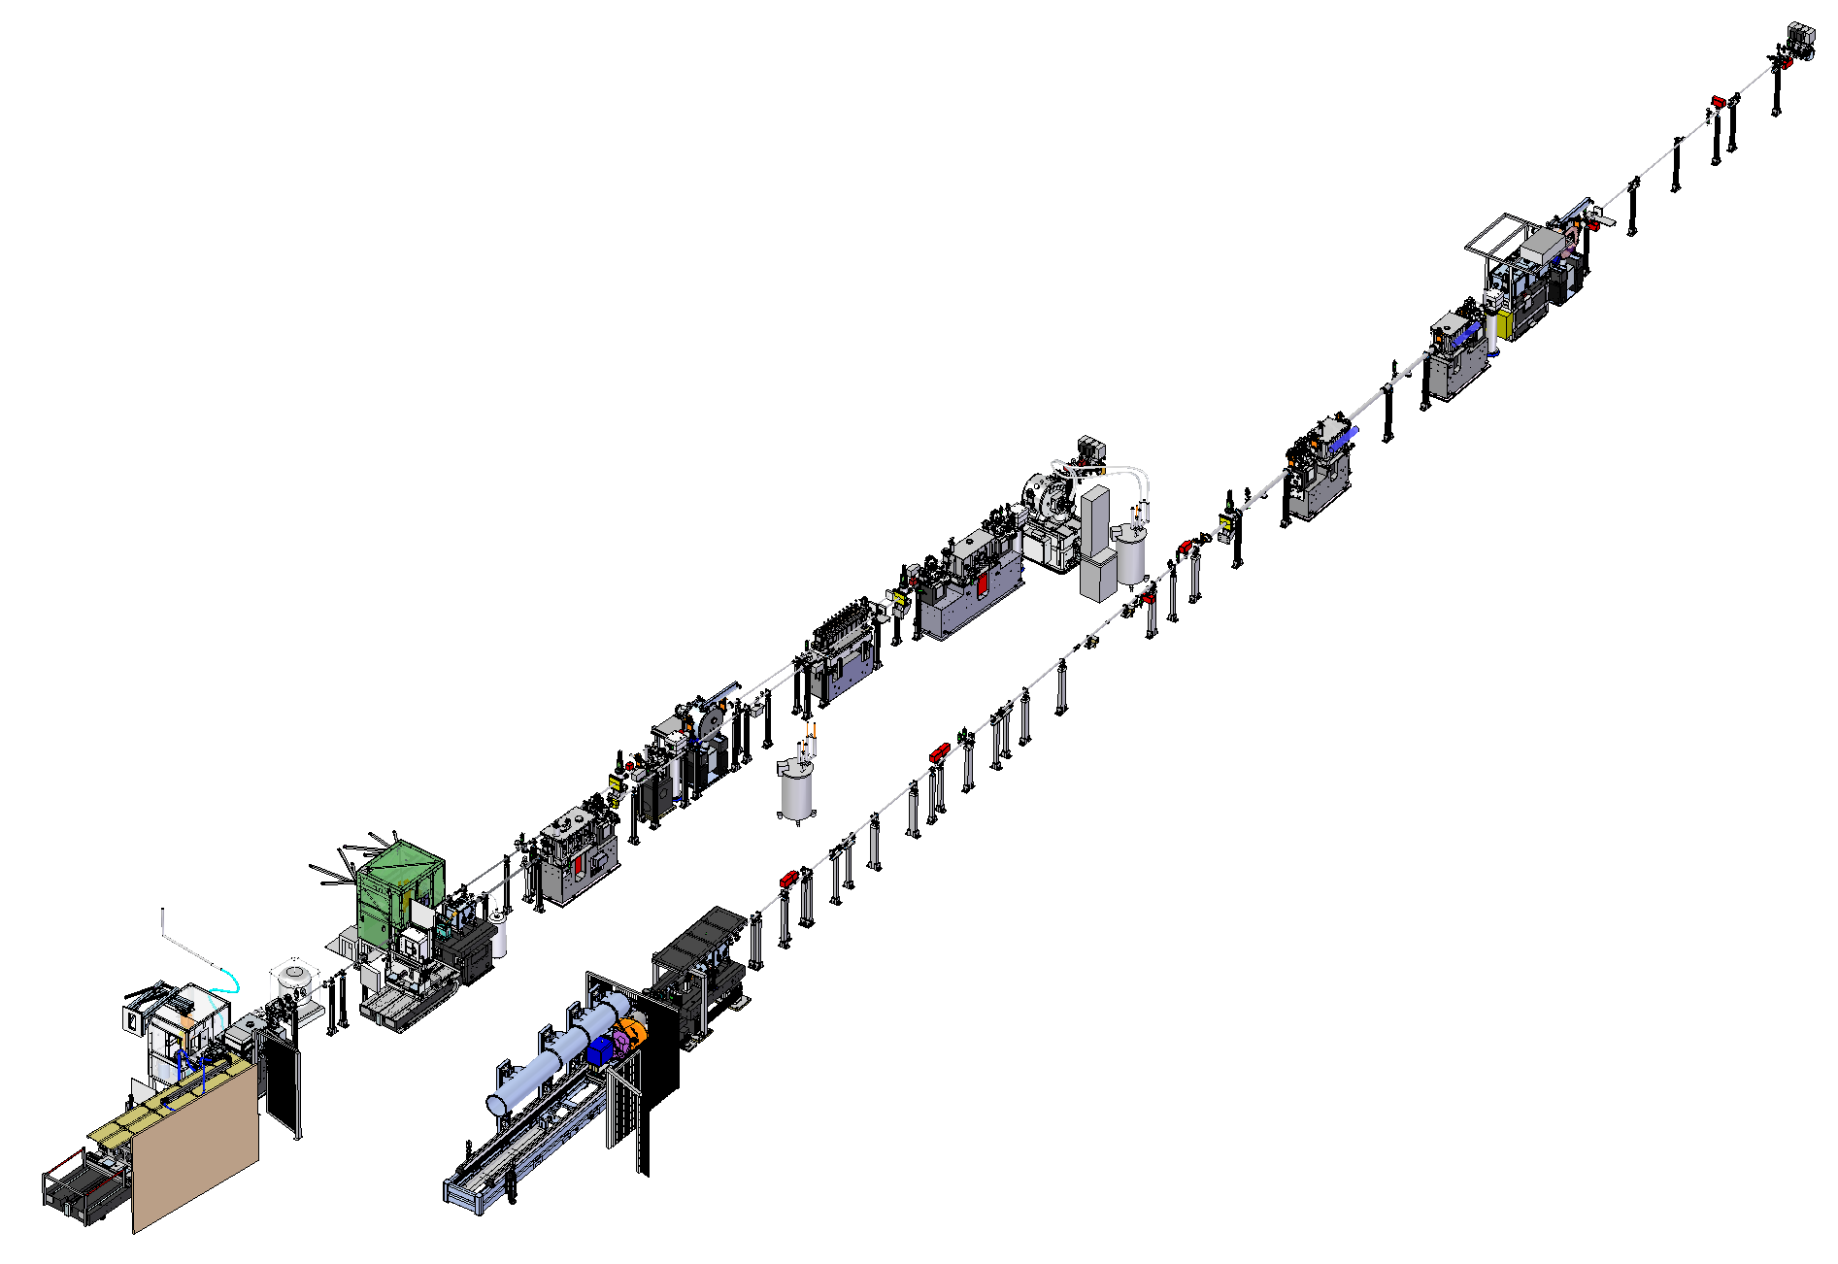
Streamlining Instrument Design at EMBL
Key goals:
Improve efficiency and reduce lead times.
Enhance collaboration and communication.
Reduce errors and rework.
Increase design quality.
Optimise resources.
Challenges:
Limited resources.
Resistance to change.
Integrating with existing legacy systems.
Ambiguous and changing requirements.
Competing priorities.

Slide 5
Tailoring Systems Engineering for Small Teams
Simplify processes.
Lightweight documentation.
Focus on critical requirements.

Slide 6
Systems Engineering Approach for Small Teams
Understand the Problem
Assess the Benefits
Need
Validate
New instrument…
Operate, Maintain, Dispose…
Understand the Solution
Assess the Solution
Requirements
Verify
Requirements
Requirements
Requirements
System Design
Integrate
Specification
Assemble
Detailed Design
Manufacture

Slide 7
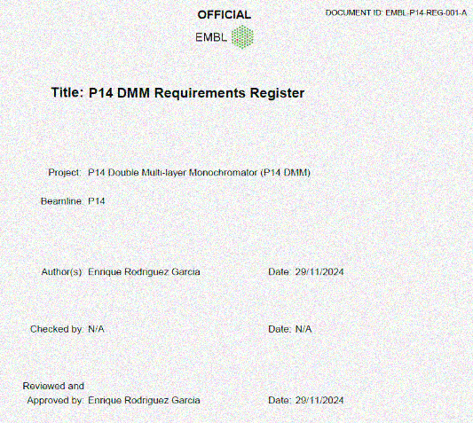
Systems Engineering Approach for Small Teams (cont.)
Requirements Analysis:
Gathered stakeholder needs through meetings.
Employed past experiences to capture functional and non-functional requirements.
Prioritized requirements based on value and feasibility.
System Design:
Utilized collaboration tools to ensure transparency and keep everyone informed.
Developed prototypes to evaluate design choices and gather feedback.
Understand the Problem
Assess the Benefits
Need
Validate
New instrument…
Operate,
Maintain,
Dispose…
Understand the Solution
Assess the Solution
Requirements
Verify
System Design
Integrate
Specification
Assemble
Detailed Design
Manufacture

Slide 8
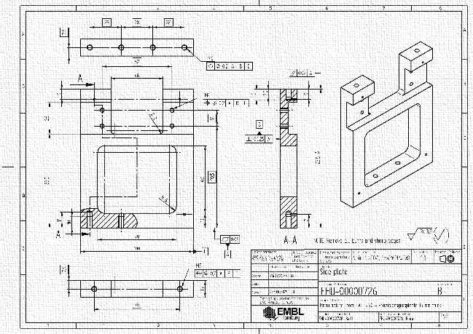
Systems Engineering Approach for Small Teams (cont.)
Integration and Testing:
Implemented a phased integration approach to minimize risks.
Conducted testing at each stage, including unit, integration, and system testing.
Verification and Validation:
Performed acceptance testing to confirm that the system meets user needs.
Tracked and resolved defects throughout the development process.
Documented the system design and test results for future reference.
Understand the Problem
Assess the Benefits
Need
Validate
New instrument…
Operate,
Maintain,
Dispose…
Understand the Solution
Assess the Solution
Requirements
Verify
System Design
Integrate
Specification
Assemble
Detailed Design
Manufacture

Slide 9
Systems Engineering Tools for Small Teams
Requirements & Risk Management: MS Excel was used for efficient tracking and management of requirements and risks, ensuring traceability and version control.
CAD Data Management: Solid Edge Data Management streamlined our CAD data organization and accessibility, facilitating collaboration and version control.
Modelling & Simulation: Mathcad and ANSYS enabled us to analyse system behaviour and predict performance, optimising design choices and reducing potential issues.
Collaboration & Project Management: Asana enhanced communication and project coordination, ensuring everyone was informed and aligned.

Slide 10
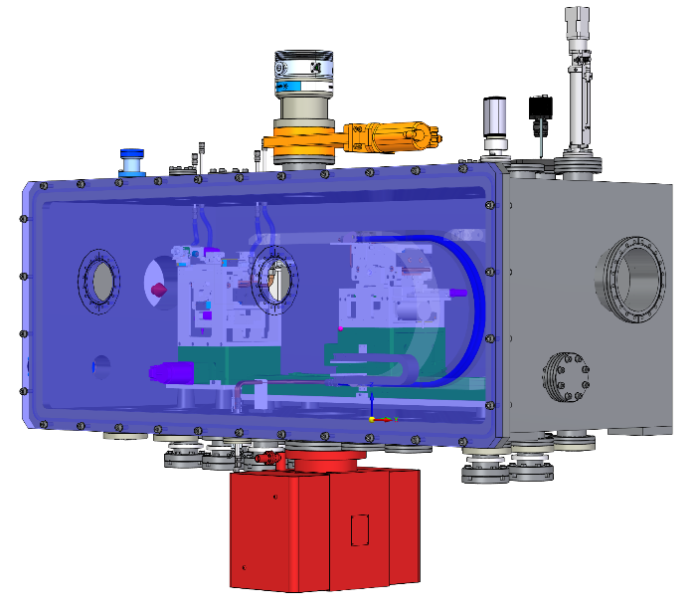
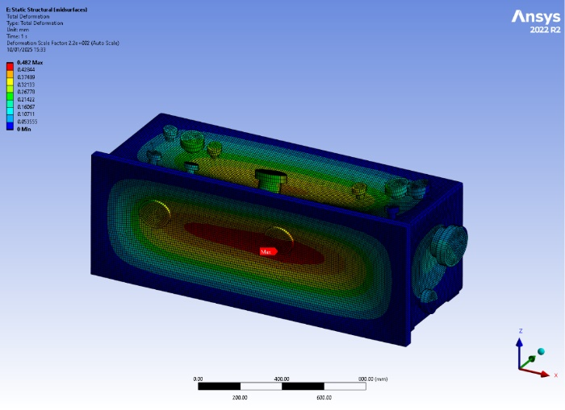
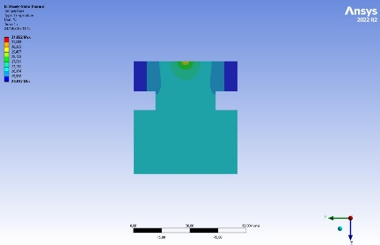
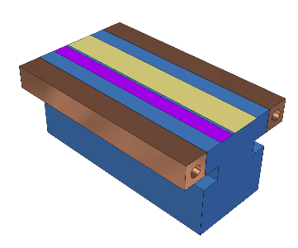
Example
P14 Double Multilayer Monochromator (on-going project).
Requirements were gathered at the beginning and updated (modified or added) during the design.
Modelling and simulation tools (Mathcad and ANSYS) were used at different design stages.
Tests were and are developed.
Collaboration platform (Asana) used throughout the whole design phases.
Common PDM system for sharing CAD information for manufacturing and assembly.

Slide 11
Challenges and Situations
Challenge 1: Resistance to change. Implementation of a new PDM system.
Solution: Conducted extensive meetings to communicate the benefits of the new system and address concerns. Also, produced a guidelines document to be used as reference.
Challenge 2: Integration issues with legacy PDM system and unmanaged CAD files.
Solution: Produced a guideline document to use data migration tools to ensure seamless integration.
Challenge 3: Unrealistic expectations.
Solution: Used a project management tool to communicate estimated durations, tasks involved and show how limited are the resources available.

Slide 12
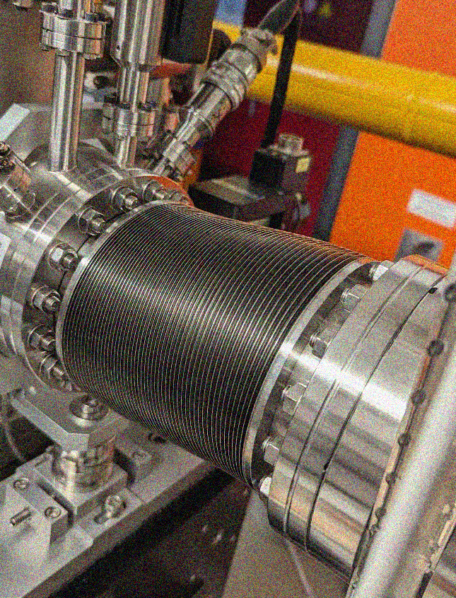
Results and Outcomes
Centralized CAD Data: Established a single source of truth for CAD models, improving accessibility and version control.
Enhanced Documentation: Improved project documentation, facilitating knowledge sharing and reducing errors.
Increased Efficiency: Streamlined workflows, reduced errors, and minimized rework, leading to greater efficiency. While difficult to quantify precisely, the impact on efficiency is evident.
Stronger Collaboration: Fostered a more collaborative environment, improving communication and coordination among team members.

Slide 13
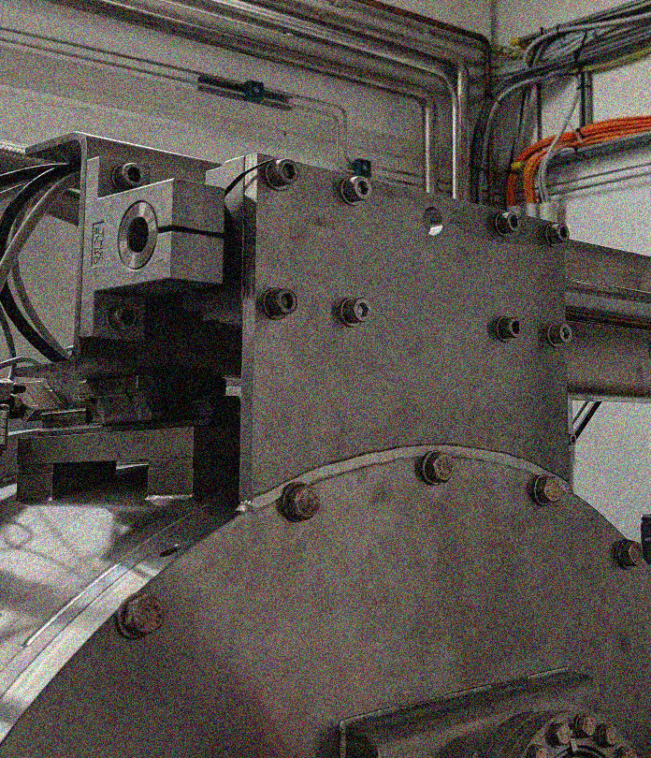
Lessons Learnt
Early Stakeholder Involvement: Engaging stakeholders early and often is crucial for gathering accurate requirements and ensuring buy-in.
Clear Communication: Effective communication is essential throughout the project lifecycle to keep everyone informed and aligned.
Continuous Improvement: Regularly review and adapt processes to improve efficiency and address new challenges.
Contingency planning: Developing alternative plans enables effective responses to unforeseen challenges.

Slide 14
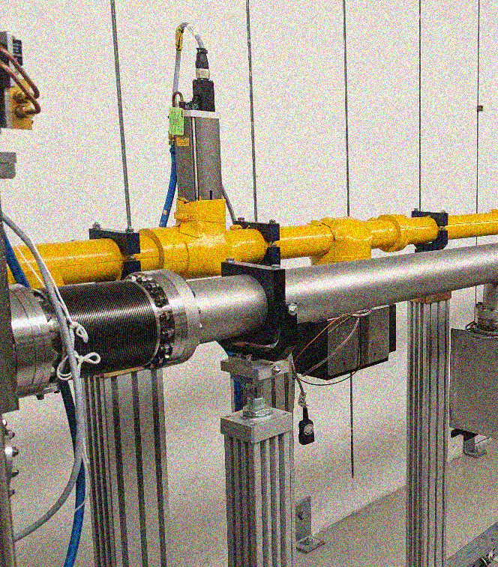
Conclusion
Systems engineering plays a vital role in the present and future of the Instrumentation Team at EMBL Hamburg.
By applying a structured and holistic approach, we were able to overcome challenges, deliver high-quality systems, and achieve significant benefits.
The principles of systems engineering can be applied to a wide range of projects to improve outcomes and drive organizational success.

Slide 15
Thank you

Slide 16
Questions and Discussion

