Slide 1
ESA - MBSE practices and example

Slide 2
Digitization & MBSE: motivations and ESA approach
Basic need for digitization of Systems Engineering practices:
Manage large amounts of (complex) information
  Maintain coherent repository(ies) for information / data
  Record nature of information / data relationships
  Maintain traceability and data continuity across engineering domains.
  Allow adequate access to users to common and coherent data sets
  “Get the right information, at the right time to the right people”

Slide 3
Digitization & MBSE: motivations and ESA approach
“Model Based Systems Engineering” (MBSE) term used loosely to refer to different aspects : digitalization concept, processes, tools, etc.
The definition of MBSE we adopt:
Framework to represent complex systems.
Model centric approach to data and information management providing unambiguous source-of-truth
Data models defined to create digital representation of (space) mission elements and their interdisciplinary relationships.
Part of extended digital engineering approach allowing data continuity across:
  Disciplines
  Project life-time
  Supply chain
But we are not there yet…

Slide 4
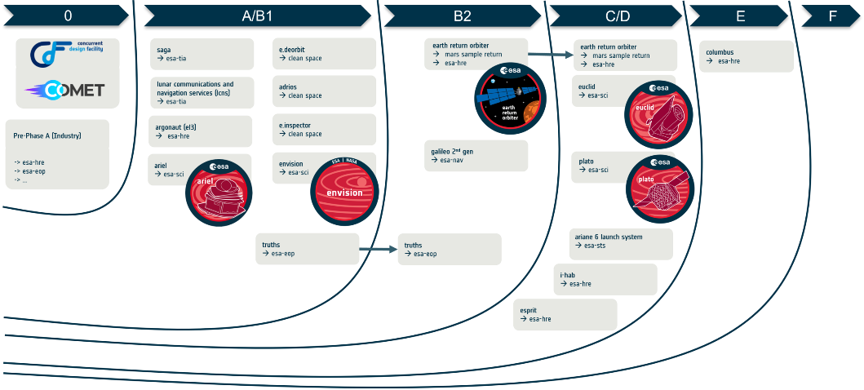
MBSE at ESA
Several ESA missions embraced MBSE approaches already at different project phases
Test cases

Slide 5
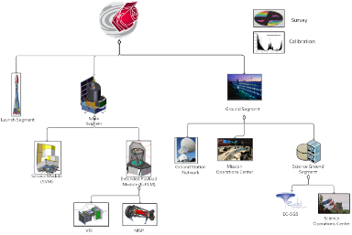
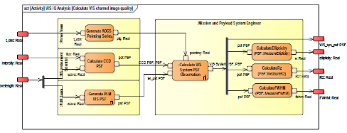
MBSE at ESA

Slide 6

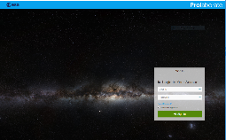
MBSE Enablers
Methodology
Tools and infrastructure
Accessibility
Methodology defined
‘Toolbox’ created based on Space centric datamodel
Common internal Cloud infrastructure created.
Simplified overhead effort for new projects
Standard model structure defined
Infrastructure in D-SCI
Improvement on web access tools
Creation of Dashboards for model access and search.
Toolsets becoming more user friendly

Slide 7
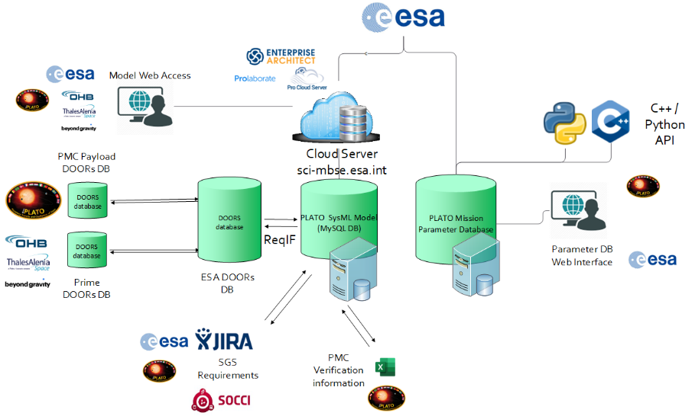
PLATO MBSE Architecture
Mission Parameter Database
System Model
More details on MBSE presentation tomorrow

Slide 8
PLATO MBSE Architecture characteristics
1
Based on data transformations – Modeling tool or language not imposed to subsystems/partners, but information incorporated using “connectors” (e.g. JIRA importer, ReqIF format from DOORs etc.

Slide 9
PLATO MBSE Architecture characteristics
Web Access interface for model data consumers and browsing, without modelling knowledge required.
2

Slide 10
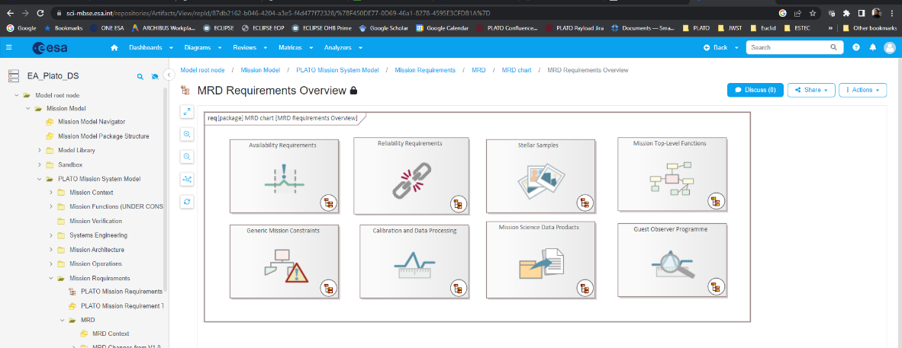
PLATO MBSE Architecture characteristics
2

Slide 11
PLATO MBSE Architecture characteristics
Self-hosted (at ESA) cloud infrastructure to ensure compliance with security and data protection measures
3

Slide 12
PLATO MBSE Architecture characteristics
API/programmatic interface created to allow integration in pipeline development and/or custom tools
4

Slide 13
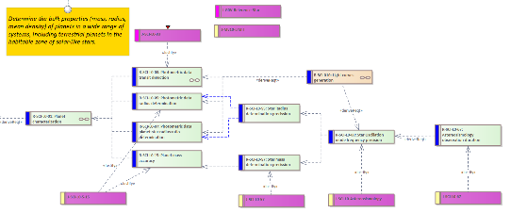
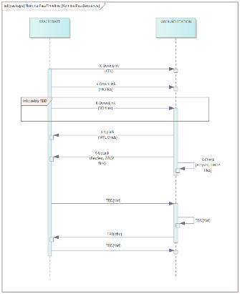
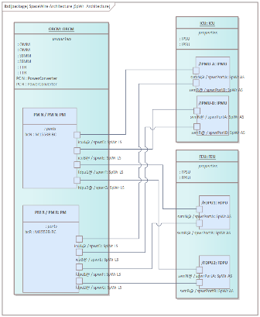
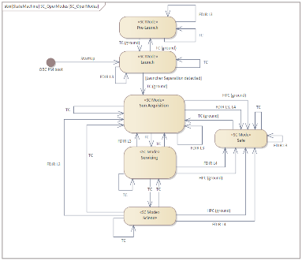
PLATO MBSE Modelling aspects - examples
Interfaces
Requirements
Operations
Modelling extended to several domains building up on the experience of Euclid
Functional

Slide 14




Limitations and lessons learned
The usage of the MBSE in PLATO is still a pilot test case to build experience for full implementation:
  PLATO does not completely abandoned traditional document-based approach.
  Model is used as the master repository for requirements traceability at mission and Agency level
  Functional aspects ‘shadowed’ from documents tracking and control.
Future work areas for consolidation of the approach in future missions:
Methodology consolidation
Data Model and exchange standards
Tools and training
Contractual setup

Slide 15


Limitations and lessons learned
SysML is a language but does not come with a modelling methodology.
A consolidated modelling methodology or framework and data model shared by all stakeholders to ensure:
  Model coherence
  Automated model checking and auditing
  Information exchange between models.
Methodology consolidation
Ongoing Space Systems Ontology group led by ESA involving European Space community
Data Model and exchange standards
Group led by ESA involving European Space community to define standards and practices for the
https://mb4se.esa.int/

Slide 16
Limitations and lessons learned
Usability and learnability of commercial tools still lacking.
Interoperability and exchange hindered by the lack of agreed standardization.
Affects acceptability in teams and dependence on key personnel
  Experience in PLATO and Euclid: effort driven by a few individuals and usage drops when they left the project.
Training
Contractual setup (at least in Europe) largely based on waterfall model, with defined milestones and deliverables (documents or review materials).
Approach for ‘continuous’ data and information exchange with a data hub not defined in contracts.
Security and intellectual property aspects across the supply chain (white vs black box model) to be defined to transition to full digital SE.
Tools and training
Contractual setup

Slide 17
Final thoughts and conclusions
Exponentially increasing pace of introduction of digital SE practices in space projects:
  Length of space missions (typical ~10 years) limits introduction of process changes after project start.
  Assessment of benefit and return on investment of MBSE still an open discussion point, however the trend is clearly towards Agile Engineering and digitization..
Standardization of data models and exchange formats required to allow tool-vendors to provide solutions for modelling.
Urgent need to define contractual and security aspects of digital transition in collaboration with all stakeholders.
Feedback from ESA ongoing MBSE efforts in missions like PLATO provide inputs to the process definition.

