Slide 1
Systems Engineering at ESA

Slide 2
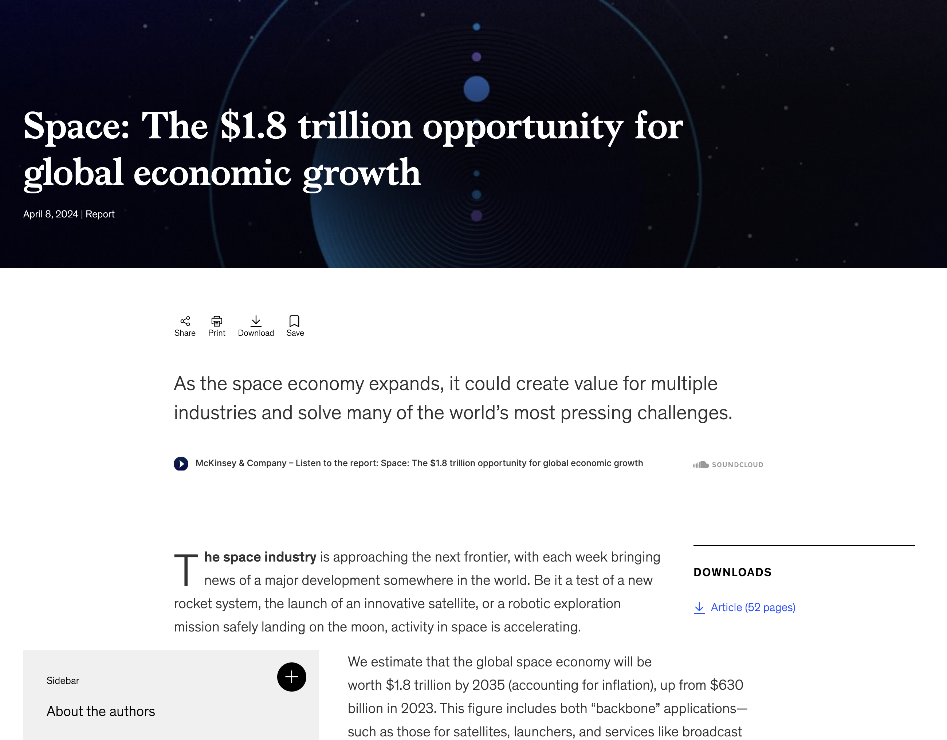
Space Environment and Context
Space is booming
New Space Economy
ESA is expanding it’s portfolio
ESA is transforming
Average number of satellites in orbit per year
x 10.5 demand increase
80% to come from constellations
75% revenues will come from governments

Slide 3
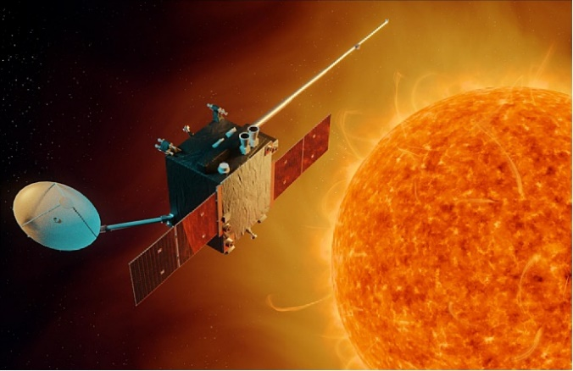
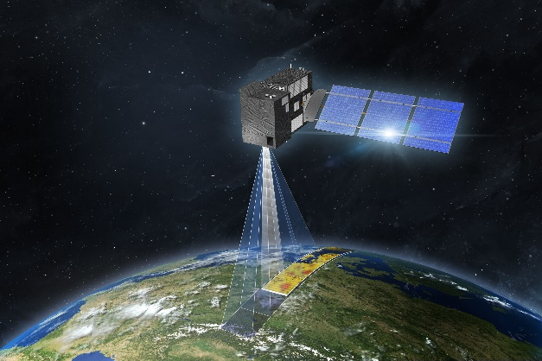
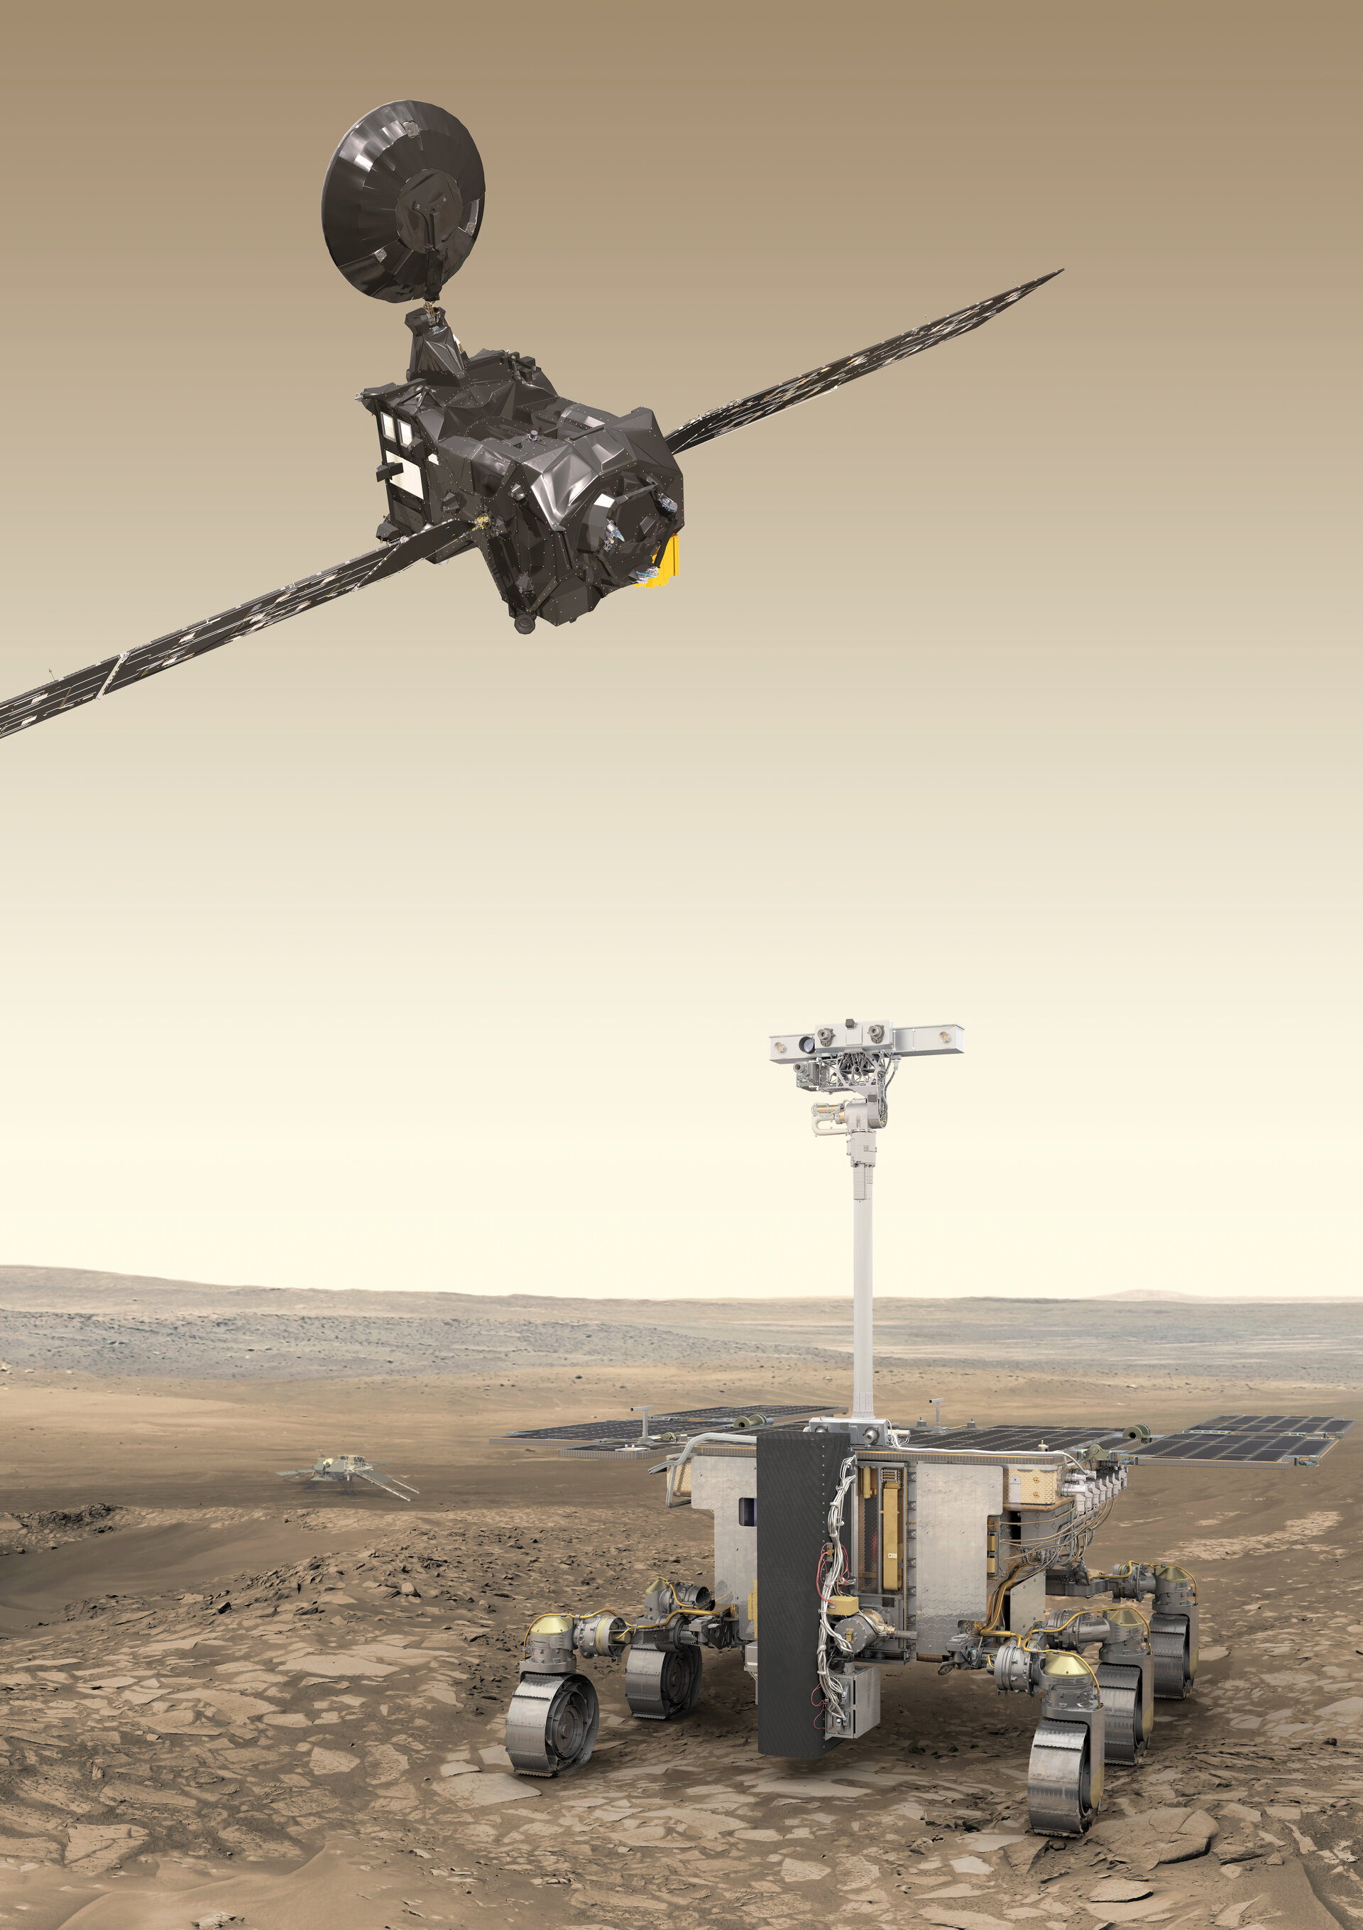
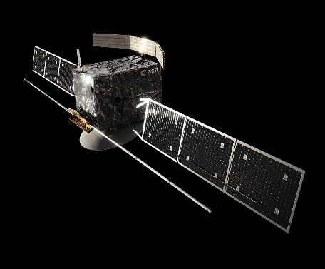
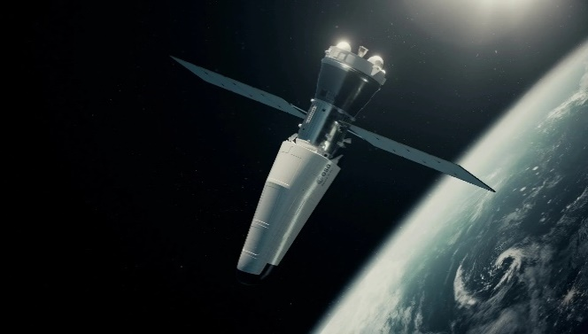
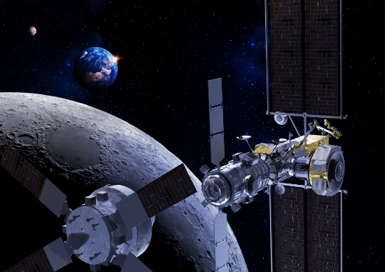
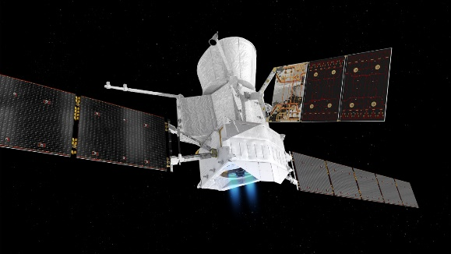
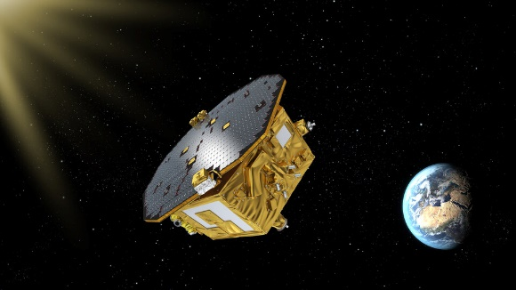
More Missions
Vigil
CO2M
ExoMars, Ariane 6, Mars Sample Return, IRIS2, Cargo Return, Galileo 2G, Flex, EnVision, Metop2G, CO2M, Harmony, Lunar Gateway, HERA, Ramses, Moonlight, Themis, SAGA, Argonaut, Space Rider, ClearSpace-1, Athena, LISA, PLATO, Sentinel, Proba III, Vigil,
And many more….
ExoMars
EnVision
Space Rider
Aeolus
LISA
Lunar Gateaway
More (industrial and complex) missions ➔ smaller teams ➔ more (sub)system engineers

Slide 4
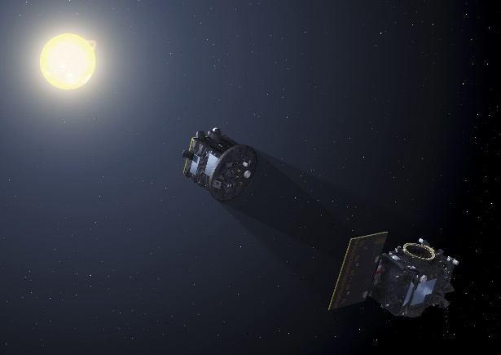
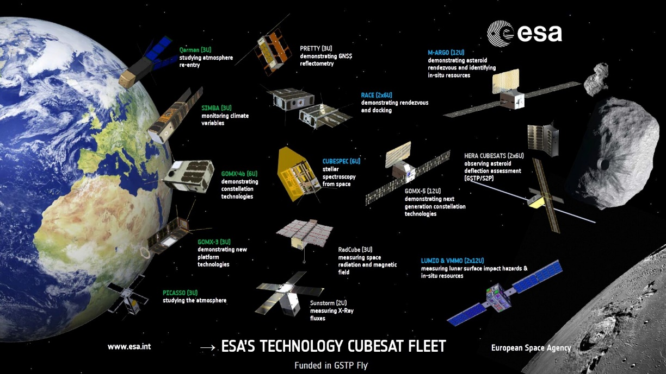
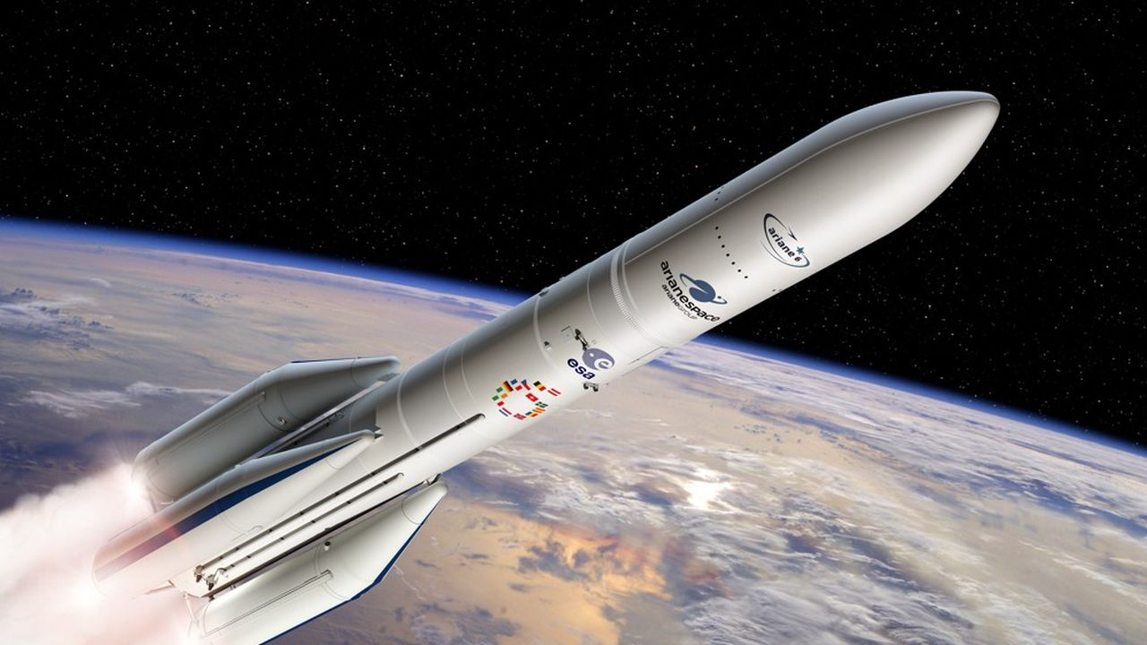
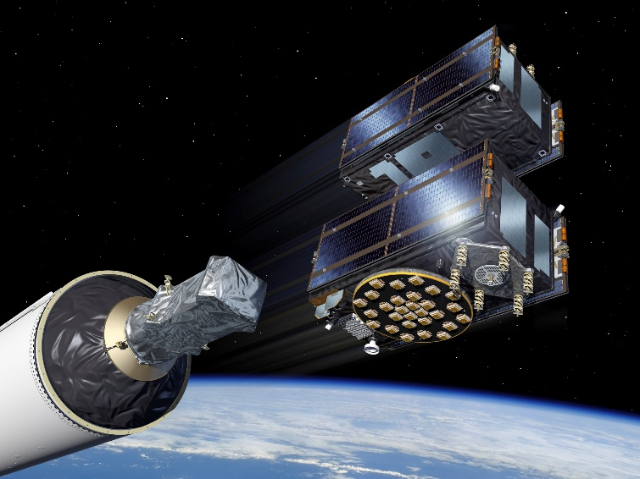
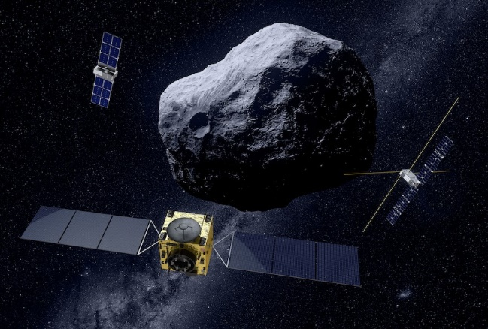
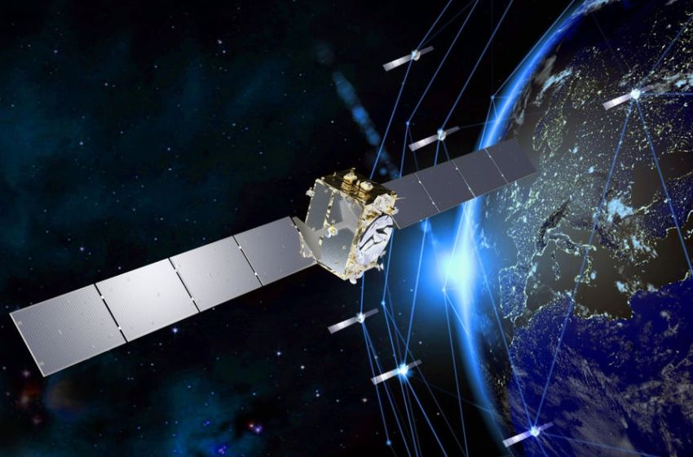
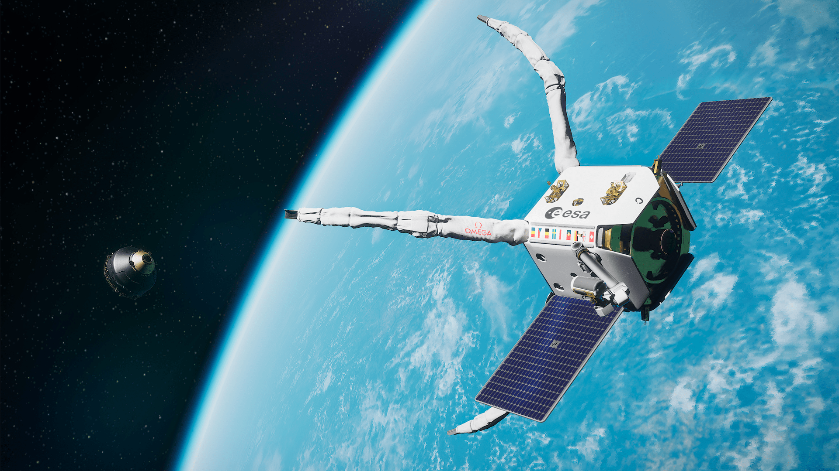
More Complexity, Faster & More Efficient
Gallileo
IOD/IOV
Proba III
Gallileo
Ariane 6
Hera
Iris²
Constellations
Systems of Sytems
AI & Quantum & Crypto technologies
ClearSpace

Slide 5










Space System Engineers Profile
Multidisciplinary Role
Fast decision making and efficiency
Managing More Complex Missions (systems of systems)
Tool Evolution (AI, MBSE...)
Security
Improving Time to React
System Engineering Role is evolving and more demanding

Slide 6




System Engineers in ESA
MORE System Engineers:
Expand the pool of talents:
Multidisciplinary mindset , SE-directed career path ➔ expert ➔ subsystem ➔ system
Recognition: Career Path, Grading, Tools
BETTER QUALIFIED:
Training, System Engineering Community,
Mindset: Multi-disciplinary, System Engineering, decision making, Sustainable engineering, System Security, Cost Engineering, Concurrent Engineering,
BETTER Equiped:
MBSE, (Improved) Space Standards (ECSS NG), Interface Standardization, modern Requirements Engineering Tools, Streamlined processes, Mission Classification, Faster Review Processes, Simulation & Modelling, AI & Data Science

Slide 7
Standardisation

Slide 8
The Fundamental Need for (Space) Standards
Competitiveness and commercialisation
Strengthen industry competitiveness and sustain the development of new EU and international markets.
Product performance and quality
Improve performance, reliability, safety, and sustainability aspects thanks to a coherent approach to development, manufacturing, supply, and services.
Knowledge transfer
Enhance engineering and product assurance knowledge while developing the capabilities of new organizations (eg SMEs).
Education
Develop and strengthen engineering, quality, reliability, safety, sustainability, and management education
avoid reinventing the wheel.
Trade facilitation and interoperability
Reduce trade barriers (including new technologies), improve legislation, and develop trust.

Slide 9

Why Was ECSS Created?
Back in the early 1990s… | Each customer had its own set of standards (eg NASA, US MIL, Industry best practices) European Space Industry had to meet different requirements Expensive
→ Need to develop a common standardization system
→ ECSS created as a common system
→ 1 pool of standards for all customers

Slide 10
ECSS Timeline, Evolution and ECSS NextGen Project
Simplify usability
Adapt/Involve New Space, SMEs
Filter according to Project
Digitalisation vs. Doc centric
E-RMS (ECSS Requirements Management System)
Industrialization (series production)
The ECSS system is fully operational (until publication of Issue D – expected by end 2025)

Slide 11
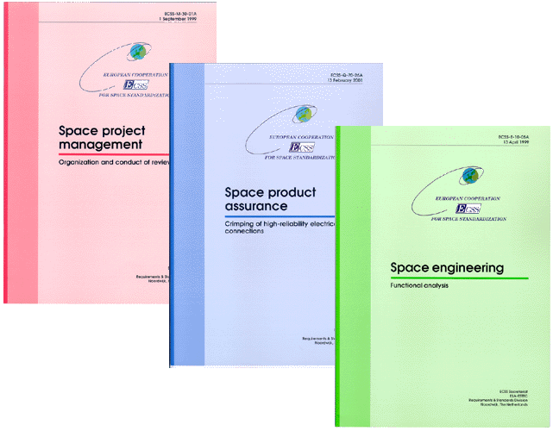






European Cooperation for Space Standardization ECSS
ECSS Purpose
Develop and maintain a single set of consistent space standards
Recognized and applied for use by the entire European Space Community
The European way of procuring space systems
Standards are made applicable by contract
ECSS Way of Working
… and many smaller companies
Capitalises on more than 40 years of experience in space projects
Developed through a partnership between ESA, National Space Agencies, and the European Space Industry (Eurospace)
A liaison with CEN, European Committee for Standardization, ensures all ECSS standards become European Norms (ECSS / CEN MoU signed 2013)

Slide 12
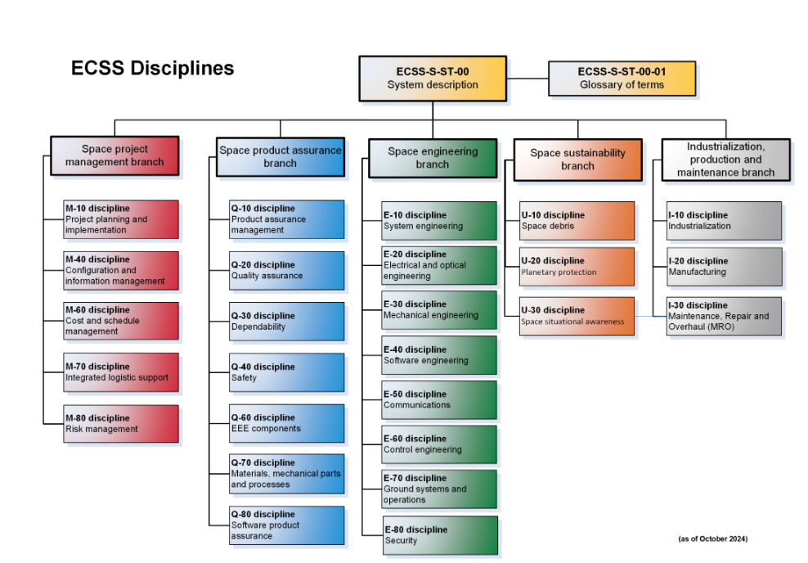
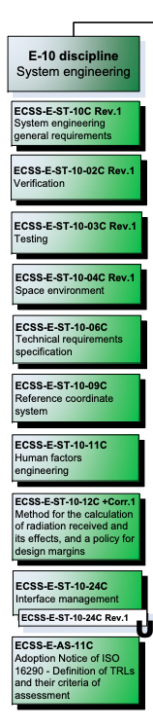
European Cooperation for Space Standardization (ECSS.nl)

Slide 13
ECSS E-10 Standards Scope
The E-10 standards cover the following System Engineering areas:
  General principles, definitions and documentation (incl. DRDs)
  Requirements specification
  Interface management
  Verification
  Testing
  Coordinate Systems
  Space Environment / Radiation
  Human Factors
Several other areas of system engineering (traditionally) are covered by standards in other disciplines,
for instance:
  Space Segment Operability (E-ST-70-11C) which defines autonomy and system requirements for operability
  Software (ECSS‐E‐ST‐40C) for the definition of the System inputs to SW
  Testing at subsystem level (e.g. propulsion) covered by the relevant discipline standards

Slide 14
Concurrent Engineering and Concurrent Design Facility
ESA ESTEC

Slide 15
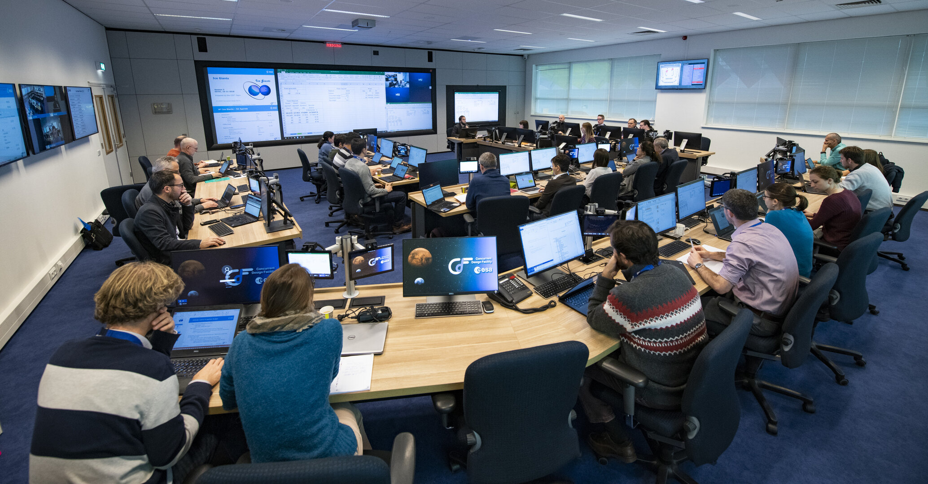
Concurrent Design Facility (CDF)
ESA CDF is an Integrated Design Environment based on Concurrent Engineering Methodology
  ESA CDF Website http://www.esa.int/CDF

Slide 16
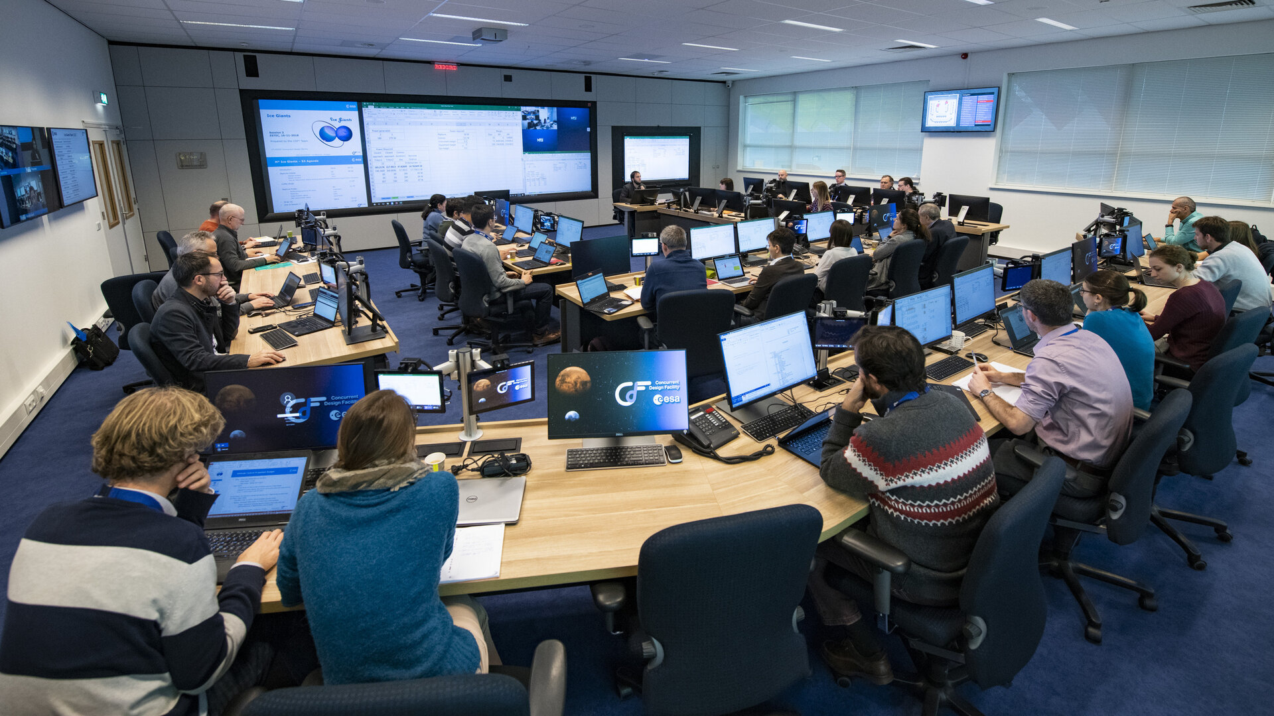
Concurrent Design Facility (CDF)
IT Infrastructure
AV Infrastructure
Team
Design Process
CE Methodology

Slide 17



CE Methodology: Interdisciplinary Communication
Approach:
Holistic
Systematic
Centralized
Focus on customer expectations
…
Multidisciplinary
Methodology:
Iterative presentations
Debate
Consensus
System awareness
…

Slide 18

Multidisciplinary Data Exchange
Central Repository (CR)
Data

Slide 19

CE Applications
CDF: An essential tool for the ESA Decision Making processes
Design
Studies
SoS
Architectures
Validation
Industrial
Activities
Reviews
Technology
Road
Mapping
Multidisciplinary
Brainstorms
Education
& Training
Lessons
Capture &
Management

Slide 20
CDF Performance
Features
Benefits
ESA's Concurrent Design Facility performs about 10 to 15 studies per year.
Technical experts working together as a multidisciplinary team.
In the same place and at the same time.
Including domains such as Operations, Assembly Integration & Verification, Programmatics, Cost Engineering, Risk Analysis, CAD, and Simulation.
Rapidly assessing the feasibility of new mission concepts.
Increased performance
Duration: reduction factor of 4
Cost: reduction factor of 2
Improved quality
CDF provides fast, consistent and complete mission design.
Detailed reporting
Technical report becomes part of the inputs to subsequent industrial activities.
Capitalisation of corporate knowledge
CDF promotes and enables further reusability.

Slide 21
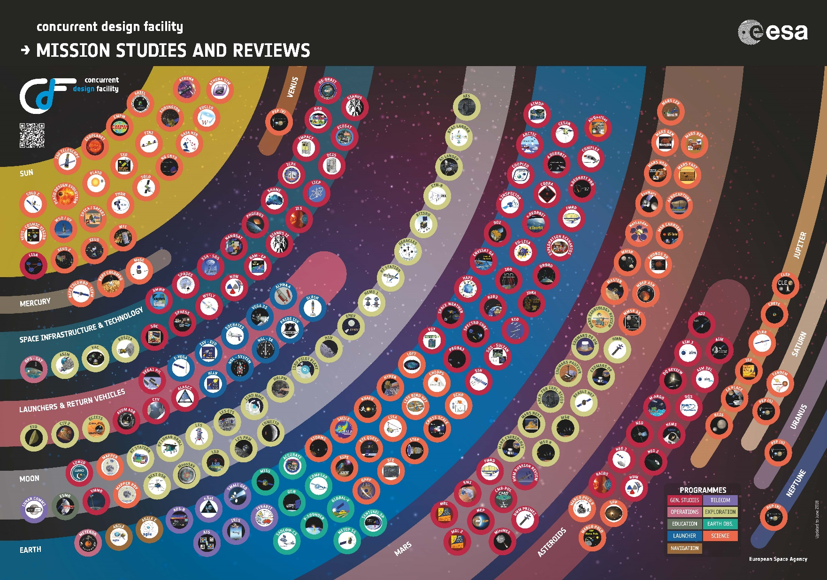
CDF Mission Studies and Reviews

Slide 22


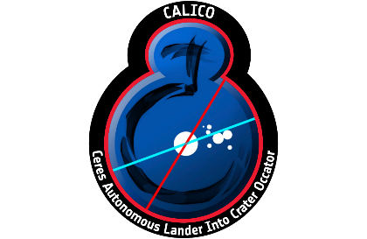




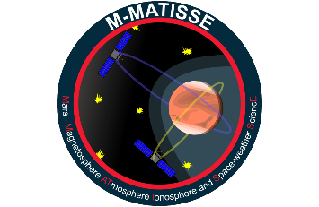

Remarkable CDF Contributions
Zero Debris
Artemis
Voyage 2050 – F2 & M7
Human Inspirator

